Slide 1


TY PTSM / Senior Cycle
Information Evening 2026

Slide 2
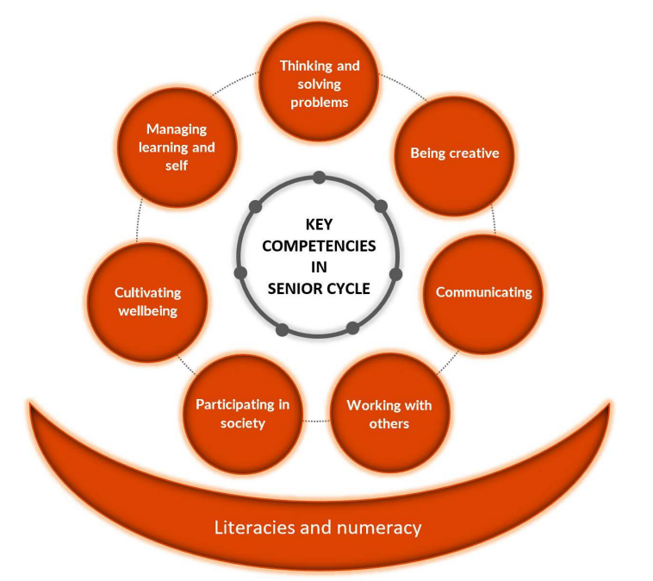
Overview of the Evening
7.00-7.30 Main Hall – all parents
Speakers –
Guidance Team
LCA / LCVP Programme Co-ordinator
Senior Leadership Team
7.30 – 8.00 P18
Information session for all parents who are going into 5th Year in Sept
7.30 – 8.00 Main Hall
Transition Year 26/27 Briefing

Slide 3
Subject and Grade Requirements for Entry to Irish Universities and Technological Universities 2026
Presented by - Kathy McManus & Teresa Connaughton. MPPS Guidance Department
Presentation 1

Slide 4
LCA Programme Overview
Presented by - Jakki Byrnes Programme Co-ordinator
Presentation 2

Slide 5
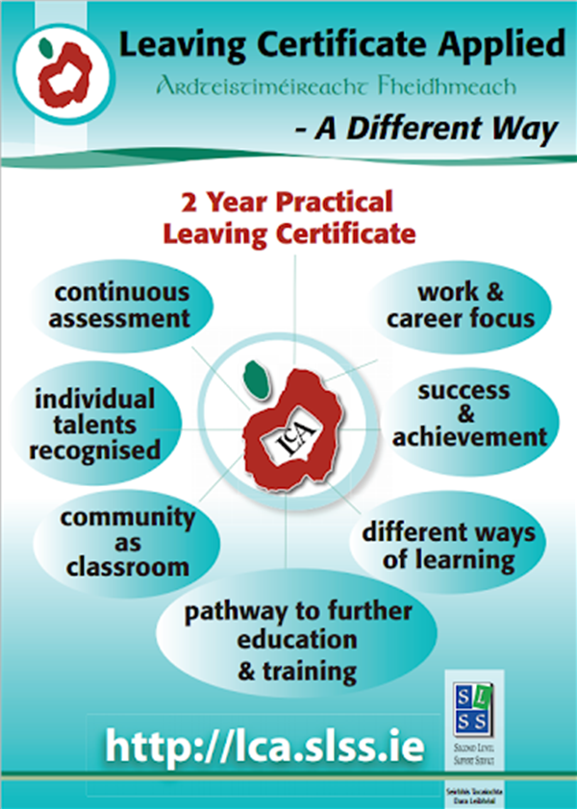
What is Leaving Certificate Applied?
It is a distinct, self-contained two-year Leaving Certificate programme aimed at preparing learners for adult and working life
It emphasises forms of achievement and excellence which the established Leaving Certificate has not recognised in the past
It offers learners specific opportunity to prepare for and progress to further education and training.

Slide 6
Small classes
Tutorial style teaching
Students go to teachers’ classrooms
Individual laptop
11 Subjects:
Irish / English & Communication / Mathematical Applications / Information & Communication Technology / Hotel, Catering & Tourism / Social Education / Vocational Preparation & Guidance / Leisure & Recreation / Horticulture / Art
LCA in MPPS

Slide 7
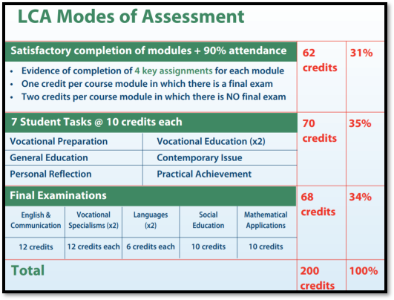

Assessment
Pass (60-69 %) (120 - 139 credits)
Merit (70-84 %) (140 - 169 credits)
Distinction (85-100 %) (170 - 200 credits)

Slide 8
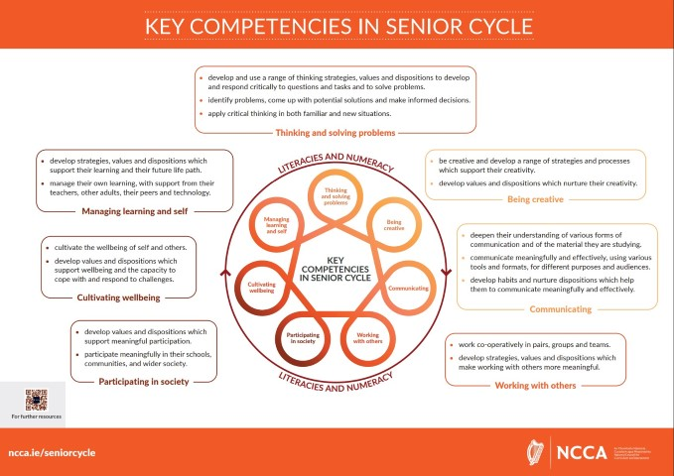
Senior Cycle Redevelopment
Presentation 3

Slide 9
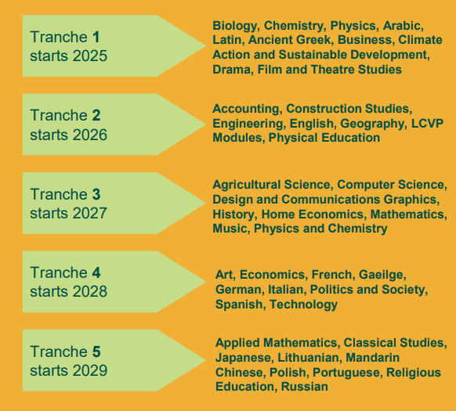
Senior Cycle Redevelopment

Slide 10
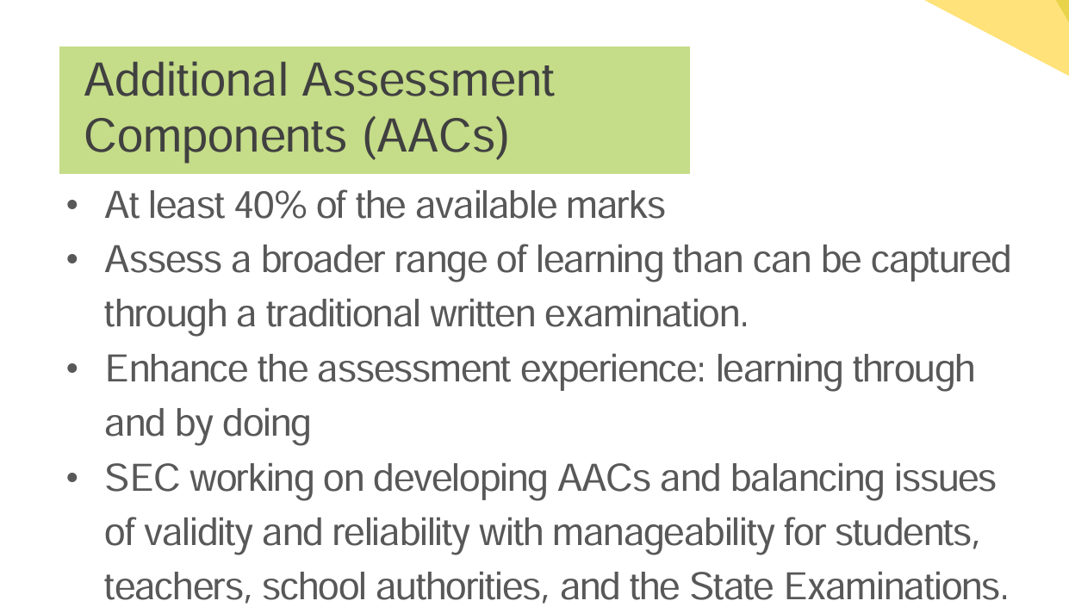
Senior Cycle Redevelopment

Slide 11
Life, Community, Work (Previously LCVP)
Develop an understanding of their personal strengths, aptitudes, interests and achievements
Build career and workplace foundations & help support more informed decision-making for their future educational journey & career path
Appreciate their role in the local community and as national citizens
Develop and demonstrate an entrepreneurial mindset
Adapt better to the challenges and opportunities of the modern world.

Slide 12
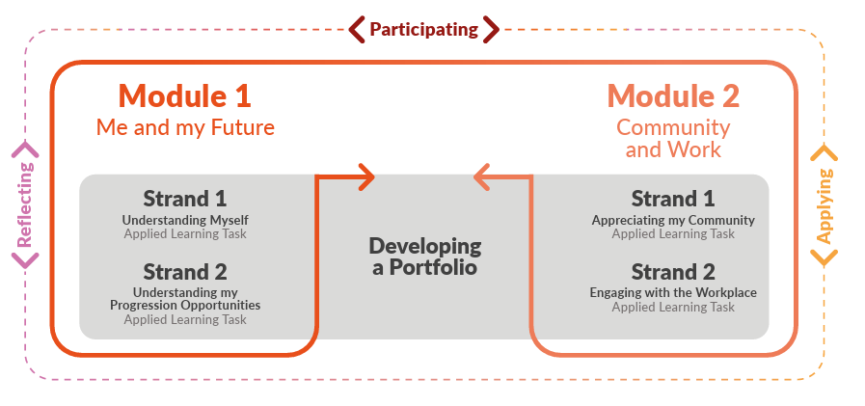

Life, Community, Work (Previously LCVP)
Assessment –
60% Portfolio (AAC)
40% Written Exam

Slide 13
Life, Community, Work (Previously LCVP)
Rationale:
The course offers practical learning opportunities for students to engage with their community and understand their societal contributions.
It emphasizes personal development, informed decision-making, and the development of transferable skills necessary for lifelong learning.
Aims:
Students will develop self-awareness regarding their strengths, interests, and contributions to society.
The course aims to build career foundations, promote active citizenship, and foster an entrepreneurial mindset.

Slide 14
Future career and study options:
Distinction 80% - 100% = 66 points
Merit 65% – 79% = 46 points
Pass 50% - 64% = 28 points
Great preparation for the world of work/life after school.
Teamwork, Communication, Digital skills, Confidence.

Slide 15

Climate Action & Sustainability – New Subject Option for 2025
Senior Cycle Redevelopment
Core Strands in Syllabus:
1. Earth Systems, Life and Environment
2. People, Power and Place (Sustainable Development)
3. Global Connections & Climate Justice
4. Applied Learning Tasks
Links with Geography, Biology, Ag Science, Economics…

Slide 16
Additional Assessment Component : Action Project
Climate Action & Sustainability – New Subject Option for 2025
AAC Worth 40% (SEC certified)
Written Paper worth 60%
AAC - Engage in an action of their choosing that relates to a topic within the brief. (Similar to IIS project in Ag Science)
Career Progression
Sustainable Engineering / Construction
Renewable Energy
Sustainable Agri Sector
Environmental Consultant

Slide 17
Who Would This Suit?
Have an Interest in the Environment
Enjoy Project-based Learning
Aspire to ‘Green’ Careers
Critical Thinking, Research and Analytical skills
Independent Learner – you get out what you put in
Choosing Geography, Biology, Ag Science, Economics

Slide 18

Students must complete Option form –
Form via APP – to indicate their preferences for the Option Subjects
2. Students must put options in order of PREFERENCE! Really consider option 5/6 as many students will get this option.
Form will open in the coming weeks
Guidance appointments available for students struggling with options
What Next?

Slide 19



Subject Options must be submitted by:
3:00pm
Friday 13th March 2026

Slide 20
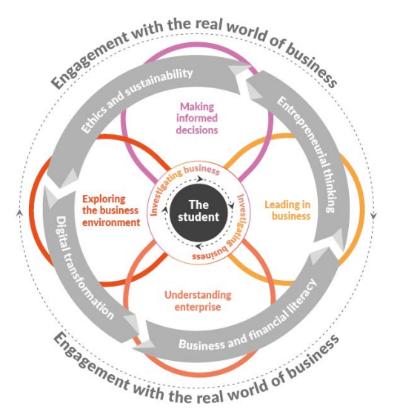
LC Business – Introduced Sept 2025
The new Leaving Certificate Business curriculum introduces several key changes:
Emphasis on Financial and Business Literacy: The curriculum now places a stronger focus on financial and business literacy, helping students understand the relevance of business in their daily lives and the global economy.
Competency Development: It aims to develop key competencies, such as critical thinking, problem-solving, and informed decision-making, to better prepare students for the business world.
Updated Content: The content has been updated to reflect current business practices and trends, ensuring students are learning about contemporary issues and technologies.
Investigative Study: A new component called the “Business Alive Investigative Study” has been introduced, encouraging students to engage in practical, real-world business investigations. This project work will be worth a minimum of 40% of the overall grade & will be externally assessed by the State Examinations Commission (SEC).
Senior Cycle Redevelopment

Slide 21

LC Biology, Chemistry & Physics – Introduced September 2025
Senior Cycle Redevelopment
The updated curriculum of Biology, Chemistry and Physics aims to foster students' curiosity and enthusiasm for the scientific study of life, fostering a deeper understanding of chemistry and physics and their applications in the modern world.
Within all the sciences, a notable change is the introduction of an additional assessment component (AAC) that is not a traditional written examination. This component will account for 40% of the total marks and will be externally assessed by the State Examinations Commission (SEC).

