Slide 1

Open Night
Incoming First Years 2027

Slide 2
MPPS
MCC
Maynooth Education Campus

Slide 3


Ethos: Core Values and Paton
Additional Educational

Slide 4
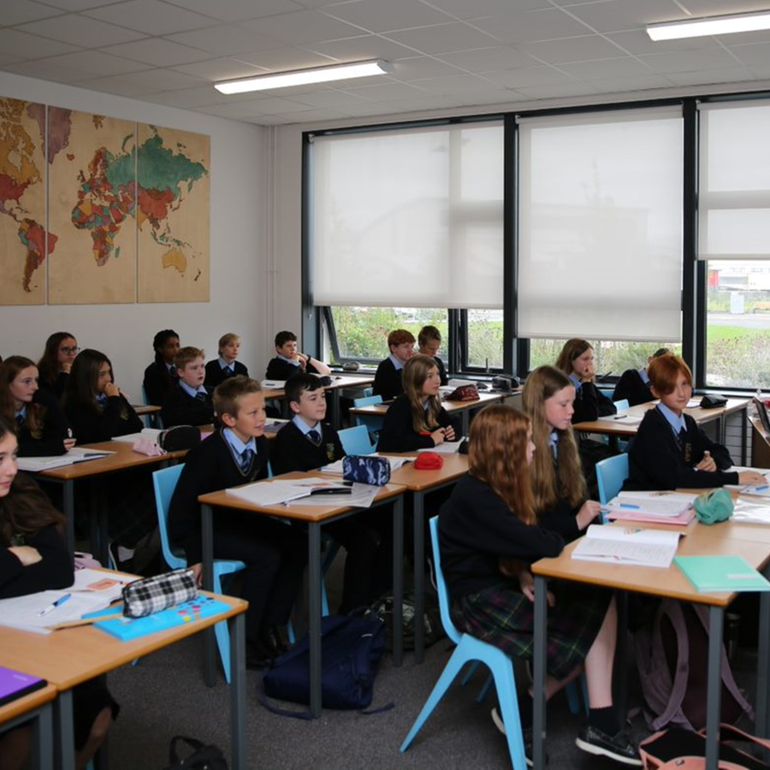
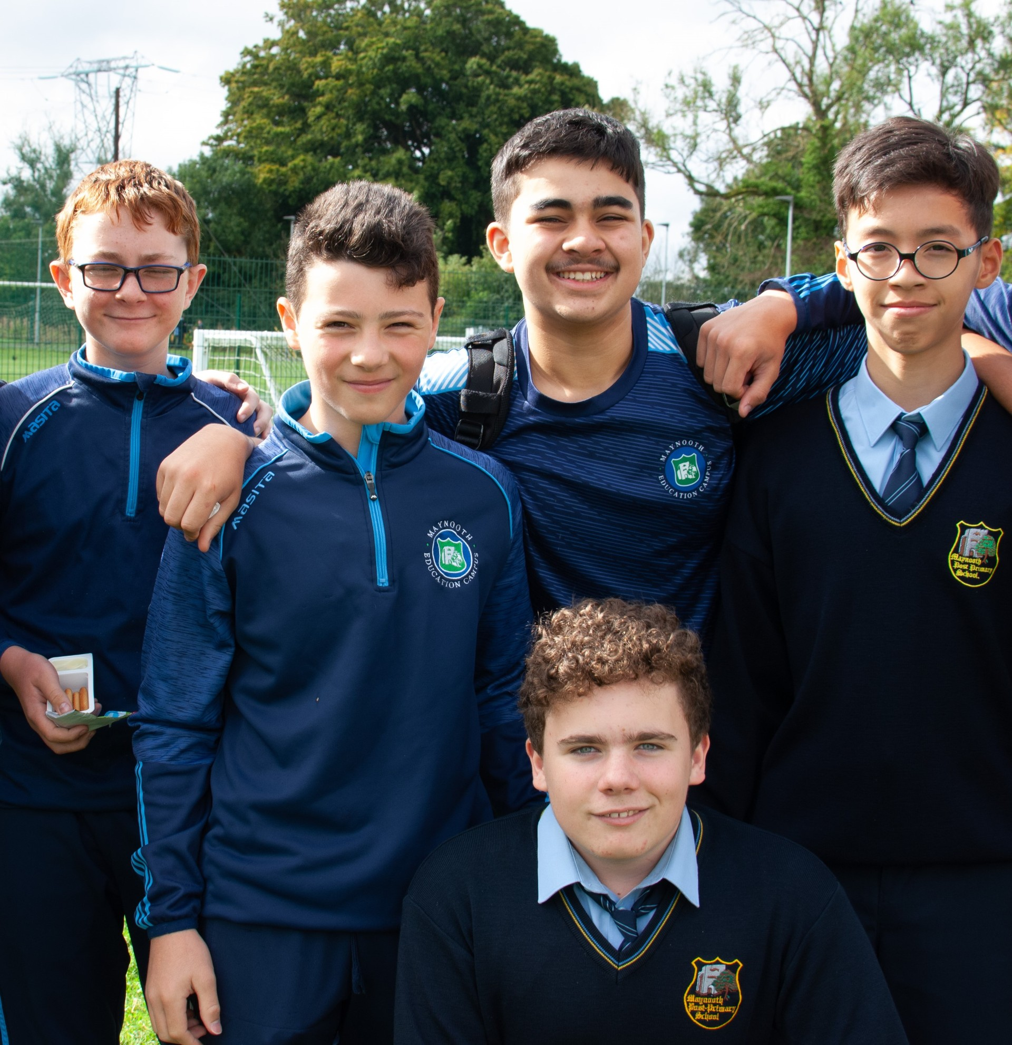
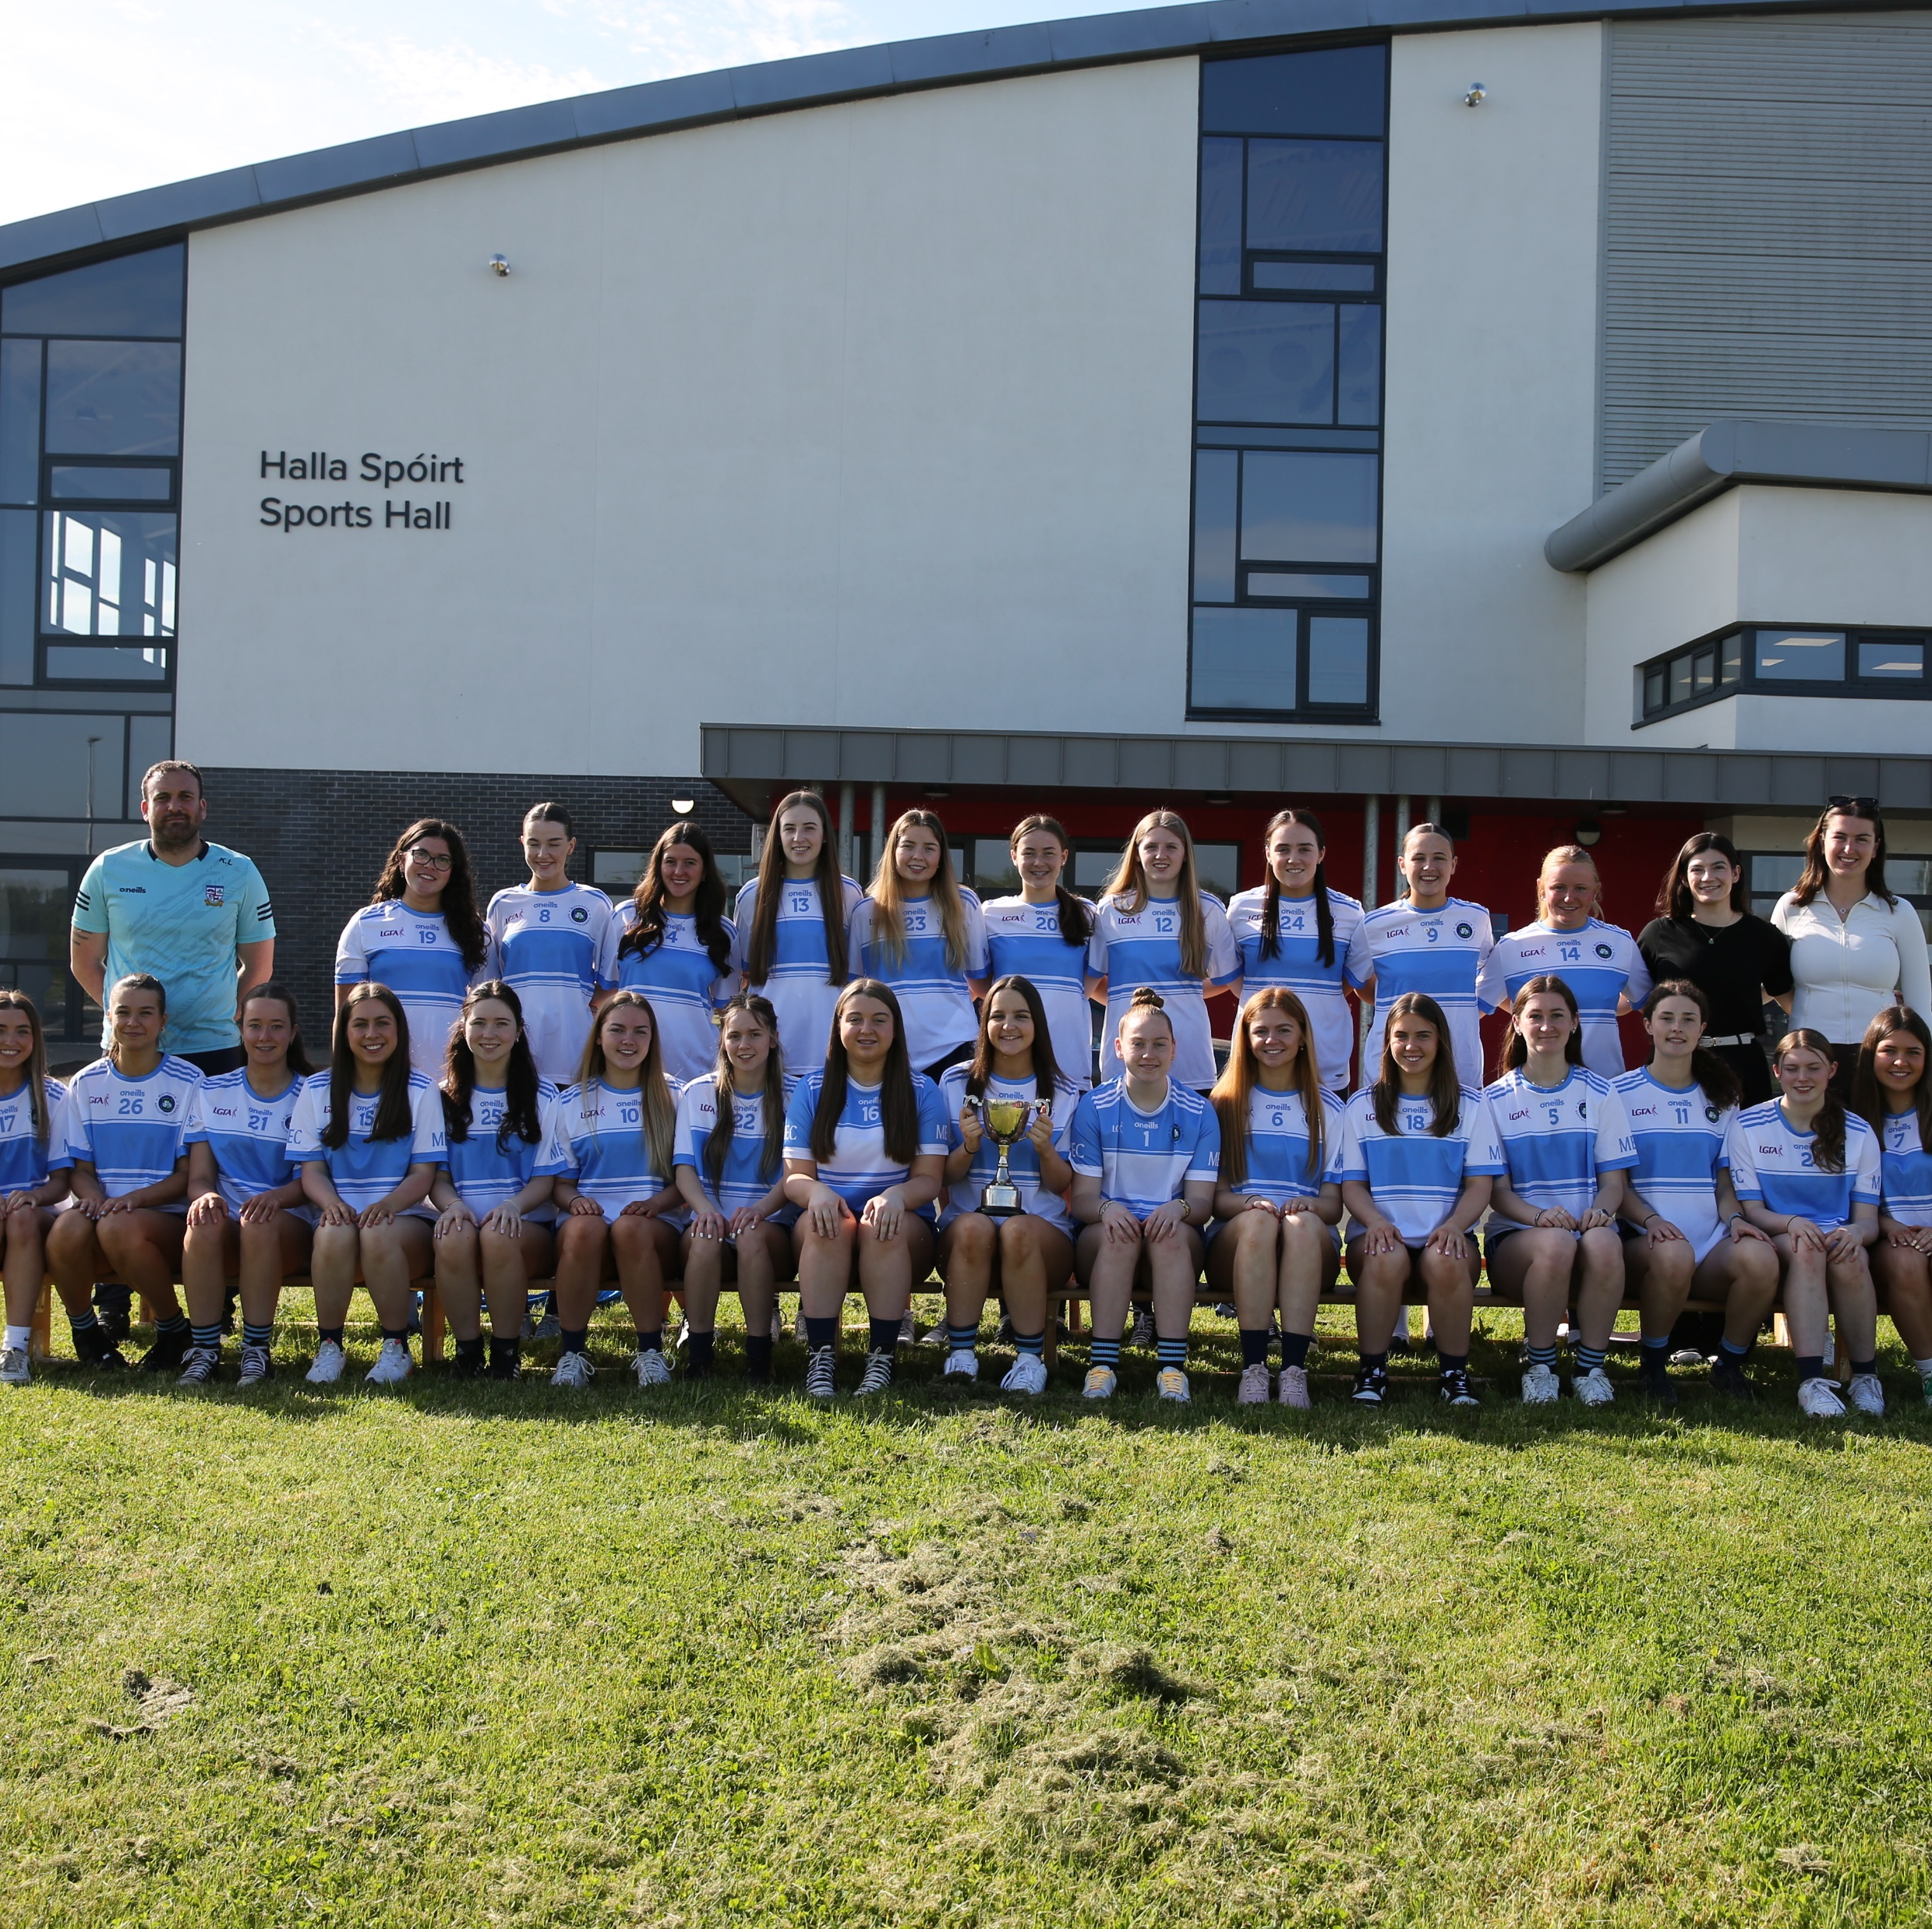
Mission Statement
Maynooth Post Primary School is a community of students, staff and parents. We aim to create a warm and caring learning environment in which all our students can achieve their full potential. We value the unique contribution of each individual in an atmosphere of tolerance, partnership and shared respect.

Slide 5
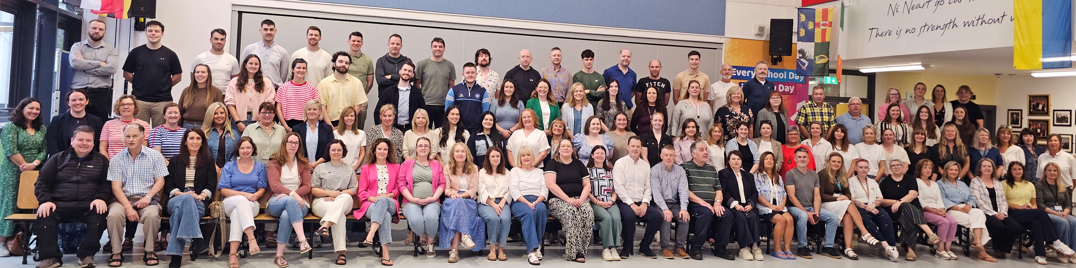
Our Staff

Slide 6
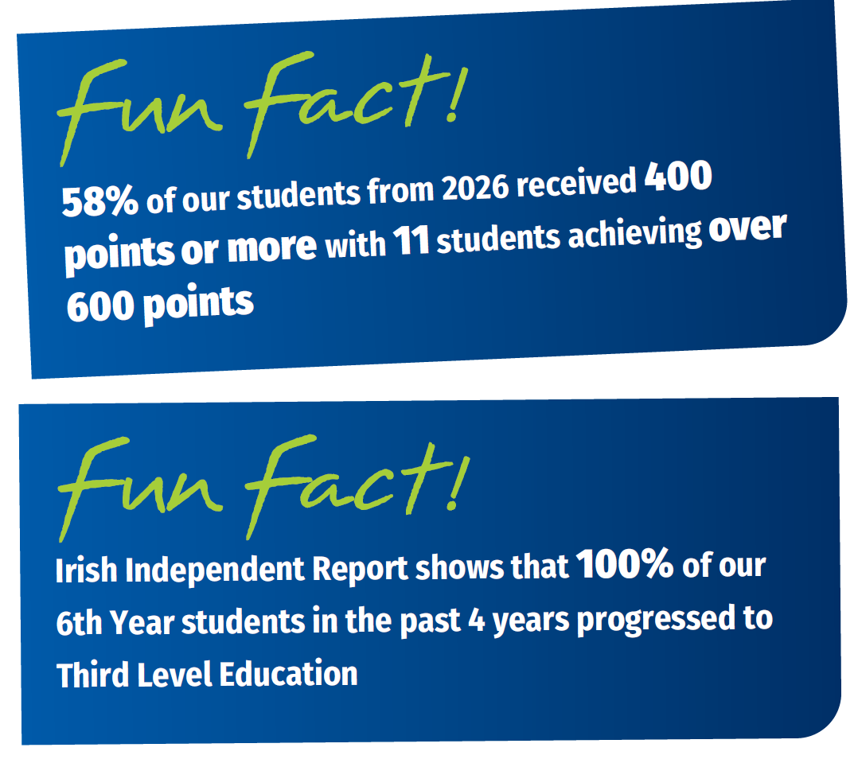
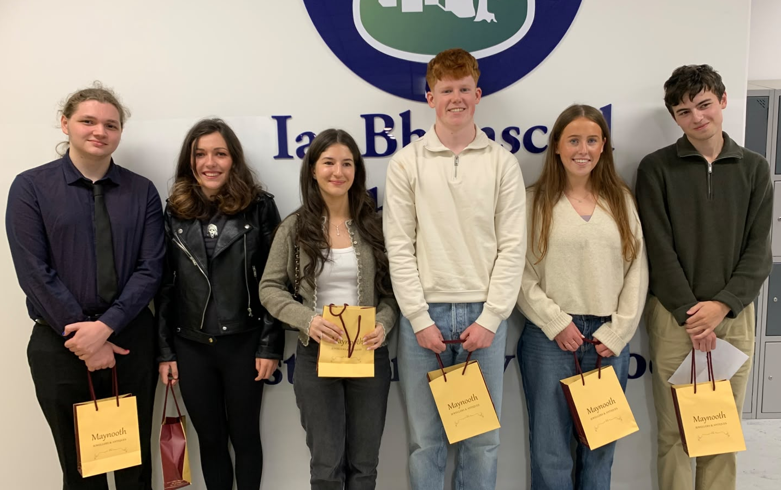
Academic Excellence
Additional Educational

Slide 7
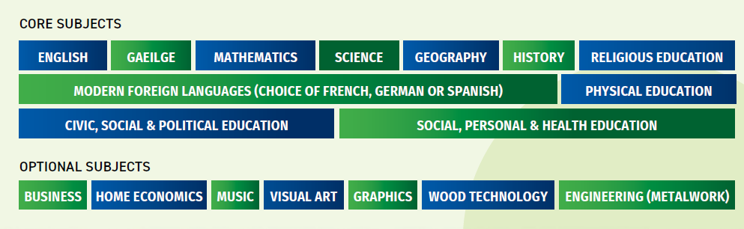
Junior Cycle Subject Choice
Additional Educational

Slide 8
Class Organisation
Optional subjects based on student’s own choice.
Policy of Mixed Ability Teaching at Junior Cycle.
First Year: All classes in each subject taught at common level.
From Second Year: Maths & Irish differentiated as Higher and Ordinary Level.

Slide 9
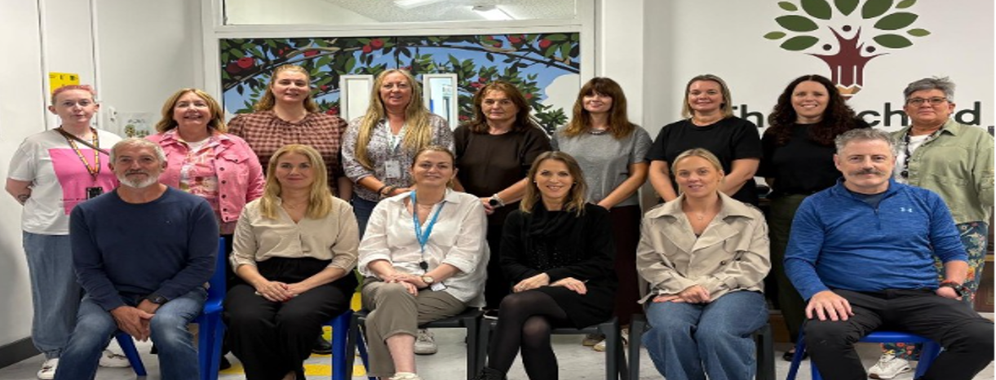
Additional
Educational Needs
  Cognitive Abilities Test
  Once a place has been offered and student is enrolled, any information regarding the student’s learning needs is requested.
  Additional Learning Support as per new General Allocation Model.

Slide 10
Induction & Integration
Assessment afternoon and school visit
Gradual start up to school year
Immediate link with a Tutor and TY mentors
Induction booklet / Welcome Pack in Wellbeing class
First Year Resource area (lunchrooms, lockers)

Slide 11
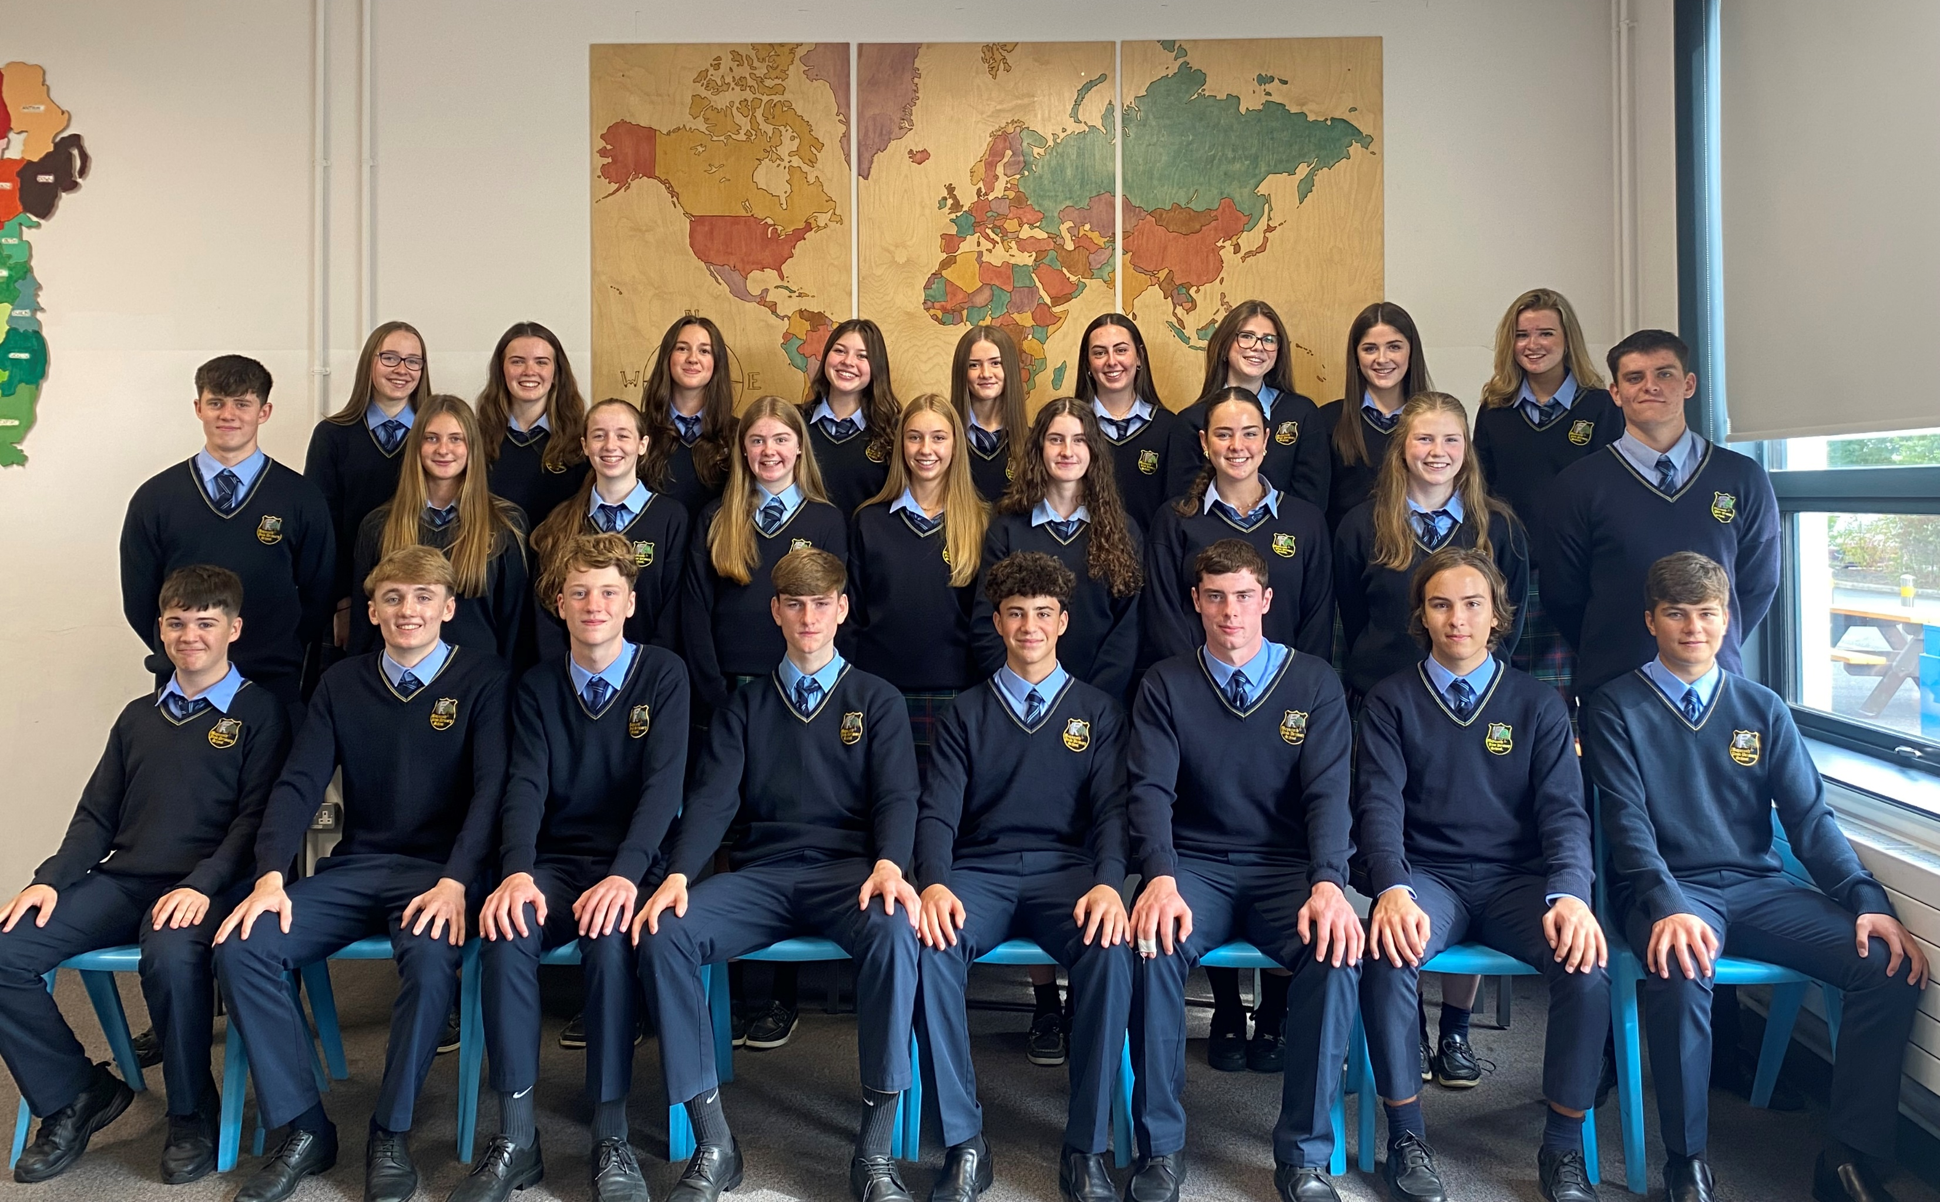
Pastoral Care
Student
Principal & Deputy Principals
Year Head
Tutors
Guidance Team

Slide 12
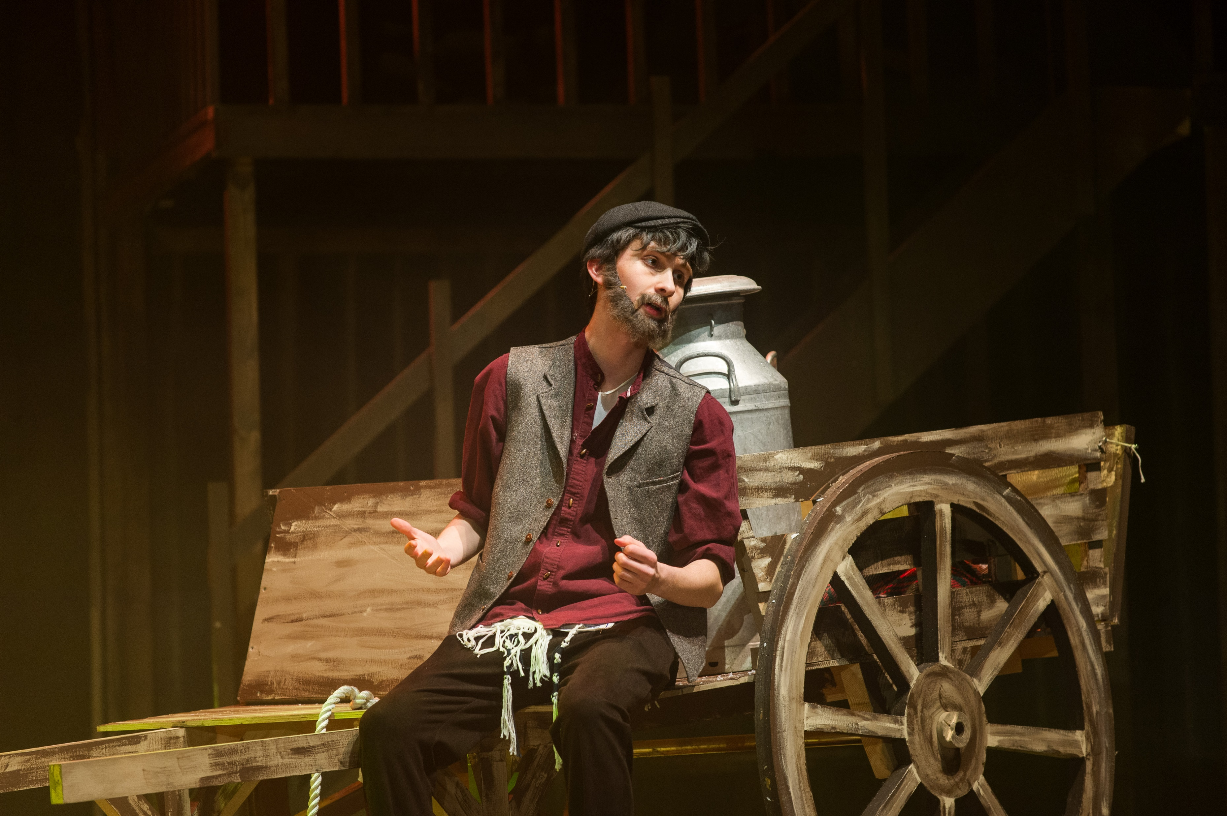
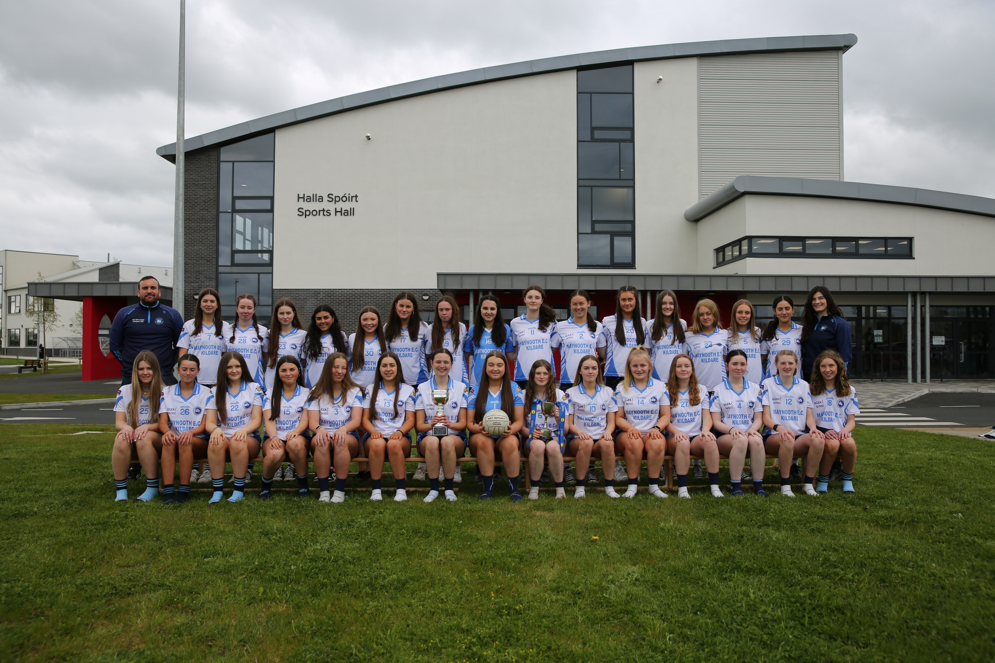
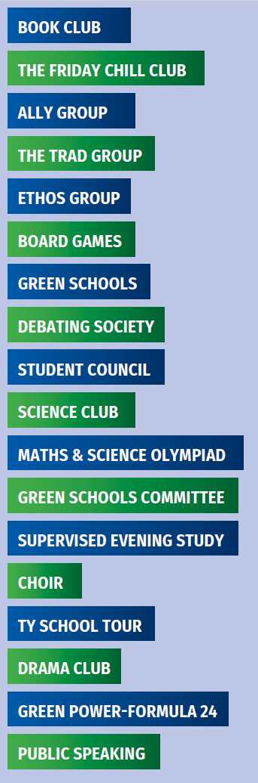

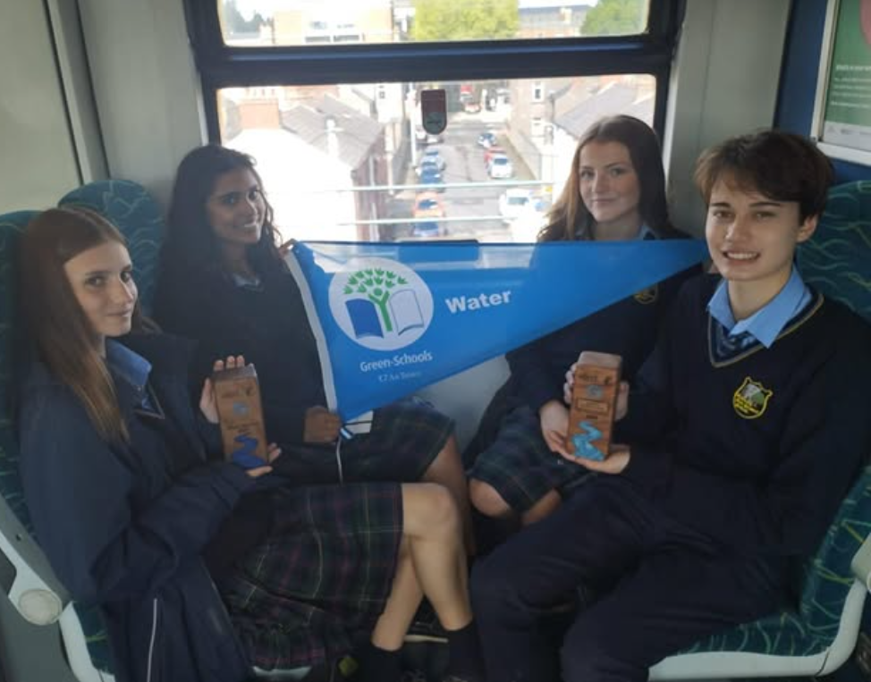
Clubs
& Societies

Slide 13


Slide 14
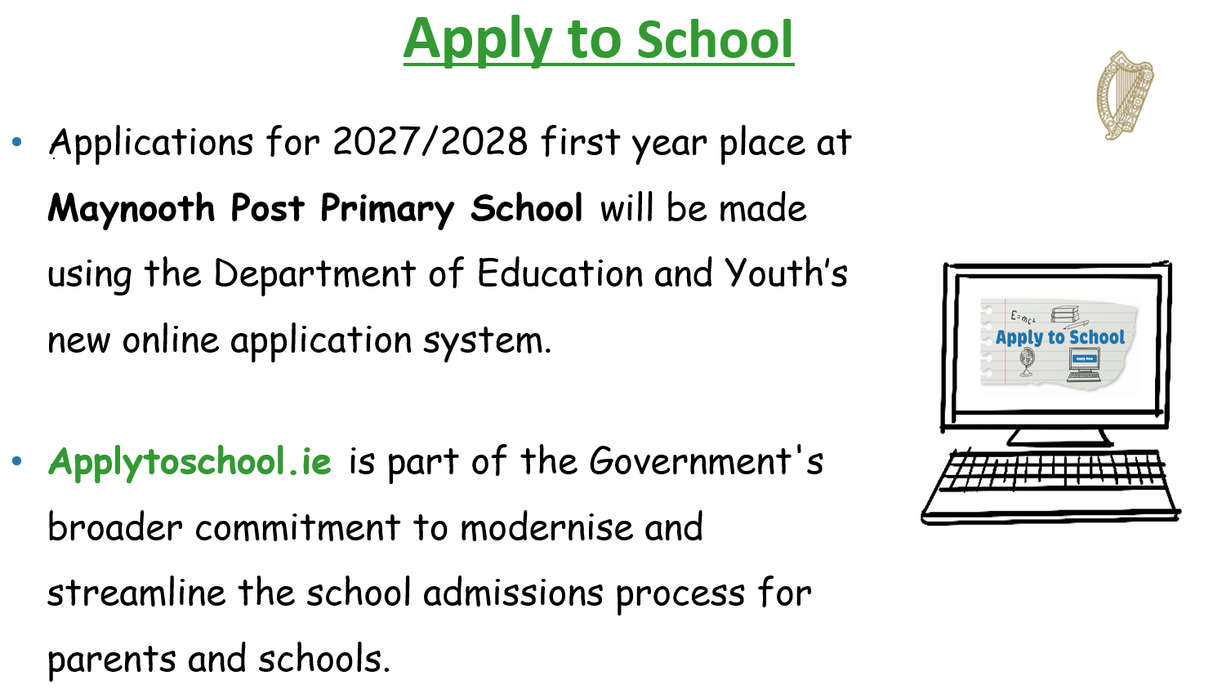

Slide 15
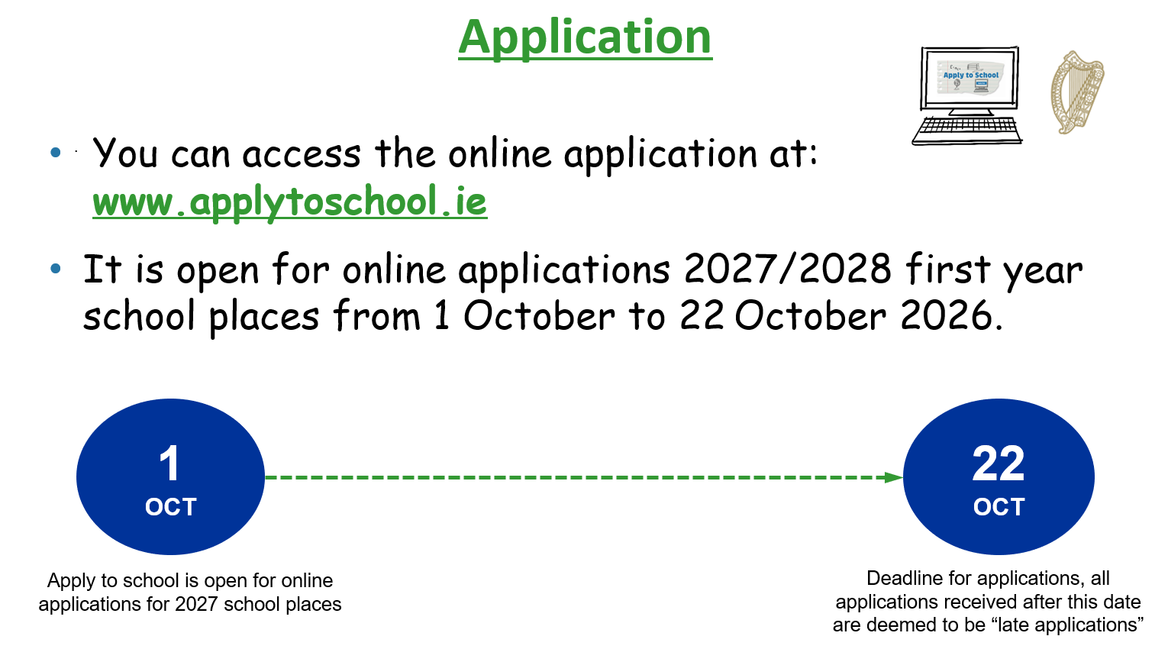

Slide 16
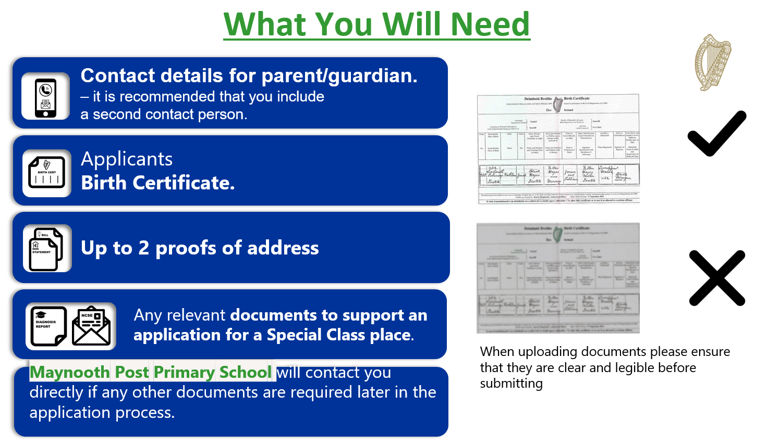

Slide 17
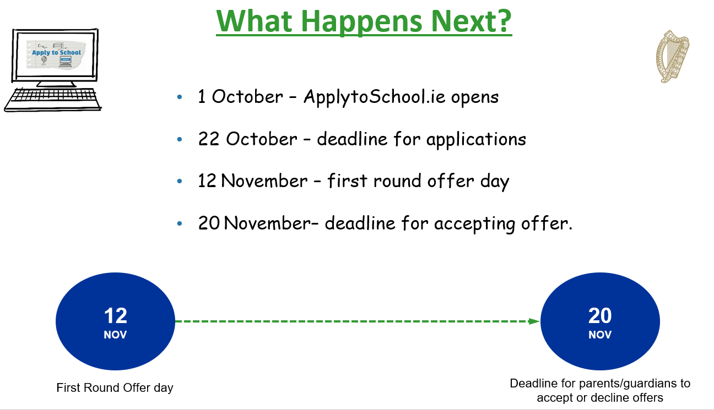

Slide 18
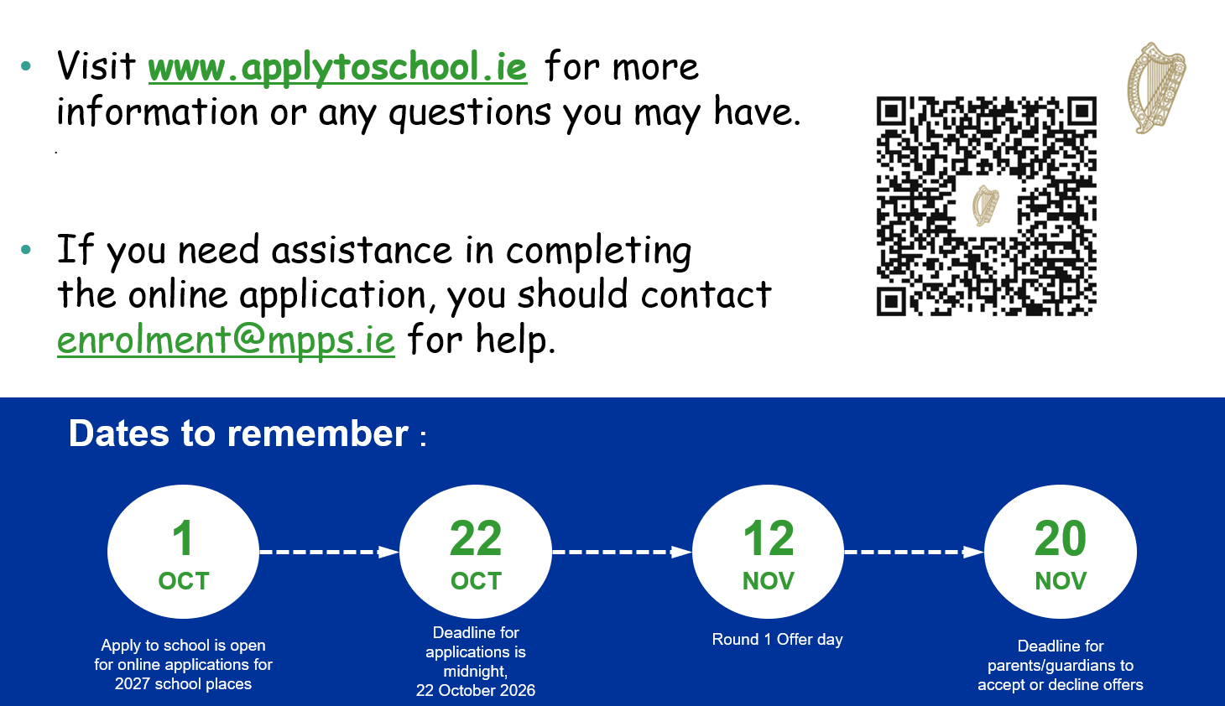

Slide 19
What then...?
Feb- Subject Options
March - Assessment Afternoon (CAT)
May – Induction Visit to school.
June- Information letters.
August – Commence First Year

Slide 20



Applications must be submitted by:
Midnight Thursday 22nd October 2026
Applications received after 23:59
will be deemed as
LATE APPLICATIONS.

