Slide 1

Incoming First Year Information Evening 2026
Scoil Chríost Rí

Slide 2
Welcome
Welcome and Introduction
Transfer Programme - This presentation is another step in a process to help your child with the transition to Secondary Education
Other steps include - Contact with Primary Schools, Primary School Passports, 1:1 Meeting in June with SLT, Summer Camps, Student Induction Programme, Entrance Assessment.

Slide 3
In this meeting....
Introduction to Scoil Chríost Rí
Daily life in SCR
Practical information
Communication
Support systems
Subject selection for 1st Year
Entrance Assessment

Slide 4
Introduction
CEIST Ethos
Expectations
Junior Cycle
TY
Senior Cycle
Arás Nano

Slide 5
Daily Life...
Timetable
Break time
Lunchtime
Canteen
Form Groups
Calendar

Slide 6
Extra-Curricular Activities
Basketball
Camogie
Gaelic Football
Volleyball
Soccer
Rugby
Athletics
Debating
Chess
Breakfast Club
Performance Club
Choir
Art Club
Sci-Fest
Mini Company
Library Committee
Cáirde Nano
Green Schools Committee
Student Council
Study

Slide 7
Practical Information
Book Rental Scheme
Lockers €20
Payments- In general on Vsware
Voluntary Contribution €80
24hr Personal Insurance €13
School Lunches
Supervision begins at 8am
Students are here all day

Slide 8
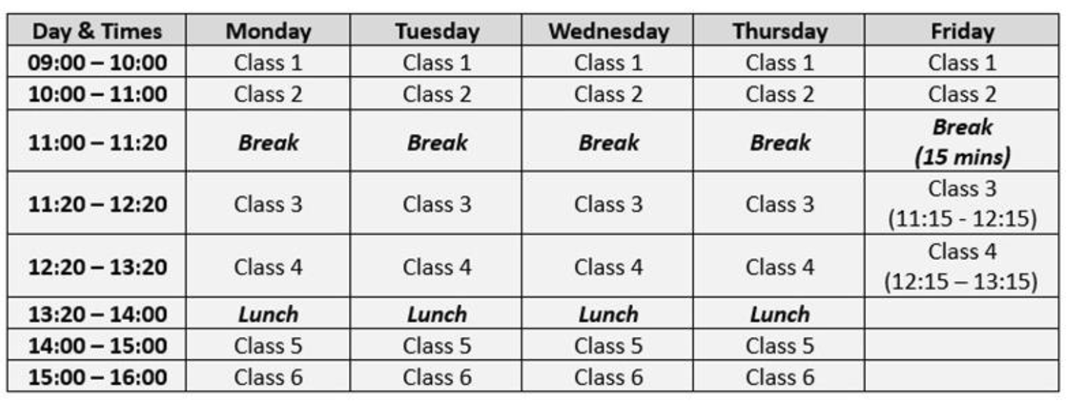
Timetable
Breakfast Club starts at 8.10am and finishes at 8.40am

Slide 9
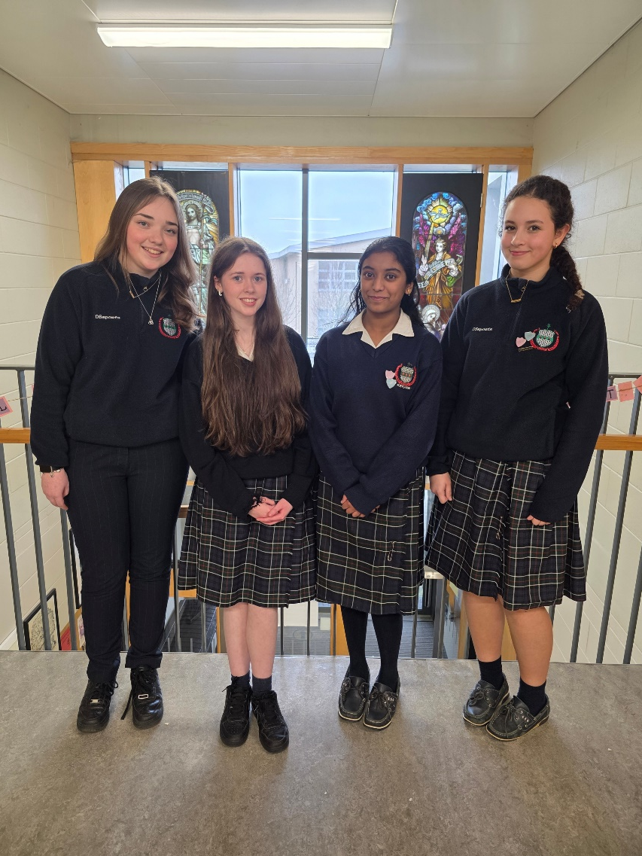
Formal Uniform
School Uniform
White blouse with revere collar, worn inside trousers or skirt. No polo shirt allowed.
Navy jumper with school crest.
Mid-calf length Scoil Chríost Rí kilt skirt or Navy Scoil Chríost Rí trousers, with fine green pinstripe.
Navy knee length socks or navy tights. Leggings are not allowed.
Navy Scoil Chríost Rí jacket (Shaws)/SCR Navy fleece (DS Sports)
Flat black/navy leather shoes only – Nike Air Force are allowed (all black)

Slide 10
PE Uniform
Scoil Chríost Rí Red and Green Half zip sports top (with crest) - only available at Shaws Portlaoise
Scoil Chríost Rí Navy with red stripe tracksuit bottoms ***- only available at Shaws Portlaoise
Any crested Scoil Chríost Rí jersey/white polo shirt. A variety available on https://www.dssports.ie/collections/scoil-chriost-ri
Runners - Runners are for PE class ONLY.
***Strictly no leggings or other tracksuit bottoms will be allowed***
Other optional Team Wear available on DS Sports for training/matches only.

Slide 11
Communication is key...
VSware (Behaviour, Attendance, Mail, Reports)
Email
Phone
Text
Journal
Reports
Parent Teacher Meetings
Website
Social Media - @scoilchriostri_portlaoise (Instagram)

Slide 12
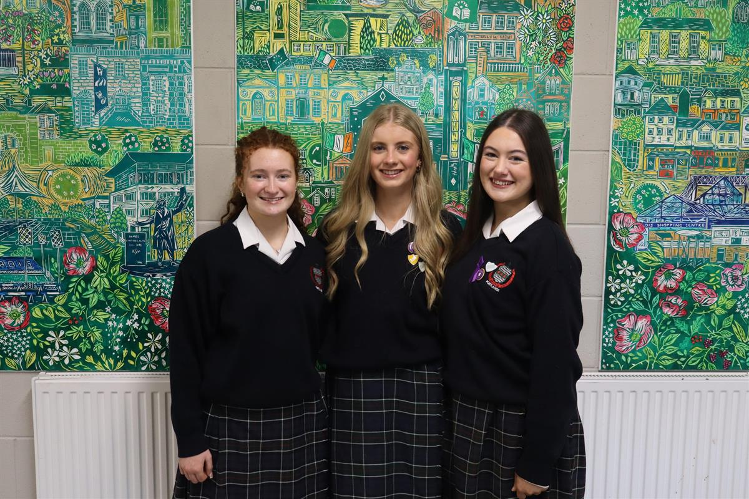
Student Leadership
Head Girl & Deputy Head Girl
Meitheal
Meantóirí
Student Council
Prefect & Vice Prefect

Slide 13
Support Staff
Class Tutor
Year Head
Guidance Counsellors
Chaplain
Special Education Needs Coordinator
Autism Class Coordinator
Pastoral Care Team

Slide 14
Chaplain
Deirdre Bailey
Contact Details:
dbailey@scrpl.ie

Slide 15
Year Head
Tom Moss
Contact Details:
tmoss@scrpl.ie
Notes:
I wish to welcome you again to our information evening and to explain our continuum of support.
We understand that every student has unique needs and abilities, and it is our goal to provide the support necessary for each student to reach their full potential. We offer a continuum of support to ensure that all students receive the help they need to succeed.
The first level of support we offer is universal support for all, all of our students avail of this support. It provided through a challenging and engaging curriculum, a safe and nurturing environment, and access to a variety of extracurricular activities. This level of support is designed to meet the needs of the majority of students.
For students who may need additional support, we offer targeted support in class. This may include small group instruction, additional resources, and differentiated instruction. These interventions are designed to help students who are struggling in certain areas to catch up to their peers.
For students who require more intensive support, we offer specialized support. This may include SSPs, specialized instruction, and guidance/other school services. These interventions are designed to help students with significant learning difficulties to make progress and achieve their goals.

Slide 16
Role of the Year Head
Pastoral Care
Behaviour Management
Attendance
Achievement and Participation
Motivation
Communication with Parents/Guardians

Slide 17

Guidance Counsellors
Our role is to assist students in making informed choices about their lives in relation to personal, educational and career decisions.
Contact details:
  Ger Murphy, Debbie O’Dwyer, Emma Scully and Karen McLoughlin
  Email: gmurphy@scrpl.ie
  dodwyer@scrpl.ie
  escully@scrpl.ie
  kmcloughlin@scrpl.ie
STUDENT
EDUCATIONAL
VOCATIONAL
PERSONAL

Slide 18
1st Year Subjects
Core Subjects:
Gaeilge, English, Maths, Science, History, Geography, CSPE (Civic, Social and Political Education), PE (Physical Education), SPHE (Social, Personal and Health Education), Religion.
Optional Subjects:
Students study two optional subjects from this list: Visual Art, Business Studies, Home Economics, Graphics, Technology, Music.
Modern Foreign Languages:
Students study one language: Spanish or French

Slide 19

VISUAL ART
Visual Art focuses on 3 main aspects – Art, Craft and Design. 1st Year Exploration, 2nd Year Process to Realisation, 3rd Year Final Project in class. No exam in June of 3rd Year.
APPLIED TECHNOLOGY
Combines a mix of metalwork, woodwork and electronics. Mix of theory & practical classes. Project 70% & Exam 30%. Might suit students who like hands on learning and are creative.
BUSINESS STUDIES
Business focuses on 3 strands; Personal Finance, The World of Work/Enterprise and The Economy. 100% Exam in 3rd Year. Mini Company Club, Student Enterprise Awards, Stationary Shop.

Slide 20

GRAPHICS
Areas looked at in class include solving, drawing and sketching. Exam 80% and Project 20%. Mix of both practical and theory. Spatial Awareness & Numeracy are important.
HOME
ECONOMICS
Topics include Nutrition, Health & Safety, Managing the household, textiles. 50% Practical Exam in April 3rd Year and 50% written exam in June. Interest in cooking and sewing are helpful but not essential.
MUSIC
Music focuses on giving students the opportunity to develop their musical knowledge, skills and cultural awareness. Practical exam in April 3rd Year for 30% and 70% written exam in June. No previous study of music required.

Slide 21

Optional Subject Choices
Do’s
Interest
Ability
Future Careers/LC Choices
Talk to other students that have picked the subject
Don’ts
Friends
“Easy” subject
Gender
Leave it to the last minute!

Slide 22
USEFUL WEBSITES
For detailed information on Junior Cycle subjects (including syllabus and examples of student work):
https://curriculumonline.ie/Junior-cycle/
A flyer with an overview for parents about Junior Cycle:
https://www.jct.ie/perch/resources/publications/jc-info-parents-post-primary-2019.pdf
A more student-friendly description of Junior Cycle subjects for research:
https://careersportal.ie/school/subject_explorer_jc.php
Sample of Junior Cycle Past Papers – www.examinations.ie

Slide 23
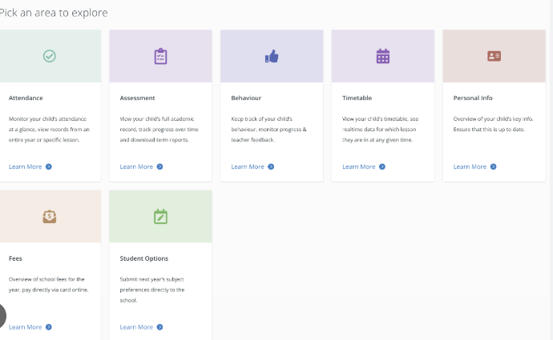
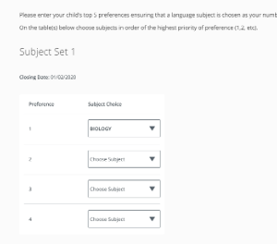
VSware Instructions
Parents are asked to:
Create a password on VSware using the username you receive (this should be completed by parents only).
Log in, go to Student Options and enter your four preferred subject choices in order of preference.
Enter your language preferences (French or Spanish) - put your preferred language in order of preference.
Options are to be entered by FRIDAY 27th FEBRUARY
You will receive a letter in May with the two option subjects and the language that your child has been allocated.
Note: We aim to give you your top preferences but there are no guarantees.

Slide 24
AEN Support
Deirdre Bennett
Contact Details:
dbennett@scrpl.ie
Notes:
I wish to welcome you again to our information evening and to explain our continuum of support.
We understand that every student has unique needs and abilities, and it is our goal to provide the support necessary for each student to reach their full potential. We offer a continuum of support to ensure that all students receive the help they need to succeed.
The first level of support we offer is universal support for all, all of our students avail of this support. It provided through a challenging and engaging curriculum, a safe and nurturing environment, and access to a variety of extracurricular activities. This level of support is designed to meet the needs of the majority of students.
For students who may need additional support, we offer targeted support in class. This may include small group instruction, additional resources, and differentiated instruction. These interventions are designed to help students who are struggling in certain areas to catch up to their peers.
For students who require more intensive support, we offer specialized support. This may include SSPs, specialized instruction, and guidance/other school services. These interventions are designed to help students with significant learning difficulties to make progress and achieve their goals.

Slide 25
AEN/SEN Support
Team Teaching (in class support)
Learning support class (withdrawal from Irish)
Specific or Targeted programmes/intervention

Slide 26
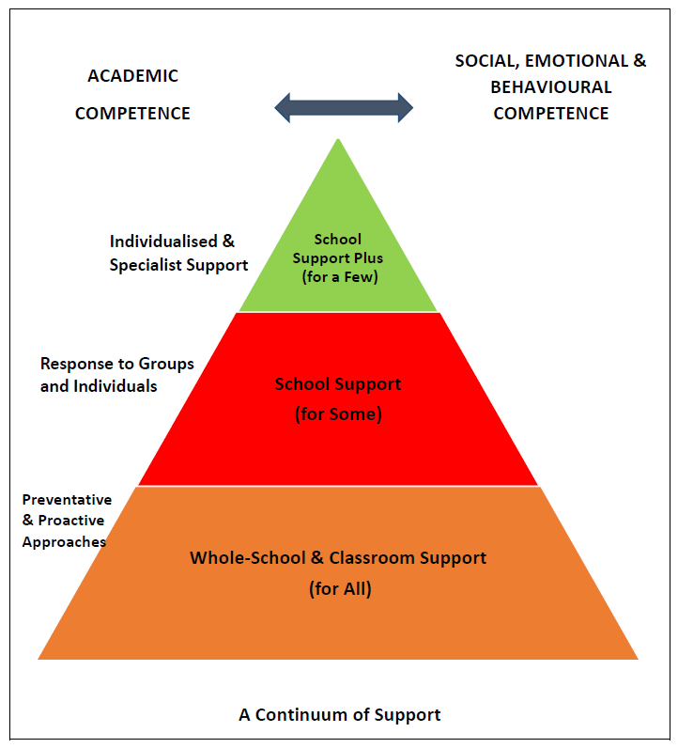
Notes:
I wish to welcome you again to our information evening and to explain our continuum of support.
We understand that every student has unique needs and abilities, and it is our goal to provide the support necessary for each student to reach their full potential. We offer a continuum of support to ensure that all students receive the help they need to succeed.
The first level of support we offer is universal support for all, all of our students avail of this support. It provided through a challenging and engaging curriculum, a safe and nurturing environment, and access to a variety of extracurricular activities. This level of support is designed to meet the needs of the majority of students.
For students who may need additional support, we offer targeted support in class. This may include small group instruction, additional resources, and differentiated instruction. These interventions are designed to help students who are struggling in certain areas to catch up to their peers.
For students who require more intensive support, we offer specialized support. This may include SSPs, specialized instruction, and guidance/other school services. These interventions are designed to help students with significant learning difficulties to make progress and achieve their goals.

Slide 27
Entrance Assessment
Saturday 7th February-Fee €30 Vsware
A-K 8:45-11am L-Z 11:15-1:30pm
Registration from 8:30am
CAT4 Assessment
Snack and drink will be provided for break time
All materials provided
Students do not need to wear their uniform
Mobile phones to be left at home
Collection arrangements are at parents' discretion

Slide 28

Cognitive Abilities Test, 4th Edition (CAT4)
Assesses a student’s reasoning abilities in four key areas
Verbal reasoning – thinking with words
Quantitative reasoning – thinking with numbers
Non-verbal reasoning – thinking with shapes
Spatial reasoning – thinking with shape and space

Slide 29
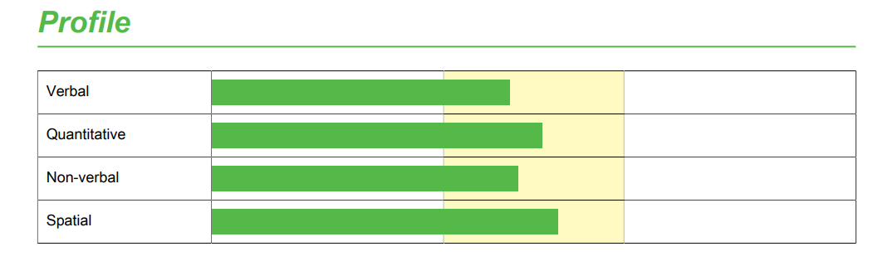
Report for Parents

Slide 30
AEN Support – Arás Nano
A class within a mainstream post-primary school that supports inclusion
Students are full members of the school community
Up to 6 students per class (3 classes in our school)
Provides tailored supports to help students access mainstream learning where appropriate
Focus on learning, regulation, independence, and life skills
Examples of Supports
Visual supports & routines
Sensory supports –s
Life skills & independence
SNA support
Alice Cosgrave
Contact Details:
acosgrave@scrpl.ie
Notes:
Arás Nano is our autism class within the mainstream school, and it’s designed to support students while keeping inclusion at the centre of everything we do. students are full members of the school community and take part in classes, activities, and school life in ways that work for them. There are six places per class, and we currently have three Arás Nano classes in the school, which allows us to provide a structured and supportive environment. Our focus is on supporting access to mainstream learning where appropriate, using a flexible and individualised approach, always guided by what helps each student feel regulated, confident, and ready to learn. Supports may include clear routines and visual supports, sensory supports, and SNA support where needed, with an ongoing focus on building independence and self-advocacy over time. Our overall aim is for students to feel safe, supported, and included, while developing the skills they need to engage confidently in school life and beyond

Slide 31
Next steps..
Jan/February 2026
May 2026
Set up your VSware account
Input your subject options using the Options tab
Fill in the forms you receive through the VSware Mail tab…
Policies Permission Form etc.
Option Subjects assigned
Book/Equipment List
Summer 2026
Summer camps
Start date and return to school information will be sent to you

Slide 32
Relevant email addresses
office@scrpl.ie - Main Office-Zita Brennan, Olive Mullhall, Anna Fitzpatrick (Secretary)
gmurphy@scrpl.ie dodwyer@scrpl.ie escully@scrpl.ie kmcloughlin@scrpl.ie (Guidance Counsellors)
dbennett@scrpl.ie - Deirdre Bennett (1st Year AEN/SEN Coordinator)
acosgrave@scrpl.ie – Alice Cosgrave- Arás Nano (ASD Class) Co-ordinator
Dp.adollard@scrpl.ie – Anne Dollard, Deputy Principal
dbailey@scrpl.ie - Deirdre Bailey, Deputy Principal

Slide 33
Questions?
We understand it’s a lot of information to digest
Take your time
Read through what we have given out
Contact us if you have any difficulties

