Slide 1
Mathematical Magic
Are these tricks maths or magic???

Slide 2
Trick 1
Think of a number between 1 and 20. Write it down.

Slide 3
Trick 1
Double it.

Slide 4
Trick 1
Add 10.

Slide 5
Trick 1
Halve it.

Slide 6
Trick 1
Take away your original number.

Slide 7
Trick 1
Is your answer 5?

Slide 8
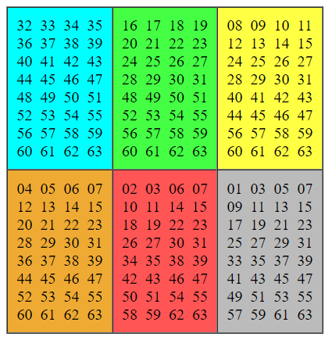
Trick 2
Pick a number between 1 and 63. Tell me what colour cards your number is on? For example, if you picked 45, it is on the blue, yellow, orange & grey card. I’ll tell you the number you picked. Look under the blue box to see how to do this.
Add the smallest number on each coloured card where the number appears. That is the secret number.
Notes:
Add the smallest number on each coloured card where the number appears. That is the secret number.

Slide 9
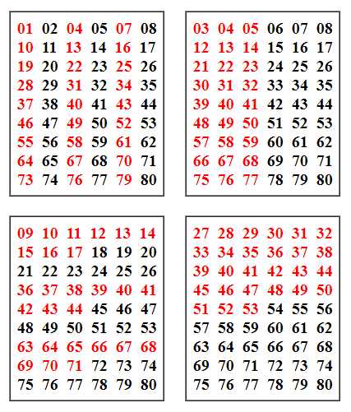
Trick 3
Pick a number between 1 and 80. Tell me what colour it is on each card. I’ll tell you the number you picked. Look under the blue box to see how to do this.
Add the smallest same colour number on each card the number appears in. The total will be the secret number. If the child picks 40 he/she will say red on card 1, 2, 3 and 4 so add the four smallest red numbers to get the secret number.
Notes:
Add the smallest same colour number on each card the number appears in. The total will be the secret number. If the child picks 40 he/she will say red on card 1, 2, 3 and 4 so add the four smallest red numbers to get the secret number.

Slide 10
Trick 4
Pick a number under 10 and double it.

Slide 11
Trick 4
Add 8 to the result.

Slide 12
Trick 4
Divide the result by 2.

Slide 13
Trick 4
Subtract the original number...

Slide 14
Trick 4
Convert this into a letter of the alphabet. (1=A, 2=B, 3=C, 4=D, etc.)

Slide 15
Trick 4
Think of the name of a country which starts with this letter.

Slide 16
Trick 4
Think of an animal whose name starts with the country's second letter.

Slide 17
Trick 4
Think of the colour of that animal...

Slide 18
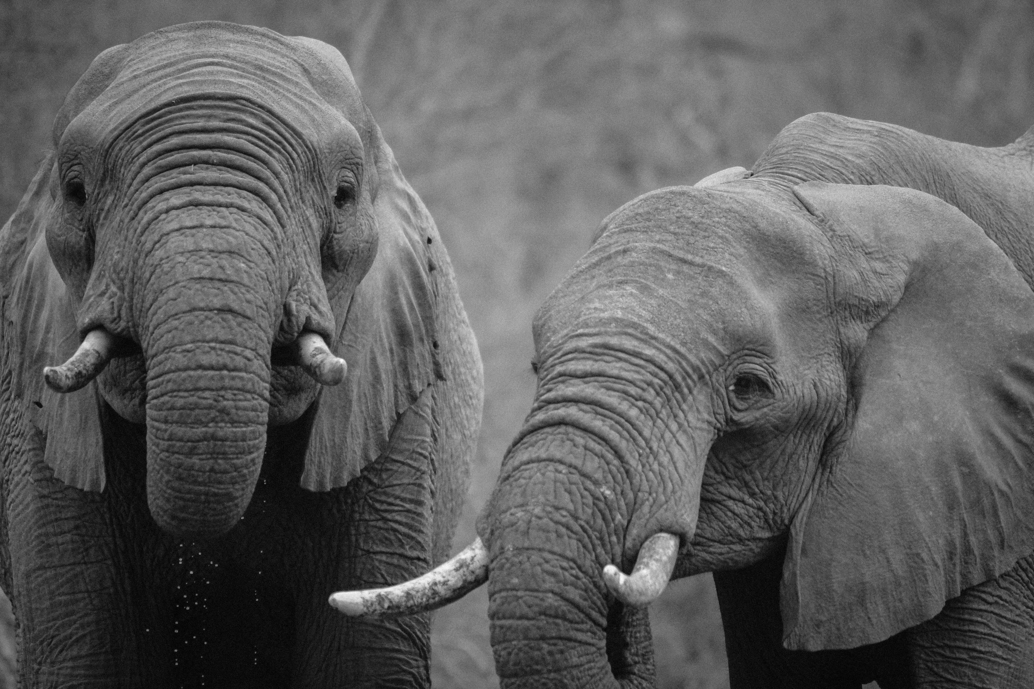
But there are no grey elephants in Denmark.

Slide 19
Trick 5
Write down your age.

Slide 20
Trick 5
Multiply it by 1/5 of 100.

Slide 21
Trick 5
Add on today's date (e.g. 2 if it's the 2nd of the month).

Slide 22
Trick 5
Multiply by 20% of 25.

Slide 23
Trick 5
Now add on your shoe size (if it's a half size round to a whole number).

Slide 24
Trick 5
Finally subtract 5 times today's date.

Slide 25
Trick 5
Show me your final answer! Are the hundreds your age and the tens and units are your shoe size?

Slide 26
Trick 6
Pick a 3-digit number where the first and last digits differ by 2 or more and write it down.
e.g. 259, 361, 692, 558

Slide 27
Trick 6
Find the "reverse" number, obtained by reading it backwards and write it down.
e.g. 259 → 952, 361→163

Slide 28
Trick 6
Subtract the smaller of these two numbers from the larger one.
e.g. 361 - 163

Slide 29
Trick 6
Add the result to its own reverse.
e.g. 136 + 631

Slide 30
Is your answer 1089?

