Slide 1
Tasks that make students think
New Primary Maths Curriculum

Slide 2
Odd One Out
Which picture, image or number does not belong.
There is no right or wrong answer.
Success is based on the ability to justify their answer.
Which one do you think is the odd one out and why?
Is there another reason why that one is the odd one out?
Can you give me a reason why everyone is the odd one out?

Slide 3
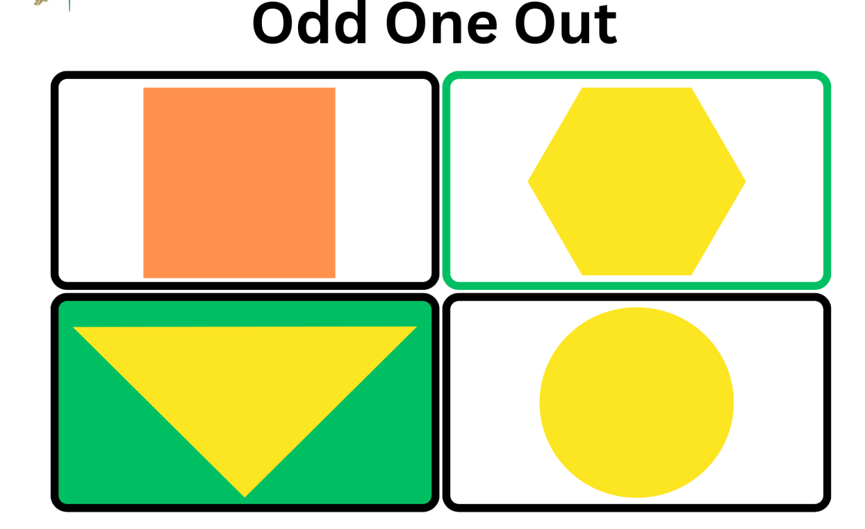

Slide 4
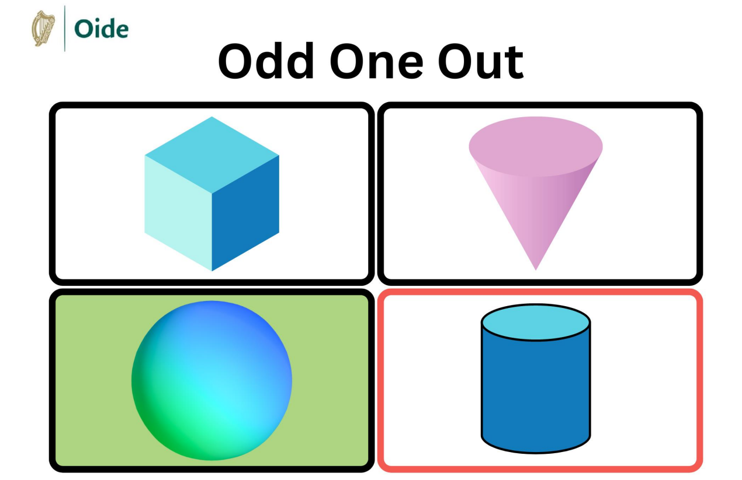

Slide 5
