Slide 1
Tasks that make students think
New Primary Maths Curriculum

Slide 2
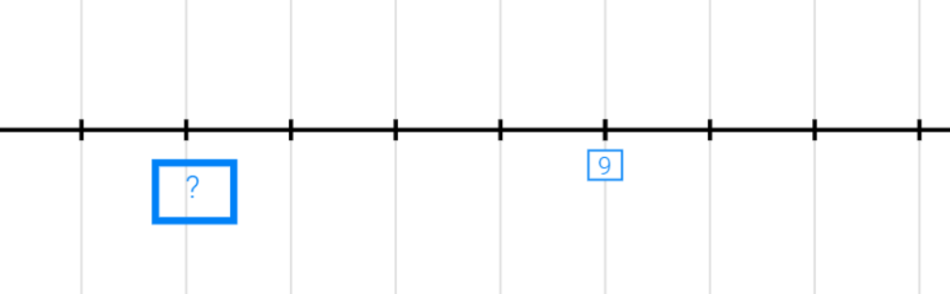
What number is missing at the question mark? Can you justify your answer?

Slide 3
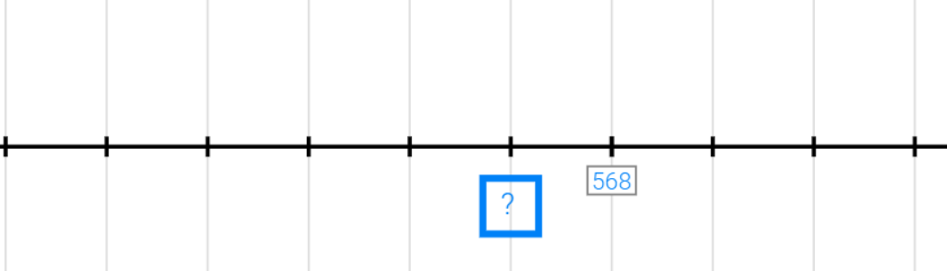
What number is missing at the question mark? Can you justify your answer?

Slide 4
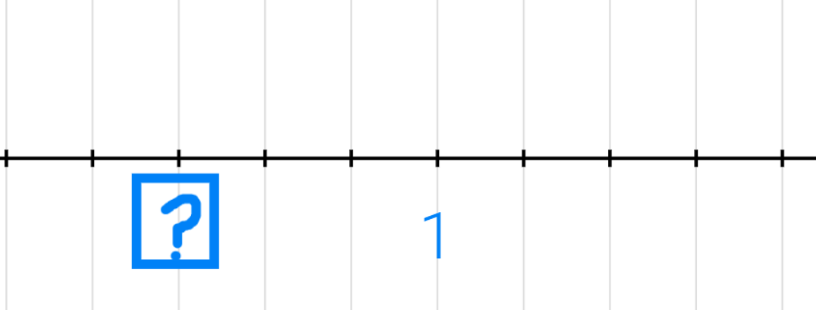
What number is missing at the question mark? Can you justify your answer?

Slide 5
