Slide 1
Tasks that make students think
New Primary Maths Curriculum

Slide 2
Target Boards
A target board is a collection of numbers.
The teacher can ask a variety of open and closed questions.

Slide 3
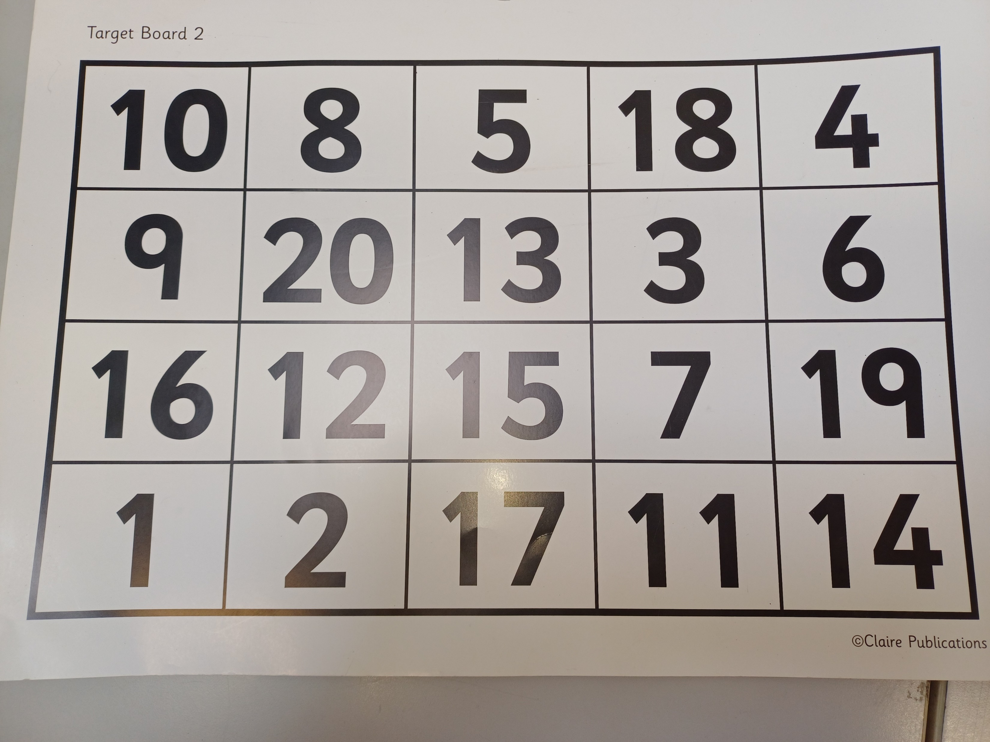
Closed Questions
1 Add 10 to all the numbers in the top row.
2. What is the difference between 3 and 19?
3. What is the total of the last column?
Open Questions
Tell me two numbers that have a difference of four.
Tell me three numbers that have a total of 30.
Tell me an odd number. How do you know?
Which numbers are factors of 20?
List the prime numbers.

Slide 4
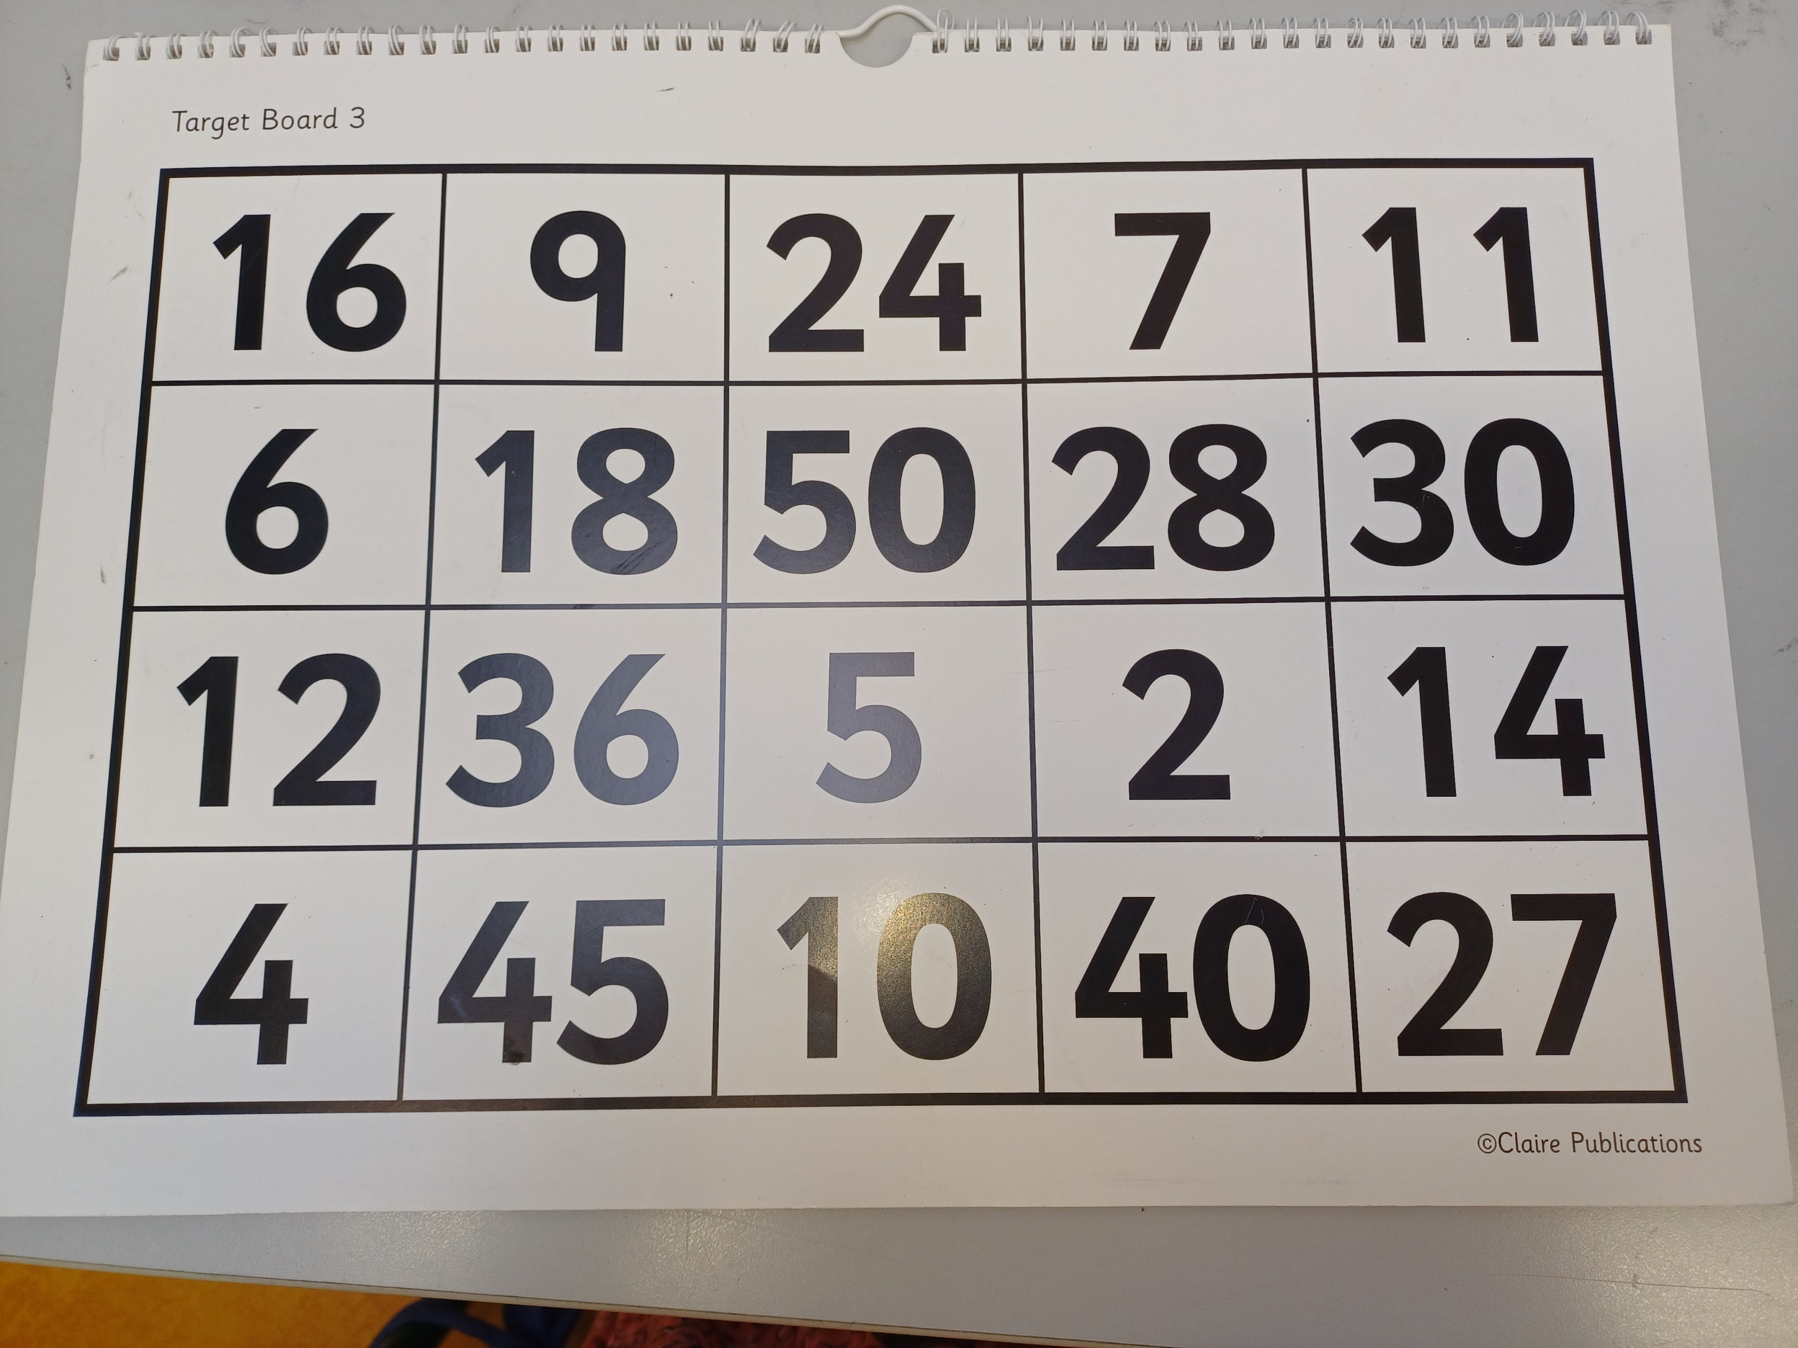
The Target Number is 25.
When I point to different numbers on the Target Board tell me how I can get to the Target Number.
Remember you can add, subtract, square and take-away, treble and minus, double, divide, multiply.
How can you get to the target number in one, two or three steps?

