Slide 1
Tasks that make students think
New Primary Maths Curriculum

Slide 2
Most of these problems can be solved in multiple ways
Suitable for most classes. Numbers may need to be adjusted.
Can be solved using concrete materials or with a whiteboard and marker.
Start with the easiest version of the problem and encourage your children to think mathematically.
Ask questions to encourage discussion. See next slide.
As children explain their strategy ask them to show their workings out or show on IWB.
Demonstrate how you would solve the problem.

Slide 3
Questions to ask to promote Maths Talk…
1. What answer did you get?
2. Any other answers? (Write all possible answers on the board)
3. How did you get that? / Can you explain your strategy and your answer?
4. Hands up who used the same strategy as ______.
5. Is that the only way to solve the problem? / Anyone use another strategy?
6. Will this strategy always work? / Can you think of a rule to help predict the answer for any number? / What do you notice?

Slide 4
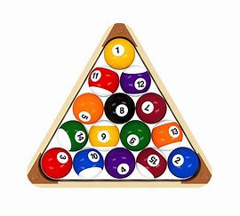
1. What total do you get if you
Add all the numbers between 1 and 5?
Add all the numbers between 1 and 10?
Add all the numbers between 1 and 20?
Add all the numbers between 1 and 100?

Slide 5
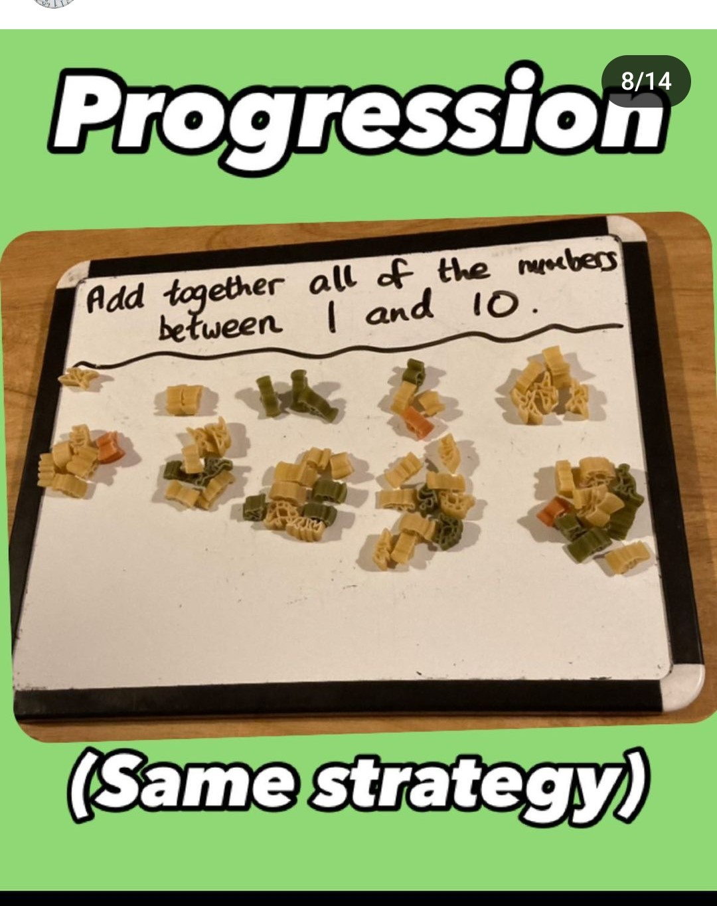
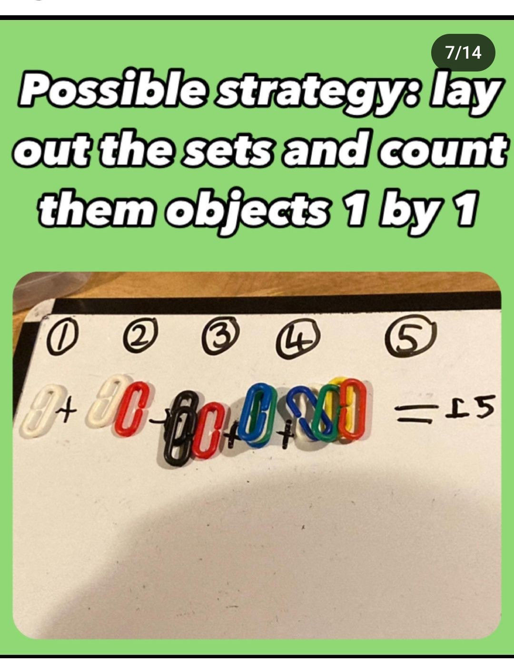
Did anyone work it out using concrete amterials?

Slide 6
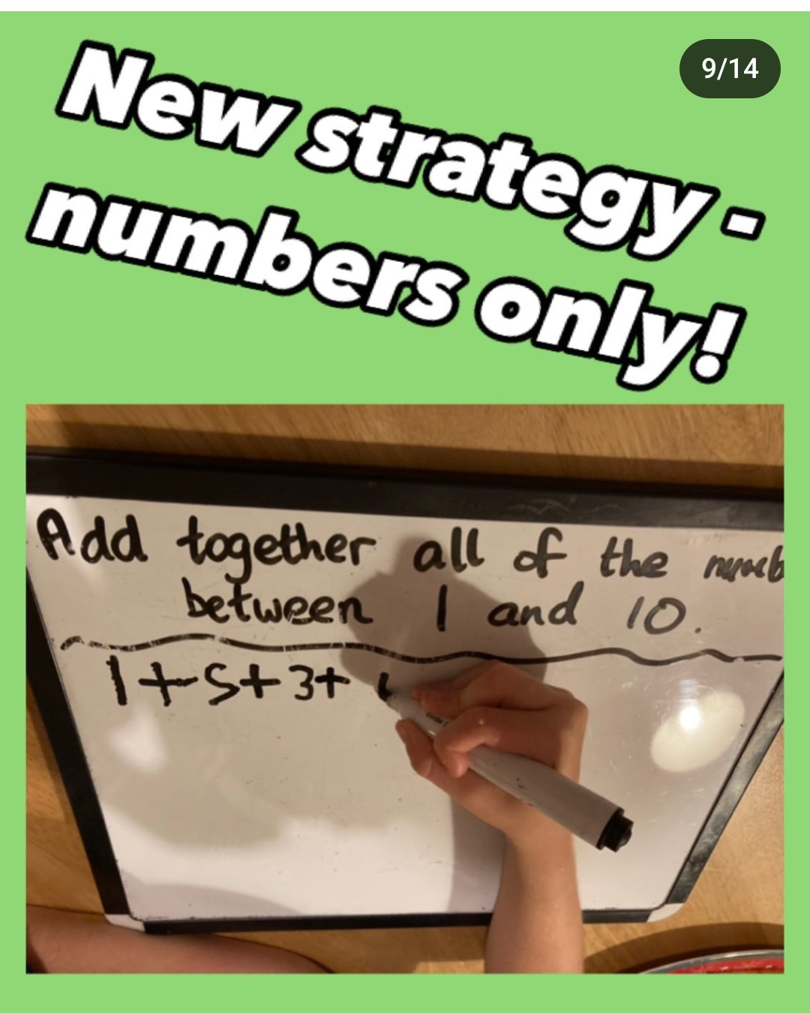
Did anyone work it out like this?

Slide 7
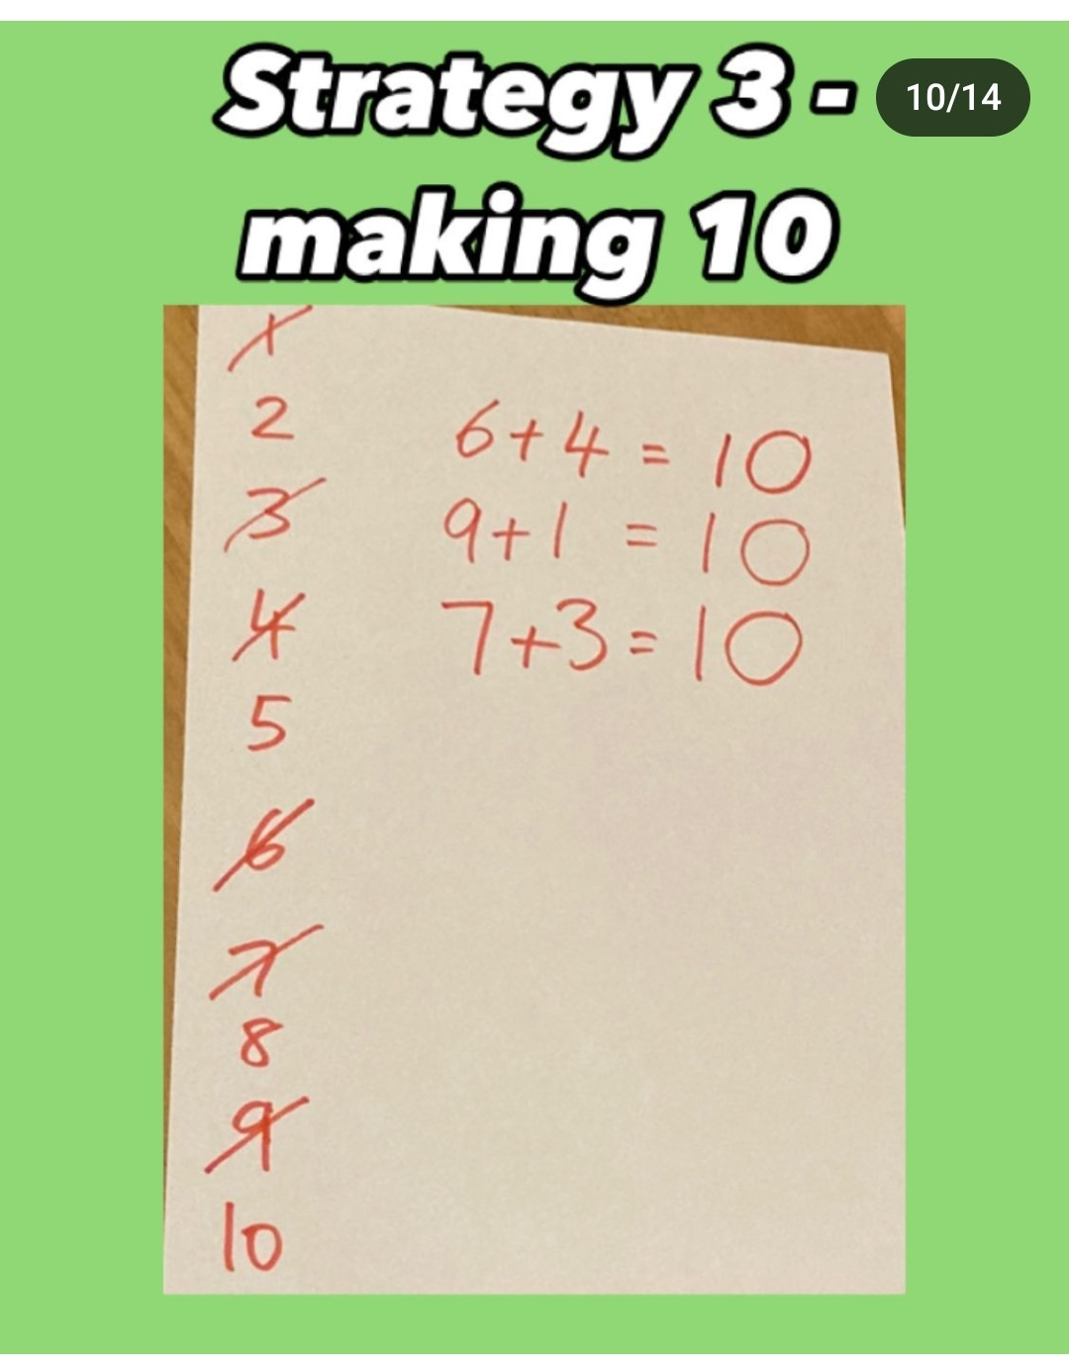
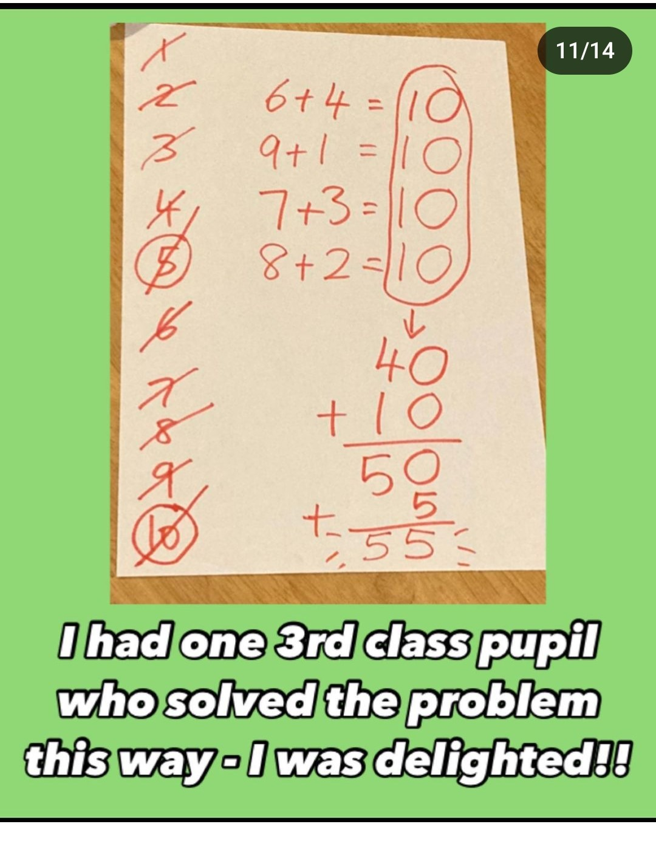
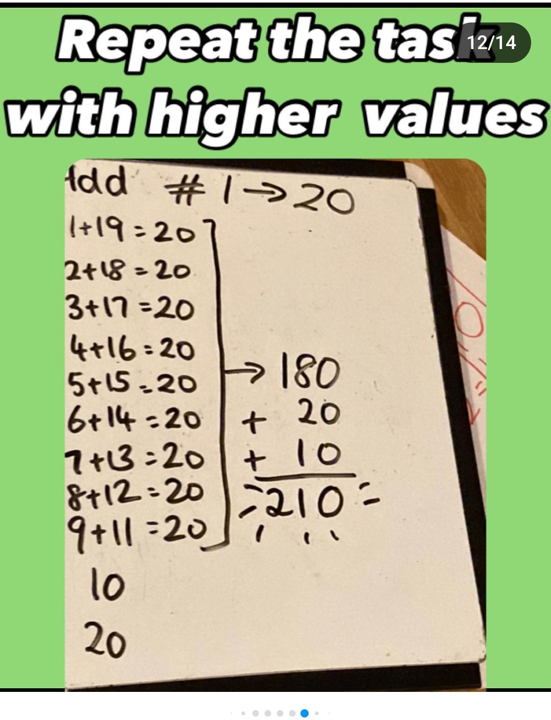
Did anyone add the numbers in a different order (making friendly numbers)?

Slide 8
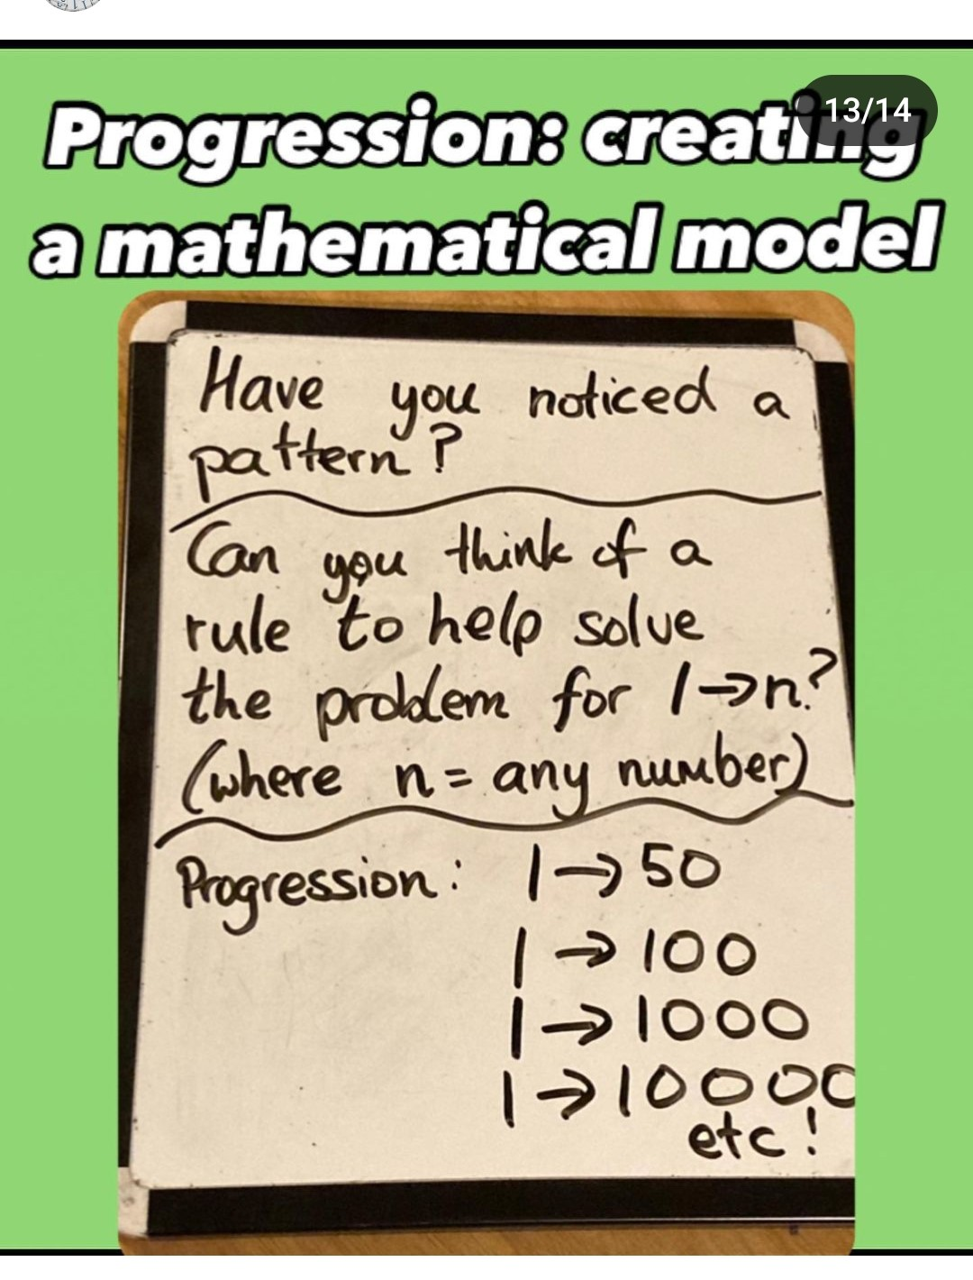
For older classes..you may have worked how a rule for all numbers?

