Slide 1
Tasks that make students think
New Primary Maths Curriculum

Slide 2
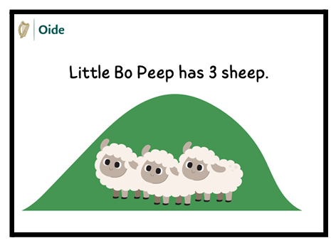
What maths questions could you come up with for this picture?
Little Bo Peep has 3 sheep. She bought 5 more. How many does she have now?
¼ of Little Bo Peep’s herd of sheep is 3. How many did she have altogether?
Little Bo Peep has 3 sheep. The sheep ran a total of 19.2km. How far did each sheep run?
Little Bo Peep has 3 sheep. Each sheep weighs 60kg before it is shorn. The shearer removed 3 kg of fleece. What percentage of the sheep’s weight was removed?

Slide 3
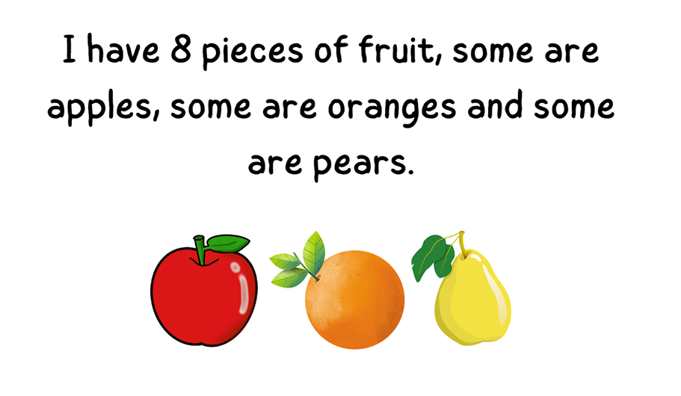
Can you come up with maths questions for this picture?

Slide 4
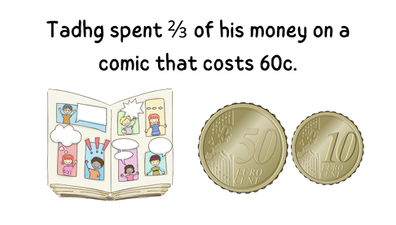
Can you come up with maths questions for this picture?

Slide 5
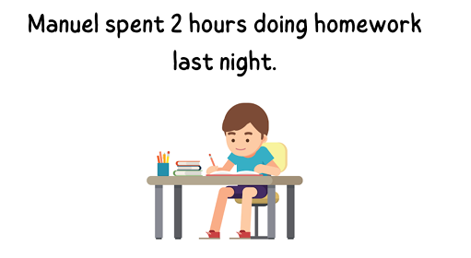
Can you come up with maths questions for this picture.

Slide 6
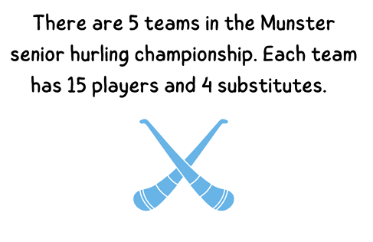
Can you come up with maths questions for this picture.

