Slide 1
TRANSITION YEAR
NEWBRIDGE COLLEGE

Slide 2
THE TY TEAM
Julie O’Keeffe
  Programme Coordinator
David Brew
  Dean
Neville Conroy
  4th Year Deputy Principal

Slide 3
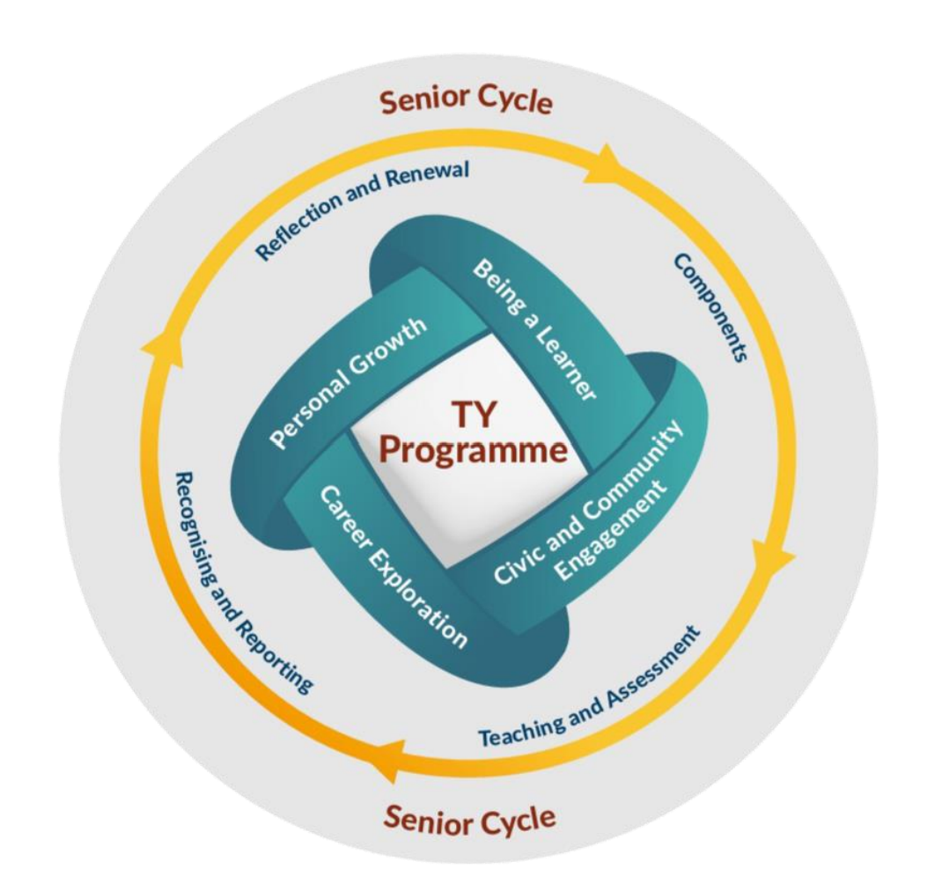
PROGRAMME AIMS
1. Nurture the development of the student as a whole person by building on their previous experiences, through a curriculum designed by the school that is aligned to the TY Programme Statement.
2. Create space and opportunities for meaningful, enjoyable learning experiences through which the key competencies of the student can be developed in the classroom and school, in the home and in their role as local, national and global citizens.
3. Expand the student’s experience and awareness of diverse future pathways and nurture the student’s capacity to sustain their growth and development through a process of lifelong learning.
4. Evolve continuously to support the learning and development of the student through a reflection and renewal process, involving students, teachers, school leaders, parents, and community partners.

Slide 4
PROGRAMME COMPONENTS
Civic and Community Engagement
Students make a positive difference in their school, community and society. They learn to act on their responsibilities and exercise their rights as local, national and global citizens in ethical and sustainable ways.
Personal Growth
Students mature socially & emotionally over the course of TY, developing in areas such as health and wellbeing, autonomy, identity, empathy, leadership.
Career Exploration
Students explore diverse future pathways in a guided and coordinated manner, gaining first-hand workplace experience and developing career-related competencies
Being a Learner
Students build on previous learning experiences and develop as senior cycle students.

Slide 5
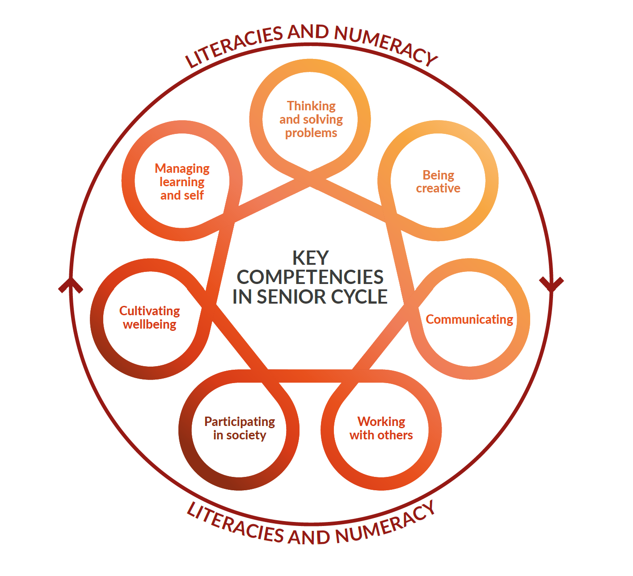
TY & SENIOR CYCLE

Slide 6
CORE SUBJECTS
WELLBEING
- Physical Education (PE)
Double class per week
- SPHE
1 class per week
English
Irish
Maths
French/German
Religion
Portfolio Development
1 class per week
2/3 CLASSES PER WEEK

Slide 7
SUBJECT SAMPLING
History
Geography
Art
Music
DCG
Construction Studies
Science (Physics, Chemistry & Biology)
Business (Business, Economics & Accounting)
TY SPECIFIC
Computers (ICDL)
Mini-Company
Law
Chinese
Leadership
Politics & Society
Road Safety

Slide 8
TIMETABLE
Portfolio 1 class
English 3 Classes
Irish 2 Classes
Maths 3 Classes
Fren/Ger 3 Classes
Science 2 Classes
Computers 4 Classes
Religion 2 Classes
Business 2 Classes
Drawing Double
  Woodwork
Art Double
P/E Double
History 1 Class
Geography 1 Class
Law 1 Class
Chinese Double
or
Leadership Double
Pol Soc Double
TOTAL
33 classes
Modules 1 Class
Careers: Ms. Mulvey
Music: Ms. O’Brien
Road Safety: Ms. Connaire

Slide 9
EVENTS
Bernard Casey Drama Workshop
Ideas Made Real
YOETY
Student Enterprise Programme
TY Christmas Fair
Think Languages Week
Intellectual Property Office
Forensic Fun Workshop (JFK)
Young Scientist
iWish
Model UN/Debating (EYP)
Drumming Workshop
BOI Money Smarts Quiz
Beekeeping Workshop
DCU Trip
CCJ Visit
Breakthrough Cancer Research Walk & Talk
Marie Keating Foundation Workshop
Cuan Mhuire Athy
Daisy Project (Irish Wheelchair Association)
KAS Programme
Ombudsman for Children Visit
Just One Life (Road Safety Workshop)
Community Garda Guest Speaker
Green Schools Workshop

Slide 10
PORTFOLIO DEVELOPMENT CLASS
Personal Growth
Goal setting
Being a Learner
Reflecting on experience as senior cycle learner (LC subjects)
Career Exploration
Work Experience
Civic & Community Engagement
Gaisce
Reflective Practice
Community work
4A – Ms. G McCluskey
4B – Mr. E Redmond
4C – Ms. Y Carey
4D – Mr. D Farrell
4E – Mr. E Conroy
4F – Mr. E Conroy
1 class per week

Slide 11
Optional Extras
POOL LIFEGUARD COURSE
€230 (includes registration, manual, certification with Water Safety Ireland)
Starting: September 14th (Monday)
Approx 12 weeks
Must be 16 years old at time of examination
2 courses to be completed online: Children First (Save cert) & CISM Stress Awareness Training
Delphi Adventure Resort
Mon 19th Apr – Wed 21st Apr
€220 pps (due SEPT 25th)
BARISTA COURSE
14th – 17th December €50 pps

Slide 12
WORK EXPERIENCE
Defence Forces
Law Library - Bar Council
Solicitors of the Future
Garda Open Day
Garda Work Experience
National Gallery of Ireland
Trinity College Dublin – Science courses
St. James’ Hospital/Tallaght Hospital
RCSI
RTE
Dietetics – TUD
Centre for Talented Youth Courses
Every Friday.
Documentation
  Information Form
  Evaluation Form
  Insurance Certificate
Block weeks
  Advance notice
  Information Form
  FORMS COLLECTED BY PORTFOLIO CLASS TEACHER
APPLICATIONS THROUGH TY COORDINATOR
{one nomination from the school}
DIRECT APPLICATION FROM STUDENTS
{supporting documents required from school}

Slide 13
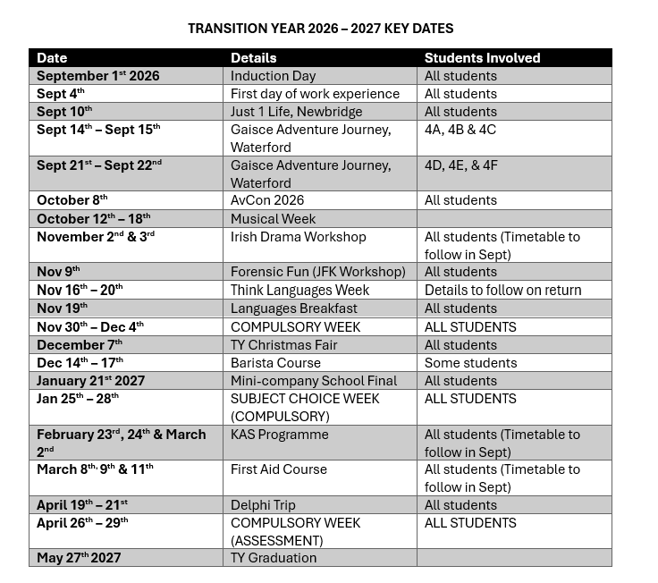
Gaisce Adventure Journey
MIT Payment Required
COMPULSORY WEEKS
Nov 30th - Dec 4th Assessment
Jan 25th - 28th Subject Choice
April 26th - 29th Assessment
Delphi Trip

Slide 14
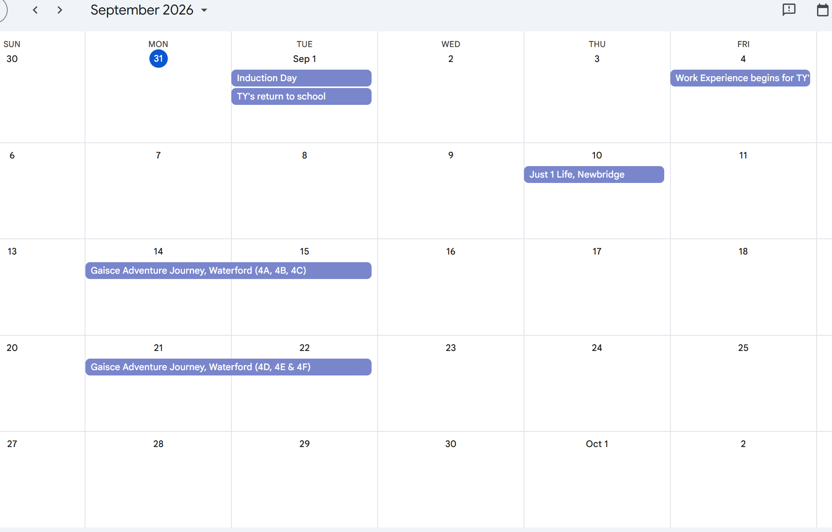
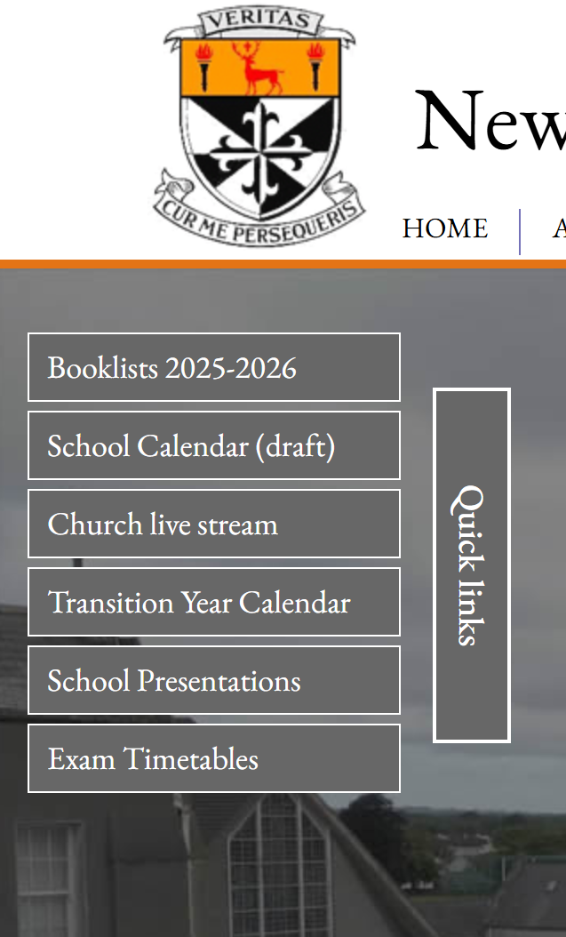
CALENDAR

Slide 15
GAISCE
Students will register in school with their PAL. Payment of €15 will be required to finalise registration
4A – Ms. G Mc Cluskey
4B – Mr. A Doyle
4C – Ms. Y Carey
4D – Mr. G Doyle
4E – Ms. R Kelly
4F – Ms. R Kelly
BRONZE AWARD Agree a challenge in four activities as follows:-
SKILL e.g. touch-typing - Participate one hour per week for 13 weeks
COMMUNITY e.g. first aid - Participate one hour per week for 13 weeks
PHYSICAL e.g. swimming - Participate one hour per week for 13 weeks
ADVENTURE - Organise a two day hike/cycle/canoe trip
26 weeks on one of the above
Students must be registered for Gaisce to go on adventure journey
Parental support and encouragement is vital.

Slide 16
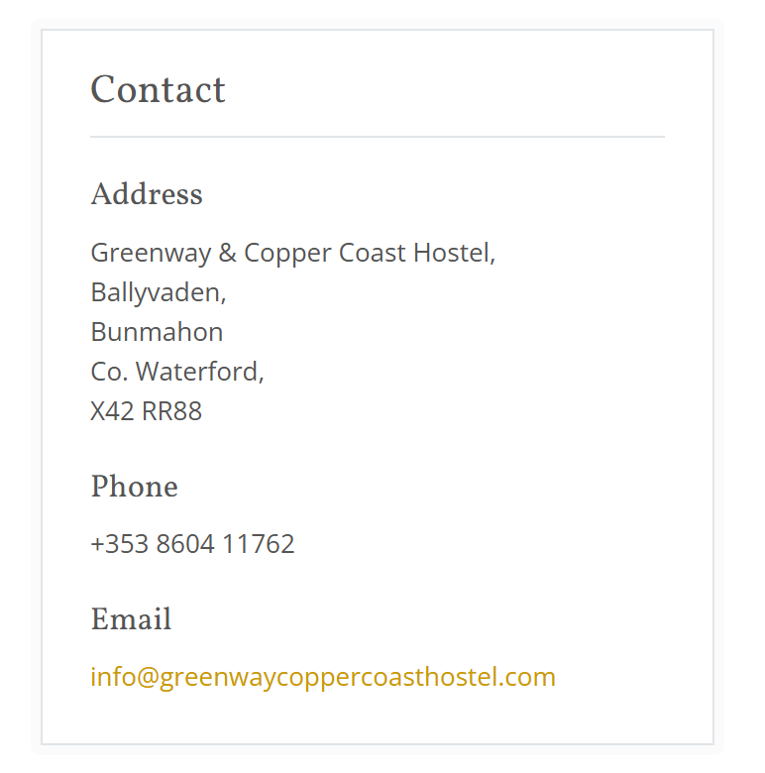
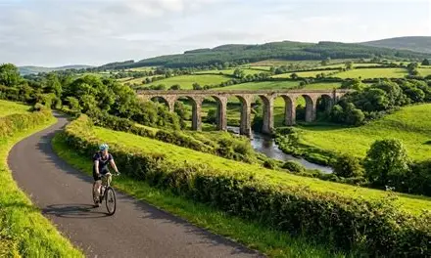
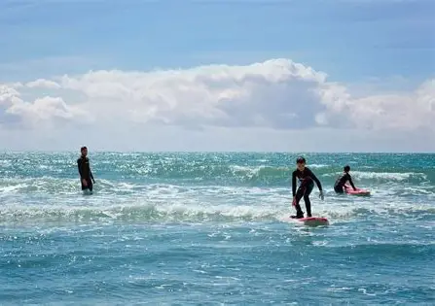
Gaisce Adventure Journey
Rain Gear
Sturdy walking shoes
Swim suit & towel
Rucksack (Small backpack for cycling)
Towel
Toiletries
Night clothes
1 full change of clothes
LUNCH, DINNER & BREAKFAST
4A, 4B & 4C Monday 14th Sept – Tuesday 15th
4D, 4E & 4F Monday 21st Sept – Tuesday 22nd
PAYMENT (€68) ON MIT PAYMENTS

Slide 17

DELPHI TRIP
MONDAY 19TH APRIL – WEDNESDAY 21ST APRIL 2027
€220 pps (subsidised by Newbridge College)
Full payment by September 25th to secure place.

Slide 18
ICT
ICDL
  Module 1 – Computer Essentials
  & Online Essentials
  Module 2 – Teamwork
  Module 3 – Documents
  Module 4 – Presentations
  Module 5 – Spreadsheets
  Module 6 – Using Databases
  Module 7 – Web Editing
  Module 8 – Advanced Presentations
  Module 9 – Advanced Docuements
  Module 10 – Financial Spreadsheets
Saving work on a network
  OneDrive
Use of Internet for research
  Newbridge College ‘Responsible Internet/Computer Use Policy’
  HTML

Slide 19
COMMUNICATION
Vsware/iClass App are the primary means of communication with parents.
Transition Year Calendar – regularly updated
Teams/Students will need to look at Teams on a daily basis.
Email/Text
Communication with students
  Daily Notices
  Email
  Teams
This week on Teams…
Naas Park Run (Volunteer – Gaisce)
Pool Lifeguard
Houses of the Oireachtas TY Programme

Slide 20
ASSESSMENT
Please note compulsory weeks in December & April/May for assessment
Reports
  Christmas and summer
  GRADE along with progress, effort, behaviour and comment.
Portfolio
  Assessed at Christmas & Summer.
End of year interview
VSware
  Ongoing assessment by class teachers
Attendance & participation in class work and activities is key.

Slide 21
Questions

