Slide 1

Welcome
Dean
Supporting Student Progress & Development

Slide 2

Respectful
R: Responsibility - We are accountable to ourselves and others for our decisions.
E: Empathy - We take the time to acknowledge and understand others point of view.
S: Safety - We behave in a safe manner and take care of each other.
P: Pride - We take pride in ourselves and our environment.
E: Excellence - We strive to do our best in all areas of our lives.
C: Co-operation - We work together for success.
T: Truth - We speak and act honestly.

Slide 3

Dean's Role in Wellbeing
Nurturing relationships
Pastoral care
Promoting social cohesion and an inclusive atmosphere
Supporting positive mental health
Whole school approach
Supports – Wellbeing Padlet

Slide 4
Anti Bullying – Bí Cineálta
New Department of Education Model Nationwide
All suggestions of bullying behaviour will be recorded and filed.
There will also be more parental involvement with regards to any incidents.
This does not include incidents which occur outside of school with the exception of cyber bullying which can affect students in the school setting also.

Slide 5
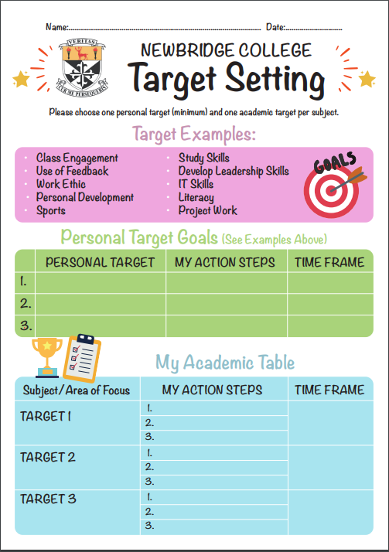
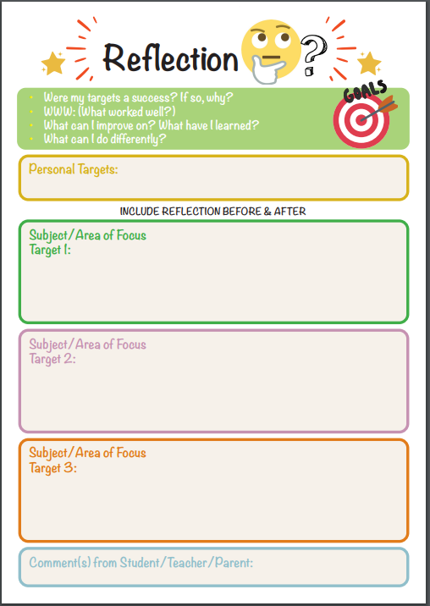
Target Setting / Organisation
Enable students take responsibility for their own learning and to reflect on own learning

Slide 6
Target Setting
Targets can be set by students and parents together, it is available in the student diary.
Examples for TY: Develop short, medium and long term goals, develop oral language skills, develop IT skills, take on a new sports activity, develop leadership skills, work experience opportunities, etc.
Students reflect on whether their targets were a success and reflect on the learning that came from the process.
Effective use of their Diaries will aid here.

Slide 7
Operational
Attendance & Punctuality
Using VS Ware
Uniform & Appearance
Discipline
Phone Use
Lockers & Locks

Slide 8
Attendance
While students will miss school for various reasons, attendance should be maximised.
Please inform us of block work experiences in advance and also log absence on VS Ware.
If engaged in other activities, please encourage sons/daughters to keep up to date with the schoolwork and also to stay in touch with their friends.
  - Obvious impact on teaching and learning.
Formal letter – if absences are high.

Slide 9
Punctuality
Parents – a key role in students punctuality
8.20am – suggested arrival time
8.40am – school classes begin
After 8.50am – sign in at enquiries
Punctuality visible in VS Ware (please view)

Slide 10
VS Ware and Absences
Please log future absences on VS Ware
- If you have done this, it will be approved by the school
If an absence is not logged, please respond to the absence texts which you receive each day.
PLEASE DO NOT GIVE YOUR SON/DAUGHTER ACCESS TO OUR VS WARE APP

Slide 11
Sign in / out on VS Ware
Students to give a note to their Dean in the morning BEFORE 9am each day , parents may also email BEFORE 9am.
Student must then go to Enquiries to sign out using their smart cards.
No requests on VS Ware will be approved after 9am so in case of emergency, please email Dean or call office.
Also please note that no advance notice is needed if a parent collects a student from Enquiries and signs them out in person.
Any breaches of this protocol results in detention.

Slide 12
Uniform
Must wear full uniform appropriately at all times
During cold spells, a black jacket is only permitted over full uniform
Only fully black footwear is permitted

Slide 13
Behaviour
  Respectfulness
- with eachother
- with teachers
- with College staff
  Vaping & similar products
- Education Module
- Bathroom Issue
- Consequences

Slide 14
Devices
Phones ARE allowed in School
BUT phones may NOT be used in class
All students should have laptops with then at all times
  - Please aid in Laptop Charging

Slide 15
Lockers & Locks
Students own responsibility
Must keep them locked
If a lock is lost, the student will be asked to bring in €30 for a replacement lock
They must report it immediately if they have lost their lock

Slide 16
iClass App
Main communication tool used by the school.
Please attach your son/daughter to your account.

Slide 17

Communication
First point of contact
VS Ware
Direct Phone Number 045 487200
dbrew@newbridge-college.ie

