Slide 1


SciFest
Where Creativity Meets Innovation
www.scifest.ie

Slide 2
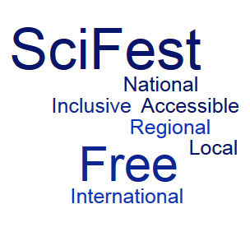
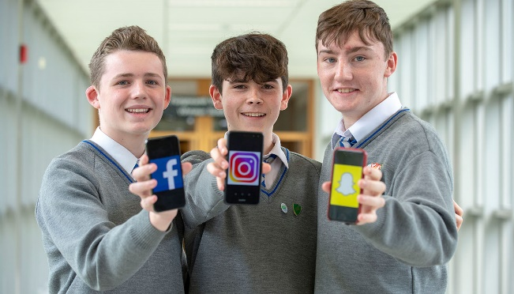
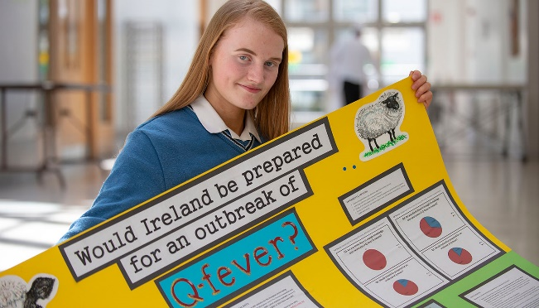
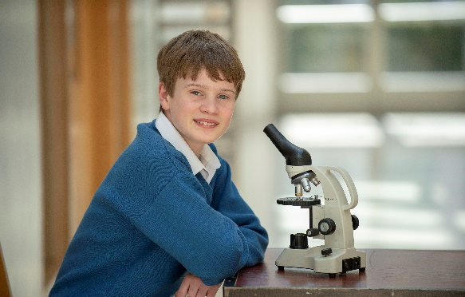
What is SciFest?
SciFest is a series of one day STEM fairs for second-level students which take place in:
Schools (SciFest@School), SciFest@TCPID and SciFest@Teen-Turn
16 Regional venues (SciFest@College), ATU (3 venues), TUS (3 venues), SETU (2 venues), MTU (2 venues), TU Dublin (3 venues), DkIT, DCU and St Mary’s College, Derry
Dublin (National final)
is
SciFest is Totally Free to Enter
www.scifest.ie

Slide 3
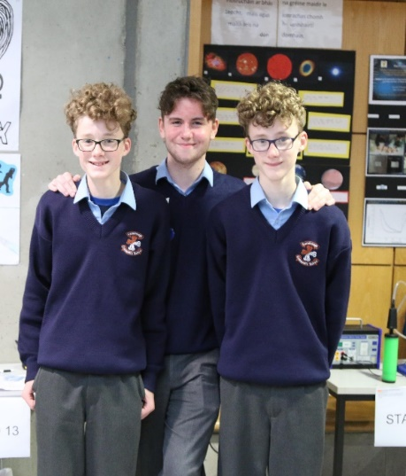
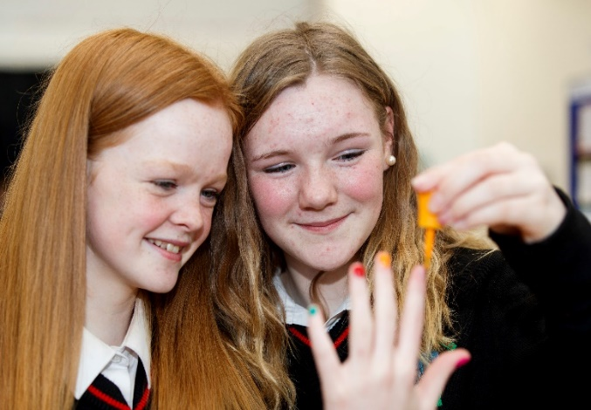
Why enter SciFest?
SciFest is an exciting way for you to:
Investigate a topic that really interests you
Research and solve a real world problem
Showcase your science, maths or technology project
Talk to experts from academia and industry about
your discoveries
Improve your problem solving, computer, presentation, and research skills
Work with others and make new friends
Compete for more than €20,000 in prizes
See real scientists in action
Visit a college’s laboratories and view the facilities
Learn about the courses available in the college
Enhance your CV
SciFest is Your Topic, Your Project, Your Achievement
www.scifest.ie

Slide 4
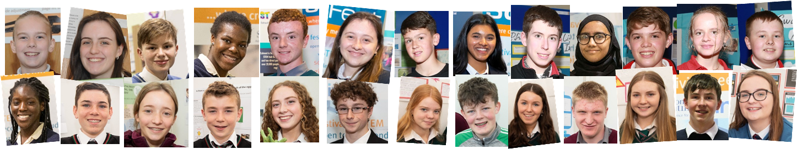
Who can enter SciFest?
SciFest is open to all second-level students. There is no entry fee.
Project Type
Individual or Group - (Max. 3 students per group – all group members
must be in attendance at the exhibition)
Age Categories
Junior: 1st Year and 2nd Year
Intermediate: 3rd Year and 4th Year
Senior: 5th Year and 6th Year
Project Categories
Physical Sciences
Life Sciences
Technology
More than 15,000 Students Participated in SciFest 2024
www.scifest.ie

Slide 5
6 easy steps to a successful project
State Problem
Look around, ask questions, identify a problem, state a hypothesis
Research
Gather as much information about the topic as
possible
Investigate
Design and carry out experiments to test the
hypothesis; collect data
Analyse
Analyse the data, discuss the findings
Conclude
Come up with a possible solution to the original problem
Present
Present findings at SciFest
Entry to SciFest is Free. It’s Hard Work but Worth it.
www.scifest.ie

Slide 6
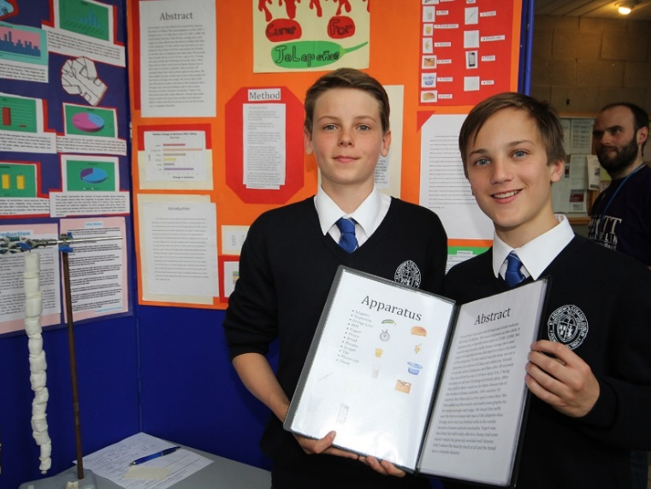
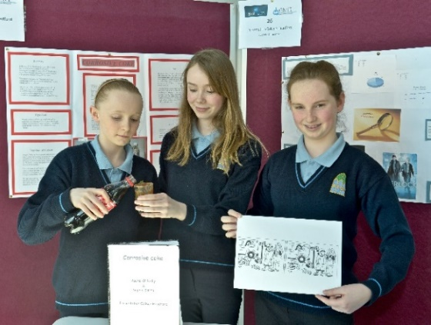
A completed project must contain
PROJECT REPORT BOOK
Title Page
Introduction
Background Research
Experimental Methods
Results
Conclusions and Recommendations
Acknowledgements
Appendices
References
SUMMARY/Abstract (included in Report Book)
This is a short description of what your project is about.
It should be no more than two typed pages in length.
VISUAL DISPLAY
See the SciFest website for lots of useful information - www.scifest.ie
Don’t be Left Behind - Get Involved Today
www.scifest.ie

Slide 7
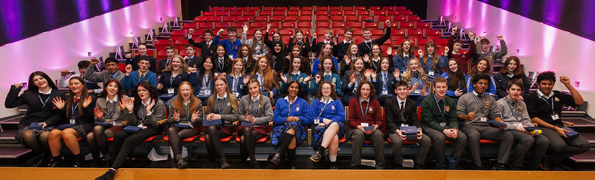
SciFest National Final
In November the Best Project Award winners and a selection of the Runner-up Best Project Award winners, of the Boston Scientific Medical Devices Award winners and of the EirGrid Climate and Delivering a Cleaner Energy Future Award winners from the 16 regional venues are invited to compete at the national final
Each of the students attending the national final is presented with a SciFest Excellence in STEM crystal plaque
One project is selected by a team of judges to represent Ireland at the Regeneron International Science & Engineering Fair (ISEF) in May in the USA
One project is selected to attend the Berlin Long Night of Science
A number of projects are selected to participate online in the Eskom EXPO for Young Scientists
SciFest National Final 2014
Dare to Imagine that this Could be YOU in 2025
www.scifest.ie
7

Slide 8
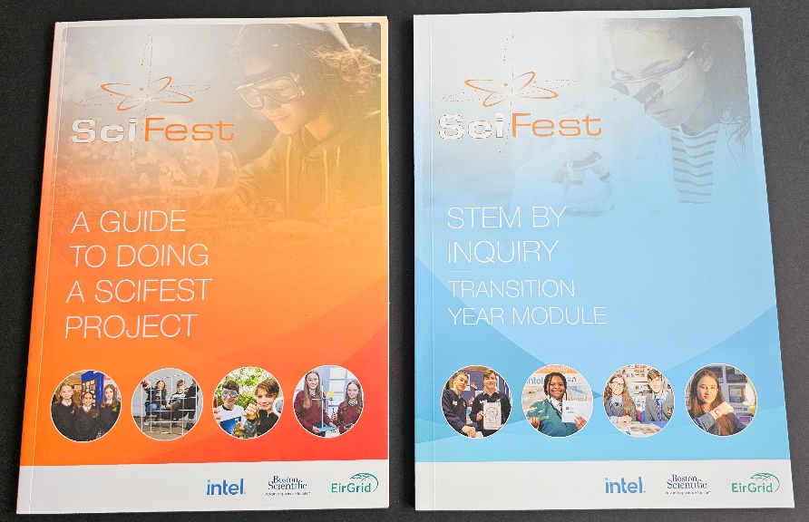


For more information and lots resources
please visit the SciFest website at
www.scifest.ie – Resources Tab
SCIFEST is a
Gaisce Challenge Partner
TY students participating in SciFest can use their participation as the Personal Skill element of the Gaisce Award.
TY students involved in organising SciFest events can use their activities as the Community Involvement element of the Gaisce Award.
SciFest
T: (+353) 1 298 8312
M: (+353) 86 379 6143
E: info@scifest.ie
W: www.scifest.ie
There’s a Booklet of over 50 Project Ideas Downloadable from the Website
www.scifest.ie

Slide 9
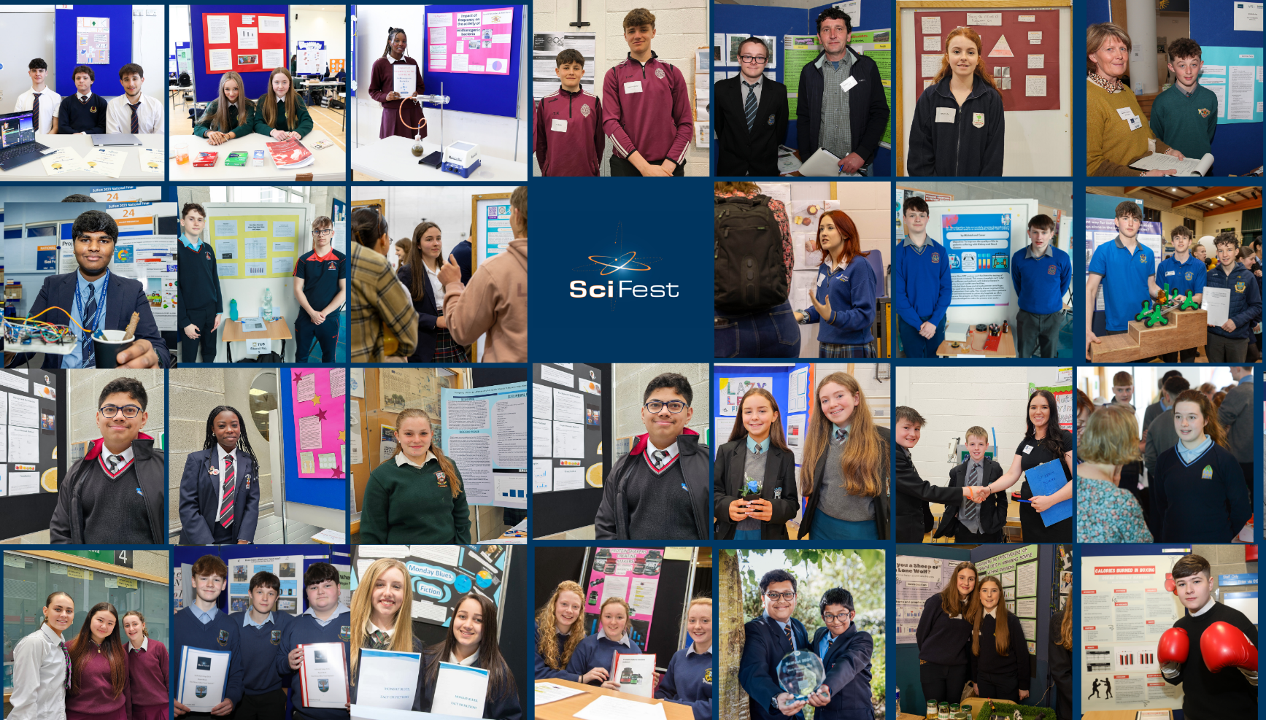

Are YOU Ready for the SciFest Challenge?
SciFest National Final 2014
At SciFest We Believe in Equal Opportunity for All
www.scifest.ie
9

Slide 10

Dates to Reminders
SciFest@College 2026 regional STEM fairs will take in Dundalk Institute of Technology,
TU Dublin (3 venues), MTU (2 venues), TUS (3 venues), ATU (3 venues), SETU (Waterford),
St Mary’s College Derry and in DCU.
SciFest is free to enter at all levels, ensuring that everyone can participate without any cost
Closing date for receipt of entries to SciFest@College 2026 is Thursday 12 March 2026.
Dates of SciFest@College events are posted on the website as they become available – see SciFest@College/Dates & Contacts.
The SciFest 2026 National Final will take in November.
Check out the SciFest website www.scifest.ie today
Watch the video https://www.youtube.com/watch?v=itSSZcGmSxo
Top Awards Include an All-expenses-paid Trip to the USA
www.scifest.ie

Slide 11
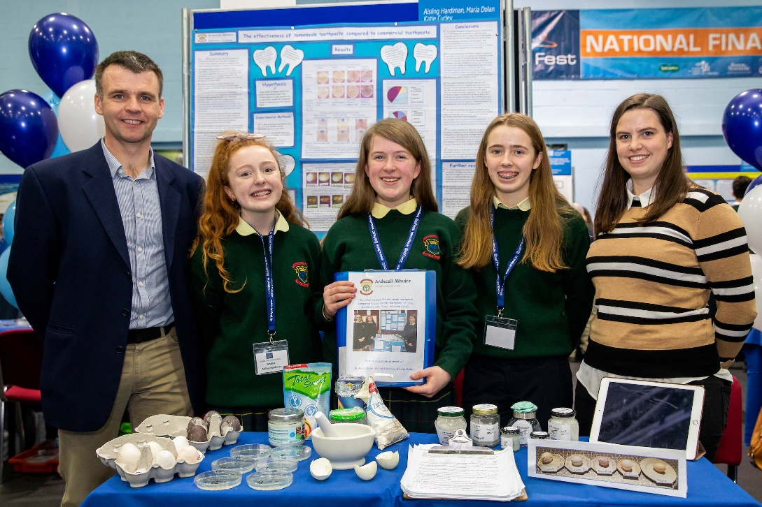
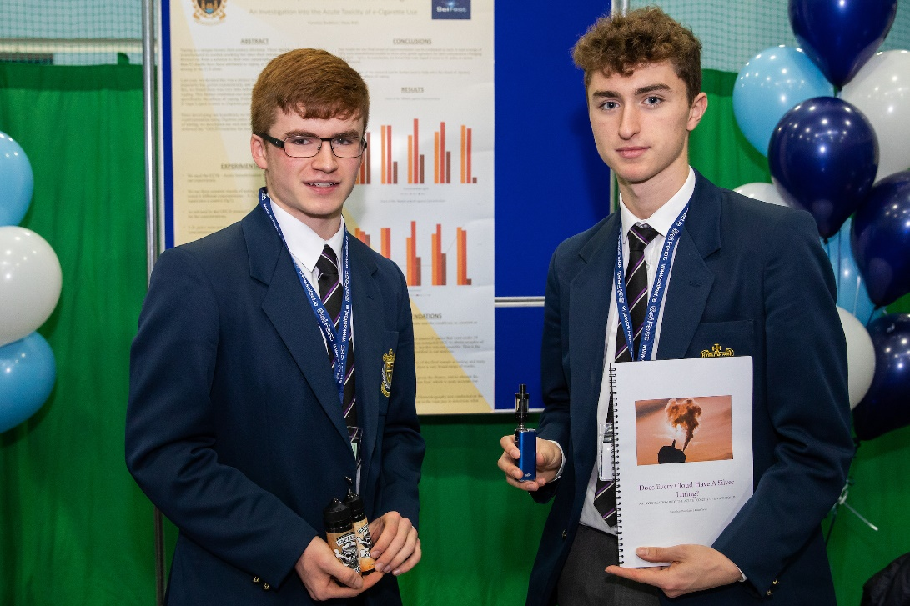





SciFest on Social Media
Follow SciFest on Instagram
Read about SciFest on ISSUU
See YOU There!
www.scifest.ie

