Slide 1
St Joseph’s College CAO Information Evening
Antoinette Donohue, Guidance Counsellor
12th November, 2025

Slide 2

2026

Slide 3









Higher Education Institutions Dublin / Kildare Region
Universities
TCD – Trinity College Dublin
Colleges
Private Colleges
UCD – University College Dublin (NUI)
MU – Maynooth University (NUI)
DCU – Dublin City University
TU Dublin (Dublin, Blanchardstown and Tallaght – Technological University Dublin
NCAD = National College of Art and Design, Dublin
NCI = National College of Ireland, Dublin
St Patrick’s Pontifical College, Maynooth
Royal College of Surgeons, Dublin
Griffith College Cork and Dublin -Grafton College of Management Sciences
-American College Dublin -Dublin Business School
-Pulse College -Grafton College of Management Sciences
-IBAT -Psychology at NCI
-ICD Business School -St Nicholas
Marino Institute of Education (Accredited by Trinity College Dublin)
It is the responsibility of each student to confirm the status of the institution that you are applying to

Slide 4
General Information
The CAO is the Central Applications Office to which Leaving Cert students apply to undergraduate courses offered by Higher Education Institutions (HEIs)
These are the courses for which “POINTS” are usually required
All students should apply to the CAO online using a laptop or desktop only
For your information the new annual student contribution fee will be €2,500

Slide 5
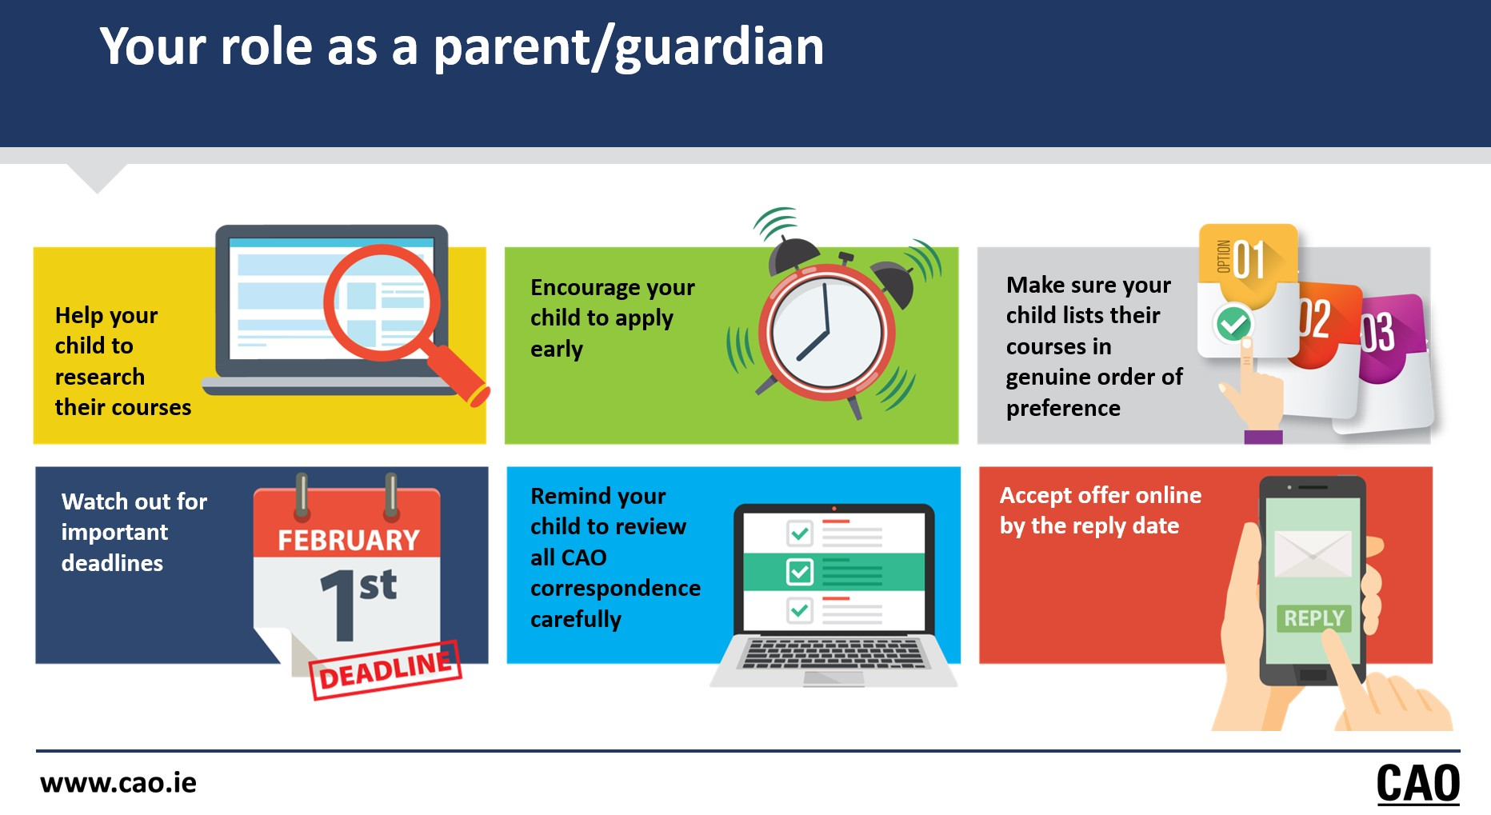

Slide 6
It is the applicants responsibility to:
Read the CAO handbook carefully, and be clear about the procedures, dates, fees and rules that apply to the Central Application System of the CAO – No printed version this year.
Research thoroughly ALL the courses for which the student is making an application
To ensure that an application is submitted complete, correct and on time
The online application requires some minimum computing facilities such as google chrome. The CAO advise that students do not make an application using smartphones or tablets.

Slide 7
Research Courses
Interview with Guidance Counsellor
www.cao.ie
www.qualifax.ie
www.careersportal.ie
HEI websites e.g. www.mu.ie or tcd.ie
Attend open days and ASK! All listed on www.cao.ie
DCU Open day is 14th and 15th Nov (Parents are welcome!)
Ask relatives, friends
College Prospectuses - mostly online
Podcasts, Instagram…..Join!

Slide 8

Application Dates and Fees
ONLINE APPLICATION | FEE | CLOSING DATE
CAO Online Application Opens |  | 5th November 2025 (12:00)
Early Online application rate | €30 | 20th January 2026 (5 pm)
Normal Online application closes. Restricted courses deadline. | €45 | 1st Feb 2026 (5 pm)
HPAT Registration opens HPAT Test |  | TBC TBC
HEAR/DARE online forms completion date |  | 1st March 2026 (5pm)
HEAR/Dare supporting documentation to arrive at CAO |  | 10th March 2026 (5pm)
Change of Mind opens | €60 | 5st May 2026 (5 pm)
Change of Mind Closes | Nil | 1st July 2026 (5 pm)
CAO Timetable of Events

Slide 9
Change of Mind
The change of mind facility is open up to the 1st February and 1st March with a fee of €10. This means that once you have applied and received a statement of application from the CAO you can go back on-line and change the order of your courses, remove courses and add courses to your original list up to these dates.
This facility returns again on 5th May (12:00 noon) up to July 1st
The change of mind facility is open to restricted courses up to the 1st of February only

Slide 10
Restricted Courses
These courses have early assessment procedures therefore can only be included in your original course choices submitted before 1st February, 2026
Courses that are restricted are clearly identifiable in the CAO handbook online with the word restricted in italics
Courses that are restricted usually require another type of assessment along with the leaving certificate e.g. interview, portfolio or performance
Examples: HEAR / DARE, Animation IADT, Medicine, Music MU, Drama TU Dublin City, Art and Design NCAD

Slide 11
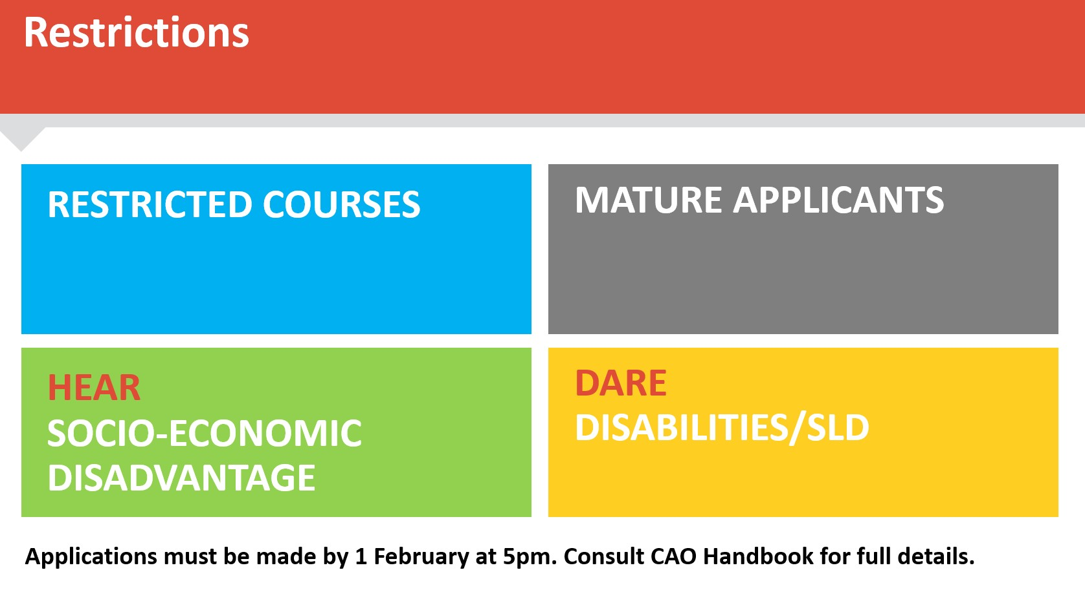
Restricted Courses

Slide 12

Irish, Foreign Language and Math Exemptions
NUI Exemptions (Maynooth University, UCD, NCAD, UCC and Galway University)
If you were: (a) Born outside Ireland – (Section B) only
(b) Born in Ireland but had primary education outside Ireland OR minimum of three continuous years outside Ireland (Section C) only
(C) Have an Irish exemption due to an SLD with a cert (Section D)
***New in 2024***
The NUI Exemption for is online only
https://www.nui.ie/news/2023/Exemptions.asp
Trinity College, Mary Immaculate and Limerick University apply directly to these universities for the exemption. Contact University admissions.
Check cao.ie for more information on exemptions.
Remember 6 subjects (excluding LCVP) are needed for Matriculation despite the exemption!

Slide 13
Making an online application
Open www.cao.ie/apply Opens on 6th November
STEP 1. (Payment needed at this stage)
REGISTER ON THE CAO STYTEM TO OBTAIN YOUR PERSONAL CAO NUMBER
NB – USE YOUR PERSONAL EMAIL ADDRESS TO REGISTER (Do not use your school email ; do not use a parents email address).
Carefully enter your details – name (as it appears on your Birth Certificate , address, DOB, phone number (for SMS text messages)
Select the qualifications relevant to you – Current Leaving Certificate Student…2026.
Select payment method (a debit/credit card is required but information will not be stored. You will be redirected to a third party payment system and then when the payment is processed you will be brought back to the cao)
Create a PASSWORD (Write down and keep carefully your password and CAO number as you will need both to log onto the website).
You will also receive an email containing your CAO number. This number is very important. You need to photograph this number and hold onto it carefully
You must press PROCEED WITH APPLICATION to obtain your CAO number and email verification code. Check you email to verify and confirm that you now have a CAO number .
Check email regularly; Add Notification for CAO; Check SPAM or TRASH ***

Slide 14
Making an online application
STEP 2.
Go to www.cao.ie and click My Application. You will need your CAO application number, your date of birth and your password to proceed.. You will then be asked to verify email and subsequently you will be brought to the qualifications section to confirm status.
Tick box 1 Irish Leaving Certificate 1985-2026
Applicants must also enter their school name, address, start year and finish year in the Secondary Level Schools Attended section of the online application (2018 to 2026). You are not asked for your Leaving Certificate Exam number at this stage. Leaving Certificate Exam numbers for 2026 have been issued to all students. This number must be kept separate to the CAO number. It is not to be confused with the CAO number. Applicants will be asked to confirm their Exam Number by the CAO via email next May 2026.
STEP 3.
Indicate if you wish to be considered for SUSI – this does not mean you have applied for SUSI
STEP 4.
Exemptions: If you wish to seek an exemption from Minimum Entry Requirements (e.g. Irish or modern language) you indicate it here. However, as every HEI differ NUI colleges require submission of proof of exemption prior to June 2026.
Do the TRIAL RUN on the CAO website

Slide 15
Making an online application
STEP 5.
There are 2 course lists (Level 8 and Level 7/6).
Log in to the My Application facility and click Add Level 8 course or Add Level 7/6.
You can add up to 10 course choices on each list.
Your choices on one list do not in any way affect your choices on the other list; both lists are separate.
You have the opportunity to make changes to your course choices lists multiple times (add, take off or change order) using the change of mind facility. There are some restrictions to this.
It is possible to receive an offer on both lists. You may then decide to accept either your Level 8 course or your Level 7/6 course.
Alternatively, you might not wish to accept either offer or defer you place until next year.

Slide 16
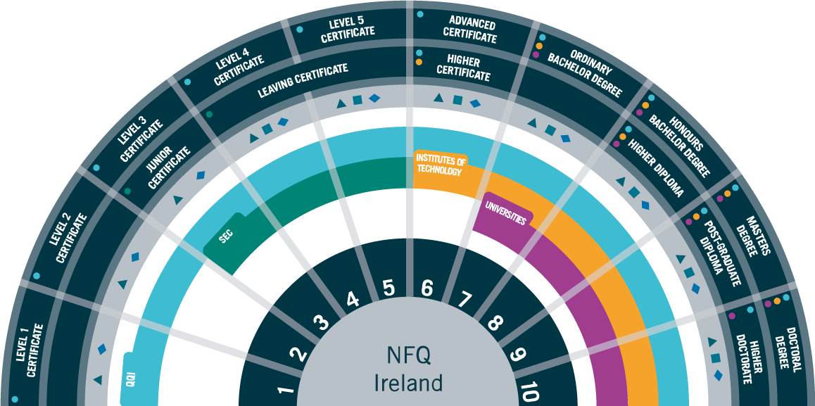
The National Qualifications ~Framework NQF

Slide 17
Level 8, 7 and 6 Courses
Level 8 Courses
Honours Degree Courses (8), example = TR024 European Studies, TCD
Level 7 and 6 Courses
Ordinary Degree Courses (7), example – TU747 Hospitality Management, TUD
Usually 3 to 4 years duration
You can choose 10 Level 8 courses
Universities, most IT’s/Colleges and Private Colleges
Higher Certificate (6), example – NC 103 Business, NCI
3 and 2 years duration
All IT’s, some Uni. & Colleges
PLC Courses are NOT part of the CAO. You do NOT need points for a PLC!

Slide 18
Order of Preference
Order of preference means ranking the choice of courses in the exact order in which you want to be considered for a place
***VERY IMPORTANT***
Both course lists must be filled out in
Genuine Order of Preference
The CAO will assume that course 1 on your Level 8 list is preferred to course 2 and course 2 is preferred to course 3 and so on….
If you are eligible for course 1, then this is the ONLY course you will be offered from the Level 8 list.
ALL OTHER COURSES LISTED BELOW THIS WILL NEVER BE OFFERED.
Similarly, if you are eligible for course 4 on your Level 8 list then all courses listed below this i.e. 5, 6, 7, 8, 9, 10 will NEVER be offered to you.

Slide 19
Order of Preference
PLACE YOUR COURSES IN GENUINE ORDER OF PREFERENCE
1. (I want this course more than any course below)
2. (I want this course more than any course below)
3. (I want this course more than any course below)
.
9. (I want this course more than any course below)
10. (I want this course! )
To do otherwise is a grave mistake

Slide 20
Order of Preference Continued
1
2
3
4
5
6
7
8
9
10
Dream Courses
Remember it’s not about
POINTS, it’s about what you WANT!
Realistic Courses
Banker Courses

Slide 21

Making an online application
STEP 6.
Indicate if you wish to be considered for HEAR and apply for HEAR. (cao.ie/hear)
Apply online to CAO by 5pm on 1 February 2026
You must indicate before 1st March, 2026 and fully complete all elements of the HEAR application.
You will be given a checklist of all documents needed.
Post your supporting document to arrive in the CAO no later than 5pm on 15th March 2026 A4 Photocopies of all supporting Documents, NOT ORIGINALS.
You don’t need to Register Post but it is advised to get PROOF OF POSTAGE!

Slide 22

What is HEAR?
The Higher Education Access Route is an admissions route for school leavers who for social, financial or cultural reasons are under-represented in third level education.
Why Apply for HEAR?
If you apply to HEAR and meet the application criteria (that is, are deemed eligible for HEAR) you may be offered a place even if you do not have enough Leaving Certificate points for your preferred course. There are also Post-entry supports such as financial, academic, social and personal supports.
You Must Meet the Income Threshold to be Considered:
Number of dependent children* in your family HEAR Income Limit Fewer than 4 = €46,790, 4-7 = €51,325, 8 or more= €55,630
Add €4,785 to the total family income for every sibling/parent enrolled in a full time college, university or post leaving certificate course.

Slide 23

Making an online application
STEP 7.
Indicate if you wish to be considered for DARE and apply for DARE. (cao.ie/dare)
Apply online to CAO by 5pm on 1 February 2026
You must disclose eligibility for DARE before 1st March, 2026 and fully complete Section A of the Supplementary Information Form SIF which is part of your CAO application. You must answer Yes to question 1 on Section A by 1st March.
The school completes Section B, the Educational Impact Statement and you must complete Section C (Evidence of Disability) or for an applicant with an SLD provide a full psycho-educational assessment.
Both Section B and C must be forwarded together to the CAO before 10th March 2026.
All documents should be photocopied before posting.
You don’t need to Register Post but it is advised to get PROOF OF POSTAGE!

Slide 24

What is ?
SUSI is Ireland’s national awarding authority for further and higher education grants. We offer support to eligible students in approved, full-time courses at PLC, undergraduate and postgraduate levels and in some cases, to students studying outside Ireland.
From 1 September 2026, the income threshold for the student contribution will increase from €115,000 to €120,000. This means more students will qualify for it than before.
Check out https://www.susi.ie/eligibility-reckoner-app-irish/

Slide 25
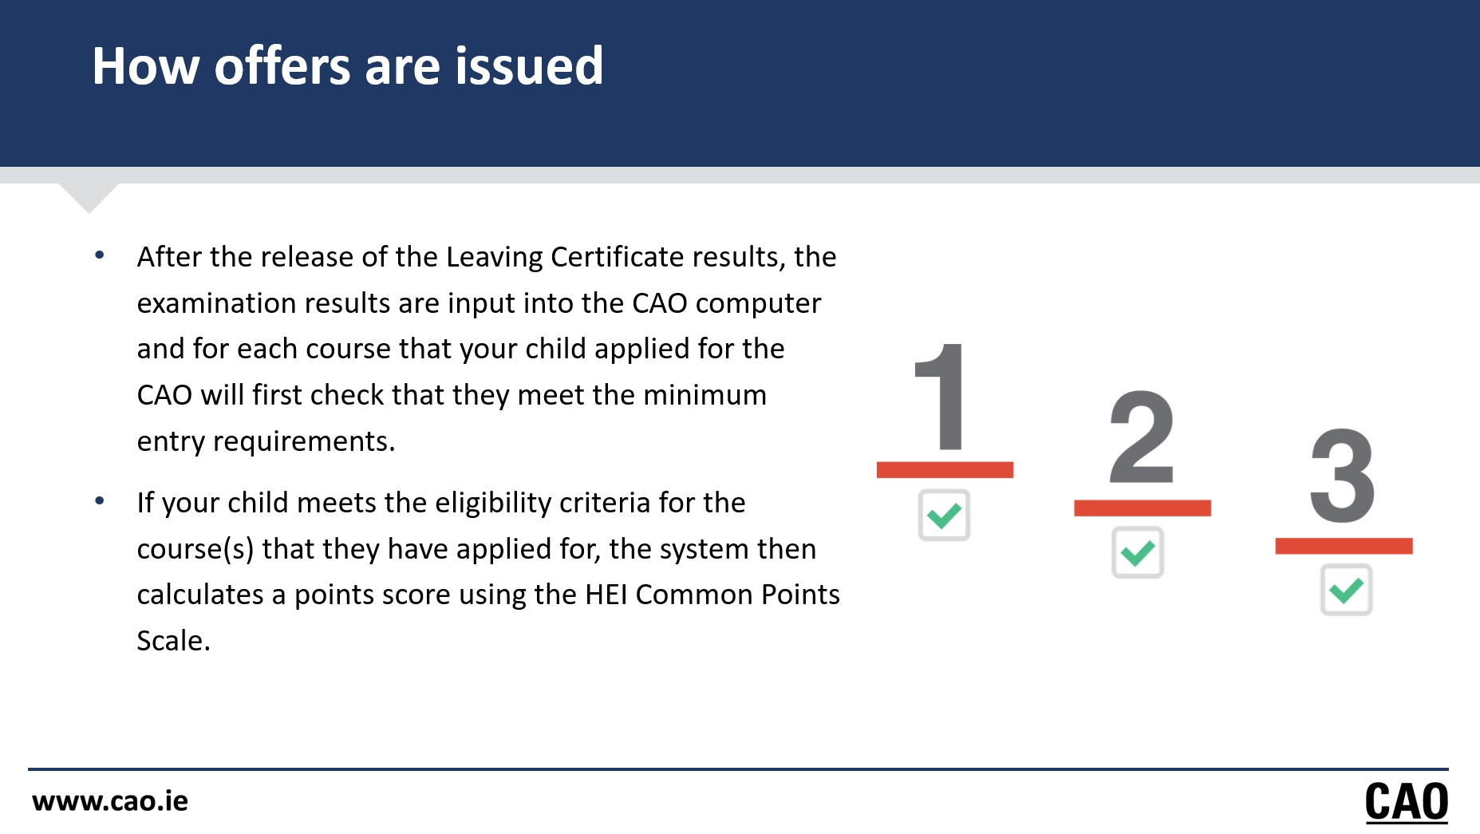

Slide 26
Offers: 3 Areas must be Satisfied
1. Minimum Entry Requirements
2. Specific Course Requirements
Biological and Biomedical Science TCD
3. Points
Engineering UCD 577
Psychology DCU 533
Pass 6 subjects
At least 2 H5
H7/O6 or higher in remaining 4
Pass in:
English
Irish
Another Language*
Mathematics*
Science Subject*
H5 Chemistry
Primary Teaching
H4 Irish
Veterinary Medicine (UCD)
O4 Maths
A third Language ***
Veterinary Med UCD 589*
Arts Maynooth 307
Law UCD 566
Global Bus Spain DCU 555
Gen Nursing TCD 423/407
Product Design TUD 412
Clinical Measurement TUD 499
Post Primary Teaching Tech Graphics DCU 402
Primary Ed Marino 473*
60 hours work exp
O4 Maths
H4 + H4 in 2 Science
O4 English
Once all 3 areas are satisfied an offer will be made!

Slide 27
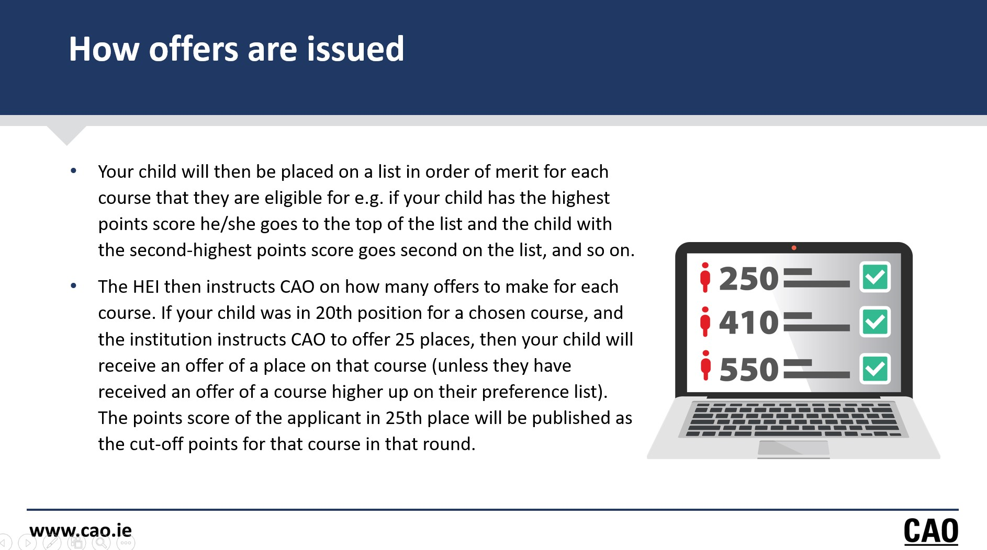

Slide 28
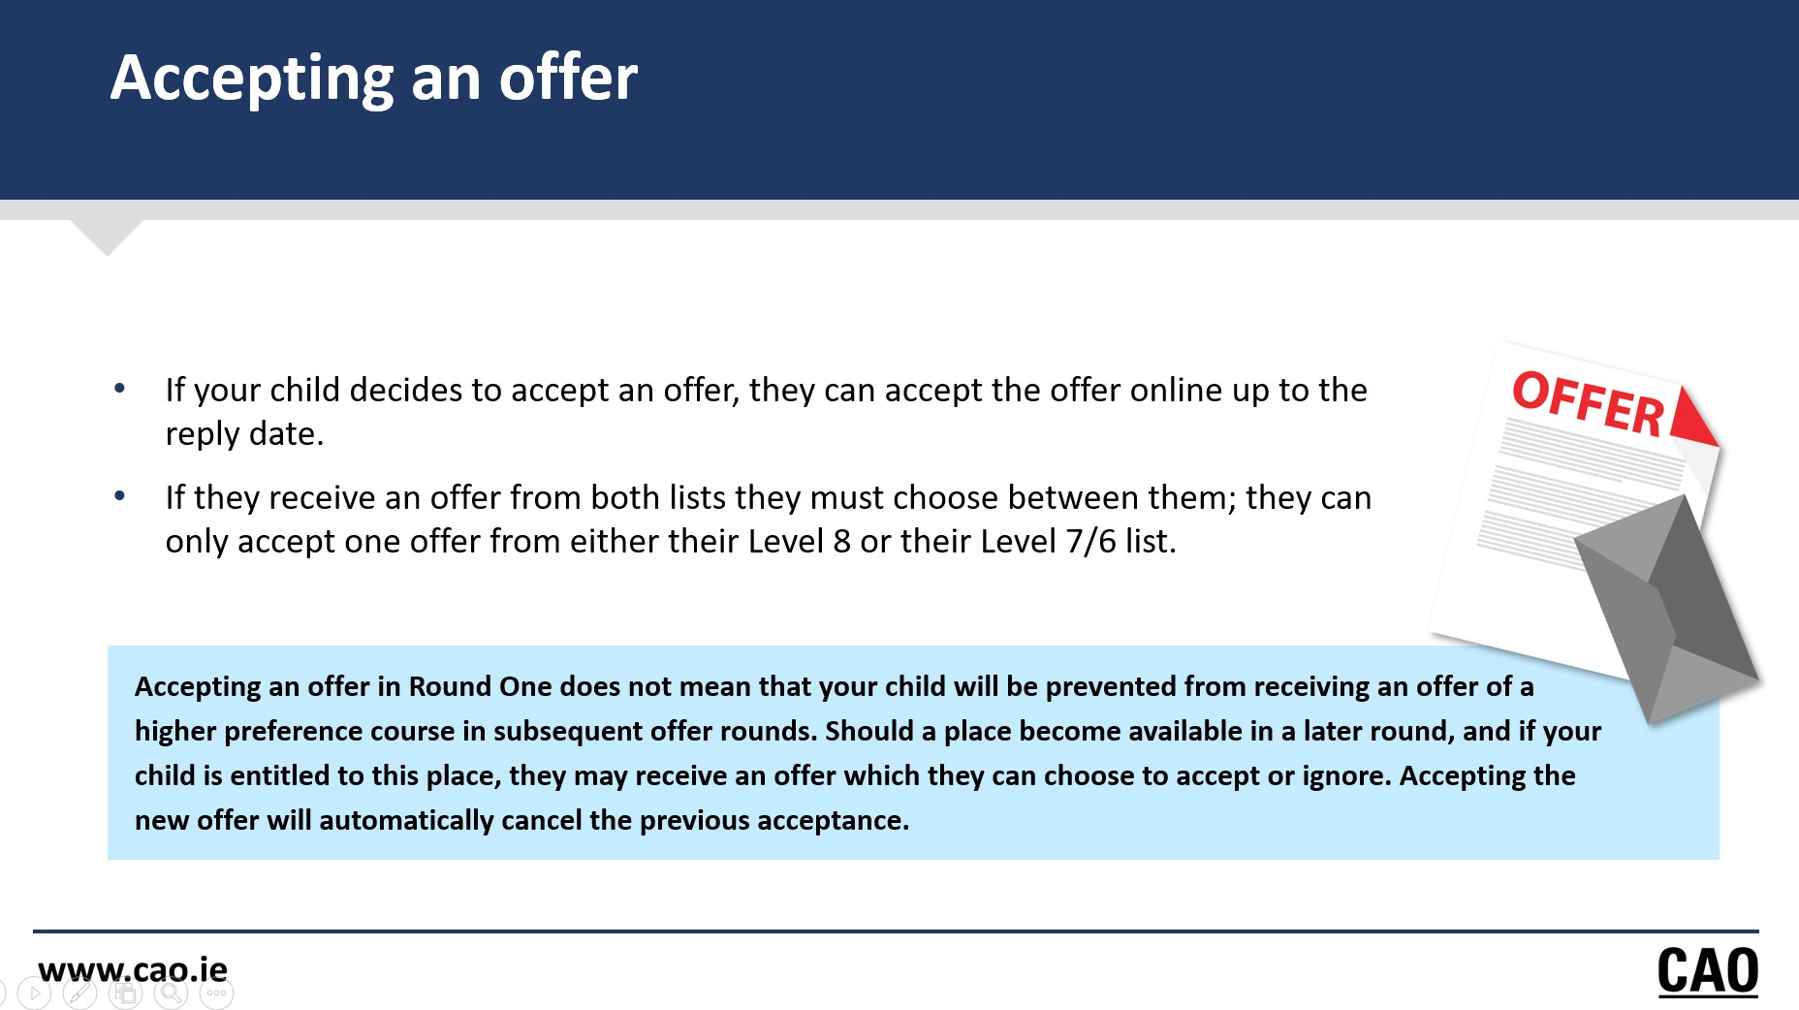

Slide 29
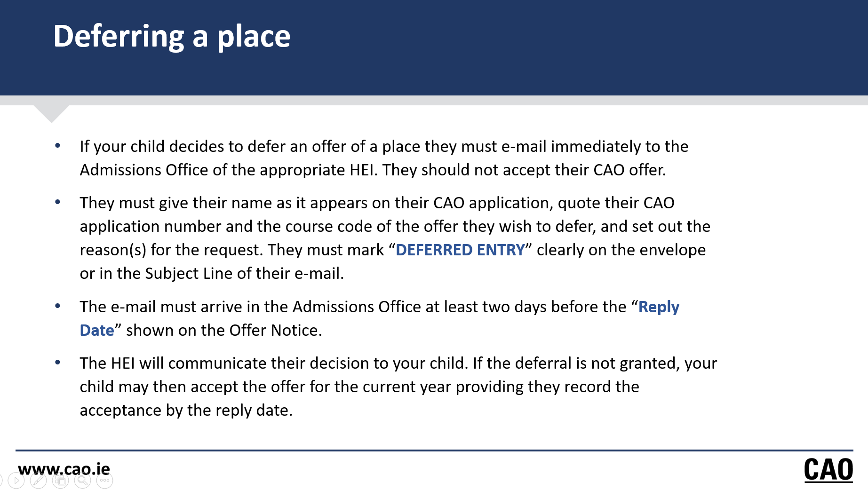

Slide 30




Level 5 Post Leaving Courses in an FET (college of Further Education and Training)
Reasons for choosing to do a Level 5 Course:
Test a Career Path: Try out a field for one year before committing to a long-term degree or apprenticeship for example Pre-Nursing in Inchicore FET.
Direct Route to Employment: The qualification is a direct pathway into entry-level jobs and apprenticeships in high-demand sectors for example Beauty Therapy in Crumlin College FET and Apprenticeship Hairdressing Crumlin College FET
Boost CAO Points: QQI Level 5 results can be used to apply to specific CAO courses through the Higher Education Links Scheme (HEIs).
Shorter 1-Year Commitment: A less overwhelming first step compared to immediately starting a three or four-year degree course.
Affordable and Local

Slide 31


CAO, UCAS, Eunicas, Plc, Apprenticeships
https://www.ucas.com/
Deadline for Medicine, Veterinary, Dentistry and Oxford and Cambridge
is 15th October 2025
Deadline for all other courses is in late January 2026
A personal statement must be submitted along with predicted scores
www.eunicas.ie
English speaking and world renowned universities
Medicine, Veterinary…Business, Physio

Slide 32

www.apprenticeships.ie
From Auctioneering and Property Services to Lab Technician and Analyst. From Accounting Technician to Cyber Security. The new apprenticeships cater for all .

Slide 33
Thank you and good night
adonohue@stjosephslucan.com

