Slide 1

RSE- Teaching Sensitive Subjects

Slide 2
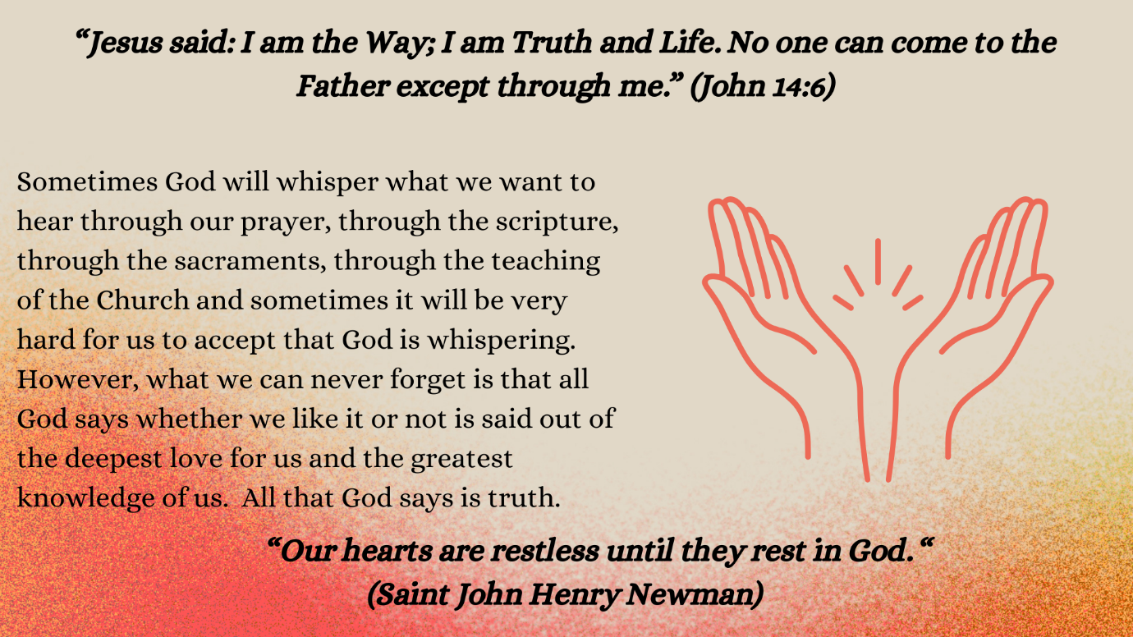

Slide 3
The teaching of the Church in our day is placed in a social and cultural context which renders it more difficult to understand and yet more urgent and irreplaceable for promoting the true good of men and women
Familiaris Concerto (1981)
Notes:
Quote from Pope St John Paul II Familiaris Consortio (November 22, 1981) | John Paul II (vatican.va)
In the intervening years, the social and cultural context is such that often the teaching of the Church is counter-cultural to the prevailing societal norms adding significantly to the challenges of those delivering the message
Does this challenge make it more, or less important that we undertake the task?

Slide 4
Pupils also raised the importance of teacher sensitivity, particularly during group/discussion work. In the discussion with pupils, during almost all school/centre visits, they emphasise the importance of supportive, nurturing and trusting relationships with staff.
ETI (2023)
Notes:
The preventative curriculum in schools and Education Other Than at School (EOTAS) centres (etini.gov.uk) 2023
The relationships between staff and students will significantly impact the learning environment
.
The class teacher knows each student and how best to respond to their needs . This applies to all aspects of the curricular and pastoral provision within the school
It is particularly important that the students explore issues around RSE in an environment where they feel safe, supported and affirmed in keeping with the schools pastoral approach

Slide 5
Sex education should also include respect and appreciation of differences, as a way of helping the young to overcome their self-absorption and to be open and accepting of others.
Amoris Laetitia (2016)
Notes:
Pope Francis 2016 papa-francesco_esortazione-ap_20160319_amoris-laetitia_en.pdf (vatican.va)
Every human being is created uniquely different by God. Recognition and acceptance of our uniqueness and that of others should be discussed so that difference is seen as something to celebrate.

Slide 6
While it is important to create an environment in which all pupils can discuss openly, teachers may not always be able to answer all questions about issues and should set appropriate boundaries. Teachers should use their professional judgement, guided by the age of the pupils, the RSE curriculum and the RSE policy for the school.
CSTS (2021)
Notes:
CSTS RSE Guidance : Relationships and Sexuality (RSE) Guidance for Catholic schools - 2021 - Catholic Schools Trustee Service (catholiceducation-ni.org)

Slide 7
Respect and love ought to be extended also to those who think or act differently than we do in social, political and even religious matters. In fact, the more deeply we come to understand their ways of thinking through such courtesy and love, the more easily we will be able to enter into dialogue with them.
Gaudium et Spes (1965)
Notes:
Gaudium et spes 1965 (vatican.va)
We live in an ever-changing world where we encounter others, on a daily basis, who differ from us in their views on many issues.
This requires that all engagements with others are conducted in a respectful manner so that all are encouraged to listen carefully to those with whom they agree and disagree. Disrespect, in whatever form it arises, should be challenged by all.
This approach will be underlined in the RSE policy and in other connected policies; for example, the Anti-Bullying Policy.
It is helpful to ensure that all discussions/debates are undertaken based on a set of rules agreed by staff and students - an outline Code of Conduct is provided in the CSTS Guidance document : RSE Guidance - Catholic Schools Trustee Service (catholiceducation-ni.org). The school may already have something similar in place

Slide 8
Schools should acknowledge the right of pupils and others to disagree with the Churches perspective, and their right to respectfully offer alternative perspectives and to engage in open and productive dialogue. However, while their may be differing perspectives on issues, the school, adopting an invitational approach, should not avoid teaching what it is that the Church professes.
CSTS RSE Guidance (2021)
Notes:
Relationships and Sexuality (RSE) Guidance for Catholic schools - 2021 - Catholic Schools Trustee Service (catholiceducation-ni.org)
In discussions the personal circumstances of those involved should be avoided and discussions should be based on the stories and scenarios offered within the RSE curriculum.
Staff should not engage in discussions about their personal circumstances, those of their students, or those of the students’ families

Slide 9
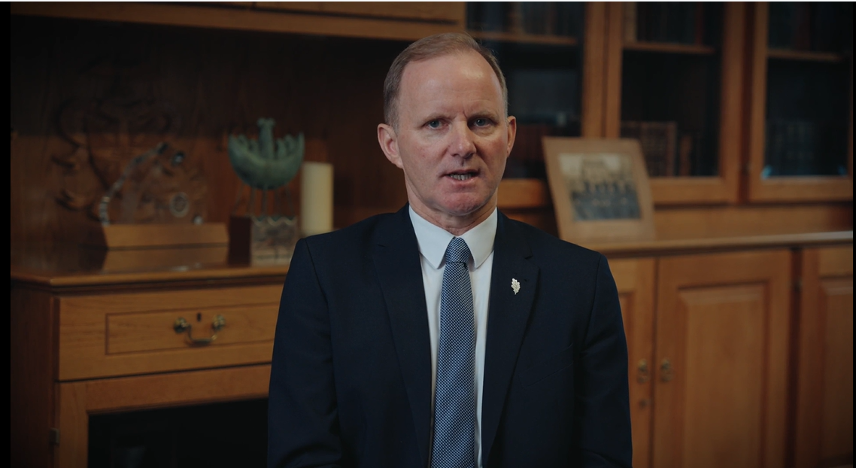


Slide 10
Are there any questions that may arise which you would feel are not suitable for discussion with the students or that you are not comfortable discussing?
How might you respond to the students?
Notes:
These two questions can be explored with the staff to clarify the school’s expectations and to ensure that staff feel comfortable to deliver the RSE curriculum. – might be useful as a small group discussion.
In many cases, a student’s question may be genuine, seeking clarification or information, in some cases the intent may be disruptive. It will be important that staff can offer considered and accurate responses to student questions. Which of these responses are helpful? (this may vary depending on the age and maturity of the student)
You may wish to draw up a list and create an extra slide to aide this discussion
That’s not relevant to the current discussion, we will look at that another time
That is a topic that we consider next year
It sounds like that is something important to you. Could you speak to me after class about that issue
That is a question best asked of your parent
That is something you will learn about when you are older
As a school it is important that all staff involved in the delivery of RSE are confident in their role. This may mean that particular staff may be more suited to delivering some topics, or that the support of an outside agency might help to build staff confidence and competence. It is for each school to determine how the programme is delivered.

