Slide 1

Developing an RSE Policy

Slide 2


Slide 3
The Department requires each school to have in place its own written policy on how it will address the delivery of RSE. A school’s RSE policy should be subject to consultation with parents and endorsed by a school’s Board of Governors.
Dept of Ed. Circular 2016/13
Notes:
Circular 2016/13 Relationships and Sexuality Policy in Schools (education-ni.gov.uk)
It is likely that you are in a process of reviewing an existing policy.
How effective this review is will be determined by the consultation undertaken with students, parents, staff and Governors, along with consideration of any additional requirements from the Department of Education or advice from ETI
It is important that you keep a record of the consultation undertaken with the various stakeholders (this will provide evidence for the ETI proforma )
You may find the CSTS Guidance a useful document in reviewing the policy : RSE Guidance - Catholic Schools Trustee Service (catholiceducation-ni.org)

Slide 4
The delivery of RSE must prepare pupils to view relationships in a responsible and healthy manner and should be taught in harmony with the ethos of the school and reflect the moral and religious principles held by parents and school management authorities.
DE Circular 2016/13
Notes:
The school policy should clearly articulate the ethos and values which the school will promote within the RSE programme
The RSE programme in a Catholic school should offer the young people a breadth of knowledge across all aspects of RSE but with a strong emphasis on Relationships. These are not just discussed within the curriculum but modelled in all school interactions.

Slide 5
Whilst the Board of Governors and the Principal have statutory responsibility to deliver the minimum curriculum content, they also have autonomy over when, how and who is involved in curriculum delivery, aligned with the ethos of the school. This includes the change to the curriculum made by the Secretary of State as outlined above……. It should also be consistent with a commitment to equality, good relations and diversity within the school and its community as outlined in Chapter 3 of the Guide for Governors 2023.
DE Circular 2024/01
Notes:
Circular 2024-1 - Guidance on Amendments to the Relationships and Sexuality Education.pdf (education-ni.gov.uk)
While this guidance was developed to respond specifically to the changes required by the the Relationships and Sexuality Education (Northern Ireland) (Amendment) Regulations 2023 which relates only to the KS3 & KS4 requiring that pupils “Receive age-appropriate, comprehensive and scientifically accurate education on sexual and reproductive health and rights, covering prevention of early pregnancy and access to abortion”. It is important to note that the Department has once again reminded schools that the delivery of aspects of RSE should be consistent with the ethos of the school.
In relation to the specifics of the regulations, which impact only at KS3 & 4 it should be noted that the Living Love Programme at KS3 and the under development KS4 programme will address these issues in a manner consistent with the Catholic ethos while addressing the requirements of the legislation

Slide 6
Relationships and Sexuality Education in a Catholic school is situated within a moral and values framework that is derived ultimately from the life and teaching of Christ.
Archbishop Eamon Martin (2018)
Notes:
This is a critically important element of RSE in a Catholic school.
How does the schools’ RSE policy relate to, and reflect, the ethos of the school?
Are there phrases from the Mission statement / aims etc which can be linked appropriately in the policy?
An RSE policy links with many other policies. Is the messaging consistent?
How is the RSE policy lived in the relationships in the school?
It is important that the policy identifies a rationale for the position taken by the school as a Catholic school this might include reference to the dignity of each person, the morals and values framework presented to pupils etc.
There is lots of information available in RSE-Guidance-Booklet-Post-Primary.pdf (catholiceducation-ni.org)/ RSE-Guidance-Booklet-Post-Primary.pdf (catholiceducation-ni.org)

Slide 7
Sex education should provide information while keeping in mind that children and young people have not yet attained full maturity. The information has to come at a proper time and in a way suited to their age….. Young people need to realise that they are bombarded with messages that are not beneficial for their growth towards maturity.
Amoris Laetitia (2016)
Notes:
papa-francesco_esortazione-ap_20160319_amoris-laetitia_la.pdf (vatican.va)
In agreeing a policy, it is important to note that the policy and the curricular content is specific to your school and the needs of your school community, developed in consultation with your parents/ carers
It will be important for staff to have time to consider this as the policy is developed
A good start point will be to consider if the current policy remains fit for purpose

Slide 8
… with respect to the fundamental rights of the person, every type of discrimination, whether social or cultural, whether based on sex, race, colour, social condition, language or religion, is to be overcome and irradicated as contrary to God’s intent.
Gaudium et Spes(1965)
Notes:
Gaudium et spes (vatican.va)
As our school communities become more diverse and the society around it changes there is a need to reflect how this impacts on the school and on our young people.
How is this reflected in the RSE policy or in other policies in the school ?
Sign off, following full consultation, must be by the Board of Governors

Slide 9
ETI 23/24 Inspection Proforma Questions :
As required by Circular 2013/16, does the policy include consultation with parents, pupils and endorsement by the board of governors?
Does the RSE and preventative curriculum address in age-appropriate ways, healthy and respectful relationships, including appropriate use of language and behaviours?
Does this include the holistic overview, review, monitoring and evaluation of the effectiveness of the content and delivery of the RSE and preventative curriculum to empower children and young people to make informed choices and keep themselves safe?
Notes:
Note; These are standard questions across all school settings – it should be noted that the topics listed in the last question are not intended content for all schools.

Slide 10
ETI 23/24 Inspection Proforma Questions :
Does the evaluation include consultation with children and young people and outline how their views will be listened to, respected and acted upon, where appropriate?
Are staff provided with professional learning opportunities to be confident in handling current and more sensitive issues, such as, consent, violence against women and girls, domestic abuse, healthy sexual relationships, gender, transgender issues, contraception, pregnancy and abortion, menstrual health and wellbeing, social media and online safety?
Notes:
Note; These are standard questions across all school settings – it should be noted that the topics listed in the last question are not intended content for all schools.

Slide 11
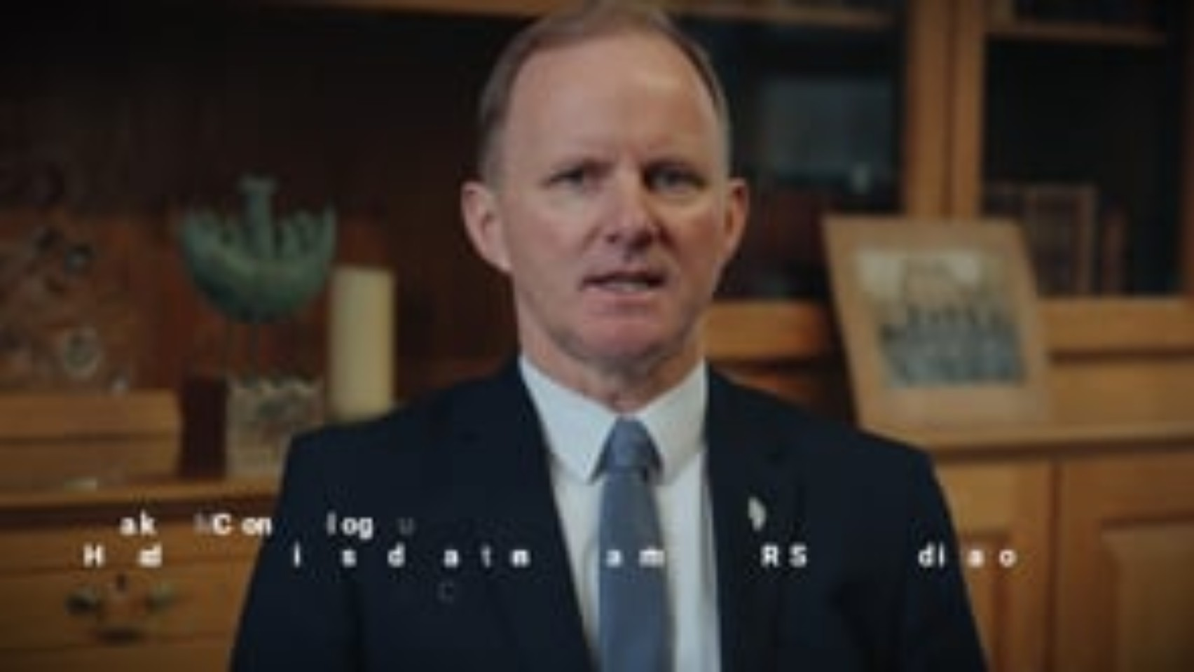

Slide 12
Having watched the video how might we as a school proceed/ Next steps?

