Slide 1

RSE and the Ethos and Values of a Catholic School

Slide 2
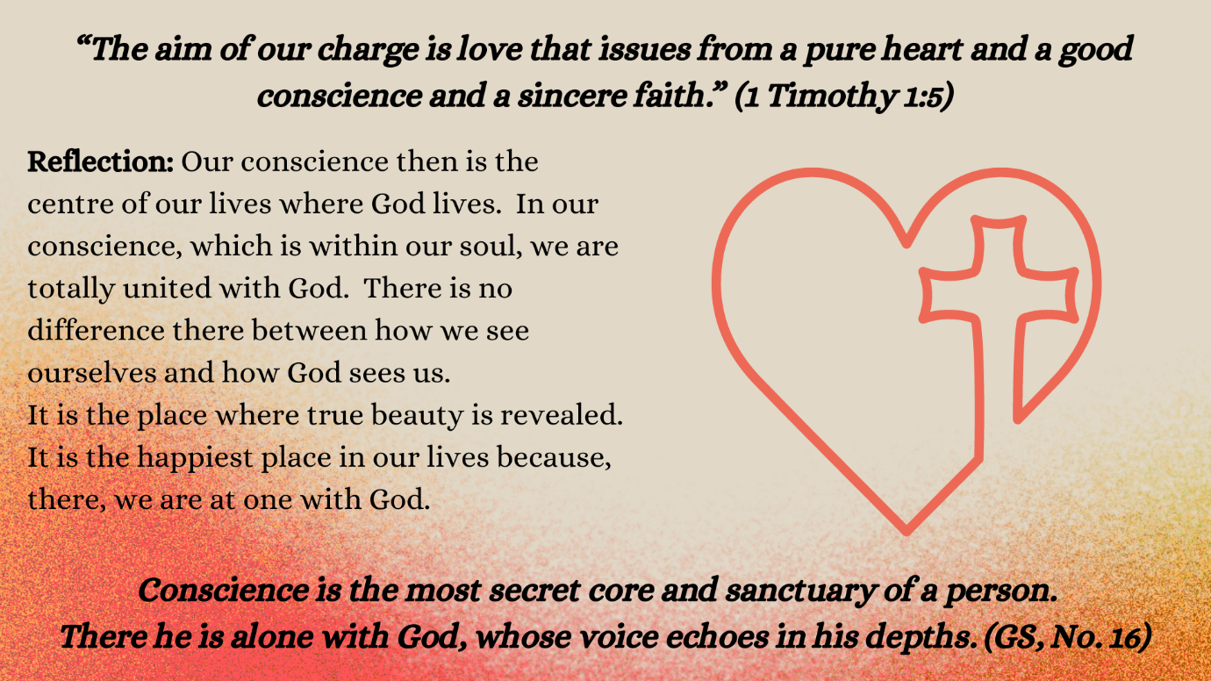

Slide 3
Catholic schools can assist parents and families by helping young people find moral reference points, by offering a morals and values framework, or roadmap, to guide them. Such a framework will be centred on the Gospel, and especially on the principle of loving God and loving our neighbour as ourselves.
Archbishop Eamon Martin (2018)
Notes:
Keynote-address-by-Archbishop-Eamon-Martin-to-JMB/AMCSS .pdf (2018) - this is a 4-page document and you might find it a useful document to share as part of any staff discussion or as background reading for staff. It may also be a helpful introduction to RSE for Governors

Slide 4
Our schools need to be places where everyone feels valued for their innate dignity, even if the young people are struggling to find themselves. They also need to be places where pastoral support is at the forefront of what they provide, so that no one is abandoned, even if some might fall away from the teaching of the Church in the manner of their living.
Learning to Love (2017)
Notes:
Learning to Love (2017) Catholic Bishops Conference of England and Wales
Discussion:
What situations/circumstances might arise where the school needs to be mindful of and ensure that, the value and dignity of each individual is respected?
In reflecting on this it is important to acknowledge the significant role staff knowledge of their students plays. The individual circumstances of the students at any time will be a factor in determining how topics are addressed within the curriculum. Depending on circumstances staff may feel it is appropriate to discuss any concerns with senior management / co-ordinator before beginning a specific topic.

Slide 5
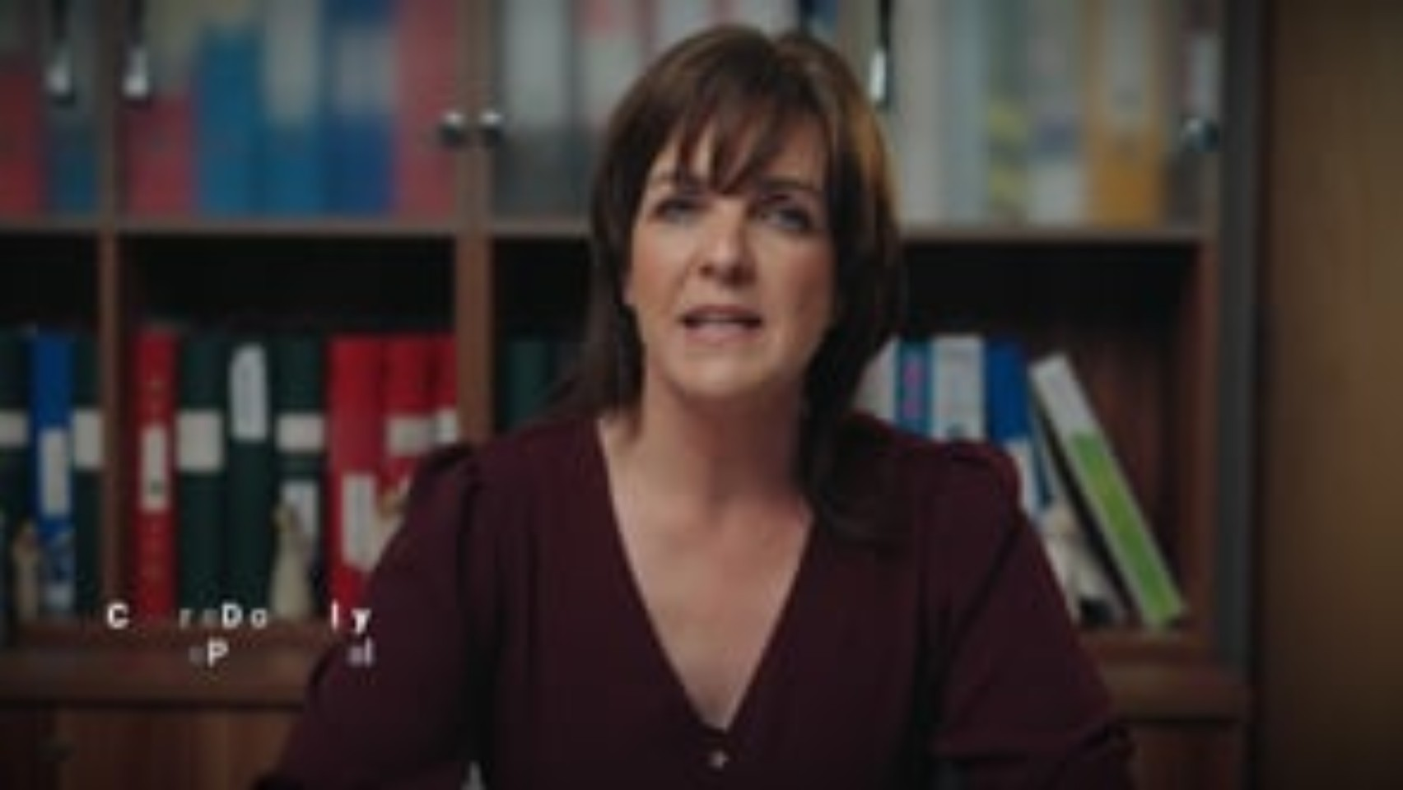

Slide 6
It is easy nowadays to confuse genuine freedom with the idea that each individual can act arbitrarily as if there were no truths, values and principles to provide guidance and everything were possible and permissible.
Amoris Laetitia (2016)
Notes:
Amoris Laetitia 2016 Apostolic Exortation Pope Francis
The Church’s teaching is that we have a God-given free will but that such a freedom can only be fully realised when we are invitationally offered a Christian understanding from which we can then discern our moral understanding. This framework offers the idea that there are right and wrong choices, that decisions have consequences for ourselves and for others.
No one would allow a young child to walk along the roadside without first ensuring that they had awareness of the potential dangers and were given appropriate strategies – e.g. Walk facing the traffic, stay close to the inside, wear hi viz clothing , know how to safely cross etc.
We are also mindful that others have different views on these issues. We may have pupils who do not come from a Catholic faith background, or any faith background. As a Catholic school therefore , what we do is to propose a particular Catholic vision of sexuality linked to our values and our understanding of the human person as made in the image and likeness of God. The young person as they mature can reflect on this particular view but determine freely their own moral compass by which they will live their lives

Slide 7
… it is important to stress that Catholic moral educators are concerned with the development of character and virtue rather than enforcing obedience to moral rules. Moral development is about being invited to be a certain kind of person, and to live a certain type of life in response to the loving invitation of God.
Hession 2015
Notes:
Hession Anne (2015) Catholic Primary Religious Education in a Pluralist Environment. Veritas
Anne Hession is a lecturer in DCU
It is important to understand that there is no value free approach to RSE or indeed to any aspect of education. Even an attempt to provide a ‘value free’ or ‘neutral’ education is in itself a value base. Its also important to be aware that for many parents, one of the significant attractions of Catholic education, is that it offers a values/ morals framework which they see as important in their children’s development

Slide 8
Every human person is precious and has value that does not depend on what they have or on their abilities but on the simple fact that he or she is a person, in the image of God.
Pope Francis (2012)
Notes:
Pope Francis: Speaking at the Seraphic Institute of Assisi 2021 (Catholic World Report)
Do we feel that value ourselves?
Do we ensure all members of the school community feel valued? Any examples of policy/ practice which demonstrate this?
Do we need to make this valuing of the human person more explicit for students/ staff/ the wider community? How might we do this?

Slide 9
The Catholic school ought therefore to be a community inspired by Gospel values and transmitting Gospel values, including: the sacredness of human life; the dignity of the person; integrity; peace; tolerance; justice; honesty and truth; holiness; gentleness and compassion; mercy and forgiveness; purity; respect.
Archbishop Eamon Martin (2018)

Slide 10
Within the vision of Catholic education, we hope to equip young people with the skills, attitudes, and values to become confident, capable, critical, and discerning thinkers who are ready to contribute to and shape their world and contribute to the Common Good.
Catholic Schools – Delivering for Communities (2022)
Notes:
Catholic Schools Delivering for Communities (2022) CCMS/ CSTS Copies of this are in every school
What are the skills, attitudes, and values we as a school are promoting that will ensure that the young people learn to live in relationships with others?
Where are these evident in our Mission/ Vision/Aims ?
Where are they evident in our Policies and Practices?
Where are they evident in our Curricular Provision?
Christian Values: Love, Compassion. Forgiveness, Humility, Hope, Courage, Justice, Integrity, Empathy, Respect, Honesty, Kindness
You might find it useful to have a table/flip chart ready to record the responses from the discussion

