Slide 1

6th Year
Parent and Guardian Information

Slide 2
In Firhouse Educate Together Secondary School, our Senior Cycle education:
places students at the centre of the educational experience, enabling them to actively participate in their communities and in society
supports students to be resourceful and confident learners in all aspects and stages of their lives
supports students to develop self-advocacy skills.

Slide 3

Overview
Settling into 6th Year
Assessments in 6th Year
Guidance
Supports – School, Home & Self
Leaving Cert Established
  Additional Assessment Components (AACs)
  Subject with Other Additional Project Work
School Reminders
  Systems & Structures

Slide 4
Settling into 6th Year
Routines and Habits are the key to a successful year
Engagement in School Work
Homework & Revision
Balance
Attendance
Lifestyle
Self Reflection Questions:
Academic | Wellbeing | School | Life
How do you actually study effectively? What mistakes should you avoid? What should you do when you're falling behind? Study Plan in Journal p.115 | How do you deal with stress? How do you maintain friendships? How do you get enough sleep? When should you ask for help? | What makes a good relationship with teachers? How should you use supervision lessons? What should you do if you're struggling? | How do you balance school with friends, sport, work and family? How do you avoid making the Leaving Cert your entire identity?

Slide 5
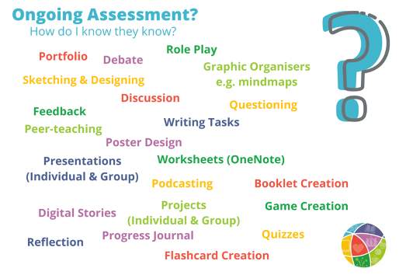
Assessments in 6th Year
Vsware Engagement for ongoing work
November Exams: Week of 2nd November
Mock Exams: Week of 1st February & 8th February
Leaving Certificate Exams starts June 9th
Leaving Certificate Established: AACs, Orals and Projects (Slides 11-14)
Leaving Certificate Applied: Tasks to be completed for end of Session 3 and Session 4

Slide 6
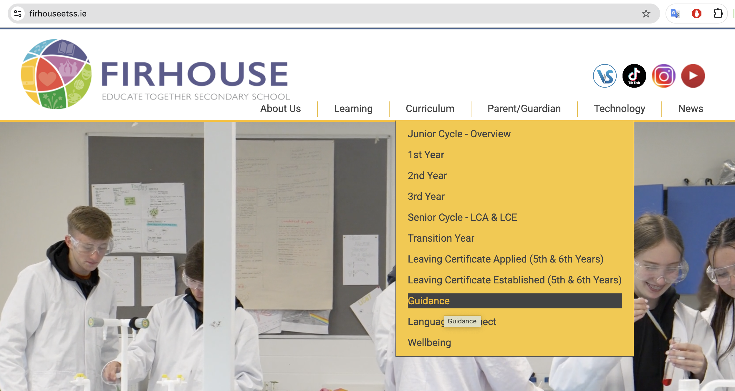
Guidance Information from Eoin
More specific details and updates were sent out by vsmail from Eoin on 11th and 29th of September
Includes information about Open Days and CAO Applications
All 6th Year students have 1 hour of Guidance with Eoin once a week and will have a 1:1 meeting in the coming weeks
Lots of information can be found on the school website: https://www.firhouseetss.ie/page/Guidance/16064/Index.html

Slide 7

Student Progress Meeting
CANCELLED DUE TO INDUSTRIAL ACTION
Alternative Arrangements TBD
Wednesday 7th October 2025
16:15 to 18:45
Students to attend with parents/guardians for greatest impact
Opportunity for student, parent/guardian and teacher to check in on learning and provide guidance and clarity to further progress learning

Slide 8
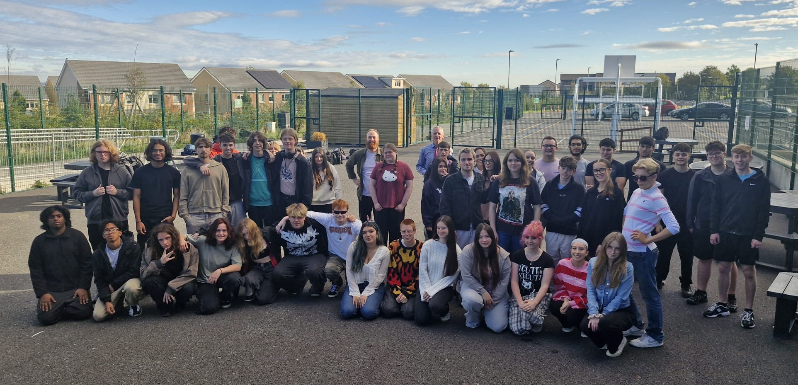
The 6th Year Team
Tutors: Thomas (Bravo), Paul (Spidey), Lisa (Wazowski)
SSA: Sara
Progress Leader: John D
All Systems, Structures & Supports are largely in line with previous years
– see Slide 15-21 for specifics around Communication, Technology, General Expectations, Restorative Practice
6th Years can also avail of the school’s Supervised After School Study Programme (2 hours Monday, Wednesday & Thursday) for €10 per week* - contact John D if you would like more information
*Varies slightly depending on calendar

Slide 9
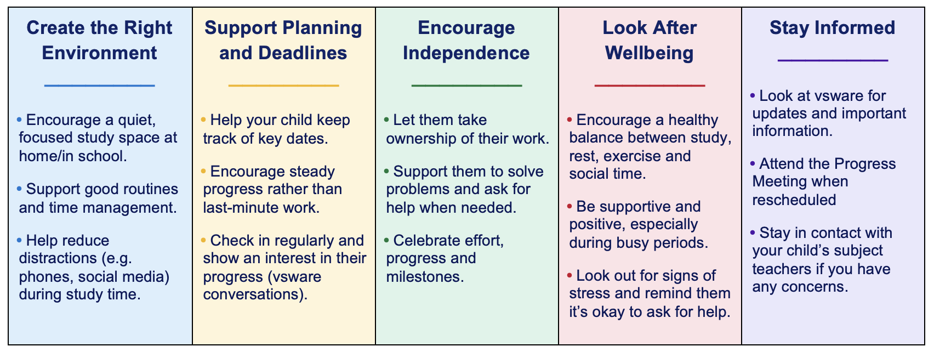
How Parents & Guardians Can Help Support
During Check & Connect we will be talking to students about studying techniques, strategies to help eliminate distractions, goal setting and what makes a productive study space – please chat about these at home too.

Slide 10
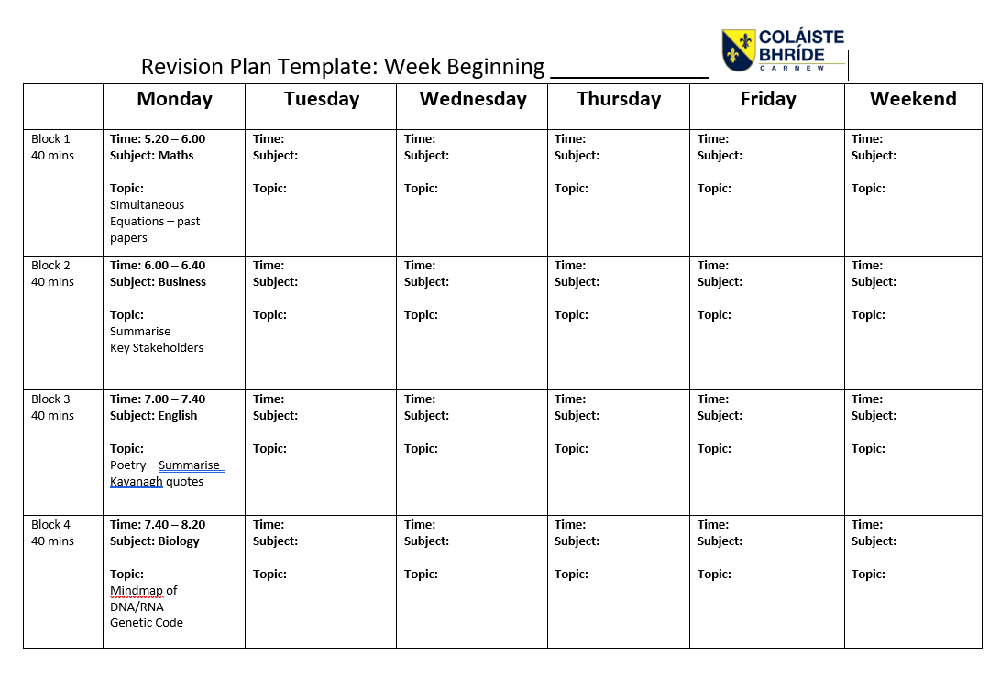
How Students Can Support Themselves
Be Organised!!!
A Sample Study Timetable (edit to suit you):
Attendance
A Study Timetable is essential
  Create a plan for the year and hold yourself accountable
Subject Folders & Materials
Have specific, realistic, goals that you are working towards

Slide 11
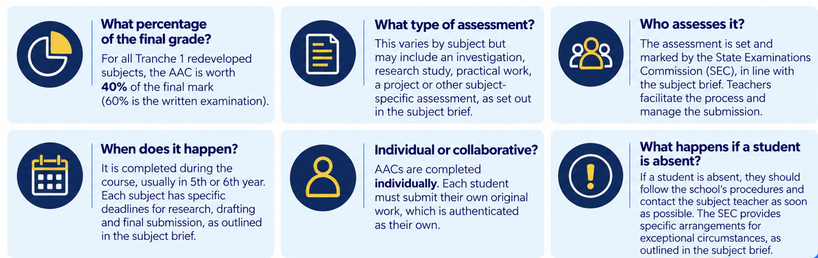
Leaving Cert Established: What has changed?
Senior Cycle is being redeveloped - your children are the first cohort to experience these changes
Tranche 1 Subjects – Biology and Business – have an Additional Assessment Component (AAC)
  Completion Dates: Biology = Friday 26th February and Business = 12th March
Each subject has its own assessment brief, but the key features are similar:
John C will be running a Referencing workshop with students in the coming weeks and updating teachers with any information from the SEC

Slide 12
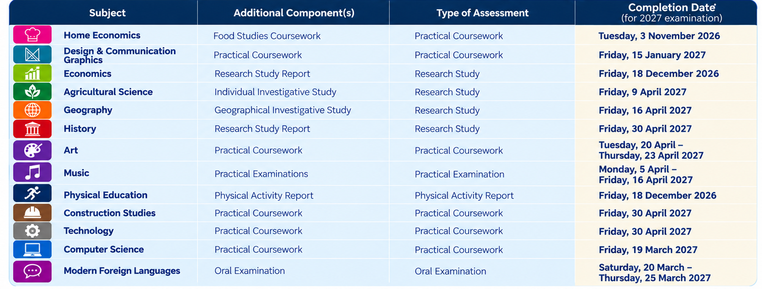
Other Subjects with Project Components
Arrow highlights subjects offered to students at FETSS this year, full listed provided for students studying an additional subject outside of our school

Slide 13
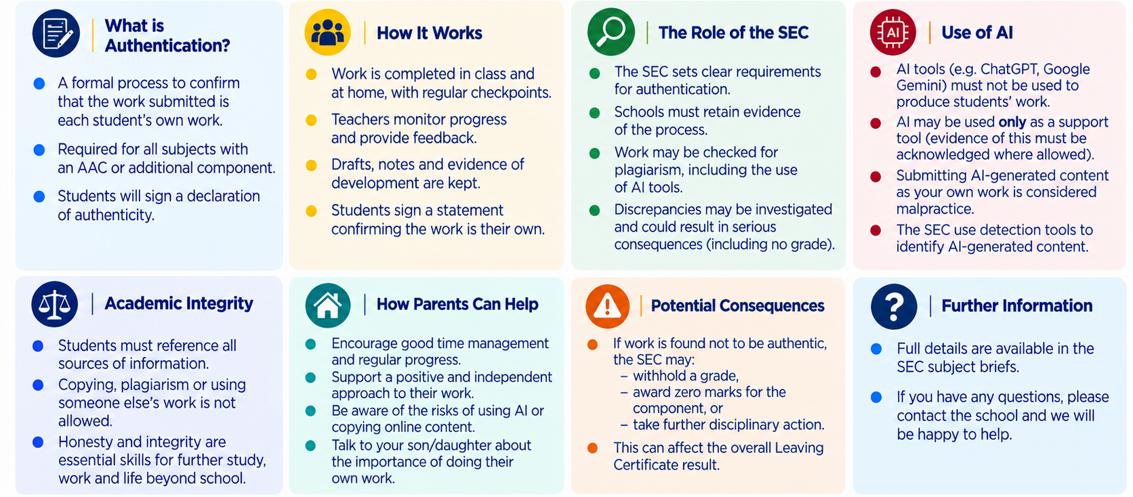
Authentication of AACs and Project Work
Note: if you are doing an additional subject (outside of FETSS) make sure you let Andrew know.

Slide 14
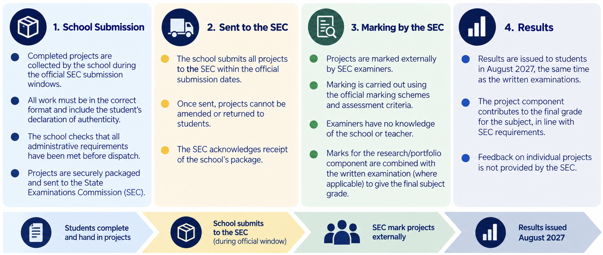
Submission of AACs and Project Work

Slide 15

Reminder about Systems and Structures

Slide 16


Communication Guidelines

Slide 17
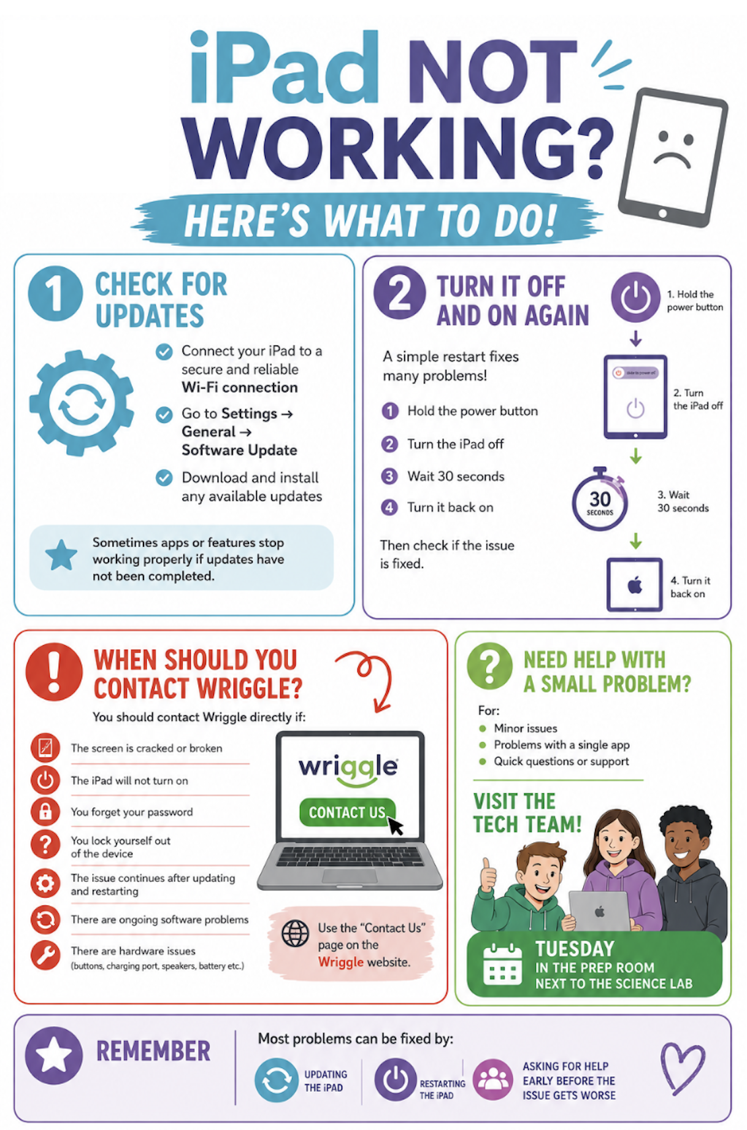
Technology Issues

Slide 18

General Expectations
Attendance
On time – arrival at 8:20 for first class to begin at 8:30
iPads charged to over 80% when arriving at the school
Journals, Wellread Book and Stationery in school and on the desk during all lessons
Readiness and growth mindset for learning
Engaging and trying your best in all lessons

Slide 19


Attendance
VSware is how you report any absences.
You can even schedule in partial absences for the likes of appointments.
A reminder to get the absences in before 8:30am so we know in advance where your child is.
Miss a day
More likely to get sick
Increased anxiety
Disconnect from friends and learning
Refusal to go to school

Slide 20

Restorative Role Modelling
All members of the School Community should be mindful of our values and attempt to contribute to the positive atmosphere of the school
Reminder of the Relationships and Behaviour Code of Practice Policy and other policies on the website: https://www.firhouseetss.ie/page/Policies/4341/Index.html
The 6th Year students have made an excellent start to the year, and I’m proud to be associated with them

Slide 21
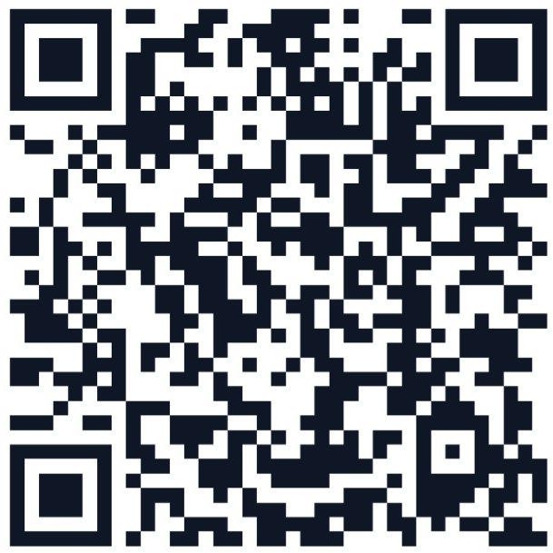
Thank You!
Final Reminder: In the 'Technology' section we have a VSware for Parents/Guardians page where you can find all the information on how to navigate VSware effectively.
If you have any questions please message Julie in the office and she will pass it on to the relevant team member.
If there is anything for me I’ll get back ASAP!

