Slide 1
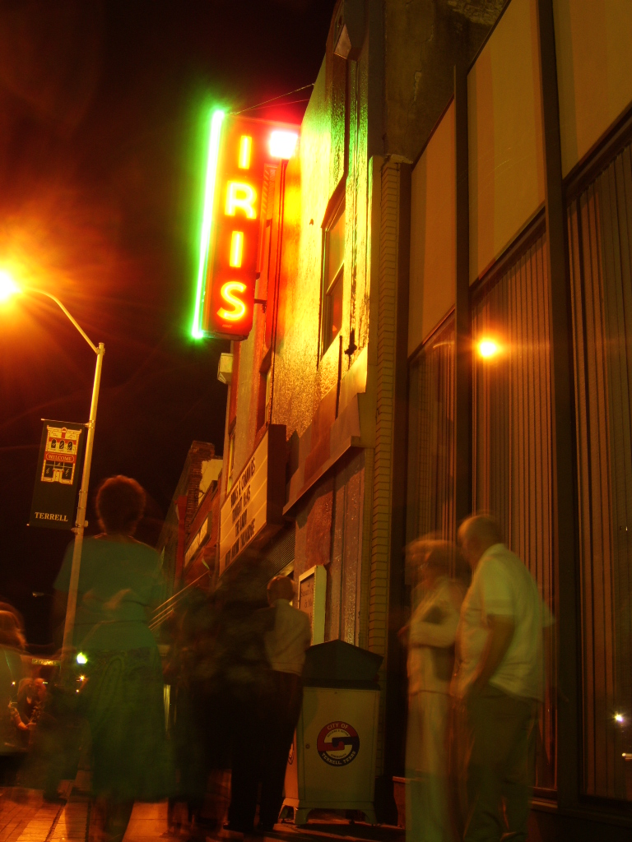
Terrell – A Track Record of
Success
Property values doubled from 2000 to 2009 - $500 million to $1 Billion
Forbes List of Fastest Growing Cities in the United States (July, 2007) – ranked 96 of 100 with a 34% population increase
Recognized for planning excellence by the Texas State Legislature
National League of Cities publication
Entrepreneur Magazine Publication
Home to six Fortune 500 Companies
Recipient of Governor’s Community Economic Development Award

