Slide 1
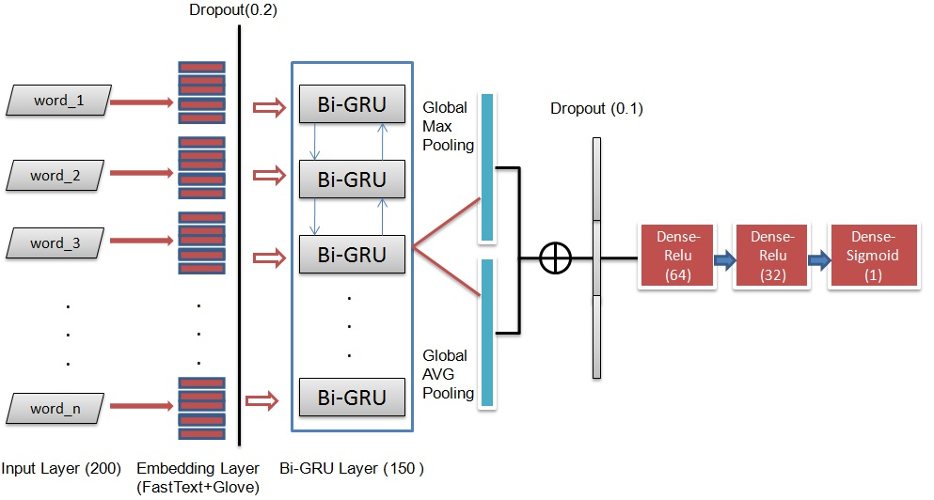
Combining FastText and Glove Word Embedding for Offensive and Hate speech Text Detection
--26th International Conference on Knowledge-Based and Intelligent Information & Engineering Systems (KES 2022)
--Deep Learning Indaba 2022, Tunis, Tunisia; 21st to 26th August 2022
Nabil Badri, Ferihane Kboubia, Anja Habacha Chaibi RIADI Laboratory, ENSI School, University of Manouba, 2010 La Manouba, Tunisia
Abstract
Methodology
Results
Conclusion
Over the past decade, increased use of social media has led to an increase in hate content. To address this issue new solutions must be implemented to filter out this kind of inappropriate content. Because manual filtering is difficult, several studies have been conducted in order to automate the process. This paper introduces a method based on a combination of Glove and FastText word embedding as input features and a BiGRU model to identify hate speech from social media websites. The obtained results show that our proposed model (BiGRU Glove FT) is effective in detecting inappropriate content. This model detect hate speech on OLID dataset, using an effective learning process that classifies the text into offensive and not offensive language. The performance of the system attained 84%, 87%, 93%, 90% accuracy, precision, recall, and f1-score respectively
Based on the review of features and the prominent classifiers used for text classification in the past work, we present, in this section, our approach of inappropriate English textual content detection.
Our approach is based on a deep learning classification model (BIGRU) and a combination of word embedding techniques (Glove and FastText) as features. Our proposed BiGRU-Glove-FT model takes an input text and outputs the probability of this input text belonging to the inappropriate class (Offensive or Not Offensive). The input text is fed into the model in the form of a combination of ”Glove and FastText” word embedding matrix. BiGRU-Glove-FT model consists of eight sequential layers—(a) Input Layer, (b) Embedding Layer, (c) SpacialDropout layer, (d) Bidirectional(GRU) layer, (e) 1D Globalaverage pooling and 1D Global max pooling layer, (f) Concatenation layer, (g) Dropout layer, and finally (h) Dense layer as shown in Figure 1 below:
The able below, presents the overall results of various techniques on the test set of the evaluation dataset. It is interesting to note that the other deep learning techniques such as RoBERTa, also perform significantly better (82%, 83%, 81%, P, R, and F1 respectively) than SVM baseline algorithms. In general, results of RoBERTa and BiGRU are comparable, the best results were obtained with these two models, which is not surprising since these models are considered by many to be the state of the art. BiGRU also performs best for hate speech detection, followed by RoBERTa. We compare our BiGRU Glove FT model with five baselines— (a) RoBERTa, (b) BiGRU with FastText only, (c) BiGRU with Glove only, (d) BiLSTM and SVM (Marcos Zampieri,2019). This model gives the best performance on F1-score which measures the overall quality of classification and also shows significant improvement over the baseline approaches as shown in table 5 below. BiGRU Glove FT model achieved better Acc, P, R, and F1 values of (84%), (87%), (93%), and (90%) in Not Offensive classe, and P(77%), R(63%) and F1(69%) in Offensive classe respectively, marking an improvement in these metrics compared to RoBERTa model.
This paper presented a novel system (BiGRU Glove FT) geared to automatically classify two kinds of online inap-propriate content, focusing on Twitter. Indeed, the use of social networks motivated us to train contextual embedding based on the Twitter dataset, and use the information learned in this language model to identify offensive language and hate speech in the text. We tested some supervised machine learning classifier for hateful and offensive content in Twitter, we worked on two datasets such as OLID dataset, a new dataset with annotation of type and target of offensive language. It is the official dataset of the shared task SemEval 2019 Task 6: Identifying and Categorizing Offensive Language in Social Media [55], and Hate speech dataset which is the official dataset of the shared task: Large Scale Crowdsourcing and Characterization of Twitter Abusive Behavior [15]. The models with hyper-parameters yielded the best results in both tasks. We concluded that superior results on different NLP tasks have been produced by neural net-works based on dense vector representations. This trend is triggered by the effectiveness of word embedding [29, 30] and methods of deep learning [47]. Deep learning enables multi-level automatic feature representation learning. In contrast, traditional machine learning based NLP systems liaise heavily on hand-crafted features. Such hand-crafted features are time-consuming and often incomplete. The classification results rely on deep learning models showed very high levels of performance at reducing false positives and produced promising results with respect to false neg-atives. In the future, we plan to explore more the use of deep neural network architectures for the task of hate speech detection. We will investigate the application of other word embedding techniques. We would extend this focus to additional datasets such as Arabic dataset.
Introduction
With the widespread of internet, huge increase in smartphone usage rate in recent years, the freedom of expression privilege granted after the Tunisian revolution, the mask of anonymity that the internet provides, and despite the fact that Twitter’s terms of use forbid such inappropriate content, the spread of derogatory and hate speech has increased. It became easy to spread inappropriate content on social media, such as Twitter and Facebook, against individuals or groups. Furthermore, toxic language can take various forms, such as cyberbullying, which was one of the major reasons behind suicide [2
In this paper, we perform extensive experiments to tackle the problem of inappropriate content classification us-ing machine learning and neural network models with hyper-parameter optimization and word mbeddings features on two different English datasets. We will introduce our proposed models (BiGRU Glove FT) which consists of a combination of FastText (FT) and Glove word embedding as input features with BiGRU model. The rest of the paper is structured as follows. In section 2, we present the related literature for offensive and hate speech classification. In section 3, we present our proposed methodology. In section 4, we introduce the experimen-tations and results. In section 5, we take the discussion of implementation challenges notice. In section 6, we finish with a conclusion and future work.
For benchmarking purposes, a number of traditional machine learning models were used namely: Multinomial Nave Bayes (MNB), Logistic Regression (LR), Random Forest (RF), eXtreme Gradient Boosting machines (XGB) , and Support Vector Machines with RBF kernel (SVM). Along with these models, varieties of word representation methods were included: Count Vectors as features, Term Frequency Inverse Document Frequency (TF-IDF), N-gram word level TF-IDF and N-gram character level TF-IDF. And based on the satisfactory performance of neural networks on text classification tasks and previous work on English inappropriate content classification, we study the use of RoBERTa model for the text classification of inappropriate content.
Acknowledgements
To my dear supervisor: Mss Ferihane and Mss Anja, I just wanted to send you a note of appreciation to thank you for helping me reach my goals during the last two years. I could not have done it without your support and advice. I am grateful that you took the time out of your day to help me. You're a one-of-a-kind boss!
Also to "Deep Learning Indaba 2022" community, I send you big thanks because you gived me this opportunity to expose my research and to know you , thank you all

