Slide 1
Acute diagnosis and management
Ryder Trauma Center SOLID ORGAN INJURY: lIVER
Diagnosis of liver injury by CT scan
Authors: Monika Lay MD, Nicholas Carter MD
Approved: Namias 5/9/24
Hemodynamically Stable?
No
Operating Room
Yes
Management dependent on patient’s overall injury burden, co-morbidities, and attending discretion
Evidence of major vascular injury?
Yes
IR for emergent angioembolization
Repeat scan in 48-72 hours
No
 | Grade 1 | Grade 2 | Grade 3 | Grade 4 | Grade 5
Disposition | Floor | IMCU | IMCU | TICU | TICU
Serial CBCs | q8 x 24 hrs | q8 x 24 hrs | q8 x 24 hrs | q8 x 24 hrs | q8 x 24 hrs
Abd Exams
Interval CT in 3-5 days | If develops SIRS, jaundice, concern for bile leak/biloma, or at attending discretion to evaluate for pseudoaneurysm | none | none
DVT ppx | Within 24-48 hours, if Hgb drop ≤ 2g and no transfusion requirements
Activity | OOB | OOB | Bedrest x24 hrs | Bedrest x24 hrs | Bedrest x24 hrs
These guidelines were prepared by University of Miami trauma surgeons based on current review of medical literature and practice. They should be considered general practice guidelines and not protocols or policies. All management should be at the discretion of the responsible physician.

Slide 2
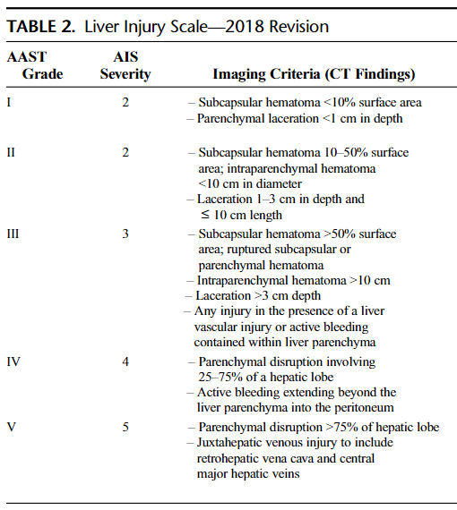
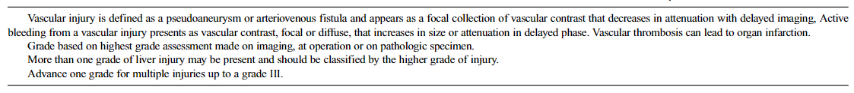
AAST Injury Scoring Scale

Slide 3
References
EAST practice management guidelines, 2012
https://www.east.org/education-resources/practice-management-guidelines/details/hepatic-injury-blunt-selective-nonoperative-management-of
AAST Injury Scoring Scales
https://www.aast.org/resources-detail/injury-scoring-scale
Kozar R, Crandall M, Shanmuganathan K, et al.. Organ injury scaling 2018 update: Spleen, liver, and kidney. Journal of Trauma and Acute Care Surgery. 2018; 85 (6): 1119-1122. doi: 10.1097/TA.0000000000002058.

