Slide 1
Empowering Living Kidney Donors: Enhancing Education and Risk Assessment
Notes:
Speaker to introduce themselves and disclose affiliation

Slide 2
Disclosure
This program is sponsored by Sanofi. I am being compensated and/or receiving an honorarium from Sanofi in connection with this presentation
The content contained in this presentation was developed by Sanofi and is not eligible for continuing medical education (CME) credits
Notes:
This program is sponsored by Sanofi. I am being compensated and/or receiving an honorarium from Sanofi in connection with this presentation
The content contained in this presentation was developed by Sanofi and is not eligible for continuing medical education (CME) credits

Slide 3
Program Objectives
Discuss steps that can be taken within the transplant community to help support living kidney donors
Review available tools to evaluate the risk of ESRD for living kidney donors and how they can facilitate the donor-evaluation process
Highlight transplant center practices and their impact on the number of living kidney donor transplants
Emphasize the importance of follow-up with living kidney donors
Understand the role of genetic testing in the living kidney donor- evaluation process
Identify gaps in the living kidney donor-evaluation process and discuss opportunities to improve
Assess the impact of kidney paired donations on transplant trends at your institution
ESRD, end stage renal disease.
Notes:
Throughout the course of today’s presentation, we will challenge current notions regarding living kidney donation. Our goal is to assess these standards and discuss the following objectives:
Discuss steps that can be taken within the transplant community to help support living kidney donors
Review available tools to evaluate the risk of ESRD for living kidney donors and how they can facilitate the donor-evaluation process
Highlight transplant center practices and their impact on the number of living kidney donor transplants
Emphasize the importance of follow-up with living kidney donors
Understand the role of genetic testing in the living kidney donor-evaluation process
Identify gaps in the living kidney donor-evaluation process and discuss opportunities to improve
Assess the impact of kidney paired donations on transplant trends at your institution
Keep in mind: it is important that the patient does not feel coerced to donate

Slide 4
Positive Experiences and Risks of LDKT
LKDs may have many positive experiences, but there are also potential risks involved
Throughout today’s discussion, we will review both the potential positive outcomes and risks associated with LDKT
LDKT, living donor kidney transplant; LKD, living kidney donor.
Notes:
Living kidney donors may have many positive experiences, but there are also potential risks involved
Throughout today’s discussion, we will review both the potential positive outcomes and risks associated with LDKT

Slide 5
Exploring the Considerations of Living Kidney Donation
Notes:
Let’s begin our discussion today by exploring some of the considerations of living kidney donation

Slide 6
  “Donating your kidney to someone where you can leverage your one kidney to help all these other people, that’s really compelling.”
  - Ned Brooks, organ donor
Why I became a living organ donor. NewYork-Presbyterian Health Matters. April 19, 2021. Accessed October 8, 2024. https://healthmatters.nyp.org/why-i-became-a-donor/
Notes:
Ned Brooks, an organ donor, said, “Donating your kidney to someone where you can leverage your one kidney to help all these other people, that’s really compelling”
It’s our duty as clinicians to ensure that the benefits and risks of kidney donation are clear to potential donors, and to enhance our degree of support of donors before, during, and after donation
Reference:
Why I became a living organ donor. NewYork-Presbyterian Health Matters. April 19, 2021. Accessed October 8, 2024. https://healthmatters.nyp.org/why-i-became-a-donor/

Slide 7
LDKT Is Associated With Greater 5-Year Patient Survival
Than Other Approaches
Adjusted 5-Year Survival of Incident ESRD Patients After Onset of ESRD in 2017¹
Based on OPTN Data as of March 2024
There are nearly
90,000
people waiting for a kidney³
Survival probability, %
It can take
3-5 years
to receive a deceased donor kidney⁴
0
1
2
3
4
5
Years from ESRD onset
LDKT is the preferred treatment approach for many patients with ESRD, but is limited by availability of donors²
ESRD, end stage renal disease; LDKT, living donor kidney transplant; OPTN, Organ Procurement and Transplantation Network.
1. National Institute of Diabetes and Digestive and Kidney Diseases. 2023 Annual Data Report. National Institutes of Health; 2023. Accessed August 20, 2024. https://usrds-adr.niddk.nih.gov/2023 2. Rudow DL, et al. Am J Transplant. 2015;15(4):914-922. 3. Organ donation statistics. Health Resources & Service Administration. March 2024. Accessed August 21, 2024. https://www.organdonor.gov/learn/organ-donation-statistics. 4. National Kidney Foundation. The Kidney Transplant Waitlist. Accessed August 21, 2024. https://www.kidney.org/kidney-topics/kidney-transplant-waitlist
Notes:
This graph shows the adjusted 5-year survival rate for patients with incident ESRD after the initial onset of ESRD in 2017, categorized by treatment modality¹
Recipients of living donor kidney transplants (LDKTs) had greater survival over 5 years compared with recipients of deceased donor transplants¹
By Year 5, LDKT recipients have an even greater 5-year survival rate compared to patients on dialysis, with a survival rate of ~90% compared with ~40%, respectively¹
[Click for animation to continue presentation of the slide]
Based on OPTN data as of March 2024, there were nearly 90,000 people waiting for a kidney, which can take 3-5 years on average to receive^{2,3}
Therefore, while LDKT is the preferred approach for many patients with ESRD, it is limited by the availability of donors⁴
References:
National Institute of Diabetes and Digestive and Kidney Diseases. 2023 Annual Data Report. National Institutes of Health; 2023. Accessed August 20, 2024. https://usrds-adr.niddk.nih.gov/2023
Organ donation statistics. Health Resources & Service Administration. March 2024. Accessed August 21, 2024. https://www.organdonor.gov/learn/organ-donation-statistics
The kidney transplant waitlist. National Kidney Foundation. April 3, 2024. Accessed August 21, 2024. https://www.kidney.org/kidney-topics/kidney-transplant-waitlist
Rudow DL, Hays R, Baliga P, et al. Consensus conference on best practices in live kidney donation: recommendations to optimize education, access, and care. Am J Transplant. 2015;15(4):914-922. doi:10.1111/ajt.13173

Slide 8
Many Living Kidney Donors May Experience Positive Psychosocial Effects
In a study of 56 participants, several living kidney donors report having positive effects associated with their organ donation experience¹
Many donors feel a deep sense of fulfillment, with little to no regret about donating, and would make the same decision to donate again²⁻⁴
Main Considerations¹
Health and wellness | Time and financial | Interpersonal
More proactive about health Reduced stress/worry about transplant recipient Emotional or mental effects (e.g., personal growth, particularly their relationship with the recipient) | Reduced caregiving burden for donors in interdependent relationships with their recipients Return to normalcy | Help the recipient In instances where the donor is a family member, may create a closer relationship between recipient and family Sense of courage, confidence, and resilience
1. Van Pilsum Rasmussen SE, et al. Transplant Direct. 2020;6(12):e626. doi:10.1097/TXD.0000000000001068 2. Dew MA. Accessed August 30, 2024. https://www.livingdonortoolkit.com/sites/default/files/pdf/Chapter%2013%20%20Psychosocial%20Risks%20of%20kidney%20donation_0.pdf 3. Cazauvieilh V, et al. Transpl Int. 2023;36:11827. doi:10.3389/ti.2023.11827 4. Wadstöm J, et al. Ann Transplant. 2019;24:234-241.
Notes:
One approach that might help address the limited availability of living kidney donors is to highlight the positive psychosocial effects of living kidney donors^{1,2}
Living kidney donors typically report having positive feelings about their organ donation experience, including health and wellness benefits, time and financial benefits, and interpersonal benefits^{1,2}
Health and wellness related benefits include more proactiveness about health and reduced stress/worry about transplant recipient²
Reduced caregiving burden and a return to normalcy can be classified as time and financial benefits²
Interpersonal benefits include closer relationships with the recipient and family in instances where the donor is a family member. Additional benefits may include a sense of courage, confidence, and resilience²
Many donors feel a deep sense of fulfillment, with little to no regret about donating. Many would also make the same decision to donate again²⁻⁴
References:
Dew MA. Psychosocial risks of living kidney donation. AST Live Donor. Accessed August 30, 2024. https://www.livingdonortoolkit.com/sites/default/files/pdf/Chapter%2013%20%20Psychosocial%20Risks%20of%20kidney%20donation_0.pdf
Van Pilsum Rasmussen SE, Robin M, Saha A, et al. The tangible benefits of living donation: results of a qualitative study of living kidney donors. Transplant Direct. 2020;6(12):e626. doi:10.1097/TXD.0000000000001068
Cazauvieilh V, et al. Transpl Int. 2023;36:11827. doi:10.3389/ti.2023.11827
Wadstöm J, et al. Ann Transplant. 2019;24:234-241.

Slide 9
Prior Living Kidney Donors Receive Waitlist Prioritization If They Require a Kidney Transplant
PLDs began receiving priority, regardless of waiting time, over most other local candidates on the OPTN kidney waiting list in September 1996
  PLDs are allowed to receive this priority more than once, if needed
Based on data from the OPTN on PLDs who were added to the kidney waiting list and received PLD priority between January 1, 2010, and July 31, 2015, in the United States
  After PLDs received their PLD priority, the waiting time spent before deceased donor transplant was
  23 days*
  (95% CI, 20-30)
Data have shown that PLDs’ priority on the waiting list is notably shorter than those of comparable non-PLD candidates
CI, confidence interval; OPTN, Organ Procurement and Transplantation Network; PLD, prior living donor.
The Kaplan-Meier median waiting time spent in active status with PLD priority (ie, excluding all time in inactive status or without PLD priority).
Wainright JL, et al. Clin J Am Soc Nephrol. 2016;11(11):2047-2052.
*
Notes:
As of September 1996, prior living kidney donors receive prioritization on the OPTN kidney waiting list over most other local candidates
This priority placement can be received more than once, if needed
Between January 2010 – July 2015, waiting time spent before a decreased donor transplant was 23 days for prior living donors after receiving priority
References:
Wainright JL, et al. Clin J Am Soc Nephrol. 2016;11(11):2047-2052

Slide 10



How to Support the Needs of Living Kidney Donors
Living donation can be a profound way to help a loved one or stranger in need¹
However, individuals considering living donation must look at the potential medical, psychosocial, and financial effects associated with donating an organ¹
As a Transplant Community, We Have an Obligation and Responsibility To²
Ensure that the LKD option is presented to
all potential
donors and recipients consistently
and informatively
Identify and eliminate disparities in LKDs
(eg, race, sex, and socioeconomic status)
Develop systems to improve efficiencies in the process (eg, donor education and evaluation) while maintaining integrity and rigor
LKD, living kidney donor.
1. Living Donor Toolkit. American Society of Transplantation. Accessed October 4, 2024. https://www.livingdonortoolkit.com 2. Rudow DL, et al. Am J Transplant. 2015;15(4):914-922.
Notes:
Living donation can be a profound way to help a loved one or stranger in need. However, individuals considering living donation must also examine the potential medical, psychosocial, and financial effects of donating an organ¹
As a transplant community, we have an obligation and responsibility to²
Ensure that the living kidney donor option is presented to all potential donors and recipients consistently and informatively
Identify and eliminate disparities in living kidney donation such as race, sex, and socioeconomic status
Develop systems to improve efficiencies in process such as donor education and evaluation, while maintaining integrity and rigor
References:
Living Donor Toolkit. American Society of Transplantation. Accessed October 4, 2024. https://www.livingdonortoolkit.com
Rudow DL, Hays R, Baliga P, et al. Consensus conference on best practices in live kidney donation: recommendations to optimize education, access, and care. Am J Transplant. 2015;15(4):914-922.

Slide 11
Possible Risk-Benefit Framework Considerations
Current donor evaluation and selection processes often consider potential risks to donors, with less emphasis on potential benefits of donation¹
A risk-benefit approach could potentially allow for consideration of donors who might experience significant positive outcomes, even in cases where their risk profile may have previously been considered outside typical acceptance parameters²
1. Lentine KL, et al. Clinical J Am Soc Nephrol. 2019;14(4):597-608. 2. Organ Procurement and Transplantation Network. Living Non-Directed Organ Donation. Accessed January 29, 2025. https://optn.transplant.hrsa.gov/professionals/by-topic/ethical-considerations/living-non-directed-organ-donation/
Notes:
The current donor evaluation and selection processes often consider potential risks to donors, with less emphasis on potential benefits of donation¹
A risk-benefit approach could potentially allow for consideration of donors who might experience significant positive outcomes, even in cases where their risk profile may have previously been considered outside typical acceptance parameters²
References:
Lentine KL, Lam NN, Segev DL. Risks of Living Kidney Donation Current State of Knowledge on Outcome Important to Donors. Clinical J Am Soc Nephrol. 2019;14(4):597-608.
Organ Procurement and Transplantation Network. Living Non-Directed Organ Donation. Accessed January 29, 2025. https://optn.transplant.hrsa.gov/professionals/by-topic/ethical-considerations/living-non-directed-organ-donation/

Slide 12
Living Kidney Donors:
Ways to Evaluate the Risk of ESRD
Notes:
In this next section, we will look at some novel ways to evaluate the risk of ESRD in potential living kidney donors and the tools that can be used to improve this assessment

Slide 13
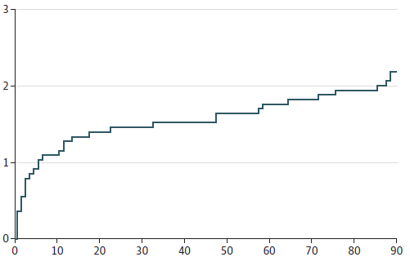
Perioperative Mortality Risk Is Low for Living Kidney Donors
Improvements in donor selection, perioperative care, and surgical technique have led to the decline in perioperative mortality risk for LKDs
Overall Risk of Mortality in the First 90 Days
After Donor Nephrectomy
A national registry study was conducted using data on LKDs from the Scientific Registry of Transplant Recipients from 1993 to 2022
36 out of 164,593 donors died within
90 days postdonation (2.2 per 10,000 cases)
  50% of deaths occurred within the first
  7 days
Risk per 10,000 donors
Days postdonation
Perioperative mortality after living donation declined substantially in the past decade compared with prior decades, to fewer than 1 event per 10,000 donations
LKD, living kidney donor.
Massie AB, et al. JAMA. 2024;332(12):1015-1017.
Notes:
Perioperative mortality risk is low for living kidney donors
The replacement of open donor nephrectomy as standard of care almost completely with laparoscopic nephrectomy, as well as improvements in donor selection, perioperative care, and surgical technique, have led to the decline in perioperative mortality risk for living kidney donors
A national registry study was conducted using data on living kidney donors from the Scientific Registry of Transplant Recipients from 1993 to 2022
Of the 164,593 donors in the study, 36 died within 90 days postdonation—that is, 2.2 deaths per 10,000 donations
50% of deaths occurred within the first 7 days
Perioperative mortality after living donation declined substantially in the past decade compared with prior decades, to fewer than 1 event per 10,000 donations
Reference:
Massie AB, Motter JD, Snyder JJ, Levan ML, Segev DL. Thirty-year trends in perioperative mortality risk for living kidney donors. JAMA. 2024;332(12):1015-1017.

Slide 14
The Risk of ESRD in Living Kidney Donors
When donating a kidney, LKDs accept the long-term risk of developing ESRD¹
LKDs (Black, Hispanic, and White donors) had a higher estimated lifetime-risk of ESRD than similarly healthy non-donors, as examined in a cohort study²
Cumulative Incidence of ESRD in
LKDs vs Matched Healthy Non-Donors²
40
Absolute Risk of ESRD per 10,000 Patients²
P<0.001
Live donors
(n=96,217)
Race/ Ethnicity | Donors | Non-Donors | P Value
Black | 74.7 | 23.9 | <0.001
Hispanic | 32.6 | 6.7 | 0.002
White | 22.7 | 0.0 | <0.001
30
20
ESRD per 10,000 donors
Non-donors
(n=96,217)
10
0
0
3
6
9
12
15
Years
Having a clear understanding of the risk of ESRD may help to inform discussions with individuals who are considering living kidney donation²
Figure reproduced with permission from JAMA. 2014;311(6):579-586. © 2014 American Medical Association. All rights reserved.
ESRD, end-stage renal disease; LKD, living kidney donor.
1. Lentine KL, et al. Transplantation. 2017;101(8S suppl 1):S1-S109. 2. Muzaale AD, et al. JAMA. 2014;311(6):579-586.
Notes:
When donating a kidney, living kidney donors accept a variety of possible outcomes, the most direct effect being the long-term risk of developing ESRD¹
A study by Muzaale et al compared outcomes of 96,217 living kidney donors (who donated from April 1994 to November 2011) with those of matched controls. This study found that by age 80, living kidney donors had a higher estimated lifetime-risk of ESRD (90 per 10,000) than similarly healthy non-donors (14 per 10,000) ²
The cumulative incidence of ESRD in living kidney donors compared with matched healthy non-donors is shown in this graph²
The rate of estimated cumulative incidence of ESRD in living kidney donors was 8 times higher than the rate in similarly healthy non-donors
Donors=30.8 per 10,000 (95% confidence interval [CI], 24.3-38.5)
Healthy non-donors=3.9 per 10,000 (95% CI, 0.8-8.9; P<0.001)
The absolute risk of ESRD per 10,000 patients differed depending on race/ethnicity. Both Black donors and non-donors had the highest absolute risk, while risk was lowest among both White donors and non-donors²
However, overall, the magnitude of the absolute risk increase of ESRD in living kidney donors was small. Therefore, having a clear understanding of the risk of ESRD may help to inform discussions with individuals who are considering living kidney donation²
To better our understanding of this risk, can anyone think of analogies with similar risk?
References:
Lentine KL, Kasiske BL, Levey AS, et al. KDIGO Clinical Practice Guideline on the Evaluation and Care of Living Kidney Donors. Transplantation. 2017;101(8S suppl 1):S1-S109.
Muzaale AD, Massie AB, Wang MC, et al. Risk of end-stage renal disease following live kidney donation. JAMA. 2014;311(6):579-586.

Slide 15
Estimated Risk of ESRD in Living Kidney Donors Varies According to Donor Characteristics
Incidence of ESRD Stratified by Relatedness to Recipient¹
Analysis of national registry data in
133,824 LKDs revealed¹
  Male sex, Black, and greater BMI were associated with a higher risk of ESRD
  Older age was associated with a higher risk of ESRD in non-Black donors, but the association between age and risk was not statistically significant in Black donors
  Donors who were closely biologically related to their recipient had a higher risk of ESRD
A separate analysis of 1901 Caucasian LKDs found that a total of 9 donors (0.47%) developed ESRD, all of whom were biologically related to their recipients, suggesting that risk of ESRD may be influenced by hereditary factors²
Non-related
First-degree related
100
ESRD per 10,000 (death-censored)
50
0
0
5
10
15
20
25
Time since donation, years
Republished with permission of J Am Soc Nephrol, from Massie AB, et al. 28,9 © 2017; permission conveyed through Copyright Clearance Center, Inc.
Providing accurate estimates of risk to potential LKDs may help improve the shared decision-making process and lend support to clinical decisions made during donor evaluation¹
BMI, body mass index; ESRD, end-stage renal disease; LKD, living kidney donor.
1. Massie AB, et al. J Am Soc Nephrol. 2017;28(9):2749-2755. 2. Mjøen G, et al. Kidney Int. 2014;86(1):162-167.
Notes:
An analysis of national registry data in 133,824 living kidney donors between 1987 and 2015 found that the estimated risk of developing ESRD varied according to donor characteristics, from fewer than 7 cases per 10,000 donors to at least 256 cases per 10,000 donors 20 years postdonation¹
In a multivariable analysis, the risk of ESRD was highest in male donors, Black donors, and donors who were first-degree biologic relatives of their recipient¹
Male sex (adjusted hazard ratio [aHR]=1.88 [95% CI, 1.50-2.35]; P<0.001), Black donors (aHR=2.96 [95% CI, 2.25-3.89]), and greater BMI (aHR per 5 kg/m²=1.61 [95% CI, 1.29-2.00]; P<0.001) were associated with a higher risk of ESRD
Older age was associated with a higher risk of ESRD in non-Black male donors (aHR per 10 years of age=1.40 [95% CI, 1.23-1.59]; P<0.001), but the association between age and risk was not statistically significant in Black donors
As shown in the graph, donors who were closely biologically related to their recipient had higher risk of ESRD (aHR=1.70 [95% CI, 1.24-2.34]; P<0.01)
A separate analysis of 1901 Caucasian LKDs found that a total of 9 donors (0.47%) developed ESRD, all of whom were biologically related to their recipients, suggesting that the risk of ESRD may be influenced by hereditary factors²
ESRD was mainly attributed to immunologic diseases
Providing accurate estimates of risk to potential living kidney donors may help improve the shared decision-making process and lend support to clinical decisions made during donor evaluation¹
References:
Massie AB, Muzaale AD, Luo X, et al. Quantifying postdonation risk of ESRD in living kidney donors. J Am Soc Nephrol. 2017;28(9):2749-2755.
Mjøen G, Hallan S, Hartmann A, et al. Long-term risks for kidney donors. Kidney Int. 2014;86(1):162-167.

Slide 16
Obesity Is a Risk Factor for ESRD
Evidence supports that obesity is associated with an increased risk of nonalcoholic fatty liver disease, which has been linked to the development of CKD^{1,2}
In a study of 119,769 LKDs, the estimated risk of ESRD 20 years after donation was significantly greater for LKDs with obesity (BMI >30 kg/m²) vs donors without obesity³
  The risk was similar for male and female donors, Black and White donors, and across the baseline eGFR spectrum
Cumulative Incidence of Postdonation ESRD Events Among LKDs by Obesity Status at Time of Donation³
100
Obese
Non-obese
80
60
ESRD events per 10,000 donors
40
20
0
0
5
10
15
20
Years after donation
Reprinted from Kidney Int, 91(3), Locke JE, et al. 699-703, © 2017, with permission from Elsevier.
Long-term lifestyle modifications may help
ameliorate risks of ESRD associated with obesity³
BMI, body mass index; CKD, chronic kidney disease; eGFR, estimated glomerular filtration rate; ESRD, end-stage renal disease; LKD, living kidney donor.
1. Fabbrini E, et al. Hepatology. 2010;51(2):679-689. 2. Marcuccilli M, et al. Int J Mol Sci. 2016;17(4):562. doi:10.3390/ijms17040562 3. Locke JE, et al. Kidney Int. 2017;91(3):699-703.
Notes:
Evidence supports that obesity is associated with an increased risk of nonalcoholic fatty liver disease, which has been linked to the development of chronic kidney disease (CKD)^{1,2}
In a study of 119,769 living kidney donors, the estimated risk of ESRD 20 years after donation was significantly greater for LKDs with obesity (BMI >30 kg/m²) vs counterparts without obesity³
For each unit increase in BMI above 27 kg/m², there was an associated significant 7% increase in ESRD risk³
The impact of obesity on ESRD risk was similar for male and female donors, Black and White donors, and across the baseline estimated glomerular filtration rate (eGFR) spectrum³
The graph shows cumulative incidence of postdonation ESRD events among living kidney donors by obesity status at time of donation. At 20 years postdonation, the cumulative incidence of ESRD among living kidney donors with obesity was 93.9 per 10,000 compared with 39.7 per 10,000 among their counterparts without obesity³
While the absolute risk for postdonation ESRD remains low, living kidney donors with obesity have a 1.9-fold higher risk of developing ESRD than their counterparts without obesity³
It is important to note that long-term lifestyle modifications may help ameliorate risks of ESRD associated with obesity³
Lifestyle changes, such as weight loss programs, for potential LKDs with obesity both pre- and postdonation may help to maintain weight and mitigate the risk of ESRD³
References:
Fabbrini E, Sullivan S, Klein S. Obesity and nonalcoholic fatty liver disease: biochemical, metabolic, and clinical implications. Hepatology. 2010;51(2):679-689.
Marcuccilli M, Chonchol M. NAFLD and chronic kidney disease. Int J Mol Sci. 2016;17(4):562. doi:10.3390/ijms17040562
Locke JE, Reed RD, Massie A, et al. Obesity increases the risk of end-stage renal disease among living kidney donors. Kidney Int. 2017;91(3):699-703.

Slide 17
Tools Are Now Available to Help Evaluate the Baseline Risk of ESRD Prior to Donation
A tool to help predict LKD candidates’ long-term risk of ESRD in the absence of kidney donation could help make the criteria by which a candidate is accepted or declined more empirical and transparent¹
Johns Hopkins University developed an online risk tool (www.transplantmodels.com/esrdrisk) to help evaluate LKD candidates and quantify the pretransplant risk of ESRD based on demographic and health characteristics^{1,2}
Projections of the Incidence of ESRD in the United States According to
Age, Race, and Sex for the Base-Case Scenario¹
Lifetime Projected Incidence of ESRD
15-Year Projected Incidence of ESRD*
1.6
1.6
1.4
Black men
Black women
White men
White women
1.4
Black men
Black women
White men
White women
1.2
1.2
1.0
1.0
Incidence, %
Incidence, %
0.8
0.8
0.6
0.6
0.4
0.4
0.2
0.2
0.0
0.0
20
30
40
50
60
70
80
20
30
40
50
60
70
80
Age, years
Age, years
From N Engl J Med, Grams ME, et al. 374(5), 411-421. © 2016 Massachusetts Medical Society. Reprinted with permission from Massachusetts Medical Society.
BMI, body mass index; eGFR, estimated glomerular filtration rate; ESRD, end-stage renal disease; LKD, living kidney donor.
*The base-case scenario for the 15-year projected risk is the following: an age-specific eGFR (114, 106, 98, 90, 82, 74, and 66 mL per minute per 1.73 m² for an age of 20, 30, 40, 50, 60, 70, and 80 years,
respectively), systolic blood pressure of 120 mm Hg, a urinary albumin-to-creatinine ratio of 4, a BMI of 26, and no diabetes mellitus or use of antihypertensive medication.
1. Grams ME, et al. N Engl J Med. 2016;374(5):411-421. 2. Lentine KL, et al. Transplantation. 2017;101(8S suppl 1):S1-S109.
Notes:
As you can see in the graphs, this model revealed a substantial variation in the projected risks of ESRD according to age, race, and sex¹
The highest 15-year risk was among middle-aged Black men, while many older living kidney donor candidates had lower estimated long-term risks of ESRD, even in the presence of health conditions that are often considered to be contraindications to donation, including low eGFR or mild hypertension
A tool to help predict the long-term risk of ESRD in living kidney donor candidates in the absence of kidney donation could help make the criteria by which a candidate is accepted or declined more empirical and transparent¹
Johns Hopkins University developed an online risk tool based on demographic and health characteristics to help evaluate, counsel, and accept living kidney donor candidates^{1,2}
The tool can be found at www.transplantmodels.com/esrdrisk
Use of the online risk tool may help reduce the number of living kidney donors in whom ESRD develops after donation, support donation among people whose long-term risk was previously misunderstood, and enhance informed consent and shared decision-making with donor candidates¹
References:
Grams ME, Sang Y, Levey AS, et al. Kidney-failure risk projection for the living kidney-donor candidate. N Engl J Med. 2016;374(5):411-421.
Lentine KL, Kasiske BL, Levey AS, et al. KDIGO Clinical Practice Guideline on the Evaluation and Care of Living Kidney Donors. Transplantation. 2017;101(8S suppl 1):S1-S109.

Slide 18
Tools to Help Evaluate the Postdonation Risk of ESRD in LKDs
Distribution of Predicted ESRD in LKDs Postdonation
True risk prediction for LKDs must also include absolute risk if the individual does donate their kidney
A prediction model has been constructed using national registry data to estimate the absolute risk of ESRD
  The risk calculator can be found at www.transplantmodels.com/donesrd/
The full range of predicted 20-year risk of ESRD (per 10,000 donors) postdonation was wide and varied according to donor characteristics, with a median (IQR) of
  1 (1-2) cases per 10,000 donors at 5 years
  6 (4-11) cases per 10,000 at 10 years
  16 (10-29) cases per 10,000 at 15 years
  34 (20-59) cases per 10,000 at 20 years
300
Median
IQR
1st/99th percentile
200
ESRD per 10,000 donors
100
0
0
5
10
15
20
Years after donation
Predicted ESRD risk is calculated for each individual.
50% of predicted survival curves fall between the dashed lines,
but a few individuals have substantially higher predicted risk.
Republished with permission of J Am Soc Nephrol, from Massie AB, et al. 28,9 © 2017; permission conveyed through Copyright Clearance Center, Inc.
These tools may help improve the accuracy of long-term ESRD risk assessment and support LKD candidates in making educated decisions about donation
ESRD, end-stage renal disease; IQR, interquartile range; LKD, living kidney donor.
Massie AB, et al. J Am Soc Nephrol. 2017;28(9):2749-2755.
Notes:
Although tools to predict baseline long-term ESRD risk are useful, true risk prediction for living kidney donors must also include absolute risk if the individual does donate their kidney
Postdonation ESRD risk in living kidney donors is likely to be higher than the estimated baseline risk calculated prior to donation
A prediction model has been constructed using national registry data to estimate the absolute risk of ESRD
The risk calculator can be found at www.transplantmodels.com/donesrd/
The full range of predicted 20-year risk of ESRD (per 10,000 donors) postdonation was wide and varied according to donor characteristics, with a median (interquartile range [IQR]) of
1 (1-2) cases per 10,000 donors at 5 years
6 (4-11) cases per 10,000 at 10 years
16 (10-29) cases per 10,000 at 15 years
34 (20-59) cases per 10,000 at 20 years
Accurate estimates of long-term ESRD risk may help support living kidney donor candidates in making educated decisions about donation
Reference:
Massie AB, Muzaale AD, Luo X, et al. Quantifying postdonation risk of ESRD in living kidney donors. J Am Soc Nephrol. 2017;28(9):2749-2755.

Slide 19
Educating Living Kidney Donors About the Potential Risk of ESRD Can Help in the Decision-Making Process
In 2022, OPTN updated the living donor exclusion criteria to remove type 2 diabetes as an absolute contraindication.* As these criteria continue to evolve, transplant programs have a responsibility to support donor candidates and ensure that they are aware of potential risks as part of their decision-making process¹⁻³
In 2017, KDIGO published clinical practice guidelines on the evaluation and care of living kidney donors, including weighing risks of ESRD¹
Framework to Accept or Decline Donor Candidates Based on Transplant Program’s Threshold of Acceptable Projected Lifetime Risk of Kidney Failure¹
Transplant program declines donor candidate
Donation-attributable risk (may vary by
demographic and health characteristics)
Transplant program’s threshold for
acceptable postdonation risk
Aggregate risk related to health
characteristics in the absence of donation
(eg, GFR, blood pressure, BMI, smoking)
Projected lifetime risk of kidney failure, %
Transplant program accepts donor candidate
Candidate decides whether to proceed
Demographic-related (age, sex, race)
risk in the absence of donation
Candidate A
Candidate B
Candidate C
Used with permission from Lentine KL, et al. Transplantation. 2017;101(8S suppl 1):S1-S109. © 2017 Wolters Kluwer Health, Inc.
BMI, body mass index; ESRD, end-stage renal disease; GFR, glomerular filtration rate; KDIGO, Kidney Disease: Improving Global Outcomes; OPTN, Organ Procurement and Transplantation Network.
For potential living donors without end organ disease or unacceptable lifetime risk of complications.
1. Lentine KL, et al. Transplantation. 2017;101(8S suppl 1):S1-S109. 2. Muzaale AD, et al. JAMA. 2014;311(6):579-586. 3. Organ Procurement and Transplantation Network. Modify living donor exclusion criteria. Accessed October 8, 2024. https://optn.transplant.hrsa.gov/media/d2hlvxv1/policy-notice_modify-ld-excl-crit_ldc.pdf
*
Notes:
In 2022, OPTN updated the living donor exclusion criteria to remove type 2 diabetes as an absolute contraindication for potential living donors without end organ disease or unacceptable lifetime risk of complications. As these criteria continue to evolve, transplant programs have a responsibility to support donor candidates and ensure that they are aware of potential risks as part of their decision-making process¹⁻³
In 2017, Kidney Disease: Improving Global Outcomes (KDIGO) published clinical practice guidelines providing recommendations on the evaluation and care of living kidney donors before, during, or after to assist medical professionals who work in transplantation¹
Each donor candidate has a long-term risk (cumulative incidence) of developing kidney failure, influenced by the combination of risks projected by their demographic and health characteristics at the time of evaluation plus the risk attributable to donation. This figure shows the transplant program’s threshold for acceptable postdonation risk based on the candidate’s characteristics¹
References:
Lentine KL, Kasiske BL, Levey AS, et al. KDIGO Clinical Practice Guideline on the Evaluation and Care of Living Kidney Donors. Transplantation. 2017;101(8S suppl 1):S1-S109.
Muzaale AD, Massie AB, Wang MC, et al. Risk of end-stage renal disease following live kidney donation. JAMA. 2014;311(6):579-586.
Organ Procurement and Transplantation Network. Modify living donor exclusion criteria. June 27, 2022. Accessed October 8, 2024. https://optn.transplant.hrsa.gov/media/d2hlvxv1/policy-notice_modify-ld-excl-crit_ldc.pdf

Slide 20
Considering Other Risks of
Living Kidney Donation
Notes:
In this section, we will explore additional risks of living kidney donation outside of ESRD and how to address some of the challenges

Slide 21
LKDs May Experience Negative Psychosocial Effects
LKD Negative Experiences
Worse physical health since donation¹
Persistent fatigue and pain¹
Current or future health concerns as a result of donation^{2,3}
Unfavorable changes in donor’s
body image²
Worsened relationships with other
family members³
Elevated emotional distress and/or psychiatric disorders^{2,3}
Understanding both the positive and negative psychosocial effects of living kidney donation is important³
LKD, living kidney donor.
1. Wirken L, et al. Am J Transplant. 2015;15(12):3041-3054. 2. Clemens KK, et al. Am J Transplant. 2006;6(12):2965-2977. 3. Dew MA, Myaskovsky L, Steel JL, et al. Curr Transplant Rep. 2014;1(1):24-34.
Notes:
While living kidney donors are known to experience many positive psychosocial effects, some may also experience negative psychosocial effects, such as
Worse physical health since donation¹
Persistent fatigue and pain¹
Current or future health concerns as a result of donation^{2,3}
Unfavorable changes in donor’s body image²
Worsened relationships with other family members³
Elevated emotional distress and/or psychiatric disorders^{2,3}
Understanding both the positive and negative psychosocial effects of living kidney donation is important³
References:
Wirken L, van Middendorp H, Hooghof CW, et al. The course and predictors of health-related quality of life in living kidney donors: a systematic review and meta-analysis. Am J Transplant. 2015;15(12):3041-3054.
Clemens KK, Thiessen-Philbrook H, Parikh CR, et al. Psychosocial health of living kidney donors: a systematic review. Am J Transplant. 2006;6(12):2965-2977.
Dew MA, Myaskovsky L, Steel JL, et al. Managing the psychosocial and financial consequences of living donation. Curr Transplant Rep. 2014;1(1):24-34.

Slide 22
Prevalence of Donor Regret Among Living Kidney Donors was 2.1%
2.1% of LKDs reported regretting their donation, according to a questionnaire study
Studies have reported that most LKDs would be willing to donate again, but donors with negative psychosocial outcomes postdonation may be at higher risk for regret
Risk Factors Associated With Regret of Donation in LKDs
(N=825)
Risk Factor | aRR (95% CI) | P Value
Black | 3.78 (0.75-18.92) | 0.1
Age at survey completion (per 10 years) | 0.98 (0.58-1.65) | 0.9
Positive GAD-2 screen | 5.68 (1.20-26.90) | 0.03
Development of any comorbidity | 1.53 (0.35-6.74) | 0.6
Trouble obtaining or changing insurance | 3.13 (0.75-12.98) | 0.1
Recipient graft loss | 4.59 (0.57-36.81) | 0.2
Subjects with anxiety were more likely to regret donation
Although there is a low prevalence of anxiety, depression, and regret of donation
among LKDs, these may be interrelated conditions
aRR, adjusted relative risk; CI, confidence interval; GAD-2, generalized anxiety disorder 2 item; LKD, living kidney donor.
Holscher CM, et al. BMC Nephrol. 2018;19(1):218. doi:10.1186/s12882-018-1024-0
Notes:
Beyond negative psychosocial effects, donors may experience risks such as regret of donation. However, prevalence of regret is low
2.1% of living kidney donors reported regretting their donation, according to a questionnaire study of living kidney donors
Studies have reported that most living kidney donors would be willing to donate again, but donors with negative psychosocial outcomes postdonation may be at higher risk for regret
Subjects with anxiety were more likely to regret donation
Reference:
Holscher CM, Leanza J, Thomas AG, et al. Anxiety, depression, and regret of donation in living kidney donors. BMC Nephrol. 2018;19(1):218. doi:10.1186/s12882-018-1024-0

Slide 23
Anxiety and Depression May Occur in LKDs Postdonation
LKDs may experience anxiety and depression postdonation, which can be associated with higher rates of disability, illness, and death
  In a study of 825 LKDs, 5.5% (41/742) screened positive for anxiety and 4.2% (31/741) for depression
Risk Factors Associated With Positive GAD-2 Screening in LKDs
Risk Factor | aRR (95% CI) | P Value
Positive PHQ-2 screen | 13.72 (6.78-27.74) | <0.001
Years since donation (by year) | 0.93 (0.89-0.98) | 0.006
Married/living with a partner | 0.52 (0.26-1.05) | 0.07
Hypertension | 1.54 (0.96-2.48) | 0.08
Recipient alive | 0.82 (0.38-1.78) | 0.6
A positive PHQ-2 depression screen was more likely in LKDs whose recipients experienced graft loss (aRR=5.38 [95% CI, 1.29-22.32]; P=0.02)
In the United States, predonation psychiatric assessments are mandated by the OPTN for all LKDs
Psychological screening at follow-up may help support LKDs, particularly those with risk factors for anxiety and/or depression
aRR, adjusted relative risk; CI, confidence interval; GAD-2, generalized anxiety disorder 2 item; LKD, living kidney donor; OPTN, Organ Procurement and Transplantation Network; PHQ-2, Patient Health Questionnaire-2.
Holscher CM, et al. BMC Nephrol. 2018;19(1):218. doi:10.1186/s12882-018-1024-0
Notes:
Living kidney donors may experience anxiety and depression postdonation, which can be associated with higher rates of disability, illness, and even death
In a study of 825 living kidney donors, 5.5% (41/742) screened positive for anxiety and 4.2% (31/741) for depression
As shown in the table, in a multivariable analysis, subjects who screened positive for depression (PHQ-2 screen) were more likely to have a positive GAD-2 screen, while subjects who donated more recently were less likely to have a positive GAD-2 screen
A positive Patient Health Questionnaire-2 (PHQ-2) depression screen was more likely in living kidney donors whose recipients experienced graft loss (aRR=5.38; [95% CI, 1.29-22.32]; P=0.02)
In the United States, predonation psychiatric assessments are mandated by the OPTN for all living kidney donors
A moderate correlation between anxiety and depression was observed (r=0.52); therefore, donors with one of these conditions may be at risk for the other as well
Psychological screening at follow-up may help support living kidney donors, particularly those with risk factors for anxiety and/or depression
Reference:
Holscher CM, Leanza J, Thomas AG, et al. Anxiety, depression, and regret of donation in living kidney donors. BMC Nephrol. 2018;19(1):218. doi:10.1186/s12882-018-1024-0

Slide 24
The Risk of Medical Problems Increases as LKDs Grow Older
In a US-based cohort study of 41,260 LKDs, it was found that the incidence of developing hypertension and diabetes increased as months postdonation increased
  Donors who were older at donation were more likely to develop hypertension and diabetes
Postdonation Incidence of Hypertension and Diabetes per 10,000 LKDs
Hypertension
Diabetes
400
20
300
310
15
15
Incidence per 10,000 donors
Incidence per 10,000 donors
200
10
162
100
5
6
74
0
2
0
6
12
24
0
0
6
12
24
Months postdonation
Months postdonation
Used with permission from Holscher CM, et al. Transplantation. 2019;103(6):1216-1223. © 2018 Wolters Kluwer Health, Inc.
As donors age, they will be at an increased risk for medical problems.
Routine follow-up will be important to preserve donor health and well-being
LKD, living kidney donor.
Holscher CM, et al. Transplantation. 2019;103(6):1216-1223.
Notes:
In a US-based cohort study of 41,260 living kidney donors, it was found that the incidence of developing hypertension and diabetes increased as months postdonation increased
The incidence of new-onset hypertension was 74, 162, and 310 cases per 10,000 people at 6 months,
12 months, and 24 months postdonation, respectively
The incidence of new-onset diabetes was 2, 6, and 15 cases per 10,000 people at 6 months, 12 months, and 24 months postdonation, respectively
It was also found that donors who were older at donation were more likely to develop new-onset hypertension and diabetes within 2 years of donation
These data suggest that as donors age, they will be at an increased risk for medical problems. Routine follow-up will be important to preserve donor health and well-being
Reference:
Holscher CM, Bae S, Thomas AG, et al. Early hypertension and diabetes after living kidney donation: a national cohort study. Transplantation. 2019;103(6):1216-1223.

Slide 25
Development of Hypertension Is Common in Living Kidney Donors
Postdonation
Within 2 years of nephrectomy, 3.1% of living kidney donors developed hypertension and 0.15% developed new-onset diabetes, both of which are predominant but manageable causes of postdonation ESRD¹
An analysis of 24,533 older (aged ≥50 years) living kidney donors found that, while the risk of ESRD was higher in donors with vs without hypertension, the absolute risk was low and there was no increase in mortality risk 15 years postdonation²
Incidence of Hypertension and Diabetes per 10,000 Living Kidney Donors at 6 Months, 1 Year, and 2 Years Postdonation¹
 | Complete Case Estimate | Estimate by Inverse Probability Weighting | Estimate by Multiple Imputation
New-onset hypertension
6 months postdonation | 74 | 98 | 78
1 year postdonation | 162 | 200 | 164
2 years postdonation | 310 | 362 | 319
New-onset diabetes
6 months postdonation | 2 | 2 | 4
1 year postdonation | 6 | 6 | 6
2 years postdonation | 15 | 15 | 15
Used with permission from Holscher CM, et al. Transplantation 2019;103:1216-1223. © 2019 Wolters Kluwer Health, Inc.
Early postdonation care for donors should emphasize healthy lifestyle practices, management of modifiable risk factors (eg, obesity), and early detection/management of comorbidities¹
ESRD, end-stage renal disease.
1. Holscher CM, et al. Transplantation. 2019;103(6):1216-1223. 2. Al Ammary F, et al. Clin J Am Soc Nephrol. 2019;14(7):1048-1055.
Notes:
Hypertension is another risk common among living kidney donors postdonation
Within 2 years of nephrectomy, 3.1% of living kidney donors developed hypertension and 0.15% developed new-onset diabetes, both of which are predominant but manageable causes of postdonation ESRD¹
Donor factors associated with a higher risk of developing new-onset hypertension or diabetes after living kidney donation include older age, male sex, direct relation to the recipient, higher preoperative systolic blood pressure, and higher preoperative BMI¹
After donation, those individuals who were at a higher risk of developing new-onset hypertension were found to be older, male, and related to the recipient and had a higher preoperative BMI within 2 years of donation
Individuals who were more likely to develop new-onset diabetes within 2 years of donation were older, had a higher BMI, and were Hispanic or Latino
An analysis of 24,533 older (aged ≥50 years) living kidney donors found that, while the risk of ESRD was higher in donors with vs without hypertension, the absolute risk was low and there was no increase in mortality risk 15 years postdonation²
Early postdonation care for donors should emphasize healthy lifestyle practices, management of modifiable risk factors (eg, obesity), and early detection and management of new-onset comorbidities¹
References:
Holscher CM, Bae S, Thomas AG, et al. Early hypertension and diabetes after living kidney donation: a national cohort study. Transplantation. 2019;103(6):1216-1223.
Al Ammary F, Luo X, Muzaale AD, et al. Risk of ESKD in older live kidney donors with hypertension. Clin J Am Soc Nephrol. 2019;14(7):1048-1055.

Slide 26
Perceived Financial Burden May Be Another Consequence to Living Kidney Donation
LKD candidates who were more likely to perceive donation as a financial burden were more likely to rent their home, had a lower individual household income overall and relative to ZIP code median, and were more likely to be concerned about predonation costs
Factors Associated With Perceived Donation-Related Financial Burden
100
Financial burden
86
80
No financial burden
72
Adjusted higher risk of perceived financial burden is
60
57
Percentage of participants
43
  3.7-fold for predonation cost concerns
  10.6‐fold for household income <$60,000
40
16
20
14
20
7
0
Rent home
Household income
<$60,000
Predonation cost
concerns
Income above
ZIP code median
Used with permission from Ruck JM, et al. Am J Transplant. 2018;715-719. © 2018 John Wiley and Sons.
Transplant centers can use these factors to help identify potential donors at higher risk
of perceived financial burden to help inform them of financial support resources
LKD, living kidney donor.
Ruck JM, et al. Am J Transplant. 2018;18(3):715-719.
Notes:
Financial burden is another risk to consider
Living kidney donor candidates who were more likely to perceive donation as a financial burden were more likely to rent their home, had a lower individual household income overall and relative to ZIP code median, and were more likely to be concerned about predonation costs
Predonation cost concerns were associated with a 3.7‐fold adjusted higher risk of perceived financial burden (43% vs 7%; P=0.03), and household income <$60,000 was associated with a 10.6‐fold adjusted higher risk of perceived burden (86% vs 20%; P=0.002)
Transplant centers can use these factors to help identify potential donors at higher risk of perceived financial burden to help inform them of financial support resources
Reference:
Ruck JM, Holscher CM, Purnell TS, et al. Factors associated with perceived donation-related financial burden among living kidney donors. Am J Transplant. 2018;18(3):715-719.

Slide 27
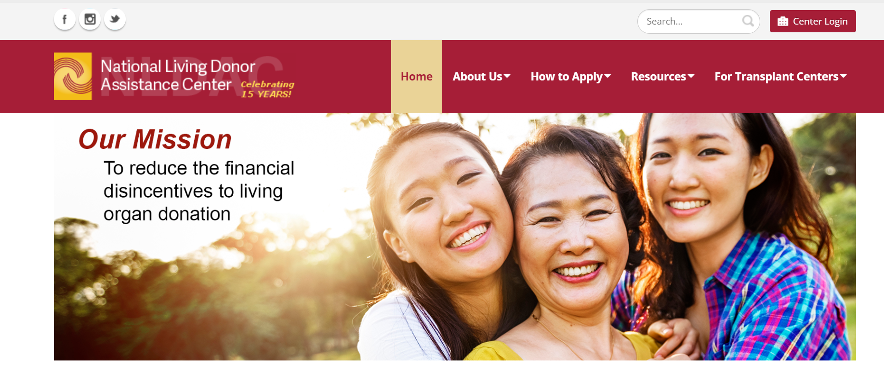
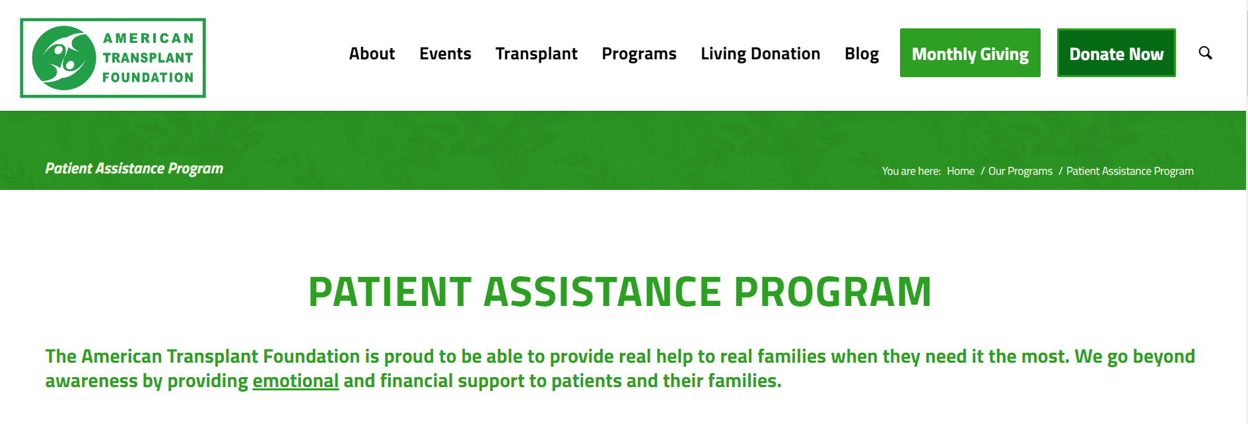

Financial Assistance May Be Available to Help LKDs Achieve Financial Neutrality
The National Organ Transplant Act (NOTA) of 1984 outlawed the buying and selling of organs, thus eliminating financial benefits from organ donation. However, donations can remain financially neutral, without imposing financial burdens on LKDs¹
Various resources are available for LKDs to achieve
financial neutrality^{2,3}
  The National Living Donor Assistance Center helps cover travel and lodging expenses for eligible donors, up to $6,000
  The National Foundation for Transplants offers fundraising assistance for LKDs to help with medical and
  nonmedical expenses
  The American Transplant Foundation offers grants to
  eligible donors
Additionally, there are federal and state laws being proposed around tax deductions, paid leave, and disability programs that help would support living donation⁴
In 2020, AST introduced the LDCOE program to recognize employers who help eliminate barriers to living donation by providing salary support to their employees who choose to be
a living donor⁵
https://www.livingdonorassistance.org/
https://www.americantransplantfoundation.org/programs/pap/
AST, American Society of Transplantation; LDCOE, Living Donor Circle of Excellence; LKD, living kidney donor.
1. Delmonico FL, et al. Am J Transplant. 2015;15(5):1187-1191. 2. Nonprofit financial aid programs for living donors. American Society of Transplantation. Accessed October 9, 2024. https://www.livingdonortoolkit.com/financial-toolkit/nonprofit-financial-aid-programs-living-donors 3. Living donation resources. National Kidney Foundation. Accessed October 9, 2024. https://www.kidney.org/patients/resources_LivingDonation 4. Federal and state laws about living donation. American Society of Transplantation. Accessed October 9, 2024. https://www.livingdonortoolkit.com/financial-toolkit/federal-and-state-laws-about-living-donation 5. AST announces new living donor circle of excellence program. Accessed October 9, 2024. https://www.kidney.org/get-involved/circle-excellence
Notes:
The National Organ Transplant Act (NOTA) of 1984 outlawed the buying and selling of organs, thus eliminating financial benefits from organ donation. However, donations can remain financially neutral, without imposing financial burdens on living kidney donors¹
Various resources are available for living kidney donors to achieve financial neutrality^{2,3}
The National Living Donor Assistance Center helps cover travel and lodging expenses for eligible donors, up to $6,000
The National Foundation for Transplants offers fundraising assistance for living kidney donors to help with medical and nonmedical expenses
The American Kidney Fund offers grants to eligible donors, up to 5 years after donation
The American Transplant Foundation also offers grants to eligible donors
Some employers may provide paid leave after donors have exhausted their vacation days to cover time off. Use of vacation days and paid leave is based on individual company and state policies^{2,4,5}
Additionally, there are federal and state laws being proposed around tax deductions, paid leave, and disability programs that would help support living donation⁵
Some transplant centers may belong to the Living Donor Circle of Excellence (LDCOE) that was launched by the American Society of Transplantation (AST) to improve the lives of transplant patients through living donation⁶
In 2020, AST introduced the LDCOE program to recognize employers who help eliminate barriers to living donation by providing salary support to their employees who choose to be a living donor⁷
References:
Delmonico FL, Martin D, Domínguez-Gil B, et al. Living and deceased organ donation should be financially neutral acts. Am J Transplant. 2015;15(5):1187-1191.
Nonprofit financial aid programs for living donors. American Society of Transplantation. Accessed October 9, 2024. https://www.livingdonortoolkit.com/financial-toolkit/nonprofit-financial-aid-programs-living-donors
Living donation resources. National Kidney Foundation. Accessed October 9, 2024. https://www.kidney.org/patients/ resources_LivingDonation
Przech S, Garg AX, Arnold JB, et al. Financial costs incurred by living kidney donors: a prospective cohort study. J Am Soc Nephrol. 2018;29(12):2847-2857.
Federal and state laws about living donation. American Society of Transplantation. Accessed October 9, 2024. https://www.livingdonortoolkit.com/financial-toolkit/federal-and-state-laws-about-living-donation
AST Living Donor Circle of Excellence. American Society of Transplantation. Accessed October 9, 2024. https://www.livingdonorcircle.com/
AST announces new living donor circle of excellence program. Accessed October 9, 2024. https://www.kidney.org/get-involved/circle-excellence

Slide 28
Follow-Up Can be Critical in Managing
Living Kidney Donors
Notes:
Next, we will highlight the importance of follow-up in the management of living kidney donors

Slide 29
Transplant Centers Are Required to Collect Follow-Up Data on LKDs for 2 Years
In 2013, the OPTN/UNOS mandated that transplant centers meet thresholds for collecting and reporting clinical and laboratory data for LKDs at 6 months, 1 year, and
2 years postdonation¹
An analysis of SRTR data for 31,615 LKDs found that complete and timely follow-up significantly increased from 33% in 2013 to 54% in 2015¹
This increase was observed even though only 43% of centers were compliant¹
Proportions of Complete and Timely Clinical and Laboratory Follow-Up in LKDs
Before and After Policy Implementation¹
Pre-implementation
Post-implementation
Percentage of complete clinical and laboratory data
Time
Increasing compliance with follow-up may enhance
living kidney donor outcomes^{1,2}
LKD, living kidney donor; OPTN, Organ Procurement and Transplantation Network; SRTR, Scientific Registry of Transplant Recipients; UNOS, United Network for Organ Sharing.
1. Henderson ML, et al. Am J Transplant. 2017;17(12):3131-3140. 2. Kulkarni S, et al. Am J Transplant. 2016;16(12):3385-3391.
Notes:
In 2013, OPTN/UNOS mandated that transplant centers meet thresholds for collecting and reporting clinical and laboratory data for living kidney donors at 6 months, 1 year, and 2 years postdonation¹
An analysis of SRTR data for 31,615 living kidney donors found that complete and timely follow-up significantly increased from 33% in 2013 to 54% in 2015 (P<0.001)¹
With only 43% of centers being compliant with follow-up, more effective, supportive, and long-term monitoring is needed in order to enhance living kidney donor outcomes^{1,2}
References:
Henderson ML, Thomas AG, Shaffer A, et al. The national landscape of living kidney donor follow-up in the United States. Am J Transplant. 2017;17(12):3131-3140.
Kulkarni S, Thiessen C, Formica RN, et al. The long-term follow-up and support for living organ donors: a center-based initiative founded on developing a community of living donors. Am J Transplant. 2016;16(12):3385-3391.

Slide 30
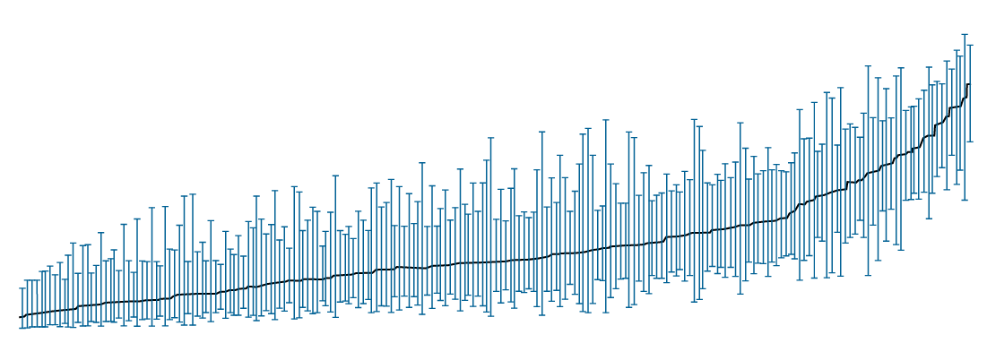
Transplant Centers Have Significant Variability in LDF
Analysis of SRTR data also showed that the odds of non-timely or incomplete LDF at 6 months varied significantly by transplant center
For 6-month LDF, center-level variation accounted for 19% of the variance in the non-timely or incomplete submission of clinical data (interclass correlation=0.19 [95% CI, 0.15-0.24])
Overall, in this study, 57% of centers did not meet the national reporting thresholds in the 2013 OPTN/UNOS mandate
Transplant Center Variability in
Non-Timely or Incomplete LDF Clinical Data
100%
80%
60%
Predicted probability of non-timely or incomplete submission
40%
20%
0%
Transplant center
CI, confidence interval; LDF, living donor follow-up; OPTN, Organ Procurement and Transplantation Network; SRTR, Scientific Registry of Transplant Recipients; UNOS, United Network for Organ Sharing.
Henderson ML, et al. Am J Transplant. 2017;17(12):3131-3140.
Used with permission from Henderson ML, et al. Am J Transplant. 2017;17:3131-3140. © 2017 John Wiley and Sons.
Notes:
The same analysis of SRTR data also showed that the odds of non-timely or incomplete living donor follow-up (LDF) at 6 months varied significantly by transplant center
For the 6-month LDF, center-level variation accounted for 19% of the variance in the non-timely or incomplete submission of clinical data (interclass correlation=0.19 [95% CI, 0.15-0.24])
In this graph, reflecting the time frame of February 2013 through June 2015, the blue dots forming a line represent the center-level probabilities for a reference donor and are calculated from empirical Bayes estimates. Please note, this graph serves as a model to illustrate that the same donor could have had different experiences with LDF depending on the center
The reference donor is a non-Black and non-Hispanic female between 35 and 54 years old, with no history of hypertension or smoking prior to donation
She is married, is the spouse of the kidney recipient, has a college degree, was working for income, and was insured at the time of donation
At the time of donation in 2015, the donor had a BMI between 19 and 24, an eGFR of ≥100 before donation, and went to a small transplant center (1-19 donors per year)
Overall, in this study, 57% of centers did not meet the national reporting thresholds in the 2013 OPTN/UNOS mandate
Reference:
Henderson ML, Thomas AG, Shaffer A, et al. The national landscape of living kidney donor follow-up in the United States. Am J Transplant. 2017;17(12):3131-3140.

Slide 31
Electronic Mobile Messaging May Be a Useful Tool for Follow-Up of LKDs
In-person follow-up for LKDs presents a number
of challenges¹
Electronic mobile messaging may be a useful tool to reduce the burden of follow-up among LKDs postdonation, for donors and centers^{1,2}
  Text messaging had consistently higher response rates up to 24 months postdonation vs email in a study of 67 LKDs²
  94% of 100 LKDs surveyed owned a smartphone¹
  79% of smartphone-owning participants perceived that it would be useful to access LKD resources and complete their required postdonation follow-up with resources on their smartphones¹
Response Rate by Contact Method
For LKDs²
100
80
60
Percent response rate
40
Overall
20
Text
Email
0
0
6
12
18
24
Months since donation
Used with permission from Ruck JM, et al. Clin Transplant. 2018;32(2).
© 2018 John Wiley and Sons.
Electronic messaging tools may facilitate follow-up and help improve communication between LKDs and transplant centers¹
LKD, living kidney donor.
1. Eno AK, et al. JMIR Mhealth Uhealth. 2018;6(10):e11192. doi:10.2196/11192 2. Ruck JM, et al. Clin Transplant. 2018;32(2). doi:10.1111/ctr.13184
Notes:
In-person follow-up for living kidney donors presents a number of challenges, including logistical and administrative barriers for centers, and costs and functional barriers for donors¹
Electronic mobile messaging may be a useful tool to reduce burden of follow-up in living kidney donors postdonation,
for donors and centers^{1,2}
In a study of 67 living kidney donors, the majority selected email or text messaging as their preferred method of contact. As shown in the graph, overall response rates were consistently higher for those using text messaging vs email²
In a survey of 100 living kidney donors, 94% owned a smartphone and 79% of smartphone-owning participants perceived that accessing living kidney donor information and resources on their smartphone would be useful to complete their required postdonation follow-up¹
Electronic messaging tools may facilitate follow-up and help improve communication between living kidney donors and transplant centers¹
References:
Eno AK, Thomas AG, Ruck JM, et al. Assessing the attitudes and perceptions regarding the use of mobile health technologies for living kidney donor follow-up: survey study. JMIR Mhealth Uhealth. 2018;6(10):e11192. doi:10.2196/11192
Ruck JM, Zhou S, Thomas AG, et al. Electronic messaging and communication with living kidney donors. Clin Transplant. 2018;32(2). doi:10.1111/ctr.13184

Slide 32
Methods to Help Improve Postdonation Follow-Up Compliance in LKDs
In a guidance document, the OPTN provides strategic recommendations to maintain contact with LKDs to help facilitate timely postdonation follow-ups¹
Studies are currently being conducted to assess novel strategies to improve adherence with postdonation follow-ups in LKDs, including^{2,3}
Key OPTN Recommendations¹
Use not only regular mail and telephone contacts, but also emails and texts to communicate with donors | Consider calling donors using a cell phone rather than the medical center’s main line | Use internet search strategies to locate difficult-to-find donors
Develop plans for repeated attempts at contact that span at least 1 month and potentially several months | If the donor misses an appointment unexpectedly, try to reach the donor within 24 hours to reschedule the appointment | Routinely review and update donors’ contact information each time they are successfully contacted postdonation
  Whether financial incentives can help promote compliance
  Whether using a mobile health app can help improve compliance and postdonation care
LKD, living kidney donor; OPTN, Organ Procurement and Transplantation Network.
1. Procedures to collect postdonation follow-up data from living donors. Organ Procurement and Transplantation Network. Accessed October 9, 2024.
https://optn.transplant.hrsa.gov/professionals/by-topic/guidance/procedures-to-collect-post-donation-follow-up-data-from-living-donors/#rec3/
2. Levan ML, et al. BMC Nephrol. 2020;21(1):465. doi:10.1186/s12882-020-02117-9 3. Henderson ML, et al. JMIR Res Protoc. 2019;8(1):e11000. doi:10.2196/11000
Notes:
In a guidance document, the OPTN provides strategic recommendations to maintain contact with living donors to help facilitate timely postdonation follow-ups¹
The key suggestions are shown in the table on the slide
Studies are currently being conducted to assess novel strategies to improve adherence with postdonation follow-ups in living kidney donors, including^{2,3}
Whether financial incentives can help promote compliance
Whether using a mobile health app can help improve compliance and postdonation care
References:
Procedures to collect post-donation follow-up data from living donors. Organ Procurement and Transplantation Network. Accessed October 9, 2024. https://optn.transplant.hrsa.gov/professionals/by-topic/guidance/procedures-to-collect-post-donation-follow-up-data-from-living-donors/#rec3/
Levan ML, Waldram MM, DiBrito SR, et al. Financial incentives versus standard of care to improve patient compliance with live kidney donor follow-up: protocol for a multi-center, parallel-group randomized controlled trial. BMC Nephrol. 2020;21(1):465. doi:10.1186/s12882-020-02117-9
Henderson ML, Thomas AG, Eno AK, et al. The impact of the mKidney mHealth System on live donor follow-up compliance: protocol for a randomized controlled trial. JMIR Res Protoc. 2019;8(1):e11000. doi:10.2196/11000

Slide 33
Annual Primary Care Physician Visits Are Important to Monitor LKDs Postdonation
Postdonation counseling can be helpful to promote the health of all LKDs, but especially LKDs at increased risk of not receiving regular monitoring
Risk of Having Fewer-Than-Annual PCP Visits
Postdonation With Predonation PCP Visit Frequency
 | Odds Ratio | P Value
Male | 1.1 | 0.6
Less than college education | 1.8 | <0.01
Black | 1.6 | 0.1
Smoking history | 1.1 | 0.7
Time to follow-up (per year) | 1.0 | 0.08
Fewer than annual PCP visits before donation | 14.4 | <0.001
Predonation PCP visit frequency was the strongest predictor of
postdonation PCP visit frequency
New, non-traditional follow-up methods may be needed to ensure LKDs receive appropriate postdonation monitoring and care
LKD, living kidney donor; PCP, primary care physician.
Alejo JL, et al. Clin Transplant. 2017;31(7). doi:10.1111/ctr.12992
Notes:
Annual PCP visits are recommended for living kidney donors, as they need to be monitored for long-term health postdonation
One of the strongest predictors of postdonation frequency of PCP visits was predonation PCP visit frequency (odds ratio=14.4; P<0.001)
Donors who had fewer-than-annual PCP visits before donation were significantly more likely to report
fewer-than-annual PCP visits after donation (P<0.001)
Male donors (particularly single men) and less-educated donors were less likely to visit their PCP annually postdonation
Annual follow-ups of living kidney donors to monitor renal function and subsequent clinical management are critical and can help overcome barriers faced by transplant centers
Postdonation counseling can be helpful to promote the health of all living kidney donors, but especially may help living kidney donors with increased risk factors, such as non-partnered men, those with less than college education, and those who had fewer annual PCP visits prior to donation
New, non-traditional follow-up methods may be needed to ensure living kidney donors receive appropriate postdonation monitoring and care
Reference:
Alejo JL, Luo X, Massie AB, et al. Patterns of primary care utilization before and after living kidney donation. Clin Transplant. 2017;31(7). doi:10.1111/ctr.12992

Slide 34
Genetic Testing in Living Kidney Donor Risk Assessment
Notes:
In this section, we will discuss the role of genetic testing and its implementation in living kidney donor risk assessment

Slide 35
Benefits and Risks of Genetic Testing in LKDs
Key Benefits and Risks of Genetic Testing
Benefits
Assessing potential risks of inherited kidney disease, such as the risk of CKD or ESRD following donation
Improving safety of kidney donation through precision medicine testing
Risks
Reducing opportunities for living donation in those who may never develop CKD
Increasing the cost of donor evaluation/motivate need for additional testing
Creating potential for center paternalism based on genetic test results
Selection of testing modalities may depend on the donor’s clinical picture, preferences, insurance coverage, and out-of-pocket costs
A deeper understanding of the benefits and logistics of genetic testing is needed to advance the implementation of genetic testing in CKD
CKD, chronic kidney disease; ESRD, end-stage renal disease; LKD, living kidney donor.
Caliskan Y, et al. Curr Transplant Rep. 2022;9(2):127-142.
Notes:
Key benefits of genetic testing include being able to assess potential risks of inherited kidney disease, such as risk of CKD or ESRD following donation, and improving safety of kidney donation through precision medicine testing
By contrast, risks associated with genetic testing may include reduced opportunities for living donation in those who may never develop CKD, increased the cost of donor evaluation, and increased need for additional testing. Moreover, genetic testing may create potential for center paternalism regarding recipient treatment decisions based on the test results
Selection of testing modalities may depend on the donor’s clinical picture, preferences, insurance coverage, and out-of-pocket costs
Genetic testing may provide further risk stratification, facilitating living kidney donor assessment and informing the candidate’s decision to proceed with donation
Reference:
Caliskan Y, Lee B, Whelan A, Abualrub F, Lentine KL, Jittirat A. Evaluation of genetic kidney diseases in living donor kidney transplantation: towards precision genomic medicine in donor risk assessment. Curr Transplant Rep. 2022;9(2):127-142.

Slide 36
Genetic Evaluation Is Increasingly Used to
Identify Inherited Kidney Disease in Potential Candidates
Recent advances in sequencing technology have highlighted the importance of genetics in kidney diseases¹
Who Should Get Tested?
Living Donor Candidates With…
At least 1 first-degree relative with known or suspected
genetic kidney disease
(including early onset, extra-renal features, multiple family members, cystic disease, and aHUS)^{1,2}
A family history of kidney disease with unknown etiology²
At least 1 family member with
the high-risk APOL1 alleles²
Sub-Saharan African ancestors (APOL1 genotyping)³
Genetic testing may help further risk stratification, facilitating LKD assessment and informing the candidate’s decision to proceed with donation¹
aHUS, Atypical Hemolytic Uremic Syndrome; APOL1, apolipoprotein L1; LKD, living kidney donor.
1. Caliskan Y, et al. Curr Transplant Rep. 2022;9(2):127-142. 2. Thomas CP, et al. Am J Transplant. 2023;23(5):597-607. 3. Lentine KL, et al. Transplantation. 2017;101(8S suppl 1):S1-S109.
Notes:
Recent advances in sequencing technology have highlighted the importance of genetics in kidney diseases¹
Evidence supports that physiologic parameters (eg, GFR, albuminuria, and electrolyte excretion) of the kidney are partially inheritable, and familial clustering of nephropathy has been observed in 10% to 29% of adults with CKD
Given that living kidney donors are at increased risk of ESRD compared with healthy non-donors (8-11 times higher) and many living kidney donors are first- or second-degree relatives of the recipients, genetic testing can play an important role in the evaluation and care of living kidney donors¹
Living donors that should consider genetic testing include
Donors with at least 1 first-degree relative with known or suspected genetic kidney disease, including early onset, extra-renal features, multiple family members, cystic disease, or aHUS^{1,2}
Donors with a family history of kidney disease with unknown etiology²
Donors with at least 1 family member with the high-risk APOL1 alleles²
Donors with sub-Saharan African ancestors (APOL1 genotyping)³
Genetic testing may help further risk stratification, facilitating living kidney donor assessment and informing the candidate’s decision to proceed with donation¹
References:
Caliskan Y, Lee B, Whelan A, et al. Evaluation of genetic kidney diseases in living donor kidney transplantation: towards precision genomic medicine in donor risk assessment. Curr Transplant Rep. 2022;9(2):127-142.
Thomas CP, Daloul R, Lentine KL, et al. Genetic evaluation of living kidney donor candidates: a review and recommendations for best practices. Am J Transplant. 2023;23(5):597-607.
Lentine KL, Kasiske BL, Levey AS, et al. KDIGO Clinical Practice Guideline on the Evaluation and Care of Living Kidney Donors. Transplantation. 2017;101(8S suppl 1):S1-S109.

Slide 37
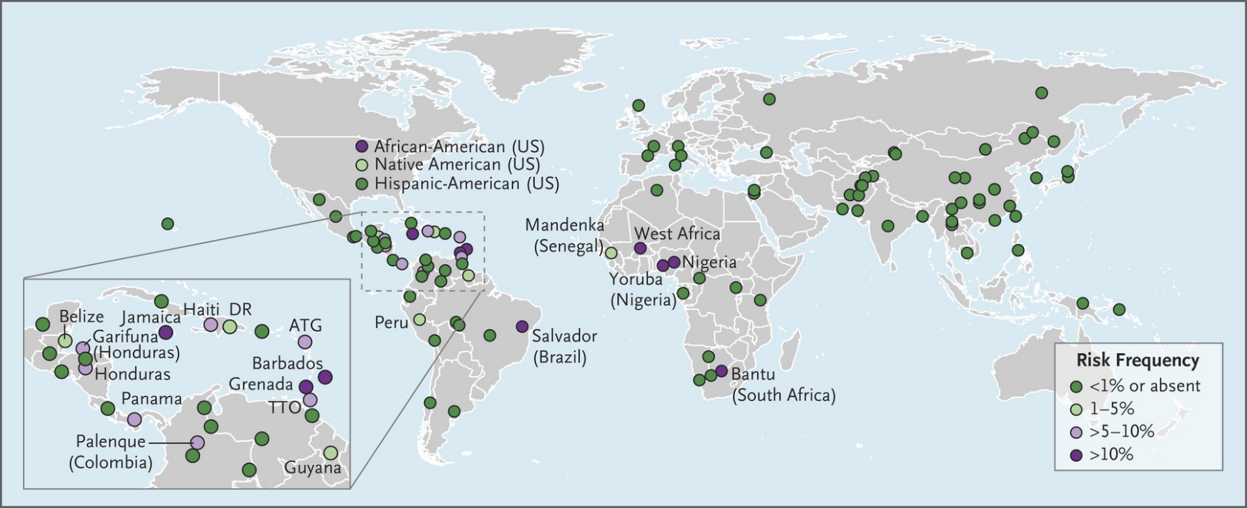
Prospective Data Are Needed to Better Understand the Role of APOL1 Genetic Testing in LKD Evaluations
Retrospective data have shown that the presence of 2 APOL1 gene renal-risk variants contributes to LKDs of African ancestry having a higher risk of developing ESRD compared with demographically matched healthy non-donors¹
Due to a lack of prospective data, the role of APOL1 genotyping in LKD evaluation remains uncertain²
  However, it is generally recommended to inform all LKD candidates of appropriate ancestry about the APOL1 gene and the potential risk of renal disease
  If genetic testing is deemed appropriate, it should only be offered following genetic counseling
Frequencies of APOL1 Renal-Risk Variants³
APOL1, apolipoprotein L1; ATG, Antigua and Barbuda; DR, Dominican Republic; ESRD, end-stage renal disease; LKD, living kidney donor; TTO, Trinidad and Tobago; US, United States.
1. Doshi MD, et al. Transplantation. 2021;105(10):2132-2134. 2. Caliskan Y, et al. Curr Transplant Rep. 2022;9(2):127-142. 3. Nadkarni GN, et al. N Engl J Med. 2018;379(26):2571-2572.
From Nadkarni GN, et al. N Engl J Med. 2018;379(26):2571-2572. A more detailed map is available at http://APOL1.org. opens in new tab
Notes:
Retrospective data have shown that the presence of 2 APOL1 gene renal-risk variants contributes to living kidney donors of African ancestry having a higher risk of developing ESRD compared with demographically matched healthy non-donors¹
The presence of 2 APOL1 renal-risk variants occurs in approximately¹
11% to 32% of African Americans, sub-Saharan Africans, and Western Africans
5% to 22% of Afro-Brazilians, Afro-Caribbeans, or Black Hispanics/Latinx
0% of European Americans
The National Institutes of Health has initiated APOLLO, a prospective, multicenter study to better understand the impact of APOL1 renal-risk variants on donor and recipient outcomes¹
Currently, due to a lack of prospective data, the role of APOL1 genotyping in LKD evaluation remains uncertain^{1,2}
However, it is generally recommended to inform all living kidney donor candidates of appropriate ancestry about the APOL1 gene and the potential risk of renal disease
African American living kidney donor candidates with known independent risk factors for the development of ESRD, such as age <44 years, male sex, obesity, hypertension, and low to normal eGFR, may be considered for testing
If genetic testing is deemed appropriate, it should only be offered following genetic counseling
References:
Doshi MD, Gordon EJ, Freedman BI, et al. Integrating APOL1 kidney-risk variant testing in live kidney donor evaluation: an expert panel opinion. Transplantation. 2021;105(10):2132-2134.
Caliskan Y, Lee B, Whelan A, et al. Evaluation of genetic kidney diseases in living donor kidney transplantation: towards precision genomic medicine in donor risk assessment. Curr Transplant Rep. 2022;9(2):127-142.

Slide 38
Broad Utilization of Genetic Testing in Transplant Evaluation Is Associated With Various Challenges
While genetic testing is becoming a more familiar tool in nephrology practice, there is still limited evidence regarding best practices and clinical application of actionable genetic findings
Considerations for Implementation of Genetic Testing
Maintaining an up-to-date list of nephropathy-associated genes
Establishing best practice guidelines
Obtaining third-party payor coverage for necessary follow-up care associated with detecting medically actionable genetic findings
Addressing physician knowledge gaps
Developing decision support tools for electronic health records
Identifying long-term effects of genetic findings on nephrologic care
Routine use of genetic testing in transplant evaluation is associated with technical, logistical, and ethical challenges that need to be addressed for wider implementation
Caliskan Y, et al. Curr Transplant Rep. 2022;9(2):127-142.
Notes:
While genetic testing is becoming a more familiar tool in nephrology practice, there is still limited evidence regarding best practices and clinical application of actionable genetic findings
Routine use of genetic testing in transplant evaluation is associated with technical, logistical, and ethical challenges that will need to be addressed, and the table on the slide highlights some key points to consider when facilitating wider implementation of genetic testing in transplant practice
Ultimately, it will take a concerted effort within the transplant and nephrology communities to incorporate kidney genomics into mainstream practice across transplant centers
Reference:
Caliskan Y, Lee B, Whelan A, Abualrub F, Lentine KL, Jittirat A. Evaluation of genetic kidney diseases in living donor kidney transplantation: towards precision genomic medicine in donor risk assessment. Curr Transplant Rep. 2022;9(2):127-142.

Slide 39
Opportunities to Bridge Gaps in Living Kidney Donations
Notes:
Now that we have discussed the current state of living kidney donation, let us talk about what gaps exist in patient care and the opportunities that are availlable to bridge these gaps

Slide 40
Racial and Ethnic Disparities Exist With Living
Kidney Donation
Numbers of Black, Hispanic, or Asian LKDs have remained stable over the last 10 years and are substantially lower than their White counterparts^{1,2}
Over the past 2 decades, increased attention and efforts have aimed to reduce racial/ethnic disparities in LDKTs within the United States¹
Compared with receipt of LDKTs among White patients, the incidence of living kidney donation among other races has continued to decrease over time¹
  From 1995 to 1999, the adjusted sub hazard ratio was:
    Black patients: 0.45 (95% CI, 0.42-0.48)
    Hispanic patients: 0.83 (95% CI, 0.77-0.88)
    Asian patients: 0.56 (95% CI, 0.50-0.63)
  From 2010 to 2014, the adjusted sub hazard ratio was:
    Black patients: 0.27 (95% CI, 0.26-0.28)
    Hispanic patients: 0.52 (95% CI, 0.50-0.54)
    Asian patients: 0.42 (95% CI, 0.39-0.45)
These findings suggest that other national evidence-based strategies are needed to more effectively address racial/ethnic disparities¹
CI, confidence interval; LDKT, living donor kidney transplant; LKD, living kidney donor.
1. Purnell TS, et al. JAMA. 2018;319(1):49-61. 2. Lentine KL, et al. Am J Transplant. 2022;22(suppl 2):21-136.
Notes:
Numbers of Black, Hispanic, and Asian living kidney donors have remained stable over the last 10 years and are substantially lower than their White counterparts^{1,2}
Over the past 2 decades, increased attention and efforts have aimed to reduce racial/ethnic disparities in LDKTs within the United States¹
One study found that, compared with receipt of LDKTs among White patients, the incidence of living kidney donation among other races/ethnicities has continued to decrease over time¹
From 1995 to 1999, the adjusted sub hazard ratio was
Black patients: 0.45 (95% CI, 0.42-0.48)
Hispanic patients: 0.83 (95% CI, 0.77-0.88)
Asian patients: 0.56 (95% CI, 0.50-0.63)
From 2010 to 2014, the adjusted sub hazard ratio was
Black patients: 0.27 (95% CI, 0.26-0.28)
Hispanic patients: 0.52 (95% CI, 0.50-0.54)
Asian patients: 0.42 (95% CI, 0.39-0.45)
In the most recent report from the United States Renal Data System, the number of LDKTs increased among minority patients between 2017 and 2019; nevertheless, the number of minority recipients of LDKTs remains substantially lower than the number of White recipients³
These findings suggest that current efforts to reduce racial/ethnic disparities in LDKTs are inadequate and that other national evidence-based strategies are needed to more effectively address these disparities¹
References:
Purnell TS, Luo X, Cooper LA, et al. Association of race and ethnicity with live donor kidney transplantation in the United States from 1995 to 2014. JAMA. 2018;319(1):49-61.
Lentine KL, Smith JM, Hart A, et al. OPTN/SRTR 2020 Annual Data Report: Kidney. Am J Transplant. 2022;22(suppl 2):21-136.
United States Renal Data System. 2021 USRDS Annual Data Report: Epidemiology of Kidney Disease in the United States. Bethesda, MD: National Institutes of Health, National Institute of Diabetes and Digestive and Kidney Diseases; 2021:ESRD vol, chap7.

Slide 41
The Evaluation Process May Also Contribute to the Racial Disparities in Living Kidney Donation
The evaluation of potential LKDs involves a complex, multistep screening process and medical examinations that may be a source of racial disparities in LDKTs¹
  Compared with non-Black donor candidates, Black donor candidates experienced longer delays following referral and during the evaluation process and were less likely to progress through the evaluation process
In a recent policy change, OPTN now requires the use of race-neutral eGFR calculations to more accurately estimate eGFR values and reduce existing disparities²
Cumulative Incidence of Donation: Time From Donor
Candidate Referral to Donation by Race¹
50
Non-Black
Black
Cumulative percentage
of donation
25
0
HR=0.41 (95% CI, 0.27-0.79); P<0.001
0
4
8
12
16
20
24
Months
Used with permission from Kumar K, et al. Clin Transplant. 2018;32(7): e13291. © 2018 John Wiley and Sons.
Standardizing the evaluation process for all LKD candidates across centers may help increase LDKTs overall while also reducing racial disparities^{1,3}
CI, confidence interval; eGFR, estimated glomerular filtration rate; HR, hazard ratio; LDKT, living donor kidney transplant; LKD, living kidney donor; OPTN, Organ Procurement and Transplantation Network.
1. Kumar K, et al. Clin Transplant. 2018;32(7):e13291. doi:10.1111/ctr.13291 2. Organ Procurement and Transplantation Network. Establish OPTN requirement for race-neutral estimated glomerular filtration rate (eGFR) calculations. Accessed July 25, 2022. https://optn.transplant.hrsa.gov/media/xn3nhhjr/policy-notice_establish-optn-req-for-race-neutral-egfr-calcls_mac.pdf
3. Waterman AD, et al. Clin J Am Soc Nephrol. 2013;8(6):995-1002.
Notes:
Now, let’s look at the racial disparities that may occur during the living kidney donor evaluation process
The evaluation of potential LKDs involves a complex, multistep screening process and medical examinations that may be a source of racial disparities in LDKTs¹
In a study evaluating racial disparities in LDKTs, Black donor candidates experienced significantly longer delays following referral and during the evaluation process compared to non-Black donor candidates (hazard ratio [HR]=0.41 [95% CI, 0.27-0.79]; P<0.001)¹
Black donor candidates were less likely to progress through the evaluation process, specifically from medical screening to evaluation and from clearance to donation¹
More Black donor candidates were deemed medically ineligible due to hypertension and obesity
Black donor candidates were younger and more likely to be male, obese, biologically related to the transplant recipient, living near the transplant center, and of lower socioeconomic status compared with non-Black donor candidates
As shown in the figure, the 1- and 2-year cumulative incidence of donation was 14% and 30%, respectively. The 1- and 2-year cumulative incidence of donation among Black donor candidates was 8% and 20%, respectively, in comparison with 17% and 36%, respectively, for non-Black donor candidates
In a recent policy change, OPTN has begun to require the use of race-neutral eGFR calculations to more accurately estimate eGFR values and reduce existing disparities²
Ensuring that centers complete the evaluation process for all living kidney donor candidates and standardizing the evaluation process across centers may also help increase LDKTs overall while also reducing racial disparities^{1,3}
References:
Kumar K, Tonascia JM, Muzaale AD, et al. Racial differences in completion of the living kidney donor evaluation process. Clin Transplant. 2018;32(7):e13291. doi:10.1111/ctr.13291
Organ Procurement and Transplantation Network. Establish OPTN requirement for race-neutral estimated glomerular filtration rate (eGFR) calculations. Accessed July 25, 2022. https://optn.transplant.hrsa.gov/media/xn3nhhjr/policy-notice_establish-optn-req-for-race-neutral-egfr-calcls_mac.pdf
Waterman AD, Peipert JD, Hyland SS, et al. Modifiable patient characteristics and racial disparities in evaluation completion and living donor transplant. Clin J Am Soc Nephrol. 2013;8(6):995-1002.

Slide 42
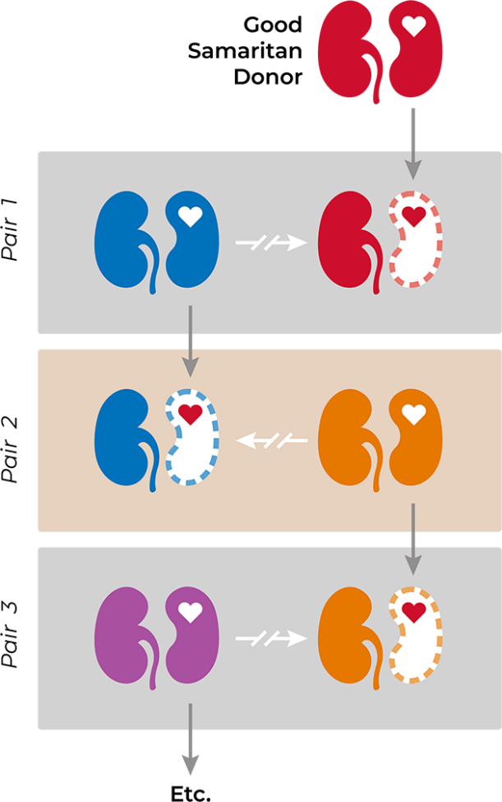
The Kidney Paired Donation Program Allows Kidney Transplant Candidates With Incompatible but Willing Donors to Receive a Living Donor Kidney Transplant
Kidney Paired Donation
Benefits of Kidney Paired Donation¹
Incompatible kidney donor
An opportunity for a transplant candidate to be matched with a suitable donor
The recipient in the original compatible pair may receive a higher quality kidney than they would have received from their original donor
The donor is prioritized in the unlikely event that they need a kidney transplant
KPD programs may provide a number of other benefits and protections for living donors (eg, reimbursement for lost wages)
Centers that participate in KPD do more overall transplants
As of 2021, 1 in every 5 living donor transplants was done via KPD¹
While donor, recipient, and transplant-center motivations may vary, the entry of compatible pairs into exchange programs may create system-wide benefits²
KPD, kidney paired donation.
1. Garg N, et al. Am J Transplant. 2024;24(1):46-56. 2. Chipman V, et al. Am J Transplant. 2022;22(1):266-273.
Notes:
Kidney Paired Donation (KPD) is being increasingly used by compatible donor-recipient pairs to obtain more suitable kidneys for the respective recipients¹
Many incompatible donor-recipient pairs enter kidney paired exchange programs to overcome incompatibilities due to blood type, human leukocyte antigens (HLA) mismatch, donor-specific antibodies, time, or other factors²
Benefits of KPD include¹
An opportunity for a transplant candidate to be matched with a suitable donor
The recipient in the original compatible pair may receive a higher quality kidney than they would have received from their original donor
LKD donor prioritization in the unlikely event that they are in need of a kidney transplant
KPD programs providing many other benefits and protections for living donors (eg, reimbursement for lost wages), which may incentivize donors to participate in KPD instead of donating to a recipient at the same center
Centers participating in Kidney Paired Donation doing more overall transplants
As of 2021, 1 in every 5 living donor transplants was done via KPD¹
While donor, recipient, and transplant center motivations may vary, the entry of compatible pairs into exchange programs may create system-wide benefits²
References:
Garg N, Thiessen C, Reese PP, et al. Temporal trends in kidney paired donation in the United States: 2006-2021 UNOS/OPTN database analysis. Am J Transplant. 2024;24(1):46-56.
Chipman V, Cooper M, Thomas AG, et al. Motivations and outcomes of compatible living donor–recipient pairs in paired exchange. Am J Transplant. 2022;22(1):266-273.

Slide 43
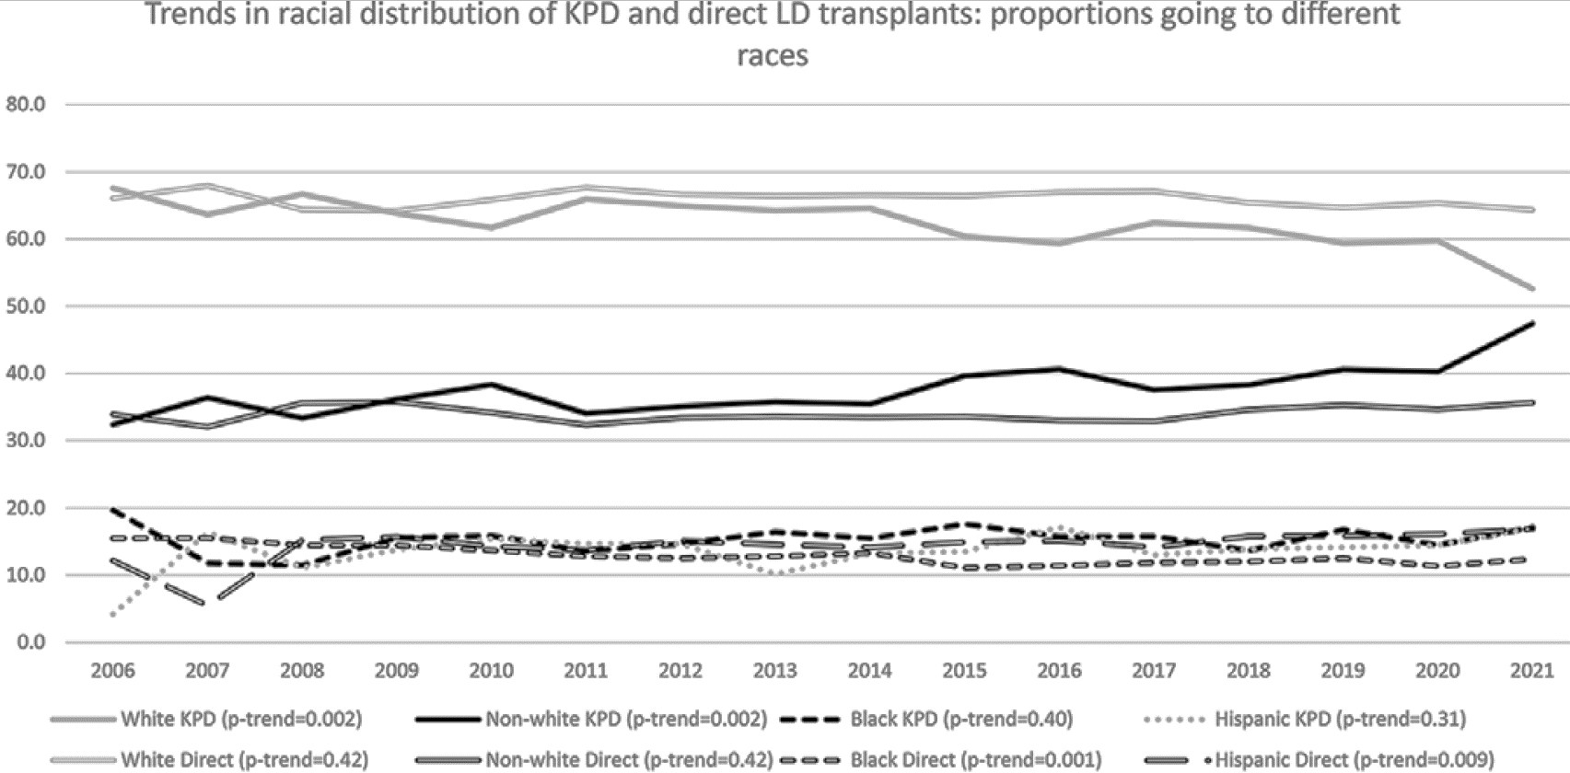
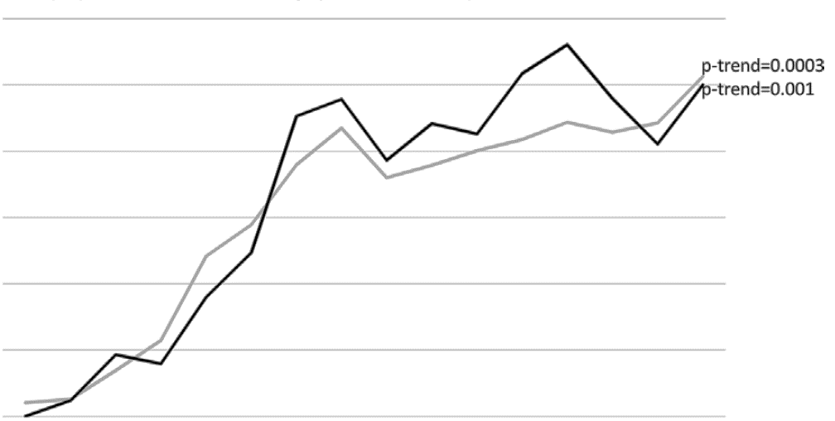



An Increasing Proportion of KPD Transplants Are Going to Non-White, Sensitized and Highly Sensitized Recipients
Trends in KPD in the United States using national registry data from 2006 to April 8, 2022…
Minority populations were not further disadvantaged in KPD compared to their White counterparts
At least 50% of the LDKTs in sensitized and highly sensitized recipients in 2021 were via KPD
Proportion of KPD Transplants Going to Different Races
Proportion of Sensitized and Highly Sensitized LD Recipients That Are via KPD
80
60
70
p-trend=0.0003
60
50
p-trend=0.001
50
40
Percent
40
30
30
Percent
20
20
10
0
10
2006
2007
2008
2009
2010
2011
2012
2013
2014
2015
2016
2017
2018
2019
2020
2021
White KPD (p-trend=0.002)
Non-White KPD (p-trend=0.002)
Black KPD (p-trend=0.40)
Hispanic KPD (p-trend=0.31)
0
2006
2007
2008
2009
2010
2011
2012
2013
2014
2015
2016
2017
2018
2019
2020
2021
White Direct (p-trend=0.42)
Non-White Direct (p-trend=0.42)
Black Direct (p-trend=0.001)
Hispanic Direct (p-trend=0.009)
% of LD Sensitized
% of LD Highly Sensitized
KPD maximizes utilization of potential donors and helps to overcome barriers for minority and sensitized kidney transplant recipients
KPD, kidney paired donation; LD, living donor; LDKT, living donor kidney transplants.
Garg N, et al. Am J Transplant. 2024;24(1):46-56.
Notes:
LDKT is less likely to occur in minority populations compared to their White counterparts, and this disparity has worsened over time. However, a recent study showed that minority populations were not further disadvantaged in KPD compared to their White counterparts
The study was based on registry data from the OPTN/UNOS database (as of April 8, 2022) used to investigate trends in KPD use in the United States from 2006 to April 8th, 2022
The study also showed that at least 50% of the LDKTs in sensitized and highly sensitized recipients in 2021 were via KPD
KPD maximizes utilization of potential donors and helps to overcome barriers for minority and sensitized kidney transplant recipients
Reference:
Garg N, Thiessen C, Reese PP, et al. Temporal trends in kidney paired donation in the United States: 2006-2021 UNOS/OPTN database analysis. Am J Transplant. 2024;24(1):46-56.

Slide 44
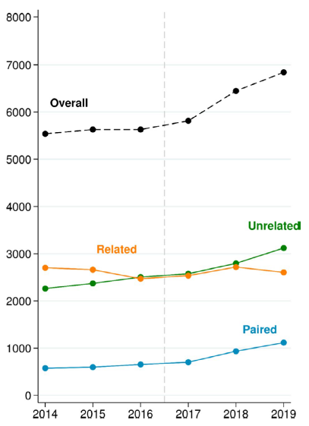
While Donation by Biologically Related Individuals Has Decreased Over Time, Kidney Paired Donation Has Increased
Annual Number of LKDs in the United States
From 2014 to 2019
Between 2005 and 2017, there was a decline in the annual number of LKDs in the United States, driven by the decline in biologically related donors¹
Between 2017 to 2019, there has been a sustained increase in the overall number of donors, driven predominantly by the increase in KPD and
unrelated donors¹
From 2014 to 2019¹
  Related donors declined by 4%
  Unrelated donors increased by 38%
  Paired donors increased by 94%
Number of donors
Figures used with permission from Al Ammary F, et al. Am J Transplant. 2019;19(9):2614-2621. © 2019 John Wiley and Sons.
The entry of compatible pairs into exchange programs can help create system-wide benefits²
KPD, kidney paired donor; LKD, living kidney donor.
1. Al Ammary F, et al. Am J Transplant. 2020;20(12):3590-3598. 2. Chipman V, et al. Am J Transplant. 2022;22(1):266-273.
Notes:
While donation by biologically related individuals has decreased over time, kidney paired donation has increased¹
Between 2005 and 2017, there was a decline in the annual number of live kidney donors in the United States, driven by the decline in biologically related donors, who have historically been the majority of this population¹
Recently, a national study of living kidney donors (N=35,900) from 2014 to 2019 showed a sustained increase in the overall number of donors driven predominantly by the increase in unrelated and paired donors¹
This study used data from the SRTR external release made available in April 2020. The SRTR data system includes data on all donors, wait-listed candidates, and transplant recipients in the United States, submitted by the members of the OPTN
The study showed that from 2014 to 2019¹
Related donors declined by 4%
Unrelated donors increased by 38%
Paired donors increased by 94%
These data shed light on how the entry of compatible pairs into exchange programs can help create system-wide benefits²
References:
Al Ammary F, Yu Y, Ferzola A, et al. The first increase in live kidney donation in the United States in 15 years. Am J Transplant. 2020;20(12):3590-3598.
Chipman V, et al. Am J Transplant. 2022;22(1):266-273.

Slide 45
Summary
Many donors feel a deep sense of fulfillment, with little to no regret about donating, and would make the same decision to donate again¹⁻³
A balanced risk-benefit evaluation may help transplant centers in assessing LKDs⁴
Educating donors about the risk of ESRD and providing accurate risk estimates may help inform decisions during donor evaluation^{5,6}
Postdonation follow-up of living kidney donors is critical to ensure early detection of any health concerns and subsequent clinical management⁷
Electronic messaging tools may facilitate follow-up and help improve communication between living kidney donors and transplant centers⁸
Incorporating genetic testing in the living kidney donor evaluation process may help assess the risk of kidney diseases, including CKD and ESRD, postdonation; however, additional challenges will need to be addressed to facilitate the implementation of genetic testing in transplant practice⁹
Racial disparities in the evaluation process might account for the substantially lower numbers of Black, Hispanic, or Asian living kidney donors vs White living kidney donors^{10,11}
Kidney paired donation maximizes utilization of potential donors and helps overcome barriers for sensitized kidney transplant recipients¹²
CKD, chronic kidney disease; ESRD, end-stage renal disease; LKD, living kidney donor.
1. Dew MA. Accessed August 30, 2024. https://www.livingdonortoolkit.com/sites/default/files/pdf/Chapter%2013%20%20Psychosocial%20Risks%20of%20kidney%20donation_0.pdf 2. Cazauvieilh, V, et al. Transpl Int. 2023;36:11827. doi:10.3389/ti.2023.11827 3. Wadstöm J, et al. Ann Transplant. 2019;24:234-241. 4. Van Pilsum Rasmussen SE, et al. Am J Transplant. 2017;17(10):2567-2571. 5. Muzaale AD, et al. JAMA. 2014;311(6):579-586. 6. Massie AB, et al. J Am Soc Nephrol. 2017;28(9):2749-2755. 7. Alejo JL, et al. Clin Transplant. 2017;31(7). doi:10.1111/ctr.12992 8. Eno AK, et al. JMIR Mhealth Uhealth. 2018;6(10):e11192. doi:10.2196/11192 9. Caliskan Y, et al. Curr Transplant Rep. 2022;9(2):127-142. 10. Purnell TS, et al. JAMA. 2018;319(1):49-61. 11. Kumar K, et al. Clin Transplant. 2018;32(7):e13291. doi:10.1111/ctr.13291 12. Garg N, et al. Am J Transplant. 2024;24(1):46-56.
Notes:
In summary, many donors feel a deep sense of fulfillment, with little to no regret about donating, and would make the same decision to donate again¹⁻³
A balanced risk-benefit evaluation may help transplant centers in assessing living kidney donors⁴
Educating donors about the risk of ESRD and providing accurate risk estimates may help inform decisions during donor evaluation^{5.6}
Postdonation follow-up of living kidney donors is critical to ensure early detection of any health concerns and subsequent clinical management⁷
Electronic messaging tools may facilitate follow-up and help improve communication between living kidney donors and transplant centers⁸
Incorporating genetic testing in the living kidney donor evaluation process may help assess the risk of kidney diseases, including CKD and ESRD, postdonation; however, additional challenges will need to be addressed to facilitate the implementation of genetic testing in transplant practice⁹
Racial disparities in the evaluation process might account for the substantially lower numbers of Black, Hispanic, or Asian living kidney donors vs White living kidney donors^{10,11}
Kidney paired donation maximizes utilization of potential donors and overcomes barriers for sensitized kidney transplant recipients¹²
References:
Dew MA. Psychosocial risks of living kidney donation. AST Live Donor. Accessed August 20, 2024. https://www.livingdonortoolkit.com/sites/default/files/pdf/Chapter%2013%20%20Psychosocial%20Risks%20of%20kidney%20donation_0.pdf
Cazauvieilh, V, et al. Psychological impact of living kidney donation: A systematic review by the EAU-YAU Kidney Transplant Working Group. Transpl Int. 2023;36:11827. doi:10.3389/ti.2023.11827
Wadstöm J, et al. Living anonymous renal donors do not regret: Intermediate and long-term follow-up with a focus on motives and psychosocial outcomes. Ann Transplant. 2019;24:234-241
Van Pilsum Rasmussen SE, Henderson ML, Kahn J, et al. Considering tangible benefit for interdependent donors: extending a risk–benefit framework in donor selection. Am J Transplant. 2017;17(10):2567-2571.
Muzaale AD, Massie AB, Wang MC, et al. Risk of end-stage renal disease following live kidney donation. JAMA. 2014;311(6):579-586.
Massie AB, Muzaale AD, Luo X, et al. Quantifying post-donation risk of ESRD in living kidney donors. J Am Soc Nephrol. 2017;28(9):2749-2755.
Alejo JL, Luo X, Massie AB, et al. Patterns of primary care utilization before and after living kidney donation. Clin Transplant. 2017;31(7). doi:10.1111/ctr.12992
Eno AK, Thomas AG, Ruck JM, et al. Assessing the attitudes and perceptions regarding the use of mobile health technologies for living kidney donor follow-up: survey study. JMIR Mhealth Uhealth. 2018;6(10):e11192. doi:10.2196/11192
Caliskan Y, Lee B, Whelan A, et al. Evaluation of genetic kidney diseases in living donor kidney transplantation: towards precision genomic medicine in donor risk assessment. Curr Transplant Rep. 2022;9(2):127-142.
Purnell TS, Luo X, Cooper LA, et al. Association of race and ethnicity with live donor kidney transplantation in the United States from 1995 to 2014. JAMA. 2018;319(1):49-61.
Kumar K, Tonascia JM, Muzaale AD, et al. Racial differences in completion of the living kidney donor evaluation process. Clin Transplant. 2018;32(7):e13291. doi:10.1111/ctr.13291
Garg N, Thiessen C, Reese PP, et al. Temporal trends in kidney paired donation in the United States: 2006-2021 UNOS/OPTN database analysis. Am J Transplant. 2024;24(1):46-56.

Slide 46
Moving Forward: The Impact of Living Kidney Donation
What role do you and your center play in increasing LDKTs at your center?
What are some ways you and your center can support living donations and living kidney donors?
How do you educate living kidney donors about the risk of ESRD?
How does your center support living kidney donors who need financial assistance?
What role does your center play in postdonation follow-up of living kidney donors?
Does your center use genetic testing for living kidney donors? If so, how is genetic testing used at your center?
What does your center do to overcome the racial and ethnic disparities related to living kidney donation?
If your center participates in a KPD, has it enabled you to do more transplants? If not, what barriers prevent your center from participating in a KPD?
ESRD, end-stage renal disease; KPD, kidney paired donor; LDKT, living donor kidney transplant.

Slide 47
© 2025 Sanofi. All Rights Reserved.
MAT-US-2016153-v4.0-01/2025

