Slide 1

GLOBAL PEACE INITIATIVE
MAHARISHI VEDIC PANDITS FOR WORLD PEACE
GLOBAL PEACE INITIATIVE
Notes:
Just read the slide.

Slide 2
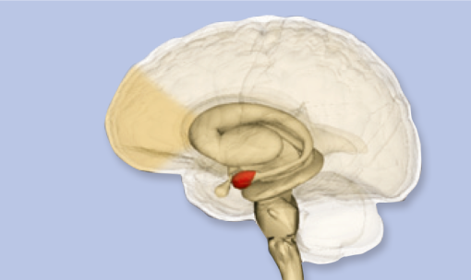
超越瞑想テクニック
ストレスを減らし
脳機能を改善する
前頭皮質
脳の構造
扁桃体
GLOBAL PEACE INITIATIVE

Slide 3
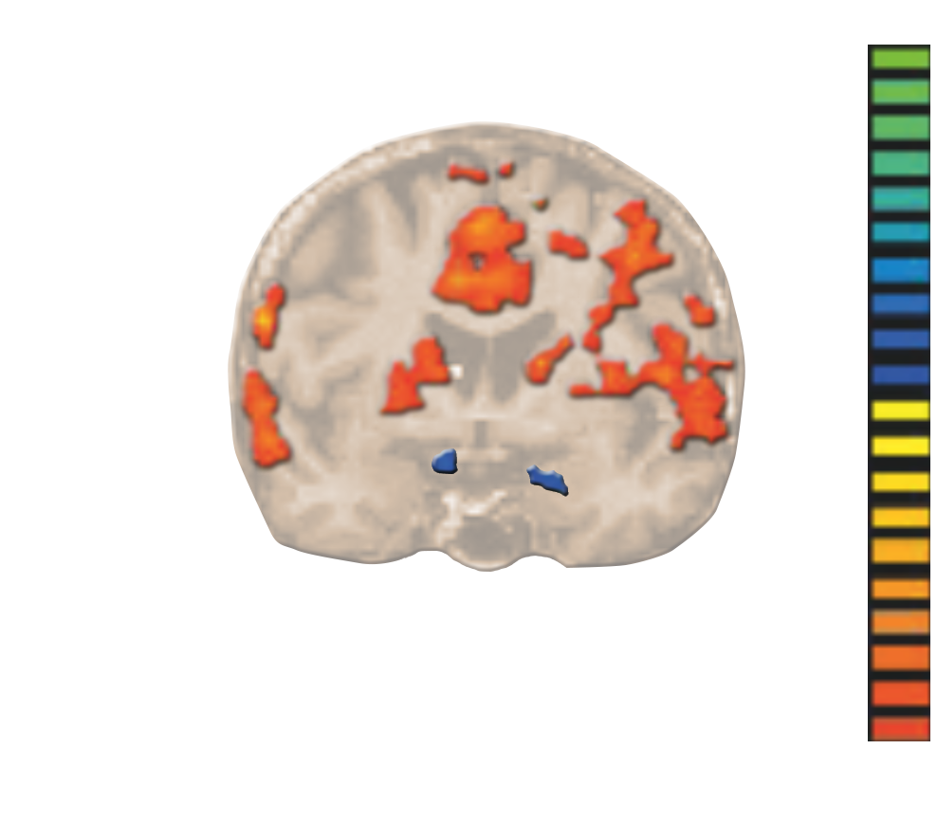
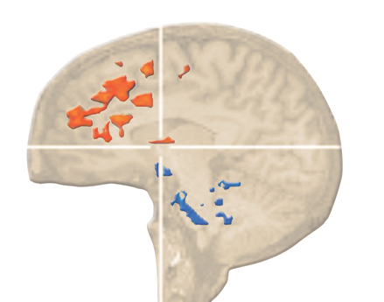
脳機能の改善
扁桃体活動の減少
前頭皮質の活動の増大
超越瞑想の実践は、扁桃体と周囲の皮質下の構造（青色の部分）の活動を非活性化し、前頭皮質（オレンジ色の部分）の活動を刺激します。
GLOBAL PEACE INITIATIVE

Slide 4
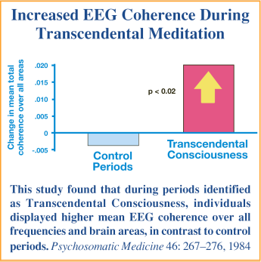
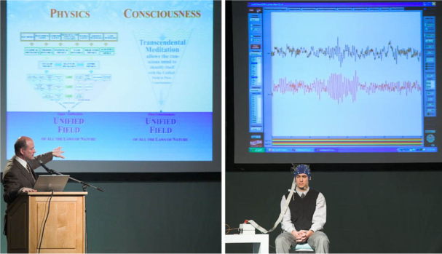

超越瞑想中の脳波の同調
超越瞑想による
超越意識の体験中の脳波の同調の増大
すべての自然法則の統一場と
意識の統一場
Increased EEG coherence during Transcendental Meditation
全域にわたる同調の平均値の変化
対照期間
超越意識
This study found that during periods identified
as Transcendental Consciousness, individuals displayed higher mean EEG coherence over all frequencies and brain areas, in contrast to control periods. Psychosomatic Medicine 46: 267–276,1984
GLOBAL PEACE INITIATIVE

Slide 5
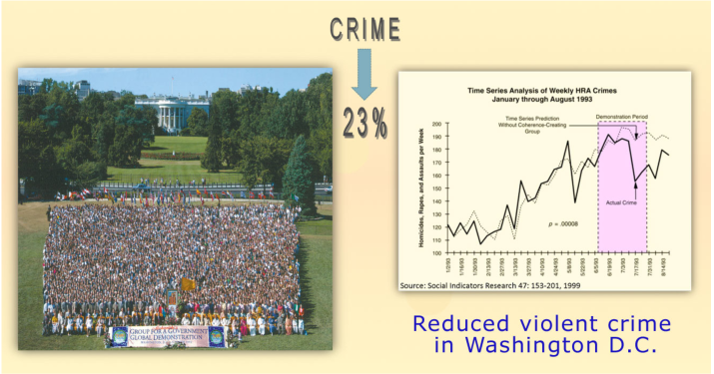
グループ瞑想は社会のストレスを減らします。
犯罪の減少
Crime
23%
ワシントンD.C.での暴力犯罪の減少
GLOBAL PEACE INITIATIVE

Slide 6
  科学的研究によって、人口の１％が超越瞑想を実践すると犯罪率の低下、事故や入院患者数の減少が起こり、 社会に肯定的傾向がみられることが明らかになりました。
GLOBAL PEACE INITIATIVE

Slide 7
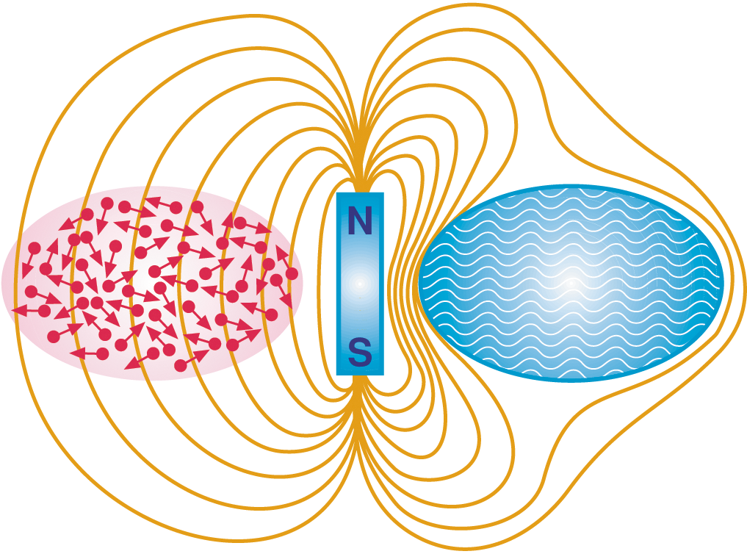
マイスナー効果
量子物理学の超伝導作用にみられる実例
通常の
伝導体
超伝導体
GLOBAL PEACE INITIATIVE

Slide 8

地球的なマハリシ効果
拡大マハリシ効果
数千人の平和創造のエキスパート達が、
世界の社会的ストレスを効果的に減少させることができます。
GLOBAL PEACE INITIATIVE

Slide 9
SCIENCE
Dr Hagelin
WHAT IS MAHARISHI YAGYA?
The full length plus short version of the Hagelin video 'What is Maharishi Yagya’
are hosted on Vimeo on private settings. You can watch both on the English material site.
Here is the link with an anchor:
https://material.vedicpandits.org/english-material/#PPT_Videos

Slide 10

世界平和の公式
“ヨーガ
（統一された意識）
の周囲では、敵対的傾向は消滅する”
マハリシ・パタンジャリ
GLOBAL PEACE INITIATIVE

Slide 11
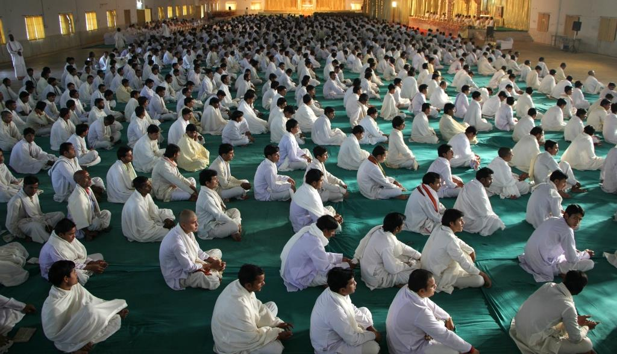
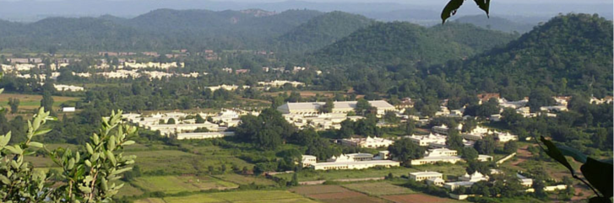
Maharishi Vedic Pandits
– a peace creating group in the centre point of India
GLOBAL PEACE INITIATIVE

Slide 12
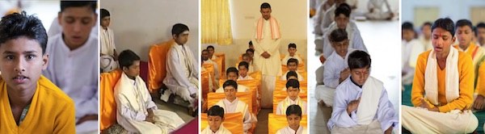
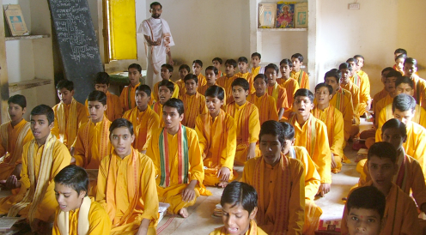
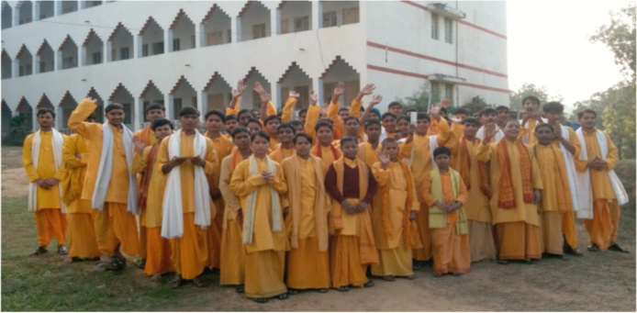
ヴェーダのパンディットの伝統を復活
特別に組まれた訓練プログラムによって
________________________________________________________________
10～15歳のブラーミンに属する子供たちが、地域の学校で学んでいます。
地域の訓練センターでは、毎日の日課に従って訓練されます。
GLOBAL PEACE INITIATIVE

Slide 13
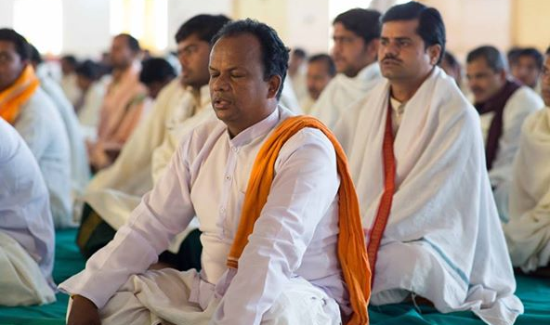
彼らは、何をしているのでしょうか?
ヨーガ
意識のテクノロジー ： 超越瞑想とヨーガのフライングを含むTMシディプログラム
ヤギャ
伝統的なヴェーダの詩句をグループで吟唱するç
ユネスコの世界無形遺産に選定されている、生命を支援する古代ヴェーダのテクノロジーを保護し実践する。
GLOBAL PEACE INITIATIVE

Slide 14
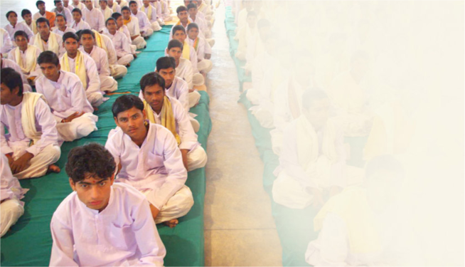
1987～1990年にマハリシは、ニューデリー近郊に7,000人のヴェーディック・パンディットを集め訓練しました。
・1989年 ベルリンの壁崩壊
・冷戦の終結 ロナルド・レーガンの言葉
「別の時、別の時代」1988年5月31日
(モスクワ訪問時)
・南アフリカでのアパルトヘイト撤廃
・世界規模の紛争停止
・何万人もの自由
・1988年8月 イラン・イラク戦争（8年間）終結
・1988年12月23日 インド首相の中国訪問
・1989年 ソ連によるアフガニスタン戦争
（9年間）終結
GLOBAL PEACE INITIATIVE

Slide 15
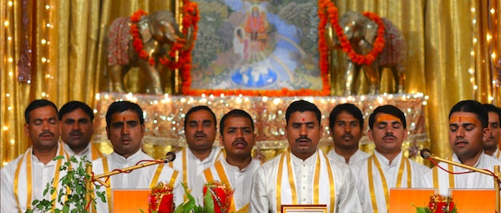
11-day
National Yagyas
for countries
1-day
Special Yagyas
for individuals
Increase good fortune
and help prevent problems
for an entire nation
Bring the blessings of Nature
to yourself, your family,
and the world
GLOBAL PEACE INITIATIVE

Slide 16
RECITATION
Maharishi Vedic Pandits
https://vedicpandits.org/ganesh-recitation/
OR
https://vedicpandits.org/recitation-clips-for-newsletters/#ganesh

Slide 17
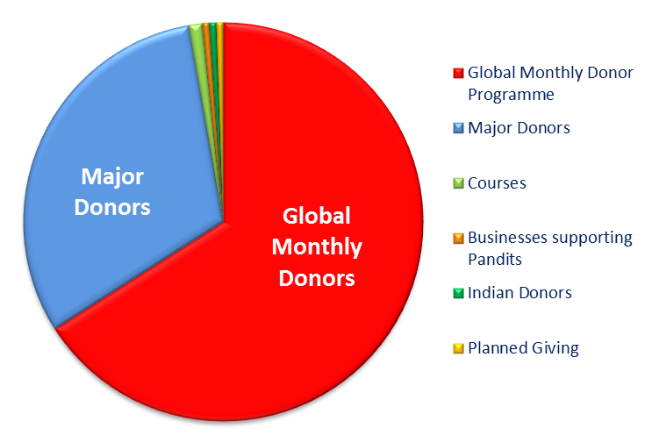


毎月の寄付による目標の達成
Global Monthly Donors
毎月の世界的
寄付プログラム
Major Donors
大口寄付
大口寄付
Courses
各種コースース
毎月の世界的
寄付プログラム
Businesses supporting Pandits
パンディットを支援する
ためのビジネス
Indian donors
インド国内からの寄付
Planned giving
GLOBAL PEACE INITIATIVE

Slide 18
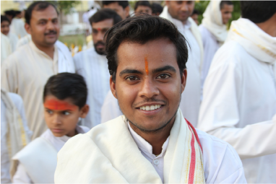
毎月の世界的寄付プログラム
団体名
■ブラーマナンダ・サラスワティ基金/BST (オランダ)
■ブラーマナンダ・サラスワティ財団/BSF (米国)
両方とも非営利団体で
寄付金は税金の控除対象になります。
毎月の世界的寄付プログラム
世界平和を目的とした、ガヴァナー・シダー・瞑想者の皆様へ
世界同時キャンペーンへのお誘い
皆様が無理のない範囲で、定期的にご参加いただければ幸いです。
GLOBAL PEACE INITIATIVE

Slide 19
私たちは何を創造しているのか？
意識の根源レベルからの永遠の世界平和
ユネスコの世界無形遺産に選定されている、生命を支援する古代ヴェーダのテクノロジーを保護し実践する。
ヴェーディック・パンディットを養成し、彼らの安定した生活を維持する。
インドの何千という家族の文化的統合を回復する。
80以上の参加国が相互に有益となる調和により、地球的な統合を創り出す。
GLOBAL PEACE INITIATIVE

Slide 20
HOW TO FIND OUT MORE?
WEBSITES
Vedicpandits.org
Vedicpandits.org/special-yagya
Maharishiindiacourses.com
Materials.vedicpandits.org
Maharishivedaapp.com
Contact: Vedicpandits.org/contact
Email: aro@maharishi.net
GLOBAL PEACE INITIATIVE

Slide 21
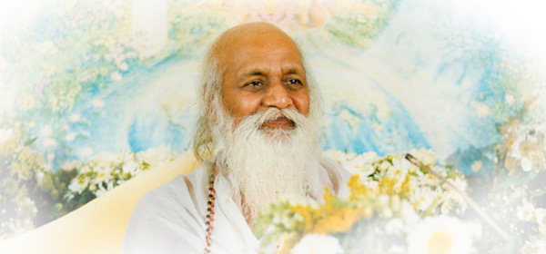
Jai Guru Dev
‘Yogic Flying and Yagyas are the only thing that will effectively uphold world consciousness on an eternal level of invincibility. I want to engage from now on as large numbers of Vedic Pandits as possible but I have to be careful that once I engage them, the funds will be there to continue to support them. The only wise thing to do now, is to establish homes of Vedic knowledge because the Vedic vibrations of the performances of the Vedic Pandits have been established to motivate life according to Natural Law for the whole world and to usher in a new golden destiny of the human race.’ – Maharishi
GLOBAL PEACE INITIATIVE

Slide 22
THE END
(A few optional advanced slides follow)

Slide 23
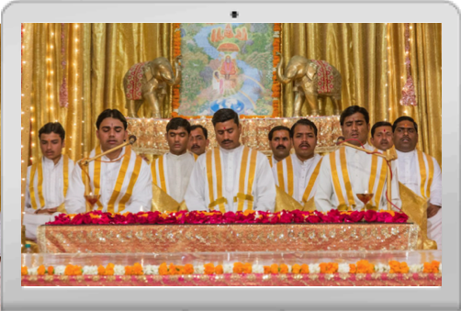
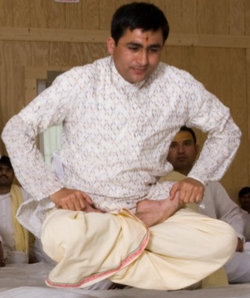
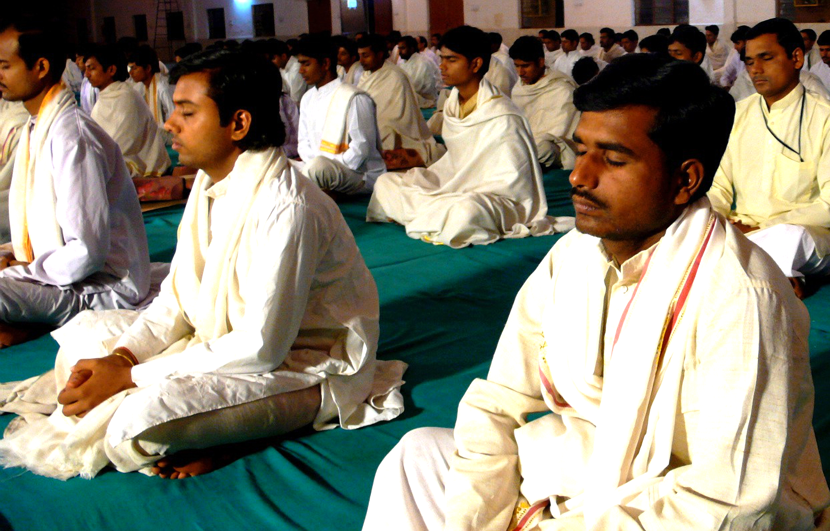
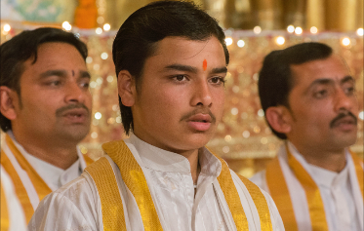
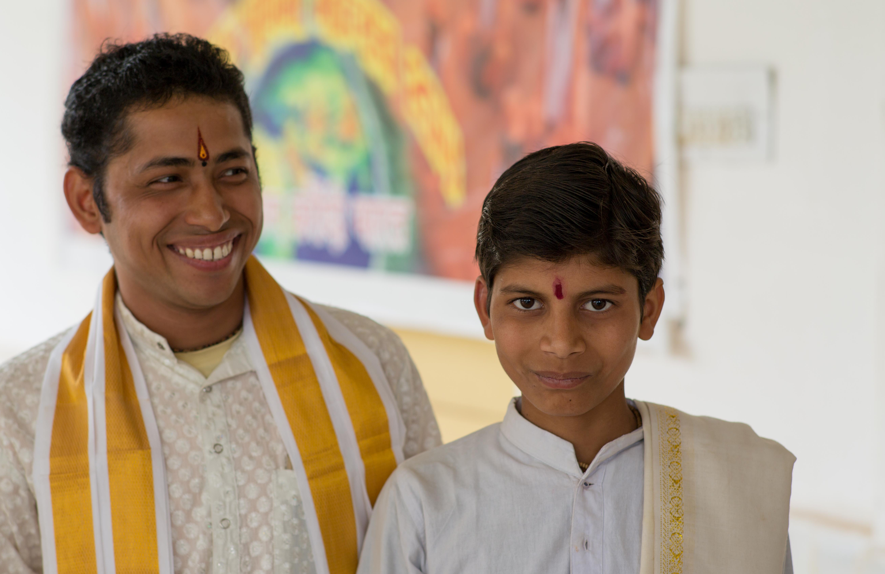
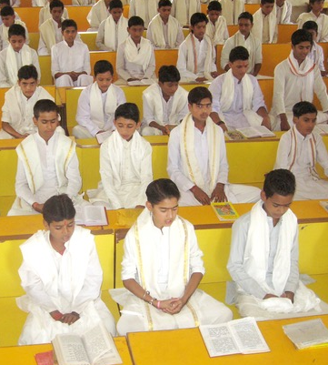
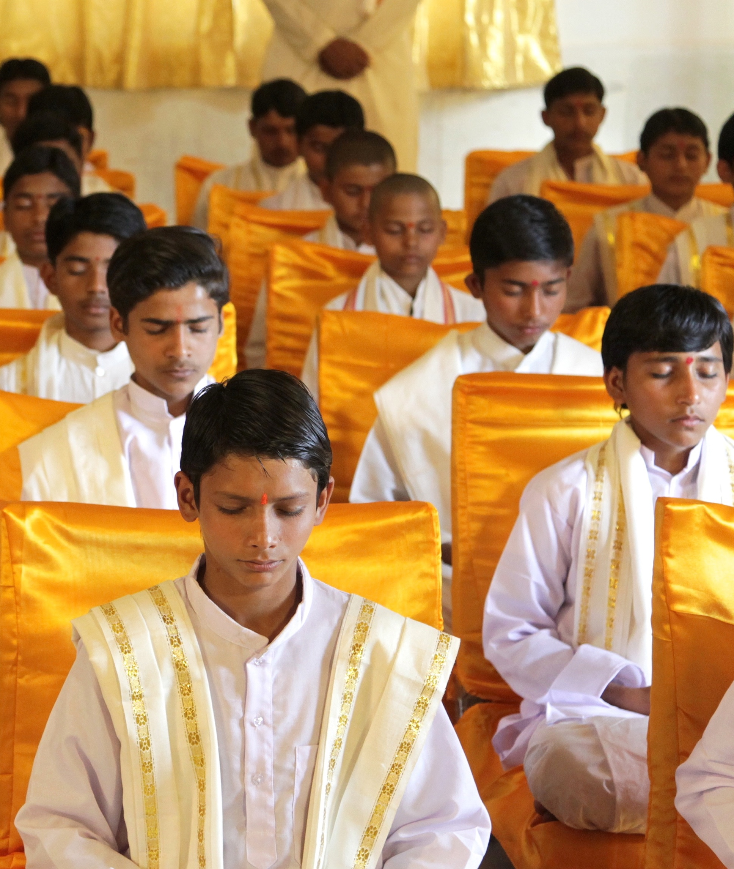
What is the only reason we have Maharishi Vedic Pandits…?
Here… there… and… everywhere… ?
Vedic events on channel
Brahmasthan & other campuses
Yoga/transcending in groups
National, Special, Other Yagyas
Generation to generation
Vedic Pandits in training
…is due to the support of regular monthly donors… 5,500 dear people from all over the world!
GLOBAL PEACE INITIATIVE
Notes:
Fortunately, we are pursuing many approaches to achieve this goal, including major donor support, associated course fees, donations from businesses, and planned giving. But by far the greatest support comes from thousands of individuals participating in the Global Monthly Donor Programme.
This monthly programme allows donors to give at whatever level is comfortable for them. It spreads the funding over many individuals so that we can all together support world peace without any stress or strain, ensuring that no-one person feels it is a burden.
Groups and individuals can also participate by supporting the Maharishi Vedic Pandits through National Yagyas for their countries and Special Yagyas for important events, such as birthdays and weddings. These valuable donations support the Pandits and ensure we move closer to our goal every day.

Slide 24
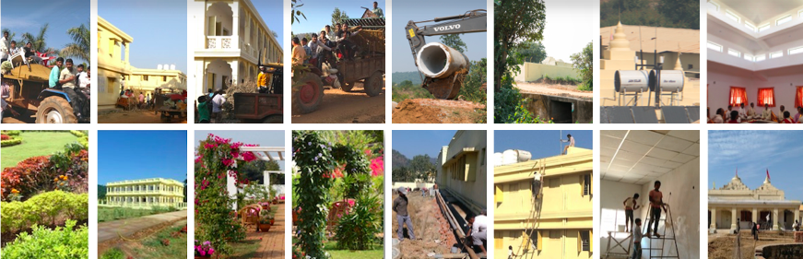
Why do the Maharishi Vedic Pandits have the following amenities…?
Here… there… and… everywhere… ?
• Vastu housing and basic needs
• Yagya halls and Mandaps
• Maintenance of infrastructure
• Gardens, recreation, education
• Kitchens and ideal meals
• Flying rooms and all facilities
…is due to the support of regular monthly donors… 5,500 dear people from all over the world!
GLOBAL PEACE INITIATIVE
Notes:
Fortunately, we are pursuing many approaches to achieve this goal, including major donor support, associated course fees, donations from businesses, and planned giving. But by far the greatest support comes from thousands of individuals participating in the Global Monthly Donor Programme.
This monthly programme allows donors to give at whatever level is comfortable for them. It spreads the funding over many individuals so that we can all together support world peace without any stress or strain, ensuring that no-one person feels it is a burden.
Groups and individuals can also participate by supporting the Maharishi Vedic Pandits through National Yagyas for their countries and Special Yagyas for important events, such as birthdays and weddings. These valuable donations support the Pandits and ensure we move closer to our goal every day.

Slide 25
A remarkably successful approach
The greatest support comes from thousands of individuals worldwide participating in the Global Monthly Donor Programme.
Donors give a modest comfortable absolutely regularly – any amount they would not miss!
Groups and individuals can also participate by supporting the Maharishi Vedic Pandits through National Yagyas for their countries and Special Yagyas for important events, such as birthdays and weddings. These valuable donations support the Pandits and ensure we move closer to our immediate goal of 9000 Maharishi Vedic Pandits.
GLOBAL PEACE INITIATIVE
Notes:
Fortunately, we are pursuing many approaches to achieve this goal, including major donor support, associated course fees, donations from businesses, and planned giving. But by far the greatest support comes from thousands of individuals participating in the Global Monthly Donor Programme.
This monthly programme allows donors to give at whatever level is comfortable for them. It spreads the funding over many individuals so that we can all together support world peace without any stress or strain, ensuring that no-one person feels it is a burden.
Groups and individuals can also participate by supporting the Maharishi Vedic Pandits through National Yagyas for their countries and Special Yagyas for important events, such as birthdays and weddings. These valuable donations support the Pandits and ensure we move closer to our goal every day.

Slide 26
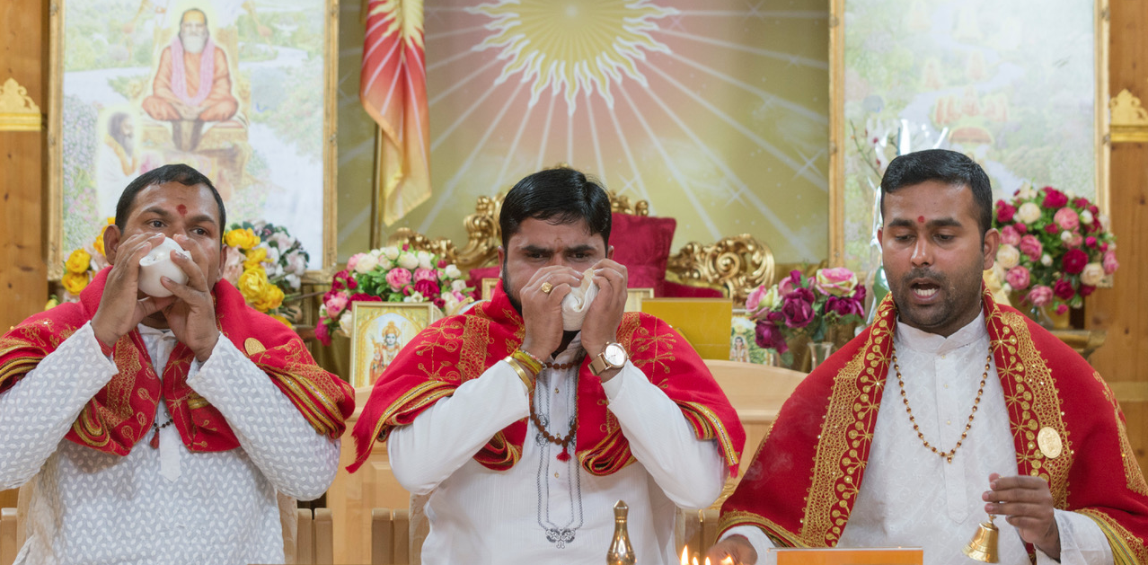
(Optional slide – needs translation)
Maharishi Vedic Pandits
– represented at MERU, Holland
for international events
Ambassador Receptions – Invincible Europe Day – usually first Saturday of the month
in MERU Holland – attend in person or connect online – live recitation and knowledge
Apply at merucourses.com
GLOBAL PEACE INITIATIVE

Slide 27
(NY & SY)
Spare blank slide with corporate ID
GLOBAL PEACE INITIATIVE

