Slide 1

Town of Oregon
2024 Proposed Budget & Approval of 2023 Tax Levy
Public Hearing & Special Meeting OF ELECTORS
November 16, 2023, at 6:00PM

Slide 2
Tonight’s Agenda:
Open Public Hearing – Town Chair
Presentation of 2024 Budget – Town Clerk
Public Comment and Questions – Town Residents
Close Public Hearing – Town Chair
Open Special Meeting of Electors – Town Chair
Approve 2023 total town tax levy (to be collected in 2024), pursuant to Wis. Stat. § 60.10(1)(b)1 – Town Residents
Motion to Adjourn – Town Residents

Slide 3
Introductions
Town Board:
Carl Walser, Chair
Arlan Kay, Supervisor
Laurie Fitzgerald, Supervisor
Kate Gladding, Supervisor
Steve Jernegan, Supervisor
Staff:
Jennifer Hanson, Town Clerk
Stephanie Goth, Treasurer/Deputy Clerk

Slide 4
Public Hearing
Open Public HEARING
PRESENTATION OF 2024 BUDGET
PUBLIC COMMENT
  Opportunity for any person to make comments or ask questions on the proposed budget.
CLOSE PUBLIC HEARING

Slide 5
Overview
General Notes Related to the 2024 Budget.
The 2024 budget does not significantly differ from the 2023 budget with exception of no major road project.
Final 2024 road work projects pending due to a developing concern related to a culvert on Marie Road and outgoing evaluation and prioritization of other road projects.
Shared Revenue increased by $82,530 which helped cover increases in Fire and EMS costs and provide funds $140,000 for major roadwork expense items.
Work on long-term planning of roads, equipment and capital improvement needs for capital budget/fund will continue into 2024.
Updates to the Comprehensive Plan were completed in 2023; and updates to the Park and Open Space Plan will continue in 2024.
In 2024, the town plans to further adopt and refine best practices with respect to communication with residents, increased town resident involvement, and a strategic plan/vision statement based on resident surveys.
The town hall administrative office remodeling funded by Federal American Rescue Plan Act monies will improve safety and security in the office, optimize workspace efficiency and ergonomic design and maximize storage.
The town will continue oversight of Town of Oregon Refuse Center (TORC) and evaluate services offered, hours of operation, and improvements to infrastructure.
In 2024, the town will continue manage its debt, plan for future borrowing needs, and explore all funding resources.

Slide 6

Budget at a glance
Overall Budget of Total Revenues and Expenditures
2024 proposed budget | $2,178,069
2023 budgeted | $2,050,099
Percentage Change | 6.24%
Non-Tax Revenue
2024 proposed budget | $998,776
2023 budget | $788,071
Percentage Change | 26.73%

Slide 7
Budget at a glance
YEAR | Total Assessed Value of Town* | Total Town Tax Levy | Town Tax Rate per $1,000
2024 Proposed Budget | $492,515,000 *Assessment Ratio .752039517 | $1,179,293 | $2.39
2023 Budget | $488,296,200 *Assessment Ratio .834821385 | $1,132,849 | $2.32
Number Change | $4,218,800 | $46,444 | $0.07
Percentage Change | .86% * Calculated by Dept of Revenue | 4.10% | 3.02%

Slide 8
Budget at a glance
Homeowner Cost ($200,000 property) – General Property Taxes
2023 payable 2024 | $478.00
2022 payable 2023 | $464.00
Percentage Change | 3.02%

Slide 9

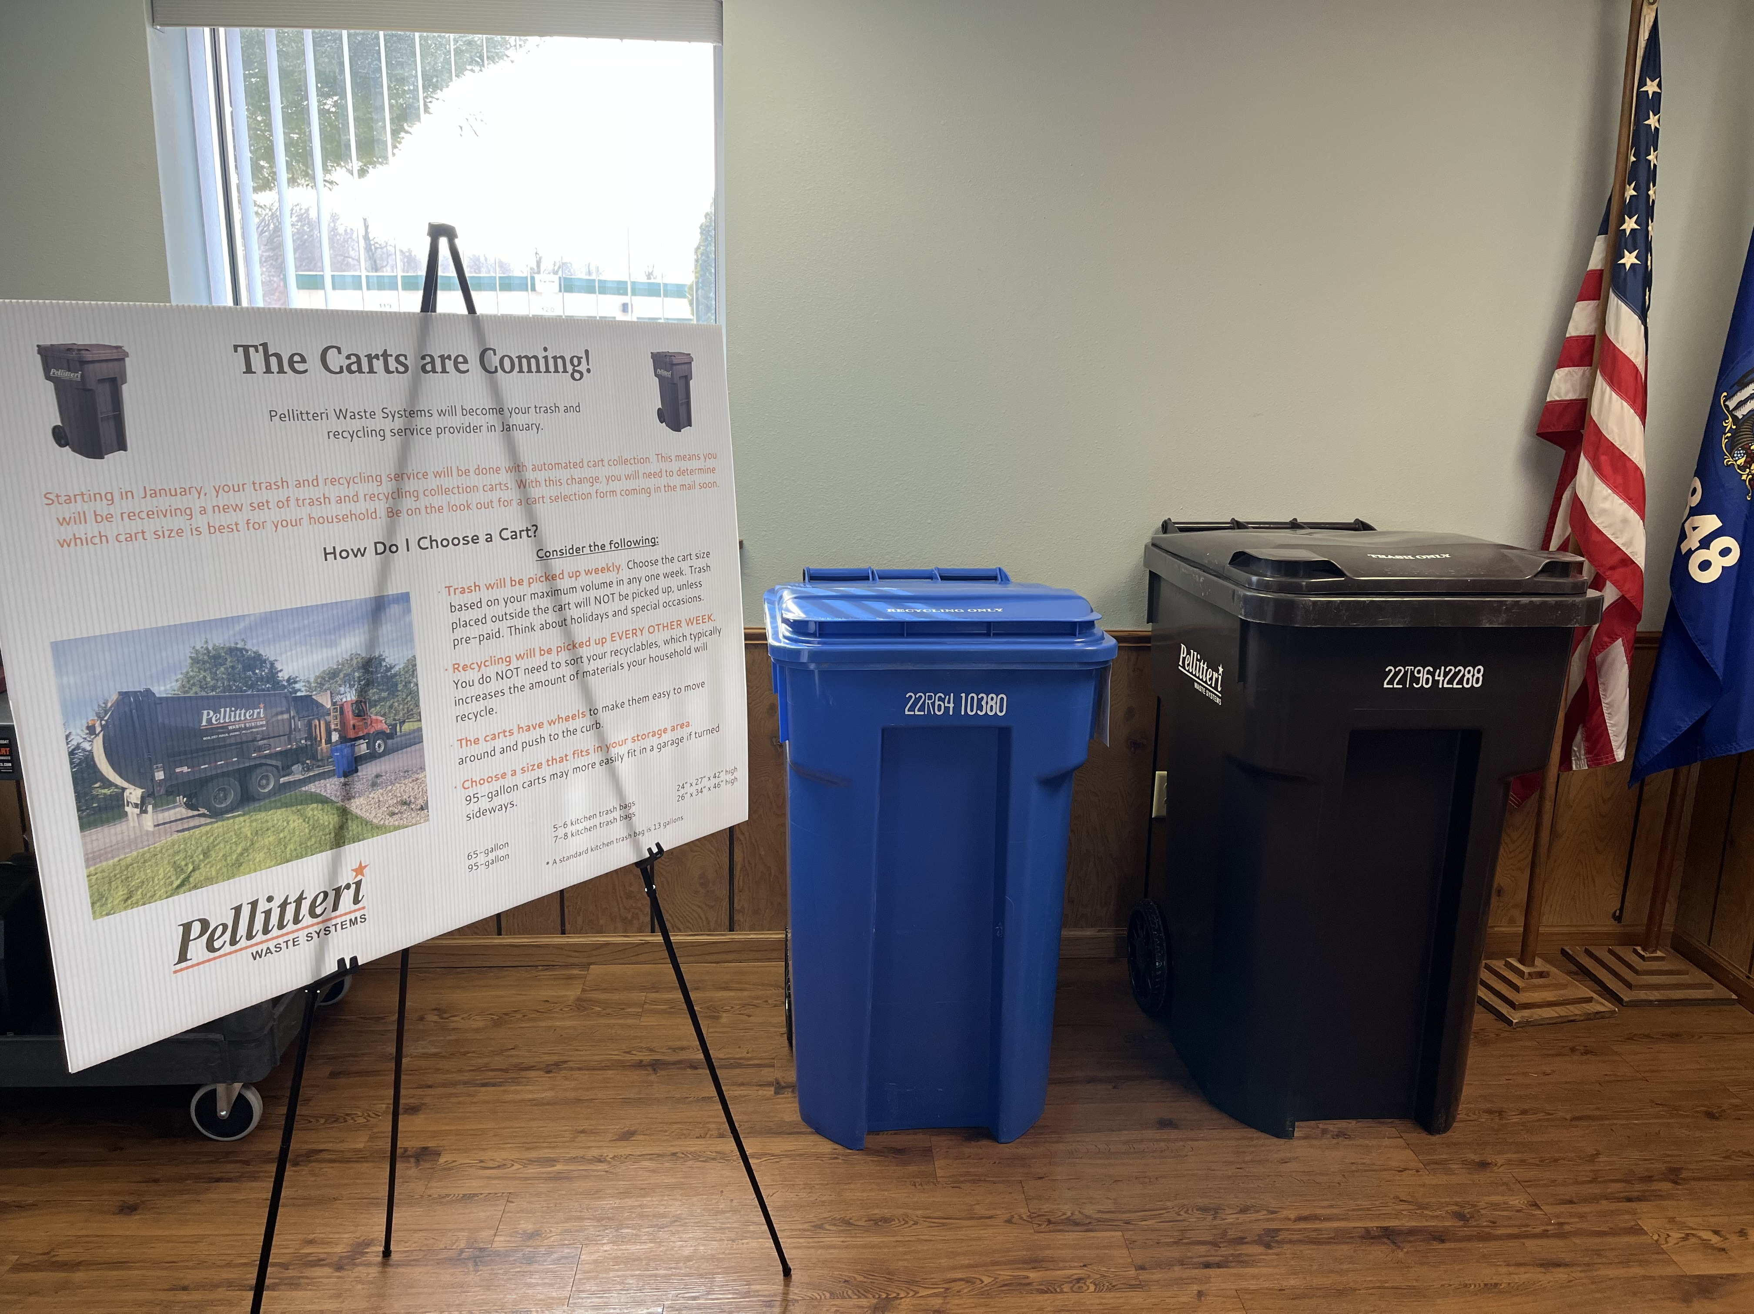
Budget at a glance
Garbage/Recycling Charges
2023 (payable 2024): $81.90 ($13.65 per month from July to December 2023)
Garbage and Recycling Charges are paid after services are received.
The January to December 2024 charges will be paid on 2024 (payable 2025) property tax bill.
The 2024 garbage and recycling charge will be $13.99 per month plus variable monthly fuel costs.

Slide 10
2024 Proposed Budget
Revenues
Property Taxes | $1, 179,293
Special Assessment | $97,788
Other Taxes | $1,600
Intergovernmental Revenues | $318,833
Licenses & Permits | $48,700
Public Charges | $29,000
Intergovernmental Charges | $600
Miscellaneous Revenues | $420,877
Other Financing | $81,378
Total Revenues | $2,178,069
Expenditures
General Government | $351,786
Public Safety | $387,752
Public Works | $1,046,598
Health & Human Services | $65,500
Cultural, Recreation | $20,737
Conservation and Development | $3,216
Debt Service | $302,480
Total Expenditures | $2,178,069

Slide 11
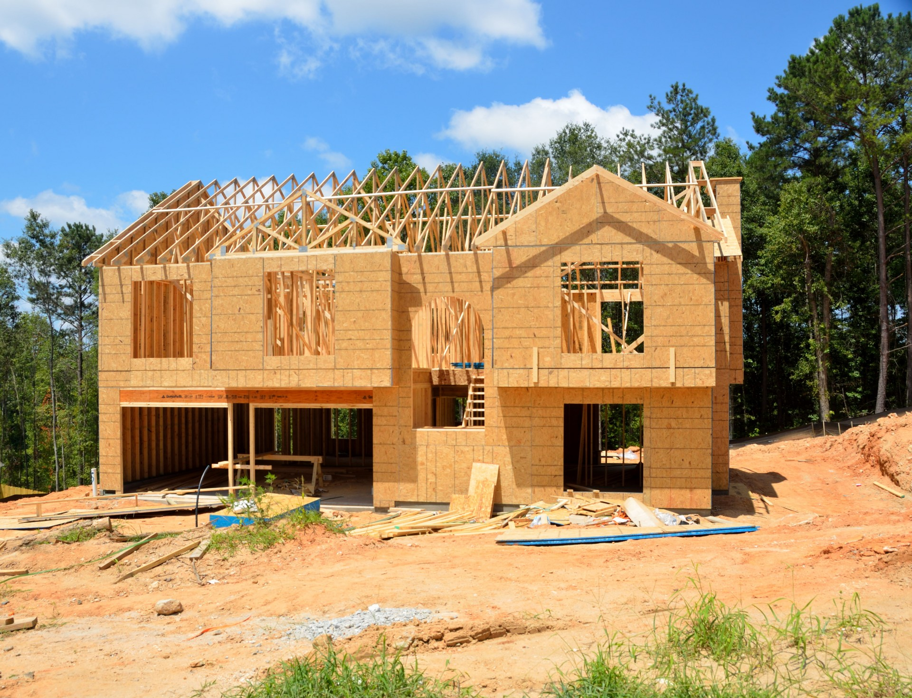
2024 Budget – Levy Limits
Town is limited to actual growth based on “net new construction” or 0%
Town of Oregon had .62% ($5,410) net new construction in 2022
Without an approved Referendum, the Town is allowed to increase General Levy to $873,231
The debt service levy for general obligation debt authorized after July 1, 2005, is $302,480
Adjustments for Brooklyn Fire of +$4,175 and Village of Oregon Annexation -$590
Final 2023 payable 2024 town levy = $1,179,293

Slide 12

The town received $347,708.94.
The town used funds:
How did the town use ARPA funds?
AV Equipment in town hall $24,500
Concrete in shed $13,500
Badger Book $8,545
Curbside $191,033
Remodel town hall administrative offices $96,090
Emergency Radios $14,040

Slide 13
2024 Budget Highlights
Revenues
Increase in shared revenue to $125,835
Add ARPA funds for curbside $61,854
Carryover of 2023 loan for equipment $263,923
Collect 2023 curbside expense $97,788
No increase in state highway aid $142,961
Decrease in fees collected at TORC $5,200
Variable interest income $15,000
Sale of highway equipment $75,000
Increase OAFED capital equipment loan $81,378

Slide 14
2024 Budget Highlights
Expenditures
Increase legal fees $12,000
Increase youth center contribution $5,000
Contribution to senior center $60,000
Increase legislative fees $18,386
Increase election expense $14,050
Remove constable expense $0
Increase OAFED $276,750
Decrease solid waste salaries $15,954
Increase OCA media contribution $4,000
Increase supplemental police services $5,310
Decrease major roadwork $140,000
Increase solid waste expense curbside $141,460
Increase recycling expense curbside $66,860

Slide 15

2024 Debt Service
 | Beginning Balance | Interest Payment | Principal Payment | Total Payment Due | Ending Balance 12/31/2024
Oregon Area Fire/EMS Department – Capital Equipment (Payoff 2024) | $81,378 | $4,883 | $81,378 | $86,261 | $0
Brooklyn Fire/EMS - Building Loan (Payoff 2035) | $122,963 | $4,315 | $8,411 | $12,727 | $114,552
2020 Road Construction -Lincoln Road & Snowplow Truck (Payoff 2024) | $86,149 | $2,160 | $86,149 | $88,308 | $0
2021 Road Construction - Hillcrest Lane & Equipment (Payoff 2025) | $221,993 | $5,565 | $109,619 | $115,184 | $112,374
2023 Road Construction – Alpine Road & Equipment (Starts 2025 & Payoff 2027) | $365,000 |  |  |  | $365,000
Total Debt Expenditures | $877,483 | $16,923 | $285,557 | $302,480 | $591,926

Slide 16
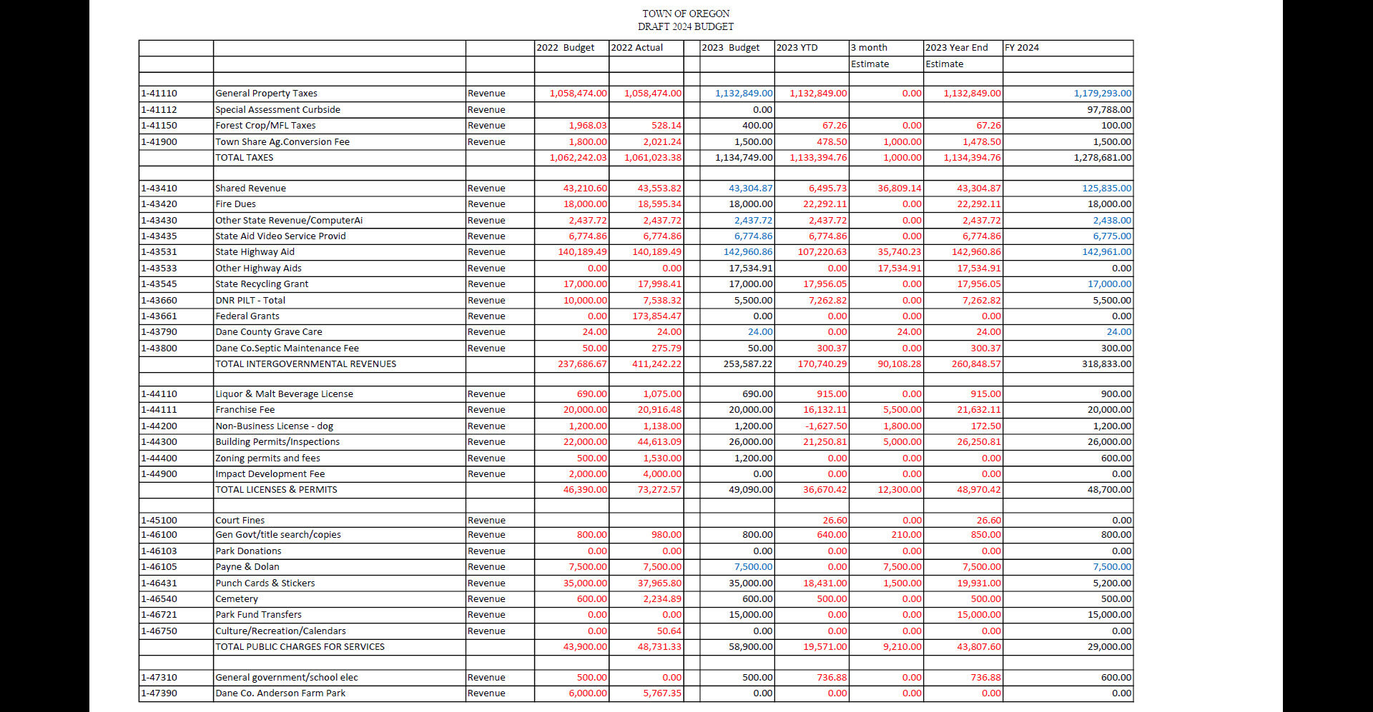

Slide 17
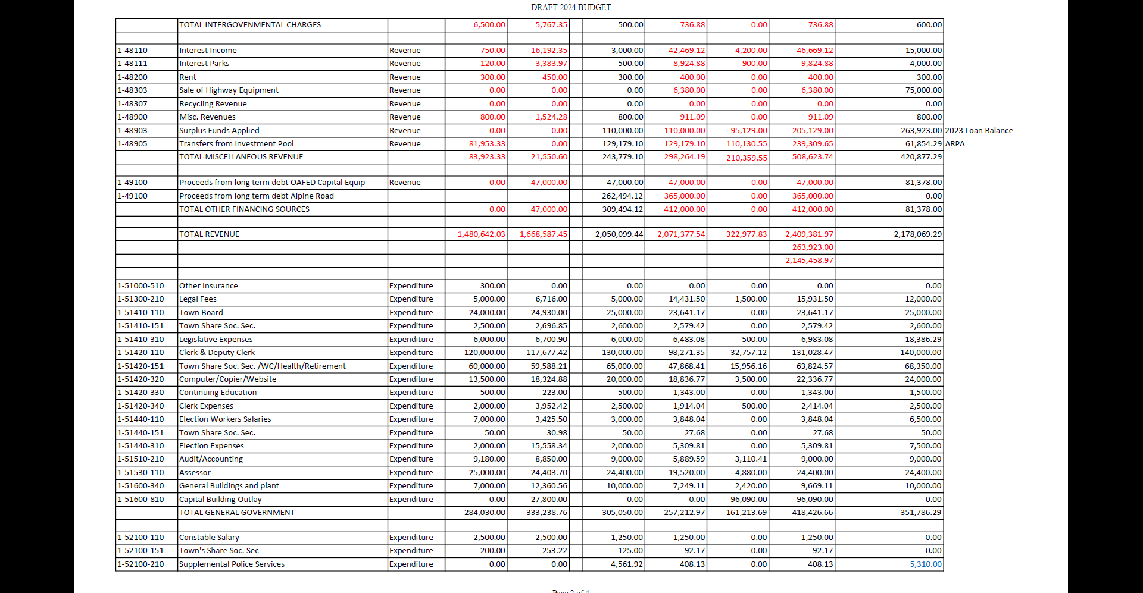

Slide 18
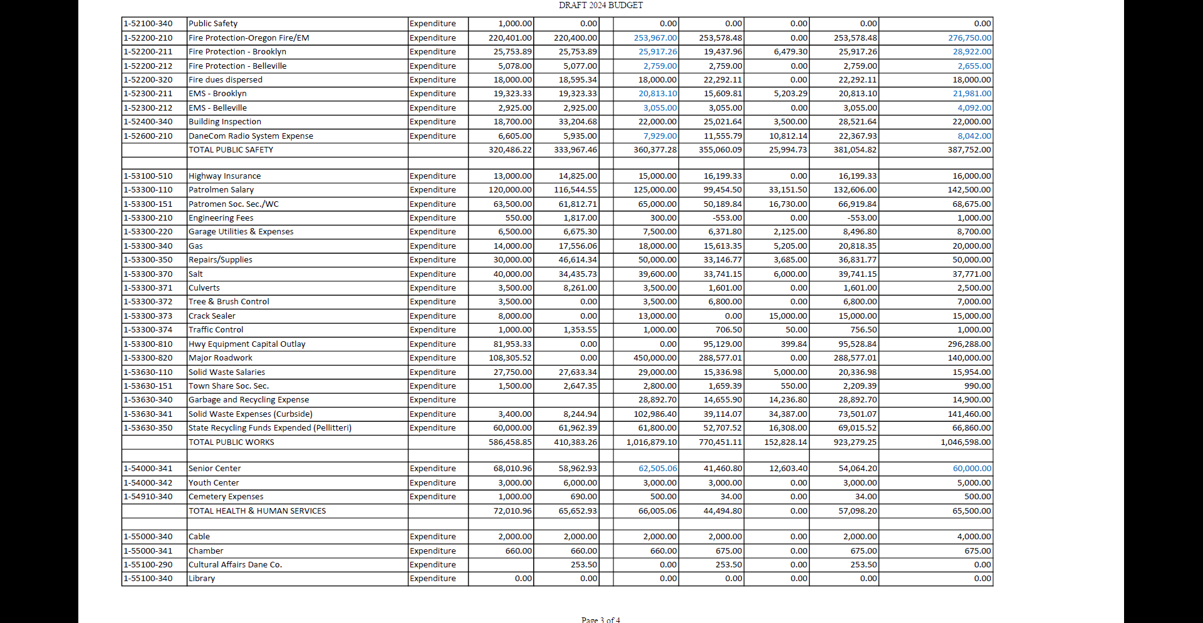

Slide 19
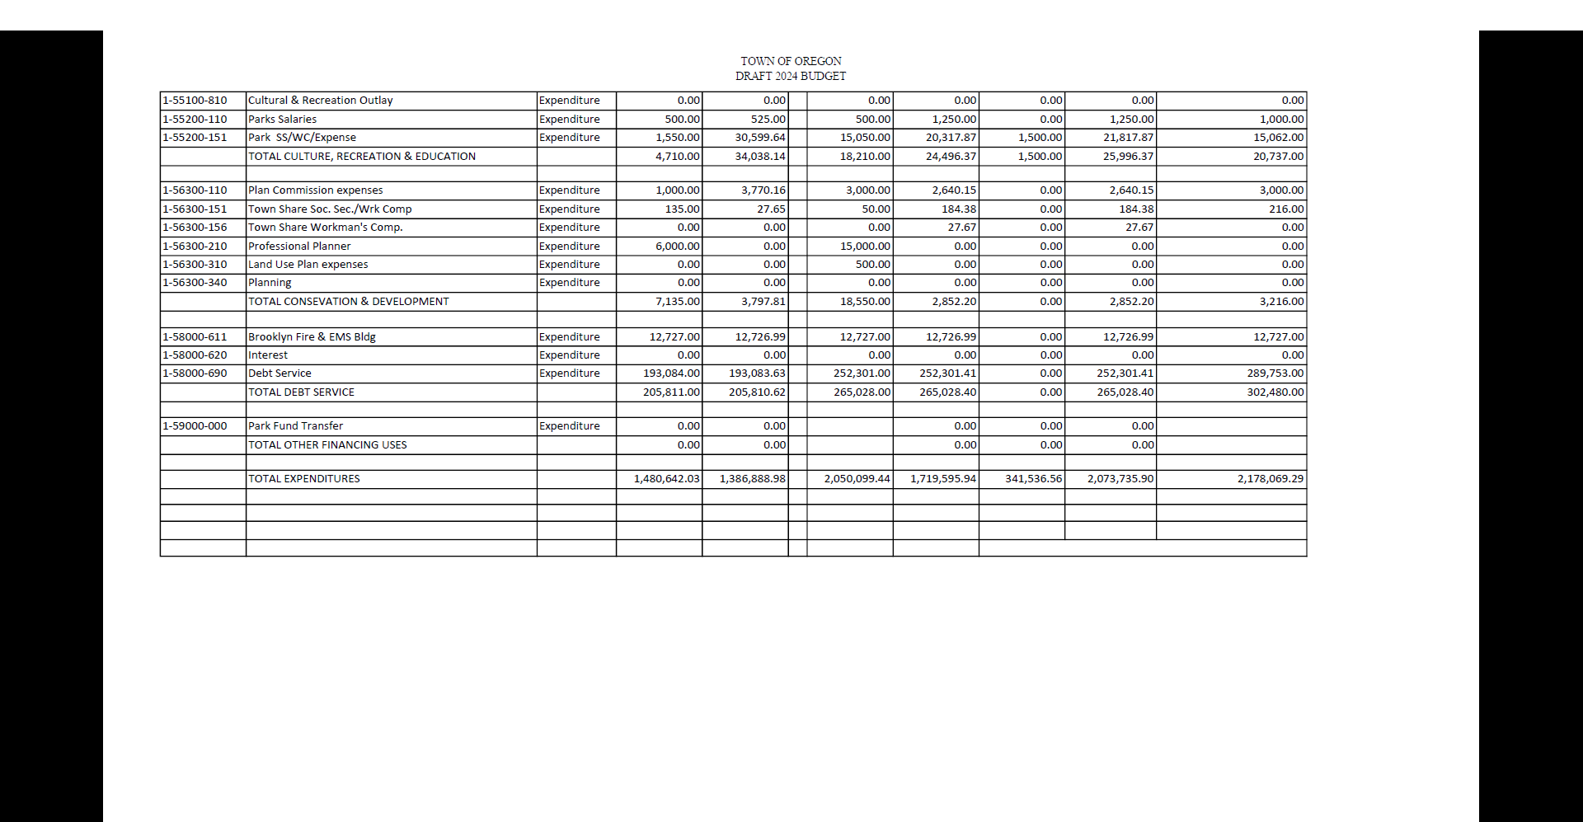

Slide 20

Questions

Slide 21
Special Town Meeting of Electors
Open SPECIAL TOWN Meeting
Motion to Adopt the 2023 town tax levy to be paid in 2024
  Requesting $1,179,29
  $876,813 – General Levy
  $302,480 – Debt Service (Required)
  Electors do not have the authority to approve specific additions or reductions in the budget
  Electors only approve the total tax levy
  Motion to Adopt the 2023 town tax levy to be paid in 2024 – Resolution No. 08-2023
Motion to Adjourn Special Town Meeting
Thank you for attending!

Slide 22
RESOLUTION OF ELECTORS TO ADOPT THE TOTAL TOWN TAX LEVY
AT SPECIAL TOWN MEETING OF TOWN ELECTORS
Town of Oregon, Dane County
Resolution No. 08-2023
Whereas, Wis. Stat. § 60.10(1)(a) authorizes the town electors of a town to adopt the town tax levy at a town meeting of the electors;
Whereas, a special town meeting of the town electors has been called and properly noticed to approve the 2023 total town tax levy (to be collected in 2024), pursuant to Wis. Stat. § 60.10(1)(a);
THEREFORE, the special town meeting of the Town of Oregon, Dane County, Wisconsin, by a majority vote of the eligible electors duly assembled and voting on this 16th day of November, 2023, hereby resolves and orders as follows:
The town electors of the Town of Oregon, Dane County, Wisconsin adopt the total town tax levy for 2023 (to be collected in 2024) in the amount of $1,179,293
The town clerk shall post or publish this resolution as required by law under Wis. Stat. § 60.80(1)(a) within 30 days after its adoption.
Adopted this 16th day of November 2023, at a Special Town Meeting of the Town Electors.
Number of town electors voting aye _________
Number of town electors voting nay _________
Number abstaining or not voting (if determined) ________
Signature of Town Meeting Chair: ______________________________
Attested by Town Clerk: ____________________________

