Slide 1



Community Digester Economic Impact Analysis
Initial Research
7/1/2019

Slide 2
Parameters
Based on a 60 minute drive time from the Town of Wrightstown
  Selected 81 Zipcodes
Provided with the following details
  $60M in near term construction impact
  Hiring of the following staff:
    11-1021 – (1) - General and Operations Managers
    11-3013 – (1) - Facilities Managers
    13-2011 – (1) - Accountants and Auditors
    51-8031 – (4) - Water and Wastewater Treatment Plant and System Operators
    49-9071 – (6) - Maintenance and Repair Workers, General
    53-3033 – (6) - Light Truck Drivers

Slide 3
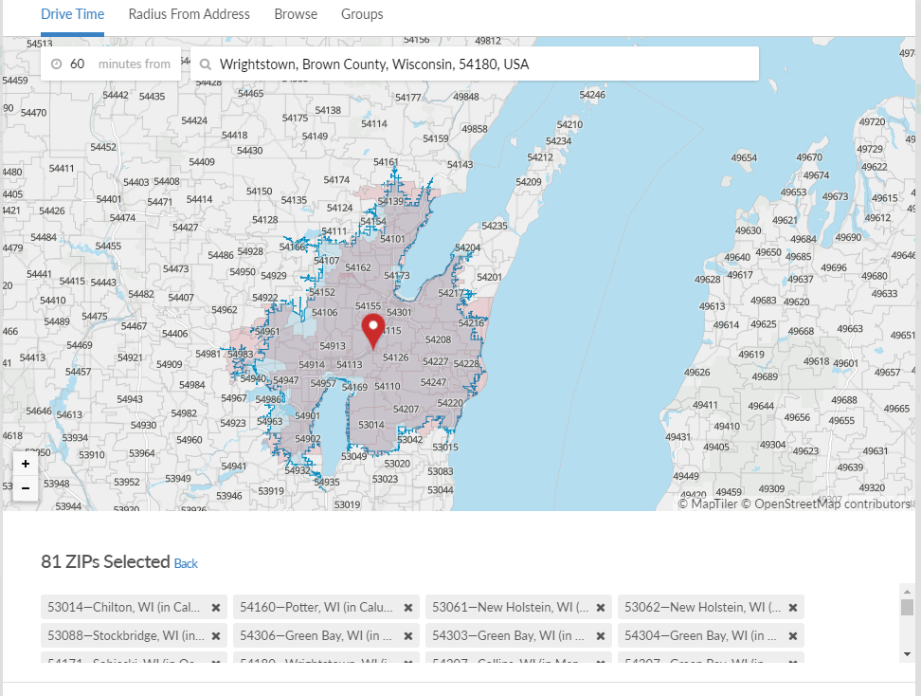
Parameters

Slide 4
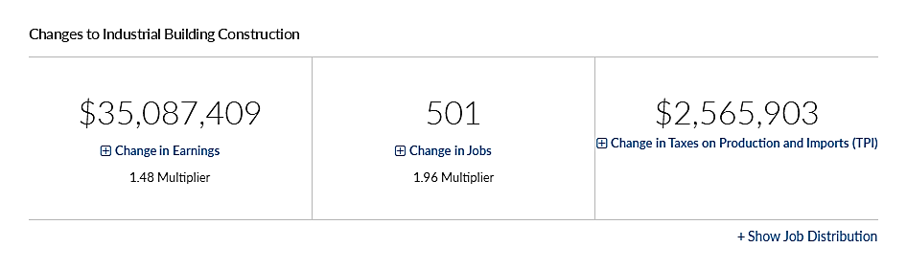
Construction Impact

Slide 5
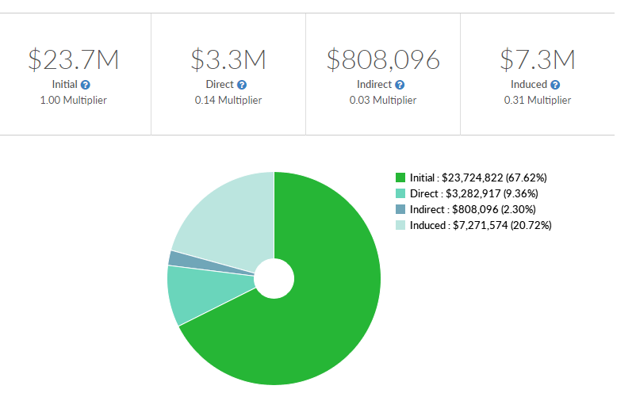
Construction impact on Earnings

Slide 6
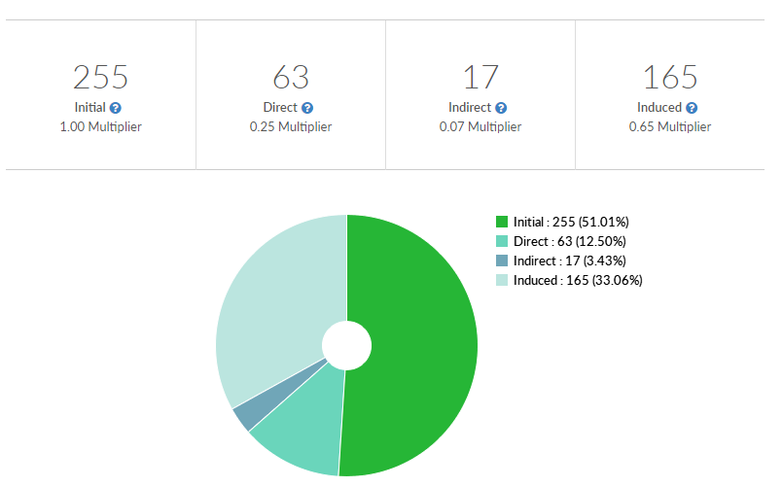
Construction Impact on Employment

Slide 7
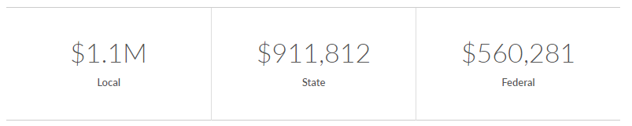
Effect on Taxes on Production & Imports from Construction Sales

Slide 8
Annual Impact - Operation
Parameters – same counties based on 60 minute drive radius
For initial evaluation utilized NAICS code of 221117 Biomass Electric Power Generation related to the addition of 19 employees
  EMSI does not currently offer an individual impacts
  Will provide details related to available workforce and wages.

Slide 9
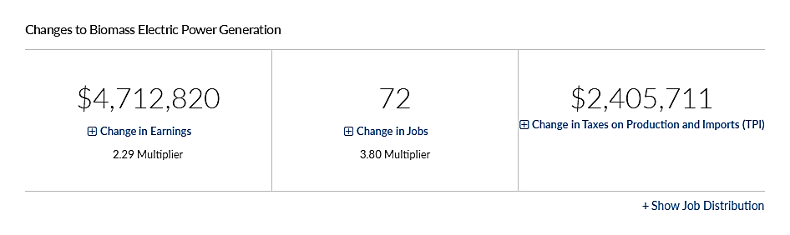
Ongoing Operational Impact

Slide 10
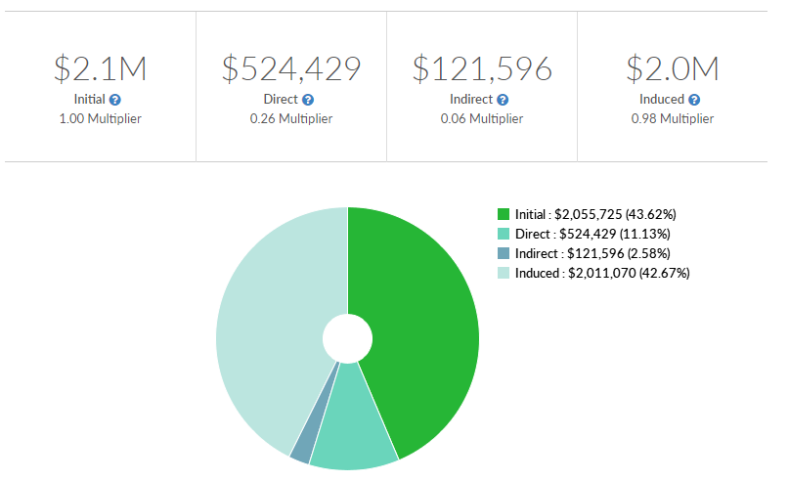
Operation Impact on Earnings

Slide 11
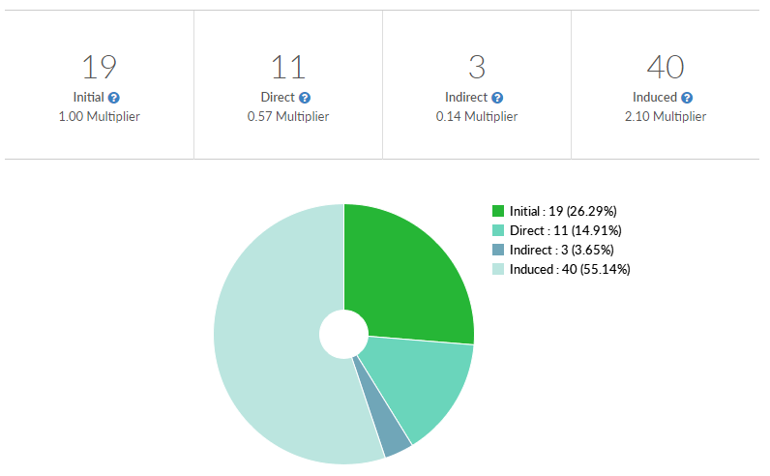
Operational Impact on Employment

Slide 12
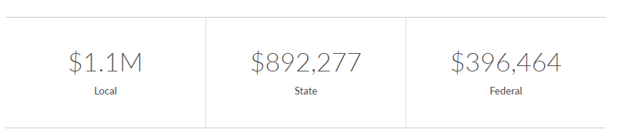
Operational Impact on Taxes

Slide 13
Notes
11-3031 is not available – substituted 11-3051

