Slide 1
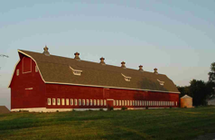
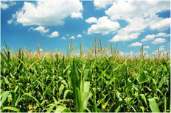
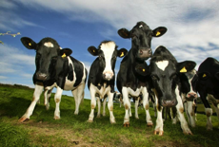
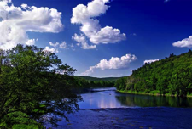
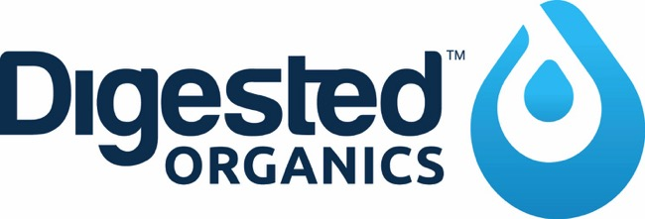
Advanced Filtration Solutions
Harvest Energy | Capture Nutrients | Reclaim Water™
Brown County
March 2019

Slide 2
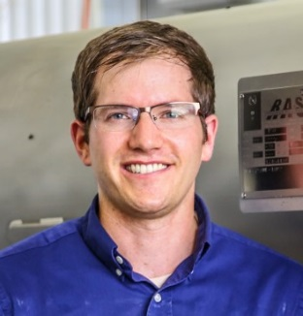
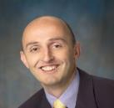
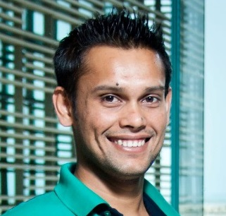
Company Background & Executive Team
Digested Organics was founded in 2013 with a mission to improve organic waste management through on-site filtration and/or anaerobic digestion to reclaim water, produce value-added products, and generate renewable energy.
Bobby Levine, Ph.D. (CEO): Chemical engineer and microbiologist; serial entrepreneur with 10+ years in waste management and bioenergy industries; 5+ years industrial fermentation experience with microalgae for animal feed, human nutraceuticals, and plant bioactivation.
Ian Charles, Ph.D. (CTO): Mechanical and control systems engineering specialist; 25+ years experience in C-level management; successful entrepreneur in cleantech space (wind turbines), automotive, and medical devices.
Sam Bagchi, Ph.D. (R&D Engineer): Environmental biologist and microbiologist; 10+ years wastewater treatment experience; helped design, build and operate numerous systems in municipal and food & beverage sites

Slide 3
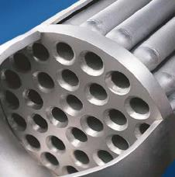
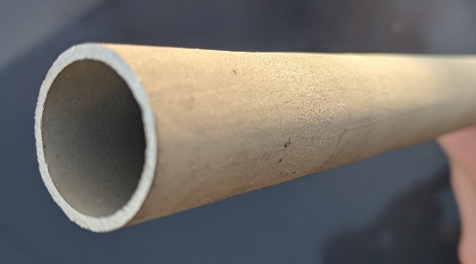
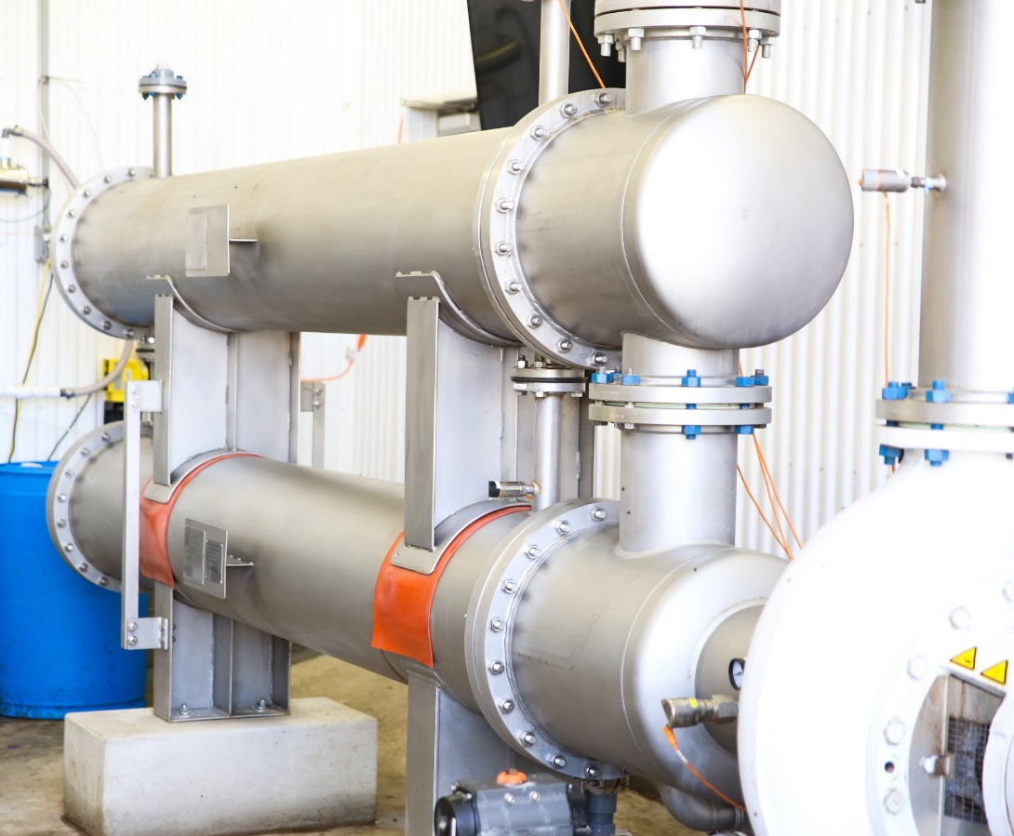
Stainless Steel Ultrafiltration
Porous stainless-steel tubular membranes (3/4”) with internal titanium dioxide coating for abrasion resistance
Welded and bolted construction in ASME pressure vessel
  10’ and 20’ lengths available in any diameter
Designed to last 10-15 years in challenging applications with little downtime, maintenance, or repair
No internal moving parts and one externally mounted centrifugal pump per stage
Can operate in batch-mode or continuously and be mounted horizontally or vertically
NO POLYMERS OR FLOCCULENTS
Proudly manufactured in the USA
Installation at dairy farm in Wisconsin (18” modules)

Slide 4
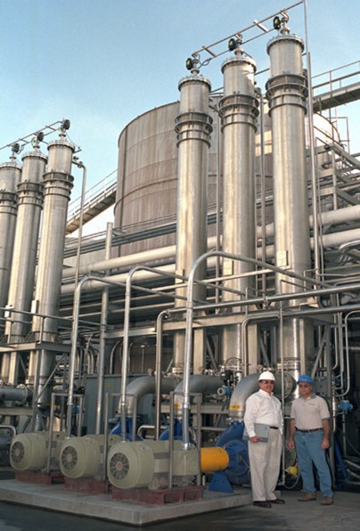
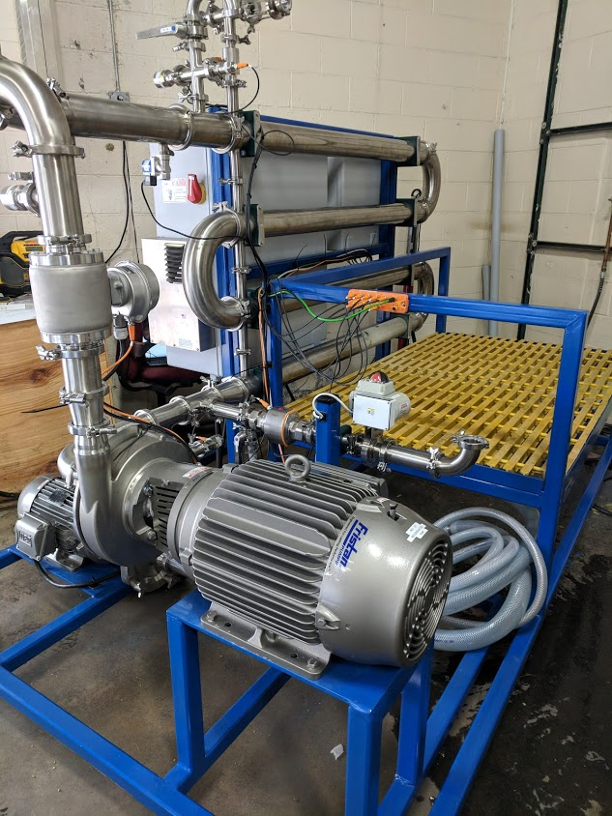
Stainless Steel Ultrafiltration
Commercial food and beverage unit for
small-scale processing
Large Industrial Application

Slide 5
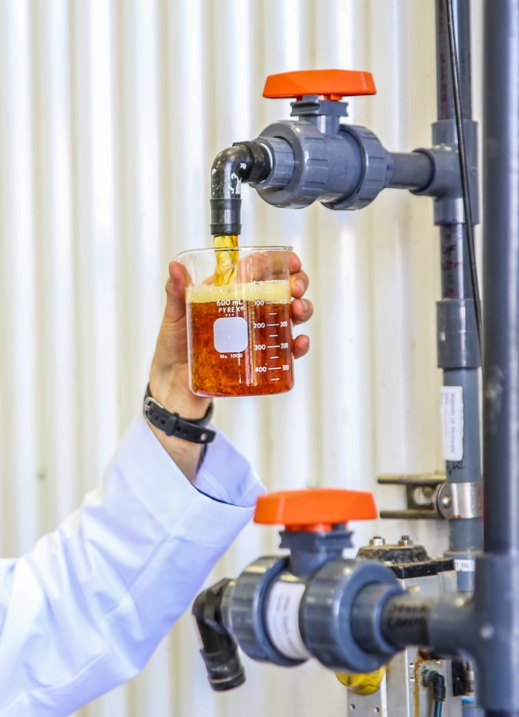
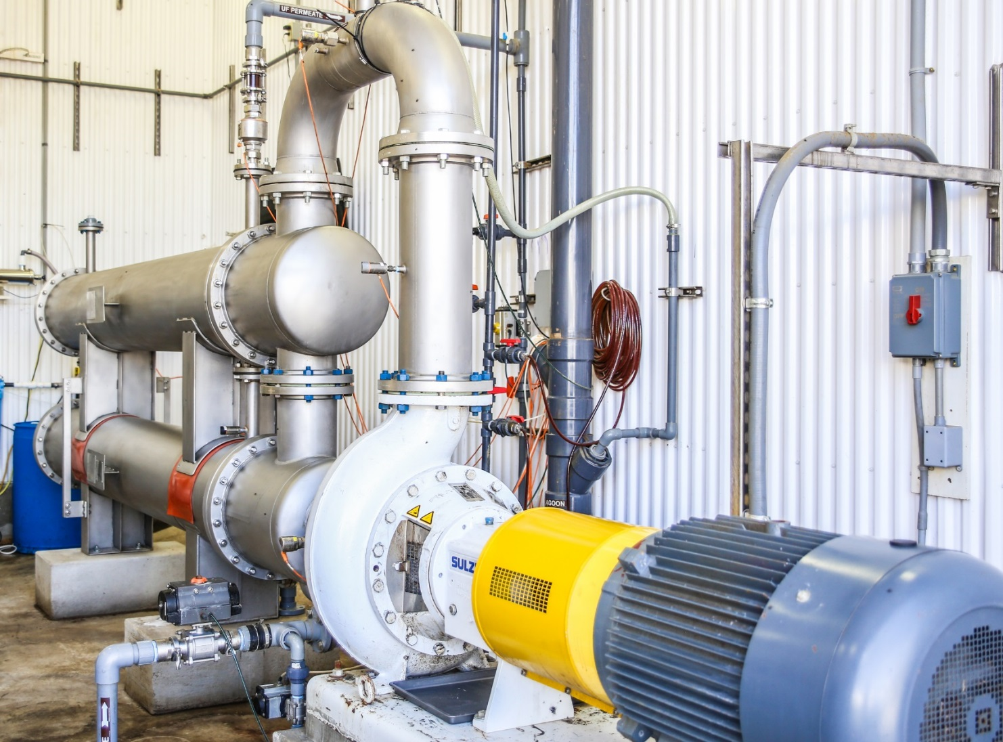
Stainless Steel Ultrafiltration
Installation at dairy farm in Wisconsin (18” modules)

Slide 6
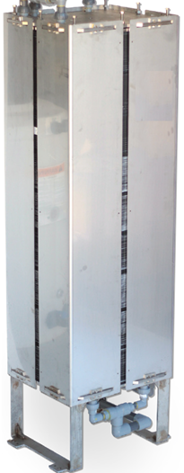
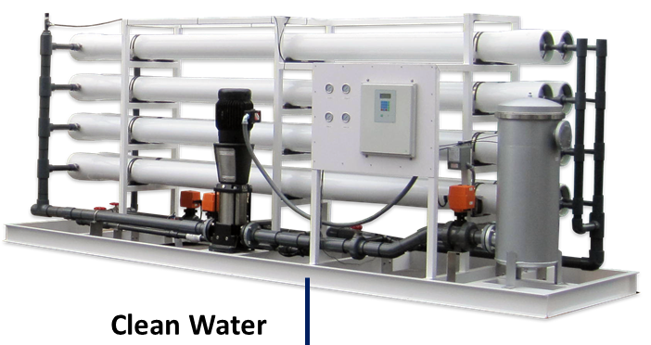
Two-Step Reverse Osmosis™
Screened Wastewater or UF Permeate
Patented high-flux and anti-fouling Forward Osmosis membrane configured in stainless hardware (“stack”)
Seawater Reverse Osmosis system with spiral wound elements
Proprietary automated controls
3-4 year expected membrane life
Proudly manufactured in the USA
Salt Water
FO Membrane Stack
Reverse Osmosis (RO)
Clean Water
Concentrate

Slide 7
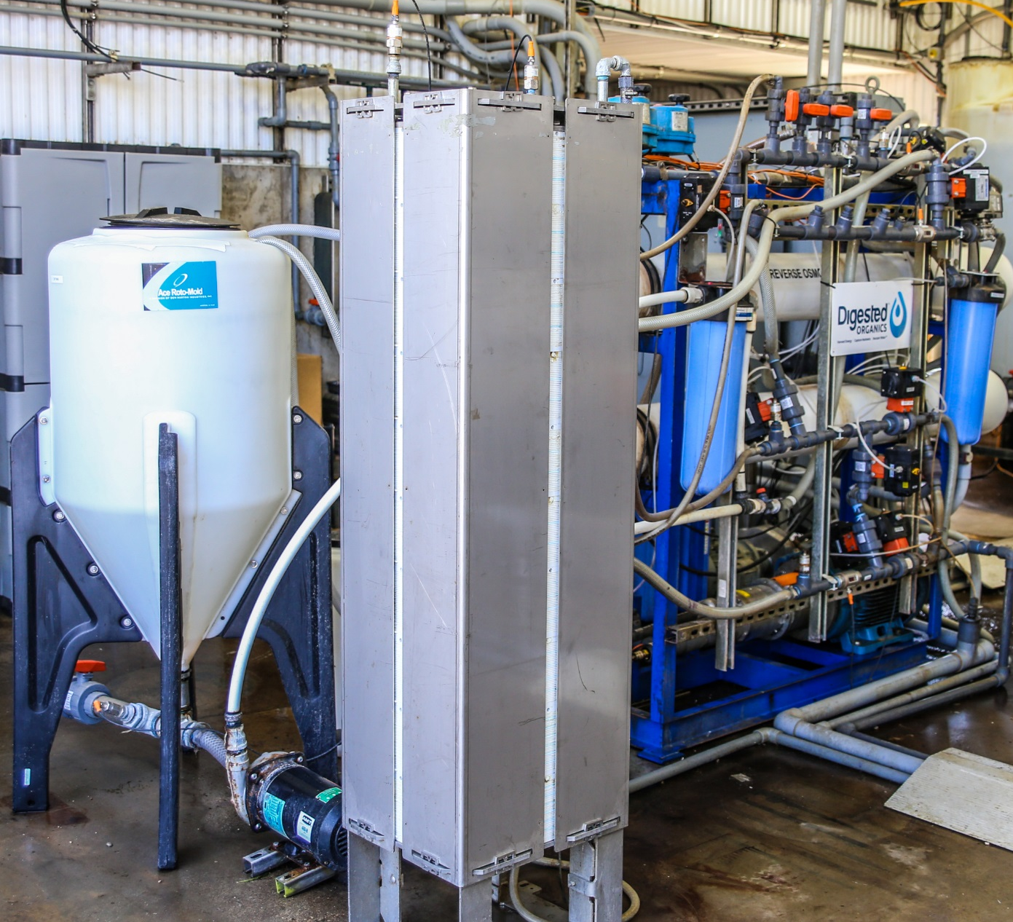
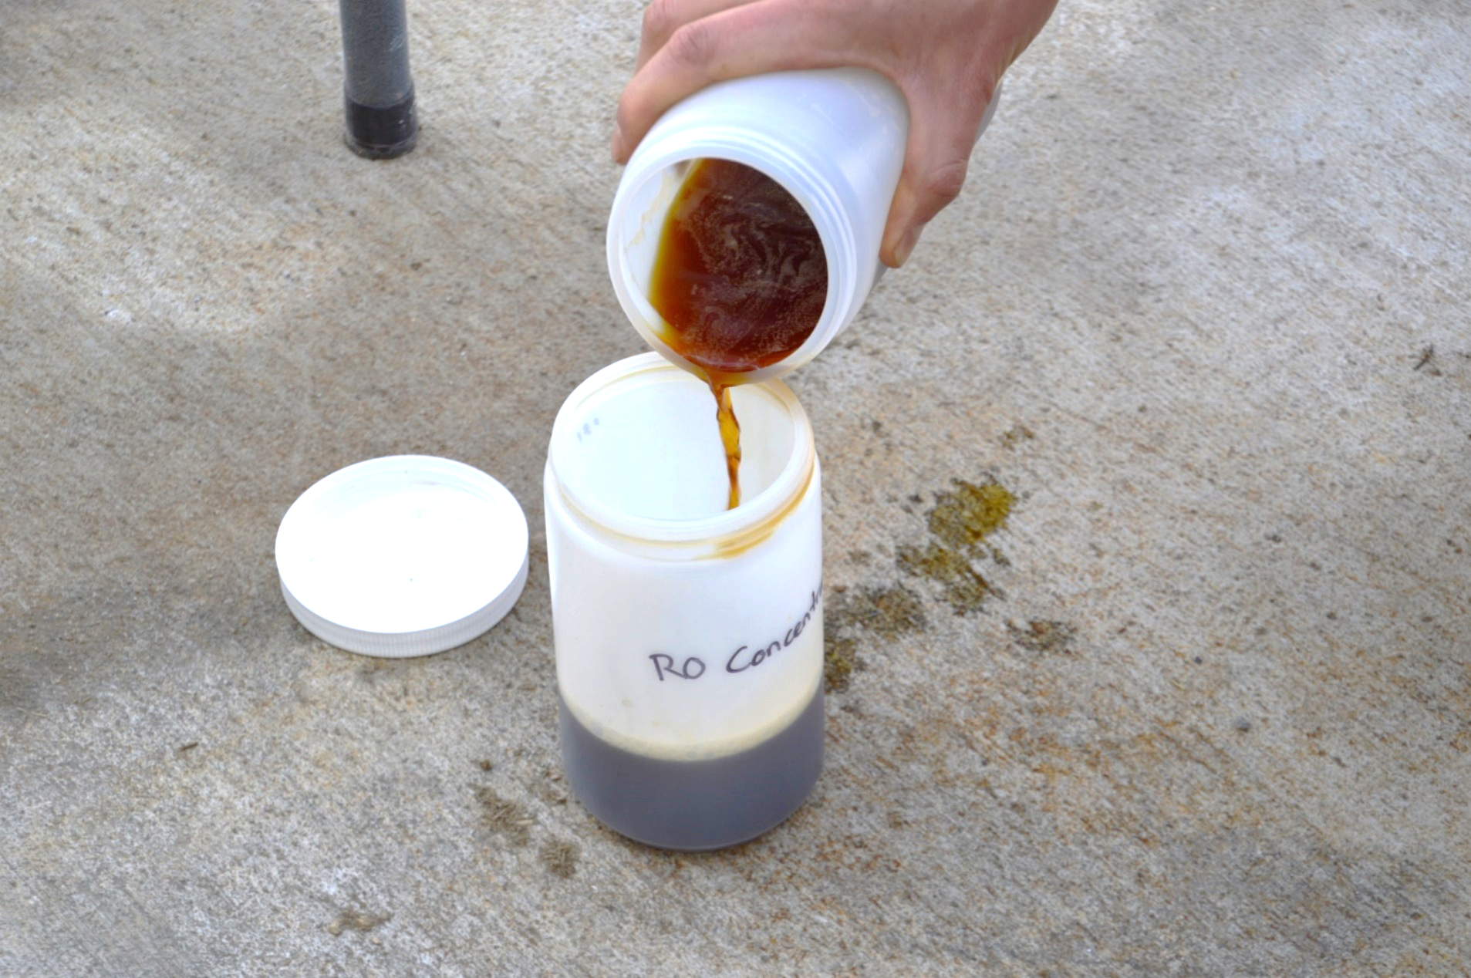
Two-Step Reverse Osmosis™
Stack produces “Stack Concentrate”, a fertilizer rich in potassium and ammonia nitrogen.
Commercial unit at Majestic

Slide 8
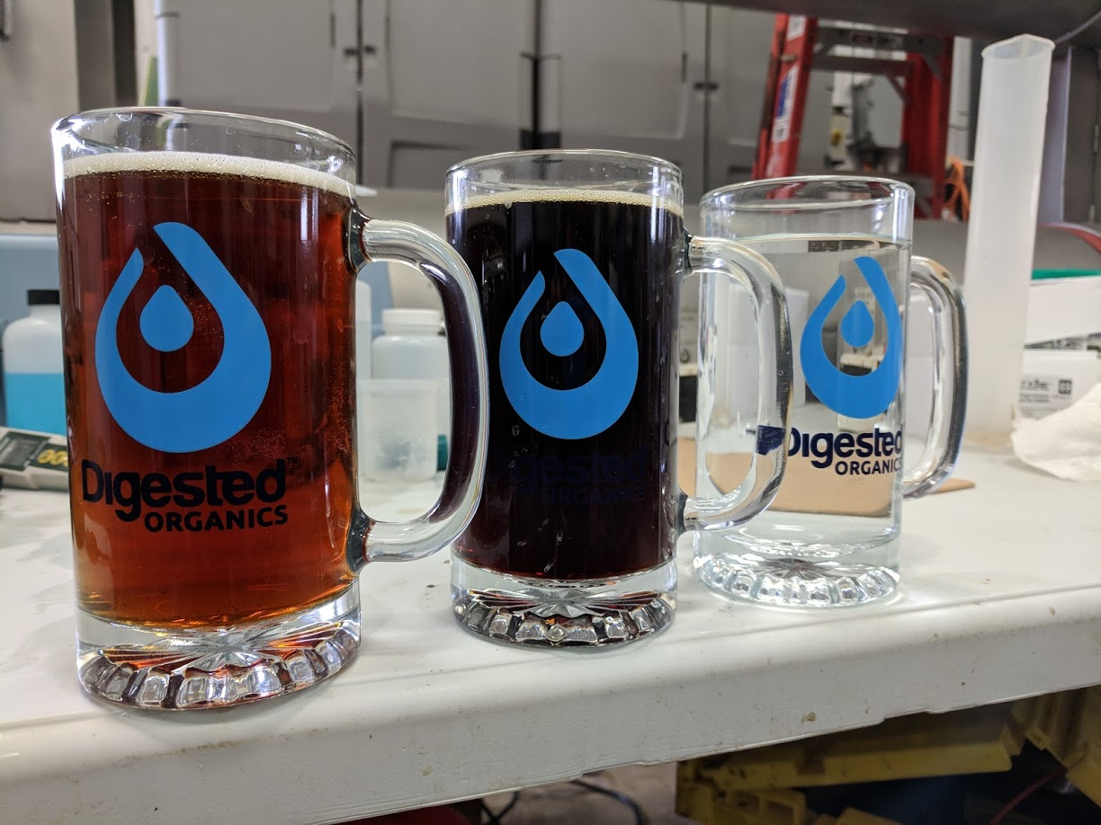
March 2018 at Majestic
UF Permeate, Stack Concentrate, RO Permeate

Slide 9
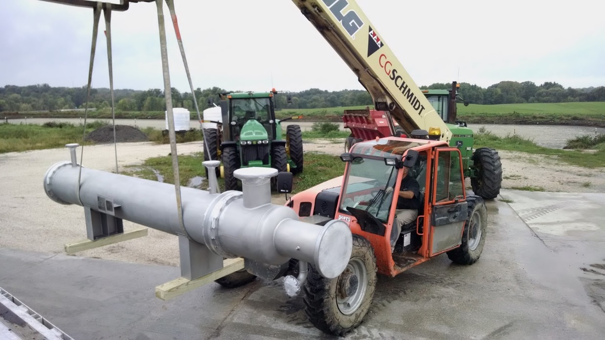
Video about Majestic Installation
Our UF and TSRO systems work at Majestic Crossing Dairy
  850 cows making about 12,500 GPD of liquid manure
  Screw-presses remove fiber, liquid manure is digested and then filtered
  Concentrated nutrients go back to the lagoon
  Water permitted for discharge or reused in parlor tank to feed cows
    Site has a DNR discharge permit for the nearby “unnamed tributary” of the Sheboygan River
Stainless UF installed October 2016
TSRO installed December 2017

Slide 10
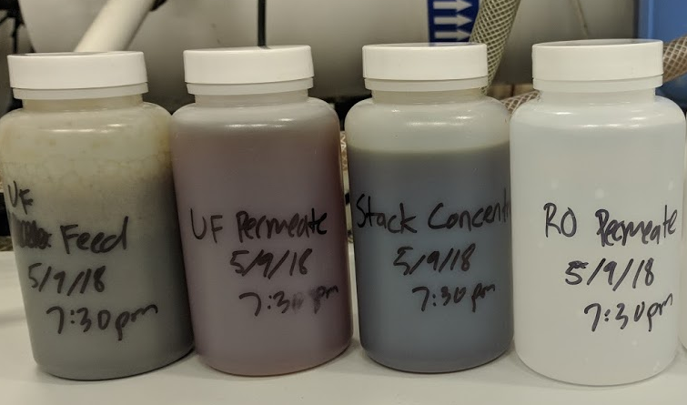
5/9/18 Grab samples taken from Majestic
Liquid Manure UF Permeate RO Permeate Discharge Standards
Suspended Solids >25,000 <4 <4 <4
BOD >10,000 >5,000 100 <5
Phosphorus 604 53 <0.01 <0.01
Nitrogen 3,710 2,180 50 <1

Slide 11
Polishing Water Prior to Discharge/Reuse
Need to remove trace amount of organic matter and ammonia nitrogen from RO permeate prior to discharge
Multi-step process:
  Aerate
  Add oxidizer like hydrogen peroxide (if needed)
  Filter water again with low-pressure RO system (>95% rejection of organic matter and ammonia)
  Filter this RO permeate through ion-exchange resin beds to remove ammonia (just like water softener except we use resin that removes NH₄⁺ instead of just calcium and magnesium)

Slide 12
How do we know the water we made is clean enough to discharge?
Several parameters are measured in real time by sensors:
  Temperature and pH
  Electrical conductivity (which corresponds to how many dissolved salts are present)
  Ammonia
Organic matter is assessed by measuring Chemical Oxygen Demand (COD) in on-site lab
  Takes 2 hours
  COD correlates to Biological Oxygen Demand (BOD), which is what DNR permits

Slide 13
What do we do if the water being produced doesn’t meet the discharge permit levels?
First, we stop discharging!
  If any sensor or lab result finds that the water being discharged is in violation of the permit, we can immediately (and automatically) stop discharging and divert the water flow to lagoon storage
We can process water through the polishing system multiple times if needed
  We can remove 90-95% of a contaminant in one pass, if we need to take multiple passes, we can.
We can adjust filter system parameters to achieve higher performance

Slide 14
How do we know this is going to work in Brown County?
We have done extensive pilot testing with manure and digested manure from facilities in Brown County and throughout WI and MI that are representative of what we will see at this site
We have over two years operating experience at Majestic, which is a more challenging manure to filter because:
  They bed on sawdust instead of fiber
  The manure is very thick due to use of robotic milkers, scrapers, and fans
  The manure is not as well digested as it will be at this site
We are working with a great team of engineers and contractors that understand manure management and wastewater treatment

Slide 15
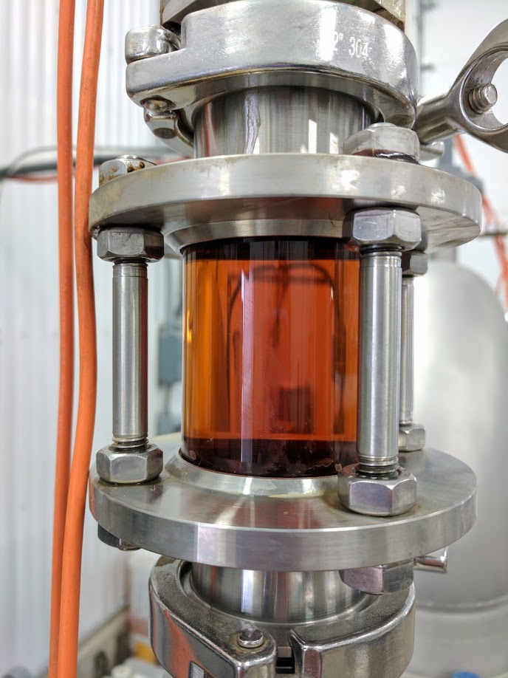
Wiese Bros. Manure Test: March 2017
(144 days after unit had been running at Majestic)
Ran 5,000 gal of Wiese’s raw pressate at Majestic
Parameter | Pressate (Raw) | UF Permeate | Percent Removal by UF
Dry Matter (%) | 4.84 | 1.58 | 67%
Nutrients (lbs/1000gal)
N | 23.9 | 15.0 | 37%
P2O5 | 6.5 | 0.22 | 97%
K2O | 14.9 | 16.1 | -8%
S | 3.4 | 3.2 | 7%
Flux was around 10-15 GFD at 60-75% permeate recovery, as expected!

Slide 16
Digesters
(Manure)
Digesters
(Food Waste)
Brown County Project
Process Flow Diagram
Screw-Presses
Fiber
Screw-Presses
Ultrafiltration
Ultrafiltration
UF Permeate Tank
Polishing
(aeration, low-pressure reverse osmosis,
ion-exchange)
Water Tank
Temperature and Hardness Adjustment
Forward Osmosis
Salt Water Tank
Reverse Osmosis
Discharge to East River
Send Back to Farms
Reuse at Facility
Evaporator Feed Tank
Evaporator
Fertilizer Tank (Outside)
Cow Drinking Water
Irrigation
Water

Slide 17
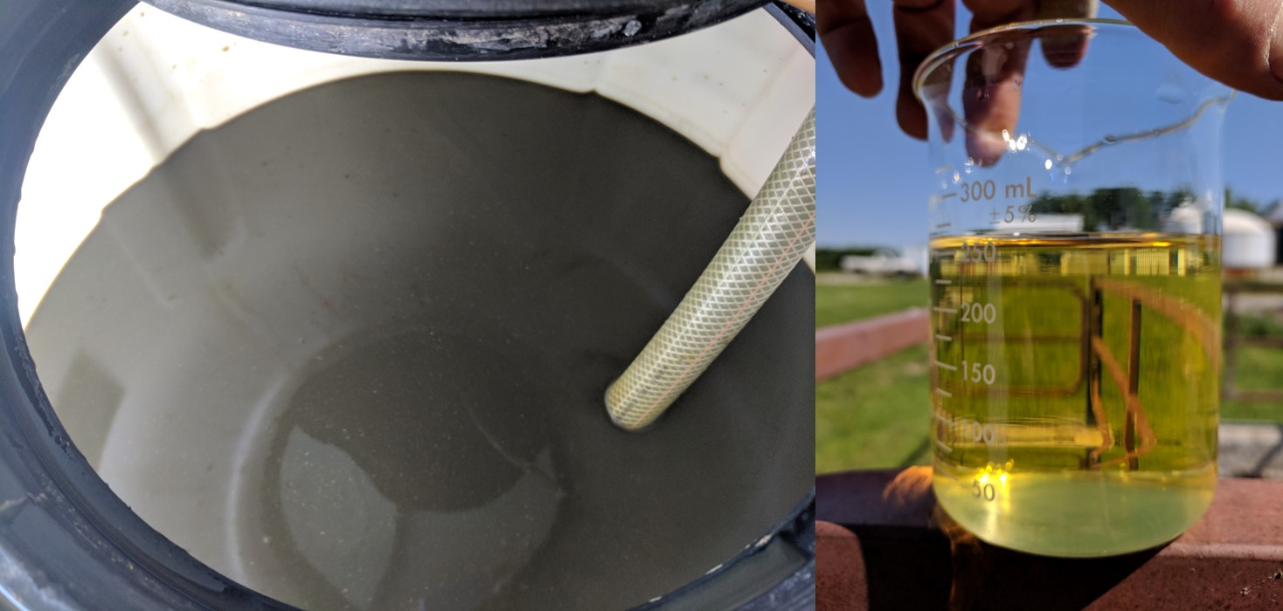
Food Waste Digestate
UF Permeate

Slide 18
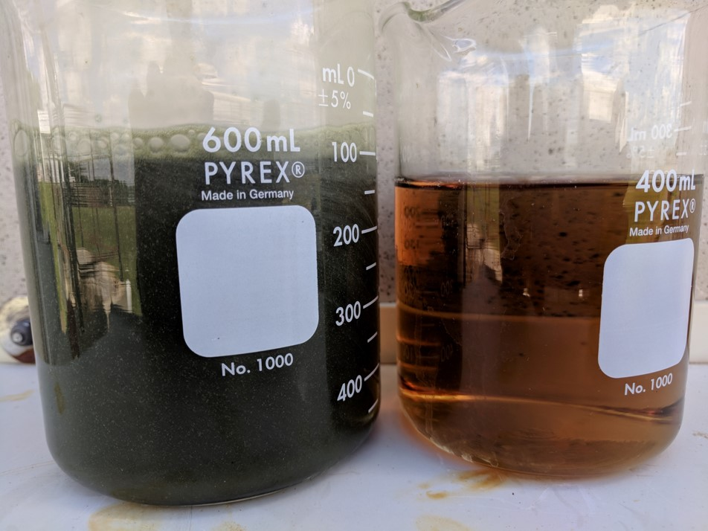
Dairy Manure Digestate
UF Permeate

Slide 19
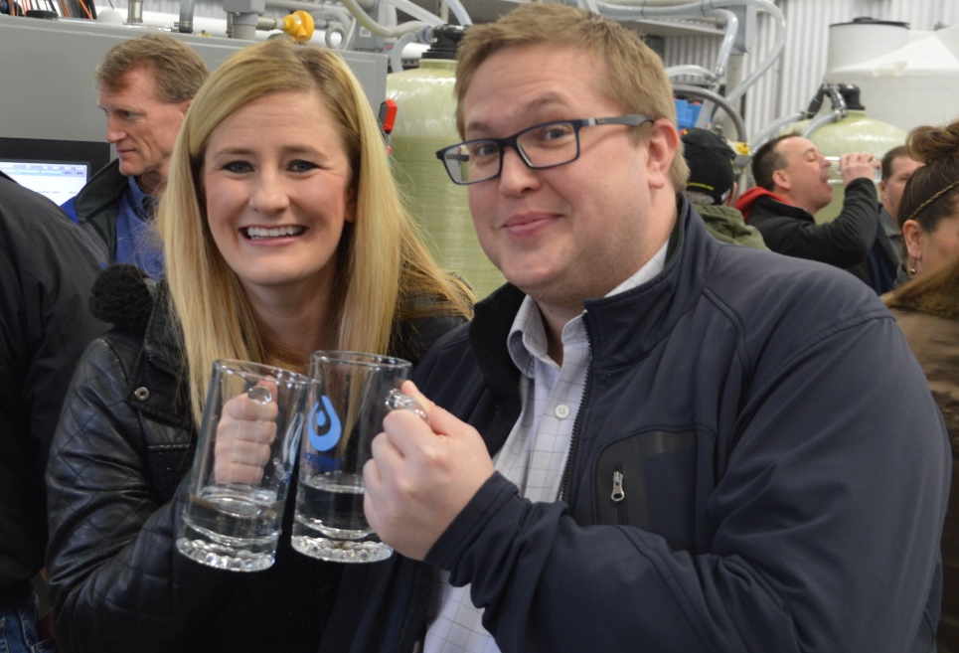
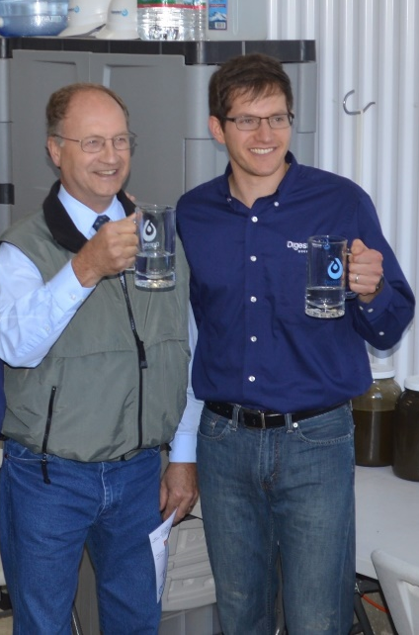
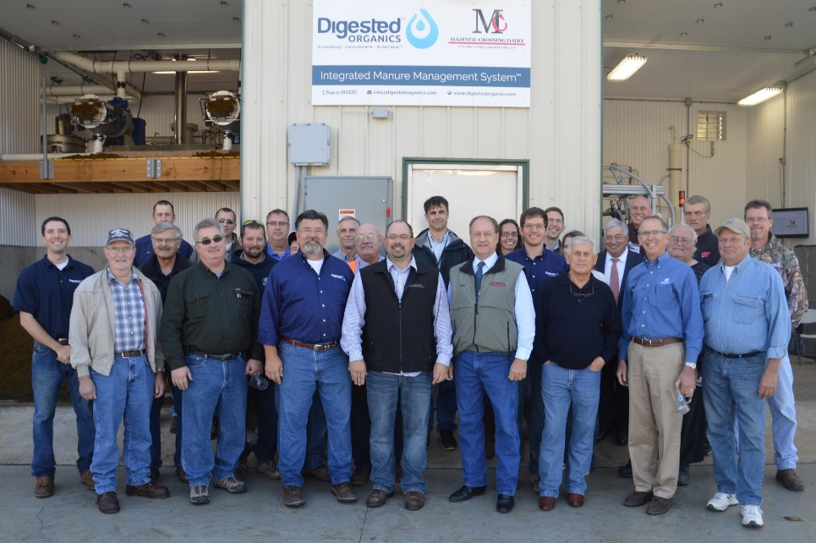
Come Drink the Water…

Slide 20

Harvest Energy | Capture Nutrients | Reclaim Water
USA Offices:
Ann Arbor, Michigan
Milwaukee, Wisconsin
For more information or to request a quote, please contact: Bobby Levine| 847-707-8433
http://www.digestedorganics.com
For more information

Slide 21
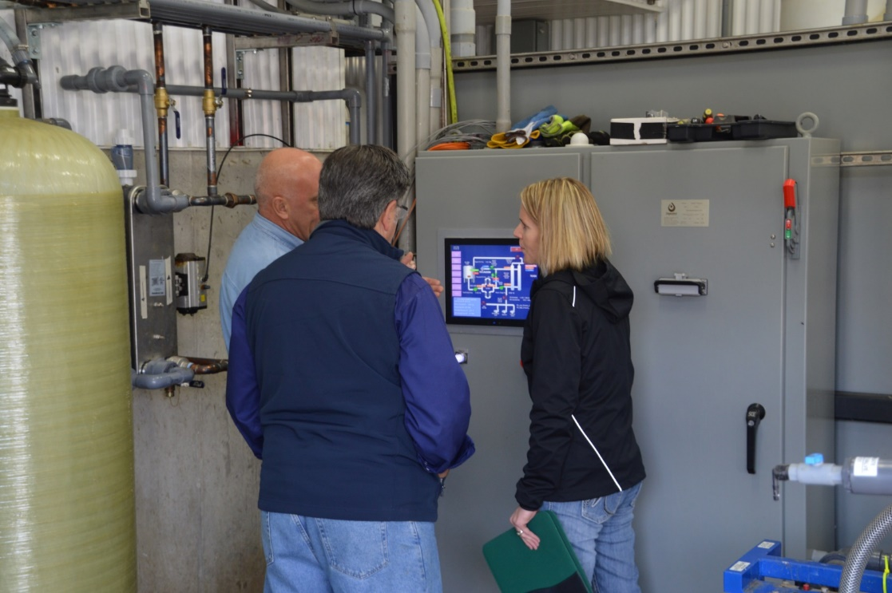
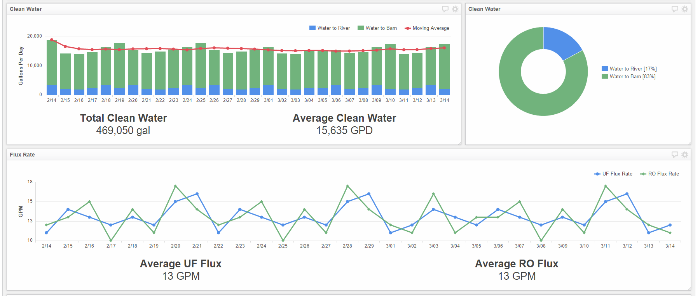
Controls and Automation
Entire system is automated so there is little to no operator attention required
System sends email and text alerts if a problem is detected
We remotely monitor all systems and can alert you if something requires attention
We recommend a daily walk through with a brief checklist (5-10 min) to ensure everything looks ok
Data is exported and presented to owner via online dashboard

Slide 22
5-9-18 Grab Samples
Parameter | UF FEED | UF PERMEATE | RO PERMEATE
Total solids (mg/L) | 53,400 | 18,500 | 505
BOD (mg/L) | NA | NA | 100
TKN (mg/L) | 3,710 | 2,180 | 50.0
NH4-N (mg/L) | 2,190 | 2,020 | 48
Organic nitrogen (mg/L) | 1,520 | 160 | 2.5
Phosphorus (total) (mg/L) | 604 | 53 | <0.01
Potassium (total) (mg/L) | 2,110 | 2,230 | 17
Sulfur (total) (mg/L) | 452 | 1,110 | 6
Calcium (total) (mg/L) | 1,580 | 689 | 0
Magnesium (total) (mg/L) | 648 | 373 | <0.1
Sodium (total) (mg/L) | 937 | 1,000 | 164
Iron (total) (mg/L) | 36.6 | 0.36 | <0.05
Manganese (total) (mg/L) | 9.4 | 0.903 | <0.005
Zinc (total) (mg/L) | 13.6 | 0.04 | <0.01
Copper (total) (mg/L) | 16.2 | <0.01 | <0.01
Conductivity (mS/cm) | 21.2 | 23.1 | 1.28
pH S.U. | 7.13 | 6.78 | 6.28

Slide 23
6/5/18 Grab Samples
Parameter | UF Permeate | Final Clean Water
Total solids (mg/L) | 20,100 | 365
COD (mg/L) | 20,640 | 60
Total Kjeldahl nitrogen (mg/L) | 2530 | 36
Ammoniacal Nitrogen (mg/L) | 2060 | 32
Organic nitrogen (mg/L) | 470 | 4
Nitrate/Nitrite (mg/L) | N/A | n.d. (<0.2)
Phosphorus (total) (mg/L) | 42.4 | 0.1
Potassium (total) (mg/L) | 2730 | 16.5
Sulfur (total) (mg/L) | 1630 | 24.1
Calcium (total) (mg/L) | 767 | 0.44
Magnesium (total) (mg/L) | 363 | 0.11
Sodium (total) (mg/L) | 1090 | 89.9
Iron (total) (mg/L) | 0.38 | 0.06
Manganese (total) (mg/L) | 1.022 | n.d.
Zinc (total) (mg/L) | 0.03 | 0.02
Copper (total) (mg/L) | n.d. | n.d.
Conductivity (mS/cm) | 25.3 | 0.798
pH S.U. | 6.41 | 6.79

