Slide 1
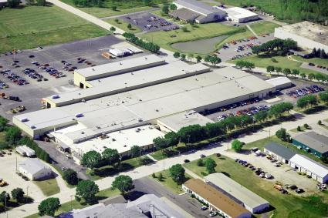
DÜrr megtec
Headquartered in De Pere, Wisconsin
Established in 1969; 600+ employees globally
Chemical, mechanical & electrical engineers & designers
110+ service, technical & support personnel
Dedicated development center & pilot laboratory support team
Engineered Products 10%
Environmental Solutions 54%
Aftermarket Services 36%
U.S. 70%
International 30%

Slide 2
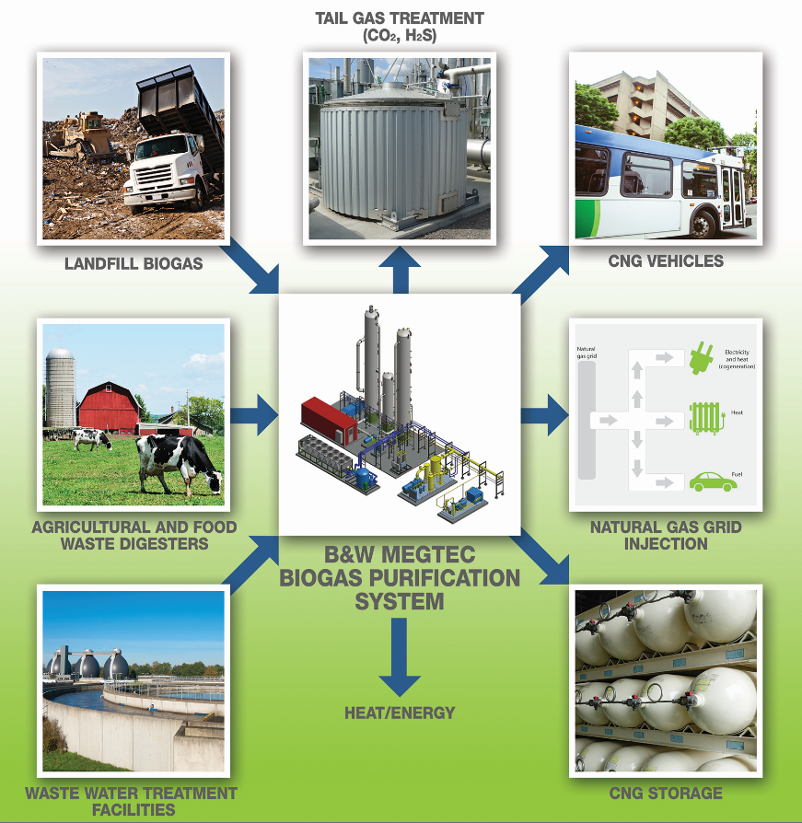

Slide 3

Water Absorption
Water scrubbing relies upon the principle that gases will dissolve (or absorb) into a liquid to maintain a pressure‐dependent equilibria (Henry’s Law).
Water is used as the working liquid since it is readily available, inexpensive, nontoxic, and is free of the contaminants that are desired to be removed.
In addition, methane has a lower water solubility than the majority of contaminants, making the process highly effective in retaining methane in the gas phase.
Water scrubbers are cost‐effective for high flow rates, and have a small space requirement. They are especially effective at removing H2S, O2 and VOCs.

Slide 4
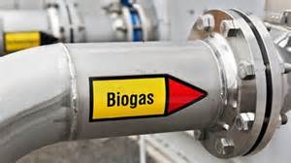
Water Absorption
Our system removes particulate, H₂S, CO₂, H₂O and siloxanes from your digester, wastewater treatment, landfill or other biogas streams.
Skid-mounted systems include a high-pressure, packed media bed, chemical-free water scrubbing and air stripper for removal of CO₂ and H₂S with minimal methane loss.
Achieves up to 98% of the methane content.
To reduce water usage, the wash water system is regenerative, as opposed to a single-pass system.
Moisture removal is accomplished via twin, regenerating desiccant chambers.
To minimize energy usage, a heated slip stream system is utilized where available heat for regeneration is taken from the pressurized biogas through a closed loop, glycol heat coil system.
If necessary, siloxane removal is done by a vertical activated carbon vessel.
Systems include necessary 316 stainless steel knock-out pots and flash drum with demister pads. Main gas pump is configured with an oil-free, direct drive, two-stage twin rotary screw, constructed of 304 stainless steel compressor.
Fresh water metering and circulation pumps are constructed of 316 stainless steel. All systems are fully assembled and factory tested to reduce field installation and start-up time. Should treatment of the tail gas be required, MEGTEC can also provide a flameless, regenerative oxidizer.

Slide 5
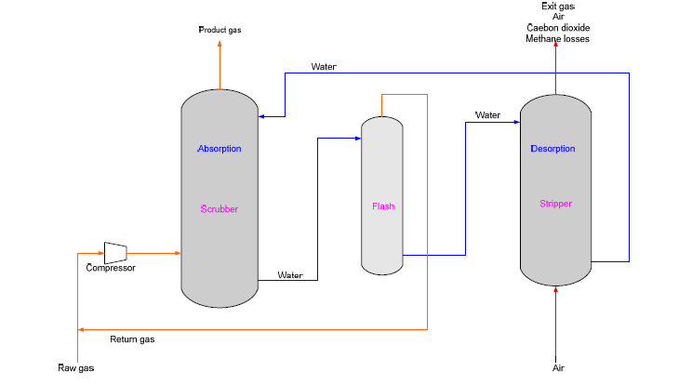
Water Absorption

Slide 6
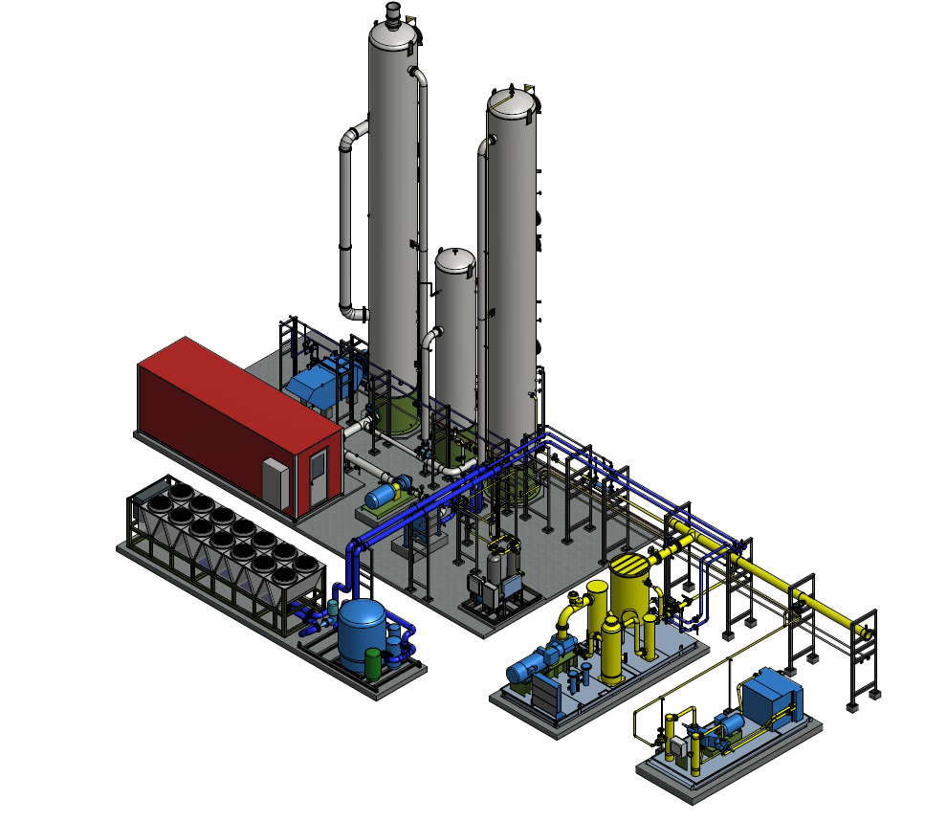
Water Absorption System
Sizes from 300 CFM and up. Twin systems over 3,000 CFM

Slide 7
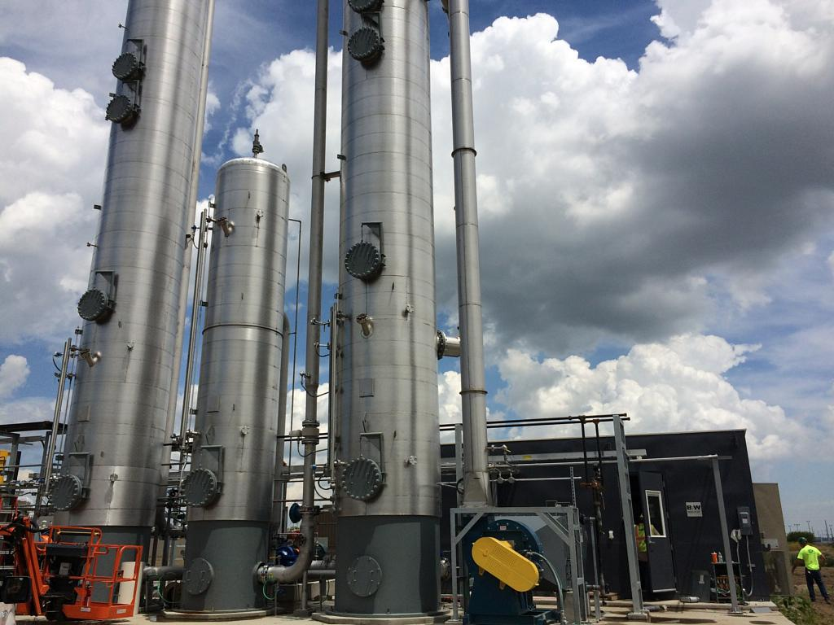
Water Absorption System Installation

