Slide 1
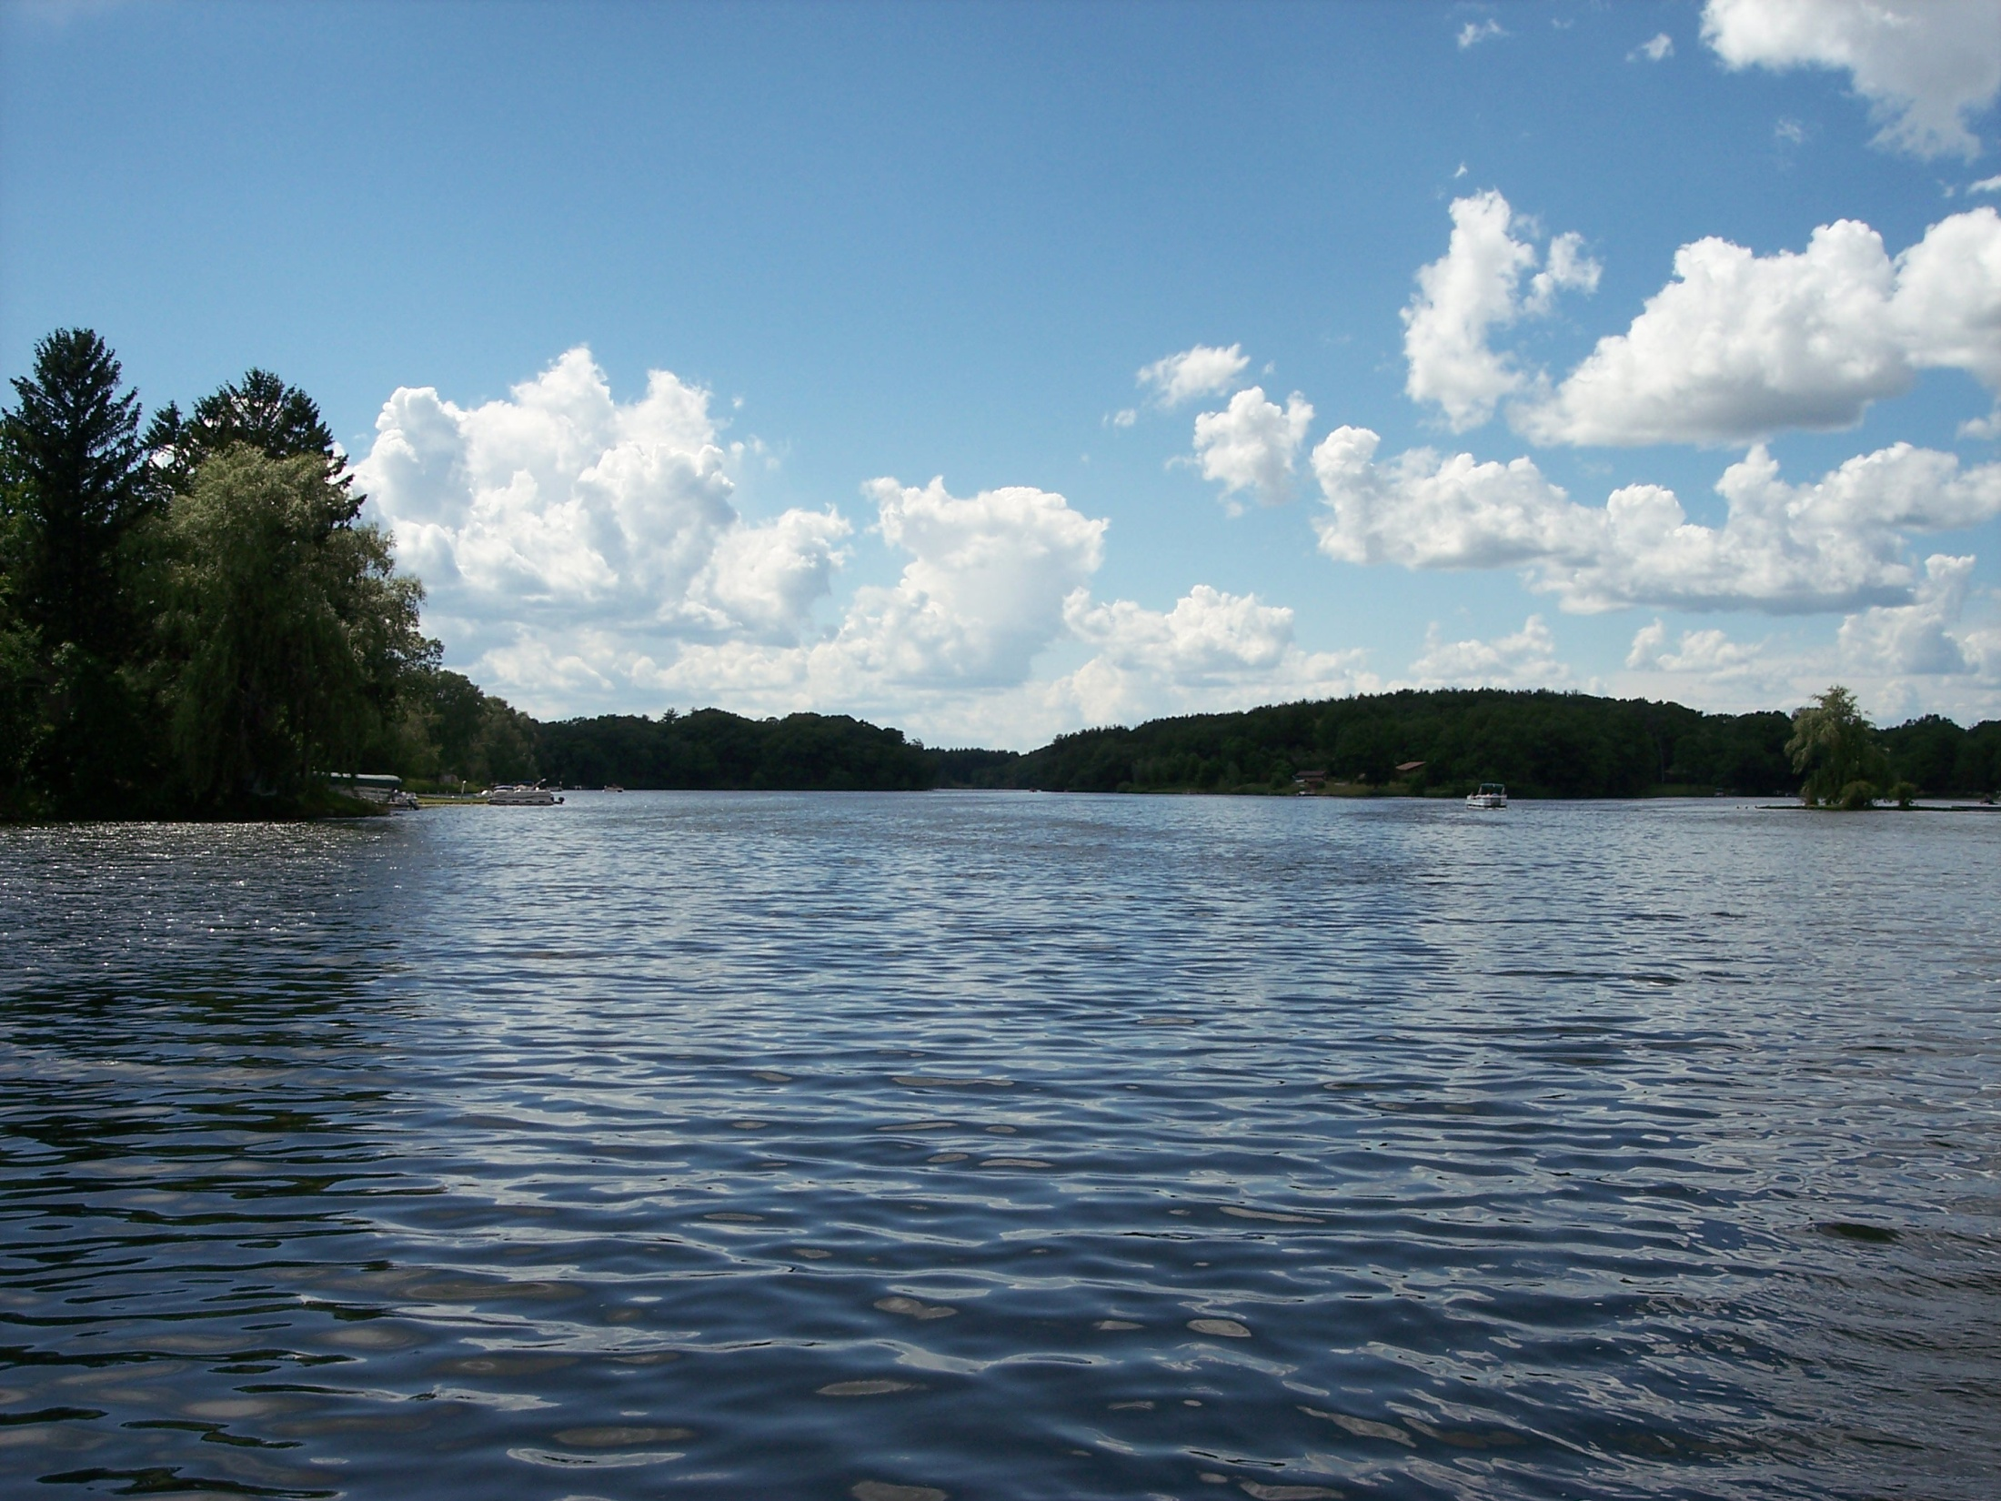

Lawrence Lake P&R District
P.O. BOX 233
WESTFIELD, WI 53964
Annual Meeting:
July 4th, 2009

Slide 2
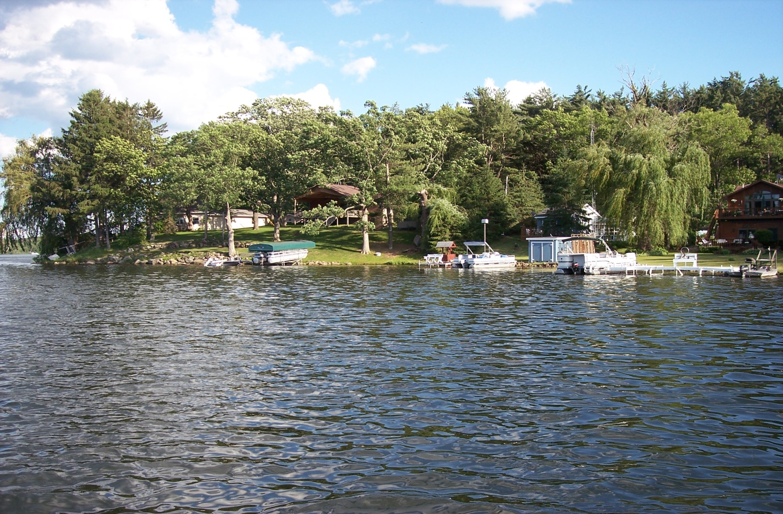
Welcome Members

Slide 3
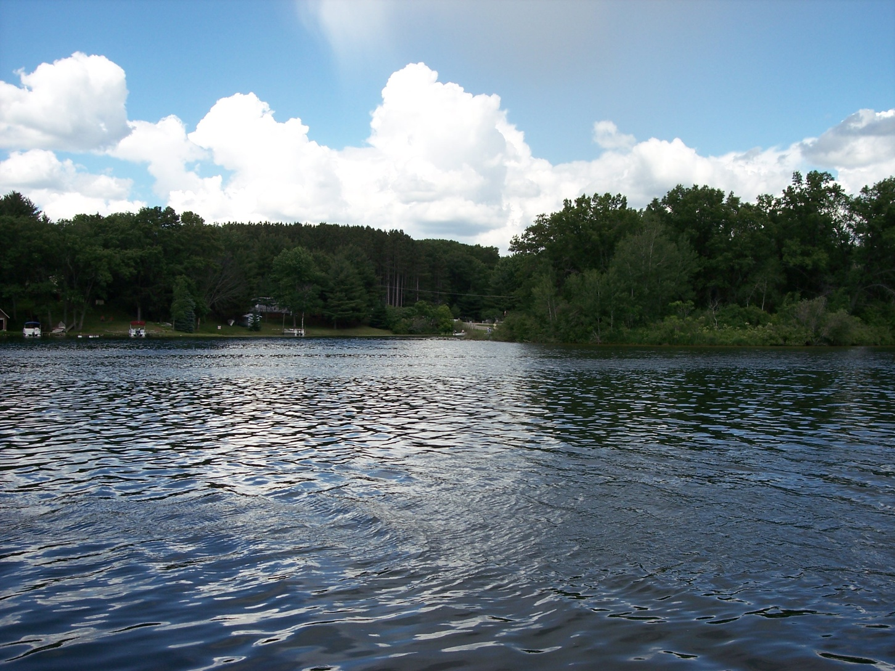
Minutes from Annual Meeting:
July 5th, 2008

Slide 4

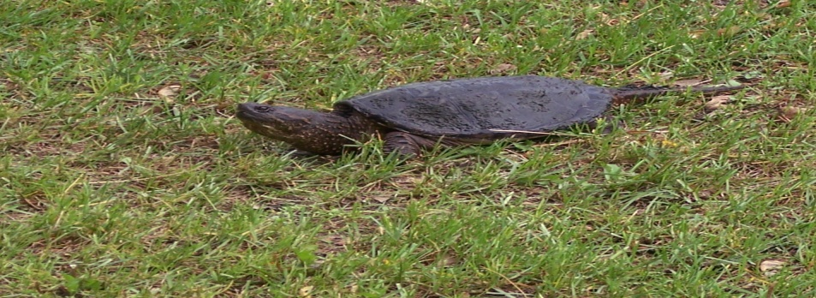

Meeting called to order by the President at 1005 AM
A moment of silence called by the President: For all service members who have served and that are serving.
Members present: Robert Cunningham, President
Mark Kranzer, Secretary
Joni Wilson, Treasurer
Karl Schulz, Township President

Slide 5
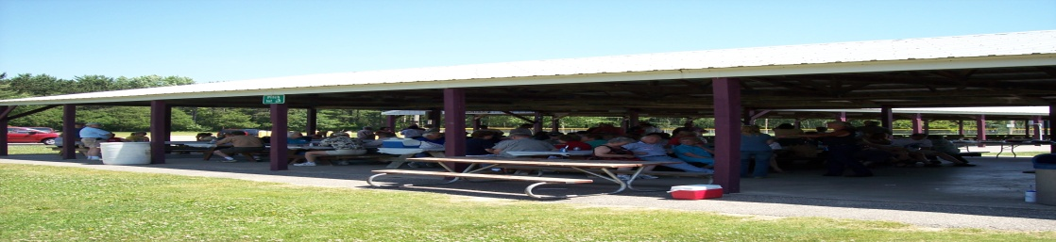
Minutes read from 2007 Annual Meeting:
Member Ray Schmidt had concerns about budget from 2007 Annual Meeting, and wanted to see published budget for year.
Budget was voted on and passed by Membership.
Member Schmidt wanted information on money spent on Water/Silt study.

Slide 6
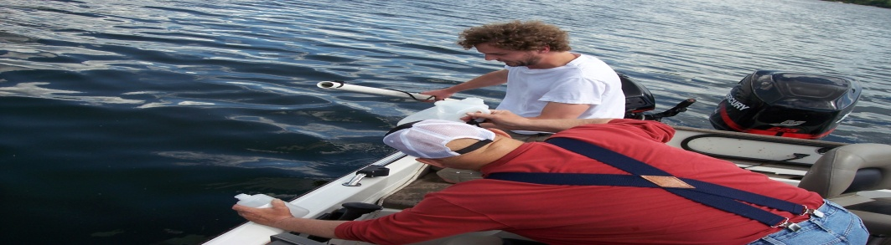
Amendment to 2007 minutes: Members voted on silt study by Leasch Environmental Services, this covered laboratory costs, and permits.
(This section was omitted from the minutes by the Secretary during file transfer).
Member Schmidt made motion to accept minutes with noted corrections. The motion was seconded and the motion was passed by the Membership

Slide 7
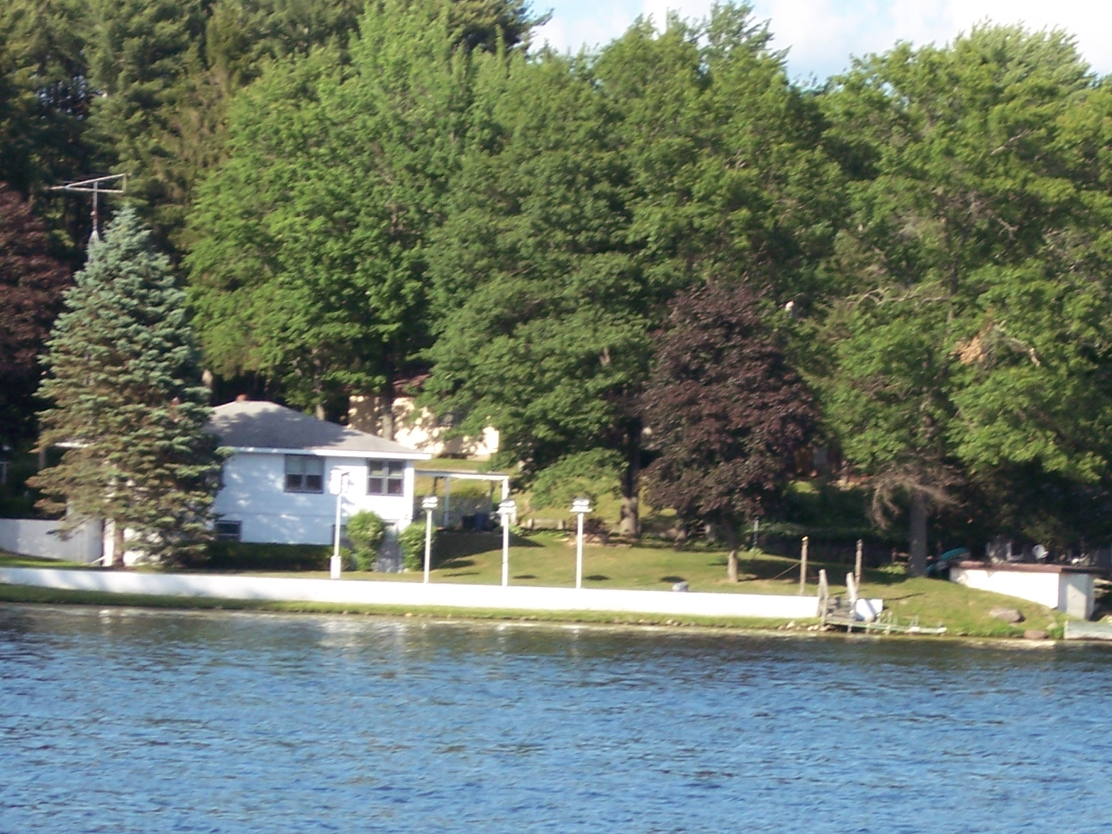
Treasurer’s Report:
Report read by Treasurer, who showed update of all accounts for the year. Expenses and Incomes were noted and read to Membership.
Member Schmidt had inquiries about a budget on Silt Study and payments made: Explained that money for study was approved by the Membership at the 2007 Annual Meeting.

Slide 8
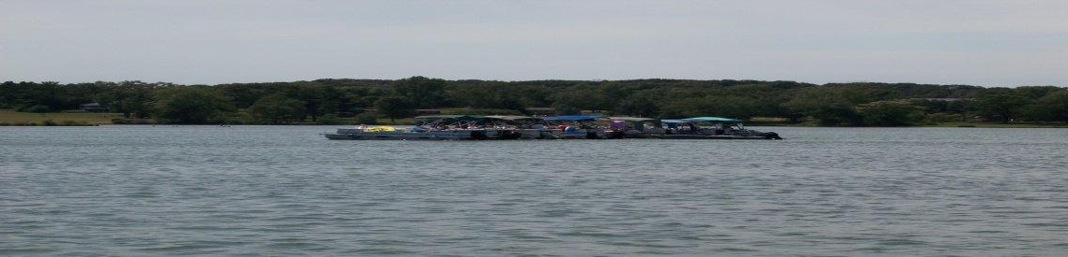
Member Schmidt had questions about money spent for Gypsy Moth spraying this past spring. Member Schmidt wanted to know who approved the payment for the spraying. The President explained during the October Board Meeting a large number of the Membership was present for the meeting with concerns about the Gypsy Moths. The Members present approved the District spending money for the spraying. The spraying costs would be shared by the DNR/Marquette County/The District. The District might also be refunded part of the fee that was paid for the spraying.

Slide 9
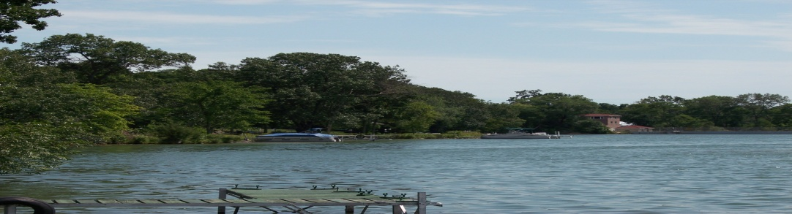
Motion made by Membership to continue with meeting, Member Schmidt made motion to accept Treasurer’s Report; motion seconded and passed by the Membership.
Proposed budget was read by the President, Member Schmidt made a motion to transfer $5000.00 from expenses to balance budget. Motion was seconded and passed by the Membership

Slide 10
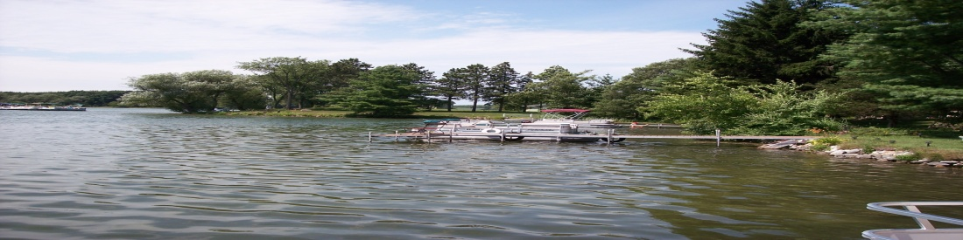
Old Business:
Gypsy Moths: Spraying was completed in June, and notice of spraying was mailed to Membership. Three zones around lake were spayed with positive results noted (Refer to Zone Map, from mailing). Further study will be completed by the DNR to see if further sprayings are needed.

Slide 11
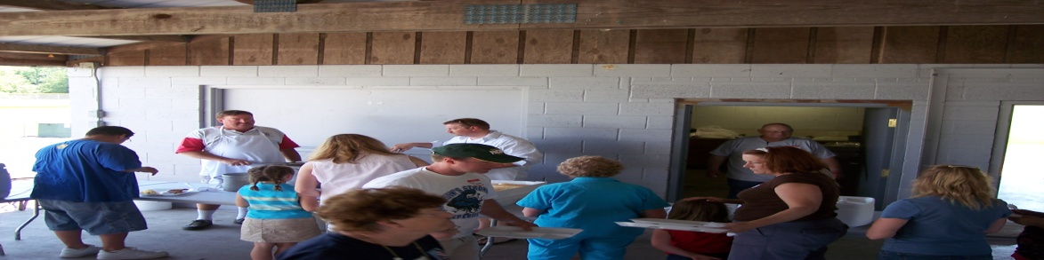
Silt Removal: The President meet with the District’s DNR representative about the silt removal from the head waters of the Lake. High cost factors are present for dredging the area (approximately $250,000- $500,000), DNR recommends a draw down during the months of August, September, and November, to properly compact the silt. If the draw down is done during winter months the silt would not compact properly, moisture would remain in the silt and would react like a sponge when water is reintroduced to the silt. The President also received a copy of the silt samples, and the Engineering Company’s recommendations. The DNR seems open minded about the different options available to the District, permits and grants are slow going for requesting, and applying

Slide 12
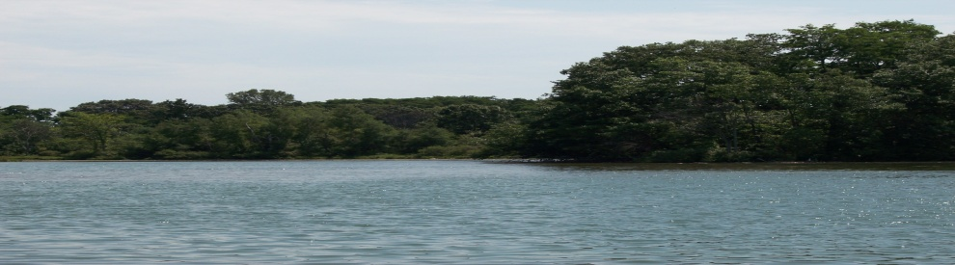
`
Weed Control: The Lake was recently sprayed by Marine Bio-Chemists. It was also noticed that Lilly Pad populations are down from the past, this is do to the heavy snow/ice during the winter. Lilly Pads are a shallow water aquatic plant that is one of the first to suffer from hard winters. Natural plant growth is normal on the Lake. Grants for weed control have been applied for, and are due out this August: these grants cover spraying, and study costs

Slide 13
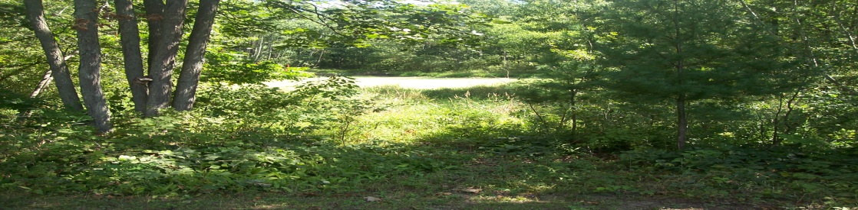
No Wake Ordinance: Information was presented to the Township Board, the Board voted to table the Ordinance until more information was collected on the reason/impact for a complete No Wake Ordinance to the Lake.

Slide 14
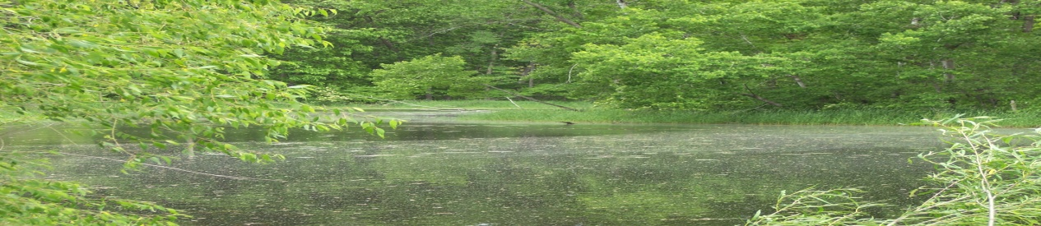
Shoreline Erosion/Control: Wisconsin bans the use of Fertilizers that contain phosphates on any properties on or adjacent to waterways. Rip-raps can be placed, but proper permits need to be secured from the DNR, and strict guidelines are to be followed. Planting of natural plants along shorelines will help against erosion, with the help of Bio Logs, to hold the plants in place.

Slide 15
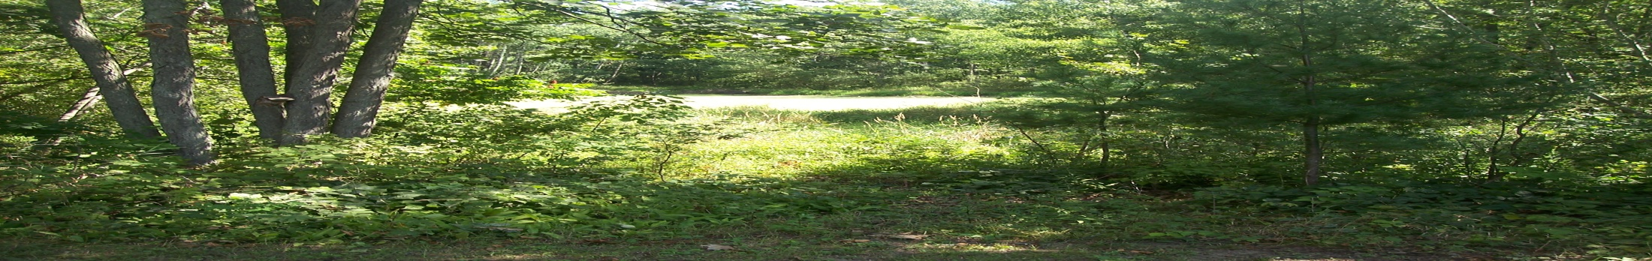
The logs are biodegradable and do not harm the environment. Ice damage is the leading cause for erosion, the ice as it expands pushes against the shoreline. This can cause the shoreline to push upward, or rip-rap to be pushed under the existing shoreline causing humps, and ridges.

Slide 16
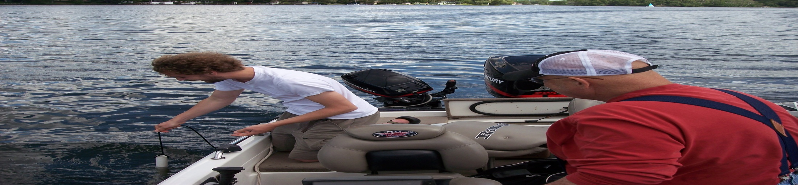
. A possibility to eliminate this problem would be a draw down of 6-8 inches from November through ice off. By doing this the ice will not push against the shoreline. Approval for a draw down would have to be approved by the DNR and the Membership. It was also noted people are “hugging” closer to the shore when traveling around the rock bar off Boy Scout Island, causing shoreline damage.

Slide 17
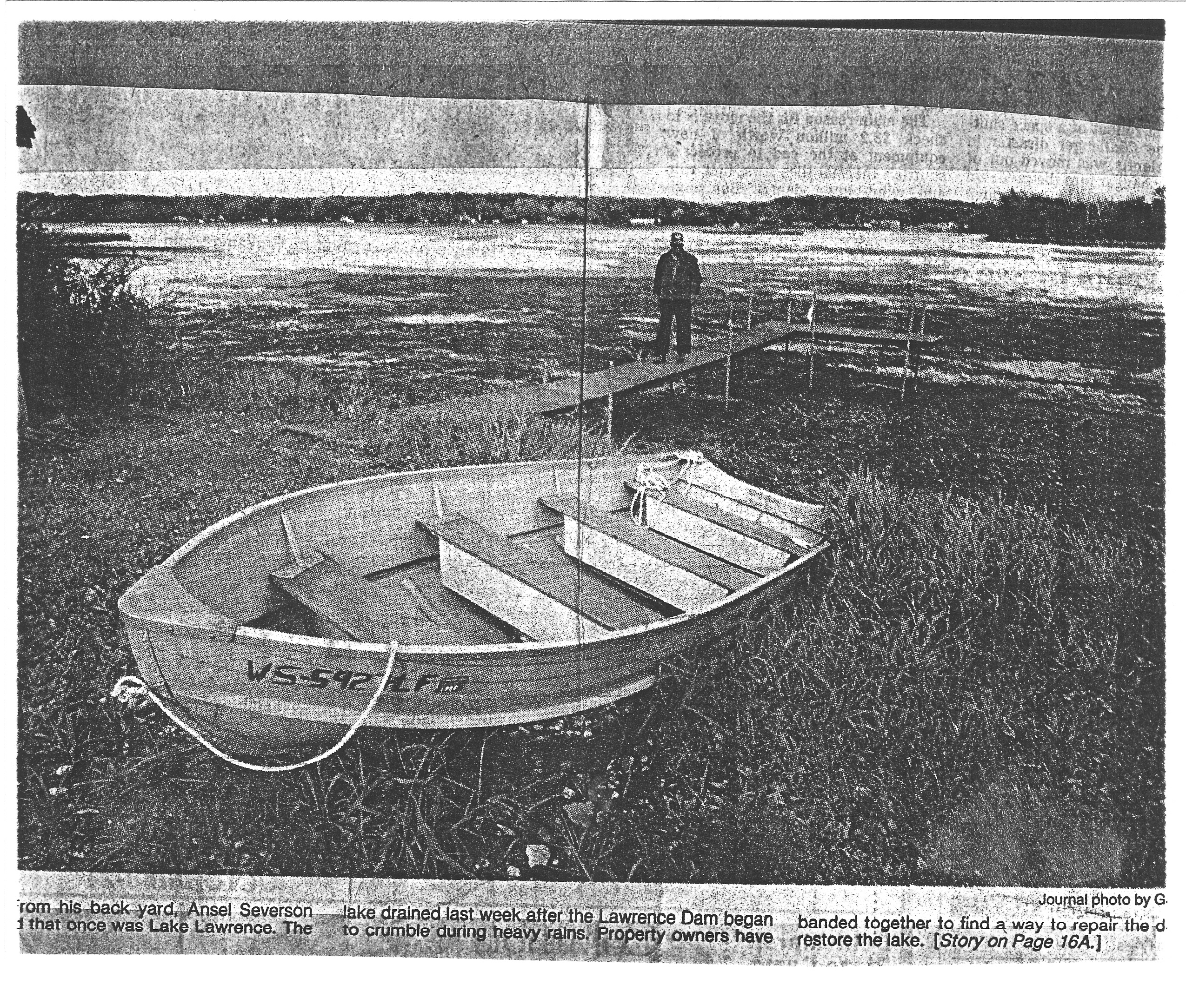
New Business:
Election of Board President: Ray Schmidt & Fritz Menke made a motion to nominate Bob Cunningham for reelection as president. The motion was accepted, and voted on by the Membership. Bob Cunningham accepted the position of President for another 3 year term

Slide 18
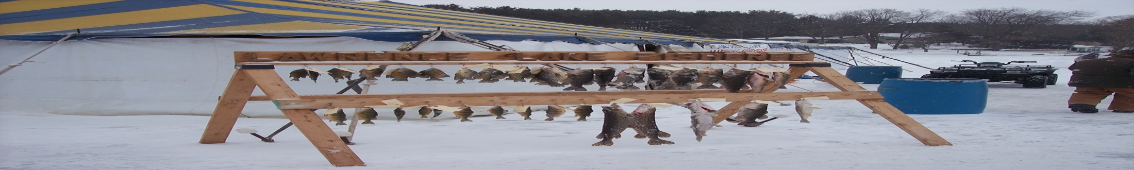
Tax Adjustments: With the cost of Gypsy Moth spraying there is a chance that the Association fee would be increased $16.00-$20.00 per household for this upcoming year.
Ray Schmidt made a motion for not increasing the fees for next year, instead by using existing funds that were freed up with the balancing of the budget. The motion was made and seconded and passed by the Membership.

Slide 19
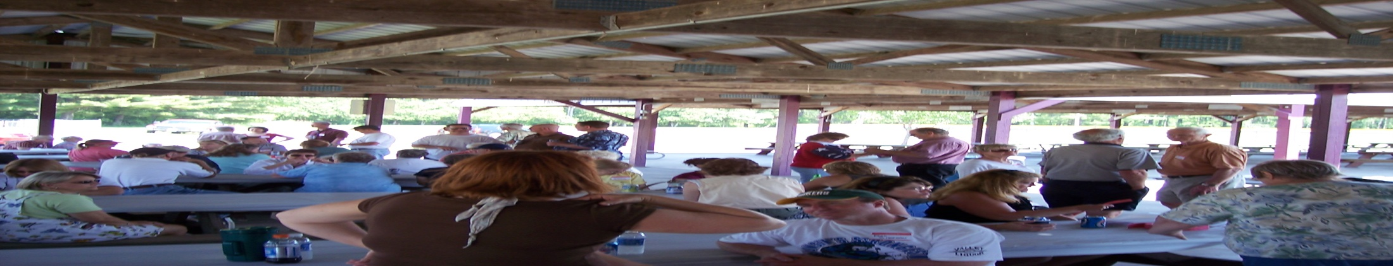
Donations: Donation to Township/ Sportsman’s Club for ramp up keep.
A motion was made by the Secretary for a donation to help with the upkeep of both landings. The motion was not seconded, and would be tabled as funds became available for donations.
Fritz Menke, of the Sportsman’s Club was grateful for the offer, but the Sportsman’s Club does not need the funding or assistance at this time.

Slide 20
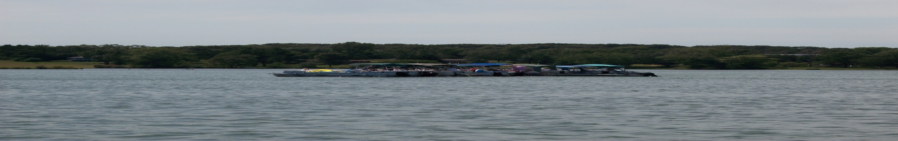
Donation to Fire/EMS agencies placed on hold, until funds become available.
Ray Schmidt made a motion that when funds from third party sources became available, donations could be made with those funds. The motion was seconded and passed by the Membership.

Slide 21
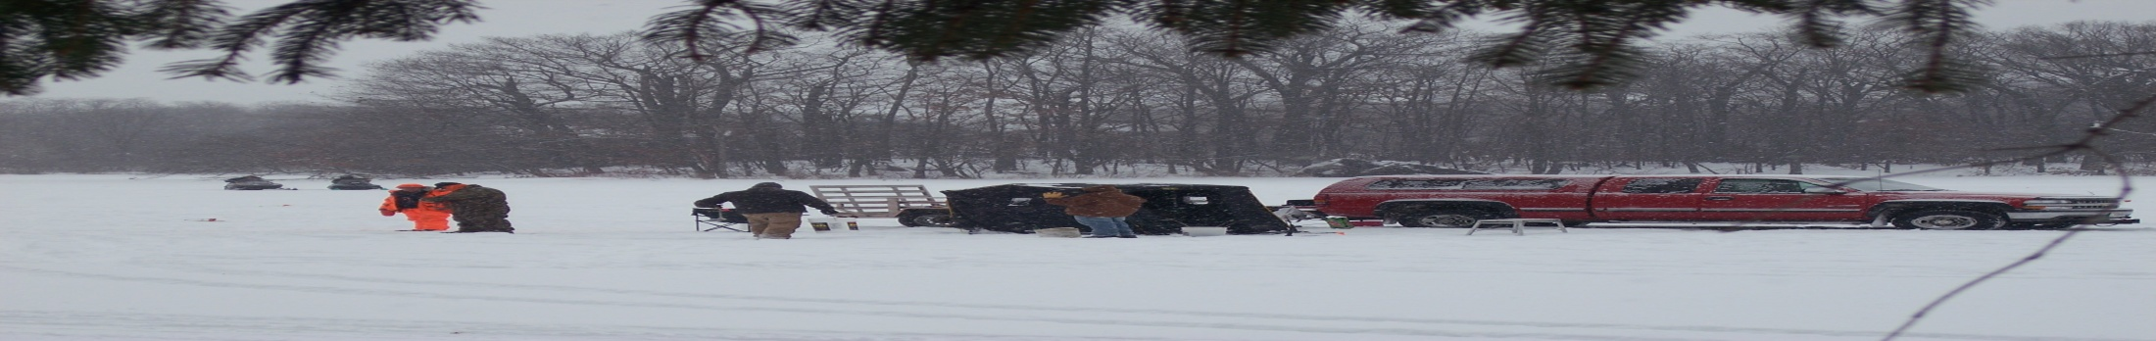
Raffles: The District is in the process of looking into the use of raffles to help generate revenue for the District. The District would have to apply for State permits, which are a minimal cost for the application.

Slide 22
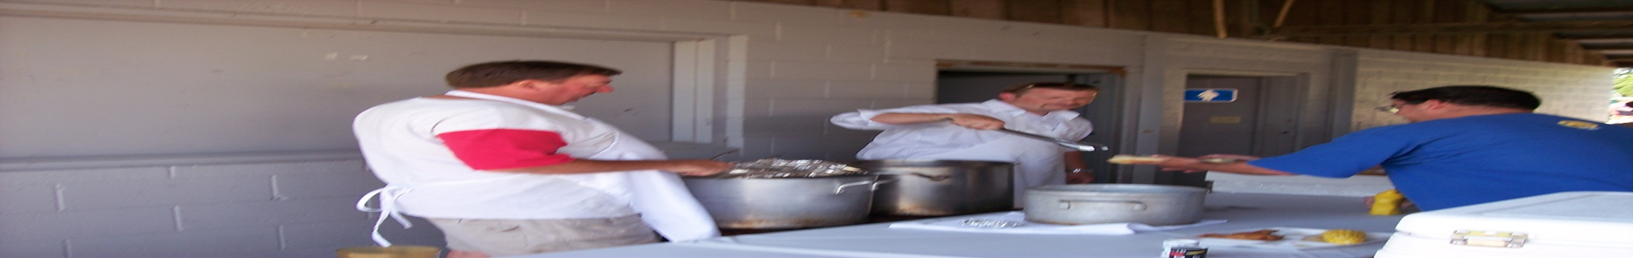
Ramps continued: The ramps are in need of repairs in the water, we would have to make contact with the DNR about any repairs that need to be made. The Township maintains the ramps up to the water.

Slide 23
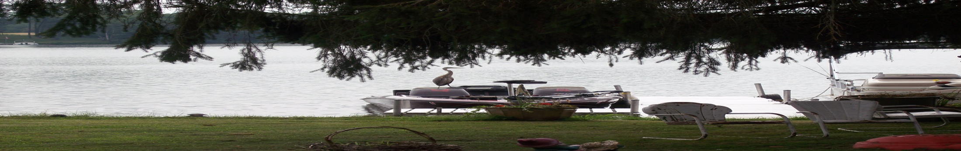
DNR: Our current DNR contact is a local representative with offices in Wautoma. He was recently issued a boat by the DNR; this in turn will make his job easier visiting his assigned lakes.

Slide 24
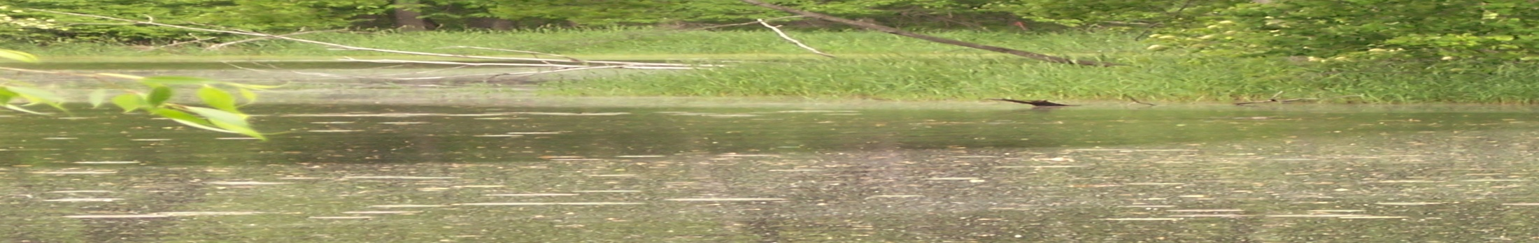
Other Business:
Watershed Study: The Montello Lake Association is in the process of completing a watershed study from the head waters of Lawrence Creek, down to Montello Lake. The Study is being completed by the UW Extension Program in Stevens Point. The study is trying to find the source for the heavy aquatic plant problem in Montello Lake. The study encompasses the following areas: Water clarity/PH/ temperature at different depths, and oxygen levels. Preliminary reports on Lawrence Lake are positive, at this time.

Slide 25
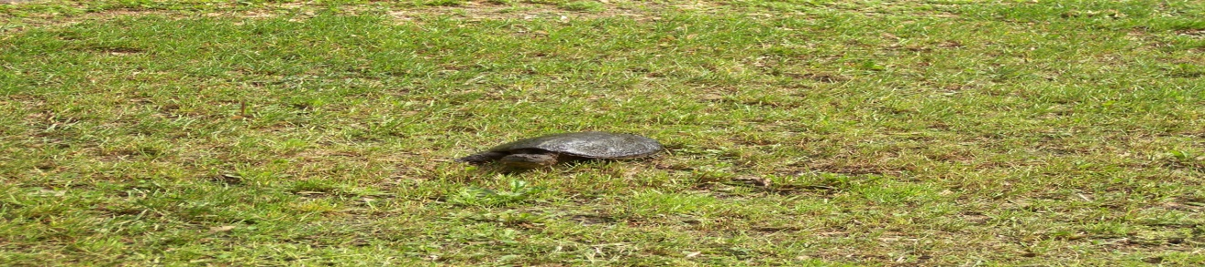
Membership: At this time there are a total of 116 on water members, and 133 off water. This total encompasses the entire watershed of the Lake. If an off Lake Member (no lake access) no longer wants to be part of the District, they may petition the Board for removal.

Slide 26
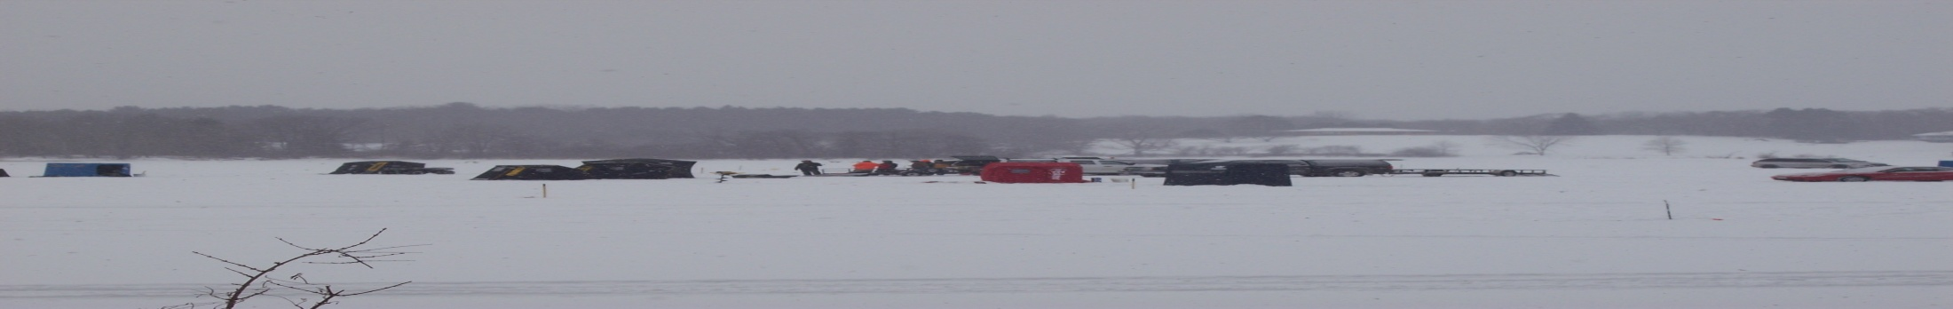
Logging: With new construction going up around the Lake, logging is being done to open the land for new homes. It has been noted by Members that once the heavy timber is removed the area is not being totally cleaned up. This is leaving the area an eyesore until the new construction goes up. Contact has to be made with the reality/ construction firms doing the work. If this does not resolve the issue, contact needs to be made with Pat Kilby at the Marquette County Conservation Office, in the Industrial Park in town. Zoning for the area also needs to be confirmed for residential for the new construction.

Slide 27
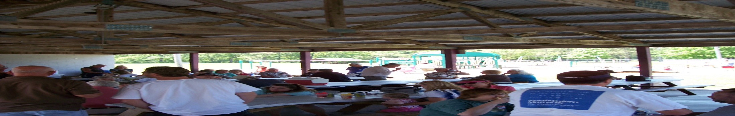
Website: The District has purchased a domain name for the next three years, at a cost of $114.00. We also purchased an upgraded hosting package for the same amount of time for $131.00 . The Website name is: www.lawrencelakeprdistrict.com. The site should be up and running in the next couple weeks. The site will include: Our Home Page, with Mission Statement/ District news section/ upcoming district events/ photo gallery/various links/e-mail to the Board Members. The District is also putting letters in the mail for local business if they would like to advertise on the site. Once we get responses from the business a yearly fee will be discussed with them.

Slide 28
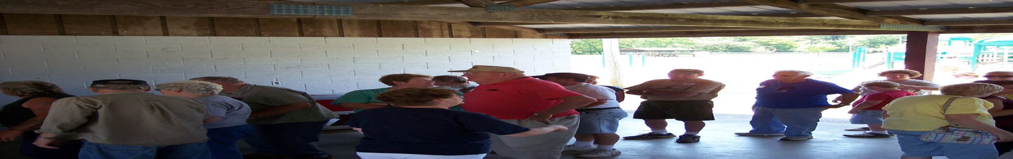
Meeting adjourned at 1140: Motion made by Ray Schmidt to adjourn meeting. Seconded and passed by the Membership.

