Slide 1
Lawrence Lake
Drawdown?
September 12, 2009
Ted M. Johnson
Water Resource Biologist
DNR - Wautoma

Slide 2
Agenda
Review ‘natural’ lake hydroperiods
Discuss benefits / drawbacks of DD’s
Discuss results of recent local DD’s
Future management
  Decisions made by lake district, local government, DNR, misc. stakeholders
    Educate and learn!
    Adaptive!

Slide 3
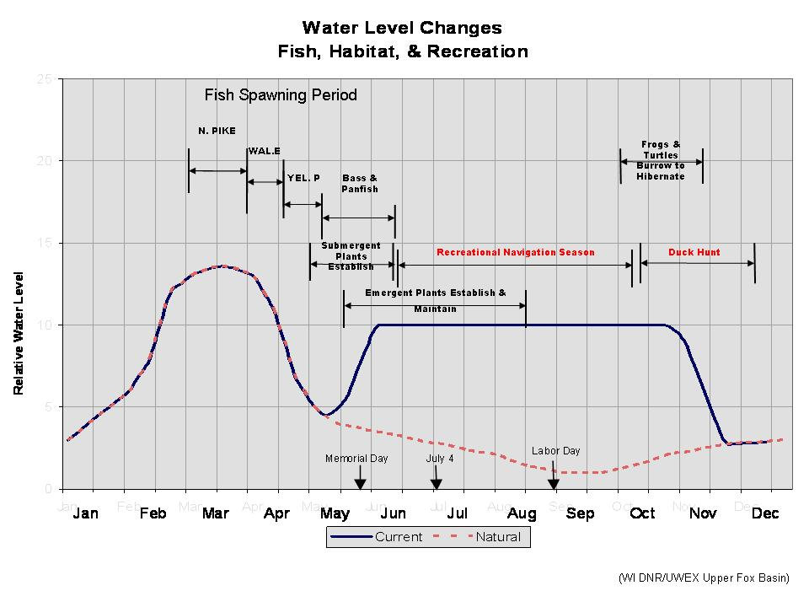
Oops Area

Slide 4
Water Level Cycling in Natural Lakes
The Low Year
Emergent plants expand excess nutrients used
Littoral Zone (may be found deeper)

Slide 5
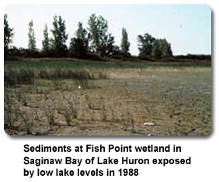
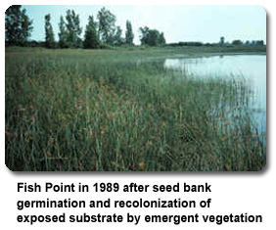
Understanding and Using the Tool
Mimic Mother Nature.
Used Nationally - USGS (Great Lakes Science Center)
Used in Wisconsin - NER, WCR

Slide 6
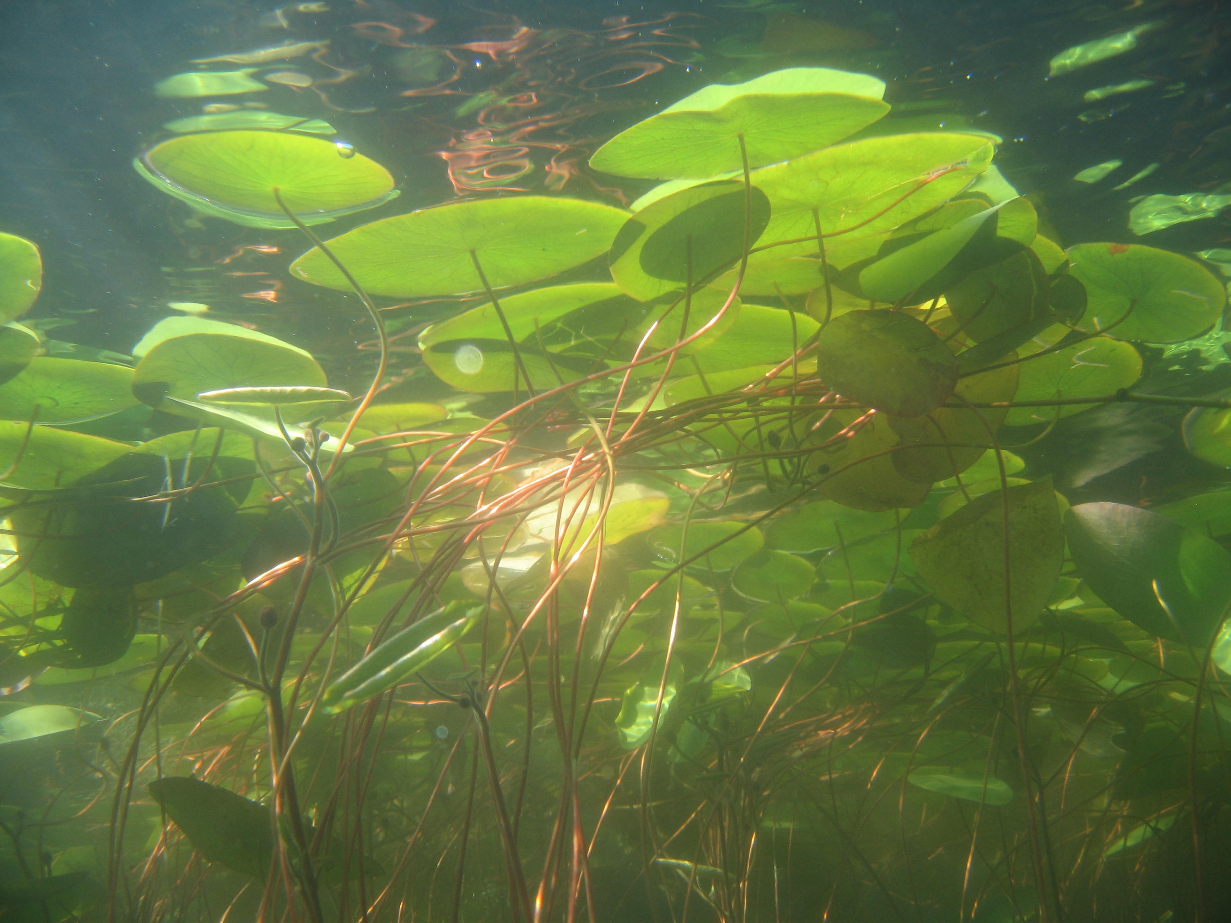
Value of emergent plants
Critical habitat for fish, aquatic insects & wildlife
Protects shorelines from erosion
Root systems hold lake-bed sediment, removes nutrients & improves water clarity
Competition that limits aquatic invasives

Slide 7
Drawdown’s
Restores natural ebb and flow
Restore natural rhythm of ecosystem
  Evolution of plants and animals
Consolidate organic sediments
Improve fish spawning substrate
Increase biological diversity (FQI)
Good health management of lake.
Control some AIS (EWM, CLP)
It’s a good thing…

Slide 8
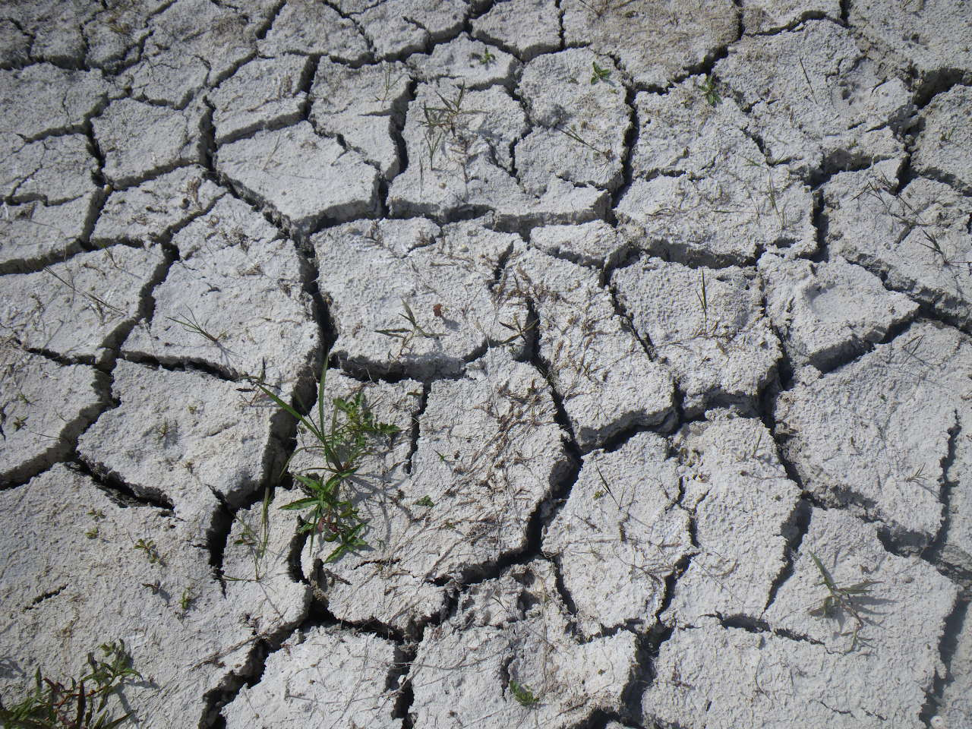
Lake Sediment
(desiccation, decomposition and consolidation)

Slide 9
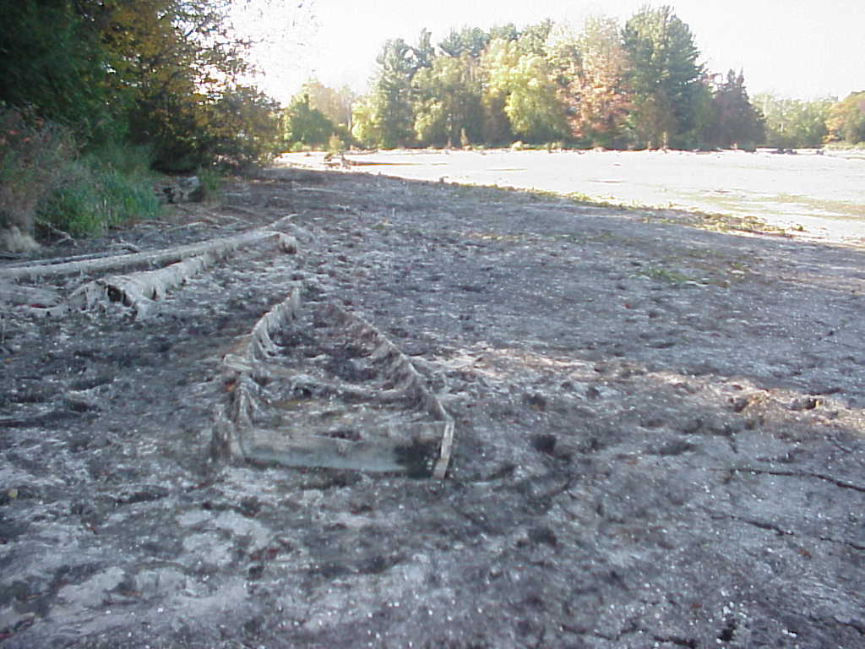
Why does this work?
(Aeration)
O₂
CO₂

Slide 10
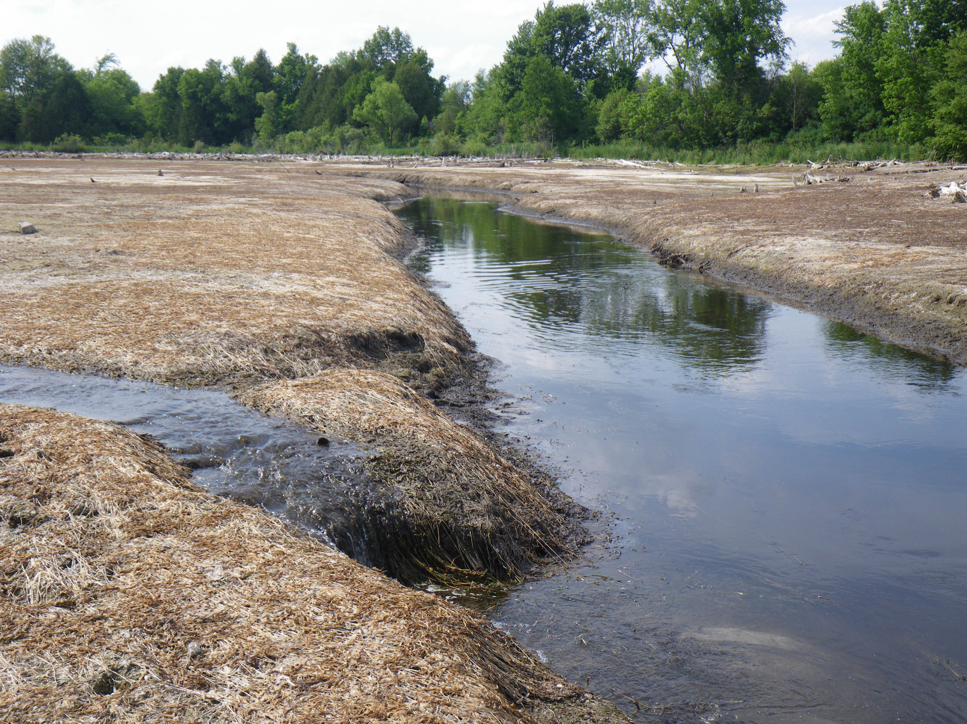
Head-cutting: Marion Pond

Slide 11
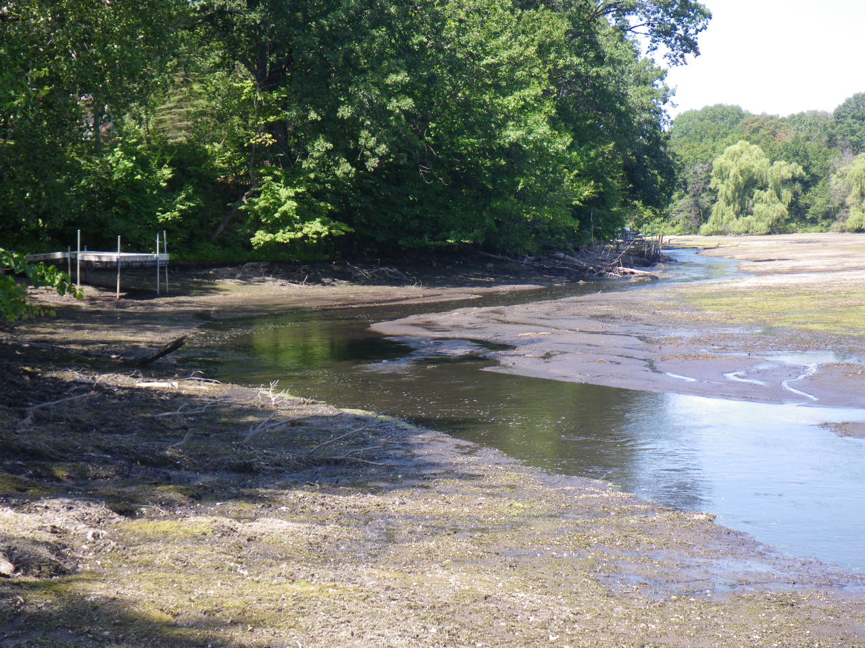
Head-cutting: Neenah Lake

Slide 12
Partial Winter Drawdown Marion Millpond, WI
September though April

Slide 13
Marion – FQI’s
Notes:
Pre 19 Post 27

Slide 14
Pre & Post EWM and CLP
Percent Coverage
Notes:
Pre – max of 74% EWM 40% CLP
Post Max 5% EWM 6% CLP

Slide 15
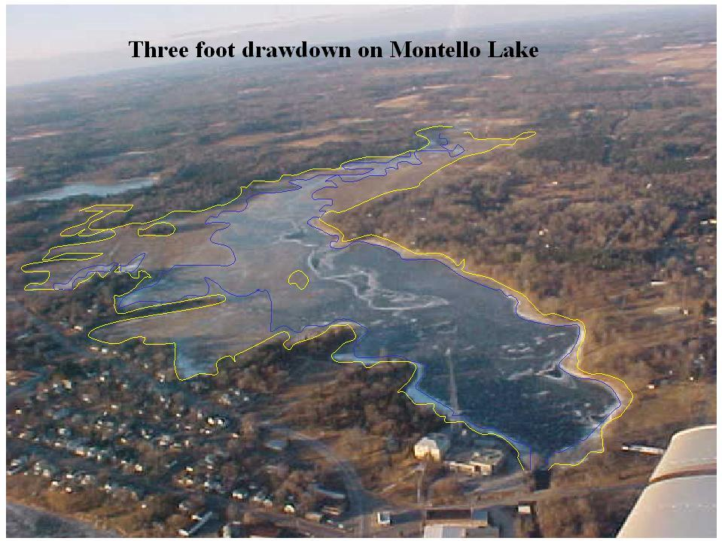
Partial Winter Drawdown Montello Lake, WI
September though April

Slide 16
Montello Lake
(Aquatic Plant Results)
Pre DD EWM frequency 80 %
Post DD EWM frequency 6 %
Pre DD FQI 18
Post DD FQI 23

Slide 17
Future Management?
DD’s are a voluntary action
  Very Adaptive
Decisions made by
  Lake District, local government, DNR, Misc. stakeholders

Slide 18
Proposal for the DD
Summer DD’s best for sediment consolidation
  Biological activity optimal
  Decreases AIS - intolerant
  Increases native plant diversity

Slide 19
Proposal for the DD
Summer DD
  as long as possible
Water levels low enough to pass sediment through the system
  as low as possible

Slide 20
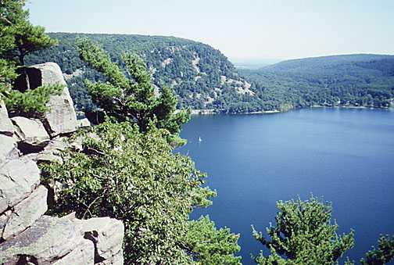
Thank You!

