Slide 1
Road Building 101
General Road Construction Information

Slide 2
Drainage: A Critical Factor
Drainage impacts pavement performance when the subgrade materials and pavement layer materials are saturated and loose strength. Water that falls on the pavement surface must be drained to curb and gutter systems or ditches. Water that penetrates the pavement from the surface; infiltrates from the sides of the road; or rises from under the pavement should not be allowed to compromise the overall strength.
To account for surface water drainage, it is important that the road be constructed with a crown or cross slope. Typically, a crown is placed in the center of the road and the pavement is sloped 2% in each direction.

Slide 3
Reconstruction Grants:
Eligible Costs: Any items that are an integral part of the street and road reconstruction which may include feasibility studies, design engineering, grading, base, paving, right-of-way acquisition or the purchase of finished hot mix asphalt.
Ineligible Costs: New Roads. Any utility work: new installation or alterations of sanitary sewers and connections, water, gas, electric, telephone, police, fire alarm facilities, parking meters, street signs or similar utilities.

Slide 4
Key Road Building Components
Crown:
The road surface should be higher in the center, not flat
Pitch:
Road surface should be sloped 2 to 3 degrees lower from the center line to the edges
Base:
The road surface should be supported by a strong base material, usually gravel
Shoulders:
Each edge of the road should have a gravel shoulder
Ditches
Wherever possible ditches should extend a short distance beyond each shoulder

Slide 5
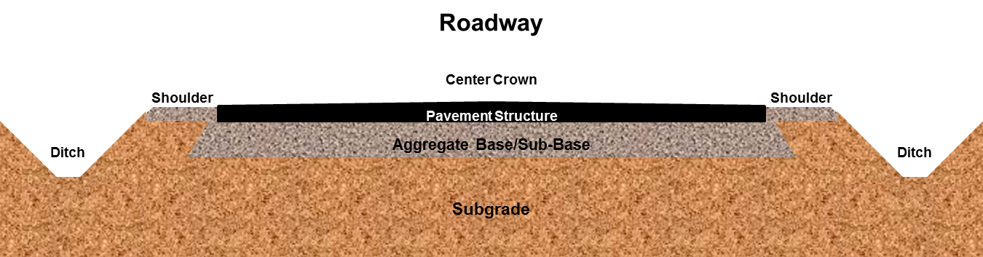
Basic Roadway Construction Diagram

Slide 6
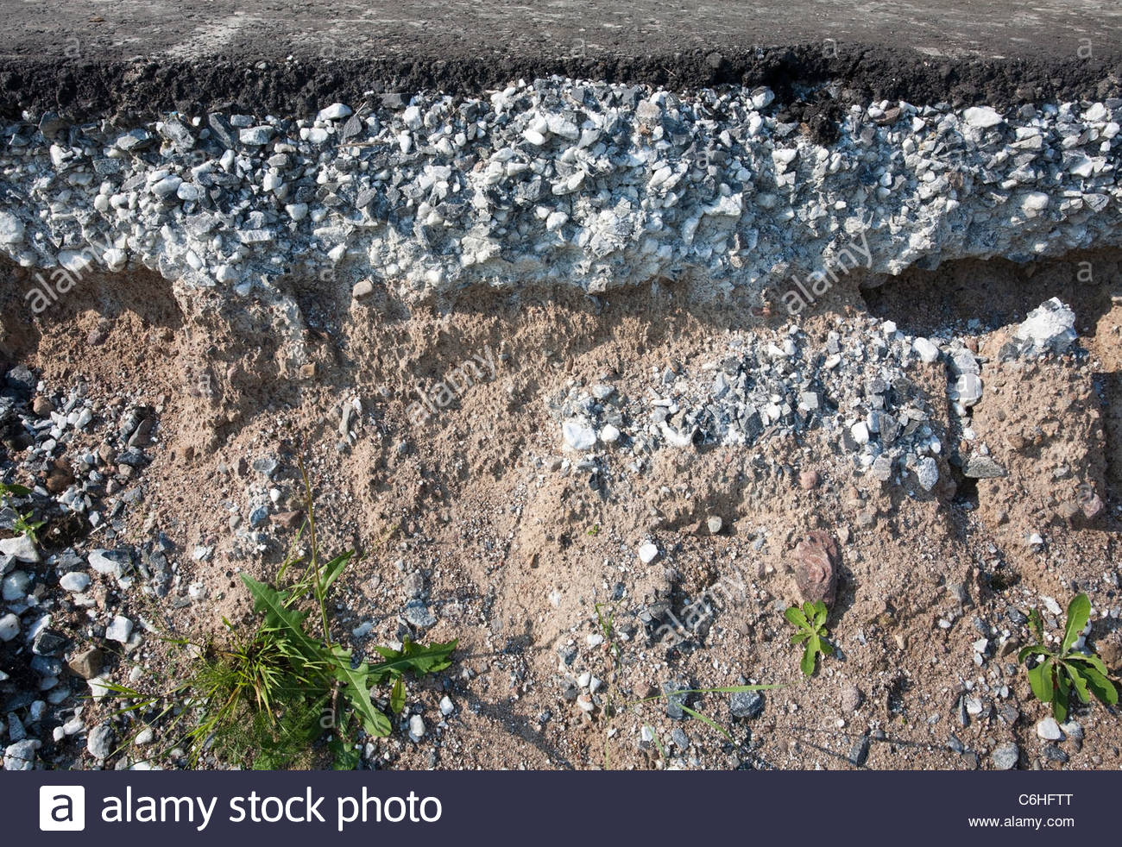
Typical Northwoods Chip Seal Cross Section
Chip Seal Surface
Gravel Base
Soil Type: Sand

