Slide 1
Town Road Survey
What You Should Know

Slide 2
Town Roads What you should know!
Mileage:
93.17 miles surveyed
29.01 miles – No improvement work currently required ( 29% )
64.16 miles – Improvement work required ( 71% )
Survey Criteria:
Occupancy (low = 1, high = 5)
Traffic (low = 1, high = 5)
Condition (poor = 5, good = 1)
Additional one half to one full point awarded for single access roads)
Maximum points awarded 15

Slide 3
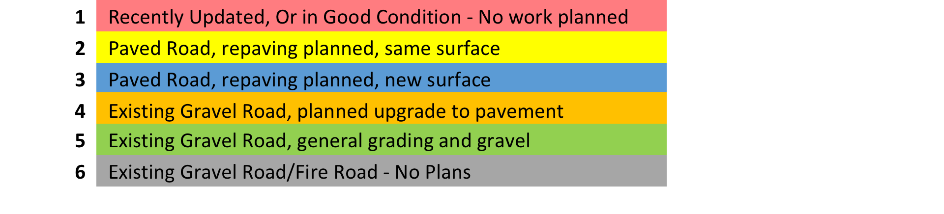
Town Roads What you should know!
Road Survey Categories:

Slide 4
Town Roads What you should know!
Key Survey Results:
High Priority Roads (High Occupancy, High Traffic, Worst Condition) were designated to become asphalt roads making them the most expensive to fix.
Allen Rd / High Lake Rd. / High – Fishtrap Lake Rd feed the largest number of residents.
North Creek Road (4.5 Miles) is the single longest town road and a key emergency road between Hwy M and Hwy H.
Newcomb Rd (3.5 Miles) and Fallon Rd (2.0 Miles) are long, single access roads.

Slide 5
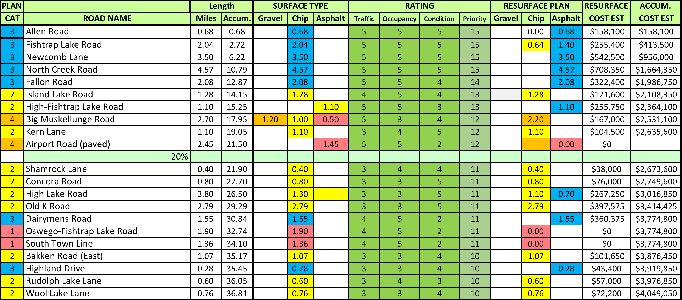
Town Roads What you should know!
Top 20 Roads:

Slide 6
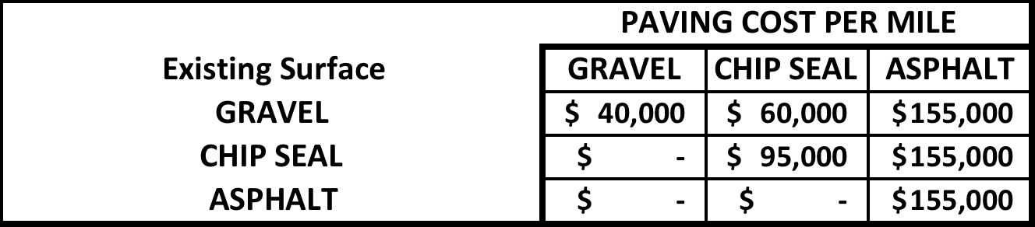
Town Roads What you should know!
Road Cost Estimate Matrix
Matrix is based on 2015 data and will be updated to create the final plan options.
Road Improvement Levels / Costs:
Gravel to Gravel - $40,000 per mile
Gravel to Chip Seal - $60,000 per mile
Chip Seal to Chip Seal - $95,000 per mile
Chip Seal to Asphalt - $155,000 per mile
Asphalt to Asphalt - $155,000 per mile
Note: 2015 Cost Data –
REQUIRES UPDATING

Slide 7
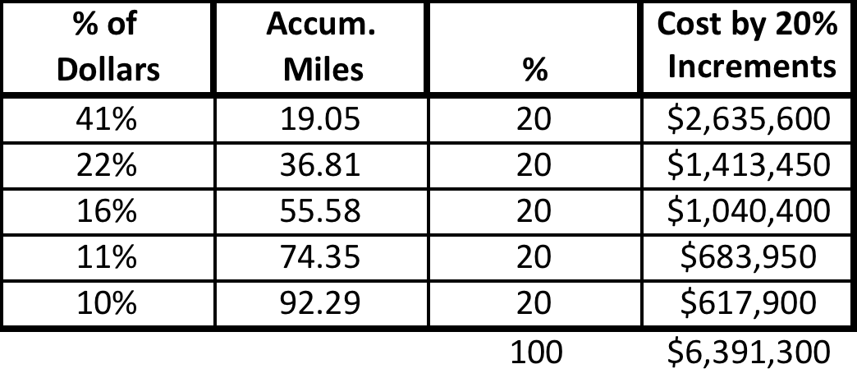
Town Roads What you should know!
Road Survey Mileage / Cost Summary
The first 19 miles of road (worst shape, highest traffic, highest occupancy) would require 41% ($2,635,600) of the total budget ($6,391,300), and cover 20% of the total miles of town roads.

Slide 8
Town Roads What you should know!
Road Materials:
Asphalt
Average Life span of an asphalt road without maintenance is 16 years to total failure.
With regular maintenance and repair, it can be extended to 30 years or more.
Asphalt is applied over the top of gravel, usually in two layers. The typical finished thickness is 3 ½”.
Chip Seal
Chip seal was originally designed as a cost effective asphalt maintenance surface not necessarily a stand alone road surface.
A chip seal surface is applied to a gravel base to provide a wearing surface and dust free environment.

Slide 9
Town Roads What you should know!
Road Materials:
Chip Seal
A gravel road is prepped for chip seal by grading and compacting to add the appropriate slope and grade for proper water drainage.
A chip seal surface is applied in two coats. The first coat, a 5/8” chip. Is applied to create a base layer of top of gravel. The second layer, a 1/4” or 3/8” chip, is applied on top of the base to create the surface layer. The finished surface is less than inch in thickness.

