Slide 1
Town Road Redevelopment Plan
Concept Introduction & Overview
Town of Boulder Junction
1 December, 2015

Slide 2
Background
Roads are the Town’s most important infrastructure asset
  Important to residents, seasonal owners and visitors
Budget makes it impossible to adequately maintain
  Able to patch / repair for routine wear & tear only
  Emergent major repairs & heavy industrial use (logging) strain our abilities
Most common complaint from electors is “roads……”
Continuing on our current path will not yield better results
  We need a ‘redevelopment’ strategy for our roads

Slide 3
Town Road Basics
120 Town Roads, approximately 93 miles
  Approximately 45, or 26 miles are unpaved, and
  Approximately 75, or 67 miles are paved
Many of our roads have not been resurfaced in >25 years
  Approaching, or past their useful life limits
Type & volume of traffic varies significantly
  Seasonal, main feeder, logging or other industrial, etc

Slide 4
Life Cycle Basics
Paved Roads can have a 25-30 year life, depending on various factors
  Usage: traffic volume, gross weight, weather, material, foundation
  Maintenance: type, frequency, timing, quality
Approximate Road ‘paving’ costs (per mile)
  Gravel $40,000
  Chip Seal $95,000
  Asphalt $155,000
Current Town Budget levels do not allow us to maintain or improve the situation – if we do nothing – it gets worse

Slide 5
Road Redevelopment Plan / Approach
Address the complete road system in shortest period of time
  Accomplish in 24 month period
  Re-baseline overall condition
  Improve our ability to ‘maintain’ the roads with traditional budget
Finance via State Loan or G.O. Bonds
  20 year term
Seek Grants & other cost share for at least 25% of total cost
This approach would set us up for the next 30-40 years if we maintain the roads at a higher level

Slide 6
Draft Concept Highlights
Work planned on 84 of 120 Town Roads (69% by mileage)
  Upgrades 16 gravel roads to paved
  Upgrades 7 paved roads to Asphalt (~14 miles)
Key Road features to be Re-Engineered/Improved (TBD)
  Culverts, shoulders, turn arounds, signage, visibility, etc.
Adds ‘Bike Lanes’ creating local ‘Loops’ (where possible)
  Airport Loop: Dairyman’s, Airport
  White Deer Loop: High-Fishtrap, High, Allen
  Old K Loop: Old K
  Marsh Road Bypass: Marsh
  North Creek Loop: North Creek

Slide 7
Redevelopment Plan Preliminary Estimate
These are preliminary estimates for planning and consideration
  Road Surface Work $ 6,393,400
  Road Improvements $ 350,000
  Engineering Work $ 250,000
  Legal Work $ 100,000
    Sub-Total $ 7,093,400
  Grants / Cost Share $-1,775,000 (~25%)
    Total Estimate Cost $ 5,318,400

Slide 8
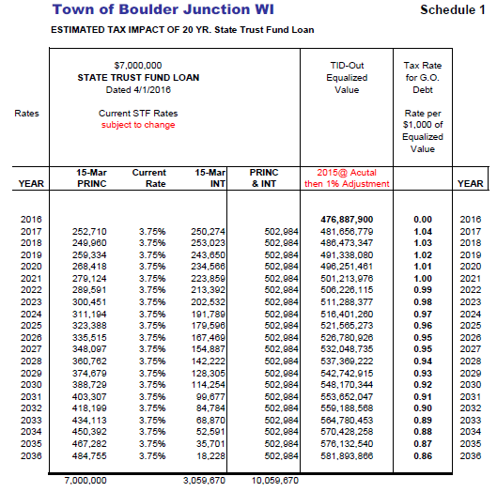
Financing Plan
Option 1
  State Trust Fund Loan
  Slightly Higher Finance Cost
  Higher Potential Tax impact
  Slightly less complicated

Slide 9
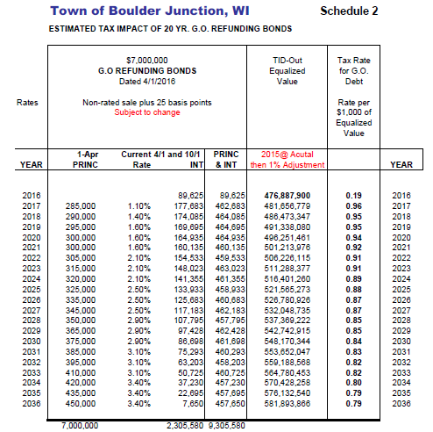
Financing Plan (cont’d)
Option 2
  General Obligation Bond Issue
  Lower potential Finance Cost
  Lower Potential Tax impact
  Slightly more complicated
    Higher Admin Cost?
Bond Special Rules
  >$7m, use within 24 months
  <$5m, use with 36 months
  To be explored more

Slide 10
Going Forward Plan / Schedule
Approval to Proceed DEC 2105
Finalize Analysis & Plan DEC-FEB 2016
Electors Review of Plan FEB 2016
Competitive Bidding process MAR-APR 2016
Contract Award MAY 2016
Road Redevelopment Work 2016-2018
  Phase 1 AUG-OCT 2016
  Phase 2 JUN-OCT 2017
  Phase 3 JUN-AUG 2018

Slide 11
Summary
Town Board is asking for advisory vote/direction from electors with regard to the Road Redevelopment Plan concept
  There is a lot of work that remains to be done, and we will not devote our resources to the project if is not a viable concept
Preliminary Road Analysis (plan) follows
  Complete Microsoft Excel File and Powerpoint Summary Briefing will be on Town Website
  This is a working copy and represents our planning efforts to-date, it is not the final plan
  It does reasonably reflect the magnitude of the proposal and challenge

Slide 12
Preliminary Plan - Reading Key
1 of 5
Color Key
  Each color is tied to type of road work planned
  Equates to prelim cost estimate

Slide 13
Preliminary Plan
2 of 5
Alpha Sort
Use key for cost plan

Slide 14
Preliminary Plan
3 of 5
Alpha Sort
Use key for cost plan

Slide 15
Preliminary Plan
4 of 5
Alpha Sort
Use key for cost plan

Slide 16
Preliminary Plan
5 of 5
Still some work to be done
  Old records have old road names
  Sorting duplications
Minimal impact due to remaining work

