Slide 1


Local Government Budgeting
Daniel Foth, JD
Local Government Specialist
Director – Wisconsin Certified Public Manager® Program
UW Madison – Extension’s Local Government Education Program

Slide 2
Agenda
Why Budget
Budget Preparation & Adoption
What Drives Local Government Revenues & Expenditures
Municipal Debt
Financial Policies
Capital Projects – Ways to Pay
Capital Improvement Plan
Levy Limits

Slide 3
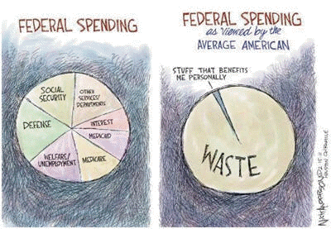
How do you view public sector budgets?

Slide 4

Public Budgeting
Notes:
I think this is how many people approach “budgeting” as a big black hole that no one understands and frankly scares people a little.
Unless you are a person who views the household budget efforts at best advisory, and since it’s all your money anyway why care?
Today’s presentation will be a high-level overview, incorporating many ideas about improving your approach to your municipal budget.

Slide 5
Why Budget?
A Municipal Budget is legally required. - Wis. Stat. § 65.90(1)
Budget can be for one or two years – See Wis. Stat § 65.90(1m)(b)
Budget preparation and approval are probably the most important duties of local government officials.
A budget sets priorities by representing what your Governing Body and community believe are important.
The budget determines:
What services will be provided;
To what extent services will be provided; and
How services will be funded.
A budget looks backward and forward to determine what has been done in the past and what to do in the future.
Good budgeting helps your community prepare for unexpected events.

Slide 6
Budget Preparation and Adoption- Wis. Stat. § 65.90(3)(b).
The Village Board is responsible for adopting the final budget
Village boards must determine the village’s tax levy by December 15 - Wis. Stat. § 61.46.
Budget must be “balanced”
Budget summary must include current year and proposed budget year numbers for
General Fund Revenues
General Fund Expenditures
Impact Fees
Fund Balances
Property Tax Contribution to Funds
Fund Revenue and Expenditure Totals
New and Discontinued Activities
Percentage change between current and proposed budgets

Slide 7
The Budget Cycle – Villages
Budget Public Hearing held.
Special workshops or special board meetings held to develop proposed budget.
Notice of public hearing and budget summary published/posted.
Village Board adopts budget at properly noticed meeting.

Slide 8
Statutory Budget Public Hearing
Must be held on the proposed budget before adoption by the Village Board Wis. Stat. s. 65.90(1)
Is an exchange of information only between the board and the public.
Changes to the budget are made at board meetings, not the budget public hearing.
Notice must include a summary of budget requirements Wis. Stat. s. 65.90(3)(b).
In 2024, the Village held a required public budget hearing and numerous discussions on the public works facility and village hall improvements.

Slide 9
Budget Basics - Revenues
Revenue v. Resources
Revenue: Property tax and non-property tax. Money received from funding source (state, federal, grants, taxes) or services provided (fees, licenses, fines, etc.)
Resources: Includes Revenue + any money carried forward (reserves) and transfers.

Slide 10
Black Creek Revenues Comparison
Municipalities | Average % | Black Creek %
Property Taxes | 46% | 44.90%
Shared Revenues & Transportation Aids | 13% | 37.52%
Licenses, permits, fees | 2% | 0.48%
Penalties and fines | 1% | 1.81%
Public charges for services | 5% | 1.41%
Intergovernmental charges for service | 2% | 1.55%
Interest income | 1% | 1.93%
State & Federal Grants | 26% | 0.33%
Other Govt Revenues | 4% | 10.07%
2022 DOR Data
https://dpi.wi.gov/sfs/outreach/team-presentations#event-ac24

Slide 11
Budget Basics - Expenditures
Requirements v. Expenditures
Expenditures: On-going costs required for operations including: Personnel, Materials and Services, Capital Outlay, and Debt Service.
Requirements: Includes Expenditures + transfers, contingency/reserves, and unappropriated ending fund balance (UEFB).
NOTE: Most Expenditures for government are related to Personnel

Slide 12
Black Creek Expenses Comparison
Municipalities | Average % | Black Creek %
General Government | 13.73% | 31.91%
Public Safety (law, fire, EMS, other) | 32.12% | 28.82%
Transportation (Roads & other) | 25.88% | 11.73%
Solid Waste | 6.40% | 6.33%
Health & Human services | 0.63% | 0.00%
Cultural and Education | 3.72 | 14.87%
Parks & Recreation | 7.27% | 6.33%
Conservation & Development | 9.91% | 0.00%
Other Expenses | 0.34% | 0.00%
2022 DOR Data

Slide 13

Operating vs. Capital Budgets
Operating budget:
appropriates monies to fund general government services and purchases for a number of programs or functions
Primary budget
Created for a single fiscal year (two year allowed)
Capital budget:
prepared for multi-year projects, such as land acquisition, building or construction projects, equipment purchases and infrastructure maintenance
Typical time frame for funding capital improvement projects is a minimum of five years
Plan for debt and other funding sources
Positive view by public and rating agencies
adapted from Ehlers
Notes:
An Operating budget is what keeps the County functioning day to day.
Capital is what keeps the county’s infrastructure functioning year to year.

Slide 14
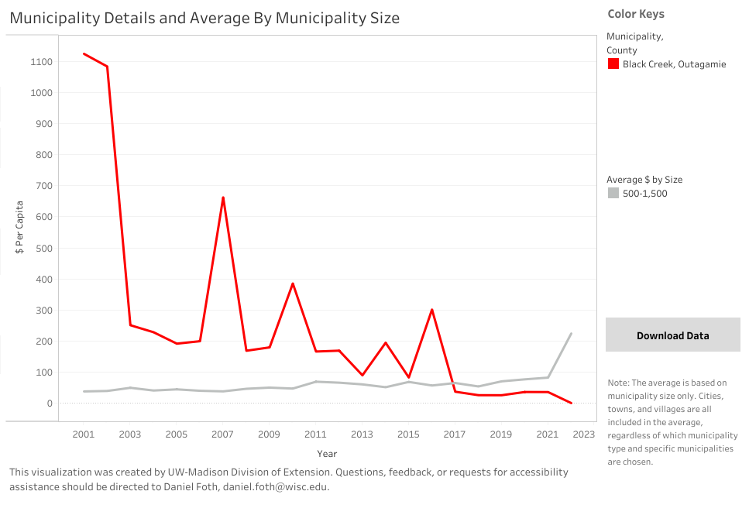
Black Creek Principal Payments
Data Timeline 2001 - 2022

Slide 15
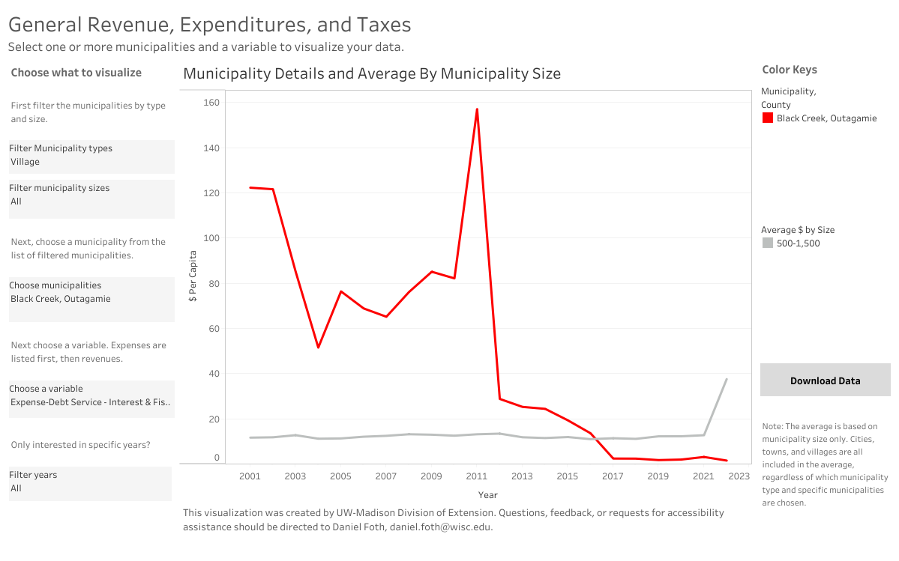
Black Creek Interest/Charges Payments
Data Timeline 2001 - 2022

Slide 16

Cash Flow and Fund Balances –
Cash Flow is Critical to keeping the doors open
A cash flow spreadsheet should be kept and updated monthly
Fund Balances
Non-Spendable = land, pre-paid amounts & inventory
Restricted = grant funds, impact fees, debt service funds
Committed = capital project(s)
Assigned = future capital projects or equipment purchases
Unassigned = working capital and emergencies
General Fund Reserve – GFOA recommends 2 months of general fund expenditures (16% avg.)
Avoid using for day-to-day expenses
Ok for non-reoccurring expenses, capital projects, reduce debt
Black Creek averages 20%
adapted from Ehlers
Notes:
Cash is king, or so the saying goes. Unlike your personal finances, county revenues are collected in certain months. Real estate taxes for example are collected in January and December. Shared revenues in July 15% and November 85%.
A fund balance is what a county can use to smooth out the cash flow, that is keep the County in the black through out the entire year. As well help your county weather difficult economic challenges.
That is why we talk about cash flow and fund balances together

Slide 17
What Drives Local Government Revenues & Expenditures
State Statutes – Budget Requirements, Revenues, Expenditures & Fund Balance(s)
Outside Factors
Municipal Plans
Strategic
Comprehensive
Financial (CIP, Operating & Staffing)
Municipal Policies
Debt
Revenue
Operating
Implementation

Slide 18

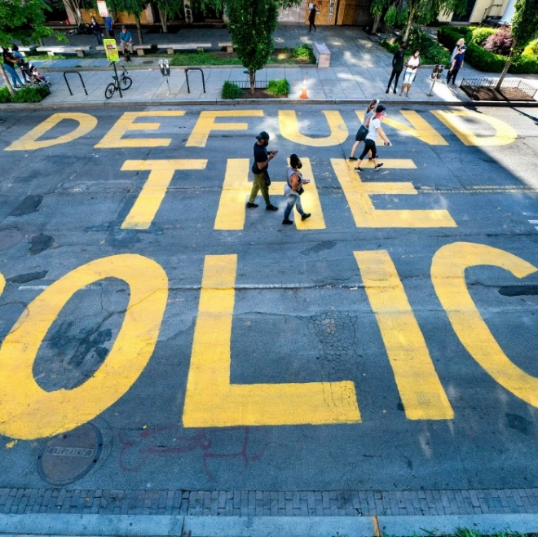

Issues That Impact Budgets

Slide 19
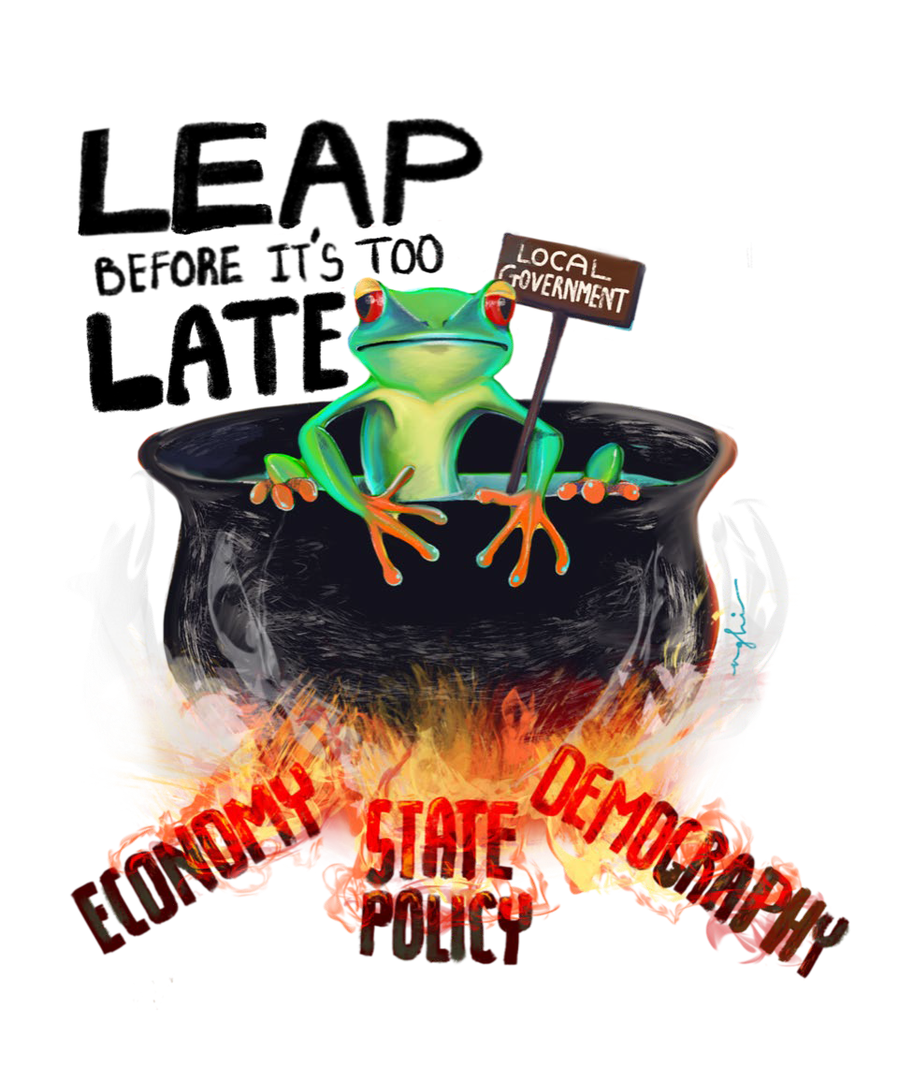
Outside Factors Impacting Your Budget
Inflation
No or low growth
Jobs
Retail Sales
Population changes
Aging workforce
Housing
State aids
Levy limits
Mandates
Image Source: Cornell Local Fiscal Stress Project. Image created by Nghi Nguyễn.
Notes:
Here are some of the areas of outside influence on WI local government budgets.
We had a major victory last year in the passage of the new shared revenue approach.

Slide 20
2019-2024 Village of Black Creek – Net New Construction

Slide 21
2016 – 2024 Rate of Inflation (CPI-U)
Source - Federal Reserve Bank of Minneapolis

Slide 22
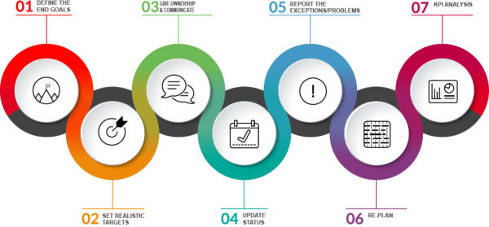
Multi-year Fiscal Planning (3-5 years)
Strategic Plan
Comprehensive Plan
Capital Improvement Plans
Financial Plan
Existing & Future Debt & Reserve Uses
Tax Base Growth Assumptions
Future Operating Revenues and Expenses
Staffing Plan
Ehlers
Notes:
Financial advisors, such as Ehlers strongly suggest local governments develop a multi-year Financial plan that incorporates:
For example, many Counties have capital improvement plans. Is your CIP a list of road improvement needs or more? A true asset management approach that consider and address existing road maintenance and replacements, further transportation needs, parks, other facilities, etc.
And incorporate input for the Counties municipal and school partners and the local government residents
A Financial Plan helps the Board, residents, bonding companies understand where your local government is at and where it is going and can provide context when making tough budget choices

Slide 23

Importance of Strong Financial Policies
Implementation Policies
Debt Policies
Revenue Policies
Operating Policies

Slide 24

Operating Policies
What constitutes a balanced budget
Level of reserves to maintain
Preparation guidelines
Assigning roles of stakeholders
This Photo by Unknown Author is licensed under CC BY

Slide 25

Debt Policies
Term of Debt
Bonds or Promissory Notes
Capital Improvement Financing
Debt to Revenue Ratio
Debt to Equalized Value Ratio

Slide 26

Implementation Policies
Fund transfers across accounts
Inter-fund borrowing
When the Elected officials or Agency head can restrict expenditures
Standards for financial accounting and reporting

Slide 27

Revenue Policies
Determine acceptable changes in tax rates
How to use one-time revenues
Service charges
Collection of delinquent taxes and charges

Slide 28

Issuing Debt
Wis. Stat. § 67.04 (1), 67.045
Constitutional limit
Article XI. Section 2: Limits the amount of debt principal a county can incur to 5% of its equalized value
Average Debt to Equalized Value for Outagamie County Villages = 2.024%
Village of Black Creek = 1.61%
DOR 2022 Data
Notes:
Debt – can be a good thing, but for the right reasons.
Strongly suggest that debt only be used for capital outlays, one-time costs, not for operating expenses.
Also, many counties set, as part of their financial plan, their debt policies that may focus on debt as a percentage of the county’s operating budget or debt repayment as a percentage of operating revenues.

Slide 29


Common Financing Methods
Defer
Deterioration of assets
Added Maintenance & Replacement Costs
Pay-as-you-go (Cash)
Generational Inequity
No Interest costs
Pay-as-you-use (Debt)
Generational Equity
Interest Costs
Citizen Complaints
Inflationary pressure
No Levy Limit Issue
Debt Capacity Concerns
Grants may/may not be available
Tax Levy Limit Concerns
OR

Slide 30
Municipal
Item | Municipal Govts
Capital Improvement Expenditures | Pay-Go Borrow, or Referendum
Operating Costs Associated with Capital Expenditure | Pay-Go, Fund Balance or Referendum
Regular Operating Costs | Pay-Go, Fund Balance or Referendum

Slide 31
What are Levy Limits?
Under current law, no political subdivision may increase its tax levy by a percentage that exceeds the unit’s “valuation factor.”
Valuation Factor = the greater of…
The percentage change in equalized value due to net new construction, OR
Zero %
Potential valuation factor changes:
Transferring responsibility for providing a service
Annexations
Debt Service
Referendum
See Wis. Stat. s. 66.0602(2)

Slide 32
Tax Rate
Tax Rate = the rate necessary to raise sufficient money from the property tax to meet the levy
(Total Levy ÷ Total Assessed Value of the Municipality)
Mill Rate = tax rate expressed in terms of dollars per thousand
Assessed Value = the value the local assessor places on each real property parcel and on each individual’s taxable personal property - this value determines what portion of the local property tax levy is covered by each property owner
See Wisconsin DOR: Guide for Property Owners - https://www.revenue.wi.gov/DOR%20Publications/pb060.pdf

Slide 33
Tax Levy
The municipal tax levy is the total amount of tax dollars collected from all taxpayers to support municipal expenditures.
Levy = Estimated Expenditures – Estimated Revenues
Example:
$2,311,939 - $1,616,594 = $695,345
What happens if the Levy exceeds Levy Limit?

Slide 34
Tax Rate Example
$ 695,345
Total Tax Levy
$2.77 per $1,000 of Assessed Value
=
$250,607,700
Aggregate Assessed Value

Slide 35
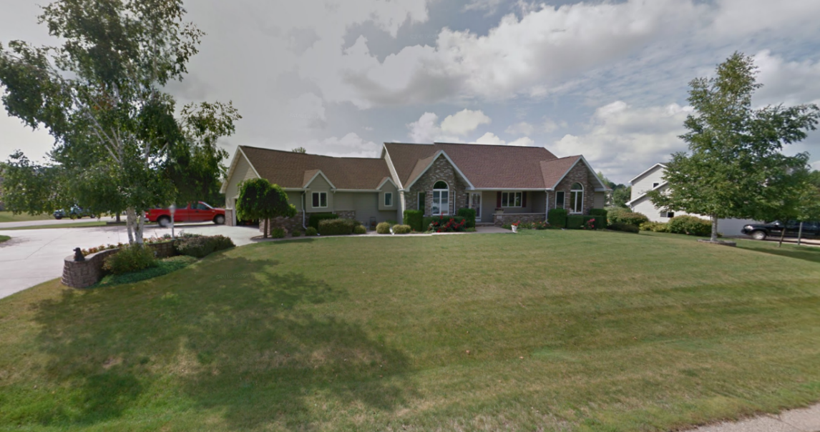
Tax Rate Example (cont.)
Property’s assessed value = $ 450,000
Total taxes paid to municipality = $1,246.50 ($2.77 x 250)

Slide 36
Black Creek Mill Rate Comparison
All Outagamie County Villages Average - | 0.01797394
Black Creek | 0.020473605
2022 DOR Data

Slide 37
Thank You!
https://localgovernment.extension.wisc.edu/
Daniel Foth, JD
Local Government Educator
Director – Certified Public Manager Program
https://localgovernment.extension.wisc.edu/cpm-program/
Daniel.foth@wisc.edu
Office: 608-262-2852
Cell: 404-805-8567

