Slide 1
Town of Stella DNR Updates
Oct. 1, 2025

Slide 2
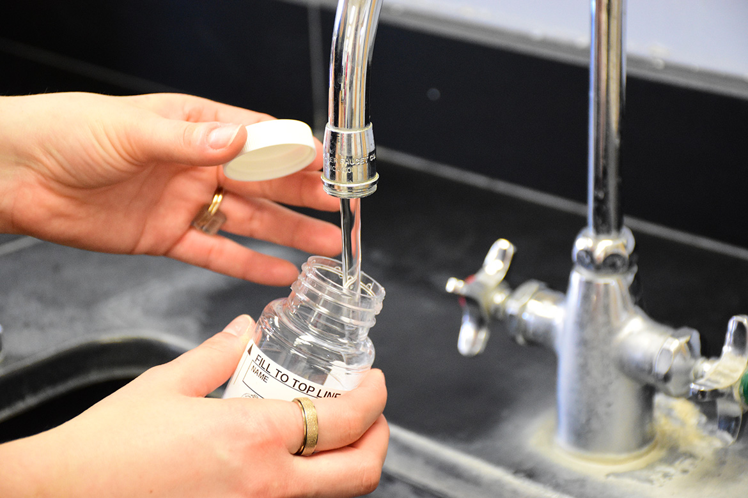
Private Well Expanded Sampling Effort
Private well PFAS sampling efforts in and around the Town of Stella
Additional sampling underway in Oneida County in partnership with EPA
Notes:
Mark
As part of the Oneida County private well PFAS sampling program, an additional 21 residents in the Town of Stella will be offered testing of their private well for PFAS.
This includes full-time and seasonal residences
Eligible households will receive a letter from the DNR
Residents will conduct the sampling of their private well
Directions are supplied with the sampling kit

Slide 3
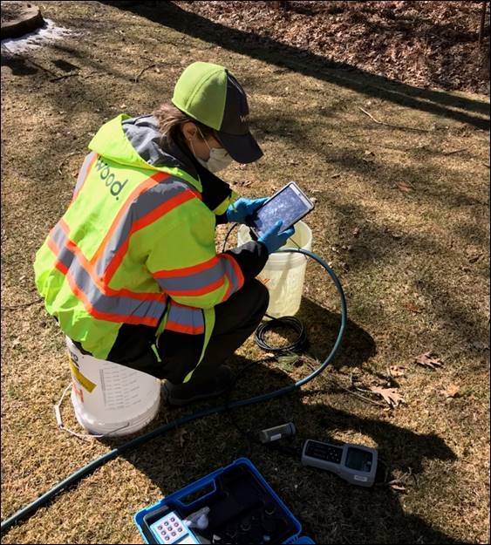
Private Well Expanded Sampling Effort
Residences will be notified of sampling results
Residences with PFAS detected above Department of Health Services’ (DHS) recommended health guidelines will receive a Health Advisory Letter
Health Advisory Letters make a residence eligible for temporary emergency water paid for by the DNR
Wood Environment and Infrastructure Solutions

Slide 4
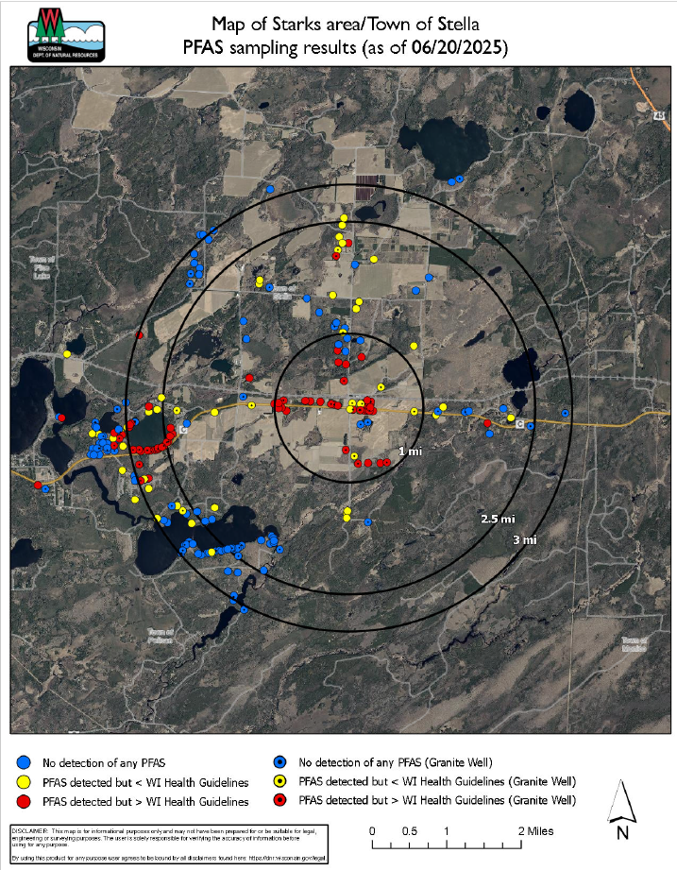
Private Well Sampling
As of June 20, 2025,
241 private wells have been sampled for PFAS
Breakdown of results:
PFAS detected above DHS’ recommended health guidelines: 88 private wells
PFAS detected below DHS’ recommended health guidelines: 39 private wells
No detection for PFAS: 114 private wells
Notes:
Mark

Slide 5
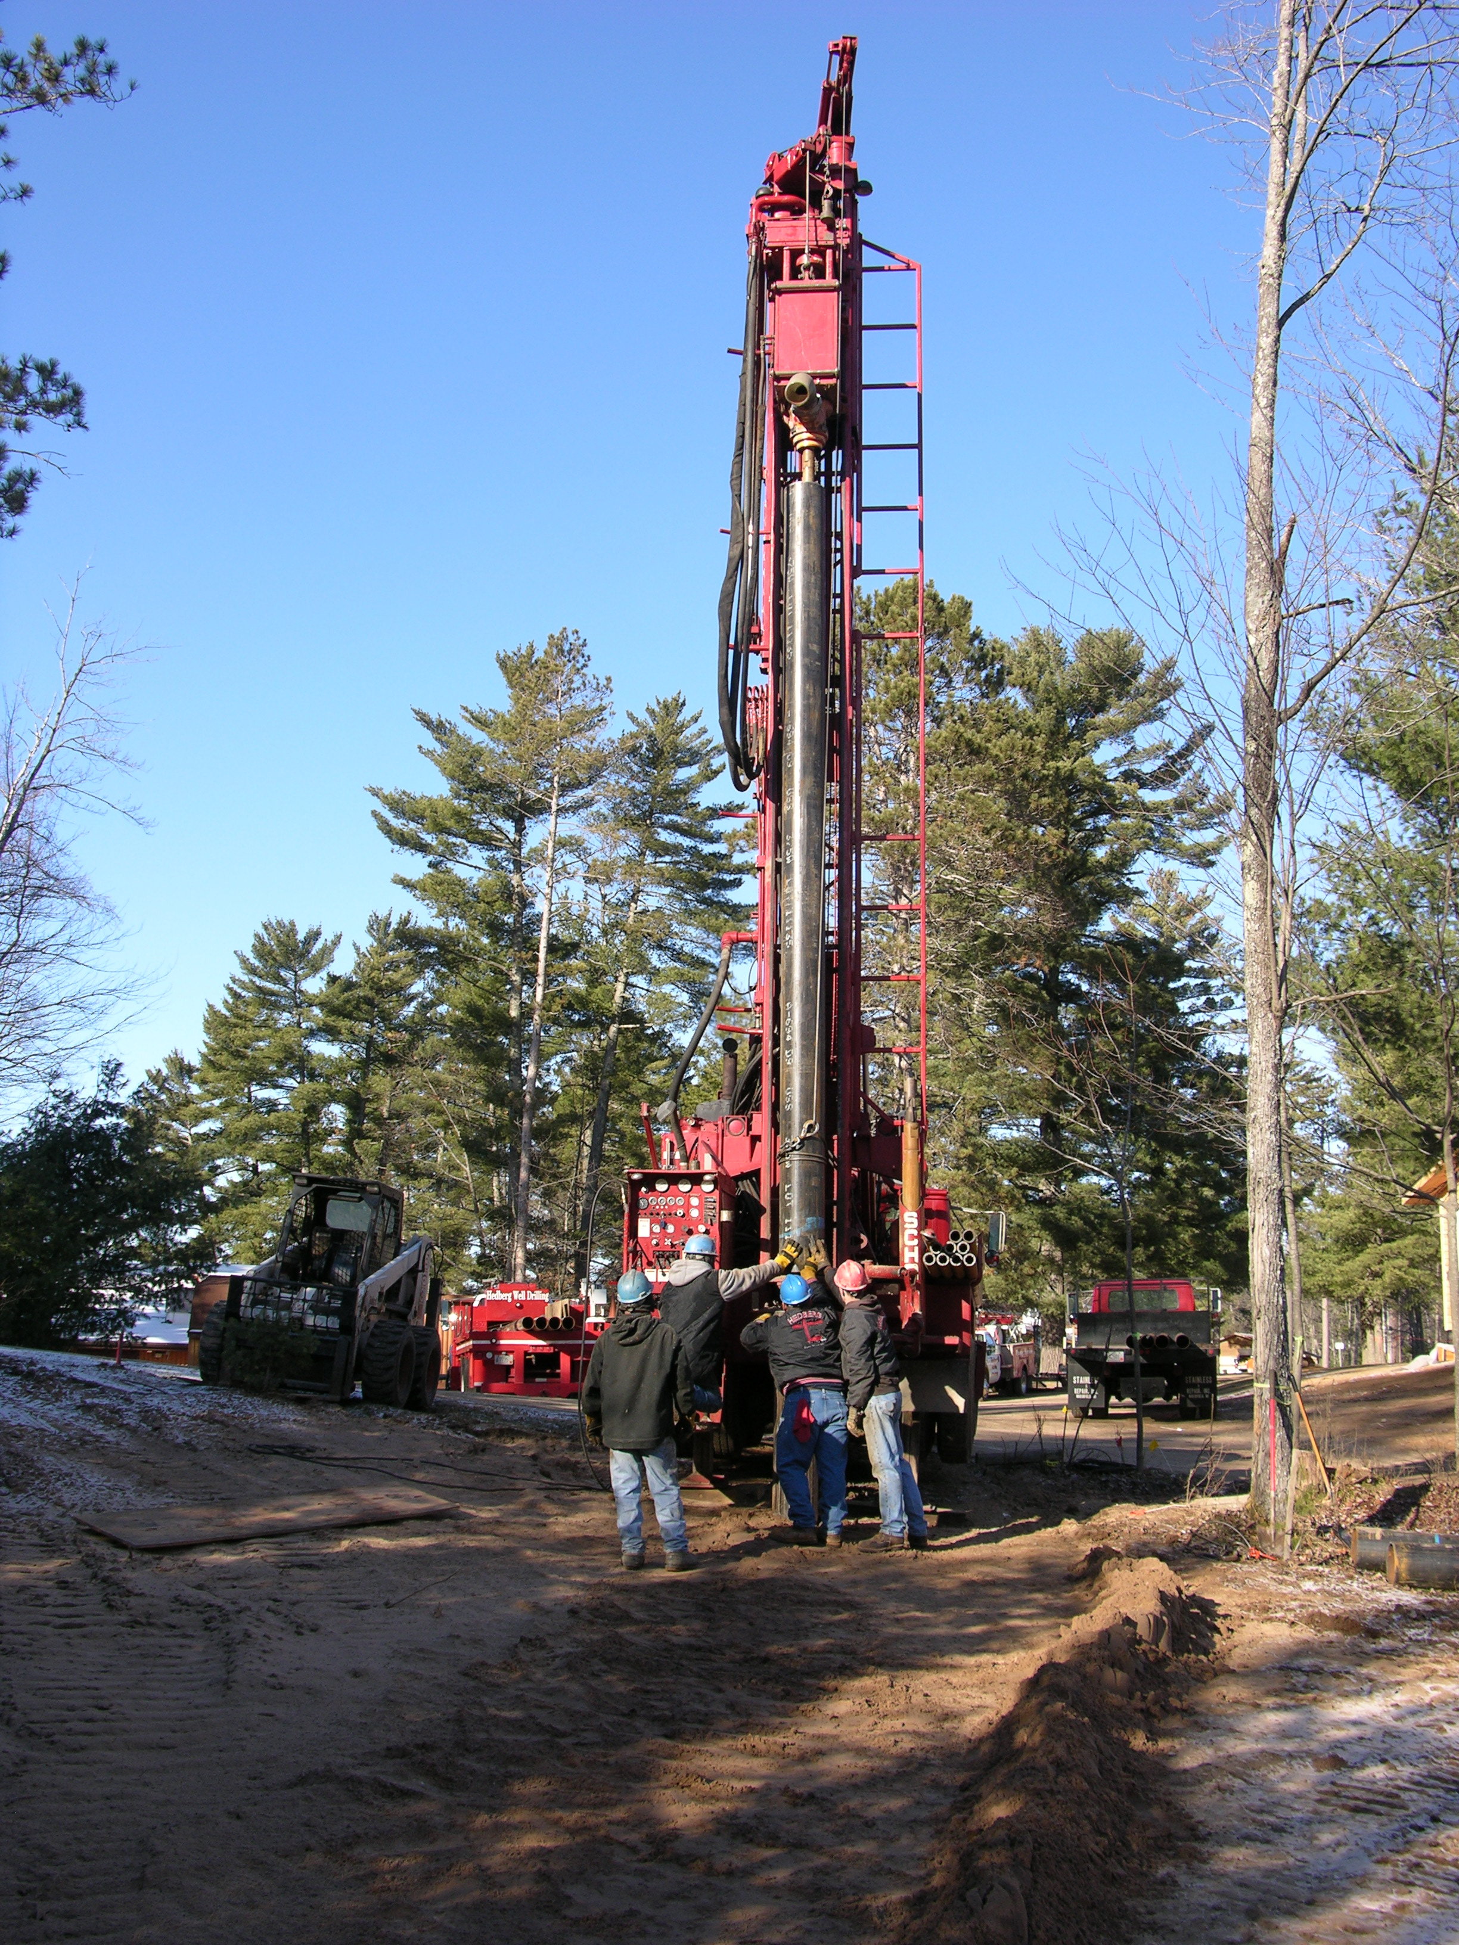
Private Well Sampling
Well Type of 88 Private Wells Over DHS’ Recommended Health Guidelines:
16 point
27 sand and gravel
25 bedrock
20 unknown
Notes:
Mark

Slide 6
Resources For Impacted Private Wells
Well recommendation
Well Compensation Grant Program
Treatment options
Reverse osmosis
Ion exchange
Granulated activated charcoal (GAC)
Notes:
Marty / CF Staff

Slide 7
Assistance To The Community
29 awards to impacted homeowners in Town of Stella
25 replacement wells
4 treatment systems
Award activities
25 projects have completed work and submitted for reimbursement
4 projects are active
3 projects are under review
Notes:
Mark
NEEDS TO BE UPDATED

Slide 8

Well Success Stories
22 wells have been installed utilizing the Town of Stella well recommendation
8 wells have no detection of PFAS
11 wells significantly reduced initial PFAS levels
3 wells had additional treatment installed
iStock/Mariya Palkina
Notes:
Mark
NEEDS TO BE UPDATED

Slide 9
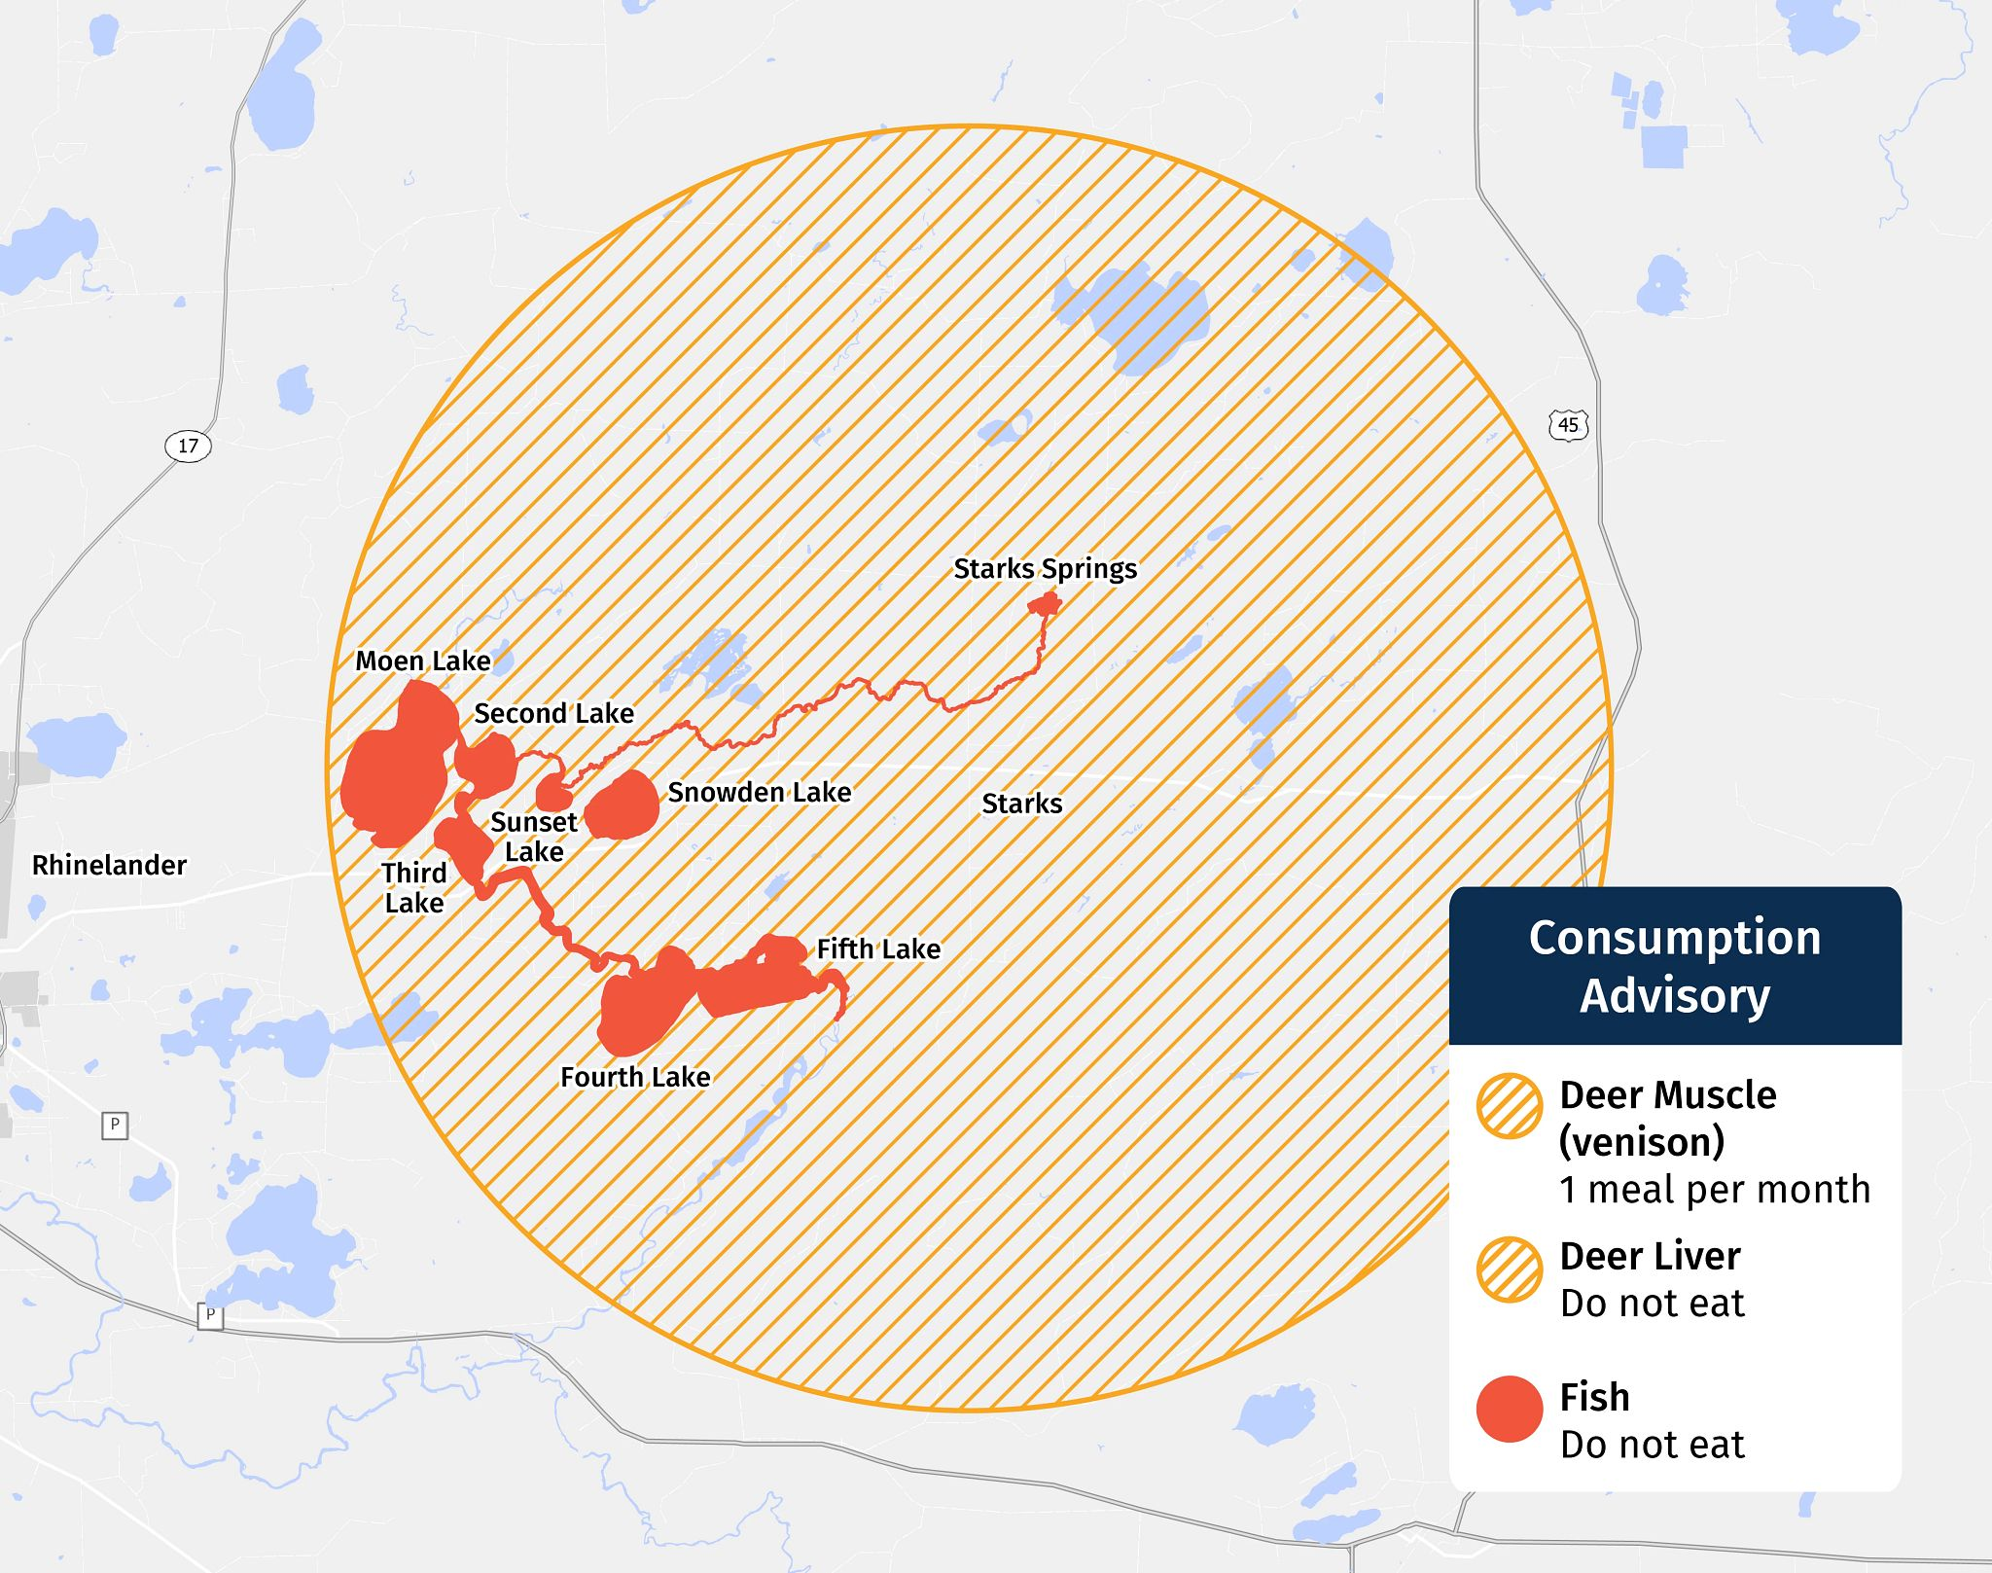
Consumption Advisories
Fish: Moen Chain and Snowden Lake
Do not eat (all species)
Deer: 5-mile radius around Town of Stella
Muscle: one meal per month
Liver: do not eat
Notes:
James
Last month, the DNR issued a series of consumption advisories, including for fish and deer in and around the Town of Stella.
We appreciate your cooperation and support with the deer sampling, as we relied upon volunteer donations.
We won’t go into great detail on the advisories now, but our fish and wildlife toxicologist, Sean Strom, is available to answer questions after the meeting. Nathan from DHS is also available for health-related questions.

Slide 10
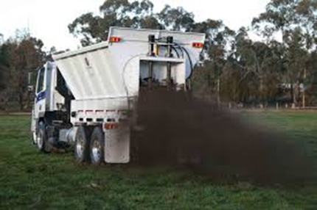
Biosolids
Historic
Current
Photo Credit: Epsom Environmental Services
Notes:
Fred

Slide 11
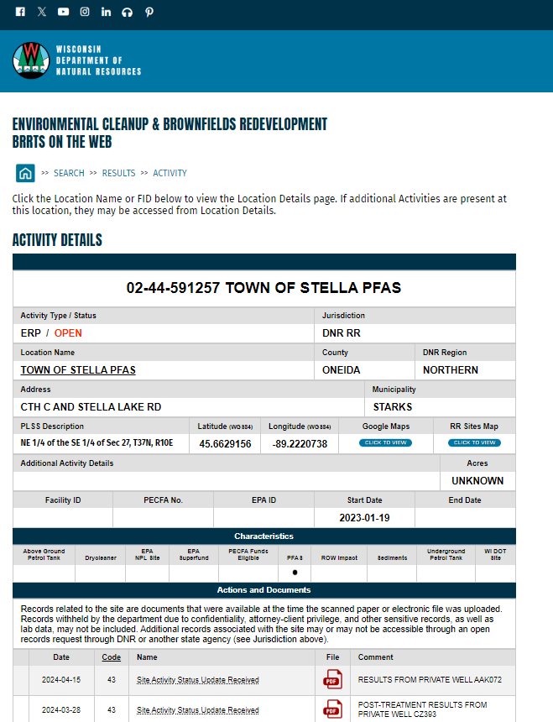
DNR’s Online Database Of Cleanup Sites
Bureau for Remediation and Redevelopment Tracking System (BRRTS) on the Web (BOTW)
Search:
In web browser: “Wisconsin DNR”
On DNR’s webpage: “BOTW”
In BOTW: Activity - “Town of Stella”
Notes:
Trevor
The Bureau for Remediation and Redevelopment Tracking System (BRRTS) on the Web (BOTW) is DNR's comprehensive online database that provides information on contaminated properties and other cleanup and redevelopment activities in Wisconsin.
The database is part of the DNR's Wisconsin Remediation and Redevelopment Database (WRRD) and includes, but is not limited to, the following information:
Investigations and cleanups of contaminated soil, groundwater, etc.
Due to the known PFAS in groundwater, the Town of Stella is an open site in BRRTS. The case number is 02-44-591257 TOWN OF STELLA PFAS.
Within the site page, you can find the Superfund preliminary assessment, Request for information letters and other documents as the investigation progresses.
The EPA published its site inspection report on 9/24/25. Following receipt of EPA’s report, the DNR issued Responsible Party letters to Ahlstrom Rhinelander LLC / Ahlstrom NA Specialty Solutions LLC; and Wausau Paper Corp./Wausau Paper Mills, LLC/Essity North America Inc. This report and the letters are available on the DNR’s Bureau of Remediation and Redevelopment’s Tracking System under BRRTS #02-44-591257.

Slide 12
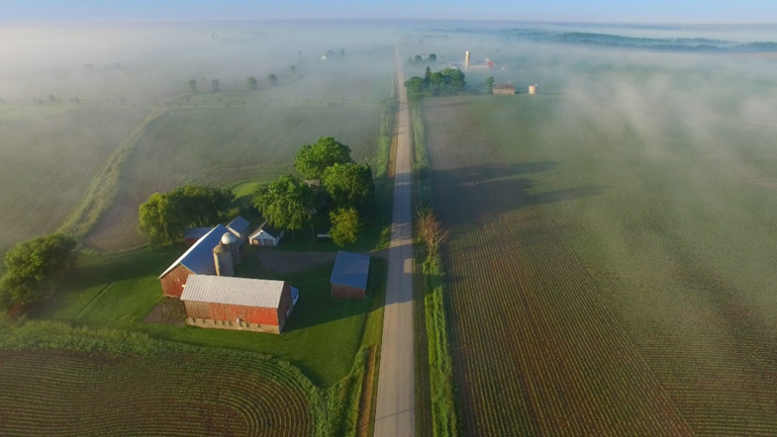
Enforcement Discretion Policy
iStock/JamesBrey
Notes:
Trevor
(remain committed to holding polluters accountable – RP letters)
The Wisconsin Department of Natural Resources issued a memo regarding enforcement discretion with Wisconsin farmers in May 2024.
It is the policy of the DNR to not pursue farmers for response actions or costs related to PFAS contamination from the land spreading of biosolids or industrial waste.
The DNR has not sent a responsible party letter to any farm or home owners for PFAS contamination
The DNR is committed to continuing to work with farmers, communities and other stakeholders to understand and address PFAS contamination.

Slide 13
(888) 626-0605 DNRStellaPFAS@wisconsin.gov

