Slide 1
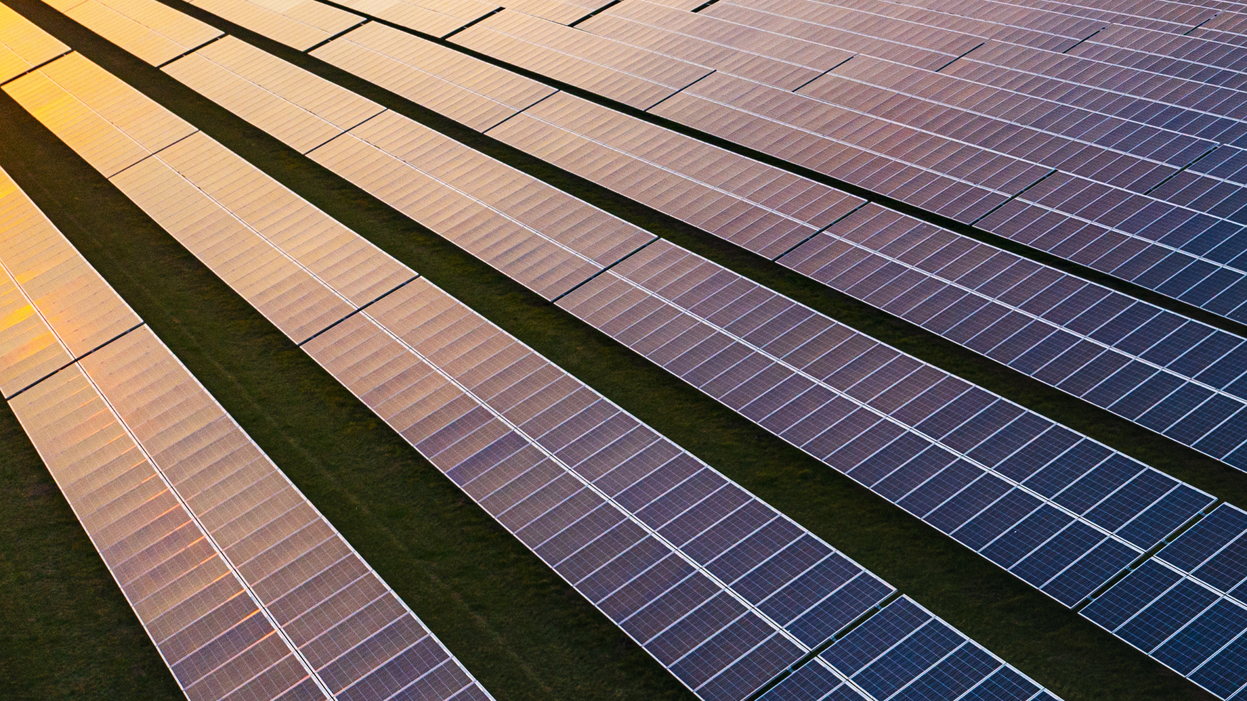
NextEra Energy Resources
Akron Solar, LLC

Slide 2
NextEra Energy is a clean energy leader
Composed of two primary businesses
NextEra Energy Resources, LLC
World’s largest generator of renewable energy
from the wind and sun
37 GW total generating capacity⁴
Operating in 41 states & Canada⁴
NextEra Energy, Inc.
Fortune 200 company¹
95-year track record
$28 B operating revenue 2023²
$118 B market cap³
NYSE: NEE
Florida Power and Light (FPL)
One of the largest US electric utilities⁴
5.9 MM customer accounts⁴
33 GW net generating capacity⁴
Fortune’s 2024 Rankings 2/1/24
Investor Report Dec 2023. as of 1/25/24.
FactSet as of 1/25/2024
As of 12/31/23 Annual Report 2023 Form 10-K

Slide 3
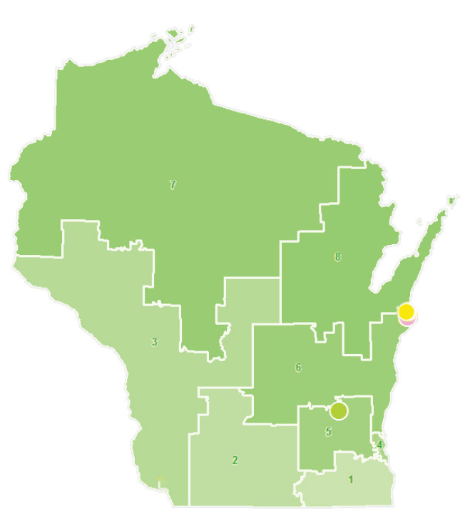
Generating affordable, homegrown energy for Wisconsin
Solar sites are compatible with agriculture and are fast becoming an important component of farm viability in many areas across the country
Investing in Wisconsin since 2007
$2.6 billion total capital investment
$114 million in annual payroll
$700,000 in annual land payments
$11.1 million in property taxes, 2023¹
Operational assets and projects in development
1 operational wind energy center
1 nuclear energy center
1 utility-scale solar energy center
3 solar projects in development
Annual Property Taxes: Includes property tax and other indirect taxes. Internal data based on 2023 full year.

Slide 4
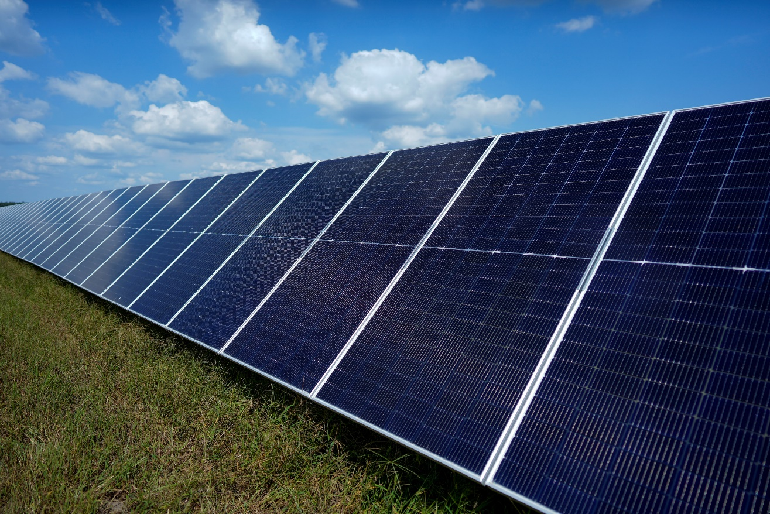
Akron Solar project overview
Located in Adams County and Wood County, WI
Town of Rome
~$380 million capital investment
Enough electricity to power approximately 50,000 homes
Gen-Tie and line tap to existing 138-kV American Transmission Co transmission line
Certificate of Public Convenience and Necessity filling targeted for Q1 2025
Commercial operation targeted for December 2028
200 MW
of clean energy

Slide 5
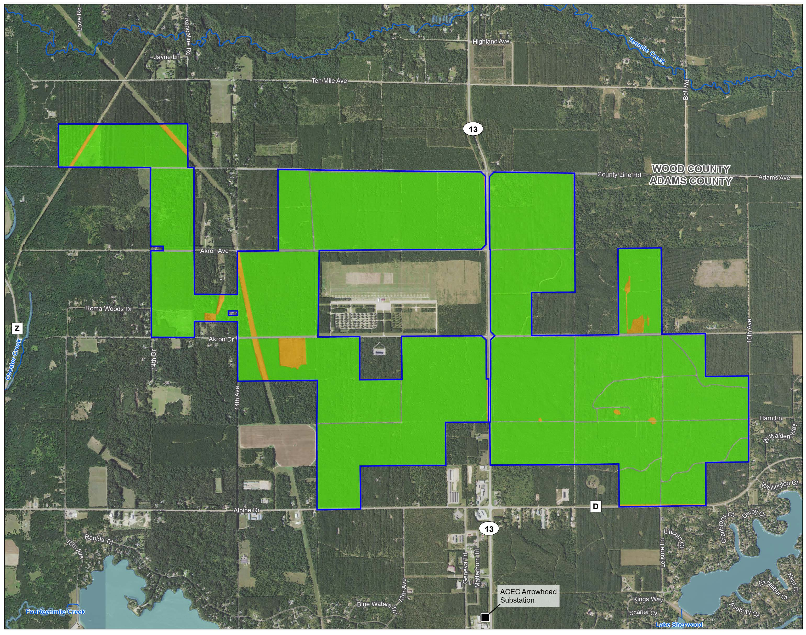
Akron Solar Project Boundary

Slide 6

Local community benefits
Shared revenue payments of $1,000,000 every year
This is split between the county and local communities that host energy facilities
Town of Rome ~ $433,334 per year
Adams County ~ $566,666 per year
Creation of approximately three new full-time, good-paying jobs
Increased activity for local businesses during construction and operations
Local sponsorships and donations

Slide 7
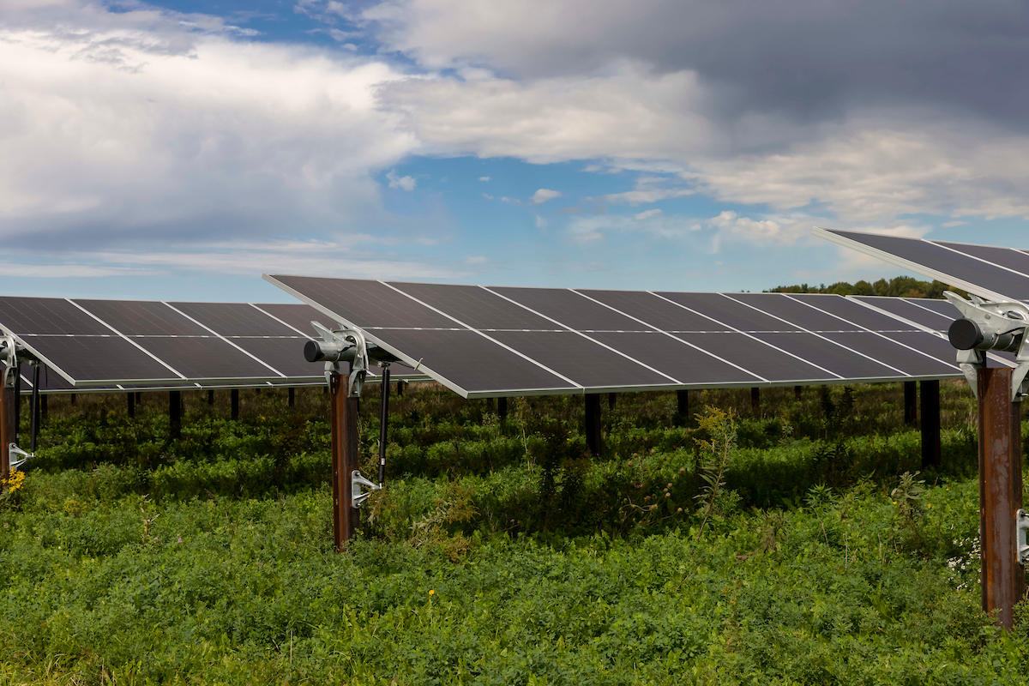
Environmental commitment
NextEra Energy Resources conducts numerous studies in coordination with federal, state and/or local agencies to ensure our projects are responsibly sited, including:
Avian use and nest surveys
Threatened and Endangered species reviews
Habitat and land cover assessments
Wetland and Waterway delineations
Cultural resource reviews and field surveys
Phase I environmental site assessments

Slide 8
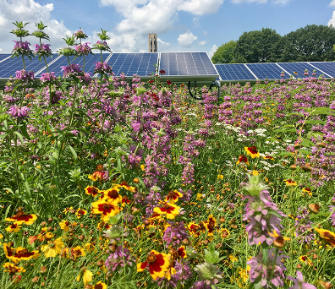
Environmental update
Completed studies:
Wetland and waterway delineation
Threatened and Endangered species and suitable habitat surveys
Cultural resources database review
Cultural field surveys
Phase 1 ESA
Initial hazardous sites review
Studies to be completed:
Noise
Visual simulations

Slide 9
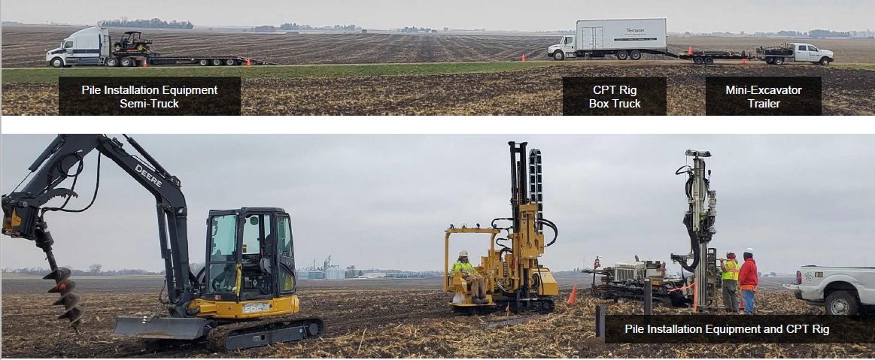
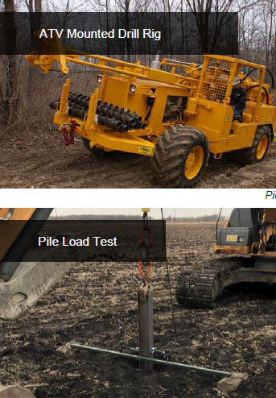
Engineering & Construction Update
Completed preliminary subsurface geotechnical investigation
Identify soil profiles
Understand soil strength and other properties
Completed LiDAR and topography surveys
Understand existing contours
Identify tree and line heights
Completed hydrology studies
Existing water flow patterns
Existing flood depths

Slide 10
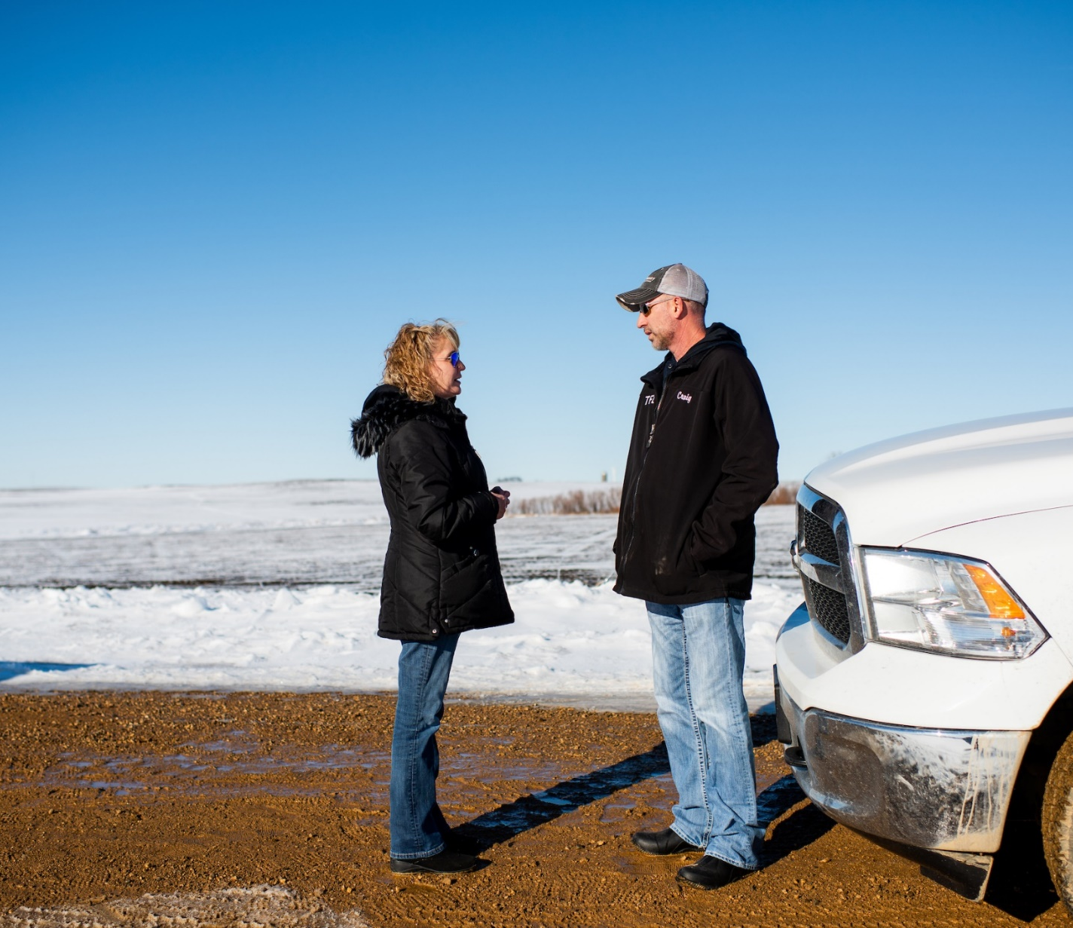
Stakeholder outreach
Extensive coordination with stakeholders, including:
Landowners and community members
Town Supervisors, County Supervisors and county staff
Town of Rome Presentation in June 2023
Economic Development Corporation Presentation summer 2023
Community Q&A in November 2023
Joined local Chamber of Commerce
Meetings with ATV/Snowmobile Clubs

Slide 11
Contact us
Danilo Cabrera Project director Phone: 305-442-5429 Danilo.Cabrera@NextEraEnergy.com
Matt Johnson Community Engagement Manager Phone: 608-705-0554 Matt.Johnson@NextEraEnergy.com

