Slide 1
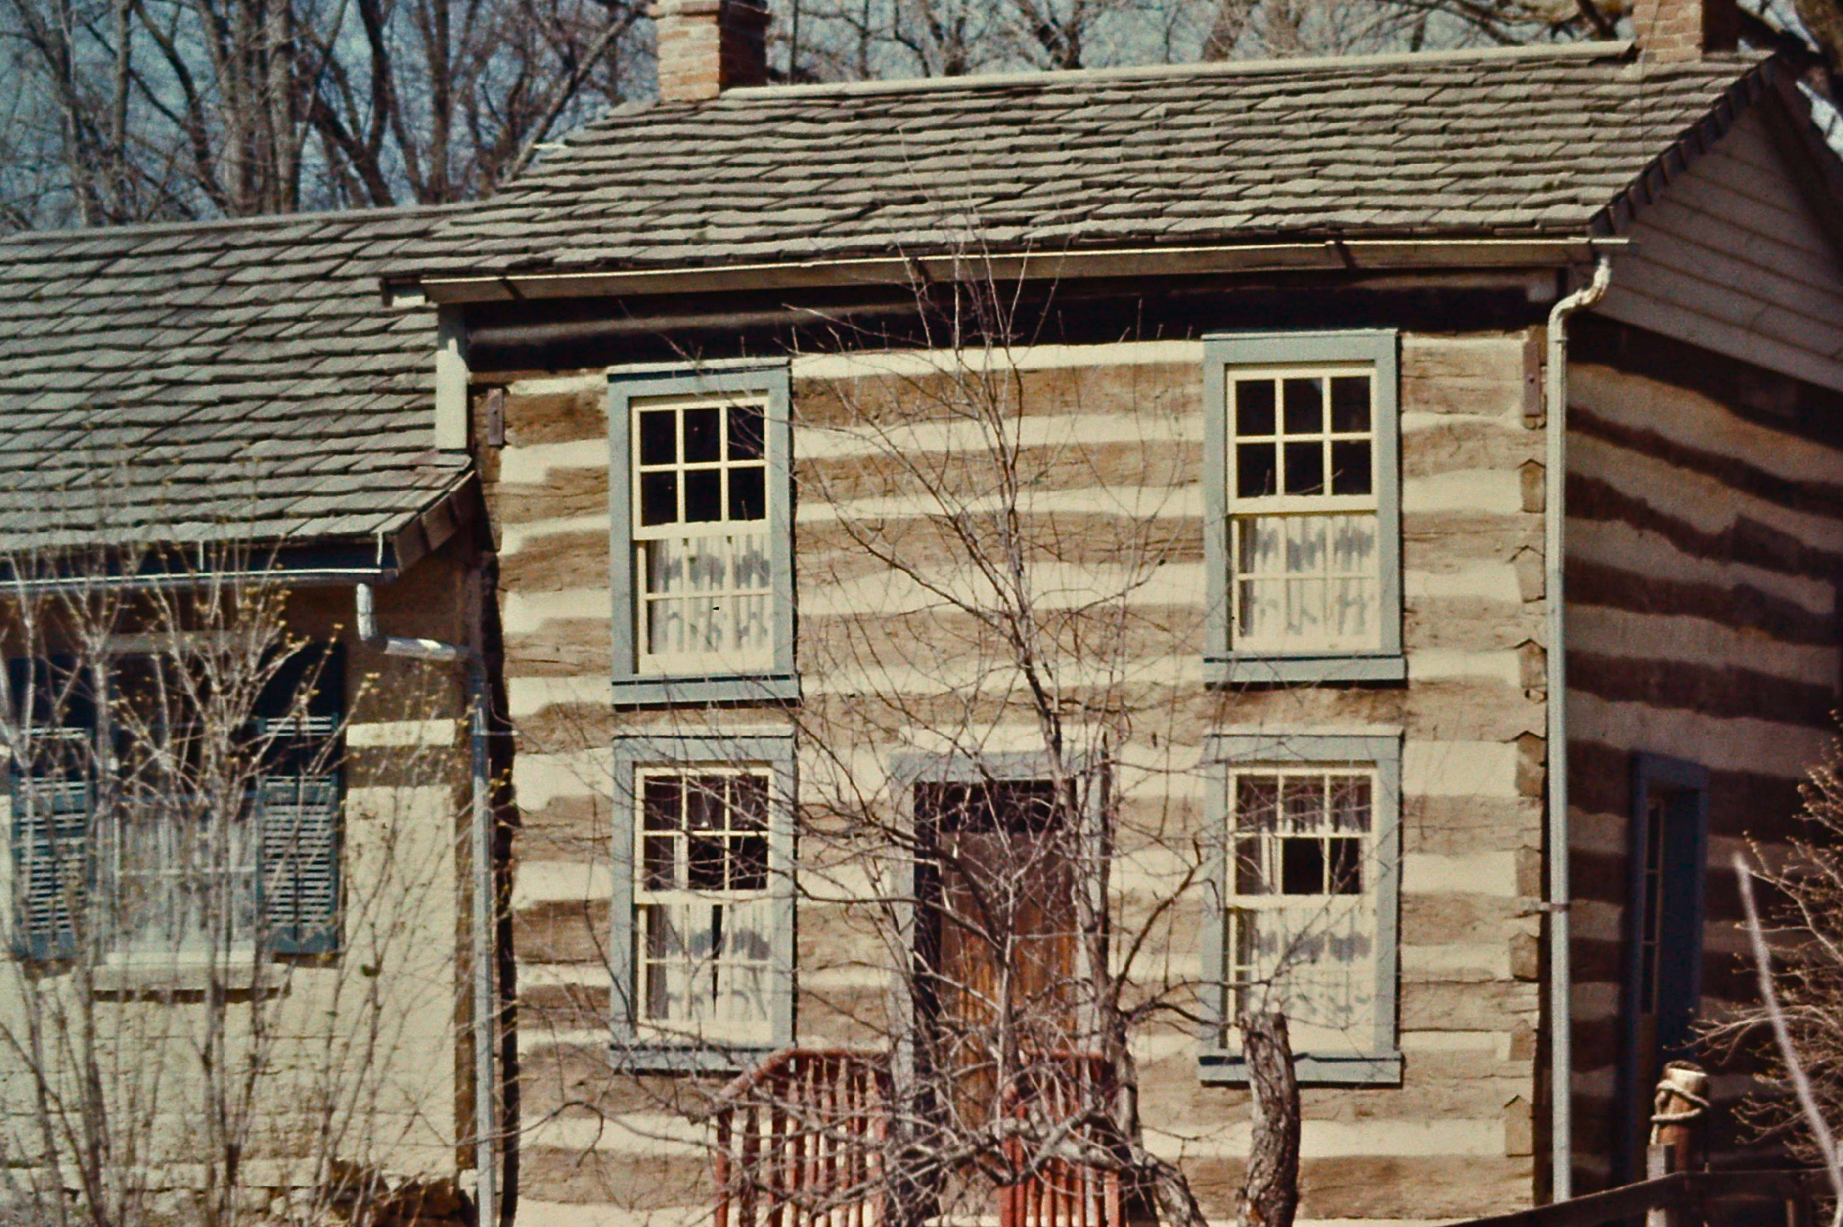
Historic Preservation Commissions
Chapter 1: History of Historic Preservation
CC BY-SA

Slide 2

Outcomes of Training
Describe the functions, operations, and responsibilities of a preservation commission
Identify key preservation laws, statutes, and programs
Explain historic preservation’s economic benefits for your community
Apply new design review and decision-making knowledge to your own commission processes
This Photo by Unknown Author is licensed under CC BY-SA

Slide 3
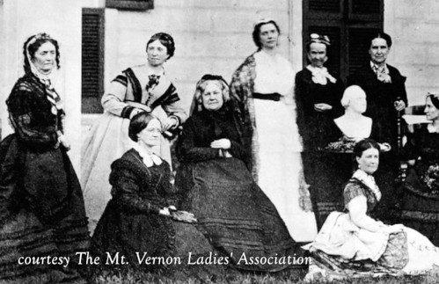
Start of a Movement
Restoration of Mount Vernon (1853)
Mount Vernon Ladies Association purchased and supervised restoration.
Influenced other private organization to establish.
Federal Government Involvement & Expansion
1906 Antiquities Act
1916 Establishment of National Park Service
1931 First Historic District formed in South Carolina.

Slide 4
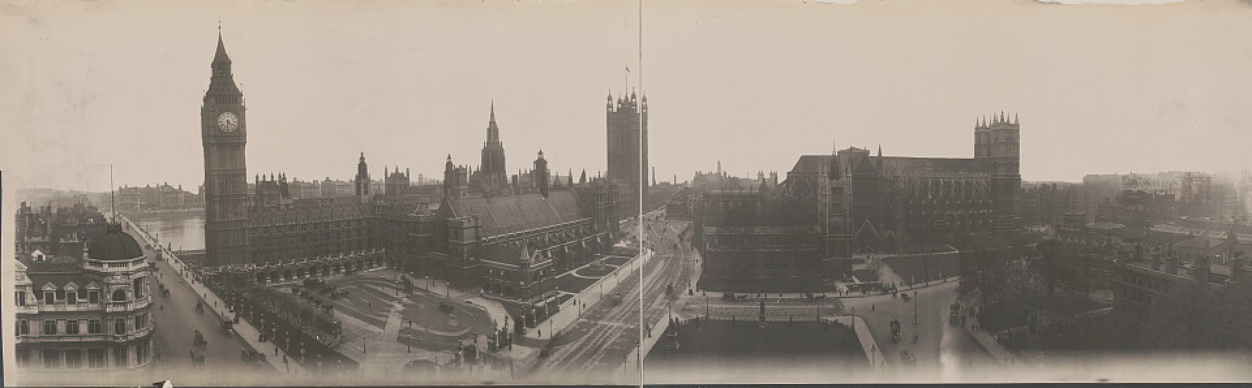
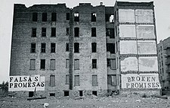
Government Role in Historic Preservation
Policy
Challenges
1935 Historic Sites Act
Conduct Surveys & Research
Acquire & Restore Historic Sites
Educate the Public on Historic Properties
1949 National Trust for Historic Preservation
Manage Site of National Significance
Stimulate Public Involvement
Provide Educational Programs
Urban Renewal in the mid-20th Century
Economic Boom of the 1950’s
White Flight focus
Federal Money to clean up Cities
Highway Development

Slide 5
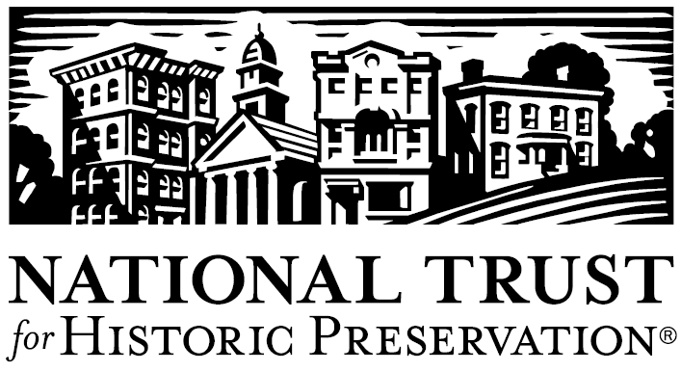
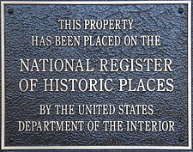
National Historic Preservation Act (1966) Enacted Section 106 requiring federal agencies or federally funded operation assess the impact of undertakings on historic resources and creating standard guidelines to follow for local government.
Economic Incentives (1980’s)
Certified Local Government (CLG) program was created
Tax Credits to owners of income-producing historic buildings.
National Trust for Historic Preservation launched the Main Street Program

Slide 6
Wisconsin Historic Preservation Timeline
1903
The Wisconsin Archaeological Society is founded
1966
The Wisconsin Historical Society is designated as the State Historic Preservation Office (SHPO).
1976
The Division of Historic Preservation – Public History of the Wisconsin Historical Society is established
1910
1917
1947
1963
The State of Wisconsin appropriates funds to purchase capitol building and returns it to its original site
The Wisconsin Federation of Women's Clubs purchases land of territorial capital.
Wisconsin enacts the Integrated Park Act
Milwaukee becomes the first community in Wisconsin to develop a historic preservation ordinance and appoint a historic preservation commission.
20XX
20XX
20XX
20XX
20XX
20XX
20XX

Slide 7

Wisconsin Historic Preservation Timeline
1985
The Wisconsin Historic Preservation Task Force is formed.
1999
Wisconsin enacts "Smart Growth" legislation requiring communities to address the preservation of cultural resources.

