Slide 1
Not Ashamed – Rom 1:1-17

Slide 2
Not Ashamed – Rom 1:1-17
The central theme of Romans:

Slide 3
Not Ashamed – Rom 1:1-17
The central theme of Romans:
“For I am not ashamed of the gospel, because it is the power of God that brings salvation to everyone who believes: first to the Jew, then to the Gentile. For in the gospel the righteousness of God is revealed—a righteousness that is by faith from first to last, just as it is written: “The righteous will live by faith.” 1:16-17

Slide 4
Not Ashamed – Rom 1:1-17
The central theme of Romans:
Vs 11 - I long to see you so that I may impart to you some spiritual gift to make you strong …

Slide 5
Not Ashamed – Rom 1:1-17
Good theology will make you strong

Slide 6
Not Ashamed – Rom 1:1-17
Good theology will make you strong
Theology matters

Slide 7
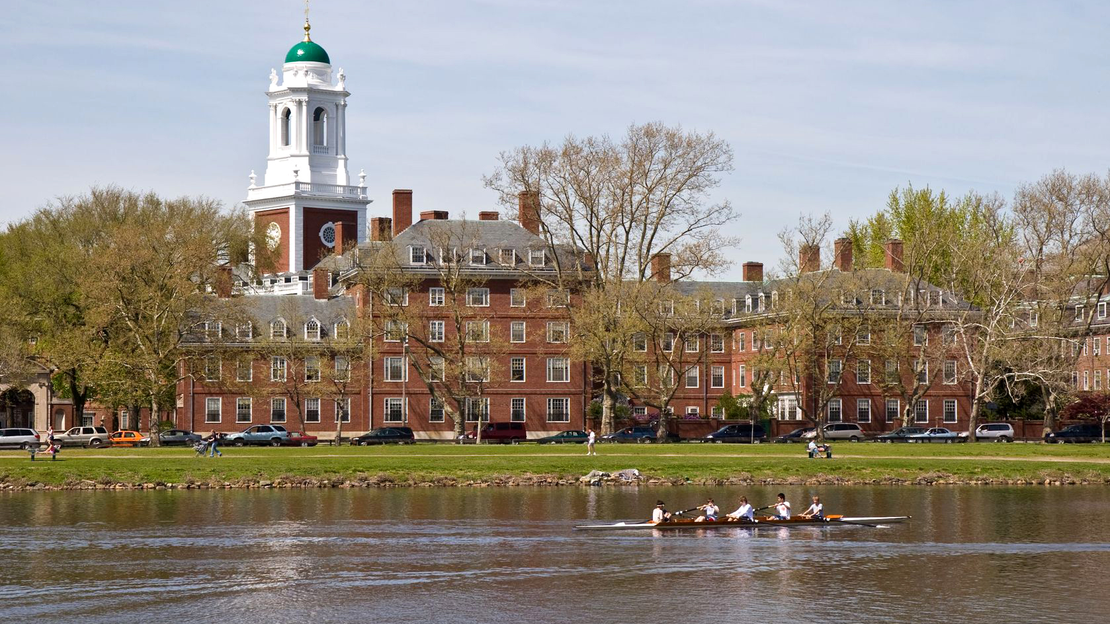

Slide 8
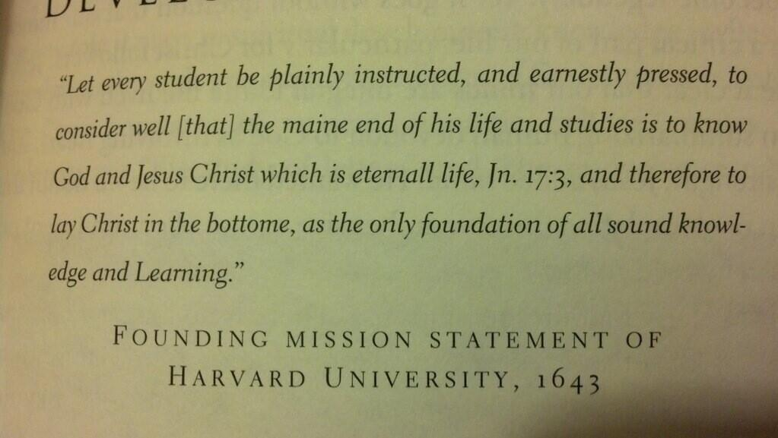

Slide 10
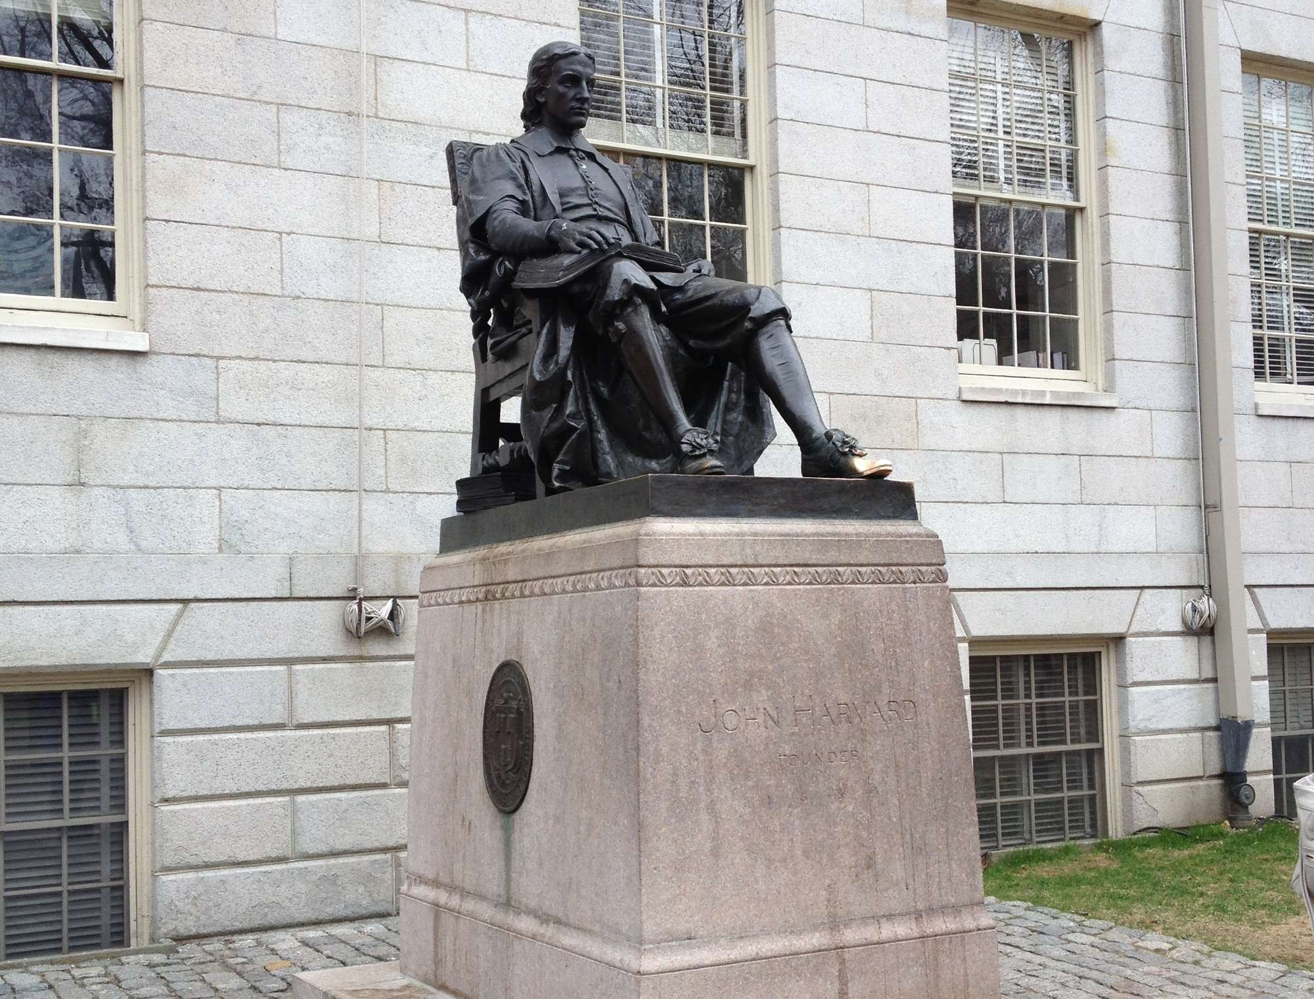

Slide 13
Not Ashamed – Rom 1:1-17
Missiology

Slide 14
Not Ashamed – Rom 1:1-17
Missiology
The nature of Paul as a missionary

Slide 15
Not Ashamed – Rom 1:1-17
Missiology
The nature of Paul as a missionary
“I am …”

Slide 16
Not Ashamed – Rom 1:1-17
Missiology
The nature of Paul as a missionary
“I am …”
1. A servant of Christ Jesus – vs 1

Slide 17
Not Ashamed – Rom 1:1-17
Missiology
The nature of Paul as a missionary
“I am …”
2. Called to be a “sent one” – vs 1

Slide 18
Not Ashamed – Rom 1:1-17
Missiology
The nature of Paul as a missionary
“I am …”
3. Set apart for the gospel – vs 1

Slide 19
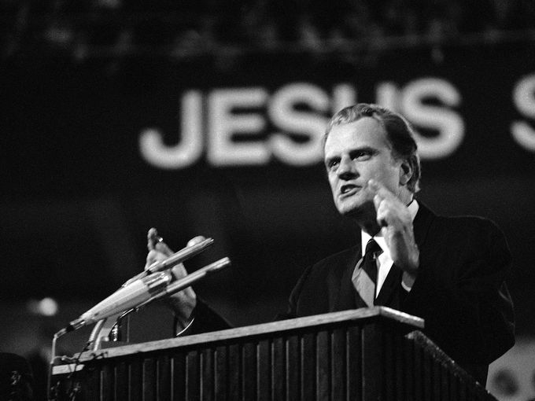

Slide 21
Not Ashamed – Rom 1:1-17
Missiology
The nature of Paul as a missionary
“I am …”
4. The recipient of grace and authority through Jesus – vs 5

Slide 23
Not Ashamed – Rom 1:1-17
Missiology
The nature of Paul as a missionary
“I am …”
5. Under obligation – vs 14

Slide 24
Not Ashamed – Rom 1:1-17
Missiology
The nature of Paul as a missionary
“I am …”
6. Eager – vs 15

Slide 25
Not Ashamed – Rom 1:1-17
Missiology
The nature of Paul as a missionary
“I am …”
7. Not ashamed – vs 16

Slide 34
I want people to have more to say about me
after I'm gone than,

Slide 35
I want people to have more to say about me
after I'm gone than,
"He was a nice guy. He chased sticks!"

Slide 36
“I am…”
A servant of Christ Jesus – vs 1
Called to be a “sent one” – vs 1
Set apart for the gospel – vs 1
The recipient of grace and authority through Jesus – vs 5
Under obligation – vs 14
Eager – vs 15
Not ashamed – vs 16

Slide 37
Discussion Questions
Of these 7 characteristics of Paul’s identity as a missionary, which are the most natural and easy for you?
Which are the hardest? In what area would growth make the biggest difference in your effectiveness as a missionary?
What would help you grow in that area?
As you head into this week, what do you most need from God during these next days together?
Pray for each other.

