Slide 2
Without Excuse - Rom. 1:13-3:20 (Anthropology)

Slide 3
Without Excuse - Rom. 1:13-3:20 (Anthropology)
Personal reflection

Slide 4
Without Excuse - Rom. 1:13-3:20 (Anthropology)
Personal reflection
Write down the names of three people you care about who don’t know God or are moving away from him.

Slide 5
Without Excuse - Rom. 1:13-3:20 (Anthropology)
Personal reflection
Write down the names of three people you care about who don’t know God or are moving away from him.
If you could ask God a question about one or two of them, what would you ask?

Slide 6
Without Excuse - Rom. 1:13-3:20 (Anthropology)
Personal reflection
Write down the names of three people you care about who don’t know God or are moving away from him.
If you could ask God a question about one or two of them, what would you ask?
To understand their condition there are six scenes you need to see from God’s perspective.

Slide 7
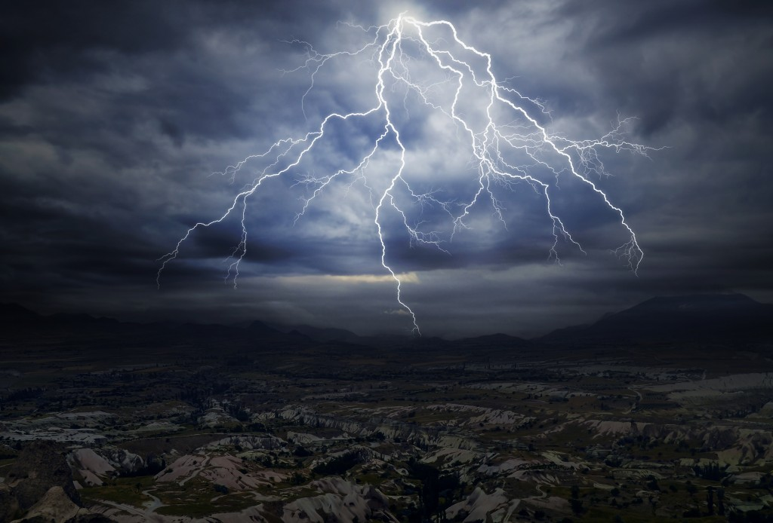
Without Excuse - Rom. 1:13-3:20 (Anthropology)
Six Scenes (that show the condition and nature of man)
Scene 1 - The wrath of God – 1:18-19

Slide 9
Without Excuse - Rom. 1:13-3:20 (Anthropology)
Six Scenes (that show the condition and nature of man)
Scene 1 - The wrath of God – 1:18-19
“…is being revealed from heaven against
all ungodliness and wickedness of men.”

Slide 10
Without Excuse - Rom. 1:13-3:20 (Anthropology)
Six Scenes (that show the condition and nature of man)
Scene 1 - The wrath of God – 1:18-19
“…is being revealed from heaven against
all ungodliness and wickedness of men.”
Wrath – God’s intolerance for evil

Slide 11
Without Excuse - Rom. 1:13-3:20 (Anthropology)
Six Scenes (that show the condition and nature of man)
Scene 2 - The three witnesses

Slide 12
Without Excuse - Rom. 1:13-3:20 (Anthropology)
Six Scenes (that show the condition and nature of man)
Scene 2 - The three witnesses
General witnesses

Slide 13
Without Excuse - Rom. 1:13-3:20 (Anthropology)
Six Scenes (that show the condition and nature of man)
Scene 2 - The three witnesses
General witnesses
1. Creation – 1:19-20

Slide 14
Sir William Herschel (1738 – 1822)
“All human discoveries seem to be made only for purpose of confirming the truths contained in the Sacred Scriptures.”

Slide 15
Sir William Herschel (1738 – 1822)
“All human discoveries seem to be made only for purpose of confirming the truths contained in the Sacred Scriptures.”
“The undevout astronomer must be mad.”

Slide 16
Without Excuse - Rom. 1:13-3:20 (Anthropology)
Six Scenes (that show the condition and nature of man)
Scene 2 - The three witnesses
General witnesses
1. Creation – 1:19-20

Slide 17
Without Excuse - Rom. 1:13-3:20 (Anthropology)
Six Scenes (that show the condition and nature of man)
Scene 2 - The three witnesses
General witnesses
1. Creation – 1:19-20
2. Conscious – 2:14-16

Slide 18
Without Excuse - Rom. 1:13-3:20 (Anthropology)
Six Scenes (that show the condition and nature of man)
Scene 2 - The three witnesses
General witnesses
1. Creation – 1:19-20
2. Conscious – 2:14-16
3. The Holy Spirit - John 16:8

Slide 19
Without Excuse - Rom. 1:13-3:20 (Anthropology)
Six Scenes (that show the condition and nature of man)
Scene 2 - The three witnesses
Special witnesses

Slide 20
Without Excuse - Rom. 1:13-3:20 (Anthropology)
Six Scenes (that show the condition and nature of man)
Scene 2 - The three witnesses
Special witnesses
1. Christ – Romans 10:8-10, Heb 1:1-3

Slide 21
Without Excuse - Rom. 1:13-3:20 (Anthropology)
Six Scenes (that show the condition and nature of man)
Scene 2 - The three witnesses
Special witnesses
1. Christ – Romans 10:8-10, Heb 1:1-3
2. Believers – Romans 10:15, Jeremiah 44:4

Slide 22
Without Excuse - Rom. 1:13-3:20 (Anthropology)
Six Scenes (that show the condition and nature of man)
Scene 2 - The three witnesses
Special witnesses
1. Christ – Romans 10:8-10, Heb 1:1-3
2. Believers – Romans 10:15, Jeremiah 44:4
3. Scripture – Romans 10:17, John 5:39

Slide 23
Without Excuse - Rom. 1:13-3:20 (Anthropology)
Six Scenes (that show the condition and nature of man)
Scene 2 - The three witnesses
3+3 witnesses

Slide 24
Without Excuse - Rom. 1:13-3:20 (Anthropology)
Six Scenes (that show the condition and nature of man)
Scene 2 - The three witnesses
3+3 witnesses
Everyone has three witnesses,
some have up to three more.

Slide 25
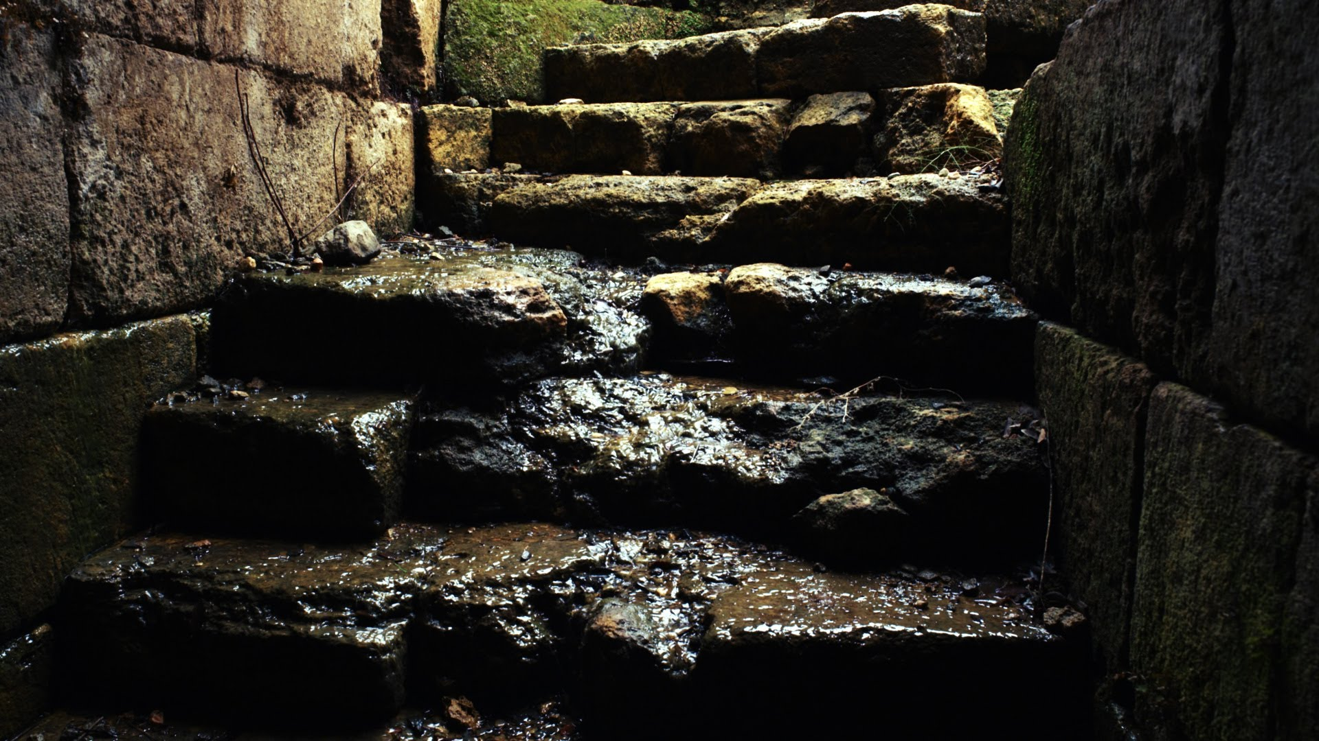
Without Excuse - Rom. 1:13-3:20 (Anthropology)
Six Scenes (that show the condition and nature of man)
Scene 3 - The stairs of departure – 1:18-32

Slide 26
Without Excuse - Rom. 1:13-3:20 (Anthropology)
Six Scenes (that show the condition and nature of man)
Scene 3 - The stairs of departure – 1:18-32
Stair 1 – Suppression - futile thinking,
darkened heart – 1: 18-21

Slide 27
“To suppose that the eye with all its inimitable contrivances for adjusting the focus to different distances, for admitting different amounts of light, and for the correction of spherical and chromatic aberration, could have been formed by natural selection, seems, I freely confess, absurd in the highest degree.”
Charles Darwin
The Origin of Species, 1872

Slide 28
GOD
1. Suppression
Stairs of Departure

Slide 29
Without Excuse - Rom. 1:13-3:20 (Anthropology)
Six Scenes (that show the condition and nature of man)
Scene 3 - The stairs of departure – 1:18-32
Stair 2 – Idolatry – claiming to be wise
they became fools – 1:22-23

Slide 30
GOD
1. Suppression
2. Idolatry
Stairs of Departure

Slide 31
Without Excuse - Rom. 1:13-3:20 (Anthropology)
Six Scenes (that show the condition and nature of man)
Scene 3 - The stairs of departure – 1:18-32
Stair 2 – Idolatry – claiming to be wise
they became fools –1:22-23
“He who does not believe in God will believe in anything.”
G.K. Cesterton

Slide 32
Without Excuse - Rom. 1:13-3:20 (Anthropology)
Six Scenes (that show the condition and nature of man)
Scene 3 - The stairs of departure – 1:18-32
Stair 3 – Sexual Impurity – sinful desires,
degrading their bodies with
one another – 1:24-25

Slide 33
GOD
1. Suppression
2. Idolatry
3. Sexual impurity
Stairs of Departure

Slide 34
In 2016, people watched 4.6 billion hours of pornography at just one website (the biggest porn site in the world). That’s 524,000 years of porn or, if you will, around 17,000 complete lifetimes.

Slide 35
In 2016, people watched 4.6 billion hours of pornography at just one website (the biggest porn site in the world). That’s 524,000 years of porn or, if you will, around 17,000 complete lifetimes.
In that same time people watched 92 billion videos (or an average of 12.5 for every person on earth). Significance: So many people are using so much porn today that it is really impossible to tabulate

Slide 36
At age 11, the average child has already been exposed to explicit pornographic content through the internet.

Slide 37
At age 11, the average child has already been exposed to explicit pornographic content through the internet.
93% of boys and 62% of girls are exposed to internet-based pornography during their adolescent years and 22% of the vast quantities of porn consumed by people aged under 18 is consumed by those aged less than 10.

Slide 38
At age 11, the average child has already been exposed to explicit pornographic content through the internet.
93% of boys and 62% of girls are exposed to internet-based pornography during their adolescent years and 22% of the vast quantities of porn consumed by people aged under 18 is consumed by those aged less than 10.
Parents are nothing short of negligent if they take no steps to protect their children from being exposed to pornography.

Slide 39
Without Excuse - Rom. 1:13-3:20 (Anthropology)
Six Scenes (that show the condition and nature of man)
Scene 3 - The stairs of departure – 1:18-32
Stair 4 – Unnatural Relations
(homosexuality) – shameful lust,
receiving in themselves the due penalty
for their sins - 1:26-27

Slide 40
GOD
1. Suppression
2. Idolatry
3. Sexual impurity
Stairs of Departure
4. Unnatural relations

Slide 42
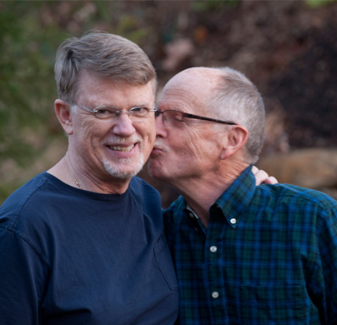
During the past thirty years, the Rev. Dr. Mel White and his husband, Gary Nixon, have traveled across the country, speaking on university campuses, organizing people of faith to do justice, and confronting religious leaders whose anti-gay rhetoric White believes, “leads to the suffering and death of God’s lesbian and gay children.”

Slide 43
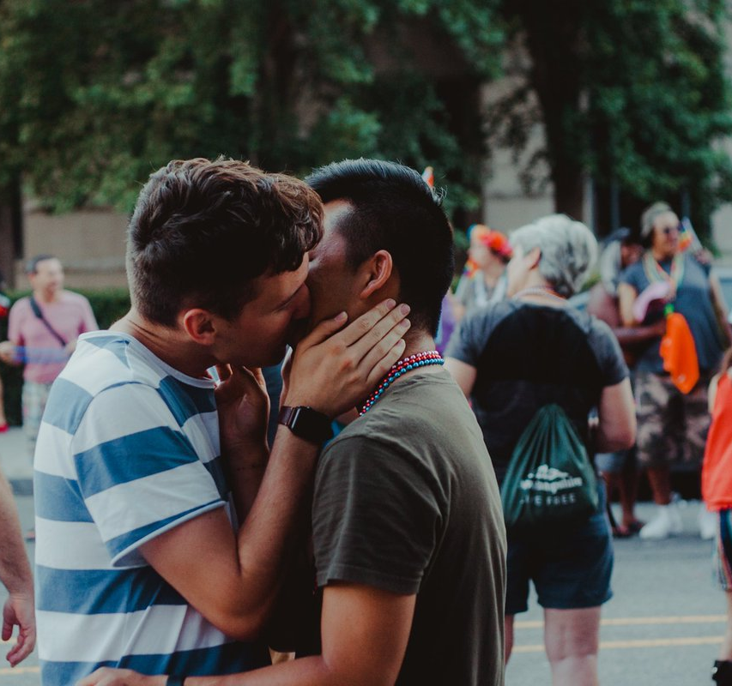
Nate – a student at Liberty university, 2016
it’s time to be real after 2 months and 4 days with this gentle, loving, compassionate man,
As any LGBTQ+ individual attending an Evangelical university knows, simply to exist is to rebel.
To breathe is to resist.
It’s okay to resist.
It’s okay to stand out.
Do what’s best for you.

Slide 44
Nate – a student at Liberty university, 2016
Silence in the face of injustice costs lives. We deserve the freedom to live without fear of a punitive institution, retributive policies, and judgment from our peers. I’m optimistic that change is coming. I see it. I feel it. Slowly and with immense effort, we can embody a supreme Love in the face of adversity.
And I believe that at the end of the day, Love wins.

Slide 46
Without Excuse - Rom. 1:13-3:20 (Anthropology)
Six Scenes (that show the condition and nature of man)
Scene 3 - The stairs of departure – 1:18-32
Stair 5 – Depraved Mind – to do and
approve what is evil – a reversed
moral compass – 1:28-32

Slide 47
GOD
1. Suppression
2. Idolatry
3. Sexual impurity
Stairs of Departure
4. Unnatural relations
5. Depraved mind

Slide 48
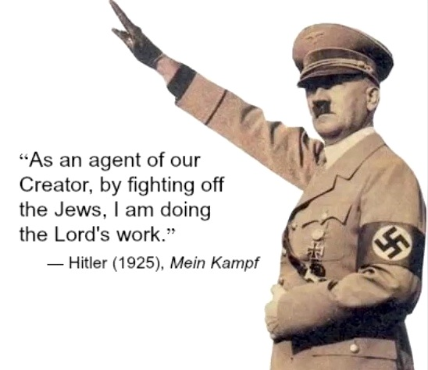

Slide 50
The Incel Rebellion has already begun! We will overthrow all the Chads and Stacys! All hail the Supreme Gentleman Elliot Rodger!”

Slide 51
“It’s an injustice, a crime because I don’t know what you don’t see in me, I’m the perfect guy and yet you throw yourselves at all these obnoxious men instead of me, the supreme gentleman,” he said. “I will punish all of you for it.”

Slide 52
Nate – a student at Liberty university, 2016
Silence in the face of injustice costs lives. We deserve the freedom to live without fear of a punitive institution, retributive policies, and judgment from our peers. I’m optimistic that change is coming. I see it. I feel it. Slowly and with immense effort, we can embody a supreme Love in the face of adversity.
And I believe that at the end of the day, Love wins.

Slide 53
Without Excuse - Rom. 1:13-3:20 (Anthropology)
Six Scenes (that show the condition and nature of man)
Scene 3 - The stairs of departure – 1:18-32
Stair 5 – Depraved Mind – to do and
approve what is evil – a reversed
moral compass – 1:28-32

Slide 54
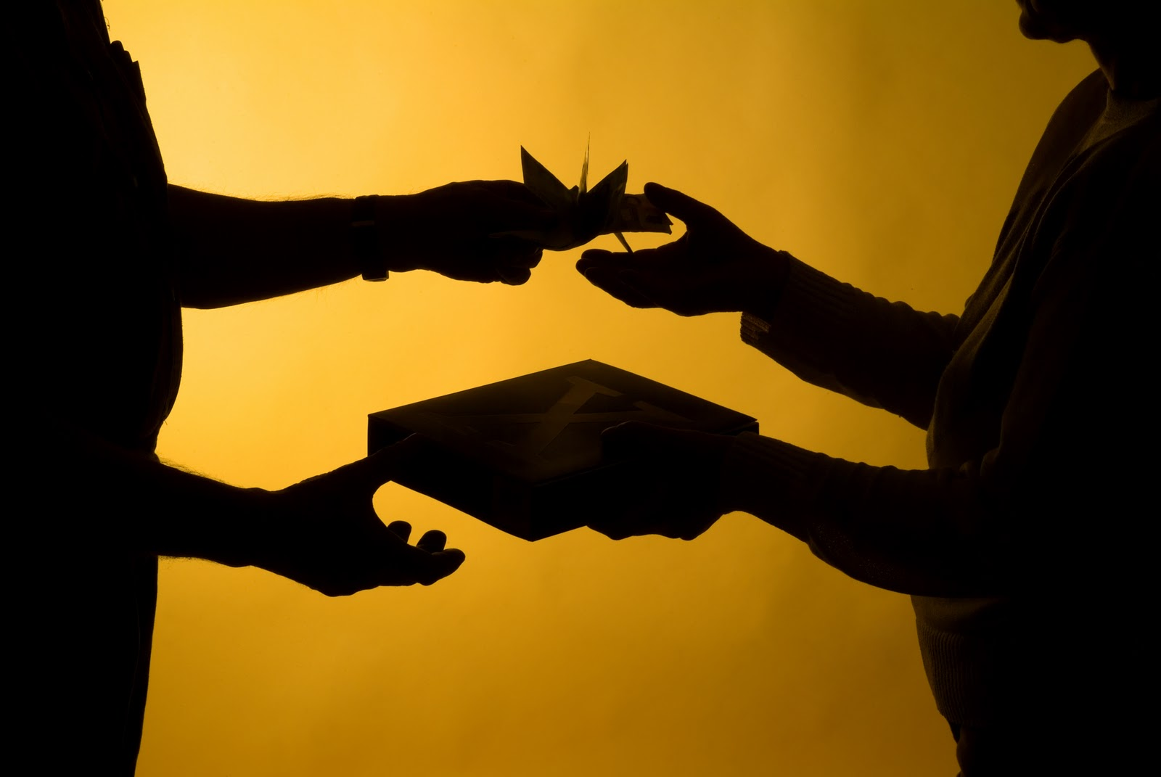
Without Excuse - Rom. 1:13-3:20 (Anthropology)
Six Scenes (that show the condition and nature of man)
Scene 4 - The great exchange – 1:23-26

Slide 55
Without Excuse - Rom. 1:13-3:20 (Anthropology)
Six Scenes (that show the condition and nature of man)
Scene 4 - The great exchange – 1:23-26
1. God’s immortal glory for fake copies – vs 23

Slide 56
Without Excuse - Rom. 1:13-3:20 (Anthropology)
Six Scenes (that show the condition and nature of man)
Scene 4 - The great exchange – 1:23-26
1. God’s immortal glory for fake copies – vs 23
2. The truth about God for a lie – vs 25

Slide 57
Without Excuse - Rom. 1:13-3:20 (Anthropology)
Six Scenes (that show the condition and nature of man)
Scene 4 - The great exchange – 1:23-26
1. God’s immortal glory for fake copies – vs 23
2. The truth about God for a lie – vs 25
3. Natural sexual relations for unnatural ones – vs 26

Slide 58
Without Excuse - Rom. 1:13-3:20 (Anthropology)
Six Scenes (that show the condition and nature of man)
Scene 4 - The great exchange – 1:23-26
The great exchange is not trading something
for something else,

Slide 59
Without Excuse - Rom. 1:13-3:20 (Anthropology)
Six Scenes (that show the condition and nature of man)
Scene 4 - The great exchange – 1:23-26
The great exchange is not trading something
for something else, but trading something
for nothing.

Slide 60
Without Excuse - Rom. 1:13-3:20 (Anthropology)
Six Scenes (that show the condition and nature of man)
Scene 4 - The great exchange – 1:23-26
The great exchange is not trading something
for something else, but trading something
for nothing.
When you fight reality, reality always wins

Slide 61
Without Excuse - Rom. 1:13-3:20 (Anthropology)
Six Scenes (that show the condition and nature of man)
Scene 4 - The great exchange – 1:23-26
1. God’s immortal glory for fake copies – vs 23
2. The truth about God for a lie – vs 25
3. Natural sexual relations for unnatural ones – vs 26

Slide 62
Without Excuse - Rom. 1:13-3:20 (Anthropology)
Six Scenes (that show the condition and nature of man)
Scene 5 - Three defendants and two ladders – 1:18-3:8

Slide 63
Without Excuse - Rom. 1:13-3:20 (Anthropology)
Six Scenes (that show the condition and nature of man)
Scene 5 - Three defendants and two ladders – 1:18-3:8
1. Godless Gabe – 1:18-32

Slide 64
Without Excuse - Rom. 1:13-3:20 (Anthropology)
Six Scenes (that show the condition and nature of man)
Scene 5 - Three defendants and two ladders – 1:18-3:8
1. Godless Gabe – 1:18-32
He is going to plead ignorance

Slide 65
Without Excuse - Rom. 1:13-3:20 (Anthropology)
Six Scenes (that show the condition and nature of man)
Scene 5 - Three defendants and two ladders – 1:18-3:8
2. Good Gwen – 2:1-16

Slide 66
Without Excuse - Rom. 1:13-3:20 (Anthropology)
Six Scenes (that show the condition and nature of man)
Scene 5 - Three defendants and two ladders – 1:18-3:8
2. Good Gwen – 2:1-16
Gwen loves the ladder of goodness

Slide 67
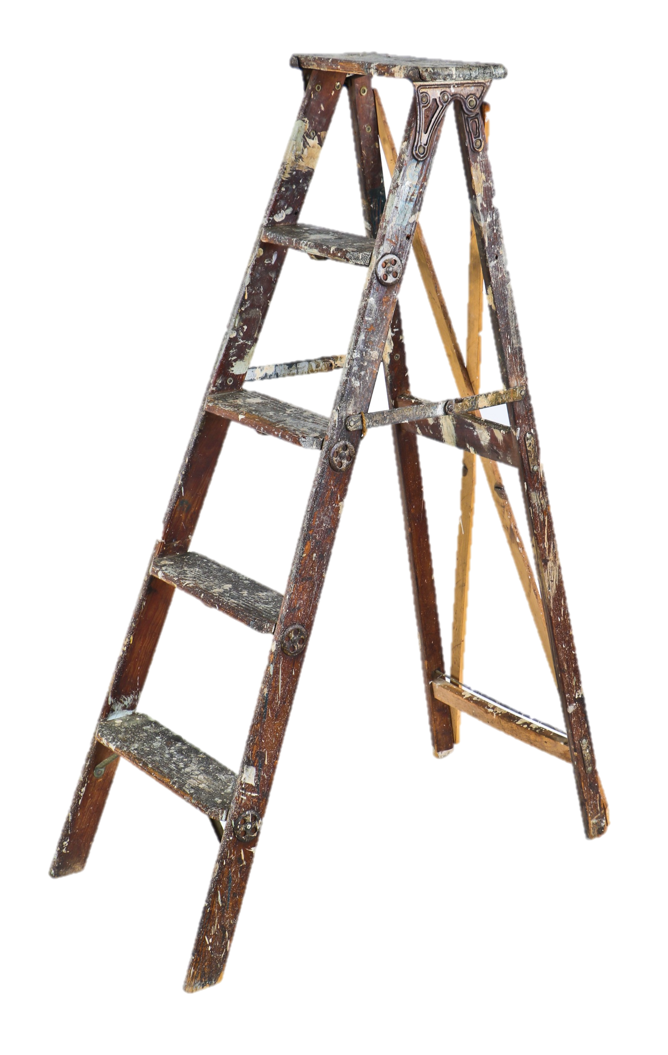
Without Excuse - Rom. 1:13-3:20 (Anthropology)
Goodness
Six Scenes (that show the condition and nature of man)
Scene 5 - Three defendants and two ladders – 1:18-3:8
2. Good Gwen – 2:1-16
Gwen loves the ladder of goodness

Slide 68
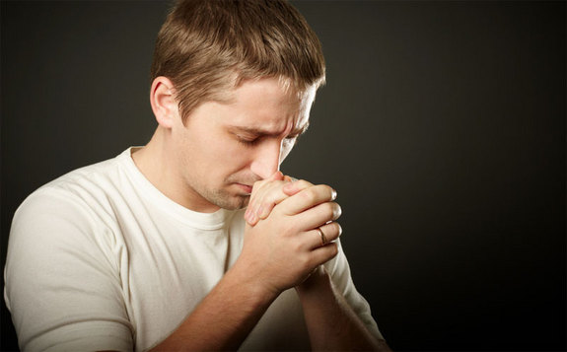
Without Excuse - Rom. 1:13-3:20 (Anthropology)
Six Scenes (that show the condition and nature of man)
Scene 5 - Three defendants and two ladders – 1:18-3:8
3. Religious Rick – 2:17-3:8

Slide 69
Without Excuse - Rom. 1:13-3:20 (Anthropology)
Six Scenes (that show the condition and nature of man)
Scene 5 - Three defendants and two ladders – 1:18-3:8
3. Religious Rick – 2:17-3:8
Rick loves the ladder of religion

Slide 70
Without Excuse - Rom. 1:13-3:20 (Anthropology)
Religion
Six Scenes (that show the condition and nature of man)
Scene 5 - Three defendants and two ladders – 1:18-3:8
3. Religious Rick – 2:17-3:8
Rick loves the ladder of religion

Slide 71
Without Excuse - Rom. 1:13-3:20 (Anthropology)
Six Scenes (that show the condition and nature of man)
Scene 5 - Three defendants
and two ladders – 1:18-3:8
The ladder of goodness
and the ladder of religion
are too short.
Goodness
Religion

Slide 72
Without Excuse - Rom. 1:13-3:20 (Anthropology)
Six Scenes (that show the condition and nature of man)
Scene 6 - The verdict - 3:9-12

Slide 73
Without Excuse - Rom. 1:13-3:20 (Anthropology)
Six Scenes (that show the condition and nature of man)
Scene 6 - The verdict - 3:9-12
No one is righteous - no one understands, no one seeks God – 3:9-18

Slide 74
Without Excuse - Rom. 1:13-3:20 (Anthropology)
Six Scenes (that show the condition and nature of man)
Scene 6 - The verdict - 3:9-12
No one is righteous - no one understands, no one seeks God – 3:9-18
Everyone is accountable - there is no excuse – 3:19

Slide 75
Without Excuse - Rom. 1:13-3:20 (Anthropology)
Six Scenes (that show the condition and nature of man)
Scene 6 - The verdict - 3:9-12
No one is righteous - no one understands, no one seeks God – 3:9-18
Everyone is accountable - there is no excuse – 3:19
No one will be justified - by their own efforts or good works – 3:20

Slide 76
Without Excuse - Rom. 1:13-3:20 (Anthropology)
Six Scenes (that show the condition and nature of man)
Scene 1 - The wrath of God – 1:18-19

Slide 77
Without Excuse - Rom. 1:13-3:20 (Anthropology)
Six Scenes (that show the condition and nature of man)
Scene 1 - The wrath of God – 1:18-19
Scene 2 - The three witnesses – 1:19-20, 2:14-16

Slide 78
Without Excuse - Rom. 1:13-3:20 (Anthropology)
Six Scenes (that show the condition and nature of man)
Scene 1 - The wrath of God – 1:18-19
Scene 2 - The three witnesses – 1:19-20, 2:14-16
Scene 3 - The stairs of departure – 1:18-32

Slide 79
Without Excuse - Rom. 1:13-3:20 (Anthropology)
Six Scenes (that show the condition and nature of man)
Scene 1 - The wrath of God – 1:18-19
Scene 2 - The three witnesses – 1:19-20, 2:14-16
Scene 3 - The stairs of departure – 1:18-32
Scene 4 - The great exchange – 1:23-26

Slide 80
Without Excuse - Rom. 1:13-3:20 (Anthropology)
Six Scenes (that show the condition and nature of man)
Scene 1 - The wrath of God – 1:18-19
Scene 2 - The three witnesses – 1:19-20, 2:14-16
Scene 3 - The stairs of departure – 1:18-32
Scene 4 - The great exchange – 1:23-26
Scene 5 - Three defendants and two ladders – 1:18-3:8

Slide 81
Without Excuse - Rom. 1:13-3:20 (Anthropology)
Six Scenes (that show the condition and nature of man)
Scene 1 - The wrath of God – 1:18-19
Scene 2 - The three witnesses – 1:19-20, 2:14-16
Scene 3 - The stairs of departure – 1:18-32
Scene 4 - The great exchange – 1:23-26
Scene 5 - Three defendants and two ladders – 1:18-3:8
Scene 6 - The verdict - 3:9-12

Slide 82
Without Excuse - Rom. 1:13-3:20 (Anthropology)
Discussion
Put one of those three people you wrote down into this picture with the six scenes. What new insights do you get into their condition in the light of these passages from Romans?
How should you relate to them based on what you see in these six scenes?
If one of them is moving away from God, what do you know about what is ahead of them based on these six scenes?

Slide 83
Without Excuse - Rom. 1:13-3:20 (Anthropology)
Discussion
How would the way you relate to lost people change if you kept these six scenes clearly in view?
How would the way you relate to believers change if you kept these six scenes clearly in view?
How is this information “good news” (gospel)?

