Slide 2
Justification by faith (Soteriology) Romans 3:21-5:21

Slide 7
Justi-fication
by Faith
in Jesus Christ

Slide 10
Justi-fication
by Faith
in Goodness

Slide 13
Justi-fication
Without your vote
in Jesus Christ

Slide 16
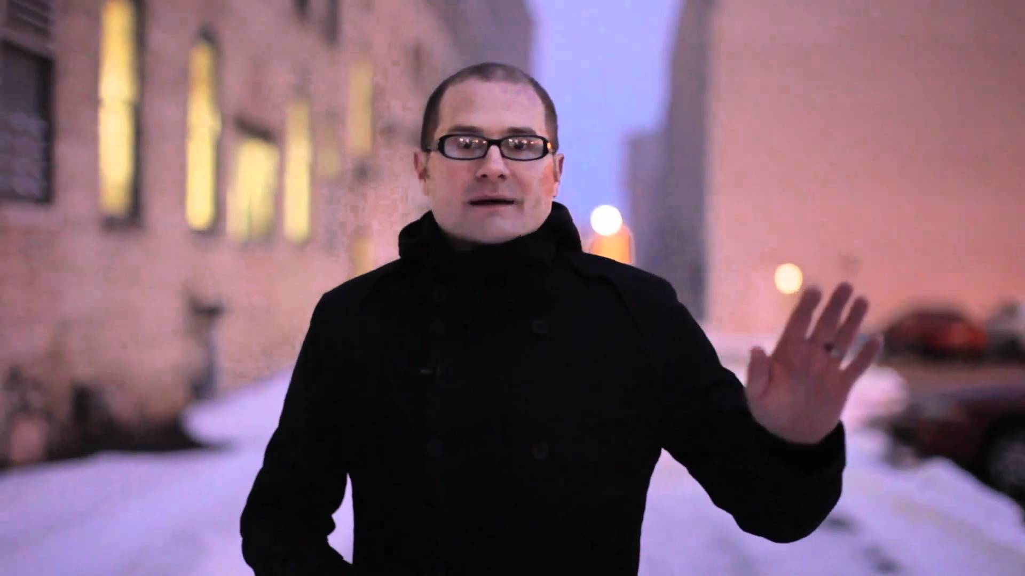

Slide 17
Justi-fication
Love wins
in Jesus Christ

Slide 18
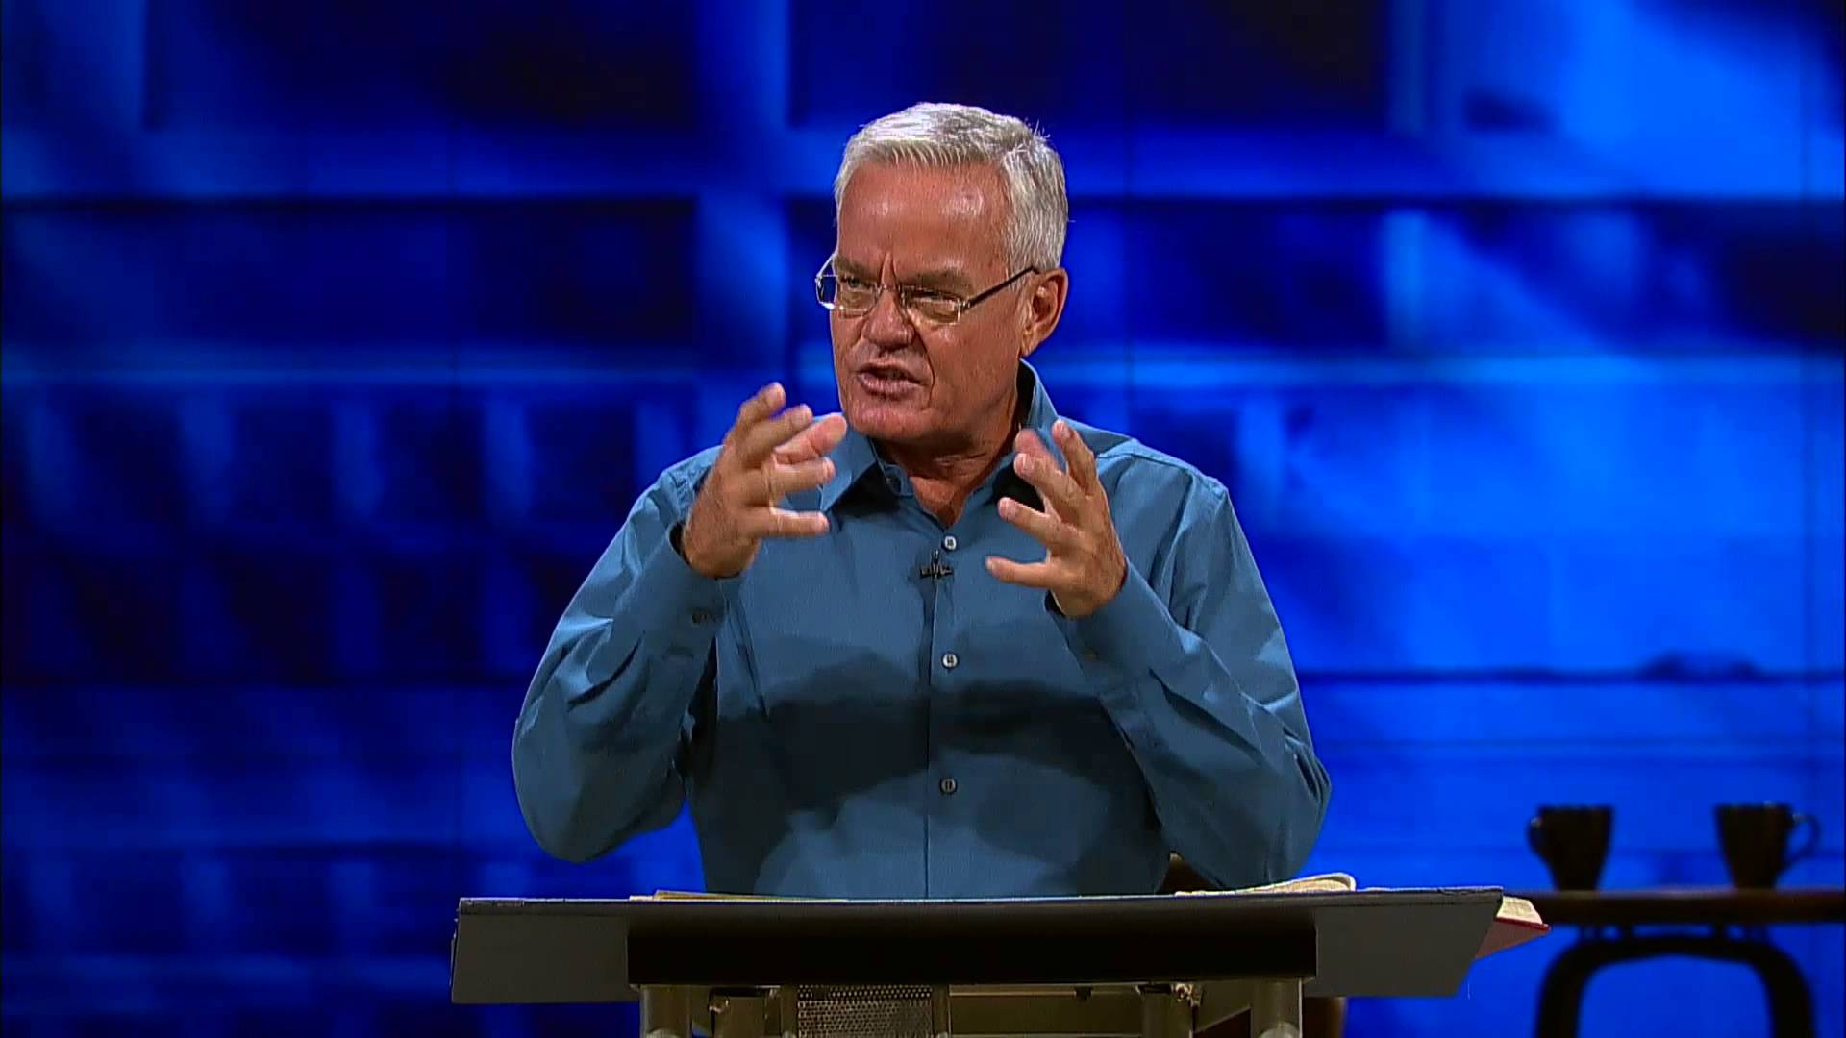

Slide 19
Justi-fication
by Faith
in the Local Church

Slide 20
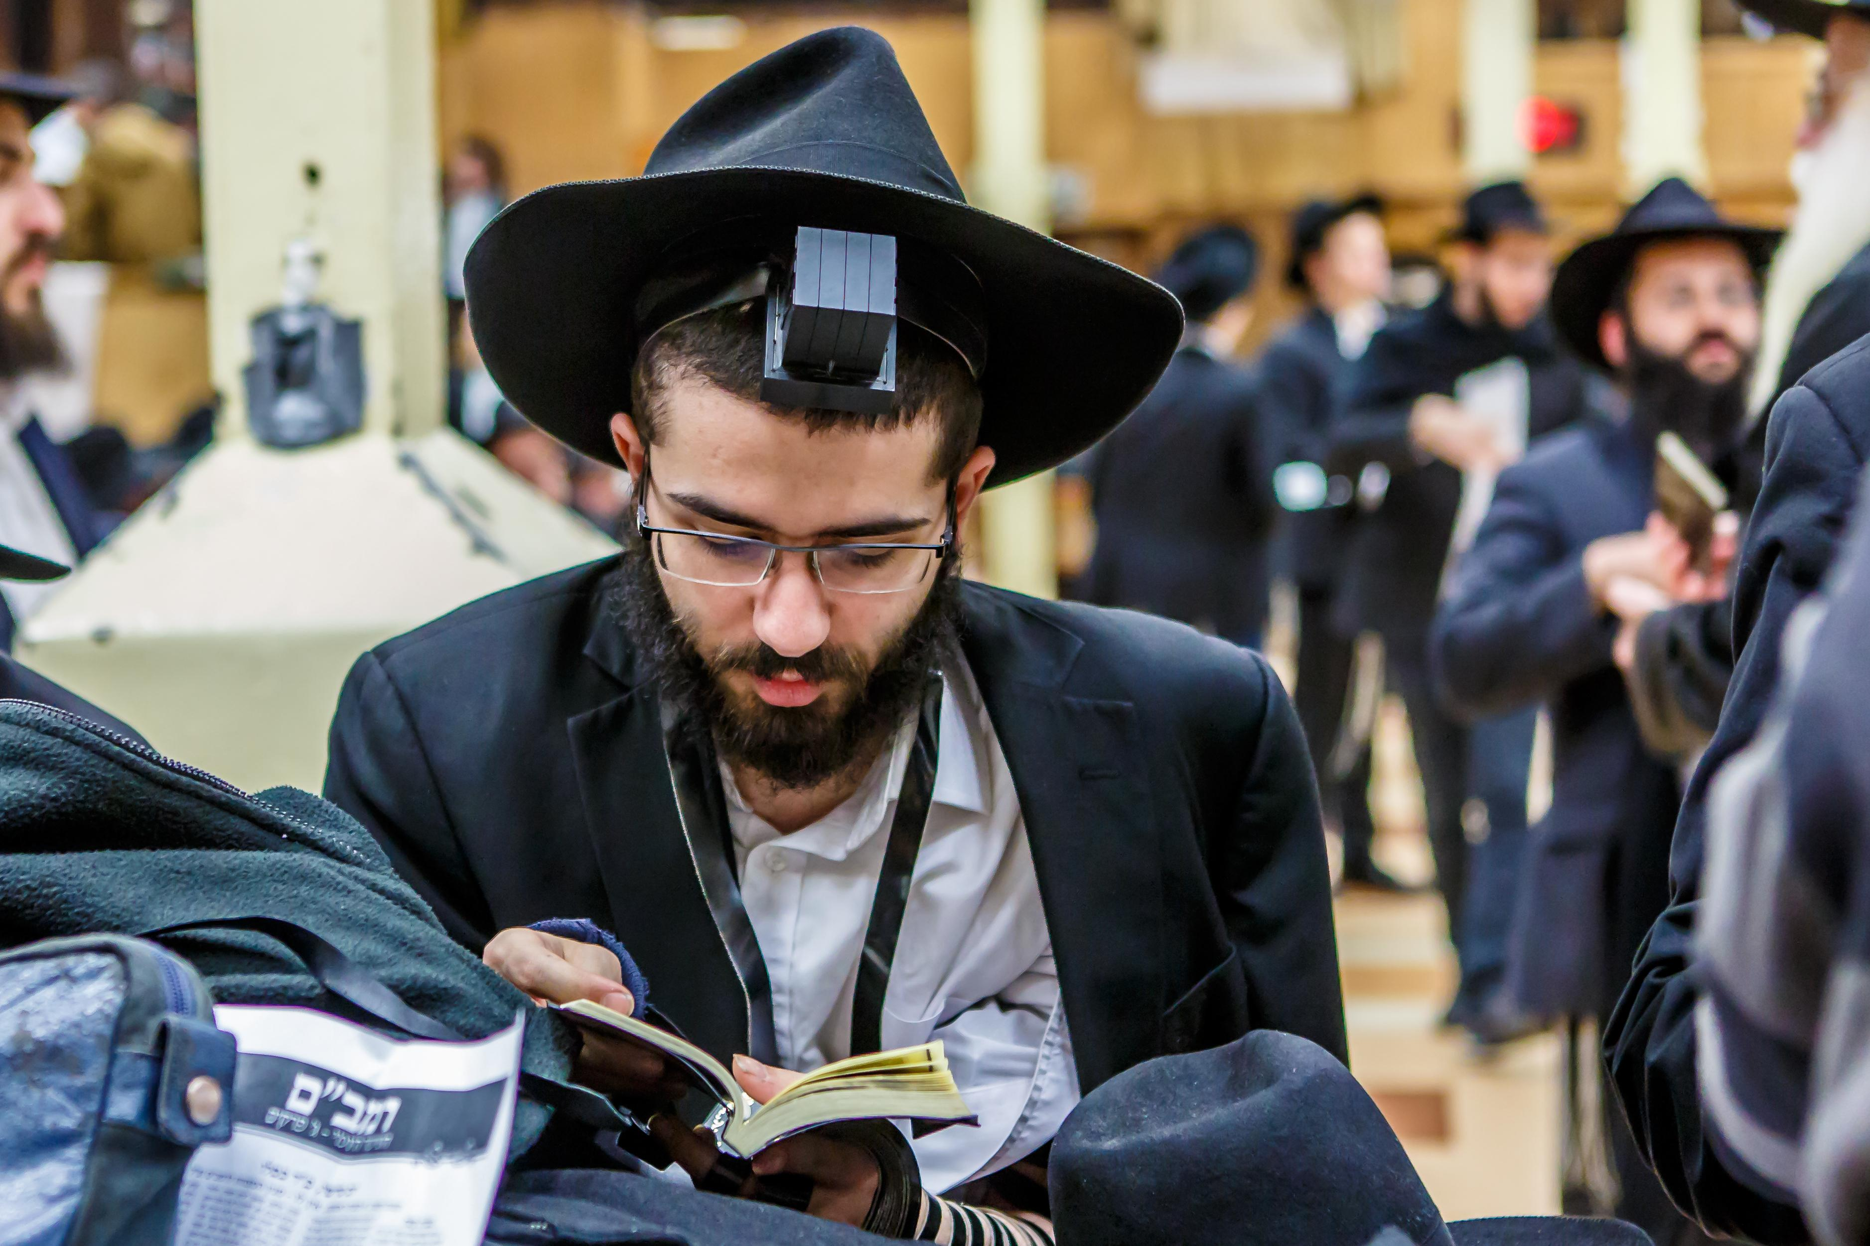

Slide 21
Justi-fication
by Keeping
The law

Slide 22
Justi-fication
by learning
The Scriptures

Slide 23
Justi-fication
by Knowlege
about Jesus Christ

Slide 24
Justi-fication
by learning
Lots

Slide 25
Success
by faith
In Myself

Slide 26
Fulfillment
by Doing
Something Significant

Slide 27
Justi-fication
by Faith
in Jesus Christ

Slide 29
I am astonished that you are so quickly deserting the one who called you to live in the grace of Christ and are turning to a different gospel— which is really no gospel at all. Gal 1:6-7

Slide 30
…Remember your theology of Man

Slide 31
…Remember your theology of Man
Six scenes,

Slide 32
…Remember your theology of Man
Six scenes,
and only one solution

Slide 33
…Remember your theology of Man
Six scenes,
and only one solution
Justification by faith in Jesus Christ

Slide 35
Justification by faith (Soteriology) Romans 3:21-5:21
Justification - 3:21 – 4:17

Slide 36
Justification by faith (Soteriology) Romans 3:21-5:21
Justification - 3:21 – 4:17
Justification - The act of making righteous
that which is not

Slide 37
Justification by faith (Soteriology) Romans 3:21-5:21
Justification - 3:21 – 4:17
Justification - The act of making righteous that which is not
Righteous - the state of one who is in the eyes of God as
they ought to be

Slide 38
Justification by faith (Soteriology) Romans 3:21-5:21
Justification - 3:21 – 4:17
Apart from the law – 3:21

Slide 39
Justification by faith (Soteriology) Romans 3:21-5:21
Justification - 3:21 – 4:17
Apart from the law – 3:21
To all who believe – 3:22-24

Slide 40
Justification by faith (Soteriology) Romans 3:21-5:21
Justification - 3:21 – 4:17
Apart from the law – 3:21
To all who believe – 3:22-24
Satisfies God’s wrath – 3:25

Slide 41
Justification by faith (Soteriology) Romans 3:21-5:21
Justification - 3:21 – 4:17
Apart from the law – 3:21
To all who believe – 3:22-24
Satisfies God’s wrath – 3:25
Demonstrates God’s righteousness – 3:25-26

Slide 42
Justification by faith (Soteriology) Romans 3:21-5:21
Justification - 3:21 – 4:17
Apart from the law – 3:21
To all who believe – 3:22-24
Satisfies God’s wrath – 3:25
Demonstrates God’s righteousness – 3:25-26
Removes boasting – 3:27-31

Slide 43
Justification by faith (Soteriology) Romans 3:21-5:21
Justification - 3:21 – 4:17
Apart from the law – 3:21
To all who believe – 3:22-24
Satisfies God’s wrath – 3:25
Demonstrates God’s righteousness – 3:25-26
Removes boasting – 3:27-31
Credits righteousness to us – 4:1-11

Slide 44
Justification by faith (Soteriology) Romans 3:21-5:21
By Faith – 4:12 – 5:6

Slide 45
Justification by faith (Soteriology) Romans 3:21-5:21
By Faith – 4:12 – 5:6
Faith - Being sure of what you hope for and confident of what you do not see (Heb 11:1)

Slide 46
Justification by faith (Soteriology) Romans 3:21-5:21
By Faith – 4:12 – 5:6
In God’s promise – 4:13 - 16

Slide 47
Justification by faith (Soteriology) Romans 3:21-5:21
By Faith – 4:12 – 5:6
In God’s promise – 4:13 - 16
In God’s power – 4:17, 21

Slide 48
Justification by faith (Soteriology) Romans 3:21-5:21
By Faith – 4:12 – 5:6
In God’s promise – 4:13 - 16
In God’s power – 4:17, 21
In spite of contrary information – 4:18 – 25

Slide 49
Justification by faith (Soteriology) Romans 3:21-5:21
By Faith – 4:12 – 5:6
In God’s promise – 4:13 - 16
In God’s power – 4:17, 21
In spite of contrary information – 4:18 - 25
Faith brings peace - 5:1

Slide 50
Justification by faith (Soteriology) Romans 3:21-5:21
By Faith – 4:12 – 5:6
In God’s promise – 4:13 - 16
In God’s power – 4:17, 21
In spite of contrary information – 4:18 - 25
Faith brings peace - 5:1
Faith give us access to grace – 5:2

Slide 51
Justification by faith (Soteriology) Romans 3:21-5:21
By Faith – 4:12 – 5:6
In God’s promise – 4:13 - 16
In God’s power – 4:17, 21
In spite of contrary information – 4:18 - 25
Faith brings peace - 5:1
Faith give us access to grace – 5:2
Faith brings hope – 5:2-5

Slide 52
Justification by faith (Soteriology) Romans 3:21-5:21
By Faith – 4:12 – 5:6
In God’s promise – 4:13 - 16
In God’s power – 4:17, 21
In spite of contrary information – 4:18 - 25
Faith brings peace - 5:1
Faith give us access to grace – 5:2
Faith brings hope – 5:2-5
Faith allows us to experience God’s love – 5:5

Slide 53
Justification by faith (Soteriology) Romans 3:21-5:21
In Jesus Christ – 5:6-21

Slide 54
Justification by faith (Soteriology) Romans 3:21-5:21
In Jesus Christ – 5:6-21
Who died for us- While we were still sinners, Christ died for us – 5:6-8

Slide 55
Justification by faith (Soteriology) Romans 3:21-5:21
In Jesus Christ – 5:6-21
Who died for us- While we were still sinners, Christ died for us – 5:6-8
Who lives for us- He reconciled us by his death, and saves us through his life – 5:9-11

Slide 56
Justification by faith (Soteriology) Romans 3:21-5:21
In Jesus Christ – 5:6-21
Who died for us- While we were still sinners, Christ died for us – 5:6-8
Who lives for us- He reconciled us by his death, and saves us through his life – 5:9-11
Who became the second Adam for us – through the obedience of one man, many will be made righteous, and receive eternal life – 5:12-21

Slide 57
Justification by faith (Soteriology) Romans 3:21-5:21
The only true gospel -

Slide 58
Justification by faith (Soteriology) Romans 3:21-5:21
The only true gospel - Justification by faith in Jesus Christ

Slide 59
Justification by faith (Soteriology) Romans 3:21-5:21
Discussion
How would the way you relate to lost people change if you kept these six scenes clearly in view?
How would the way you relate to believers change if you kept these six scenes clearly in view?
How is this information “good news” (gospel)?

Slide 60
Justification by faith (Soteriology) Romans 3:21-5:21
As you watch others play “salvation slots” around you, what are some of the most common combinations they come up with in place of Salvation by Faith in Jesus Christ?
What was the most significant thought for you as you heard Paul unpack Justification, Faith, and Jesus Christ?
What would you say if someone told you that their faith was too weak to believe in Jesus?

