Slide 2
TRANSFORMED LIVING
Practical Theology 1 | Romans 12:1-13:14

Slide 3
TRANSFORMED LIVING
Practical Theology 1 | Romans 12:1-13:14
Therefore, I urge you, brothers and sisters, in view of God’s mercy, to offer your bodies as a living sacrifice, holy and pleasing to God—this is your true and proper worship.

Slide 4
TRANSFORMED LIVING
Practical Theology 1 | Romans 12:1-13:14
Therefore, I urge you, brothers and sisters, in view of God’s mercy, to offer your bodies as a living sacrifice, holy and pleasing to God—this is your true and proper worship.
Do not conform to the pattern of this world, but be transformed by the renewing of your mind. Then you will be able to test and approve what God’s will is—his good, pleasing and perfect will.
Romans 12:1-2

Slide 5
TRANSFORMED LIVING
Practical Theology 1 | Romans 12:1-13:14
Therefore, I urge you, brothers and sisters, in view of God’s mercy, to offer your bodies as a living sacrifice, holy and pleasing to God—this is your true and proper worship.
Do not conform to the pattern of this world, but be transformed by the renewing of your mind. Then you will be able to test and approve what God’s will is—his good, pleasing and perfect will.
mercy - "visceral compassions" - is used of the deep feelings God has for us (5X in NT)

Slide 6
TRANSFORMED LIVING
Practical Theology 1 | Romans 12:1-13:14
Therefore, I urge you, brothers and sisters, in view of God’s mercy, to offer your bodies as a living sacrifice, holy and pleasing to God—this is your true and proper worship.
Do not conform to the pattern of this world, but be transformed by the renewing of your mind. Then you will be able to test and approve what God’s will is—his good, pleasing and perfect will.
sacrifice - an offering, an official sacrifice prescribed by God; hence an offering the Lord accepts because offered on His terms. (29X in NT)

Slide 7
TRANSFORMED LIVING
Practical Theology 1 | Romans 12:1-13:14
Therefore, I urge you, brothers and sisters, in view of God’s mercy, to offer your bodies as a living sacrifice, holy and pleasing to God—this is your true and proper worship.
Do not conform to the pattern of this world, but be transformed by the renewing of your mind. Then you will be able to test and approve what God’s will is—his good, pleasing and perfect will.
holy – set apart, different

Slide 8
TRANSFORMED LIVING
Practical Theology 1 | Romans 12:1-13:14
Therefore, I urge you, brothers and sisters, in view of God’s mercy, to offer your bodies as a living sacrifice, holy and pleasing to God—this is your true and proper worship.
Do not conform to the pattern of this world, but be transformed by the renewing of your mind. Then you will be able to test and approve what God’s will is—his good, pleasing and perfect will.
true and proper - “logikēn”, logical because divinely reasonable, i.e. "what is logical to God" logic working through the divine reasoning known through faith (2X in NT)

Slide 9
TRANSFORMED LIVING
Practical Theology 1 | Romans 12:1-13:14
Therefore, I urge you, brothers and sisters, in view of God’s mercy, to offer your bodies as a living sacrifice, holy and pleasing to God—this is your true and proper worship.
Do not conform to the pattern of this world, but be transformed by the renewing of your mind. Then you will be able to test and approve what God’s will is—his good, pleasing and perfect will.
worship – “latreia” – service rendered to God (5X in NT)

Slide 10
TRANSFORMED LIVING
Practical Theology 1 | Romans 12:1-13:14
Therefore, I urge you, brothers and sisters, in view of God’s mercy, to offer your bodies as a living sacrifice, holy and pleasing to God—this is your true and proper worship.
Do not conform to the pattern of this world, but be transformed by the renewing of your mind. Then you will be able to test and approve what God’s will is—his good, pleasing and perfect will.
conform to the pattern – “suschématizó” - assuming a similar outward form or expression by following the same pattern (model, mold) (1X in NT)

Slide 11
TRANSFORMED LIVING
Practical Theology 1 | Romans 12:1-13:14
Therefore, I urge you, brothers and sisters, in view of God’s mercy, to offer your bodies as a living sacrifice, holy and pleasing to God—this is your true and proper worship.
Do not conform to the pattern of this world, but be transformed by the renewing of your mind. Then you will be able to test and approve what God’s will is—his good, pleasing and perfect will.
this world – “aion” the age you live in

Slide 12
TRANSFORMED LIVING
Practical Theology 1 | Romans 12:1-13:14
Therefore, I urge you, brothers and sisters, in view of God’s mercy, to offer your bodies as a living sacrifice, holy and pleasing to God—this is your true and proper worship.
Do not conform to the pattern of this world, but be transformed by the renewing of your mind. Then you will be able to test and approve what God’s will is—his good, pleasing and perfect will.
be transformed – “metamorphoó”, "changing form in keeping with inner reality – properly, transformed after being with; transfigured (4X in NT)

Slide 13
TRANSFORMED LIVING
Practical Theology 1 | Romans 12:1-13:14
Therefore, I urge you, brothers and sisters, in view of God’s mercy, to offer your bodies as a living sacrifice, holy and pleasing to God—this is your true and proper worship.
Do not conform to the pattern of this world, but be transformed by the renewing of your mind. Then you will be able to test and approve what God’s will is—his good, pleasing and perfect will.
renewing – “anakainōsei” -make fresh, new, a new development; a renewal, achieved by God's power. (1X in NT)

Slide 14
TRANSFORMED LIVING
Practical Theology 1 | Romans 12:1-13:14
Therefore, I urge you, brothers and sisters, in view of God’s mercy, to offer your bodies as a living sacrifice, holy and pleasing to God—this is your true and proper worship.
Do not conform to the pattern of this world, but be transformed by the renewing of your mind. Then you will be able to test and approve what God’s will is—his good, pleasing and perfect will.
test and approve – “dokimazo” I put to the test, prove, examine; I distinguish by testing, approve after testing. Dokimazo is done to demonstrate what is good, i.e. passes the necessary test. It does not focus on disproving something (i.e. to show it is bad). (22X in NT)

Slide 15
TRANSFORMED LIVING
Practical Theology 1 | Romans 12:1-13:14
Two key questions:
1. How does the world squeeze you into its mold? (suschematizo)

Slide 16
TRANSFORMED LIVING
Practical Theology 1 | Romans 12:1-13:14
Two key questions:
1. How does the world squeeze you into its mold? (suschematizo)
The behavior of the world follows a classic binary pattern

Slide 17
TRANSFORMED LIVING
Practical Theology 1 | Romans 12:1-13:14
Two key questions:
1. How does the world squeeze you into its mold? (suschematizo)
Each “age” has it’s particular expressions of this pattern, but the basic model is always the same.

Slide 18
TRANSFORMED LIVING
Practical Theology 1 | Romans 12:1-13:14
Two key questions:
1. How does the world squeeze you into its mold? (suschematizo)
Each “age” has it’s particular expressions of this pattern, but the basic model is always the same.
Conformist, non-conformist

Slide 19
TRANSFORMED LIVING
Practical Theology 1 | Romans 12:1-13:14
Two key questions:
1. How does the world squeeze you into its mold? (suschematizo)
Each “age” has it’s particular expressions of this pattern, but the basic model is always the same.
Conformist, non-conformist
Actor, reactor

Slide 20
TRANSFORMED LIVING
Practical Theology 1 | Romans 12:1-13:14
Two key questions:
1. How does the world squeeze you into its mold? (suschematizo)
Each “age” has it’s particular expressions of this pattern, but the basic model is always the same.
Conformist, non-conformist
Actor, reactor
Protagonist, antagonist

Slide 21
TRANSFORMED LIVING
Practical Theology 1 | Romans 12:1-13:14
Two key questions:
1. How does the world squeeze you into its mold? (suschematizo)
Each “age” has it’s particular expressions of this pattern, but the basic model is always the same.
Conformist, non-conformist
Actor, reactor
Protagonist, antagonist
The one who accepts, the one who rebels

Slide 22
TRANSFORMED LIVING
Practical Theology 1 | Romans 12:1-13:14
But…

Slide 23
TRANSFORMED LIVING
Practical Theology 1 | Romans 12:1-13:14
But…
“Every revolutionary is sick with the disease
against which he is rebelling.”

Slide 24
TRANSFORMED LIVING
Practical Theology 1 | Romans 12:1-13:14
But…
“Every revolutionary is sick with the disease
against which he is rebelling.”
Both sides of the pattern are allowing themselves to be formed by the mold.

Slide 25
TRANSFORMED LIVING
Practical Theology 1 | Romans 12:1-13:14
Two key questions:
1. How does the world squeeze you into its mold? (suschematizo)

Slide 26
TRANSFORMED LIVING
Practical Theology 1 | Romans 12:1-13:14
Two key questions:
2. How can you be not conformed, but transformed? (metamorphoo)

Slide 27
TRANSFORMED LIVING
Practical Theology 1 | Romans 12:1-13:14
Therefore, I urge you, brothers and sisters, in view of God’s mercy, to offer your bodies as a living sacrifice, holy and pleasing to God—this is your true and proper worship.
Do not conform to the pattern of this world, but be transformed by the renewing of your mind. Then you will be able to test and approve what God’s will is—his good, pleasing and perfect will.
Be transformed – “metamorphoó”, "changing form in keeping with inner reality – properly, transformed after being with; transfigured (4X in NT)

Slide 28
TRANSFORMED LIVING
Practical Theology 1 | Romans 12:1-13:14
Two key questions:
2. How can you be not conformed, but transformed? (metamorphoo)
    Recognize that transformation is different than growth or change.

Slide 29
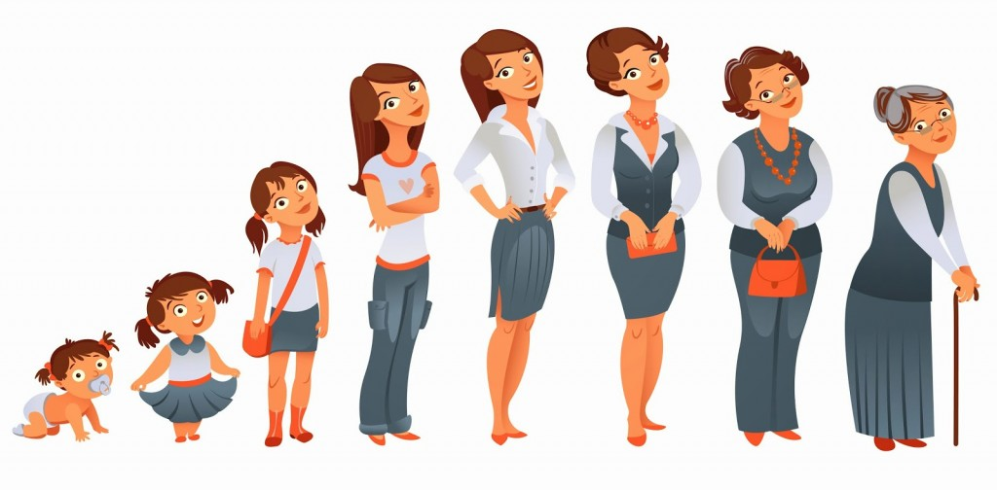

Slide 37
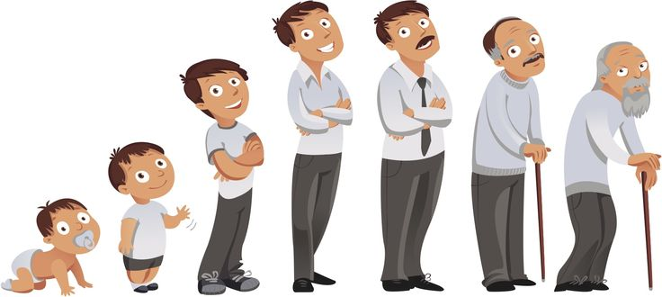

Slide 42


Slide 51
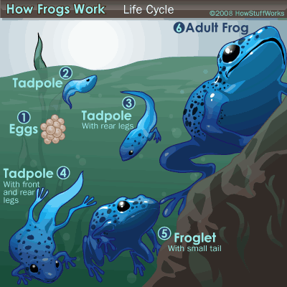

Slide 52
TRANSFORMED LIVING
Practical Theology 1 | Romans 12:1-13:14
Two key questions:
2. How can you be not conformed, but transformed? (metamorphoo)
    Recognize that transformation is different than growth or change.

Slide 53
TRANSFORMED LIVING
Practical Theology 1 | Romans 12:1-13:14
Two key questions:
2. How can you be not conformed, but transformed? (metamorphoo)
    Realize that you are not prepared for transformation until your body belongs to God (a living sacrifice)

Slide 54
TRANSFORMED LIVING
Practical Theology 1 | Romans 12:1-13:14
Therefore, I urge you, brothers and sisters, in view of God’s mercy, to offer your bodies as a living sacrifice, holy and pleasing to God—this is your true and proper worship.
Do not conform to the pattern of this world, but be transformed by the renewing of your mind. Then you will be able to test and approve what God’s will is—his good, pleasing and perfect will.
Sacrifice - an offering, an official sacrifice prescribed by God; hence an offering the Lord accepts because offered on His terms. (29X in NT)

Slide 55
TRANSFORMED LIVING
Practical Theology 1 | Romans 12:1-13:14
Two key questions:
2. How can you be not conformed, but transformed? (metamorphoo)
    Transformation begins by renewing your mind (anakainōsei)

Slide 56
TRANSFORMED LIVING
Practical Theology 1 | Romans 12:1-13:14
Therefore, I urge you, brothers and sisters, in view of God’s mercy, to offer your bodies as a living sacrifice, holy and pleasing to God—this is your true and proper worship.
Do not conform to the pattern of this world, but be transformed by the renewing of your mind. Then you will be able to test and approve what God’s will is—his good, pleasing and perfect will.
Renewing – “anakainōsei” -make fresh, new, a new development; a renewal, achieved by God's power. (1X in NT)

Slide 57
TRANSFORMED LIVING
Practical Theology 1 | Romans 12:1-13:14
Two key questions:
2. How can you be not conformed, but transformed? (metamorphoo)
    Transformation begins by renewing your mind (anakainōsei)
          Transformation requires a radical third solution

Slide 58
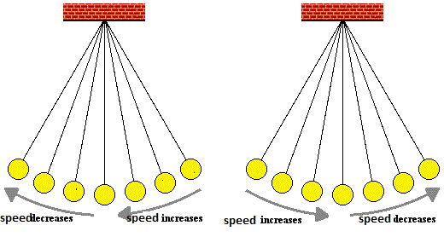

Slide 59
TRANSFORMED LIVING
Practical Theology 1 | Romans 12:1-13:14
Two key questions:
2. How can you be not conformed, but transformed? (metamorphoo)
    It continues by testing until you determine God’s will for your particular situation. You know it will be good. (dokimazo)

Slide 60
TRANSFORMED LIVING
Practical Theology 1 | Romans 12:1-13:14
Therefore, I urge you, brothers and sisters, in view of God’s mercy, to offer your bodies as a living sacrifice, holy and pleasing to God—this is your true and proper worship.
Do not conform to the pattern of this world, but be transformed by the renewing of your mind. Then you will be able to test and approve what God’s will is—his good, pleasing and perfect will.
Test and approve – “dokimazo” I put to the test, prove, examine; I distinguish by testing, approve after testing. Dokimazo is done to demonstrate what is good, i.e. passes the necessary test. It does not focus on disproving something (i.e. to show it is bad). (22X in NT)

Slide 61
TRANSFORMED LIVING
Practical Theology 1 | Romans 12:1-13:14
Two key questions:
2. How can you be not conformed, but transformed? (metamorphoo)
    It results in behavior that is good, pleasing and perfect in his eyes – and radically different than the pattern around you.

Slide 62
TRANSFORMED LIVING
Practical Theology 1 | Romans 12:1-13:14
Transformation test:
1. Living sacrifice
2. Renewed mind
3. Test and approve
4. Good pleasing and perfect

Slide 63
TRANSFORMED LIVING
Practical Theology 1 | Romans 12:1-13:14
Five places you can experience transformation
  1. Transform the way you serve – 12:3-8

Slide 64
TRANSFORMED LIVING
Practical Theology 1 | Romans 12:1-13:14
Five places you can experience transformation
  1. Transform the way you serve – 12:3-8
  2. Transform the way you love – 12:9-13, 13:8-10

Slide 65
TRANSFORMED LIVING
Practical Theology 1 | Romans 12:1-13:14
Five places you can experience transformation
  1. Transform the way you serve – 12:3-8
  2. Transform the way you love – 12:9-13, 13:8-10
  3. Transform the way you overcome evil – 12:14-21

Slide 66
TRANSFORMED LIVING
Practical Theology 1 | Romans 12:1-13:14
Five places you can experience transformation
  1. Transform the way you serve – 12:3-8
  2. Transform the way you love – 12:9-13, 13:8-10
  3. Transform the way you overcome evil – 12:14-21
  4. Transform the way you relate to the government – 13:1-7

Slide 67
TRANSFORMED LIVING
Practical Theology 1 | Romans 12:1-13:14
Five places you can experience transformation
  1. Transform the way you serve – 12:3-8
  2. Transform the way you love – 12:9-13, 13:8-10
  3. Transform the way you overcome evil – 12:14-21
  4. Transform the way you relate to the government – 13:1-7
  5. Transform the way you respond to darkness and light – 13:11-14

Slide 68
TRANSFORMED LIVING
Practical Theology 1 | Romans 12:1-13:14
Discussion
What was the most important thought from this passage for you personally?
When you are around someone who is not just growing, or changing but rather transformed, how does it impact you? What do you see it that person?
Of the four items in the transformation test, which is the hardest for you? Which is easy? Where do you move quickly, and where do you get stuck?
Of the five places you can experience transformation, which is the most relevant and needed for you right now?

