Slide 1
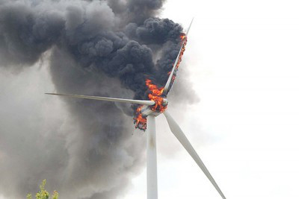
Negative Impacts of Wind

Slide 2
What are negative things you have heard?

Slide 3
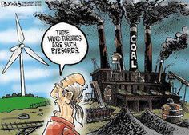
Don’t like the view.

Slide 4
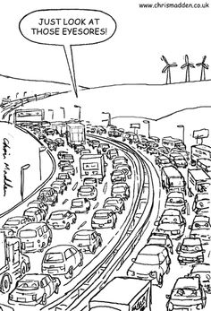

Slide 5
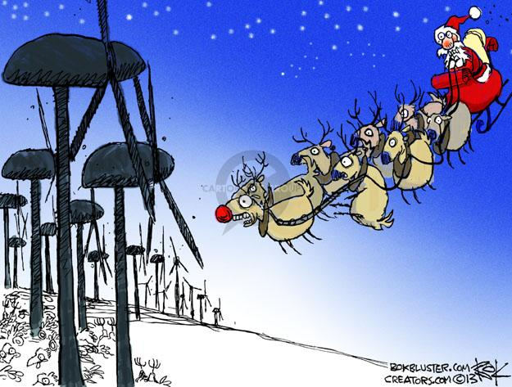
Negative impacts to wildlife & vegetation…

Slide 6
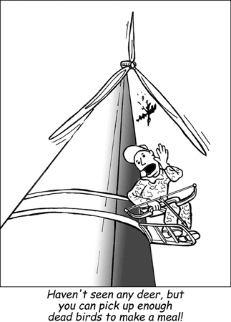

Slide 7
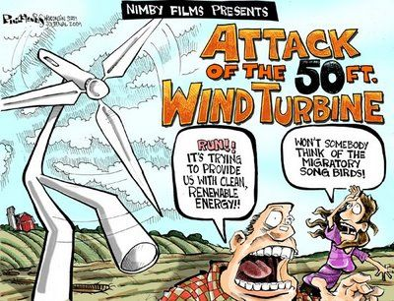

Slide 8
They are noisy…

Slide 9
They do not work…

Slide 10
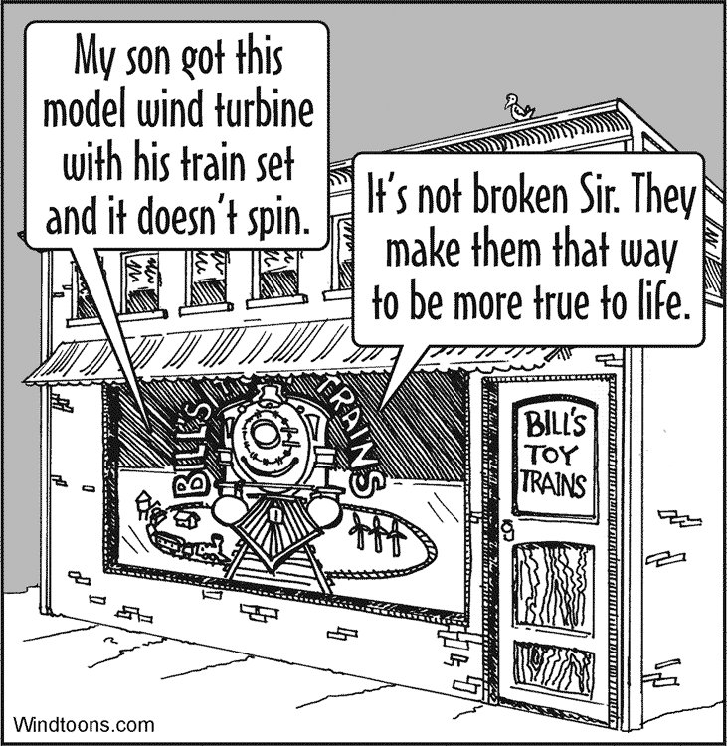
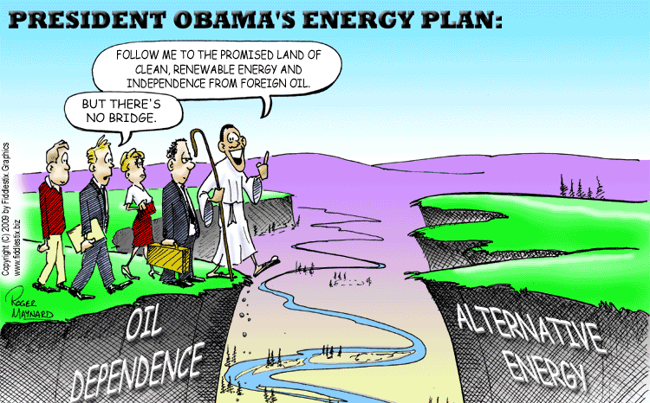

Slide 11
It’s Intermittent…

Slide 12
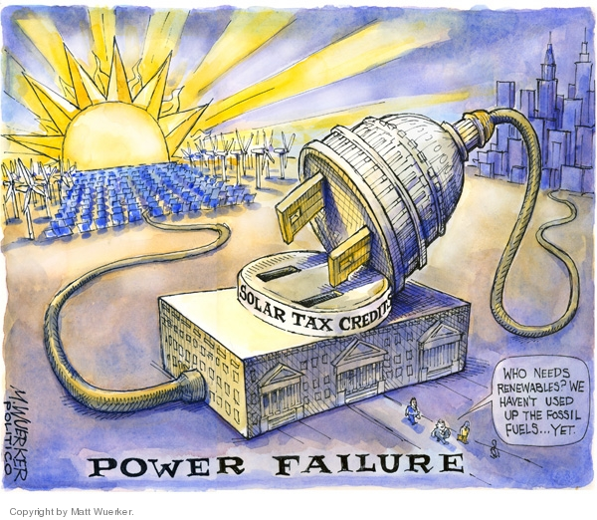
They need subsidies…

Slide 13
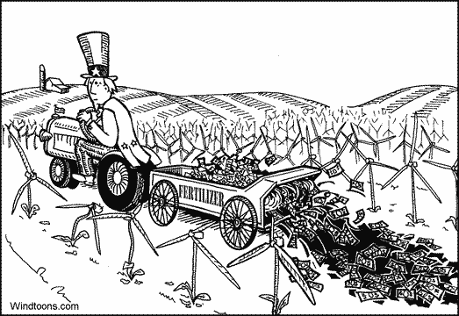

Slide 15
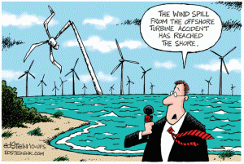

Slide 16
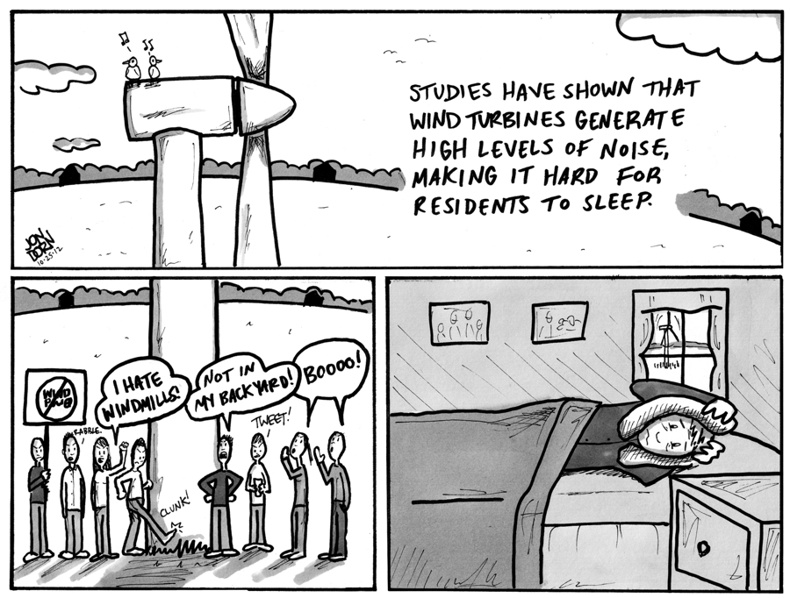

Slide 17
Some Anti-Wind “Resources”
https://www.wind-watch.org/
http://www.aweo.org/
https://quixoteslaststand.com/
http://www.windaction.org/

