Slide 1


Slide 2
Why Use Jira Reports?
Reports in Jira provide a comprehensive view of a Scrum team's progress during a sprint.
These reports track the work completed, in progress, and not finished, offering insights into how well the team is meeting its sprint goals.
They are valuable tools for both team members and stakeholders, as they offer transparency and help in identifying potential bottlenecks.
Overall, these reports help Scrum teams stay on track, improve sprint performance, and maintain transparency across the project lifecycle.

Slide 3
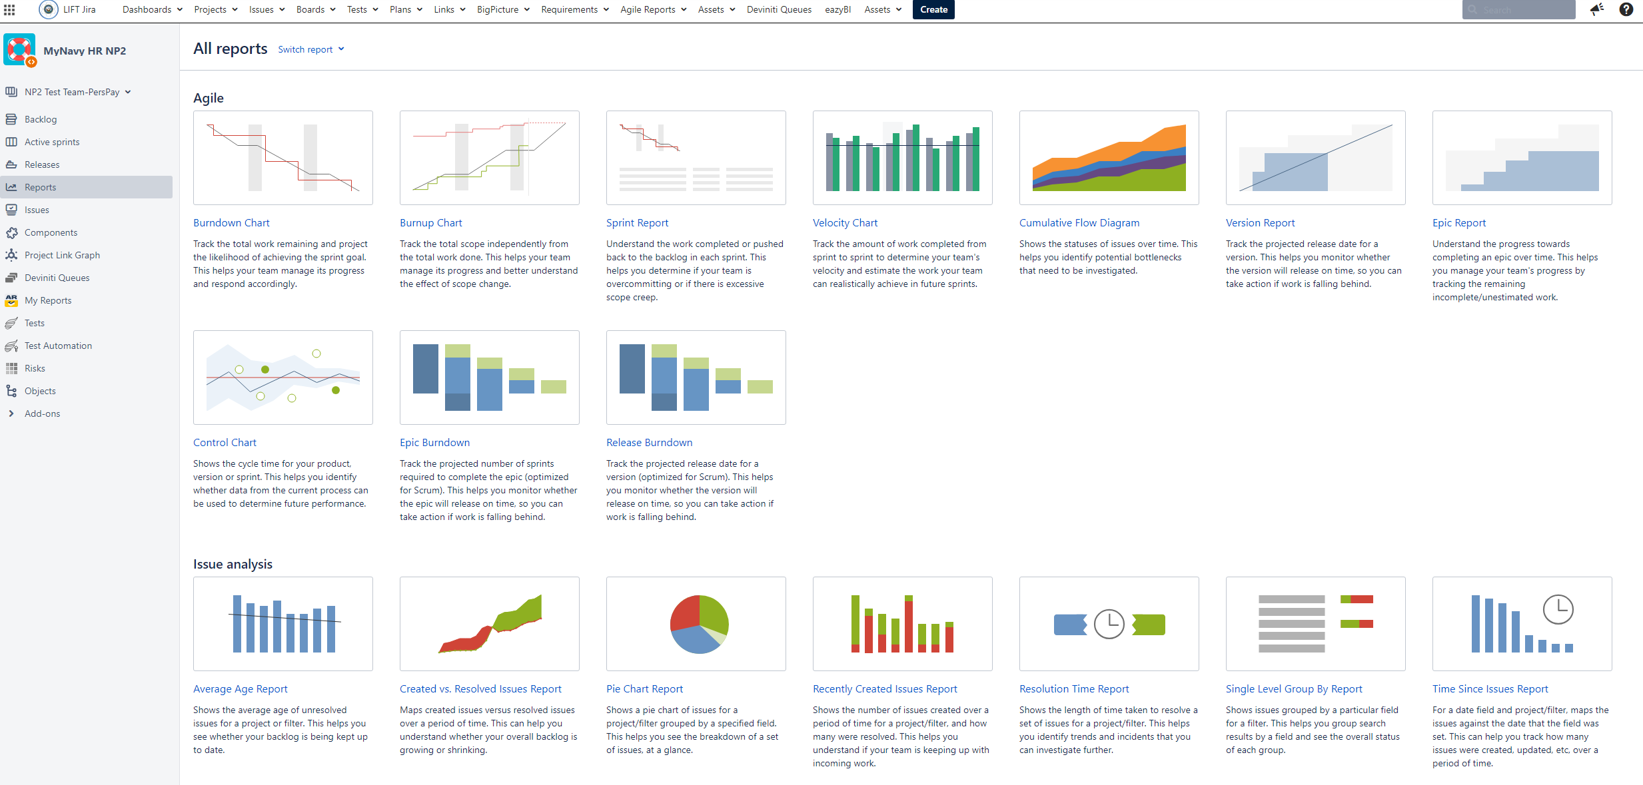

What did you do yesterday?
What do you plan to do today?
Any obstacles or challenges?

Slide 4

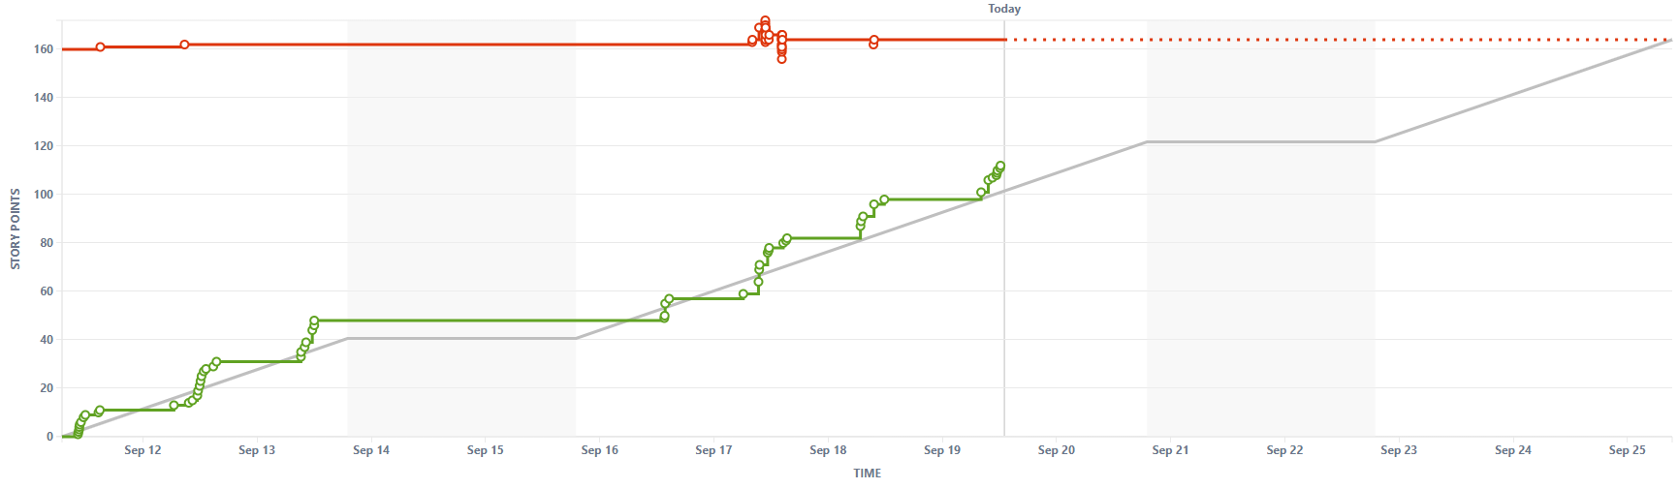
Burnup Chart

Slide 5
Burnup Chart
A burnup chart tracks a team's progress over time by showing completed work against total work (which may change due to scope adjustments). Burnup charts are great for visualizing progress and handling scope changes but may lack detail for daily tracking within sprints.
The report consists of two lines:
Work Completed Line (Green): Tracks cumulative work finished.
Total Scope Line (Red): Reflects the overall project scope, which can shift as tasks are added or removed.

Slide 6
Burnup Chart, Continued
The ideal Total Scope Line in a burnup chart is a flat, constant line that represents a fixed amount of work from the start of the project or sprint to the end. This means that the project scope remains stable, without any new tasks being added or removed throughout the work cycle.
Why is this ideal?
Stable Planning: A fixed scope allows the team to work with a clear and stable plan, improving their ability to estimate, allocate resources, and manage time effectively.
Predictable Progress: With no scope changes, the team can focus on completing the planned work without disruptions, which makes it easier to track and predict when the work will be completed.
Less Risk of Overload: By avoiding scope creep (the addition of new tasks during a sprint or project), the team can stay focused on delivering what was initially agreed upon, reducing the risk of missing deadlines or exceeding capacity.

Slide 7
Burnup Chart, Continued
When the Total Scope Line isn't flat:
If the Total Scope Line increases during the project, it indicates scope creep, which can lead to delays, resource strain, or incomplete work.
A decreasing Total Scope Line could indicate that tasks are being removed, which may be intentional (e.g., prioritization adjustments) or problematic (e.g., descoping due to time pressure).
In summary, an ideal flat Total Scope Line indicates a well-defined, stable project scope, allowing for predictable and efficient progress. In reality, scope changes are sometimes inevitable, and teams must adapt while keeping an eye on how these changes impact overall progress.

Slide 8
Burnup Chart, Continued
Benefits: | Limitations:
Clear Progress Tracking: Visualizes how much work is done versus remaining. Handles Scope Changes: Adjusts to reflect changes in project scope. Forecasts Completion: Helps predict when work will be finished. Motivates and Aligns: Encourages teams and communicates progress to stakeholders. Supports Data-Driven Adjustments: Improves future planning by analyzing past performance. | Limited Day-to-Day Detail: Less focused on daily progress compared to burndown charts. Complexity with Frequent Scope Changes: Can become difficult to interpret with frequent scope shifts. Accuracy Dependent on Estimation: Requires precise task estimation and effort logging. Better for Long-Term Tracking: More suited for projects or releases, less for sprint-level monitoring.

Slide 9
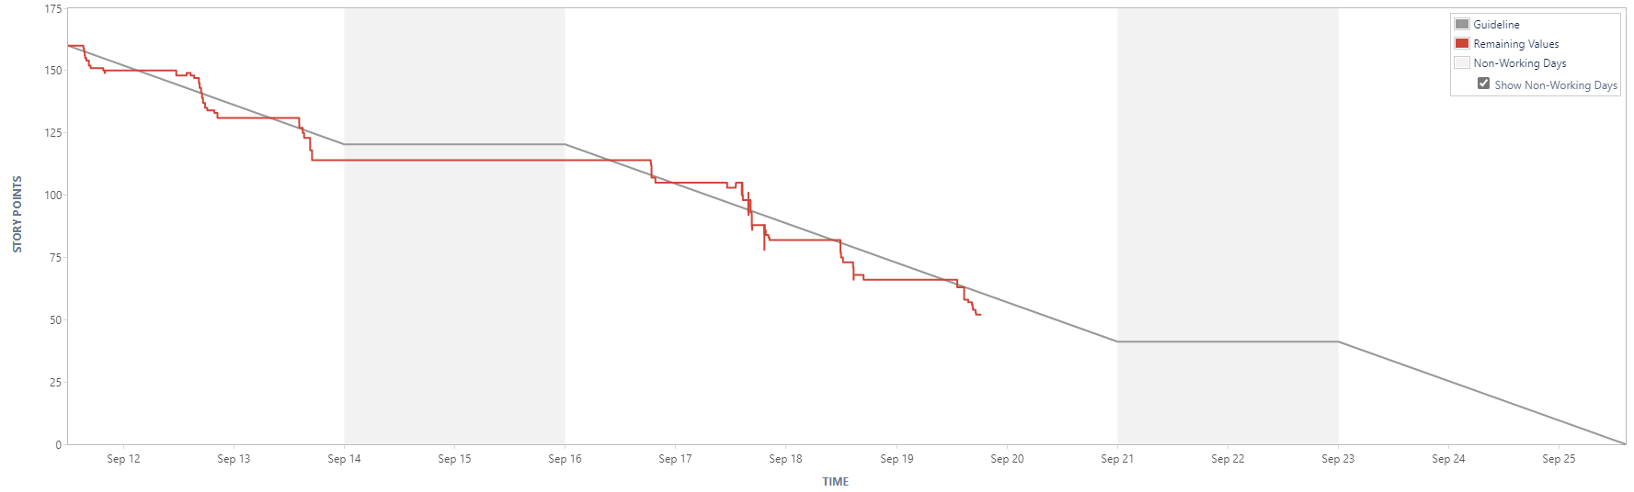
Burndown Chart

Slide 10
Burndown Chart
A burndown chart is used to track the amount of work remaining over time in a sprint or project. It shows how much work is left (vertical axis) versus the number of days or iterations (horizontal axis), helping teams monitor progress and determine whether they are on track to meet their goals.
The report consists of two lines:
Work Remaining Line: This line shows the total effort left to complete the project or sprint, decreasing as work is completed.
Ideal Work Line: A diagonal line that shows the ideal pace for completing work, often representing the target trajectory for finishing all tasks by the end of the sprint.

Slide 11
Burndown Chart, Continued
The ideal Work Remaining Line in a burndown chart is a smooth, diagonal line that starts at the total amount of planned work at the beginning of the sprint and reaches zero by the sprint’s end.
This line represents the optimal pace at which the team should be completing tasks to finish all work by the deadline.
A constant decline shows a steady reduction in the amount of work remaining, meaning that the team is completing tasks consistently throughout the sprint. It also suggests that the team is working at a balanced pace, finishing a proportional amount of work each day.
Why is it Ideal?
Tracks Balanced Progress: It reflects a well-planned sprint where the team avoids both last-minute rushes and early burnout by distributing effort evenly.
Enables Easy Comparison: This ideal line serves as a benchmark for comparing actual progress. Deviations from this line can signal potential issues, such as scope creep, inefficiencies, or over/under-estimations of task difficulty.

Slide 12
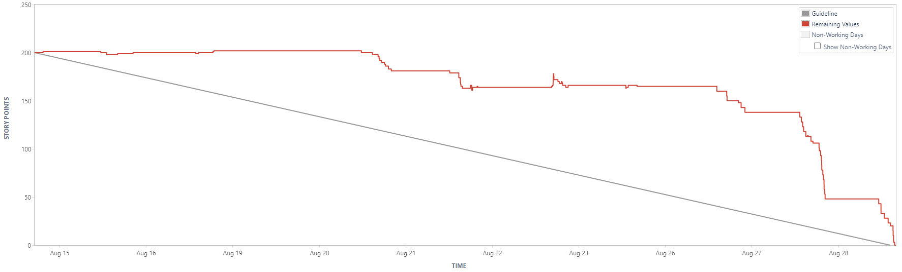
Burndown Chart, Continued
When the Work Remaining Line in a burndown chart diverges from the ideal line, it signals deviations in the team's progress:
Above the Ideal Line:
Falling Behind: Progress is slower than expected due to underestimating tasks, roadblocks, or unforeseen issues.
Scope Creep: New tasks or scope changes have been added, increasing the workload without adjusting the timeline.
Below the Ideal Line:
Ahead of Schedule: Tasks are being completed faster than planned, possibly due to overestimation or efficiency.
Rescoping: Work is removed or simplified, reducing the workload.
Irregular Fluctuations:
Inconsistent Progress: Large dips and plateaus indicate uneven task completion, often due to poor task breakdowns or dependencies.

Slide 13
Burndown Chart, Continued
Benefits: | Limitations:
Visual Tracking: Clearly shows progress by highlighting remaining work in a sprint or project. Accountability: Helps team members gauge whether they're on track, fostering accountability. Early Issue Detection: Highlights problems like delays or scope creep by comparing actual vs. ideal progress. Completion Focus: Encourages teams to prioritize finishing tasks, not just working on them. Improves Estimation: Analyzing burndown charts across sprints enhances future forecasting. Promotes Collaboration: Helps teams address bottlenecks together as they appear on the chart. | Limited Info: Tracks remaining effort but doesn’t explain delays or quality issues. No Work Distribution: Doesn't show workload distribution, making imbalances hard to detect. Ignores Scope Changes: Fails to reflect scope adjustments unless manually updated. Estimation Reliance: Accuracy depends on effort estimates; poor ones mislead progress. Needs Updates: Can mislead if not regularly updated.

Slide 14

Burnup vs. Burndown
Both charts provide valuable insight, but burnup charts tend to offer a more comprehensive view of project dynamics, while burndown charts offer quick, actionable feedback.
Burndown charts are ideal when teams need a simple and direct way to track remaining work, especially in short sprints or fixed-scope projects.
Burnup charts are more useful for larger projects or those where the scope may fluctuate, as they offer greater clarity on scope changes and overall progress.

Slide 15
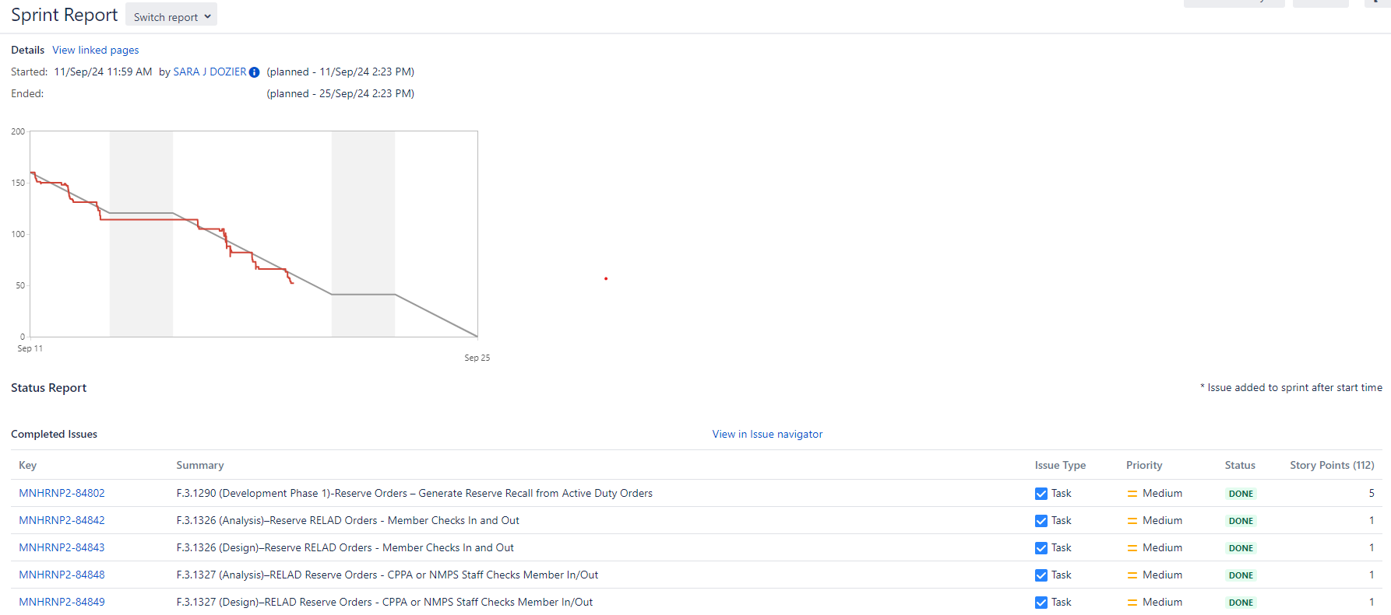
Sprint Report

Slide 16
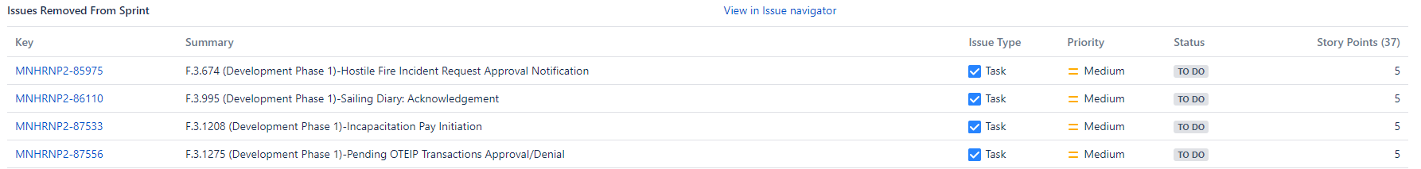
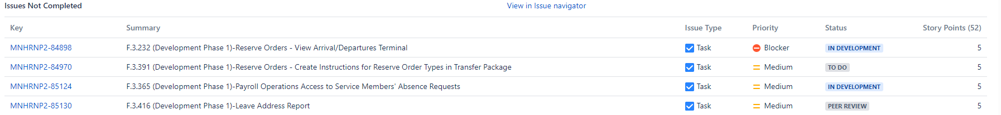
A Sprint Report in Jira provides real-time insights into the current sprint, helping teams track their progress and make informed decisions. It helps you monitor the work completed and what is being pushed back to the backlog as the sprint progresses. This allows you to spot potential issues like overcommitment or scope creep early on.

Slide 17
Sprint Report
How the Sprint Report is Helpful During a Sprint:
Real-Time Progress Tracking: Teams can continuously check what work has been completed and what remains, ensuring they stay aligned with the sprint goal.
Identifying Bottlenecks: It highlights tasks that are taking longer than expected, enabling early detection of bottlenecks or blockers.
Scope Changes: Any scope changes (added or removed work) are visible, helping teams adjust their plans and priorities mid-sprint.
Burn Down Chart Monitoring: By tracking the burn down chart throughout the sprint, teams can assess whether they are on pace to complete all work by the sprint's end.
Managing Overcommitment: Teams can see if too much work has been taken on and make decisions to adjust priorities or defer tasks before the sprint concludes.
Team Collaboration: Encourages discussions around ongoing issues or risks and enables the team to collaborate to ensure the sprint remains on track.
By using the sprint report during the sprint, teams can continuously adjust their approach, improve task management, and ensure they are on track to meet the sprint goals, reducing surprises at the end.

Slide 18
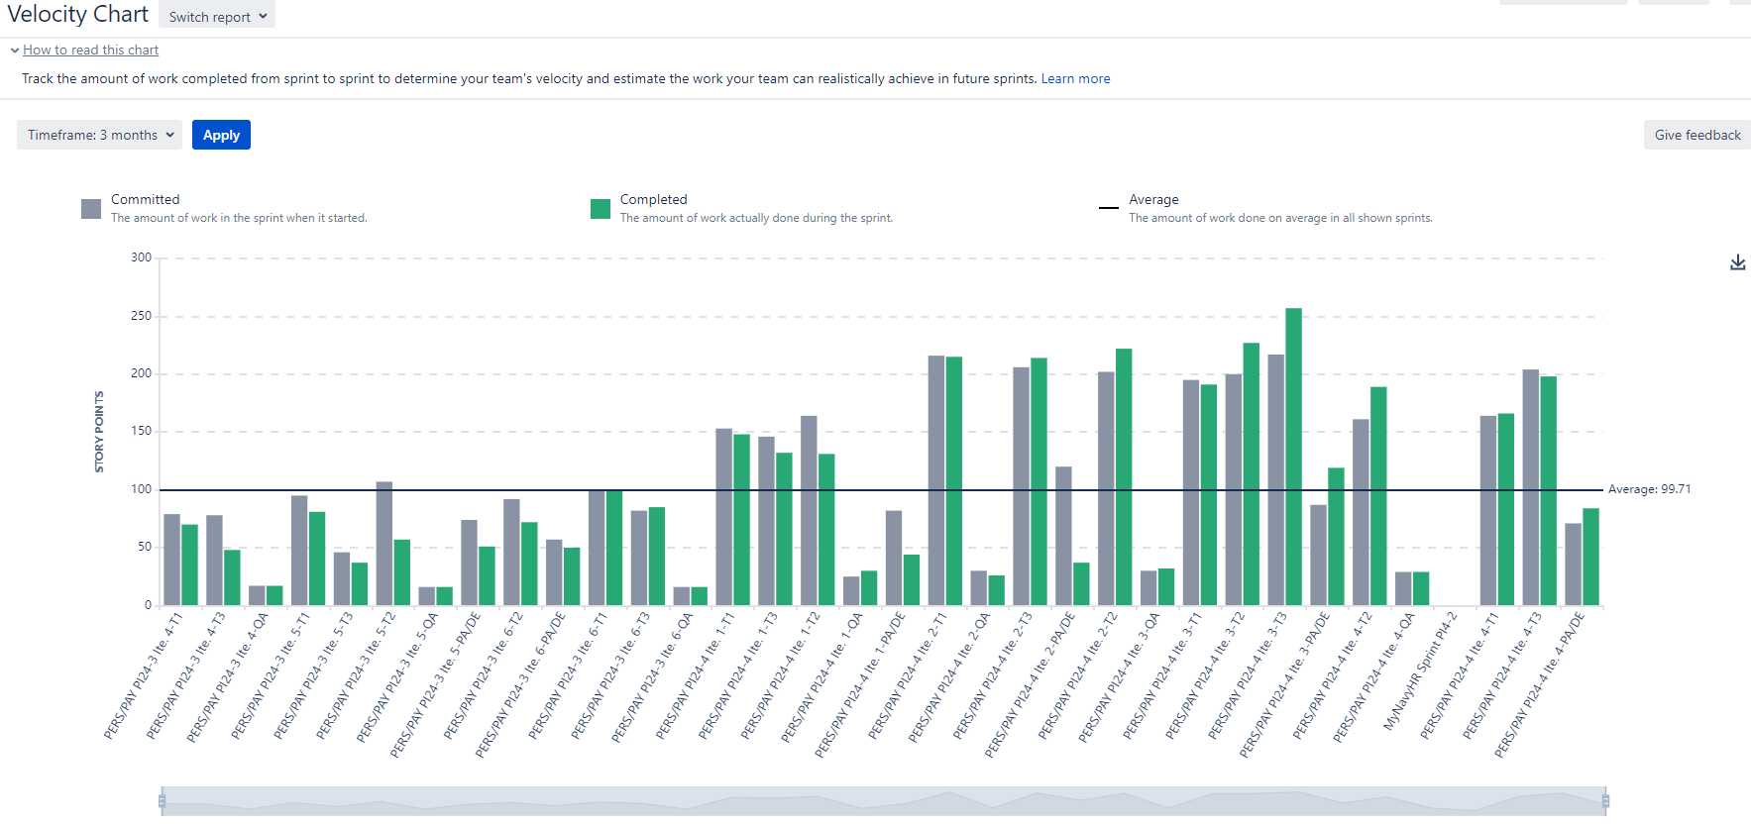
Velocity Chart

Slide 19
Velocity Chart
A Velocity Chart tracks a team's work capacity across multiple sprints. It helps teams understand their past performance and predict how much work they can realistically complete in future sprints.
Key Components of a Velocity Chart:
Completed Story Points: This shows how many story points (or other units of work, like tasks or issues) the team actually completed in each sprint.
Committed Story Points: This reflects how many story points the team initially committed to completing at the start of each sprint.
The chart typically displays both the committed and completed story points over a series of sprints, allowing for easy comparison between the team's expectations and their actual performance.

Slide 20
Velocity Chart, Continued
How the Velocity Chart is Helpful:
Capacity Planning: By reviewing past sprints, teams can estimate how much work they can commit to in upcoming sprints. If a team consistently completes 30 story points, that becomes a reliable benchmark for future sprints.
Overall, the velocity chart in Jira is a key tool for agile teams to optimize planning, improve predictability, and monitor their ongoing progress.
Progress Tracking: The chart highlights trends, such as whether the team is improving, staying consistent, or struggling to complete work.
Improvement Identification: If the team regularly completes less work than committed, it may indicate issues such as overcommitment, external blockers, or underestimation of effort. This allows teams to adjust their approach.
Stakeholder Communication: The velocity chart helps stakeholders understand the team’s capacity and manage expectations for deliverables.

Slide 21
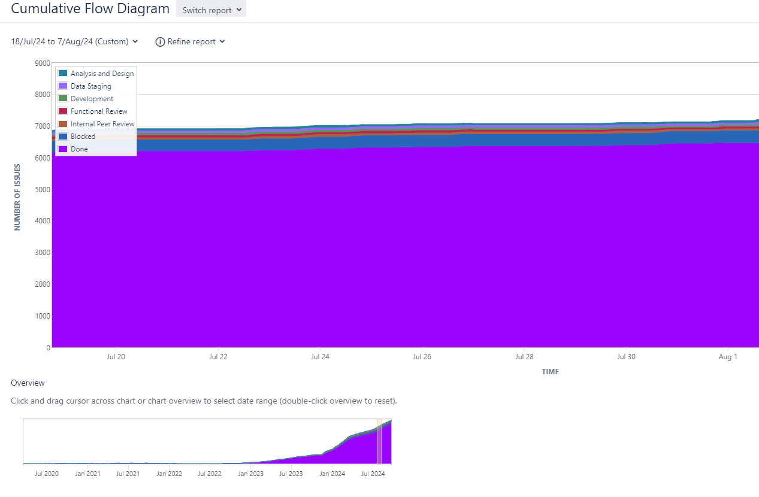
Cumulative Flow Diagram

Slide 22
Cumulative Flow Diagram
A Cumulative Flow Diagram tracks the progress of tasks through different workflow stages over time. It helps teams monitor the flow of work and identify bottlenecks, inefficiencies, or potential issues in the process.
Overall, this report provides an at-a-glance overview of a team's work progress, helping ensure smooth, efficient workflow management by identifying areas that need attention.

Slide 23
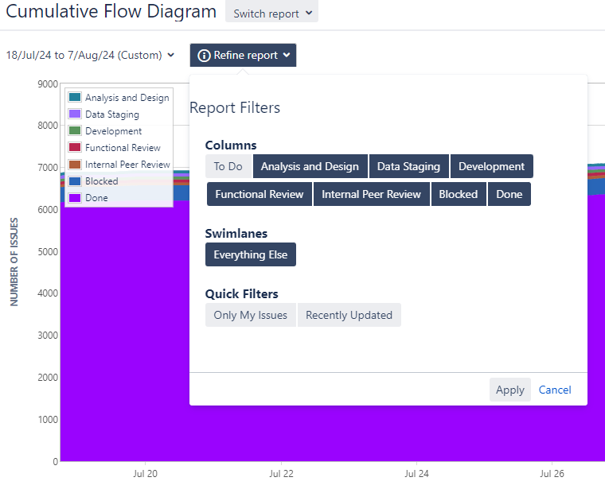
Cumulative Flow Diagram, Continued
Key Components of a Cumulative Flow Diagram:
Columns Represent Workflow Stages: The vertical axis represents various workflow stages (e.g., To Do, In Progress, Done). Each stage is depicted as a colored band.
Work Items Over Time: The horizontal axis shows time, and the diagram depicts how many work items (stories, tasks, issues) are in each stage at any given moment.
Cumulative Work: As work progresses, the bands grow, representing the accumulation of completed tasks or tasks that have moved to later stages.
You can also click Refine Report to access filter options.

Slide 24





Cumulative Flow Diagram, Continued
Identifying Bottlenecks: A sudden widening of a particular band (e.g., "In Progress" or "Review") indicates a bottleneck, meaning too much work is piling up in that stage without progressing.
Flow Stability: The CFD shows how consistently work is moving through the process. Ideally, the bands should be parallel to each other, indicating a steady flow of work through each stage.
Monitoring Work in Progress (WIP): Teams can track how much work is in each stage and ensure they are not exceeding WIP limits.
Predicting Completion: The “Done” band gives a clear view of how much work has been completed over time, helping predict when remaining work will likely be finished.
Cycle Time and Lead Time: By analyzing how quickly tasks move from "To Do" to "Done," teams can measure cycle time (time spent working on tasks) and lead time (total time from start to finish), helping with future planning and efficiency improvements.

