Slide 1
Spark Session #6: Deliver Your Value Proposition
© 2020 Keller Williams Realty, Inc.
VERSION 5.2
Notes:
TIME: 5 minutes
WELCOME participants to Deliver Your Value Proposition.
DO: Introduce yourself briefly if there are new participants.
Set expectations for the duration of the session, and timing of lunch or breaks.
FACILITATOR NOTE: The questions below are intended to promote a culture of sharing and gratitude—to enhance learning and promote happiness.
ASK: Who would like to share what they are grateful for so far in this new learning journey?
What opportunities do you see for yourself? What are you excited about?
What challenges are you encountering that we may work out together?
SAY: Today our focus in on YOU, and the value you bring to your customers, your community, and your business. We call this your Value Proposition and in this session you will have the opportunity to define and declare your Value Proposition.

Slide 2
What Successful Agents Do Every Day
Grow Business
Run Business
Lead generate for buyers and sellers
Make seller listing presentations and get listings
Make buyer presentations and get listings
Preview real estate
Market seller listings
Show buyers houses
Negotiate contracts
Transaction management to closing
Vendor management
Set goals
Compliance / risk management
Attend training and get coaching
Manage money
Notes:
SAY: Here’s the secret to being a successful real estate agent: there is no secret. Success leaves clues, so we know exactly what successful agents do every day.
Every day, agents do two types of activities: they grow their business and run their business.
EXPLAIN each activity on the slide and, if not obvious, why it’s important to their business.
SAY: The goal of our time here is to model what successful agents do every day and show you how to do it.

Slide 3
Build Daily Success
Habits
Three Aspects of Service
Deliver Value
Know and State Your Value
Recap and Aha’s
Define Your Value
Notes:
TOTAL TIME: 4 hours
OVERVIEW the agenda for the learning module.
Define Your Value- one-hour session. Includes:
Define Your Value
Three Aspects of Service
Know and State Your Value
Deliver Value
SAY; Here’s our roadmap for the day. First, we’ll define what a Value Proposition is. Next, we’ll explore the three essential aspects of the service we provide. Then we’ll dig into your unique qualities of value and finally, craft your powerful Value Proposition.
SHARE: Your personal Value Proposition.
SAY: After this one-hour module, we’ll get into our Daily Success Habits.
OVERVIEW the agenda for the Daily Success Habits
Build Daily Habits- 3-hour session. Includes:
Build your database
Script practice
Lead generation
Contract practice (optional)

Slide 4
Your Value
1
2
3
Describe
Convey
Covenant
Craft a simple and precise description of the benefits for the client
Clearly convey what you will do to earn the fee you charge
Make your Value Proposition a covenant between you and the client
Notes:
SAY: A Value Proposition …
Is a simple and precise description of the benefits the customer will get from working with you.
Should clearly convey all the things you do to earn the fee you charge.
Your Value Proposition is a covenant between you and the customer.
ASK: How will having prepared your Value Proposition help you move from leads to contracts to closed?

Slide 5
Three Aspects of Service
Build Daily Success
Habits
Deliver Value
Know and State Your Value
Recap and Aha’s
Define Your Value
Notes:
Explain how defining your value leads directly to the three aspects of service.

Slide 6
Three Aspects of Service
1
2
3
Purpose
Value Proposition
Fiduciary
Have and communicate a clear sense of how you deliver on that purpose.
Know the underlying purpose of the real estate profession.
Exhibit a continual drive to put your clients’ needs above all else.
Notes:
Participants’ Guide pg. 3
SAY: When Gary Keller was researching for The Millionaire Real Estate Agent, he noted that every top-producing agent he spoke with had a “deep and almost inherent sense of service.” You cannot grow a real estate business if you don’t prioritize your clients’ experience above all else. A stellar experience is how you earn your commission and get referrals.
We’ve identified three aspects of service: know the underlying purpose of real estate, a compelling Value Proposition, and fiduciary. Together, these aspects guarantee that your clients will have the best possible real estate experience.

Slide 7
What is the underlying purpose of real estate?
ASPECTS OF SERVICE: 1/3
Notes:
ASK: What is the underlying purpose of real estate? It’s different for buyers and sellers.
SAY: For buyers: It’s about finding them the right home, at the best price, in the right time, with the least amount of problems.
For sellers: It’s about netting them the most amount of money, in the shortest amount of time, with the least amount of problems.
ASK: What happens to your clients’ buying or selling experience if you don’t understand that this is the underlying purpose of real estate?
(Answers will vary but will ultimately point toward the transaction being a bad experience for your clients.)
SAY: It’s significant that one phrase is shared with buyers and sellers: “with the least amount of problems.”
ASK: As a realtor, what are some problems you have anticipated for your clients, and what have you done to avoid them?
(Allow for answers, and perhaps share some examples of your own.)

Slide 8
val·ue prop·o·si·tion /ˈvalyo͞o präpəˈziSH(ə)n/
ASPECTS OF SERVICE: 2/3
Notes:
SAY: Speaking of our Value Proposition, let’s define what that is exactly.
SAY: Your Value Proposition distills your service offerings into a succinct set of benefits for your client. It states what you do for the client to earn your commission and helps to explain the complexity of what you do. It also helps hold you accountable to high standards.
ASK: As we reflect on this definition, what do you see as the value of your Value Proposition? Why is it important enough to be included in our three aspects of service?
(Allow for responses, highlighting those that show that a strong Value Proposition helps your clients understand your value and expertise, protects your commission, and builds strong and trusting relationships.)
SAY: We usually have a loose understanding of how we provide our clients with value. It’s easy to forget that they might understand very little of that value. Your Value Proposition is what you bring to the experience. Your Value Proposition statement phrases your skills, expertise, and insights in language that makes them relevant to your clients.
For example, let’s say you’re fluent in English and Spanish. You may be tempted to simply say, “I’m bilingual.” That’s true, but does it convey your value to your client? Not really.
Instead, you can say, “I have access to a large pool of potential buyers for your home who are often overlooked by other agents.”
ASK: How does changing the phrasing change your client’s perception?
(Answers will vary.)
SAY: In a moment, you’re going to craft your own Value Proposition statement. Before we do that, I want to talk about the final aspect of service.

Slide 9
ASPECTS OF SERVICE: 3/3
Functionary
vs.
Fiduciary
Notes:
SAY: The third and final aspect of service is fiduciary.
ASK: What is a fiduciary and how is it different than a functionary?
SAY: Let’s go way back to middle school English class: “fiduciary” is both an adjective and a noun. As an adjective, it refers to something dealing with trust, especially relationships. You have a fiduciary duty to your clients to protect their best interests during what will likely be the largest and most frightening transaction in their life.
As a noun, “fiduciary” refers to the person who has a fiduciary obligation. You are your clients’ fiduciary.
A functionary is one who completes tasks for the client, whereas a fiduciary completes tasks and goes beyond by placing their client’s interest ahead of all others, even their own.)
SAY: Being a fiduciary is a big deal! It’s an honor. It’s more important than ever in today’s market to wear this badge of honor proudly. Helping your clients understand your fiduciary role is a big part of your Value Proposition.
ASK: What are some ways that you serve as your clients’ fiduciary during a real estate transaction?
(Answers will vary.)

Slide 10
Build Daily Success
Habits
Three Aspects of Service
Deliver Value
Know and State Your Value
Recap and Aha’s
Define Your Value
Notes:
SAY: Now we’re going to talk about your Value Proposition. We’re going to look at some data around what clients want, we’re going to get a big picture look at our current real estate market, and we’ll discuss some ways that technology can boost your Value Proposition.
ACTIVITY: REFLECT ON YOUR VALUE
Participants’ Guide pp. 4–6.
SAY: Before we do that, however, I want you to look at page 5 in your participant guide. There’s a space to write about yourself, your strengths, and your perspectives. Take a few minutes and write down responses. This will be the beginning of crafting your unique Value Proposition.

Slide 11
What Buyers Want
2018 Profile of Home Buyers and Sellers, NAR
Notes:
SAY: Here’s a look at what buyers want most from a realtor. This graph covers the top three responses and categorizes everything else as “other.” You can see the complete list in your student handout (Participants’ Guide pg. 6).
ASK: Why are we talking about this in our conversation about your Value Proposition?
(Answer: Knowing what people want makes it easier to create a compelling Value Proposition.)
INSTRUCT participants to review the list (Participants’ Guide pg. 6).
SAY: Keep in mind: these are results from buyers being asked to state the ONE thing that is most important to them. Most buyers need help with paperwork or learning about their neighborhood. But when forced to give just one answer, this is what they said.
ASK for aha’s.
REFER students to the complete list in their guide (pg. 6). Ask them to note any skills or services they offer that align with what buyers want.

Slide 12
What Buyers Value
2018 Profile of Home Buyers and Sellers, NAR
Notes:
SAY: When asked the most important factor in choosing a real estate agent, these were the top five answers from buyers. You have the complete list in your student handout.
INSTRUCT participants to review the list.
ASK for aha’s.
ASK: If there is an attribute you have that you now know, from the data, is something that buyers value, would that be a good thing to include in your Value Proposition?
(Answer: Yes!)
SAY: Absolutely! Let’s practice taking these attributes and putting them into client-centered language. Hopefully, you’ll get some ideas for when you craft your own Value Proposition.
ROLE-MODEL: Select one of the factors buyers value on page 6 and rephrase into language that explains its value to the buyer, i.e., “agent is honest and trustworthy” could be, “you can depend on me to help you make the best decisions,” or “I will work to serve your best interests.”
REFER students to their guide. Ask them to note any skills or services they offer that align with what buyers want.
ACTIVITY: Client-Centered Language: Buyers
Participants’ Guide pg. 7
Break participants into partners or small groups.
Instruct them to work through the skills and services they offer and rephrase into language that explains its value to the buyer.
(NOTE: If they are especially new to real estate and don’t feel confident about their own offerings, they can use buyers’ statements from NAR study.)

Slide 13
What Sellers Want
2018 Profile of Home Buyers and Sellers, NAR
Notes:
SAY: We’ve looked at what buyers want, now here’s what sellers want most from a realtor. This graph covers the top five responses and categorizes everything else as “other.” You can see the complete list in your student handout.
INSTRUCT participants to review the list (Participants’ Guide pg. 8).
ASK for aha’s.
REFER students to their guide. Ask them to note any skills or services they offer that align with what sellers want.

Slide 14
What Sellers Value
2018 Profile of Home Buyers and Sellers, NAR
Notes:
SAY: When asked the most important factor in choosing a real estate agent, these were the top four answers from buyers. You have the complete list in your student handout.
INSTRUCT participants to review the list.
ASK for aha’s.
ASK: What are the differences between buyers and sellers? Why do you think those differences are?
(Allow for discussion)
ACTIVITY: Client-Centered Language: Sellers
Participants’ Guide pg. 9
Break participants into partners or small groups.
Instruct them to work through the skills and services they offer and rephrase into language that explains its value to the seller. (NOTE: If they are especially new to real estate and don’t feel confident about their own offerings, they can use buyers’ statements from NAR study.)
SAY: If you’re here, it’s probably because you’re new to the industry. That’s great! Everyone starts somewhere. In your guide, there is a place to record your opportunities for growth. I want you to use that space – not to beat yourself up because you don’t have 15 years of real estate experience – but to record some areas you’d like to improve for your clients. It could be something you could do differently today, or it could be a three-year goal.
ASK for aha’s on this section.

Slide 15
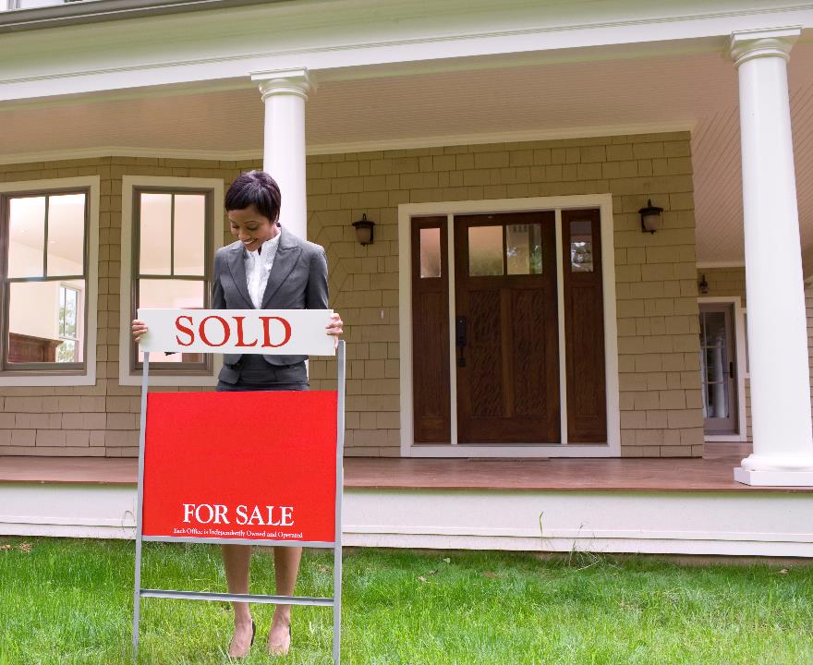
Who are your competitors?
Notes:
SAY: Real estate has undergone significant changes in the past few years. Investors have come in with the intent to disrupt the industry, and they have. iBuyers are driving down commission prices, and some companies are moving toward eliminating the agent altogether.
ASK: Who are your local competitors? Who are you competing with for clients and your commission?
(Take answers. Offer your own insights as appropriate.)
ASK: What is their Value Proposition? Why would someone choose them?
(Take answers and discuss.)
ASK: How do you counter those Value Propositions?
(Discuss answers, highlighting those that include being a fiduciary, local knowledge, and creating experiences.)

Slide 16
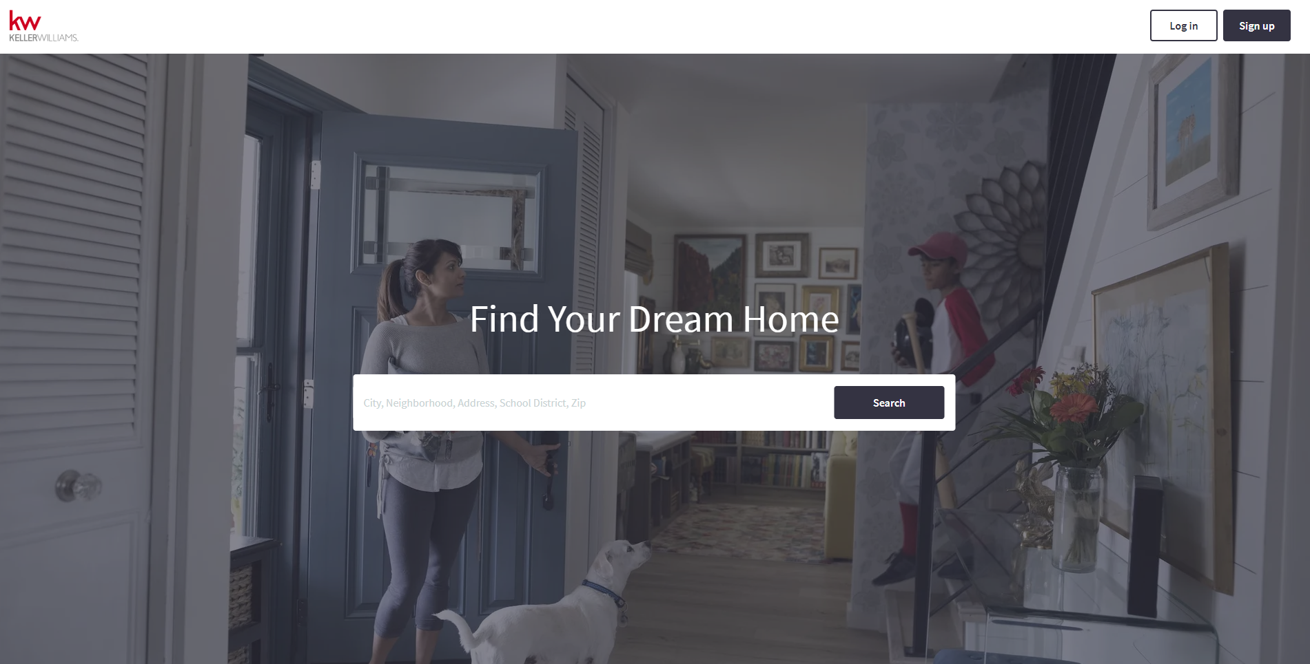
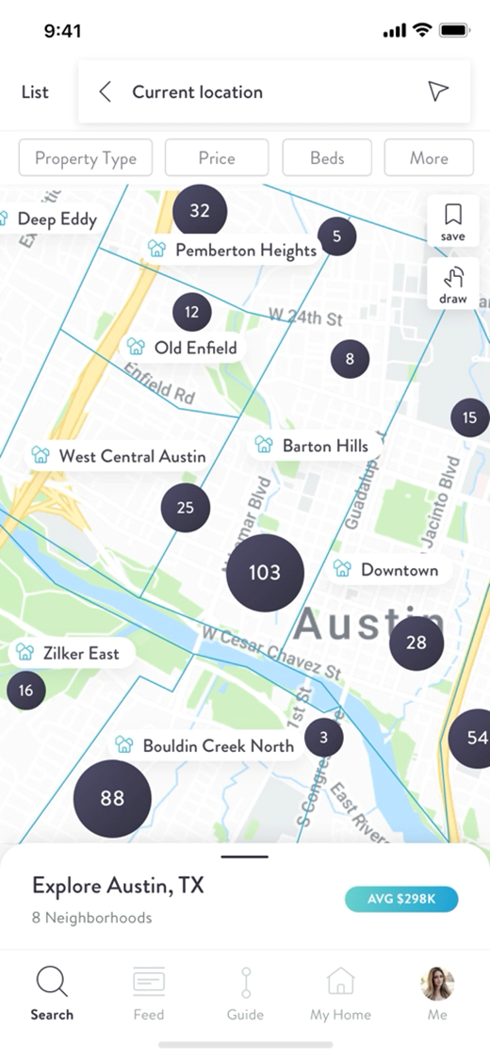
Your Technology
Notes:
SAY: Here’s a great thing about being with Keller Williams: the company is committed to adding to your Value Proposition. In today’s market, that means investing in technology that propels your business forward. We’ve already talked about Command and the KW App, now I want to focus on tech that affects your clients.
Agent Sites: allows contacts to save searches for homes; allows agents to create searches on behalf of contacts and clients.
Individualized IDX Sites: create personalized landing pages for your clients that allow them to see activity in the neighborhoods and areas they care about.
KW App: An end-to-end consumer app that using the power of AI, machine learning, and your expertise to communicate, provide transaction transparency, and remind clients of your value well after they’ve closed on a home.
ACTIVITY: Increase Your Value with Technology
Participants’ Guide pg. 11
Instruct participants to visit http://www.kwconnect.com/tech-enabled-agent and identify a piece of technology that strengthens your Value Proposition.
Ask them to share their findings with the class.
Ask what additional technology they could use to create an even better experience for their clients.

Slide 17
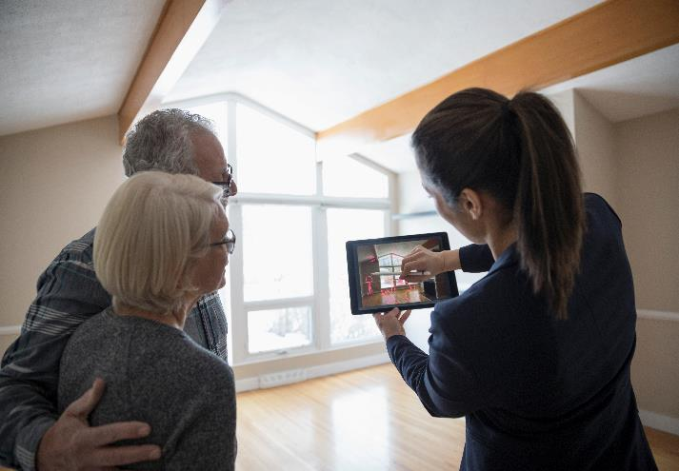
Activity
Create Your Value Proposition
Notes:
ACTIVITY: CRAFT YOUR VALUE PROPOSITION
Participants’ Guide pp. 12–13
SAY: Remember, your Value Proposition is a unique, memorable, and persuasive statement that expresses the true value of working with you, says what you’re doing to earn your commission, and holds you accountable to high standards.
REFER participants to pages 12–13.
DO: Once the activity is complete, ask participants to share their Value Propositions with the class, offering feedback.
EXPLAIN: Your personal Value Proposition as an example.
ROLE-PLAY: Ask a participant to role-play a conversation with you. You will be the agent and you will work your Value Proposition into the conversation with the participant acting as the contact.
SAY: Now it’s time to practice your Value Proposition conversations. Find a partner and practice integrating your Value Proposition into a conversation with a contact.
ASK for aha’s.

Slide 18
Build Daily Success
Habits
Three Aspects of Service
Deliver Value
Know and State Your Value
Recap and Aha’s
Define Your Value
Notes:
SAY: Now that you have a unique Value Proposition statement, let’s take a look at what delivering on that statement means.
If you say you’re going to do it, you do it.
ASK: Do you recall what KW’s stance is on integrity?
(Answer: Integrity in all things.)
EXPLAIN: If not explained previously, quickly discuss the WI4C2TS, and that Integrity is one of the KW code of ethics we all abide by.

Slide 19
Distinguish Yourself
with the information you know
Notes:
SAY: A Value Proposition isn’t just something you say; it’s something you deliver on. Now that your able to explain your value, how do you apply it?
ASK: What kinds of knowledge are you expected to have? What kinds of knowledge would truly set you apart from the competition?
(Guide discussion towards: Your fiduciary role includes being the hyperlocal expert for your clients. You should be able to tell them everything they could reasonably want to know about an area they are about to invest in. This can include zoning laws, future development plans, ecological changes, etc.
You should also have and exercise more general market knowledge, including what type of market you are in, what direction it is moving, interest rate trends, etc.)
SAY: This continuous drive for knowledge and improvement is part of our Six Personal Perspectives. Which perspective or perspectives do you think apply here?
(Answers: Learning Mindset and Self-Mastery.)
EXPLAIN: If 6 Personal Perspectives has not been discussed, quickly remind participants of Gary Keller’s Six Personal Perspectives—the best practices of all top agents.
ACTIVITY: Grow and Keep Your Expertise
Participants’ Guide pg. 14
ASK: How do you learn these things? How do you keep your knowledge up-to-date?
(Answers for local insights include: attend city planning meetings, attend HOA meetings, read local newspapers, follow neighborhood groups on social media.)
Break participants into groups. Ask them to decide on a neighborhood they’d like to specialize in. Give them 15 minutes to identify resources to self-educate, such as:
Is there an HOA? When do they meet? Are you able to find their bylaws online?
Have there been any recent news stories about new development in that area?
When does the City Council meet to discuss projects that affect that area?
Does that neighborhood have any dedicated groups on social media?

Slide 20
Create a Stellar Experience
with the services you provide
Notes:
SAY: The three aspects of service – knowing the purpose of real estate, your Value Proposition, your fiduciary role – all contribute to the same goal: ensuring the best experience for your client. Now that you understand each of those aspects, it’s on you to deliver the best experience you can.
ASK and DISCUSS:
What qualifies as an excellent real estate experience?
What services are you (or your office) responsible for providing?
What allied resources can you leverage to improve client experiences? (i.e., staging, landscaping, cleaning, carpet cleaning, home inspectors, movers, etc.)
SAY: You should also develop relationships with business in your town that people might need after they move: doctors, dentists, hairstylists, pet services, etc. This not only enables you to provide excellent service for your clients after they buy a house, it can also serve as a source for referrals.
ACTIVITY: Uphold the Standard with Allied Resources
Participants’ Guide pg. 15
In pairs, task participants with identifying one service they would like to start providing for their clients. Using their Value Proposition statements, they should identify criteria that they’re allied resource partners must meet if it’s to be a good experience for their client (for instance, if a Value Proposition emphasizes the speed at which you can help a seller get their house market-ready, you can’t work with a carpet cleaner who has a three-week backlog). After considering the criteria, write out five questions to ask anyone they’re considering becoming partners with.

Slide 21
Build Daily Success
Habits
Three Aspects of Service
Deliver Value
Know and State Your Value
Recap and Aha’s
Define Your Value
Notes:
SAY: Now that you have a unique Value Proposition statement and we know what it means to deliver on our Value Proposition, let’s recap and share aha’s.

Slide 22
Aha’s to Achievement
Recap
How has your thinking changed? What ideas or mindsets were new?
What do you feel differently about? What was meaningful to you today?
How will your behaviors be different going forward? What actions will you take going forward?
What tools, models, or systems will you definitely use? How will they make you accountable?
Notes:
TIME: 10 minutes
SAY: The goal of our time together is to help you think, feel, act, and use what you’ve learned to ignite your passion and help you achieve your Big Why.
REFER participants to the Aha’s to Achievement activity in the PG.
INSTRUCT participants to write down their aha’s for each of the categories.
ALLOW 5 minutes.
DO: Ask volunteers to share their responses with the group.
ACKNOWLEDGE common themes.
SAY: Taking the time to reflect on what you’ve learned is important in building your confidence and celebrating your growth—we’ll do this activity during each Power Session so that you can keep track of your learning journey!

Slide 23
Build Daily Success
Habits
Three Aspects of Service
Deliver Value
Know and State Your Value
Recap and Aha’s
Define Your Value
Notes:
OVERVIEW
Build Daily Habits- 3-hour session. Includes:
Build your database
Script practice
Lead generation
Contract practice (optional)

Slide 24
Spark: Goals to Set Your Career on Fire
10 | Contacts Added
10 | Conversations a Day
10 | Handwritten Notes
10 | Home Previews per Week
Notes:
EXPLAIN that the overall goal of Spark is for participants to get their first appointment. The tasks (on the slide) are the activities they need to be taking to help them reach the goal of their first appointment.
EXPLAIN that they can use reports in Command to track their database health. Their goal with their database health should be to keep their overall score at least 50% or greater.

Slide 25
Scripts
Lead generate
Uncover motivations
Identify objections
Close deals
Speak in terms the customer understands
Build confidence
Why is it important to learn, internalize and personalize scripts?
Notes:
EXPLAIN that one of the Daily Success Habits is memorizing and internalizing scripts.
EXPLAIN that learning scripts is important because:
Practicing and internalizing scripts allows your business to grow.
Just as a doctor learns anatomy before working with patients, agents need to learn scripts to prepare to have meaningful conversations with clients..
With scripts, you control the conversation by using purposeful language that helps you get to the end point: a closed transaction.
They help you communicate your value. Once you have internalized scripts you can add your Value Proposition which will help lead generation efforts and lead to closed deals.
Scripts help you uncover motivations (buyer/seller) and identify any objections so you can handle them upfront
Allow you to have a rehearsed response that delivers a powerful message in a way that the consumer will best understand
Allows you to ask questions in a way that they will be able to quickly share the information you need to better serve them
Help an agent gain confidence
ASK participants if they have any questions before moving on.

Slide 26
Role-Play: Script Practice
30 minutes
Notes:
TIME: 30 minutes
CHOOSE a relevant script from the Spark Script Book to focus on today.
EXPLAIN that after hearing an example, participants will then have time to role play the chosen script with partners. ROLE MODEL the chosen script with a volunteer.
EXPLAIN the steps (below) that participants will follow for Role Play practice:
Participants will spend five minutes reading the script aloud to themselves.
Participants will pair up with a partner and take turns reciting the script until they can work without a prompt. This should take about five minutes.
Participants can video record each other practicing scripts to watch and learn from later (optional).
Repeat steps (using the same partner) with other selected scripts until 30 minutes is up.

Slide 27
Compliance:
Do Not Call
Subscribe to the registry
Update your call list regularly
Know the state and federal laws
Check before you call
Under federal law, sellers and telemarketers (including real estate agents) are prohibited from calling consumers listed on the Federal Trade Commission’s Do Not Call Registry.
Honor consumers’ requests
Notes:
REVIEW the Rules and Exceptions regarding the Do Not Call Registry located in the beginning of the Ignite Script Book:
Subscribe to the Registry
The registry is hosted on a dedicated website. Your Market Center should subscribe to the Registry and provide you with log in credentials. Note that it is a violation of federal law to make ANY telemarketing calls without access to the Registry.
Check Before You Call
Before making a call, check to see if the consumer is on the Registry. If the consumer is on the Registry, do not call!
Update Your Call List Regularly
Delete all numbers in the Registry from your list – at least every 31 days.
Honor Consumers' Requests
Never call a consumer if the consumer requests to be placed on your personal (or your Market Center’s) do not call list. All consumer do not call requests must be placed on a list and honored permanently, unless the consumer subsequently consents to be called.
Know the State and Federal laws
Know that in addition to federal laws, many states also have laws governing telemarketing. Make sure you are familiar and compliant with your state’s laws.
EXPLAIN that participants should only be calling their sphere of influence or referrals that they have permission to have a conversation with.

Slide 28
Real-Play: Lead Generation Calling with Scripts
1 hour
Notes:
TIME: 1 hour
EXPLAIN that real-play activities done through Ignite that are done in the classroom are money-making activities done with the support and guidance of you (the trainer) and the other participants.
REVIEW the steps of the activity.
Say the affirming message out loud. “I always come from contribution. People will welcome my call.”
Call contacts from your database (people you know) and referral names you have been given by your contacts. Participants should only call people they have permission to have a conversation with.
Use the scripts provided to make calls
Suggest a met-up to reconnect
Update contact in Command by adding notes that reflect the outcome of your conversations. Do this for each contact you call.
Add the contact to a Neighborhood Nurture in Command
Call for 60 minutes and contact as many people as possible
TELL participants to turn to someone close to them. They will say the affirming message out loud to the other person before starting the real-play activity, “I always come from contribution. People will welcome my call.”
TELL participants what time class will resume.
After the 60-minute call time is over:
ASK participants to report out the results of their calls. You can ask the additional questions to further progress the conversation. Ask:
What will you do differently tomorrow?
What do you need help with?
COACH participants on any appointments they set. Role-model and role-play scripts and dialogues for these appointments where appropriate.

Slide 29
Update Contacts & Follow Up
30 minutes
Notes:
TIME: 30 minutes
DEMONSTRATE how to add contacts in Command.
Review the following help article to see how to add a contact in Command: https://answers.kw.com/hc/en-us/articles/360015702154-Add-a-Contact
DEMONSTRATE how to add notes about the conversation to the contact in Command.
Participants should add necessary notes regarding the conversations they just had.
INSTRUCT participants to write handwritten notes to 2-3 people to thank them for their time

Slide 30
Real-Play: Contract Practice
30 minutes
Notes:
** This activity is optional. TIME: 30 minutes
EXPLAIN that understanding and explaining the contract to clients is a vital part of closing a deal. Contracts are complicated and require you to be precise, so practicing with them a little every day sets you up for success for your first closing.
BRING copies of one of the contracts used by your Market Center
CHOOSE one of the suggested activities below to lead participants through using that contract. Don’t choose the same activity every day.
CLOSE READING:
ROLE MODEL how to closely read a contract by reading one section out loud.
INSTRUCT participants to closely read a section of the contract on their own. and
ASK each participant to share 3 aha’s, questions, or concerns.
PRACTICE WRITING:
CHOOSE a recently closed property and display or read the necessary closing conditions, address, etc.
INSTRUCT participants to practice writing a contract for that property.
COMPARE the participants’ contracts to the actual signed contract for that property.
EXPLAIN CONTRACTS:
DIVIDE participants into pairs.
INSTRUCT participants to read a section of the contract. and
ASK participants to practice explaining that portion of the contract to their partner as if their partner was a client.
ADDENDUM QUIZ:
LIST potential situations that would require one or more addendums to the contract.
GIVE a point to the first participant to guess the correct addendums.
ANNOUNCE the person with the most points as the winner.

Slide 31
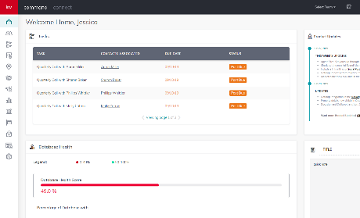
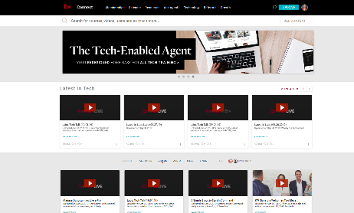
Get Help
Use Command and Connect to get help.
Command
Connect
Notes:
TIME: 5 minutes
DEMONSTRATE how to access the ? for help in Command
Explain the options
Keller Williams University (help articles and videos)
Chat with support
Post an idea (ideas.kw.com)
DEMONSTRATE how to access resources on the Tech Enabled Agent page on Connect
Technology > Tech Enabled Agent > Get Training > select one of the training options listed

Slide 32
Make Your Success List
To Do | Should Do | Priority | Task
Are tasks written as observable actions or are they written as results?
Notes:
TIME: 5 minutes
REVIEW how to create a success list:
Take 5 minutes to create a list of tasks they need to complete related to the Ignite session just attended.
After they have their list they will denote with an “X” if the item is a to do or a should do.
Then, participants will prioritize their should do’s by putting a number by each item (1 being the most important)
Instruct participants to partner up and take 5 minutes for a peer to review and provide feedback. Peer review questions:
What are the should dos and to dos?
Are you thinking in order of priority?
ASK for any volunteers to share their first priority item off their list.

Slide 33
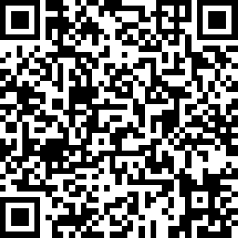
Please Complete the Ignite Survey
Scan QR code to access survey
Or type in this link
https://www.surveymonkey.com/r/8BKC5KZ
Notes:
ASK participants to complete the Ignite evaluation survey

