Slide 1
Global Disaster Outlook
Foresight and Prevention

Slide 2
Problem
Communities around the world are not well prepared to deal with and give fast response to epidemics, natural disasters and hazards.
The government and safety agents act more after something happens than act in order to prevent and take foresight measures
We need to have faster communication systems, quickly transportation with traffic vision and weather/environment conditions to move people safely when is necessary an evacuation

Slide 3
Solution
The solution has two parts. At one side is part of a Command Center that will provide faster informations and accurate data of hazards and disaster that are close to happen. Will be kind of huge Dashboard in order empower governments to act quickly and support decision taking On the other side we have an app where people can access and know about different warnings, alerts, community posts and have faster communication with government and support agents in other to not allow people suffering consequences.

Slide 4
Solution/Product Demo

Slide 5
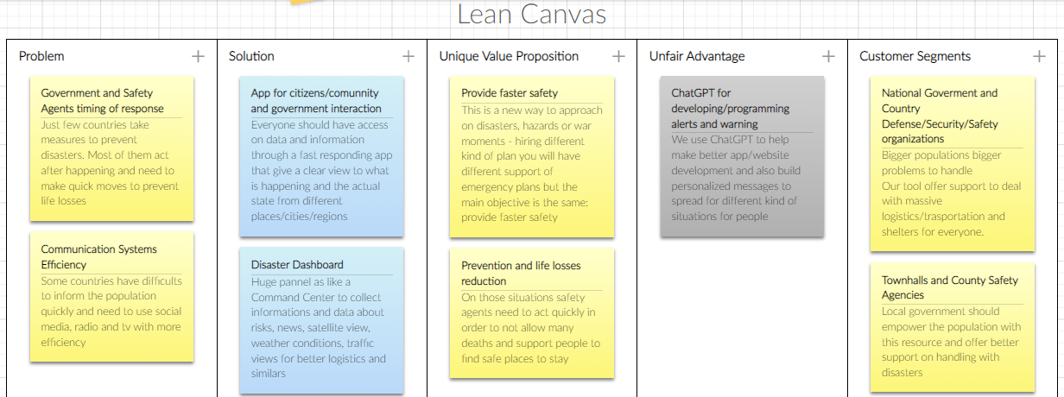

Slide 6
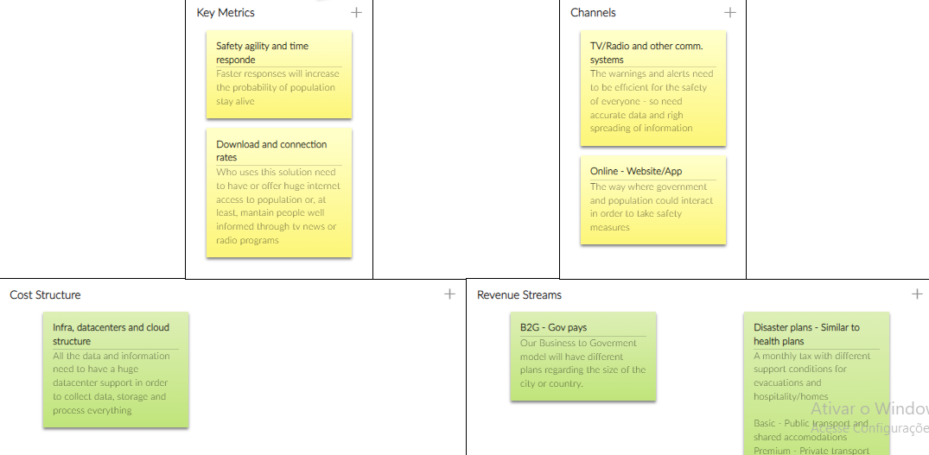

Slide 7
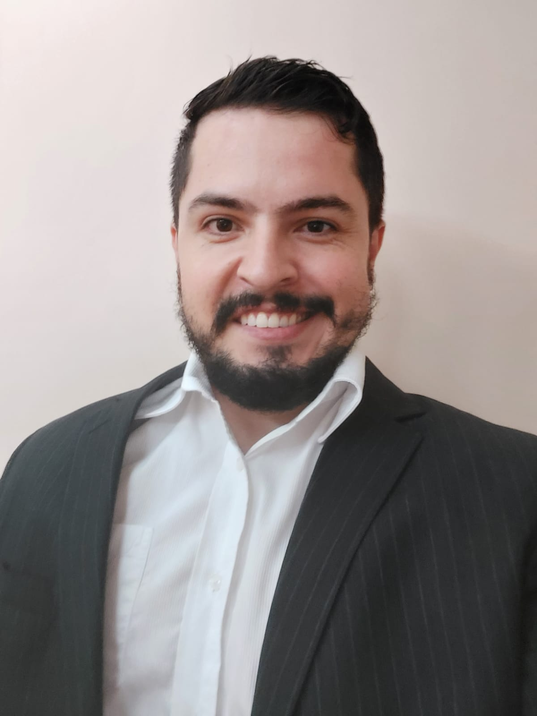
Team
Irfan Ali
Mateus Aymay

