Slide 1



Interior GPT 🏡🤖
Revolutionize your space 🏠 with Generative AI-driven interior/exterior designs 🎨, personalized floor plans 📐, and furniture sourcing 🛋️, all tailored to your style and space dimensions, All powered by OpenAi moels.

Slide 2
Here are some Features

Slide 3
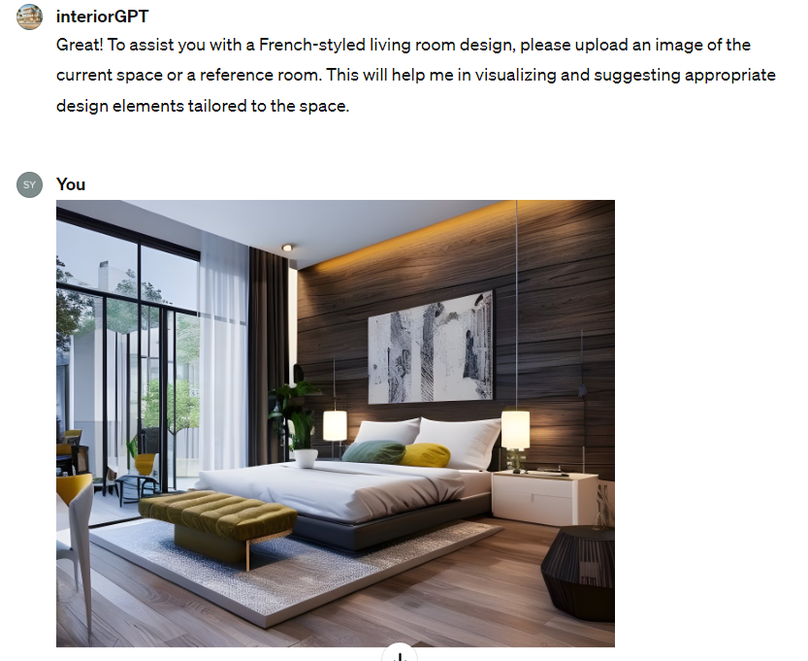
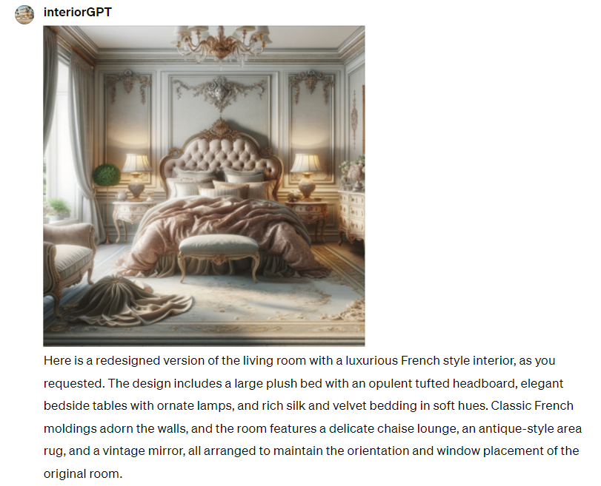
Design interior of space by uploading image

Slide 4

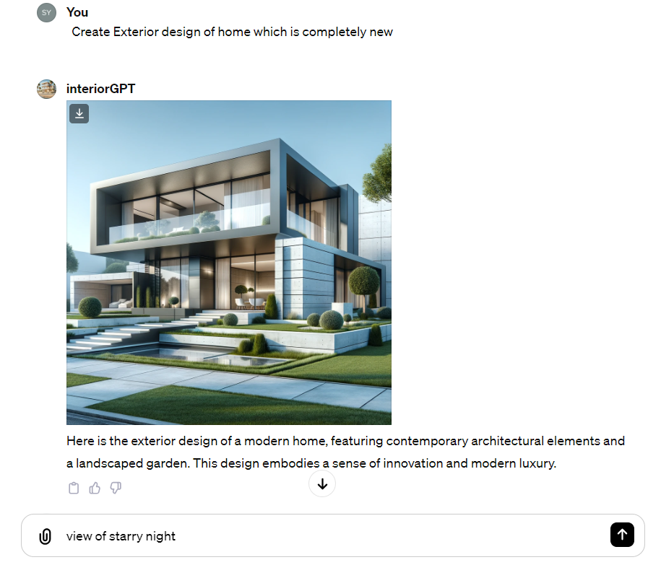

Imagine complete new Concept design for interior / exterior
Ps- you can contine asking for modification

Slide 5
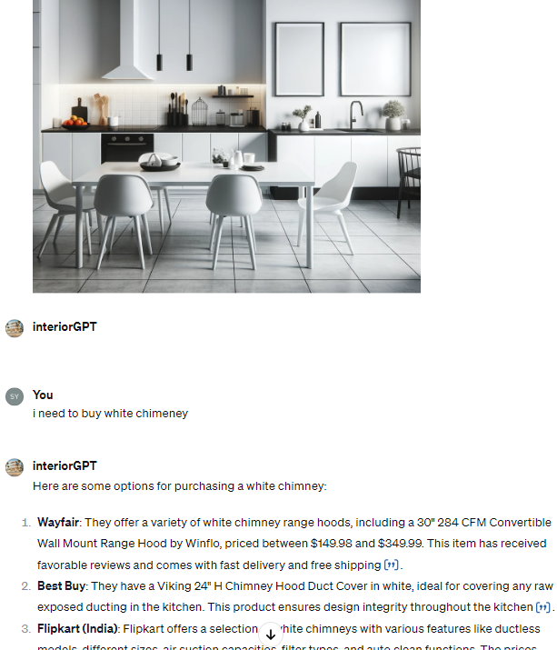
Search artefacts online - powered by big

Slide 6
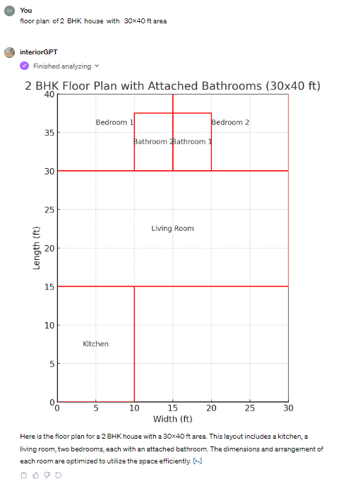
Create floor plans using GPT4 , modify it according to your need

Slide 7
Business plan
Goal
Why now
Future of Generative Art Space
The goal of interior GPT is to use artificial intelligence technology to revolutionize the way we approach interior design by generating descriptions and images of desired designs. This allows users to clearly communicate their vision and bring it to life in a tangible way.
The interior design industry is growing and there is increasing demand. App's unique combination of language and image generation sets it apart from other interior design apps, making it valuable for professionals and DIY enthusiasts. The global interior design market was worth $145.3 billion in 2020 and is projected to reach $210.0 billion by 2027, growing at a CAGR of 5.5% during the forecast period.
The Solution can be scaled using consumer grade
advance computations and can be implemented
with thorough market research analysis in
either subscription or freemium models .
More work can be done to disrupt the design market in Automobile , Clothing , Apparel , Jewelry Etc

Slide 8
Hope you had 😃!
Share your questions
Thank You!
Feel free to connect @
https://www.linkedin.com/in/sallu-mandya/
sallu.mandya@gmail.com
https://twitter.com/sallumandya
Discord -Alp_phoeniks

