Slide 1
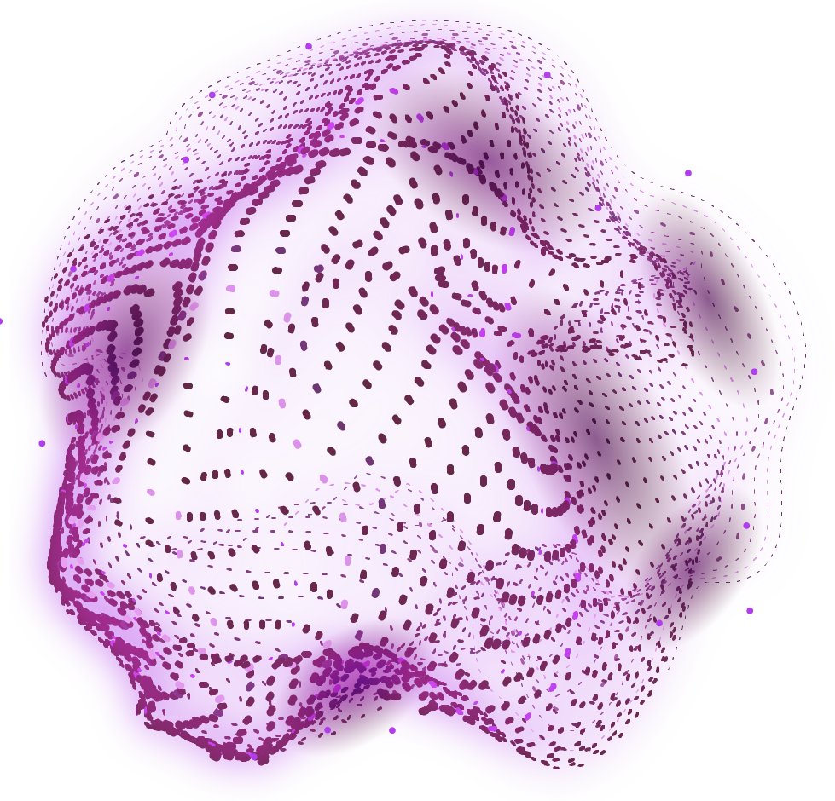


Large
Language Model
Job Description Creator
Making it easier for companies to hire, by creating fully customizable, job specific descriptions. BY QUBIT

Slide 2
TABLE OF CONTENTS
01
02
03
04
05
The Problem
You can describe the topic of the section here
The Solution
You can describe the topic of the section here
LLM use and training
You can describe the topic of the section here
TruLens and Front end
You can describe the topic of the section here
The future
You can describe the topic of the section here

Slide 3
THE STEPS WE TOOK
PROBLEM?
SOLUTION
IMPLEMENT
Identify a repetitive problem that could be made easier by AI
Think of a effective and efficient solution to tackle said problem
Move the solution from thought to reality!

Slide 4

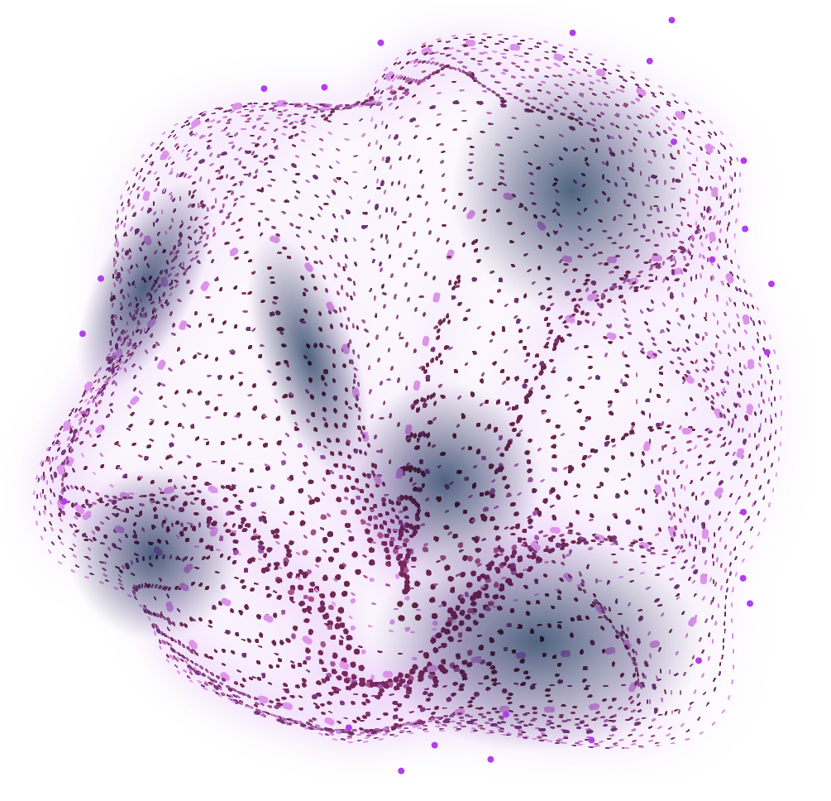
01
The problem
That could be replaced by AI

Slide 5
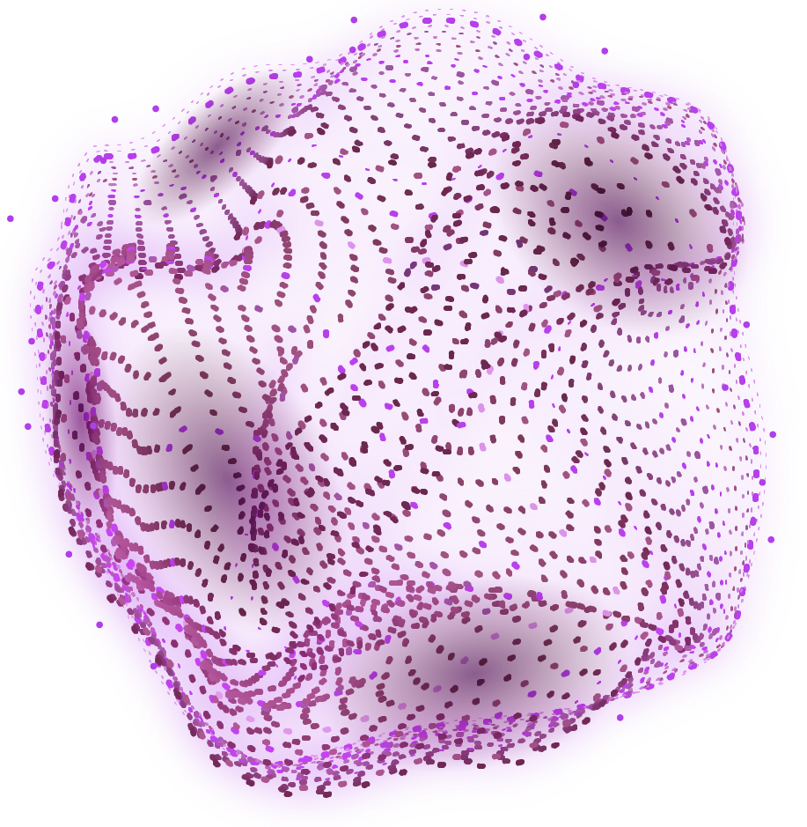
CREATE JD and fast!

Slide 6
TWO EXISTING METHODS
ONLINE
BY HAND
Difficult to get a readable and simple/efficient job description. If we try to use gpt, will have to spend hours to make perfect prompt
Making a job description by using powerpoint or ms word. Too time consuming

Slide 7
02
The Solution
To make life easier

Slide 8
OUR SOLUTION
STEP 1
Create a dataset that will be used to train LLM
STEP 2
Train the LLM
STEP 3
Use truLens to make sure correctly done

Slide 9
03
LLM Use and Training
Behind the scenes

Slide 10
DETAILS
LLM?
Trained on?
Large language model, gpt
200+ data used to finetune the model
Finetuned how?
End product?
Using Open AI
Our very own working LLM

Slide 11
04
TruLens and Front End
Behind the scenes

Slide 12
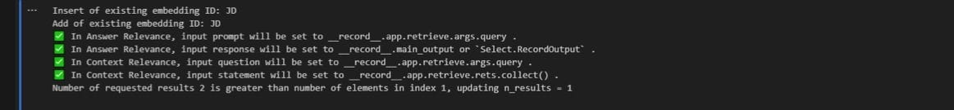
TruLens used extensively
To ensure that the output that llm gives is indeed the best and not wrong!

Slide 13

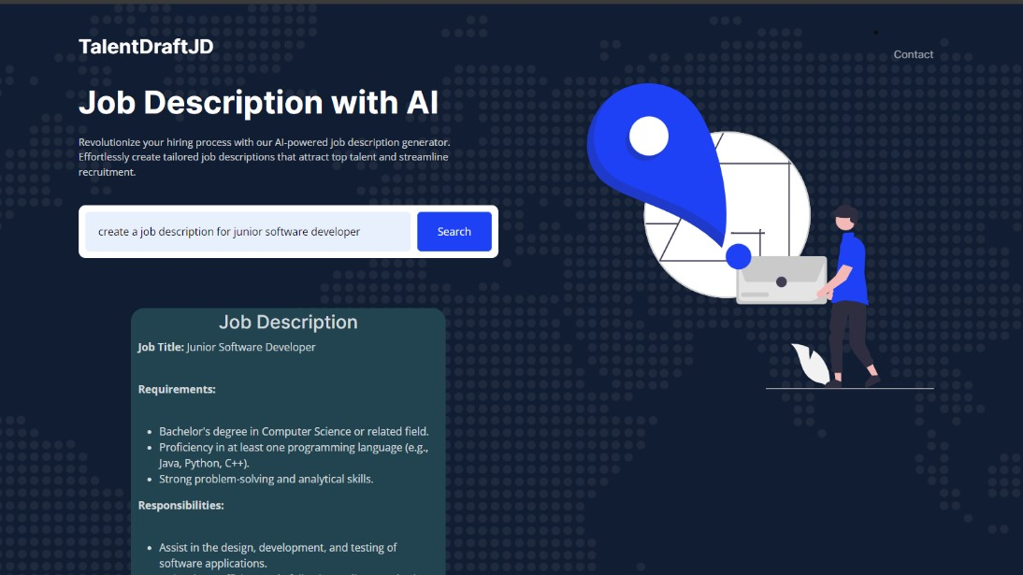
THE FRONT END

Slide 14
The front end
A website
User friendly, uses user input and sends it to our LLM using api call
The api’s output is then displayed

Slide 15
The people behind the project
NAME | INFO
Mustafa Shahzad | Student | Backend dev
Nawfal Hussain | Student
Abdullah Kapadia | Student
Umar Asif | Student | AI dev

Slide 16
THE FUTURE
Image
APP
Ads
Use jd to create a poster
Mobile app dev
To spread the name!

