Slide 1





Mind Mentor: Empowering Mental Well-being

Slide 2

Use Case
Mind Mentor enables users to upload images and descriptions of their current mood or mental state, which are analyzed by advanced AI algorithms to offer tailored advice, coping techniques, and resources for managing their mental well-being.

Slide 3


Purpose:
Mind Mentor aims to empower individuals to prioritize their mental well-being and seek support when needed, fostering a culture of self-care and resilience.
Purpose and Target Audience
Target Audience
Mind Mentor is targeted towards individuals of all ages seeking mental health support, including students, professionals, caregivers, and anyone facing life's challenges.

Slide 4

Market Strategy
Profitability
  Mind Mentor plans to leverage partnerships with mental health organizations, educational institutions, employers, and healthcare providers to reach a wide audience.
  Revenue streams include subscription models, premium features, and collaborations with corporate wellness programs.

Slide 5

Tools Used
Mind Mentor utilizes:
  Google's Gemini Ultra 1.0 for advanced AI capabilities
  Streamlit for the user interface Python for backend development.

Slide 6

Tech Stack
Python, Streamlit, Google Gemini Ultra 1.0 API, AWS (Amazon Web Services)..
Tech Stack and Scalability
Scalability:
Mind Mentor is designed to be highly scalable, with cloud-based infrastructure on AWS allowing for seamless handling of increased user load.

Slide 7
Ideas
Mind Mentor initially started as an idea to harness AI technology for mental health support, with a focus on providing personalized advice and coping strategies.
Ideas and Planning
Planning
Extensive research and user feedback informed the planning process, guiding the development of features and user experience.

Slide 8
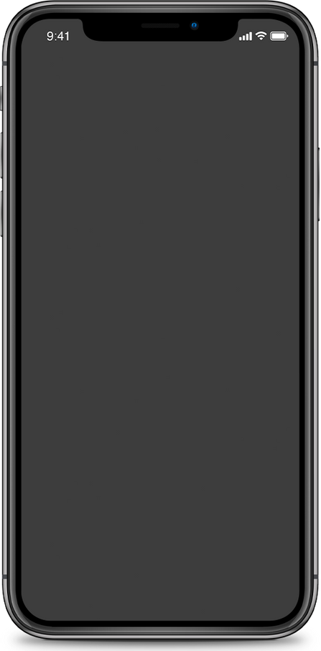


Potential Features
Future enhancements to Mind Mentor may include real-time mood tracking, community support forums, integration with wearable devices for physiological data, and multilingual support.

Slide 9
Developing accurate AI models for mood analysis, ensuring user privacy and data security, addressing the diverse needs of users, and navigating regulatory compliance in the healthcare industry were key challenges faced during development.
Challenges

Slide 10


What We Have Learned?
The development of Mind Mentor provided valuable insights into AI integration for mental health support, user-centric design principles, collaboration with healthcare professionals, and the importance of continuous improvement based on user feedback.

Slide 11
Wrapping Up: Mind Mentor is more than just an app; it's a testament to our commitment to mental health advocacy and technology-driven innovation. Together, we can create a world where mental well-being is prioritized and supported for all.

Slide 12



Future Scope of Mind Mentor
Mind Mentor aims to expand its reach globally
Forge strategic partnerships with mental health organizations
continue evolving with advancements in AI
user-centric design to better serve the needs of our users

Slide 13




Thank you for your attention!
  For more information or inquiries, please contact [laiba.idrees2003@gmail.com].
  github:[https://github.com/missLaiba22/Gemini_Mind_Mentor]
.

