Slide 1
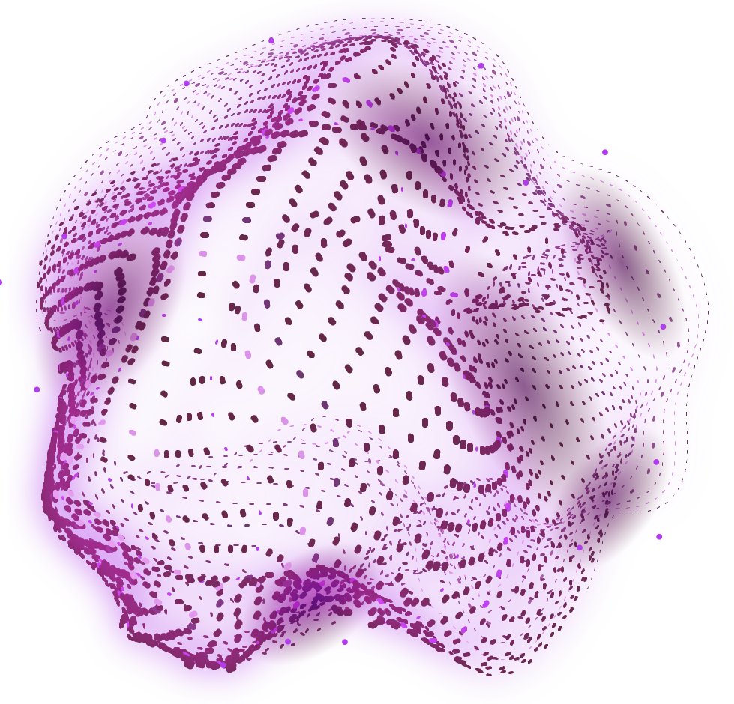
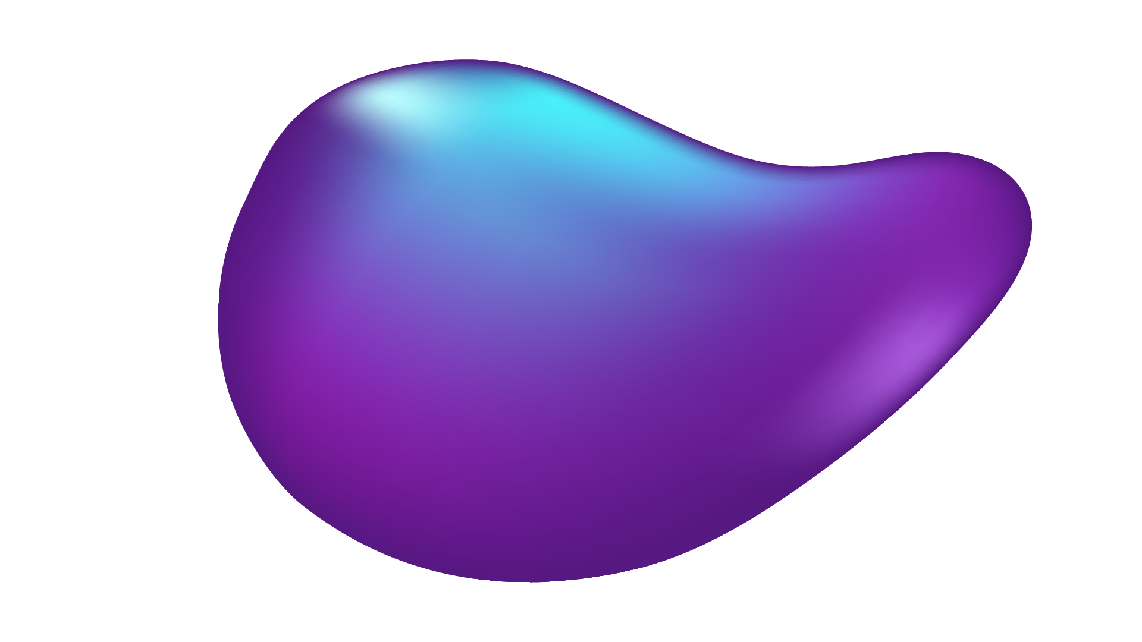

Financial Crystal Ball
The ultimate guide to online trading

Slide 2
Lay of land
INTRO | “Crystal Ball”
PROBLEM STATEMENT | Reasons for failure in stock market
SOLUTION | Empowering Gemini for market analysis
PROTOTYPE | Live demonstration of the project
BUISNESS MODEL CANVAS | Concept to Customer

Slide 3

CRYSTAL BALL ?
In fortune-telling, a crystal ball, a sphere of crystal or glass, is a tool used to supposedly see visions or gain glimpses into the future

Slide 4
PROBLEM STATEMENT
Stock market volatility
Businesses unable to grab opportunities
LOSS
Lack of financial expertise

Slide 5
NEED TO KNOW :
SELL?
HOLD?
BUY?

Slide 6
SOLUTION
Financial Crystal Ball
(Gemini comes to rescue)

Slide 7
BTS
User
Gemini
Database

Slide 8
CONSTRAINTS
Data latency :Real-time data retrieval is not currently supported due to API limitations
Data Storage Limitations : Storing high-frequency (minute and second-level) real-time data for extended periods may exceed current database capacity.

Slide 9
FUTURE DEVELOPMENTS
Personalized Accounts with Chat History
Proactive Notifications
Trigger email notifications based on changes in saved predictions due to unforeseen events.
Real time API Integration
Real World Fluctuations
Provide model with continuous stream of updated information
Expanding Variable Consideration
Correlation with stock trends
Like geopolitical factors, economic indicators , technological shifts , social media sentiments

Slide 10
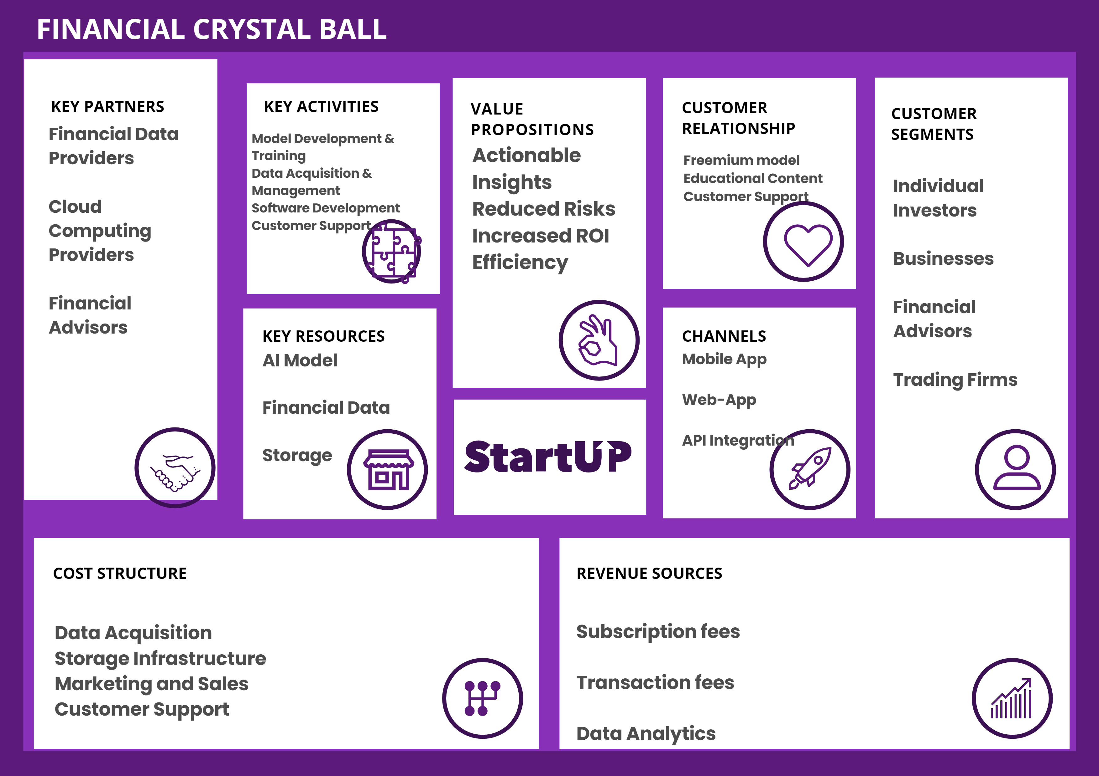
BUSINESS MODEL CANVAS

Slide 11
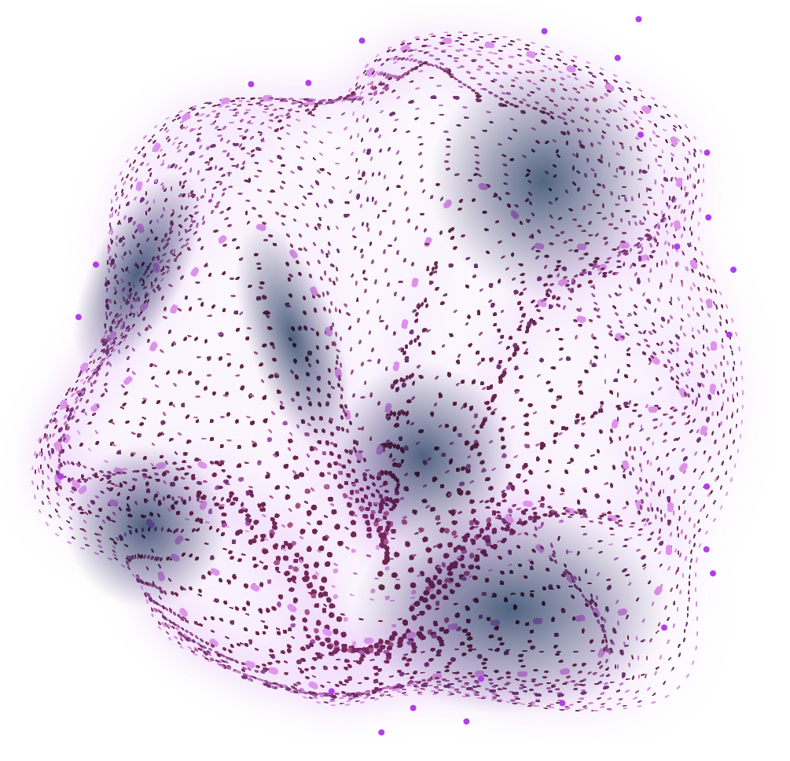
—Team FCB
JOIN US!
DO YOU HAVE ANY QUESTIONS?
“Empower your financial journey with data-driven insights ”

