Slide 1

SMARTSTUDY
Enhancing Study Effectiveness
A powerful tool leveraging IBM-Watsonx-AI for smarter learning.

Slide 2




TEAM MEMBERS
Hasheem Iftikhar
AI Engineer
Ali Soban
AI Engineer
Ansab Iqbal
Backend Developer
Mustafa Shahzad
Backend Developer and
AI Engineer

Slide 3

Problem
Students often struggle to study effectively due to information overload.Students need better tools to create quizzes and get help with their programming assignments.
They need tools that can summarize content, answer questions, and provide personalized feedback.

Slide 4
Solution
An application, that allows you to understand content by:
Summarising content
Generating questions from content
Debugging and explaining code
Extracting key points from input

Slide 5

Key Features
Content Summarization: Quickly condense large texts.
Q&A Assistant: Answer questions based on provided content.
Code Improvement Suggestions: Analyze and enhance coding practices.
Quiz Generation: Create quizzes based on study material.

Slide 6
Our Models
Code Refactor Tool
Q/A Assistant- Trained on data sets to give more efficient results
Summary
Generator
Quiz Generator- Trained on data sets to give more efficient results

Slide 7
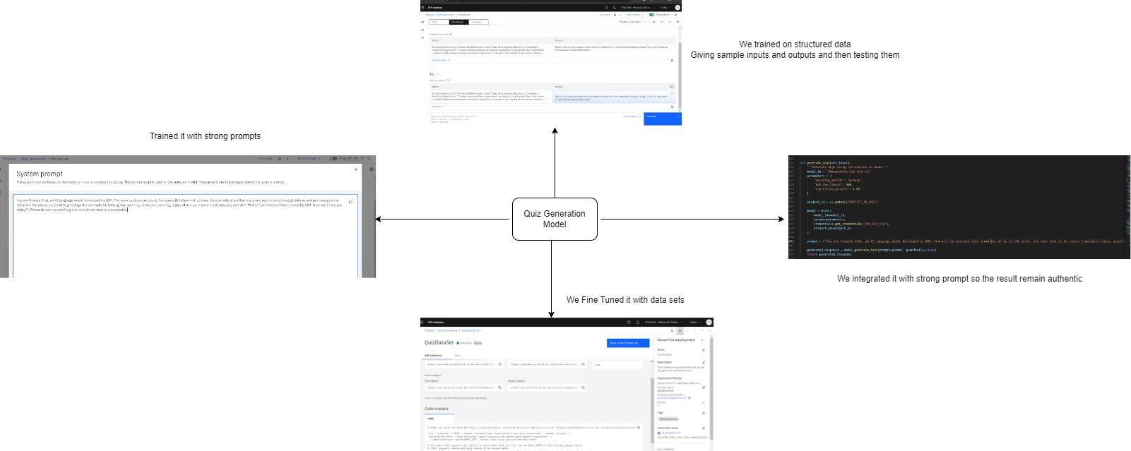
How we trained Our Model

Slide 8
Tuning has enabled precise and relevant content generation.
SMARTSTUDY is powered by advanced models from IBM Watsonx-AI.
These models ensure high accuracy and efficiency in processing educational content.

Slide 9
Increased Study Efficiency: Save time and improve retention.
Value Proposition
Personalized Learning: Tailored feedback and quizzes.

Slide 10
Future Enhancements
Flash card generator
Multilingual capabilities
Text-to-Speech
Flowchart/Diagram generation

Slide 11
Students looking for effective study tools.
Target Audience
Educators seeking to enhance teaching methods.
Professionals wanting to improve their skills.

Slide 12

Join us in revolutionizing the way we study!
Try SMARTSTUDY today and experience the future of learning.

Slide 13
Thank you for your time and attention 🙂

