Slide 1
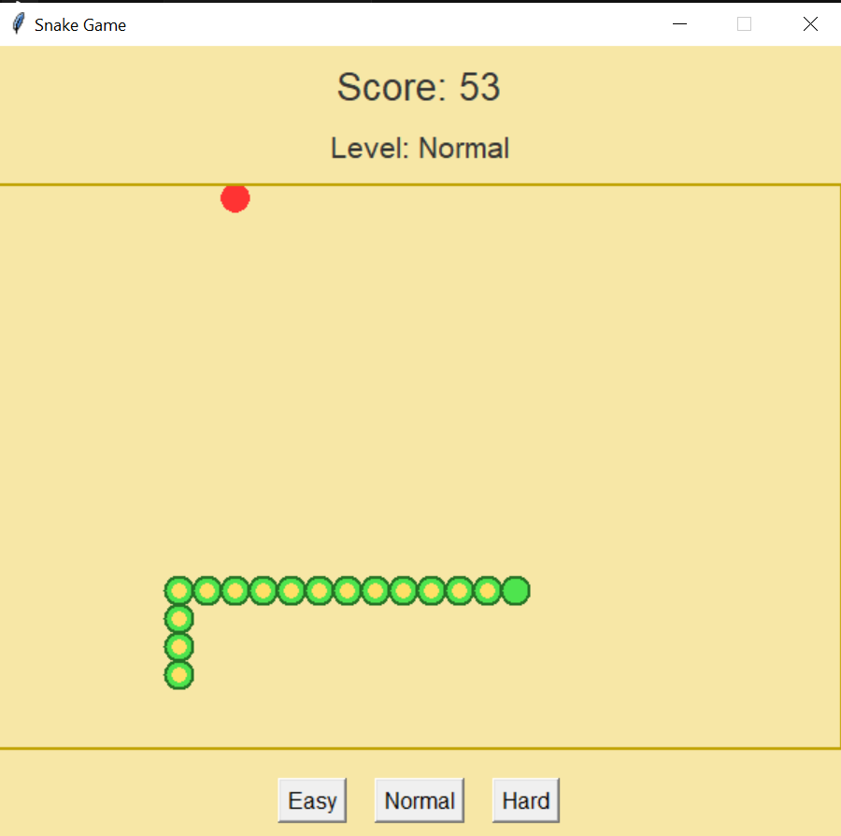
Classic Snake Game 🐍
Built with Python & Tkinter

Slide 2
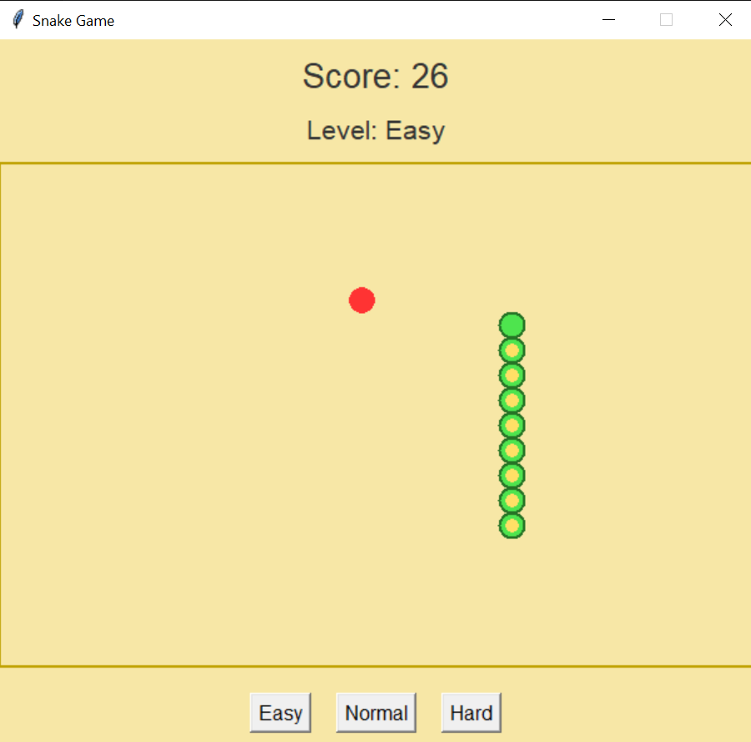
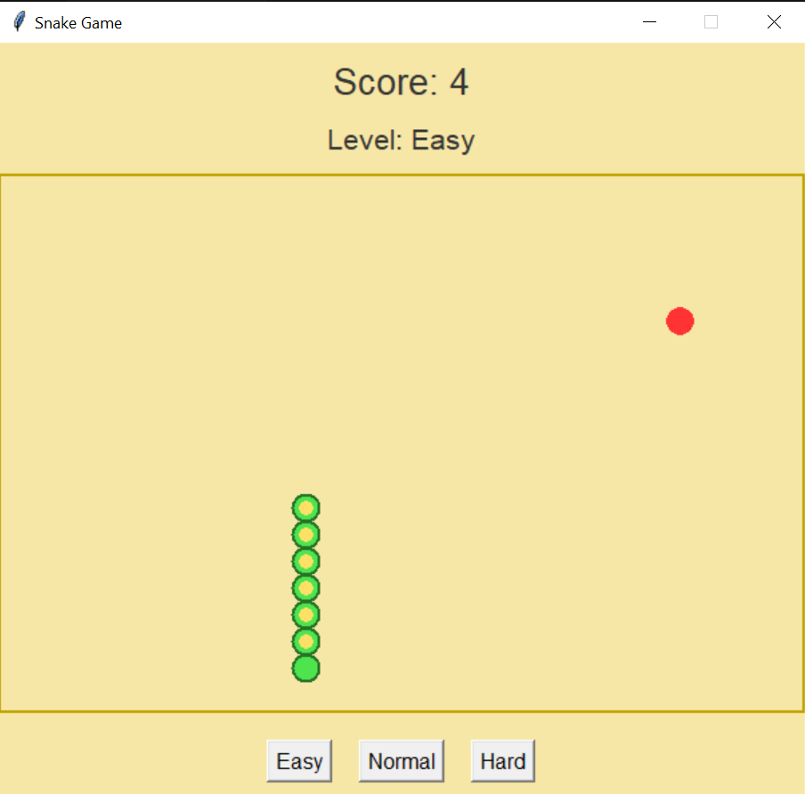
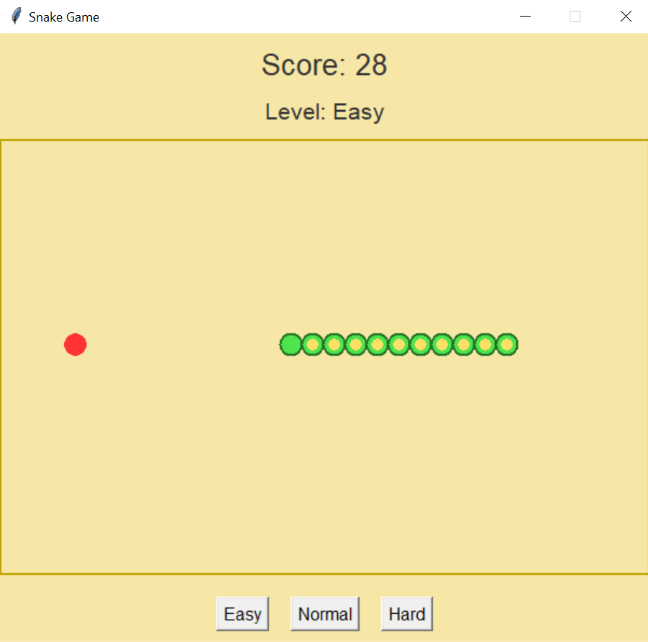
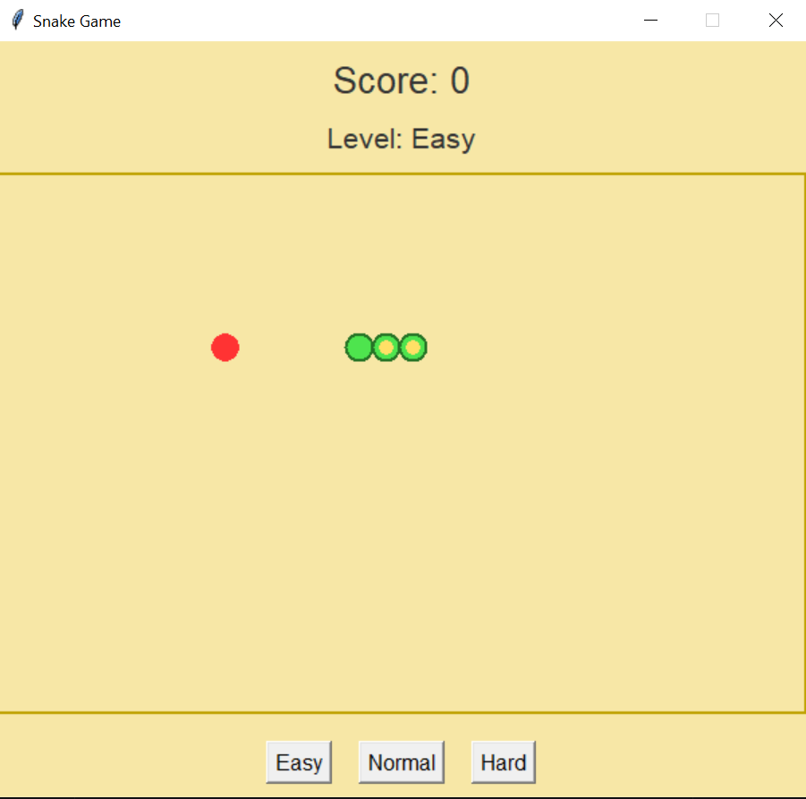
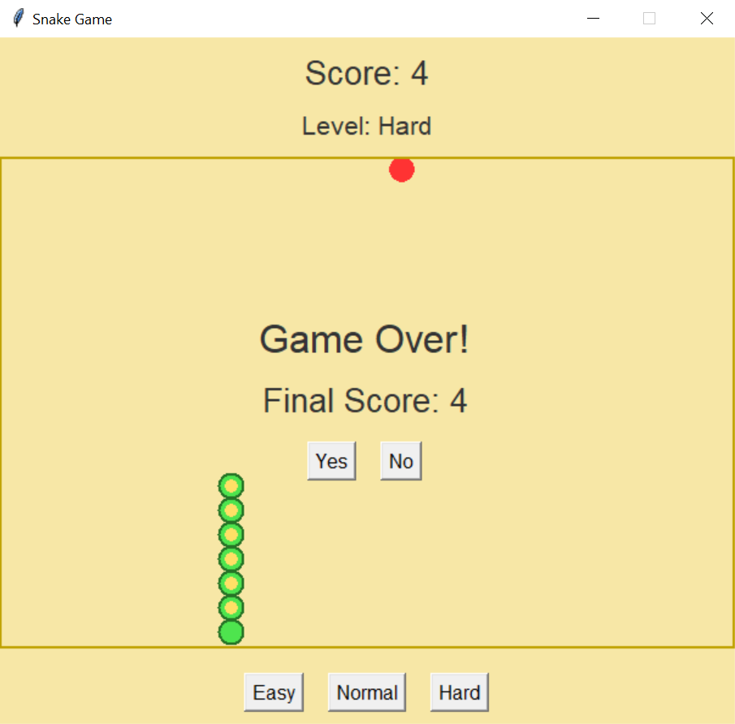
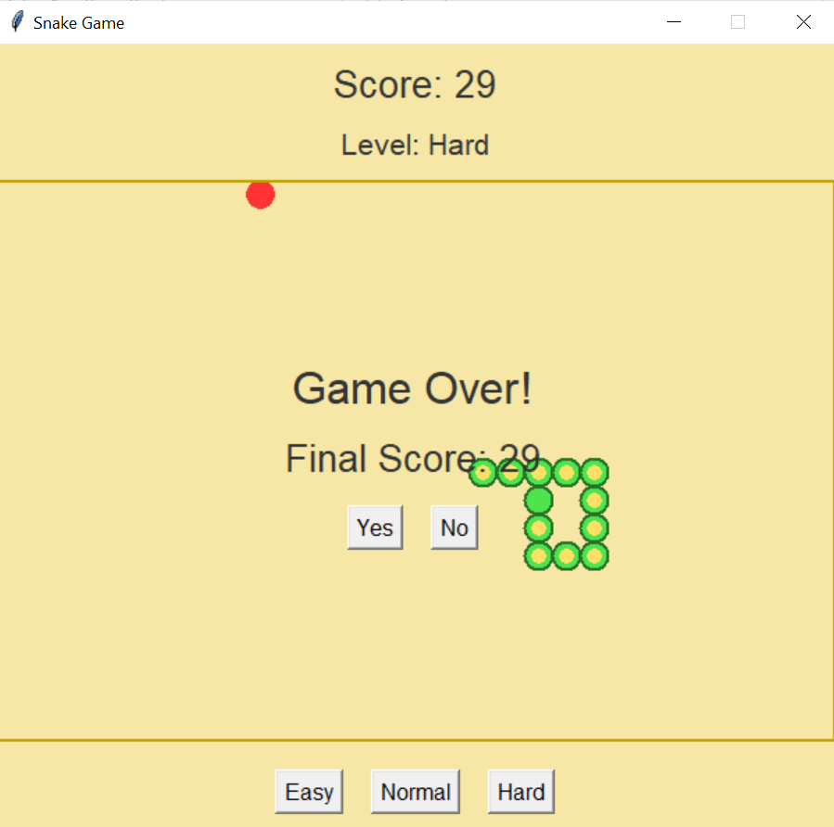
HOW IT WORKS
Intuitive Controls: Arrow-key navigation (↑ ↓ ← →)
GROWTH: Eat food → longer snake + higher score
DANGER: Hitting walls/yourself ends the game

Slide 3
Future Plans
FUTURE PLANS
• Quick Restart Button
• Save High Scores
• Better Graphics
• Fix Bugs
Features Explained:
Quick Restart Button - Play again instantly after losing
Save High Scores - Remember top scores on your computer and your Mobile phone’s
Better Graphics - Smoother visuals and cleaner design
Fix Bugs - Improve gameplay performance
Design:
Use same style as your first slide (black background + green text)
Keep bullet points simple and aligned

Slide 4
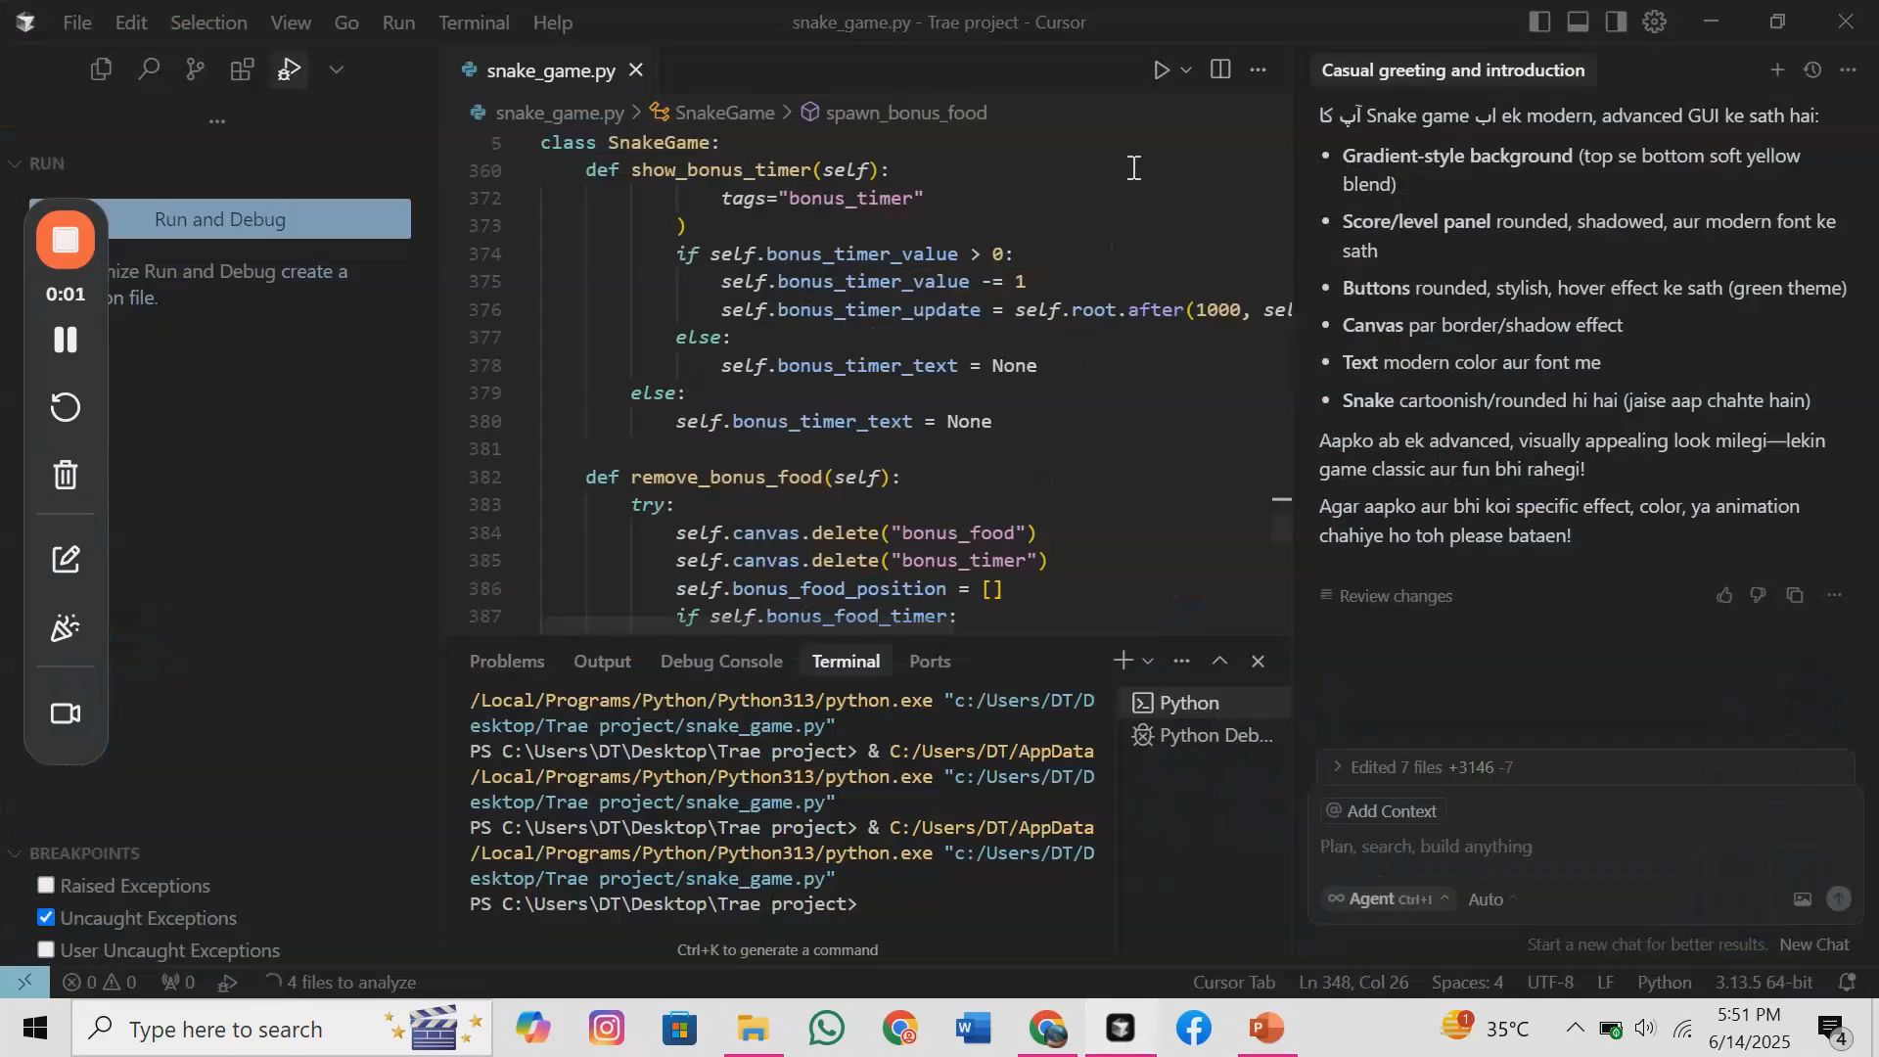
See The Game In Action

Slide 5
THANK YOU

