Slide 1



Athena
Collaborative AI development - Multiple developers, one repository, zero GIT complexity

Slide 2

The Problem: Collaboration Chaos
Barriers to Rapid Prototyping
Development teams struggle with Git workflows and merge conflicts, especially beginners
New developers spend weeks understanding existing codebases
Traditional version control intimidates non-technical team members
These barriers prevent rapid prototyping and innovation, slowing down the development process for new teams.

Slide 3
Solution: Athena | AI-Powered Collaboration
Overview Agent
Code Generation
Live
Preview
User discusses and refines project idea in plain English
AI generates full-stack application based on refined requirements
Instant deployment with real-time updates
AI Orchestration Agent
Code Review Agent
Collaborative Environment
Manages multiple change requests, orders them to avoid merge conflicts
Onboards new developers, helps them understand the repo quickly
Multiple people work on same project using common project ID

Slide 4
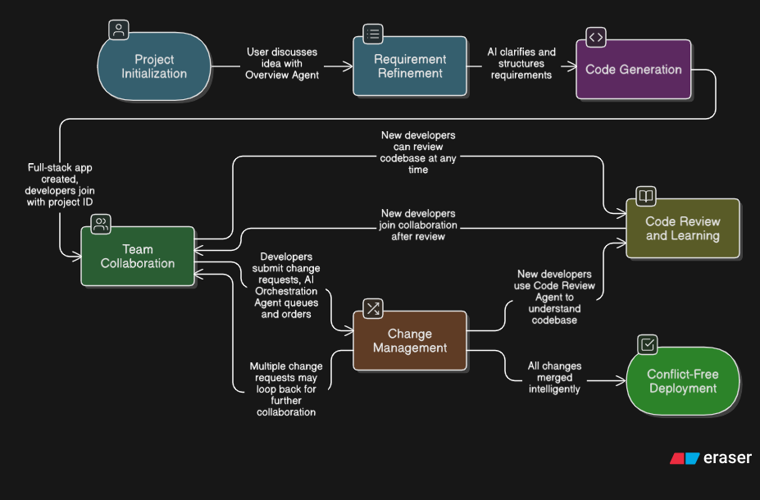

Athena’s Workflow

Slide 5
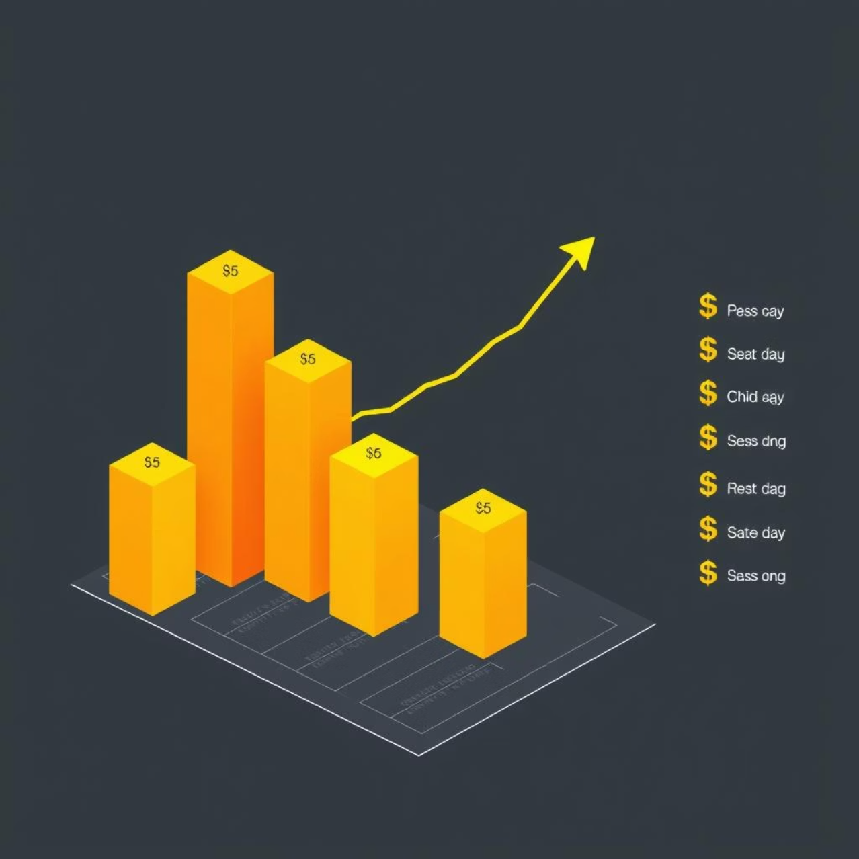

Target Market & Opportunity
Key Stats
TAM: $88.29B
Combined value of collaboration tools
SAM: ~$2.5B
Focused on early adopters: startups, bootcamp grads, hackathon teams
Target Audience
Hackathon Participants: 500,000+ annually
Bootcamp Graduates: 100,000+ per year globally
New Startups: 100,000+ annually
Freelance/Indie Devs: 20M+ worldwide

Slide 6

Competitive Advantage
Athena VS Competitors
Feature
Athena
Framer
Replit
Multi-developer collaboration
✅ Common project ID
❌ Limited team features
⚠ Basic collaboration
Git-free workflow
✅ Complete abstraction
❌ Still requires Git knowledge
⚠ Git integration required
AI orchestration
✅ Intelligent merge conflict resolution
❌ No AI orchestration
❌ Manual conflict resolution
Code review & onboarding
✅ AI-powered repo understanding
❌ Manual code review
❌ Traditional code review
Full-stack generation
✅ Complete applications
⚠ Primarily frontend
⚠ Limited full-stack

Slide 7
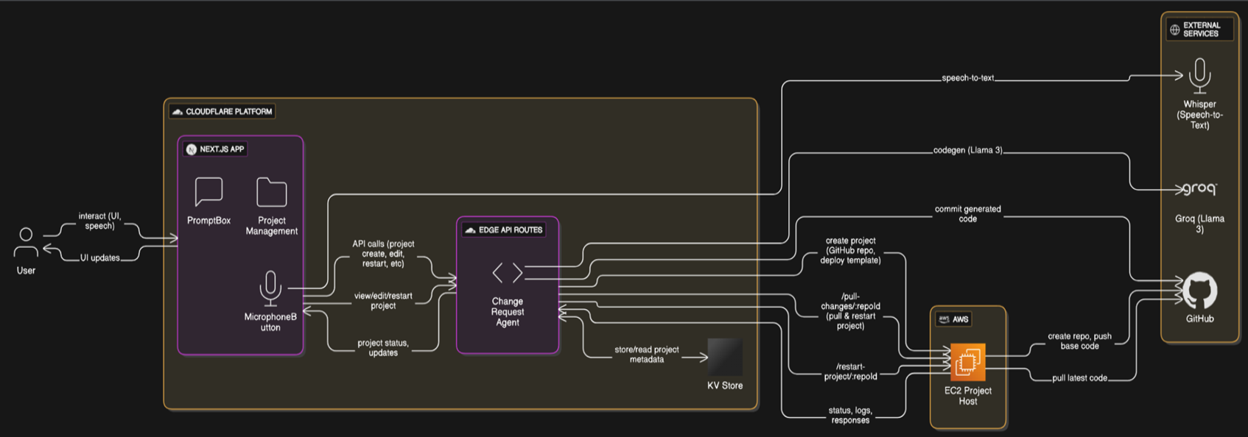

Tech Stack

Slide 8
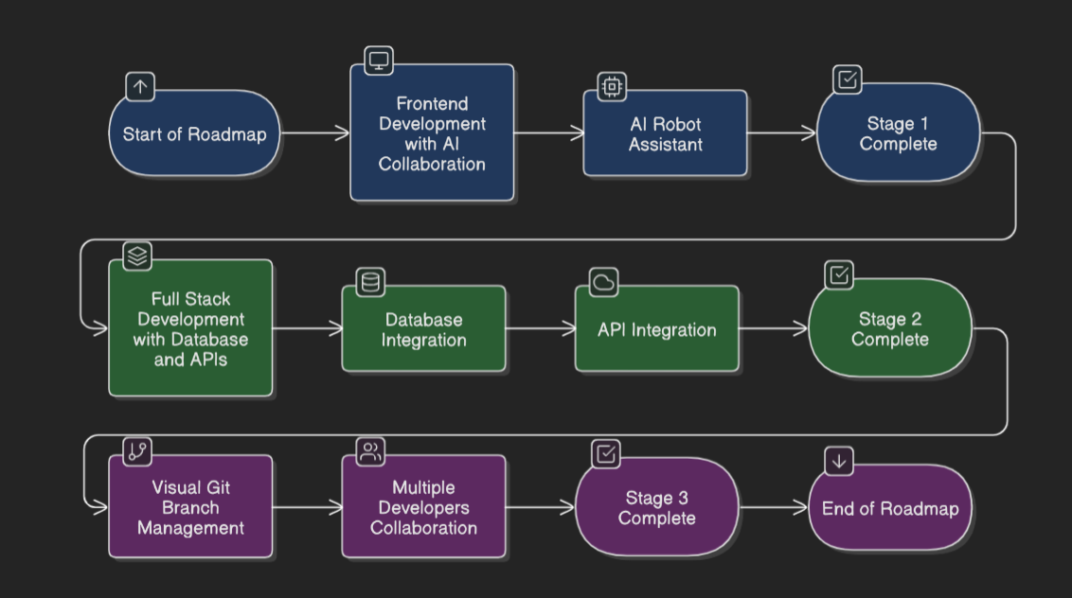
Future Development Roadmap
Current State:
Athena currently handles frontend generation with AI-powered collaboration
Next State:
Full-stack capabilities including backend, database, and API generation
Vision:
Integrated visual branch management system for seamless multi-developer workflows

Slide 9

Revenue Model
Team Collaboration Platform (SaaS)
Startups, Indie Devs – $9–$99/month/team
AI Code Assistant Add-On
All segments – $10–$25/user/month
Bootcamp/Academic Licensing
Freemium for students, paid tiers for teams and enterprise
Marketplace & Plugin Revenue Share
Indie Devs, Freelancers – 30% rev share
Enterprise Plans & Private Cloud
High-growth Startups, Tech Orgs – $499–$2,500/month

